Slide 1
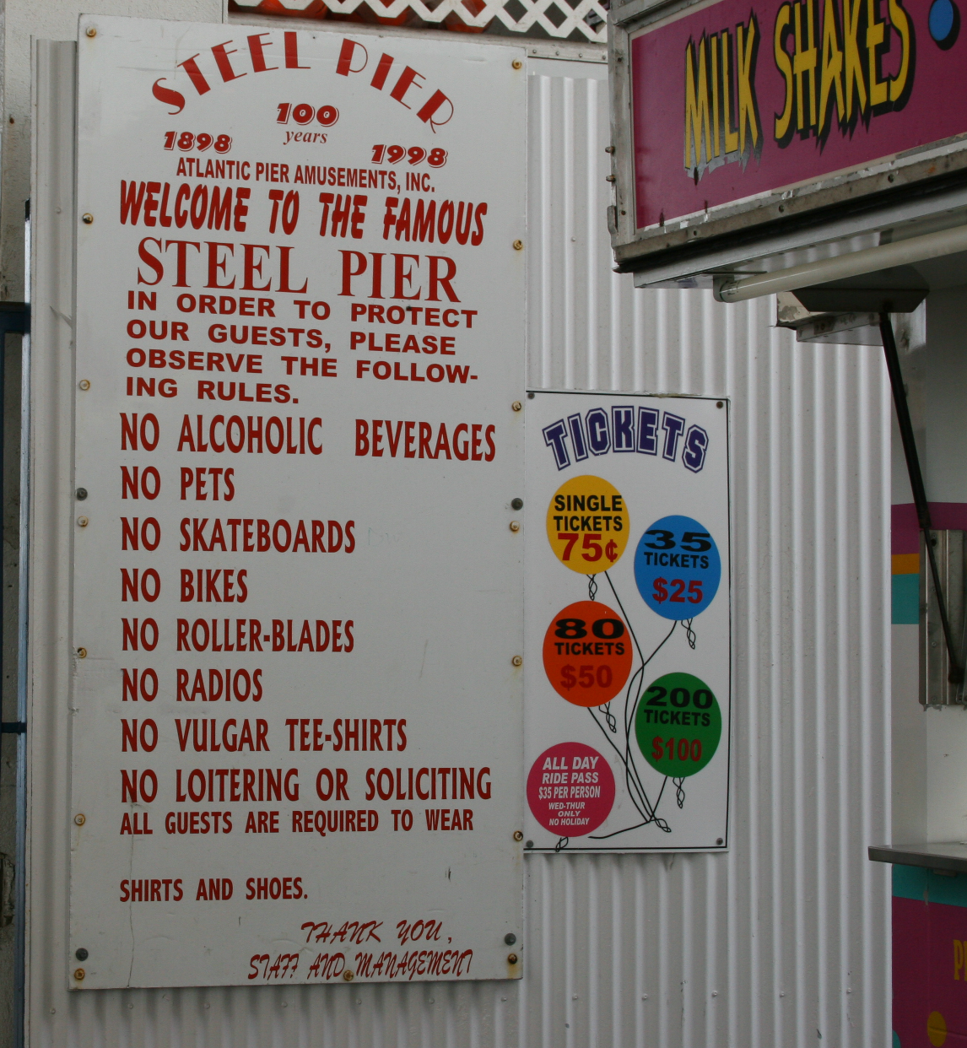
Lecture 26: Sex, Religion, and Politics
University of Virginia
cs1120 Fall 2009
David Evans

Slide 2
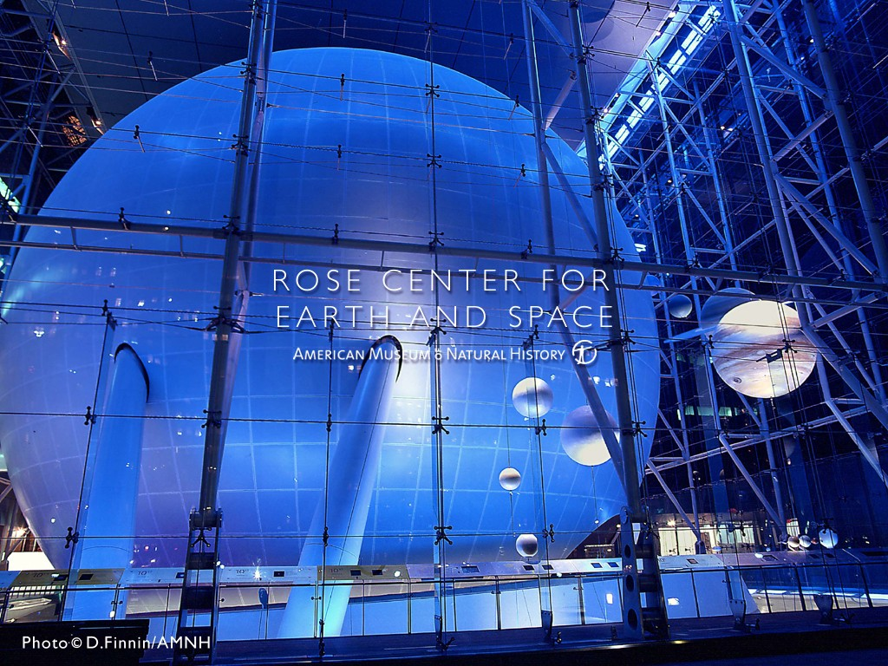
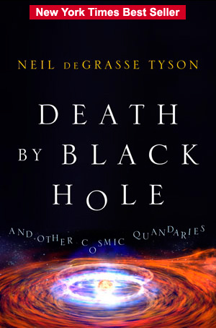
Science’s Endless Golden Age

Slide 3
“If you’re going to use your computer to simulate some phenomenon in the universe, then it only becomes interesting if you change the scale of that phenomenon by at least a factor of 10. … For a 3D simulation, an increase by a factor of 10 in each of the three dimensions increases your volume by a factor of 1000.”
What is the asymptotic running time for simulating the universe?

Slide 4
Simulating the Universe
Work scales linearly with volume of simulation: scales cubically with scale
Θ(n³)
When we double the scale of the simulation, the work octuples! (Just like oceanography octopi simulations)

Slide 5
Orders of Growth
simulating
universe
insert-sort
find-best

Slide 6
Orders of Growth
simulating
universe
insert-sort
find-best

Slide 7
Astrophysics and Moore’s Law
Simulating universe is Θ(n³)
Moore’s “law”: computing power doubles every 18 months
Dr. Tyson: to understand something new about the universe, need to scale by 10x
How long does it take to know twice as much about the universe?

Slide 8
Knowledge of the Universe
import math
# 18 months * 2 = 12 months * 3
yearlyrate = math.pow(4, 1.0/3.0) # cube root
def computing_power(nyears):
if nyears == 0: return 1
else: return yearlyrate * computing_power(nyears - 1)
def simulation_work(scale):
return scale ** 3
def knowledge_of_universe(scale):
return math.log(scale, 10) # log base 10
def computing_power(nyears):
return yearlyrate ** nyears
Notes:
(define (computing-power nyears)
(if (= nyears 0) 1
(* 1.587 (computing-power (- nyears 1)))))
;;; Simulation is Θ(n³) work
(define (simulation-work scale)
(* scale scale scale))
(define (log10 x) (/ (log x) (log 10))) ;;; log is base e
;;; knowledge of the universe is log₁₀ the scale of universe
;;; we can simulate
(define (knowledge-of-universe scale) (log10 scale))

Slide 9
Knowledge of the Universe
def computing_power(nyears):
return yearlyrate ** nyears
def simulation_work(scale):
return scale ** 3
def knowledge_of_universe(scale):
return math.log(scale, 10) # log base 10
def relative_knowledge_of_universe(nyears):
scale = 1
while simulation_work(scale + 1) <= 1000 * computing_power(nyears):
scale = scale + 1
return knowledge_of_universe(scale)

Slide 10
While Loop
Statement ::= while Expression: Block
(define (while pred body)
(if (pred)
(begin
(body)
(while pred body))))
(define x 1)
(define sum 0)
(while (lambda () (< x 100))
(lambda ()
(set! sum (+ sum x))
(set! x (+ x 1))))
x = 1
res = 0
while x < 100:
res = res + x
x = x + 1
print res
x = 1
res = 0
while x < 100:
res = res + x
print res

Slide 11
Knowledge of the Universe
def computing_power(nyears):
return yearlyrate ** nyears
def simulation_work(scale):
return scale ** 3
def knowledge_of_universe(scale):
return math.log(scale, 10) # log base 10
def relative_knowledge_of_universe(nyears):
scale = 1
while simulation_work(scale + 1) <= 1000 * computing_power(nyears):
scale = scale + 1
return knowledge_of_universe(scale)
(Note: with a little bit of math, could
compute this directly using a log instead.)

Slide 12
> >>> relative_knowledge_of_universe(0)
1.0
>>> relative_knowledge_of_universe(1)
1.0413926851582249
>>> relative_knowledge_of_universe(2)
1.1139433523068367
>>> relative_knowledge_of_universe(10)
1.6627578316815739
>>> relative_knowledge_of_universe(15)
2.0
>>> relative_knowledge_of_universe(30)
3.0064660422492313
>>> relative_knowledge_of_universe(60)
5.0137301937137719
>>> relative_knowledge_of_universe(80)
6.351644238569782
Will there be any mystery left in the Universe when you die?

Slide 13
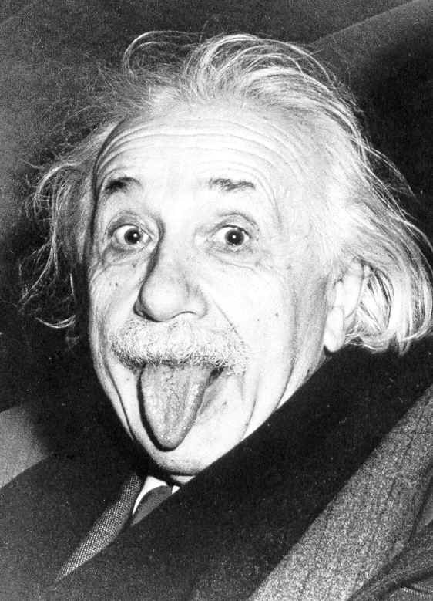
Only two things are infinite, the universe and human stupidity, and I'm not sure about the former.
Albert Einstein

Slide 14
The Endless Golden Age
Golden Age – period in which knowledge/quality of something doubles quickly
At any point in history, half of what is known about astrophysics was discovered in the previous 15 years!
Moore’s law today, but other advances previously: telescopes, photocopiers, clocks, agriculture, etc.
Accumulating 4% per year => doubling every 15 years!

Slide 15
Endless/Short Golden Ages
Endless golden age: at any point in history, the amount known is twice what was known 15 years ago
Continuous exponential growth: Θ(k^{n})
k is some constant (e.g., 1.04), n is number of years
Short golden age: knowledge doubles during a short, “golden” period, but only improves linearly most of the time
Mostly linear growth: Θ(n)
n is number of years

Slide 16
Goal-den age
Changed goalkeeper
passback rule
Average Goals per Game, FIFA World Cups

Slide 17
Computing Power 1969-2008 (in Apollo Control Computer Units)
Moore’s “Law”: number of transistors per dollar roughly doubles every 18 months!

Slide 18
Computing Power 1969-1990 (in Apollo Control Computer Units)

Slide 19
Computing Power 2009-2050?
“There’s an unwritten rule in astrophysics: your computer simulation must end before you die.”
Neil deGrasse Tyson
Human brain:
~100 Billion neurons
100 Trillion connections
Brain simulator today (IBM Blue Brain):
10,000 neurons
30 Million connections
33 years from now!
2008 = 1 computing unit

Slide 20
More Moore’s Law?
“Any physical quantity that’s growing exponentially predicts a disaster, you simply can’t go beyond certain major limits.”
Gordon Moore (2007)
Current technologies are already
slowing down...
An analysis of the history of technology shows that technological change is exponential, contrary to the common-sense 'intuitive linear' view. So we won't experience 100 years of progress in the 21st century-it will be more like 20,000 years of progress (at today’s rate). The 'returns,' such as chip speed and cost-effectiveness, also increase exponentially. There’s even exponential growth in the rate of exponential growth. Within a few decades, machine intelligence will surpass human intelligence, leading to the Singularity — technological change so rapid and profound it represents a rupture in the fabric of human history. The implications include the merger of biological and non-biological intelligence, immortal software-based humans, and ultra-high levels of intelligence that expand outward in the universe at the speed of light.
Ray Kurzweil
but advances won’t come from more transistors with current technologies...new technologies, algorithms, parallelization, architectures, etc.

Slide 21
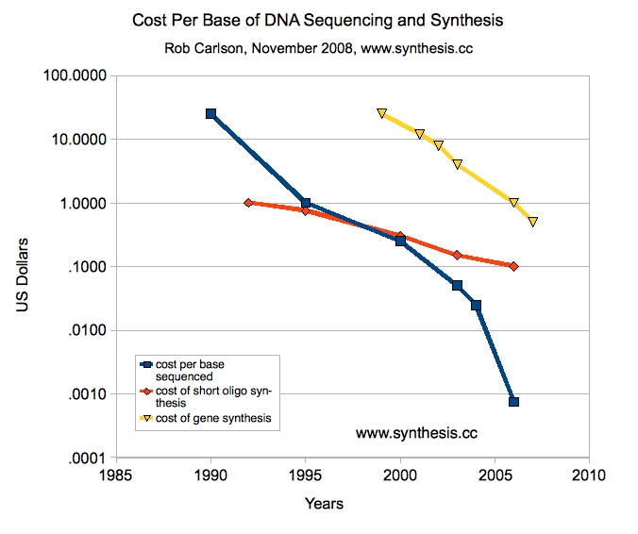

Slide 22
The Real Golden Rule?
Why do fields like astrophysics, medicine, biology and computer science have “endless golden ages”, but fields like
music (1775-1825)
rock n’ roll (1962-1973)*
philosophy (400BC-350BC?)
art (1875-1925?)
soccer (1950-1966)
baseball (1925-1950?)
movies (1920-1940?)
have short golden ages?
* or whatever was popular when you were 16.

Slide 23
Golden Ages or Golden Catastrophes?

Slide 24
PS4, Question 1e
Question 1: For each f and g pair below, argue convincingly whether or not g is (1) O(f), (2) Ω(f), and (3) Θ(g) …
(e) g: the federal debt n years from today,
f: the US population n years from today

Slide 25
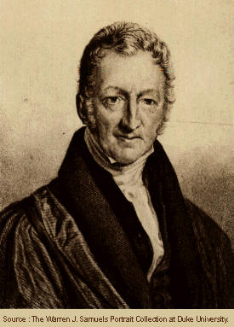
Malthusian Catastrophe
Reverend Thomas Robert Malthus, Essay on the Principle of Population, 1798
“The great and unlooked for discoveries that have taken place of late years in natural philosophy, the increasing diffusion of general knowledge from the extension of the art of printing, the ardent and unshackled spirit of inquiry that prevails throughout the lettered and even unlettered world, … have all concurred to lead many able men into the opinion that we were touching on a period big with the most important changes, changes that would in some measure be decisive of the future fate of mankind.”

Slide 26
Malthus’ Postulates
“I think I may fairly make two postulata.
First, that food is necessary to the existence of man.
Secondly, that the passion between the sexes is necessary and will remain nearly in its present state.
These two laws, ever since we have had any knowledge of mankind, appear to have been fixed laws of our nature, and, as we have not hitherto seen any alteration in them, we have no right to conclude that they will ever cease to be what they now are…”

Slide 27
Malthus’ Conclusion
“Assuming then my postulata as granted, I say, that the power of population is indefinitely greater than the power in the earth to produce subsistence for man.
Population, when unchecked, increases in a geometrical ratio. Subsistence increases only in an arithmetical ratio. A slight acquaintance with numbers will show the immensity of the first power in comparison of the second.”

Slide 28
Malthusian Catastrophe
Population growth is geometric: Θ(k^{n}) (k > 1)
Food supply growth is linear: Θ(n)
What does this mean as n→ ∞?
Food per person = food supply / population
= Θ(n) / Θ(k^{n})
As n approaches infinity, food per person approaches zero!

Slide 29
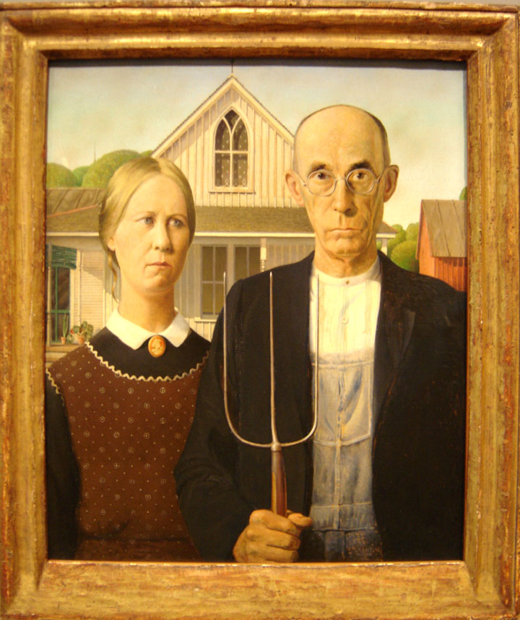
Malthus’ Fallacy

Slide 30
Malthus’ Fallacy
He forgot how he started:
“The great and unlooked for discoveries that have taken place of late years in natural philosophy, the increasing diffusion of general knowledge from the extension of the art of printing, the ardent and unshackled spirit of inquiry that prevails throughout the lettered and even unlettered world…”

Slide 31
Golden Age of Food Production
Agriculture is an “endless golden age” field: production from the same land increases as ~ Θ(1.02^{n})
Increasing knowledge of farming, weather forecasting, plant domestication, genetic engineering, pest repellants, distribution channels, preservatives, etc.

Slide 32
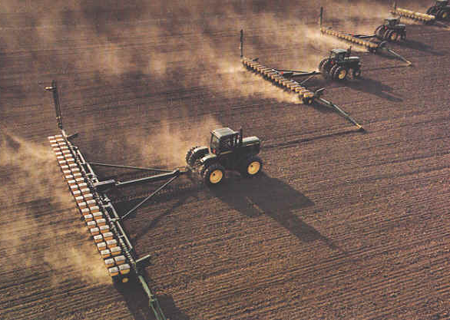
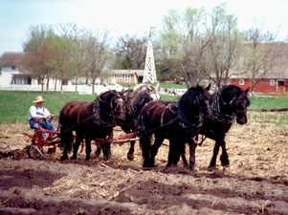
Growing Corn
1906: < 1,000 pounds per acre
2006: 10,000 pounds per acre
Michael Pollan’s The Omnivore’s Dilemma

Slide 33
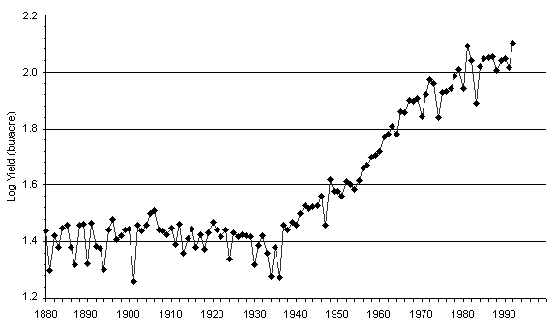
Corn Yield
Note: Log axis!
http://www.agbioforum.org/v2n1/v2n1a10-ruttan.htm

Slide 34
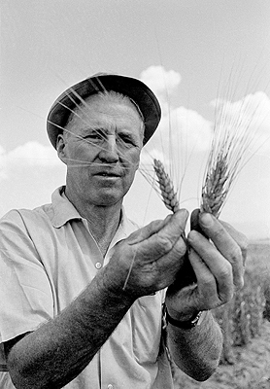
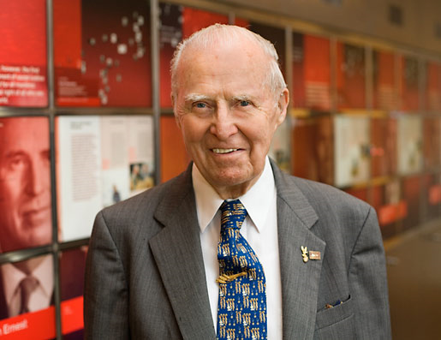
Green Revolution
Norman Borlaug (1914-2009)

Slide 35
“At a time when doom-sayers were hopping around saying everyone was going to starve, Norman was working. He moved to Mexico and lived among the people there until he figured out how to improve the output of the farmers. So that saved a million lives. Then he packed up his family and moved to India, where in spite of a war with Pakistan, he managed to introduce new wheat strains that quadrupled their food output. So that saved another million. You get it? But he wasn't done. He did the same thing with a new rice in China. He's doing the same thing in Africa -- as much of Africa as he's allowed to visit. When he won the Nobel Prize in 1970, they said he had saved a billion people. That's BILLION! BUH! That's Carl Sagan BILLION with a "B"! And most of them were a different race from him. Norman is the greatest human being, and you probably never heard of him.”
Penn Jillette (Penn & Teller)

Slide 36
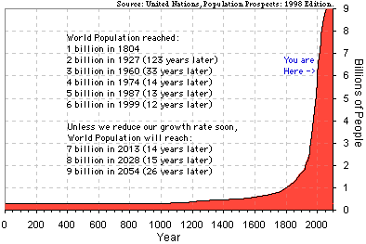
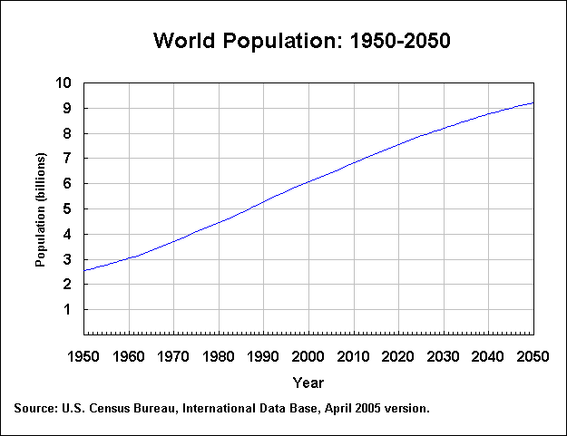
Malthus was wrong about #2 Also
Advances in science (birth control), medicine (higher life expectancy), education, and societal and political changes (e.g., regulation in China) have reduced k (it is < 1 in many countries now!)

Slide 37
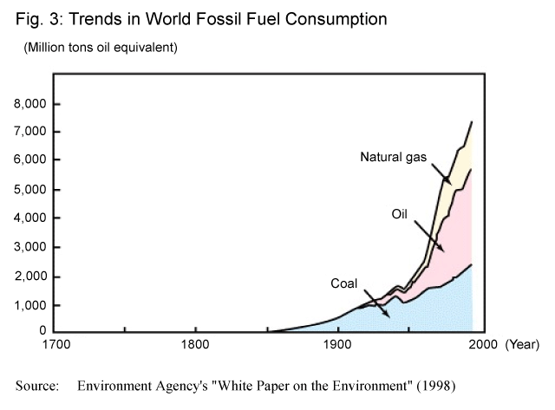
Upcoming Malthusian Catastrophes?
Human consumption of fossil fuels grows as Θ(k^{n}) (fairly large k like 1.08?)
Available fuel is constant (?)
http://wwwwp.mext.go.jp/hakusyo/book/hpag200001/hpag200001_2_006.html

Slide 38
PS4, Question 1e
g: the federal debt n years from today,
f: the US population n years from today
Debt increases:
Spending – Revenues
this varies, but usually positive
+ Interest on the previous debt (exponential)
= Θ(k^{n})
Population increase is not exponential:
rate continues to decrease
=> as n increases, debt per person approaches infinity!
This will eventually be a problem, but growth analysis doesn’t say when.

Slide 39
“Cornucopian View”
Few resources are really finite
All scientific things have endless golden ages
Knowledge accumulates
Knowledge makes it easier to acquire more
(We hope) Human ingenuity and economics and politics will continue solve problems before they become catastrophes
No one will sell the last gallon of gas for $2.45

Slide 40
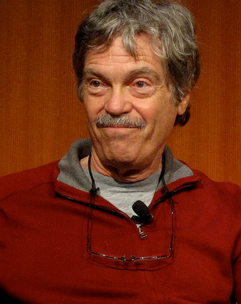
“Kay”-sian View
The best way to predict the future is to invent it.
— Alan Kay

Slide 41
Charge
When picking majors, pick a short golden age field that is about to enter its short golden age
This requires vision and luck!
Play it safe by picking an endless golden age field (CS is a good choice for this!)
Wednesday: History of Object-Oriented Programming; Interpreters

