Slide 1
Class 27: Taming of the Plagarist
cs1120 Fall 2009
David Evans
Notes:
http://en.wikipedia.org/wiki/File:Tsar01.jpg

Slide 2
Menu
Python Dictionaries
History of Object-Oriented Programming

Slide 3
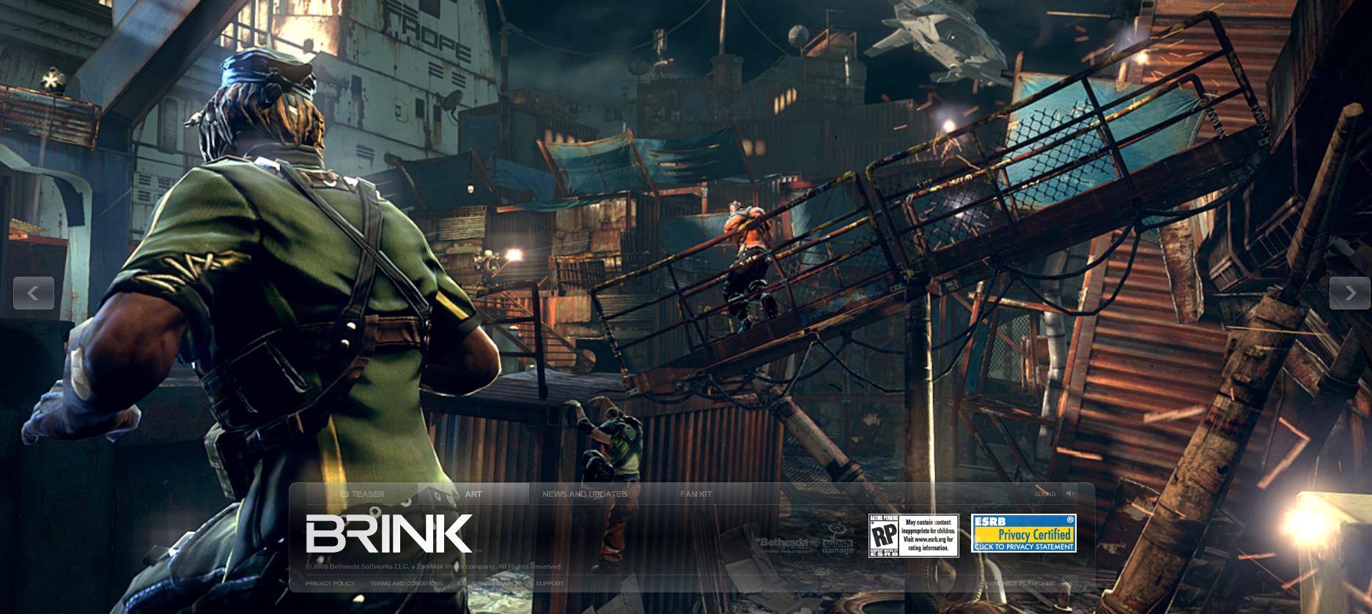
PS6-related talk tomorrow:
Thursday, October 29 at 2:00 p.m, Scholars’ Lab in the Alderman Library
“Disruptive Construction of Game Worlds” Shane Liesegang (UVa 2004 CogSci major/CS minor) Bethesda Softworks
For extra credit on PS6: mention something in your answer to Question 8 that you learned from this talk.

Slide 4
Python Dictionary
Dictionary abstraction provides a lookup table. Each entry in a dictionary is a
<key, value>
pair. The key must be an immutable object. The value can be anything.
dictionary[key] evaluates to the value associated with key. Running time is approximately constant!

Slide 5
Dictionary Example
Create a new, empty dictionary
>>> d = {}
>>> d['UVa'] = 1818
>>> d['UVa'] = 1819
>>> d['Cambridge'] = 1209
>>> d['UVa']
1819
>>> d['Oxford']
Traceback (most recent call last):
File "<pyshell#93>", line 1, in <module>
d['Oxford']
KeyError: 'Oxford'
Add an entry: key ‘UVa’, value 1818
Update the value: key ‘UVa’, value 1819

Slide 6
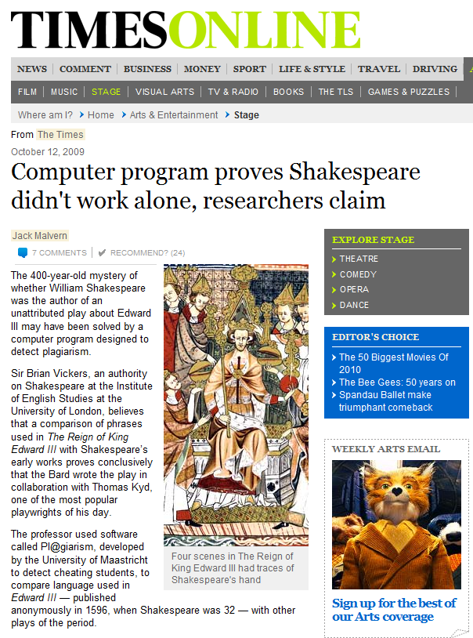
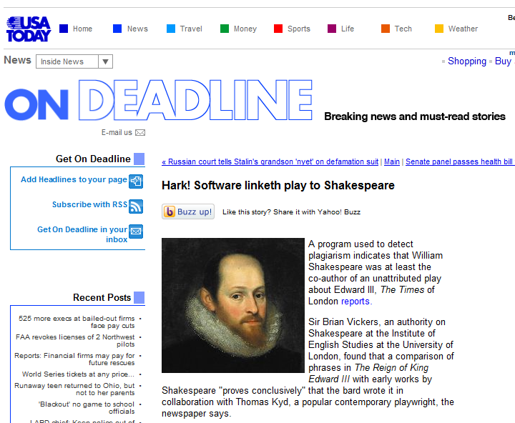
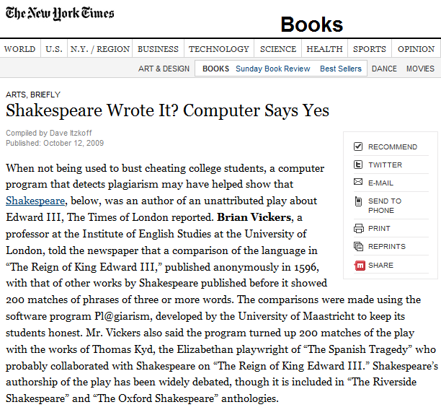

Slide 7
Histogramming
Define a procedure histogram that takes a text string as its input, and returns a dictionary that maps each word in the input text to the number of occurences in the text.
Useful string method: split()
outputs a list of the words in the string
>>> 'here we go'.split()
['here', 'we', 'go']

Slide 8
def histogram(text):
d = {}
words = text.split()
for w in words:
if w in d:
d[w] = d[w] + 1
else:
d[w] = 1
return d
>>> d = histogram(declaration)
>>> show_dictionary(d)
of: 79
the: 76
to: 64
and: 55
our: 25
their: 20
has: 20
for: 20
in: 18
He: 18
a: 15
these: 13
...

Slide 9
Showing the Dictionary
def show_dictionary(d):
keys = d.keys()
okeys = sorted(keys, lambda k1, k2: d[k2] - d[k1])
for k in okeys:
print str(k) + ": " + str(d[k])

Slide 10
Author Fingerprinting (aka Plagarism Detection)
“The program identifies phrases of three words or more in an author’s known work and searches for them in unattributed plays. In tests where authors are known to be different, there are up to 20 matches because some phrases are in common usage. When Edward III was tested against Shakespeare’s works published before 1596 there were 200 matches.”
The Times, 12 October 2009

Slide 11
def histogram(text):
d = {}
words = text.split()
for w in words:
if w in d:
d[w] = d[w] + 1
else:
d[w] = 1
return d
def phrase_collector(text, plen):
d = {}
words = text.split()
words = map(lambda s: s.lower(), words)
for windex in range(0, len(words) - plen):
phrase = tuple(words[windex:windex+plen])
if phrase in d:
d[phrase] = d[phrase] + 1
else:
d[phrase]= 1
return d
Dictionary keys must be
immutable: convert the (mutable) list to an immutable tuple.

Slide 12
def common_phrases(d1, d2):
keys = d1.keys()
common = {}
for k in keys:
if k in d2:
common[k] = (d1[k], d2[k])
return common
def get_my_homepage():
return urlopen('http://www.cs.virginia.edu/evans/index.html').read()
>>> ptj = phrase_collector(declaration, 3)
>>> pde = phrase_collector(get_my_homepage(), 3)
>>> c = common_phrases(ptj, pde)
>>> len(c)
0

Slide 13
>>> pde = phrase_collector(get_my_homepage(), 2)
>>> ptj = phrase_collector(declaration, 2)
>>> c = common_phrases(ptj, pde)
>>> show_phrases(c)
('principles', 'and'): (1, 1)
('has', 'kept'): (1, 1)
('has', 'been'): (1, 1)
('and', 'our'): (1, 1)
('design', 'to'): (1, 1)
('not', 'be'): (1, 1)
('of', 'all'): (1, 1)
('they', 'have'): (1, 1)
('by', 'the'): (1, 1)
('protection', 'of'): (1, 1)
('with', 'a'): (1, 1)
('as', 'we'): (1, 1)
('is', 'the'): (2, 1)
('them', 'to'): (1, 2)
('to', 'a'): (1, 2)
('the', 'state'): (1, 2)
('people', 'to'): (1, 2)
...
('of', 'the'): (4, 12)

Slide 14
Possible Project Idea
Make a website that allows visitors to compare text samples for common phrases.
Reminder: if you want to do a “super ambitious” web application project instead of PS7, you need to convince me by Monday (November 2). You should have a team, idea for a project, and justification explaining why it is “super ambitious”.

Slide 15
History of Object-Oriented Programming
Object-oriented programming is an exceptionally bad idea which could only have originated in California. Edsger Dijkstra
I don’t know how many of you have ever met Dijkstra, but you probably know that arrogance in computer science is measured in nano-Dijkstras. Alan Kay

Slide 16
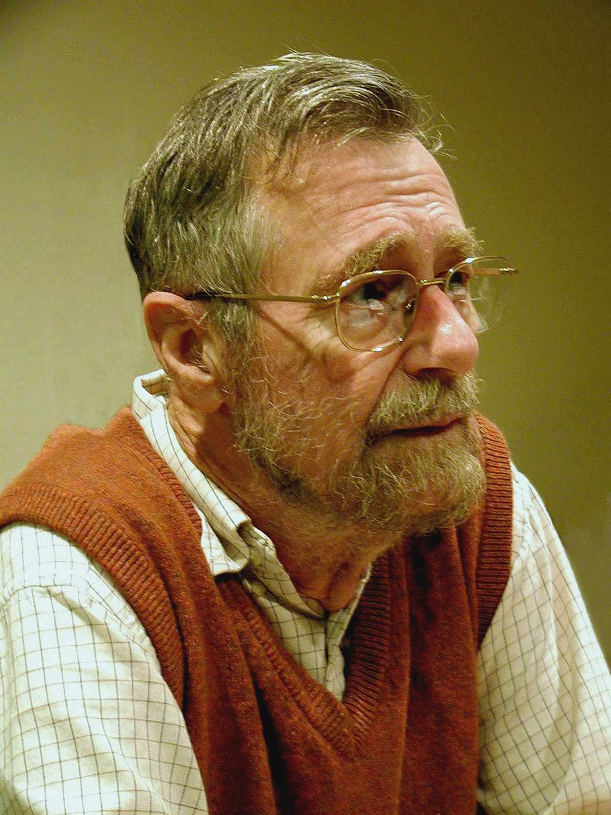
The people who are the worst at programming are the people who refuse to accept the fact that their brains aren't equal to the task. Their egos keep them from being great programmers. The more you learn to compensate for your small brain, the better a programmer you’ll be. The more humble you are, the faster you’ll improve.
Edsger Dijkstra, 1972 Turing Award
http://www.cs.utexas.edu/users/EWD/ewd03xx/EWD340.PDF

Slide 17
Computing in World War II
Cryptanalysis (Lorenz: Collossus at Bletchley Park, Enigma: Bombes at Bletchley, NCR in US)
Ballistics Tables, calculations for Hydrogen bomb (ENIAC at U. Pennsylvania)
Batch processing: submit a program and its data, wait your turn, get a result
Building a flight simulator required a different type of computing:
interactive computing

Slide 18
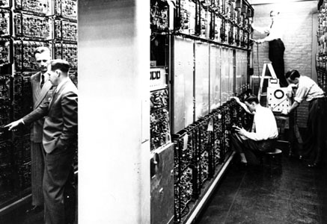
Pre-History: MIT’s Project Whirlwind (1947-1960s)
Jay Forrester

Slide 19
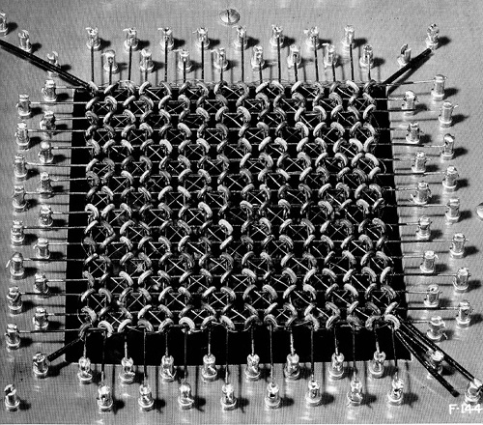
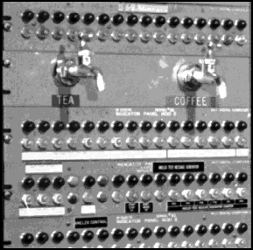
Whirlwind Innovations
Magnetic Core Memory
(first version used vacuum tubes)

Slide 20
August 29, 1949:
First Soviet Atomic Test

Slide 21
Short or Endless Golden Age of Nuclear Weapons?
Tsar Bomba (50 Mt, largest ever = 10x all of WWII)
kilotons
First H-Bomb (10Mt)
B83 (1.2Mt), largest
in currently active arsenal
Hiroshima (12kt), Nagasaki (20kt)

Slide 22
Semi-Automatic Ground Environment (SAGE)
MIT/IBM, 1950-1982
Coordinate radar stations in real-time to track incoming bombers
Total cost: ~$55B
(more than Manhattan Project)

Slide 23
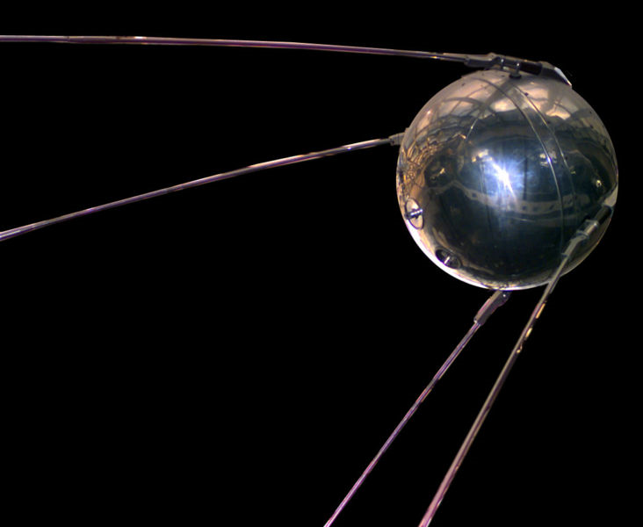
First intercontinental ballistic missile
First successful test: August 21, 1957
R-7 Semyorka
Sputnik: launched by R-7, October 4, 1957

Slide 24
What does all this have to do with object-oriented programming?
(To be continued Friday...)

Slide 25
Charge
PS6 due Friday
Friday: Trick-or-Treat Protocols, Interpreters
PS6-related talk tomorrow:
Thursday, October 29 at 2:00 p.m, Scholars’ Lab in the Alderman Library
“Disruptive Construction of Game Worlds” Shane Liesegang (UVa 2004 CogSci major/CS minor) Bethesda Softworks
For extra credit on PS6: mention something in your answer to Question 8 that you learned from this talk.

