Slide 1
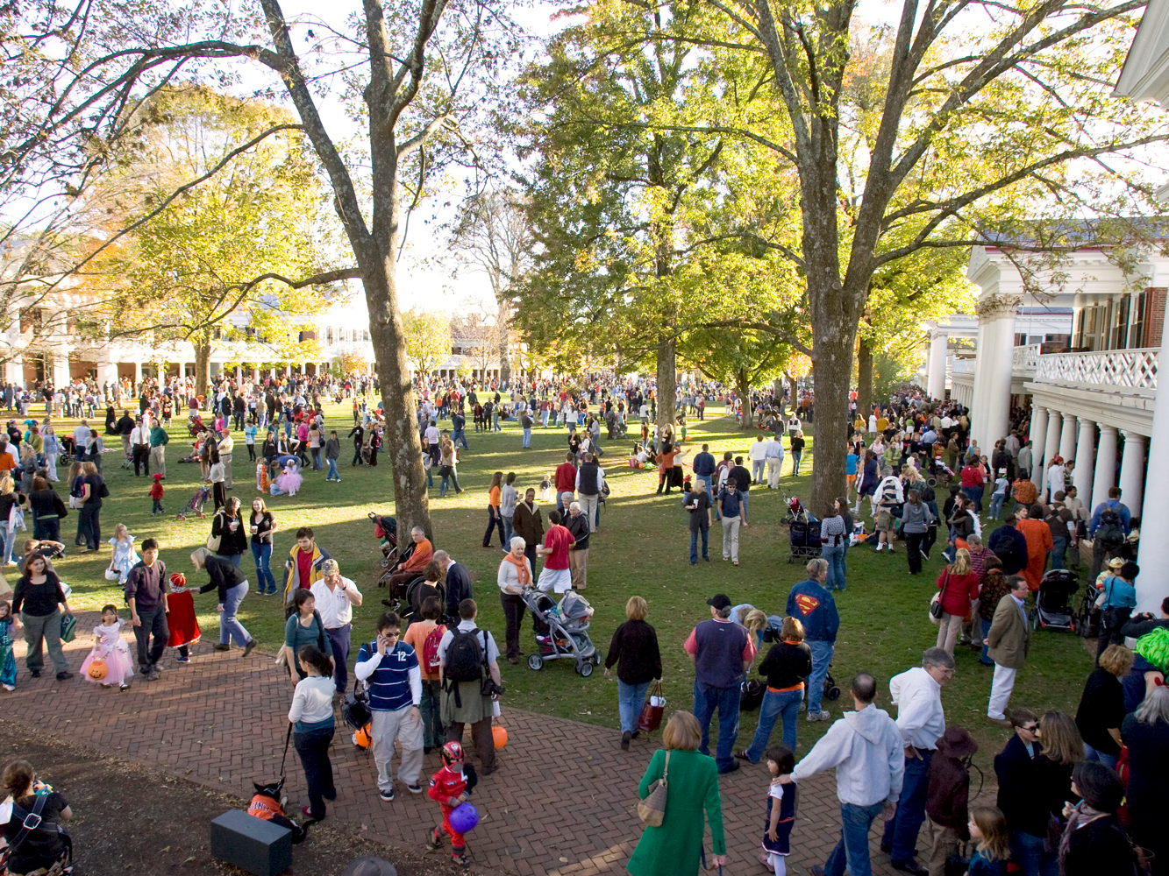
Class 28: Interpreters
cs1120 Fall 2009
David Evans

Slide 2
Menu
Introduction to Interpreters
History of Object-Oriented Programming
(time permitting)

Slide 3
“Trick or Treat” Protocols

Slide 4
“Trick or Treat” Protocols
Trick-or-Treater must convince victim that she poses a credible threat
Need to prove you know are a qualified tricker
But, revealing trickiness shouldn’t allow victim to impersonate a tricker
Except around Halloween, this is called an “authentication protocol”.

Slide 5
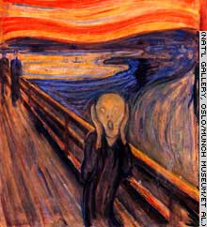
Trick-or-Treat
“Trick or Treat?”
“Prove it!”
Trickers?
Victim
“The magic word is: shazam!”
Any problems with this?

Slide 6
Cryptographic Hash Functions
One-way
Given h, it is hard to find x
such that H(x) = h.
Collision resistance
Given x, it is hard to find y ≠ x
such that H(y) = H(x).

Slide 7
Example One-Way-ish Function
Input: two 100 digit numbers, x₁ and x₂
Output: the middle 100 digits of x₁× x₂
Given x = (x₁, x₂): easy to calculate f (x).
Given h = f (x): hard to find an z such h = f (z).
“Easy” means there is a procedure with running time in O(N²) where N is number of digits
“Hard” means (we hope) the fastest possible procedure has running time in Ω(2^{N}) .

Slide 8
Trick-or-Treat
“Trick or Treat?”,
H (secret)
Trickers?
H (secret)
Valid!
Trickers
Bureau
Ouch! Now victim knows
enough to be a tricker: can just replay H (secret) to the next victim.

Slide 9
Trick-or-Treat
“Trick or Treat?”
Challenge: Z
Trickers?
R = H (secret + Z)
R, Z
Valid!
Trickers
Bureau

Slide 10
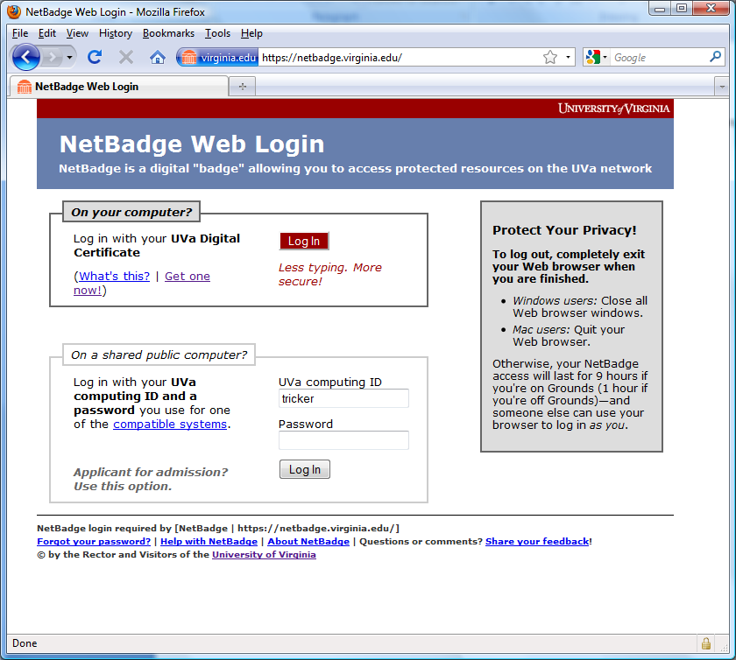
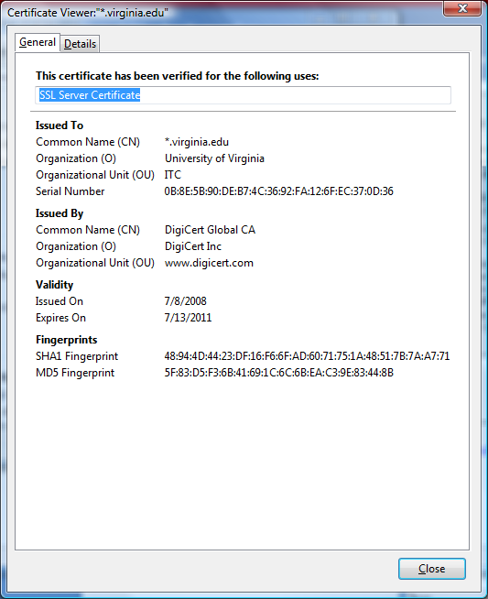
Trick-or-Treating without Calling the Tricker’s Bureau
TRICKER’S LICENSE
You know what you need to survive tomorrow....we’ll talk more about how this works on the web later.

Slide 11
Implementing Interpreters
Problem Set 7: posted today, due Monday 9 November.
Understand the Charme interpreter (described in Chapter 11)
Modify it to create a new language

Slide 12
Building a Language
Design the grammar
What strings are in the language?
Use BNF to describe all the strings in the language
Make up the evaluation rules
Describe what every string in the language means
Build an evaluator
Implement a procedure that takes a string in the language as input and an environment and outputs its value:
meval: String × Environment → Value

Slide 13
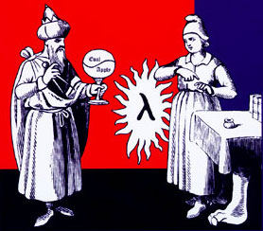
Is this an exaggeration?
It is no exaggeration to regard this as the most fundamental idea in programming:
The evaluator, which determines the meaning of expressions in the programming language, is just another program.
To appreciate this point is to change our images of ourselves as programmers. We come to see ourselves as designers of languages, rather than only users of languages designed by others.
Abelson and Sussman, Structure and Interpretation of Computer Programs (p. 360)

Slide 14
Building an Evaluator
To build an evaluator we need to:
Figure out how to represent data in programs
What is a procedure, frame, environment, etc.
Implement the evaluation rules
For each evaluation rule, define a procedure that follows the behavior of that rule.
Next: we’ll look at a high-level how the application rule is implemented
Next week and Chapter 11: detailed walk-through of the interpreter

Slide 15
def meval(expr, env):
if isPrimitive(expr):
return evalPrimitive(expr)
elif isIf(expr):
return evalIf(expr, env)
elif isDefinition(expr):
evalDefinition(expr, env)
elif isName(expr):
return evalName(expr, env)
elif isLambda(expr):
return evalLambda(expr, env)
elif isApplication(expr):
return evalApplication(expr, env)
else:
error ('Unknown expression type: ' + str(expr))
Core of the evaluator:
meval

Slide 16
Stateful Application Rule
To apply a constructed procedure:
Construct a new environment, whose parent is the environment of the applied procedure.
For each procedure parameter, create a place in the frame of the new environment with the name of the parameter. Evaluate each operand expression in the environment of the application and initialize the value in each place to the value of the corresponding operand expression.
Evaluate the body of the procedure in the newly created environment. The resulting value is the value of the application.

Slide 17
Eval
Eval and Apply are defined in terms of each other.
Apply

Slide 18
evalApplication
To apply a constructed procedure:
Construct a new environment, whose parent is the environment of the applied procedure.
For each procedure parameter, create a place in the frame of the new environment with the name of the parameter. Evaluate each operand expression in the environment of the application and initialize the value in each place to the value of the corresponding operand expression.
Evaluate the body of the procedure in the newly created environment. The resulting value is the value of the application.
def evalApplication(expr, env):
subexprs = expr
subexprvals = map (lambda sexpr: meval(sexpr, env), subexprs)
return mapply(subexprvals[0], subexprvals[1:])

Slide 19
To apply a constructed procedure:
Construct a new environment, whose parent is the environment of the applied procedure.
For each procedure parameter, create a place in the frame of the new environment with the name of the parameter. Evaluate each operand expression in the environment of the application and initialize the value in each place to the value of the corresponding operand expression.
Evaluate the body of the procedure in the newly created environment. The resulting value is the value of the application.
class Environment:
def __init__(self, parent):
self._parent = parent
self._frame = {}
def addVariable(self, name, value): ...
def lookupVariable(self, name): ...
def mapply(proc, operands):
if (isPrimitiveProcedure(proc)): ...
elif isinstance(proc, Procedure):
params = proc.getParams()
newenv = Environment(proc.getEnvironment())
...

Slide 20
To apply a constructed procedure:
Construct a new environment, whose parent is the environment of the applied procedure.
For each procedure parameter, create a place in the frame of the new environment with the name of the parameter. Evaluate each operand expression in the environment of the application and initialize the value in each place to the value of the corresponding operand expression.
Evaluate the body of the procedure in the newly created environment. The resulting value is the value of the application.
def mapply(proc, operands):
if (isPrimitiveProcedure(proc)): ...
elif isinstance(proc, Procedure):
params = proc.getParams()
newenv = Environment(proc.getEnvironment())
for i in range(0, len(params)):
newenv.addVariable(params[i], operands[i])
...

Slide 21
def mapply(proc, operands):
if (isPrimitiveProcedure(proc)): ...
elif isinstance(proc, Procedure):
params = proc.getParams()
newenv = Environment(proc.getEnvironment())
for i in range(0, len(params)):
newenv.addVariable(params[i], operands[i])
return meval(proc.getBody(), newenv)
To apply a constructed procedure:
Construct a new environment, whose parent is the environment of the applied procedure.
For each procedure parameter, create a place in the frame of the new environment with the name of the parameter. Evaluate each operand expression in the environment of the application and initialize the value in each place to the value of the corresponding operand expression.
Evaluate the body of the procedure in the newly created environment. The resulting value is the value of the application.

Slide 22
Charge
Read Chapter 11
PS7 posted today, due Monday, Nov 9
Remember to make “Trick-or-Treaters” to solve your challenge!

