Slide 1
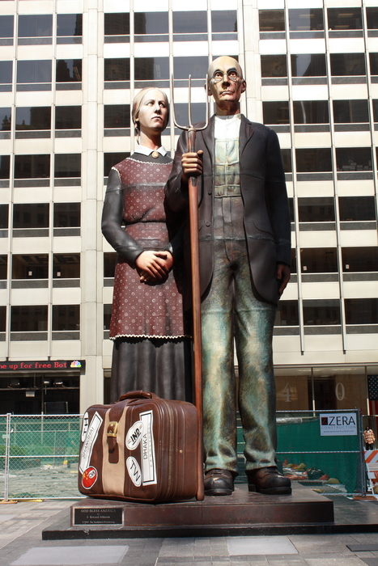
Class 29: Charme School
cs1120 Fall 2009
University of Virginia
David Evans

Slide 2
PS6: Charlottansville is an interesting and scary place!
People who get drunk and do silly things: FirstYear, Greek, FratStar, PartyingStudent, FratBoy
Things that attack students: Zombie, Aliens, Corpses, Grue, Person with swine flu who infects other students, Cops who give parking tickets, Swiper who steals clothes, Tablers who hand out flyers, BrotherMicah who proselytizes
Squirrels: DevilSquirrel, Squirrel, Squirrel
FirstYear, Visitor, NewStudent, HighSchooler
Hullabahoo
GusBurger
StreakingGnome
Academicish things: Nutritionist; Coach, AssistantCoach; TAs who can be “bribed” with Treats; SlackerStudent who avoids library and makes dumb CS jokes; KingPython, LordEvans
“MINION SCHEMERS! WE MUST CONQUER THE LANDS WITH OUR INTERPRETERS! DO NOT LOSE YOUR STRENGTH AND PERSERVERANCE!”

Slide 3
Building an Evaluator
To build an evaluator we need to:
Figure out how to represent data in programs
What is a procedure, frame, environment, etc.
Implement the evaluation rules
For each evaluation rule, define a procedure that follows the behavior of that rule.

Slide 4
How should we represent programs?
“(+ 1 2)”
Its a string of characters
Represent as a Python object: lists give structure:
['+', '1', '2']
We provide a definition of parse(s). It takes a string as input, and outputs a list of Python objects showing the structure of the input program text. You should understand it but won’t need to change it in PS7.

Slide 5
Examples
>>> parse("(+ 1 2)")[0]
['+', '1', '2']
>>> parse("(define x 3)")[0]
['define', 'x', '3']
>>> parse("(define x (+ 1 2))")[0]
['define', 'x', ['+', '1', '2']]
>>> parse("(define bigger (lambda (a b) (if (> a b) a b))))")[0]
Parse error: Unmatched close paren: (define bigger (lambda (a b) (if (> a b) a b))))
Traceback (most recent call last):
File "<pyshell#5>", line 1, in <module>
parse("(define bigger (lambda (a b) (if (> a b) a b))))")[0]
TypeError: 'NoneType' object is unsubscriptable
>>> parse("(define bigger (lambda (a b) (if (> a b) a b)))")[0]
['define', 'bigger', ['lambda', ['a', 'b'], ['if', ['>', 'a', 'b'], 'a’ 'b']]]

Slide 6
def meval(expr, env):
if isPrimitive(expr):
return evalPrimitive(expr)
elif isIf(expr):
return evalIf(expr, env)
elif isDefinition(expr):
evalDefinition(expr, env)
elif isName(expr):
return evalName(expr, env)
elif isLambda(expr):
return evalLambda(expr, env)
elif isApplication(expr):
return evalApplication(expr, env)
else:
error ('Unknown expression type: ' + str(expr))
Core of the evaluator:
meval

Slide 7
Representing Environments
global
environment
x: 12
name: “Alice”
count : 3

Slide 8
Environments
class Environment:
def __init__(self, parent):
self._parent = parent
self._frame = {}
def addVariable(self, name, value):
self._frame[name] = value
def lookupVariable(self, name):
if self._frame.has_key(name):
return self._frame[name]
elif (self._parent):
return self._parent.lookupVariable(name)
else:
evalError('Undefined name: %s' % (name))

Slide 9
def meval(expr, env):
if isPrimitive(expr):
return evalPrimitive(expr)
elif isIf(expr):
return evalIf(expr, env)
elif isDefinition(expr):
evalDefinition(expr, env)
elif isName(expr):
return evalName(expr, env)
elif isLambda(expr):
return evalLambda(expr, env)
elif isApplication(expr):
return evalApplication(expr, env)
else:
error ('Unknown expression type: ' + str(expr))

Slide 10
Definitions
def isDefinition(expr):
return isSpecialForm(expr, 'define')
def evalDefinition(expr, env):
assert isDefinition(expr)
if len(expr) != 3:
evalError ('Bad definition: %s' % str(expr))
name = expr[1]
if isinstance(name, str):
value = meval(expr[2], env)
env.addVariable(name, value)
else:
evalError ('Bad definition: %s' % str(expr))

Slide 11
Names
class Environment:
...
def lookupVariable(self, name):
if self._frame.has_key(name):
return self._frame[name]
elif (self._parent):
return self._parent.lookupVariable(name)
else:
evalError('Undefined name: %s' % (name))
def isName(expr):
return isinstance(expr, str)
def evalName(expr, env):
assert isName(expr)
return env.lookupVariable(expr)

Slide 12
def meval(expr, env):
if isPrimitive(expr):
return evalPrimitive(expr)
elif isIf(expr):
return evalIf(expr, env)
elif isDefinition(expr):
evalDefinition(expr, env)
elif isName(expr):
return evalName(expr, env)
elif isLambda(expr):
return evalLambda(expr, env)
elif isApplication(expr):
return evalApplication(expr, env)
else:
error ('Unknown expression type: ' + str(expr))

Slide 13
Primitives
def isPrimitive(expr):
return (isNumber(expr) or isPrimitiveProcedure(expr))
def isNumber(expr):
return isinstance(expr, str) and expr.isdigit()
def isPrimitiveProcedure(expr):
return callable(expr)
def evalPrimitive(expr):
if isNumber(expr):
return int(expr)
else:
return expr

Slide 14
Making Primitive Procedures
def primitivePlus (operands):
if (len(operands) == 0):
return 0
else:
return operands[0] + primitivePlus (operands[1:])
def primitiveEquals (operands):
checkOperands (operands, 2, '=')
return operands[0] == operands[1]
To apply a primitive procedure, “just do it”.
def mapply(proc, operands):
if (isPrimitiveProcedure(proc)):
return proc(operands)
elif isinstance(proc, Procedure):
...

Slide 15
def meval(expr, env):
if isPrimitive(expr):
return evalPrimitive(expr)
elif isIf(expr):
return evalIf(expr, env)
elif isDefinition(expr):
evalDefinition(expr, env)
elif isName(expr):
return evalName(expr, env)
elif isLambda(expr):
return evalLambda(expr, env)
elif isApplication(expr):
return evalApplication(expr, env)
else:
error ('Unknown expression type: ' + str(expr))
What’s left:
special forms (evalIf)
setting up the global environment

Slide 16
Charge
Start working on PS7 (after you’ve finished reading Chapter 11)
Front
abc8a … dwa2x
eab8d … jsw8a
jta9nk … mz2h
os9e … wch9a

