Slide 1
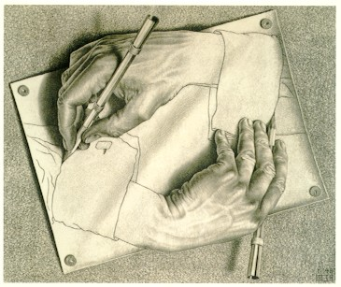
Class 3: Rules of Evaluation
David Evans
cs1120 Fall 2009

Slide 2
Menu
Questions from Notes
Computing photomosaics, non-recursive languages, hardest language elements to learn
Scheme’s Rules of Evaluation
(break: Survey Responses)

Slide 3
If it takes 60 seconds to compute a photomosaic for Problem Set 1 today on a typical PC, estimate how long it will take cs1120 students in 2012 to compute the same photomosaic? How long will it take in 2015?
> (/ (* (- 2012 2009) 12) 18)
2
> (/ 60 (* 2 2))
15
> (/ (* (- 2015 2009) 12) 18)
4
> (/ 60 (* 2 2 2 2))
15/4
> (exact->inexact (/ 60 (* 2 2 2 2)))
3.75
Difference in years * 12 = number of months
Number of months / 18 = number of doublings
according to Moore’s Law
60 seconds today, 2 doublings by 2012
15 seconds in 2012
Reality check: Moore’s “law” is just an “observation”.
60 seconds today, 4 doublings by 2015
3.75 seconds in 2015

Slide 4
Are there any non-recursive natural languages? What would happen to a society that spoke one?
Not for humans at least.
They would run out of original things to say.
Chimps and Dolphins are able to learn non-recursive “languages”, but only humans have learned recursive languages.

Slide 5
Running out of Ideas
“Its all been said before.”
Eventually true for a non-recursive language.
Never true for a recursive language.
There is always something original left to say!

Slide 6
Language Elements
When learning a foreign language, which elements are hardest to learn?
Primitives: lots of them, and hard to learn real meaning
Means of Combination
Complex, but, all natural languages have similar ones [Chomsky]
SOV (45% of all languages) Sentence ::= Subject Object Verb (Korean)
SVO (42%) Sentence ::= Subject Verb Object (English)
VSO (9%) Sentence ::= Verb Subject Object (Welsh)
“Lladdodd y ddraig y dyn.” (Killed the dragon the man.)
OSV (<1%): Tobati (New Guinea)
Scheme:
Means of Abstraction: few of these, but tricky to learn differences across languages
English: I, we
Tok Pisin (Papua New Guinea): mi (I), mitupela (he/she and I), mitripela (both of them and I), mipela (all of them and I), yumitupela (you and I), yumitripela (both of you and I), yumipela (all of you and I)
Scheme:
Expression ::= (Verb Object)
define

Slide 7
 | Pages in Revised⁵ Report on the Algorithmic Language Scheme
Primitives
Means of Combination
Means of Abstraction
 | 48 pages total (includes formal specification and examples)

Slide 8
 | Pages in Revised⁵ Report on the Algorithmic Language Scheme
Primitives | Standard Procedures Primitive expressions Identifiers, numerals |  |  | 18 2 1
Means of Combination | Expressions Program structure |  | 2 2
Means of Abstraction | Definitions | ½
 | 48 pages total (includes formal specification and examples)

Slide 9
 | Pages in Revised⁵ Report on the Algorithmic Language Scheme |  |  |  | Pages in C++ Language Specification (1998)
Primitives | Standard Procedures Primitive expressions Identifiers, numerals |  |  | 18 2 1
Means of Combination | Expressions Program structure |  | 2 2
Means of Abstraction | Definitions | ½
 | 48 pages total (includes formal specification and examples)

Slide 10
 | Pages in Revised⁵ Report on the Algorithmic Language Scheme |  |  |  | Pages in C++ Language Specification (1998)
Primitives | Standard Procedures Primitive expressions Identifiers, numerals |  |  | 18 2 1 | Standard Procedures Primitive expressions Identifiers, numerals | 356 30 10
Means of Combination | Expressions Program structure |  | 2 2 |  | Expressions, Statements Program Structure |  | 197 35
Means of Abstraction | Definitions | ½ |  |  | Declarations, Classes | 173
 | 48 pages total (includes formal specification and examples) |  |  |  | 776 pages total (includes no formal specification or examples)
C++ Core language issues list has 948 items!

Slide 11
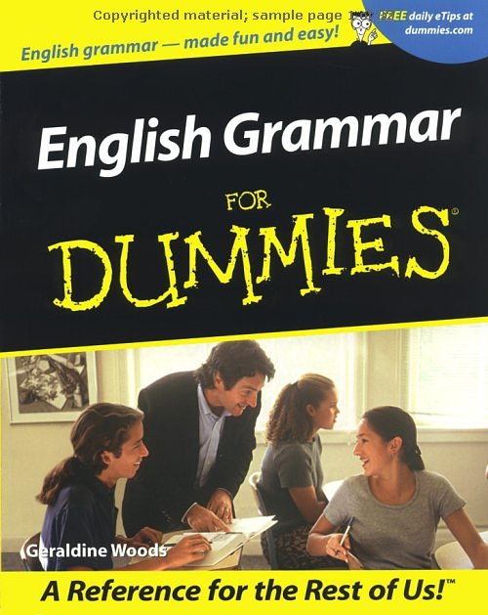
 | Pages in Revised⁵ Report on the Algorithmic Language Scheme |  |  |  | English
Primitives | Standard Procedures Primitive expressions Identifiers, numerals |  |  | 18 2 1 | Morphemes Words in Oxford English Dictionary | ? 500,000
Means of Combination | Expressions Program structure |  | 2 2 |  | Grammar Rules English Grammar for Dummies Book | 100s (?) 384 pages
Means of Abstraction | Definitions | ½ |  |  | Pronouns | ~20
 | 48 pages total (includes formal specification and examples)

Slide 12
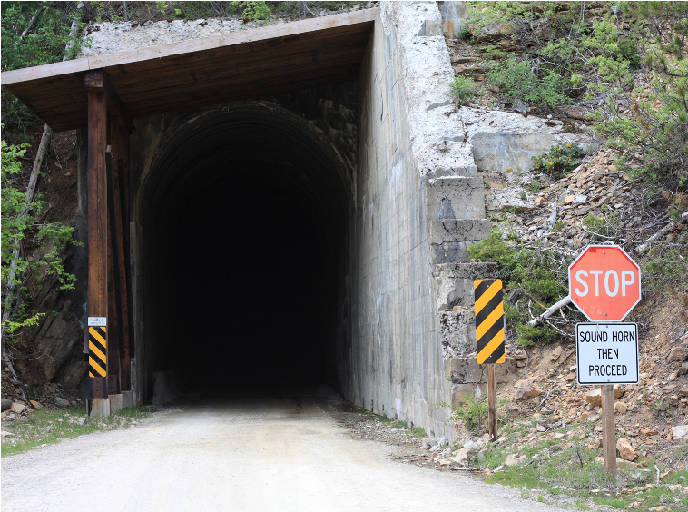
Rules of Evaluation

Slide 13
Scheme Grammar
Program ::= ε | ProgramElement Program
ProgramElement ::= Expression | Definition
Definition ::= (define Name Expression)
Expression ::= PrimitiveExpression | NameExpression
| ApplicationExpression
| ProcedureExpression | IfExpression
PrimitiveExpression ::= Number | true | false
| PrimitiveProcedure
NameExpression ::= Name
ApplicationExpression ::= (Expression MoreExpressions)
MoreExpressions ::= ε | Expression MoreExpressions
ProcedureExpression ::= (lambda (Parameters) Expression)
Parameters ::= ε | Name Parameters
IfExpression ::= (if Expression_{Pred} Expression_{Consequent} Expression_{Alt})

Slide 14
Assigning Meanings
Program ::= ε | ProgramElement Program
ProgramElement ::= Expression | Definition
Definition ::= (define Name Expression)
Expression ::= PrimitiveExpression | NameExpression
| ApplicationExpression | ProcedureExpression | IfExpression
PrimitiveExpression ::= Number | true | false| PrimitiveProcedure
NameExpression ::= Name
ApplicationExpression ::= (Expression MoreExpressions)
MoreExpressions ::= ε | Expression MoreExpressions
ProcedureExpression ::= (lambda (Parameters) Expression)
Parameters ::= ε | Name Parameters
IfExpression ::= (if Expression_{Pred} Expression_{Consequent} Expression_{Alt})
This grammar generates (nearly) all surface forms in the Scheme language.
What do we need to do to know the meaning of every Scheme program?

Slide 15
Definitions
Program ::= ε | ProgramElement Program
ProgramElement ::= Expression | Definition
Definition ::= (define Name Expression)
A definition associates the value of its expression with the name.
(define two 2)
After this definition, the value associated with the name two is 2.

Slide 16
Expressions and Values
(Almost) every expression has a value
Have you seen any expressions that don’t have values?
When an expression with a value is evaluated, its value is produced
Our goal is to define a meaning function, Eval, that defines the value of every Scheme expression:
Eval(Expression) ⇒ Value
Today we do this informally with rules in English.

Slide 17
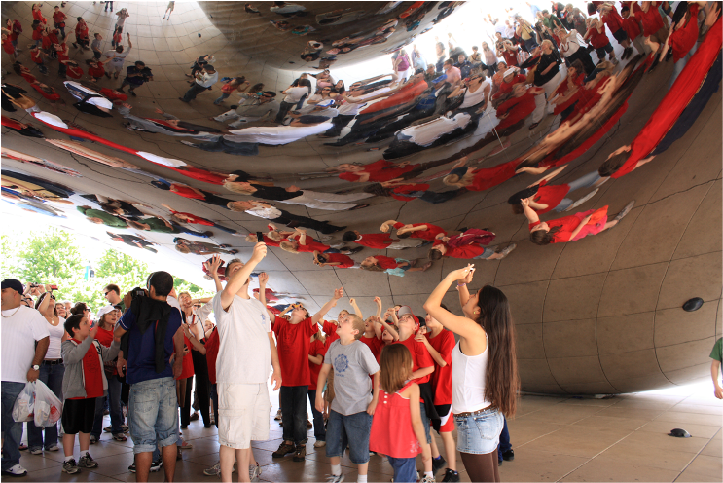
Primitive Expressions
PrimitiveExpression ::= Number | true | false | PrimitiveProcedure

Slide 18
Evaluation Rule 1: Primitives
If the expression is a primitive, it evaluates to its pre-defined value.
> 2
2
> true
#t
> +
#<primitive:+>
Primitives are the smallest units of meaning: they can’t be broken down further, you need to know what they mean.

Slide 19
Name Expressions
Expression ::= NameExpression
NameExpression ::= Name

Slide 20
Evaluation Rule 2: Names
A name evaluates to the value associated with that name.
> (define two 2)
> two
2
Caveat: this simple rule only works if the value associated with a name never changes (until PS5).

Slide 21
Application Expressions
Expression ::= Application Expression
ApplicationExpression
::= (Expression MoreExpressions)
MoreExpressions ::= ε
MoreExpressions ::= Expression MoreExpressions

Slide 22
Evaluation Rule 3: Application
To evaluation an application expression:
Evaluate all the subexpressions (in any order)
Apply the value of the first subexpression to the values of all the other subexpressions.
(Expression₀ Expression₁ Expression₂ … )

Slide 23
Rules for Application
Primitives. If the procedure to apply is a primitive procedure, just do it.
Constructed Procedures. If the procedure is a constructed procedure, evaluate the body of the procedure with each parameter name bound to the corresponding input expression value.

Slide 24
Eval and Apply are defined in terms of each other.
Without Eval, there would be no Apply, without Apply there would be no Eval!
Eval
Apply

Slide 25
Survey Responses: Majors
28 Cognitive Science
20 Computer Science
7 Psychology
4 Math
3 Economics
3 Commerce/Pre-Commerce
3 Undeclared
2 Physics
1 Environmental Sciences, English, Music

Slide 26
Survey Responses: PS Partners
For PS2 everyone will be assigned a partner.
For other problem sets, you’ll have different options.

Slide 27
Survey Responses: Office Hours
Scheduling office hours: (Set Cover Problem)
Input: a set of sets of available times
Output: the minimum size set that includes at least one element from each of the input sets
My office hours will be:
Mondays, 1:30-2:30pm [Olsson 236A]
Tuesdays, 10:30-11:30am [Wilsdorf Cafe]
Later in the course, we’ll see that this problem is equivalent to the problem of computing an optimal photomosaic!
Not a set cover: Everyone who selected at least three possible times can make at least one of these. If you can’t make office hours, email to arrange an appointment.

Slide 28
Honor Pledge

Slide 29
Finishing Scheme Meanings
Program ::= ε | ProgramElement Program
ProgramElement ::= Expression | Definition
Definition ::= (define Name Expression)
Expression ::= PrimitiveExpression | NameExpression
| ApplicationExpression | ProcedureExpression | IfExpression
PrimitiveExpression ::= Number | true | false| PrimitiveProcedure
NameExpression ::= Name
ApplicationExpression ::= (Expression MoreExpressions)
MoreExpressions ::= ε | Expression MoreExpressions
ProcedureExpression ::= (lambda (Parameters) Expression)
Parameters ::= ε | Name Parameters
IfExpression ::= (if Expression_{Pred} Expression_{Consequent} Expression_{Alt})

Slide 30
Making Procedures
lambda means “make a procedure”
Expression ::= ProcedureExpression
ProcedureExpression ::=
(lambda (Parameters) Expression)
Parameters ::= ε
Parameters ::= Name Parameters

Slide 31
Evaluation Rule 4: Lambda
A lambda expression evaluates to a procedure that takes the given parameters and has the expression as its body.
ProcedureExpression ::= (lambda (Parameters) Expression)
Parameters ::= ε | Name Parameters

Slide 32
Lambda Example: Tautology Function
make a procedure
with no parameters
with body true
(lambda
()
true)
> ((lambda () true) 1120)
#<procedure>: expects no arguments, given 1: 1120
> ((lambda () true))
#t
> ((lambda (x) x) 1120)
1120
Next class we’ll follow the evaluation rules through more interesting examples.

Slide 33
Evaluation Rule 5: If
IfExpression
::= (if Expression_{Predicate}
Expression_{Consequent}
Expression_{Alternate})
To evaluate an if expression:
Evaluate Expression_{Predicate}.
If it evaluates to a false value, the value of the if expression is the value of Expression_{Alternate}; otherwise, the value of the if expression is the value of Expression_{Consequent}.

Slide 34
Completeness of Evaluation Rules
Program ::= ε | ProgramElement Program
ProgramElement ::= Expression | Definition
Definition ::= (define Name Expression)
Expression ::= PrimitiveExpression | NameExpression
| ApplicationExpression | ProcedureExpression | IfExpression
PrimitiveExpression ::= Number | true | false| PrimitiveProcedure
NameExpression ::= Name
ApplicationExpression ::= (Expression MoreExpressions)
MoreExpressions ::= ε | Expression MoreExpressions
ProcedureExpression ::= (lambda (Parameters) Expression)
Parameters ::= ε | Name Parameters
IfExpression ::= (if Expression_{Pred} Expression_{Consequent} Expression_{Alt})
Since we have an evaluation rule for each grammar rule, we can determine the meaning of any Scheme program!

Slide 35
Now You Can Write Any Program!
You know enough now to define a procedure that performs every possible computation!
We’ll prove this later in the course
We’ll learn some more useful Scheme forms:
There are a few more special forms (like if)
But, none of these are necessary…just helpful
We have not defined the evaluation rules precisely enough to unambiguously understand all programs (e.g., what does “value associated with a name” mean?)

Slide 36
Charge
PS1 Due at beginning of class Wednesday
Read Chapter 4 by Friday
Now you know enough to produce every computation, the rest is just gravy:
More efficient, elegant ways to express computations
Ways to analyze the computations

