Slide 1
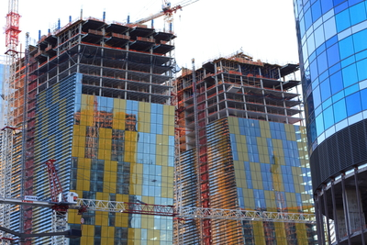
Class 30: Language Construction
cs1120 Fall 2009
David Evans

Slide 2
Menu
Checking Grades
Plans for Exam 2
Completing the Charme Interpreter
History of Object-Oriented Programming

Slide 3
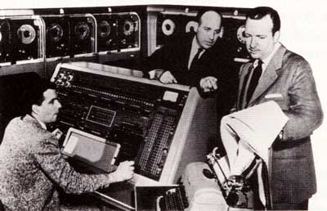
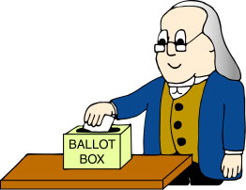
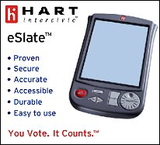
Software Voting
Univac predicts big win for Eisenhower (1952)
“We do have people complain and say they don’t get it, I completely understand what they’re saying, but it's not something I can control.”
– Sheri Iachetta, Charlottesville general registrar

Slide 4
Recap
def meval(expr, env):
if isPrimitive(expr):
return evalPrimitive(expr)
elif isIf(expr):
return evalIf(expr, env)
elif isDefinition(expr):
evalDefinition(expr, env)
elif isName(expr):
return evalName(expr, env)
elif isLambda(expr):
return evalLambda(expr, env)
elif isApplication(expr):
return evalApplication(expr, env)
else:
error ('Unknown expression ...)
To build an evaluator we need to:
Figure out how to represent data in programs
Last class: program text, Environment
Today: Procedures, primitives
Implement the evaluation rules
For each evaluation rule, define a procedure that follows the behavior of that rule.
Friday: application
Last class: definitions, names
Today: special forms, primitives

Slide 5
How should we represent procedures?
(lambda (x) (+ x x))

Slide 6
Representing Procedures
Environment pointer
x
Input parameters
(in mouth)
(+ x x)
Procedure Body

Slide 7
Procedure Class
class Procedure:
def __init__(self, params, body, env):
self._params = params
self._body = body
self._env = env
def getParams(self):
return self._params
def getBody(self):
return self._body
def getEnvironment(self):
return self._env
def __str__(self):
return '<Procedure %s / %s>' % (str(self._params), str(self._body))
def mapply(proc, operands):
if (isPrimitiveProcedure(proc)): ...
elif isinstance(proc, Procedure):
params = proc.getParams()
newenv = Environment(proc.getEnvironment())
for i in range(0, len(params)):
newenv.addVariable(params[i], operands[i])
return meval(proc.getBody(), newenv)

Slide 8
Evaluating Lambda Expressions
parse("(lambda (a) (+ a 1))")[0]
['lambda', ['a'], ['+', 'a', '1']]
def isSpecialForm(expr, keyword):
return isinstance(expr, list) and len(expr) > 0 and expr[0] == keyword
def isLambda(expr):
return isSpecialForm(expr, 'lambda')
def evalLambda(expr,env):
assert isLambda(expr)
if len(expr) != 3:
evalError ("Bad lambda expression: %s" % str(expr))
return Procedure(expr[1], expr[2], env)

Slide 9
Recap
def meval(expr, env):
if isPrimitive(expr):
return evalPrimitive(expr)
elif isIf(expr):
return evalIf(expr, env)
elif isDefinition(expr):
evalDefinition(expr, env)
elif isName(expr):
return evalName(expr, env)
elif isLambda(expr):
return evalLambda(expr, env)
elif isApplication(expr):
return evalApplication(expr, env)
else:
error ('Unknown expression ...)

Slide 10
Making Primitives
Evaluation Rule 1: Primitives
A primitive evaluates to its pre-defined value.
To implement a primitive, we need to give it its pre-defined value!

Slide 11
Primitives
def isPrimitive(expr):
return (isNumber(expr) or isPrimitiveProcedure(expr))
def isNumber(expr):
return isinstance(expr, str) and expr.isdigit()
def isPrimitiveProcedure(expr):
return callable(expr)
def evalPrimitive(expr):
if isNumber(expr):
return int(expr)
else:
return expr

Slide 12
Making Primitive Procedures
def primitivePlus (operands):
if (len(operands) == 0):
return 0
else:
return operands[0] + primitivePlus (operands[1:])
def primitiveEquals (operands):
checkOperands (operands, 2, '=')
return operands[0] == operands[1]
To apply a primitive procedure, “just do it”.
def mapply(proc, operands):
if (isPrimitiveProcedure(proc)):
return proc(operands)
elif isinstance(proc, Procedure):
...

Slide 13
So, what do we do with the primitives?
def initializeGlobalEnvironment():
global globalEnvironment
globalEnvironment = Environment(None)
globalEnvironment.addVariable('true', True)
globalEnvironment.addVariable('false', False)
globalEnvironment.addVariable('+', primitivePlus)
globalEnvironment.addVariable('-', primitiveMinus)
globalEnvironment.addVariable('*', primitiveTimes)
globalEnvironment.addVariable('=', primitiveEquals)
globalEnvironment.addVariable('zero?', primitiveZero)
globalEnvironment.addVariable('>', primitiveGreater)
globalEnvironment.addVariable('<', primitiveLessThan)

Slide 14
Evaluation Rule 5: If
IfExpression
::= (if Expression_{Predicate}
Expression_{Consequent}
Expression_{Alternate})
To evaluate an if expression:
Evaluate Expression_{Predicate}.
If it evaluates to a false value, the value of the if expression is the value of Expression_{Alternate}; otherwise, the value of the if expression is the value of Expression_{Consequent}.

Slide 15
Making Special Forms
def isIf(expr):
return isSpecialForm(expr, 'if')
def evalIf(expr,env):
assert isIf(expr)
if len(expr) != 4:
evalError ('Bad if expression: %s' % str(expr))
if meval(expr[1], env) != False:
return meval(expr[2],env)
else:
return meval(expr[3],env)

Slide 16
All Done!
def meval(expr, env):
if isPrimitive(expr):
return evalPrimitive(expr)
elif isIf(expr):
return evalIf(expr, env)
elif isDefinition(expr):
evalDefinition(expr, env)
elif isName(expr):
return evalName(expr, env)
elif isLambda(expr):
return evalLambda(expr, env)
elif isApplication(expr):
return evalApplication(expr, env)
else:
error ('Unknown expression ...)
This is a universal programming language – we can define every procedure in Charme.

Slide 17
History of Object-Oriented Programming
Object-oriented programming is an exceptionally bad idea which could only have originated in California. Edsger Dijkstra

Slide 18
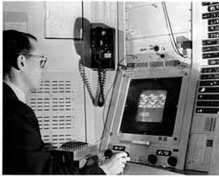
Sketchpad Ivan Sutherland’s 1963 PhD thesis (supervised by Claude Shannon)
Interactive drawing program
Light pen
Notes:
http://www.cl.cam.ac.uk/TechReports/UCAM-CL-TR-574.pdf

Slide 19
Components in Sketchpad

Slide 20
Objects in Sketchpad
In the process of making the Sketchpad system operate, a few very general functions were developed which make no reference at all to the specific types of entities on which they operate. These general functions give the Sketchpad system the ability to operate on a wide range of problems. The motivation for making the functions as general as possible came from the desire to get as much result as possible from the programming effort involved. For example, the general function for expanding instances makes it possible for Sketchpad to handle any fixed geometry subpicture. The rewards that come from implementing general functions are so great that the author has become reluctant to write any programs for specific jobs. Each of the general functions implemented in the Sketchpad system abstracts, in some sense, some common property of pictures independent of the specific subject matter of the pictures themselves.
Ivan Sutherland,
Sketchpad: a Man-Machine Graphical Communication System, 1963

Slide 21
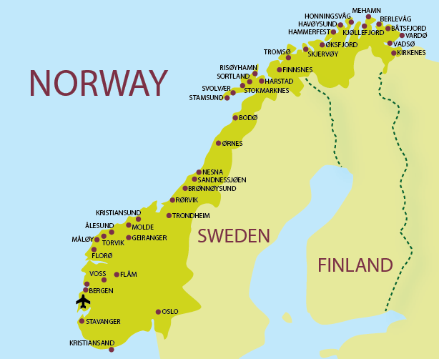
Simula
Considered the first “object-oriented” programming language
Language designed for simulation by Kristen Nygaard and Ole-Johan Dahl (Norway, 1962)
Had special syntax for defining classes that packages state and procedures together

Slide 22
Counter in Simula
class counter;
integer count;
begin
procedure reset(); count := 0; end;
procedure next();
count := count + 1; end;
integer procedure current();
current := count; end;
end
Does this have everything we need for “object-oriented programming”?

Slide 23
Object-Oriented Programming
Object-Oriented Programming is a state of mind where you program by thinking about objects
It is difficult to reach that state of mind if your language doesn’t have mechanisms for packaging state and procedures (Python has class, Scheme has lambda expressions)
Other things can help: dynamic dispatch, inheritance, automatic memory management, mixins, good donuts, etc.

Slide 24
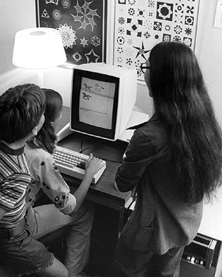
XEROX Palo Alto Research Center (PARC)
1970s:
Bitmapped display
Graphical User Interface
Steve Jobs paid $1M to visit and PARC, and returned to make Apple Lisa/Mac
Ethernet
First personal computer (Alto)
PostScript Printers
Object-Oriented Programming

Slide 25
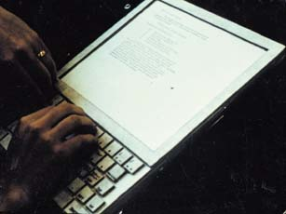
Dynabook, 1972
“Don’t worry about what anybody else is going to do… The best way to predict the future is to invent it. Really smart people with reasonable funding can do just about anything that doesn't violate too many of Newton's Laws!”
— Alan Kay, 1971
(Just a model)

Slide 26
Dynabook 1972
Tablet computer intended as tool for learning
Alan Kay wanted children to program it also
Hallway argument, Kay claims you could define “the most powerful language in the world in a page of code”
Proof: Smalltalk
Scheme is as powerful, but takes two pages
Before the end of the course, we will see an equally powerful language that fits in ¼ page

Slide 27
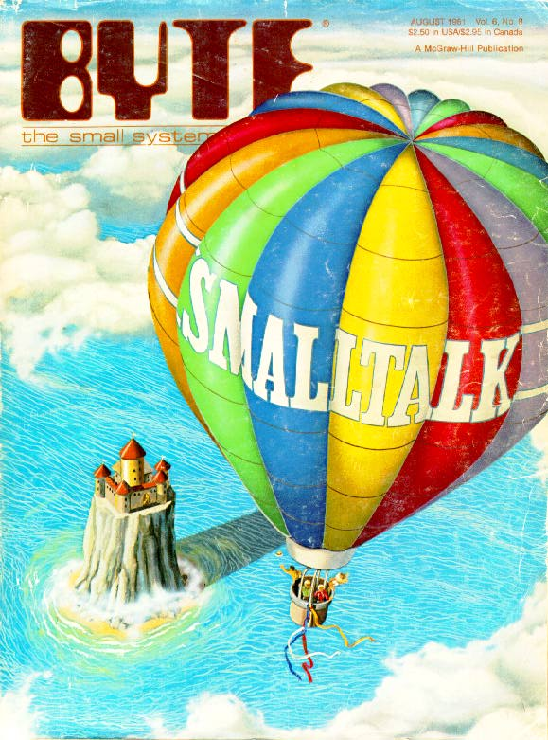
BYTE Magazine, August 1981

Slide 28
Smalltalk
Everything is an object
Objects communicate by sending and receiving messages
Objects have their own state (which may contain other objects)
How do you do 3 + 4?
send the object 3 the message “+ 4”

Slide 29
Counter in Smalltalk
class name counter
instance variable names count
new count <- 0
next count <- count + 1
current ^ count

Slide 30
So, who really was the first object-oriented programmer?
Object-oriented programming is an exceptionally bad idea which could only have originated in California. Edsger Dijkstra

Slide 31
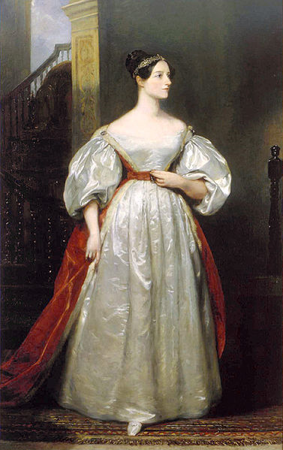
By the word operation, we mean any process which alters the mutual relation of two or more things, be this relation of what kind it may. This is the most general definition, and would include all subjects in the universe. Again, it might act upon other things besides number, were objects found whose mutual fundamental relations could be expressed by those of the abstract science of operations... Supposing, for instance, that the fundamental relations of pitched sounds in the science of harmony and of musical composition were susceptible of such expression and adaptations, the engine might compose elaborate and scientific pieces of music of any degree of complexity or extent.
Ada, Countess of Lovelace,
around 1843

Slide 32
Charge
Friday: changing the language rules
PS7 due Monday
Remember to vote (early and often!) in the Exam 2 poll before 5pm Thursday.

