Slide 1
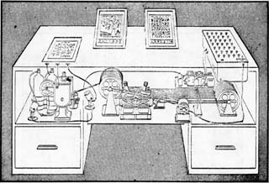
Lecture 33:
Networking
Memex Machine Vannevar Bush, As We May Think, LIFE, 1945
David Evans
http://www.cs.virginia.edu/evans

Slide 2
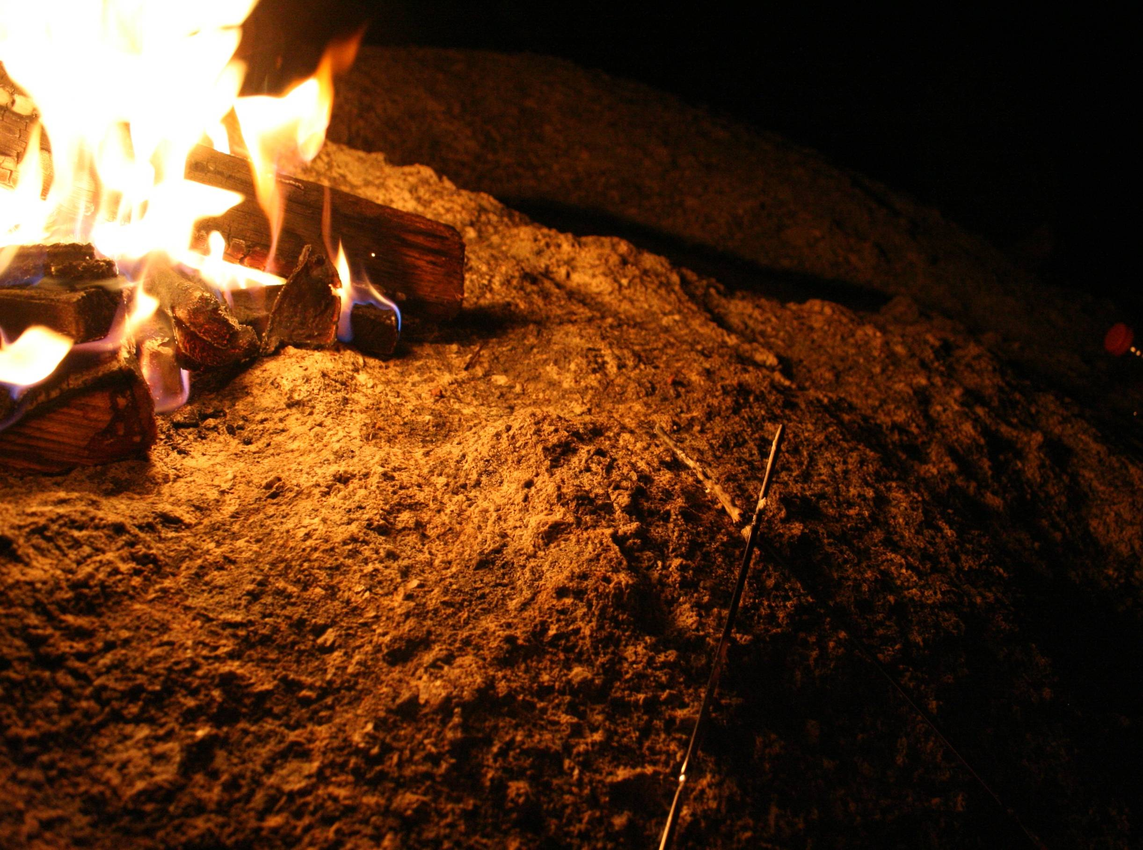
CS Department Fireside Chat
All are welcome!
Wed Nov 18, 5-6pm, Ols 228e/236d
Kim Hazelwood and Wes Weimer
Meet and ask them questions in a non-academic setting.
Learn how they became interested in computer science,
what they wish they had known when they were students,
and what their lives are like outside of the office. Ask them anything!

Slide 3
Reminders
Team Assignments: if you sent a complete team, you should have already received an email response from me that you are a team
I will finish the rest of the team assignments tomorrow
If you have team preferences, you can still send in late requests today
Go through the Django Tutorial by Sunday: nothing graded for this, but send email when you finish it (details at end of tutorial)
AC’s Exam 2 Review Session: Monday or Tuesday Evening?

Slide 4
Who Invented the Internet?

Slide 5
Who Invented Networking?

Slide 6
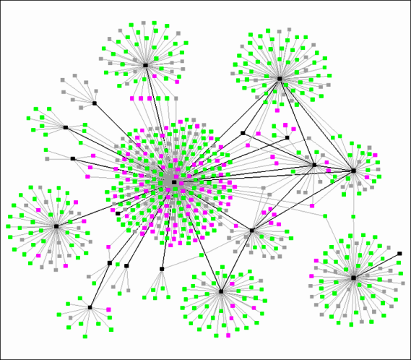
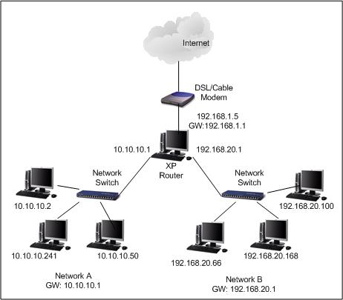
What is a Network?
Neural Network
http://flowingdata.com/2008/03/12/17-ways-to-visualize-the-twitter-universe/

Slide 7
What is a Network?
A group of three or more connected communicating entities.

Slide 8
Beacon Chain Networking
Thus, from some far-away beleaguered island, where all day long the men have fought a desperate battle from their city walls, the smoke goes up to heaven; but no sooner has the sun gone down than the light from the line of beacons blazes up and shoots into the sky to warn the neighboring islanders and bring them to the rescue in their ships.
Iliad, Homer, 700 BC
Chain of beacon’s signaled Agammemnon’s return (~1200BC), spread on Greek peaks over 600km.

Slide 9
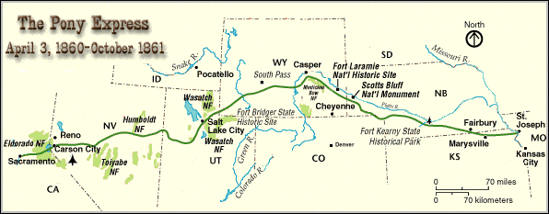
Pony Express
April 1860 – October 1861
Missouri to California
10 days
10-15 miles per horse, ~100 miles per rider
400 horses total

Slide 10
Chappe’s Semaphore Network
First Line (Paris to Lille), 1794
Mobile Semaphore Telegraph Used in the Crimean War 1853-1856

Slide 11
Networking and Power
The use of novel methods that modify established habits, often hurts the interests of those who profit the most from the older methods. Few people, with the exception of the inventors, are truly interested in helping projects succeed while their ultimate impact is still uncertain. . . . Those in power will normally make no effort to support a new invention, unless it can help them to augment their power; and even when they do support it, their efforts are usually insufficient to allow the new ideas to be fully exploited.
Claude Chappe, 1824
Chappe wanted a commercial network

Slide 12
Government wants a Monopoly on Communications
Anyone performing unauthorized transmissions of signals from one place to another, with the aid of telegraphic machines or by any other means, will be punished with an imprisonment of one month to one year, and a fine of 1,000 to 10,000 Francs.
French Law passed in 1837 made private networking illegal

Slide 13
Measuring Networks
Latency
Time from sending a bit until it arrives
seconds (or seconds per geographic distance)
Bandwidth
Rate at which can you transmit
bits per second

Slide 14
Latency and Bandwidth
Napoleon’s Network: Paris to Toulon, 475 mi
Latency: 13 minutes (1.6s per mile)
What is the delay at each signaling station, how many stations to reach destination
At this rate, it would take ~1 hour to get a bit from California
Bandwidth: 2 symbols per minute (98 possible symbols, so that is ~13 bits per minute
How fast can signalers make symbols
At this rate, it would take you about 9 days to get ps7.zip

Slide 15
Improving Latency
Less transfer points
Longer distances between transfer points
Semaphores: how far can you see clearly
Curvature of Earth is hard to overcome
Use wires (electrical telegraphs, 1837)
Faster transfers
Replace humans with machines
Faster travel between transfers
Hard to beat speed of light (semaphore network)
Electrons in copper: about 1/3rd speed of light

Slide 16
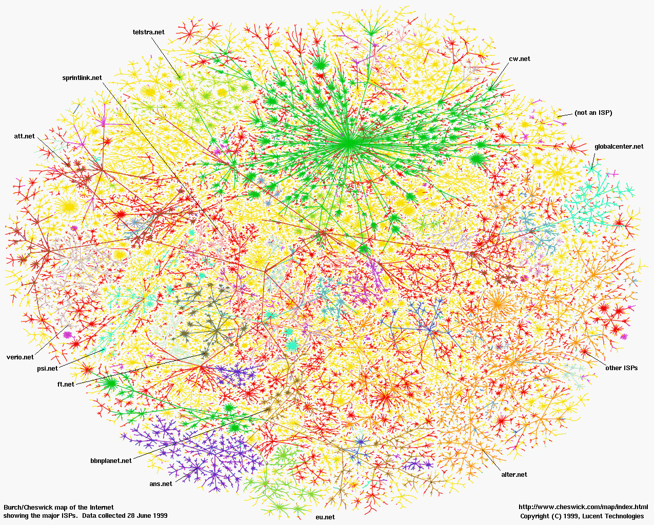
How many transfer points between here and California?

Slide 17
tracert
K:\>tracert www.cs.berkeley.edu
Tracing route to hyperion.cs.berkeley.edu [169.229.60.105]
over a maximum of 30 hops:
1 3 ms 3 ms 4 ms 128.143.69.1
2 <1 ms <1 ms <1 ms carruthers-6509a-x.misc.Virginia.EDU [....]
3 <1 ms <1 ms <1 ms new-internet-x.misc.Virginia.EDU [128.....]
4 4 ms 4 ms 4 ms nwv-nlrl3.misc.Virginia.EDU [192.35.48.30]
5 5 ms 5 ms 5 ms nlrl3-router.networkvirginia.net [192.7...]
6 18 ms 18 ms 18 ms atla-wash-64.layer3.nlr.net [216.24.186.20]
7 43 ms 43 ms 42 ms hous-atla-70.layer3.nlr.net [216.24.186.8]
8 73 ms 73 ms 73 ms losa-hous-87.layer3.nlr.net [216.24.186.30]
9 72 ms 72 ms 72 ms hpr-lax-hpr--nlr-packenet.cenic.net [137..]
10 80 ms 81 ms 81 ms svl-hpr--lax-hpr-10ge.cenic.net [137.16...]
11 145 ms 81 ms 81 ms hpr-ucb-ge--svl-hpr.cenic.net [137.164....]
12 81 ms 81 ms 81 ms g3-12.inr-201-eva.Berkeley.EDU [128.32....]
13 81 ms 82 ms 83 ms evans-soda-br-5-4.EECS.Berkeley.EDU [...]
14 83 ms 84 ms 83 ms sbd2a.EECS.Berkeley.EDU [169.229.59.226]
15 83 ms 84 ms 83 ms hyperion.CS.Berkeley.EDU [169.229.60.105]
Trace complete.
UVa
Atlanta → Houston → LA?
UCB

Slide 18
>>> cvilleberkeley = 3813 # kilometers
>>> seconds = 84.0/1000
>>> speed = cvilleberkeley / seconds
>>> speed
45392.857142857138
>>> light = 299792.458 # km/s
>>> speed / light
0.15141427321316114
Packets are traveling average at 15% of the speed of light (includes transfer time through 15 routers)

Slide 19
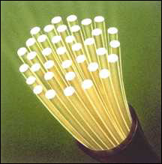
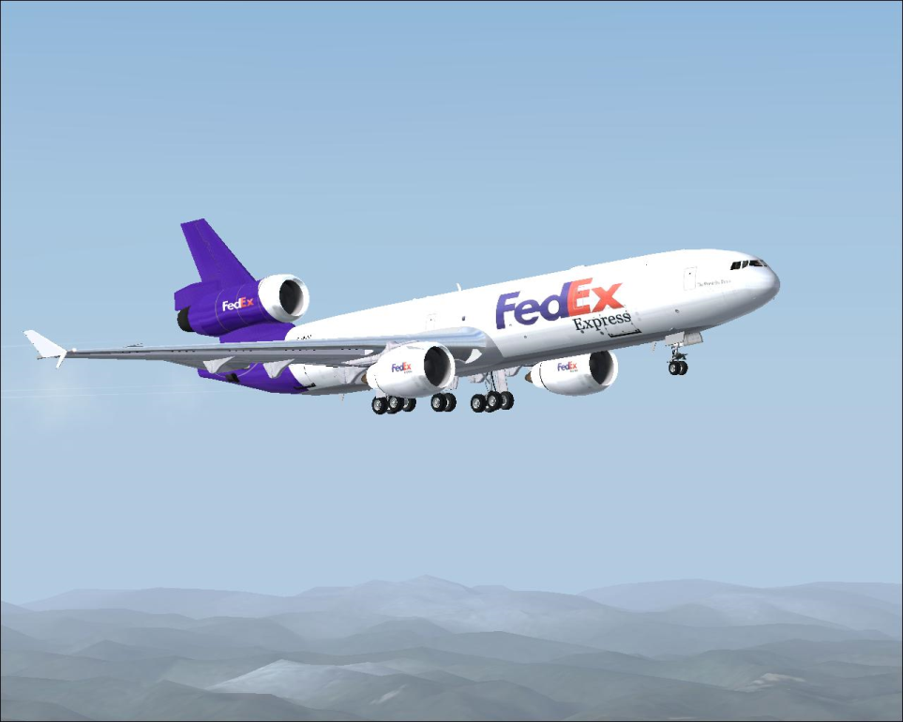
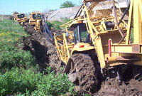
Bandwidth
How much data can you transfer in a given amount of time?

Slide 20
Improving Bandwidth
Faster transmission
Train signalers to move semaphore flags faster
Use something less physically demanding to transmit
Bigger pipes
Have multiple signalers transmit every other letter at the same time
Better encoding
Figure out how to code more than 98 symbols with semaphore signal
Morse code (1840s)

Slide 21
Morse Code
Represent letters with series of
short and long electrical pulses

Slide 22
Circuit Switching
Reserve a whole path through the network for the whole message transmission
Paris
Bourges
Lyon
Toulon
Once you start a transmission,
know you will have use of the network until it is finished. But,
wastes network resources.
Nantes

Slide 23
Packet Switching
Use one link at a time
Paris
Bourges
Lyon
Toulon
Interleave messages – send whenever the next link is free.
Nantes

Slide 24
Circuit and Packet Switching
(Land) Telephone Network (back in the old days)
Circuit: when you dial a number, you have a reservation on a path through the network until you hang up
The Internet
Packet: messages are broken into small packets, that find their way through the network link by link

Slide 25
internetwork
A collection of multiple networks connected together, so messages can be transmitted between nodes on different networks.

Slide 26
The First internet
1800: Sweden and Denmark worried about Britain invading
Edelcrantz proposes link across strait separating Sweden and Denmark to connect their (signaling) telegraph networks
1801: British attack Copenhagen, network transmit message to Sweden, but they don’t help.
Denmark signs treaty with Britain, and stops communications with Sweden

Slide 27
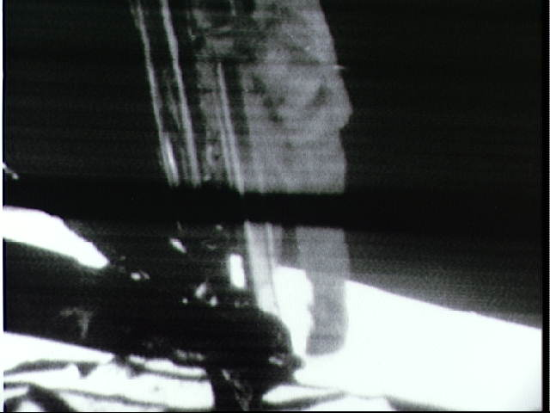
First Use of Internet
October 1969: First packets on the ARPANet from UCLA to Stanford. Starts to send "LOGIN", but it crashes on the G.
20 July 1969:
Live video (b/w) and audio transmitted from moon to Earth, and to millions of televisions worldwide.

Slide 28
Okay, so who invented the Internet?

Slide 29
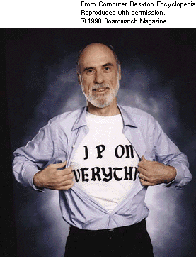
The Modern Internet
Packet Switching: Leonard Kleinrock (UCLA) thinks he did, Donald Davies and Paul Baran, Edelcrantz’s signalling network (1809)
Internet Protocol: Vint Cerf, Bob Kahn
Vision, $: J.C.R. Licklider, Bob Taylor
Government: Al Gore
First politician to promote Internet, 1986; act to connect government networks to form “Interagency Network”
Vint Cerf (Google’s Internet Evangelist)
Talk at UVa: January 29

Slide 30
The World Wide Web

Slide 31
The “Desk Wide Web”
Memex Machine Vannevar Bush, As We May Think, LIFE, 1945

Slide 32
Available within the network will be functions and services to which you subscribe on a regular basis and others that you call for when you need them. In the former group will be investment guidance, tax counseling, selective dissemination of information in your field of specialization, announcement of cultural, sport, and entertainment events that fit your interests, etc. In the latter group will be dictionaries, encyclopedias, indexes, catalogues, editing programs, teaching programs, testing programs, programming systems, data bases, and – most important – communication, display, and modeling programs. All these will be – at some late date in the history of networking - systematized and coherent; you will be able to get along in one basic language up to the point at which you choose a specialized language for its power or terseness.
J. C. R. Licklider and Robert W. Taylor, The Computer as a Communication Device, April 1968

Slide 33
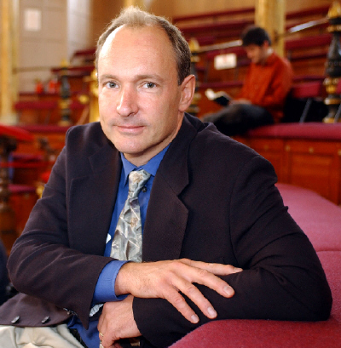
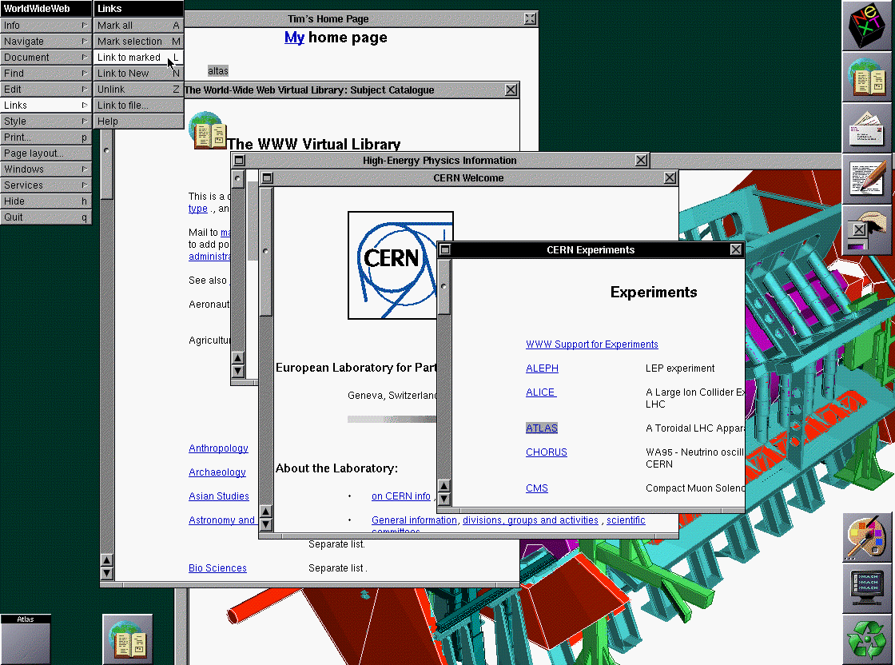
WorldWideWeb
Sir Tim Berners-Lee
CERN (Switzerland)
First web server and client, 1990
(This picture, 1993)

Slide 34
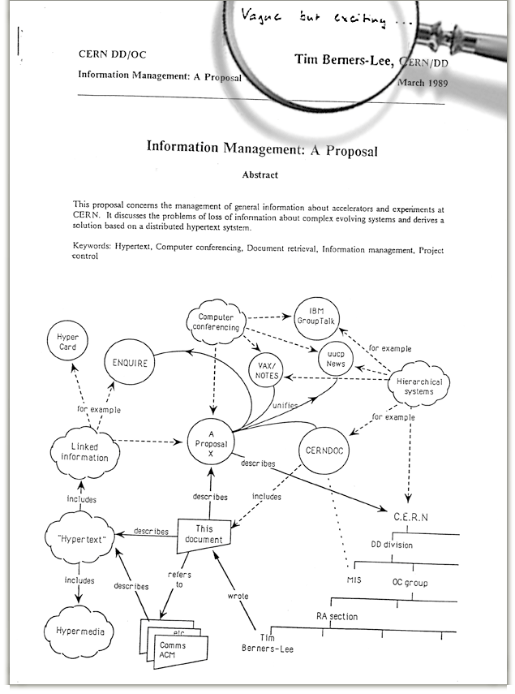
Established a common language for sharing information on computers
Lots of previous attempts (Gopher, WAIS, Archie, Xanadu, etc.)

Slide 35
World Wide Web Success
World Wide Web succeeded because it was simple!
Didn’t attempt to maintain links, just a common way to name things
Uniform Resource Locators (URL)
http://www.cs.virginia.edu/cs1120/index.html
Service
Hostname
File Path
HyperText Transfer Protocol

Slide 36
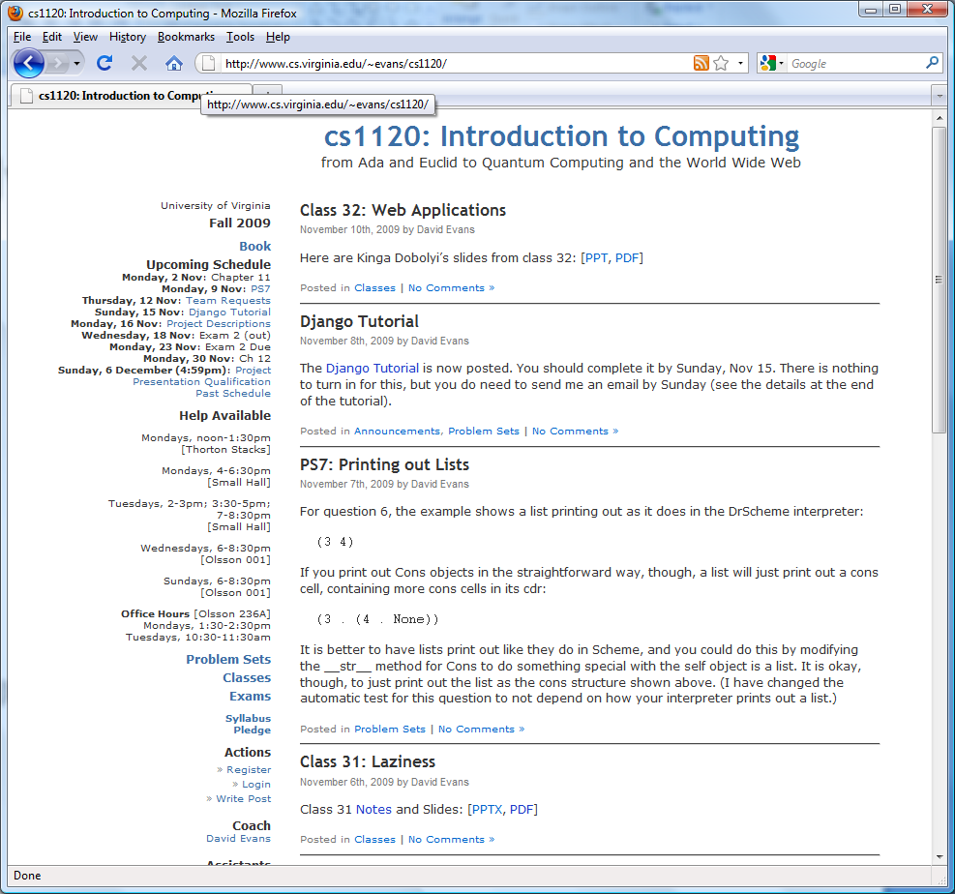
HyperText Transfer Protocol
Server
GET /cs1120/index.html HTTP/1.0
<html>
<head>
…
Contents
of file
Client (Browser)
HTML
HyperText Markup Language

Slide 37
HTML: HyperText Markup Language
Language for controlling presentation of web pages
Uses formatting tags
Enclosed between < and >
Not a universal programming language
Proof: no way to make an infinite loop

Slide 38
HTML Grammar Excerpt
Document ::= <html> Header Body </html> Header ::= <head> HeadElements </head> HeadElements ::= HeadElement HeadElements HeadElements ::= HeadElement ::= <title> Element </title>
Body ::= <body> Elements </body> Elements ::= Element Elements Elements ::= Element ::= <p> Element </p> Make Element a paragraph. Element ::= <center> Element </center> Center Element horizontally on the page. Element ::= <b> Element </b> Display Element in bold. Element ::= <a href=URL>Element</a>
Element ::= Text
What is a HTML interpreter?

Slide 39
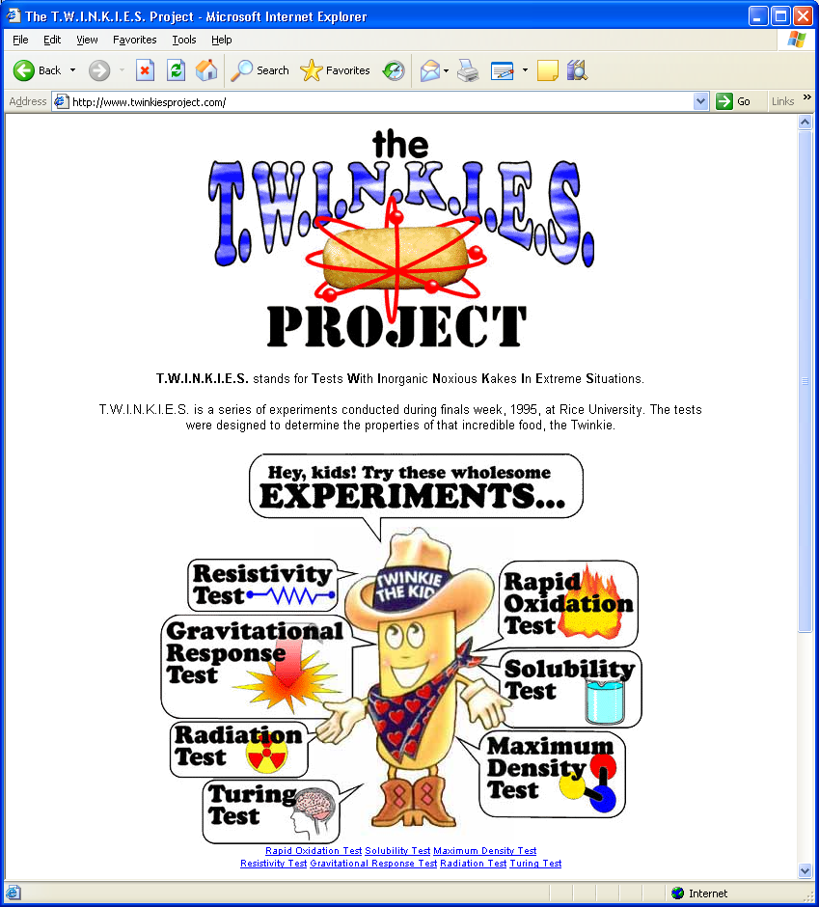
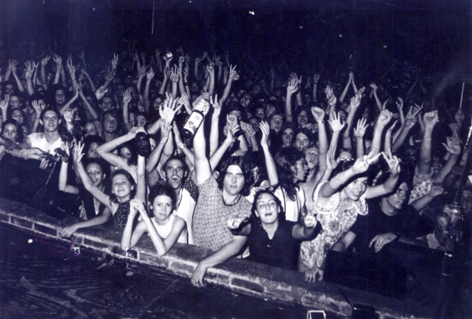
Popular Web Site: Strategy 1 Static, Authored Web Site
Drawbacks:
Have to do all the work yourself
The world may already have enough Twinkie-experiment websites
Web Programmer,
Content Producer
http://www.twinkiesproject.com/

Slide 40
Turing Test
“I propose to consider the question ‘Can machines think?’”
Alan Turing, Computing Machinery and Intelligence, 1950.

Slide 41
Imitation Game
Subject A
What’s a Twinkie?
Q: Do you like Twinkies?
Subject B
Interrogator
(Human)
Of course.

Slide 42
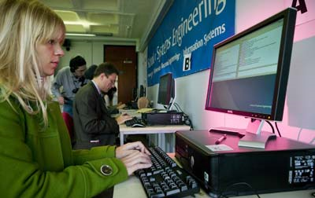
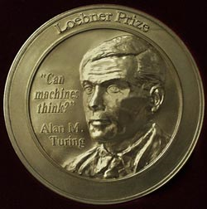
Loebner Prize

Slide 43
Human or Machine?
Hi how is it going?
Great. You?
Where do you come from?
I'm from the U.S.
Where in the States?
Do you know where Albuquerque is?
NM. I am sort of from NY.
Yep.
Sort of?
I lived in Westchester four 4 years, and before that I did my degree at Brandeis.
What do you do in Alb?
I'm an engineer -- electrical
Working on?
Systems to integrate speaker recognition
Hi, how is it going?
Hello. How are you doing?
Good, who are you?
Well, I am studying engineering. That ought to give you an idea about who I am.
No, not really?
I have a terriffic yearning to know something more about experiments?
Where are you from?
I don't know, but don't forget I can't be in three places at once.
What city do you live in?
What city -- that's rather a tricky question. The trouble is, one city seems to be much like another.
Not really. Where do you live?
In the old dairy next to the river, I believe.

Slide 44
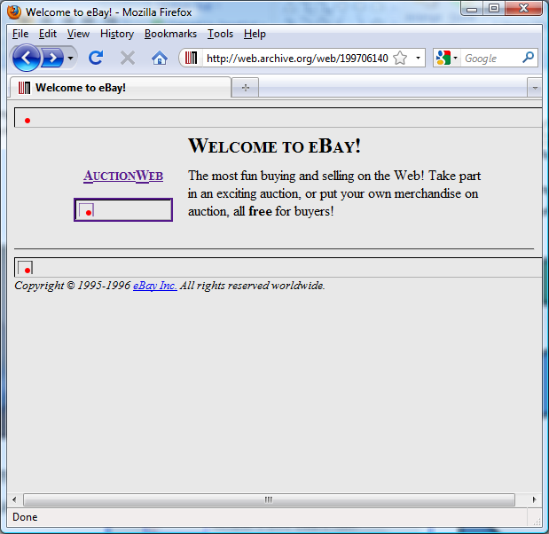
Popular Web Site: Strategy 2 Dynamic Web Applications
Attracts users
Seed content and function
Web Programmer,
Content Producer
Produce more content
eBay in 1997
http://web.archive.org/web/19970614001443/http://www.ebay.com/

Slide 45
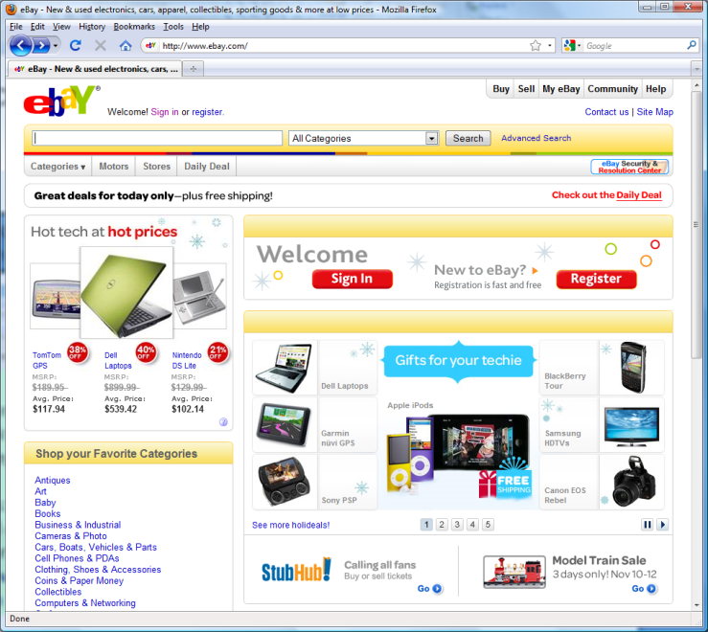
Popular Web Site: Strategy 2 Dynamic Web Applications
Attracts users
Seed content and function
Advantages:
Users do most of the work
If you’re lucky, they might even pay you
for the privilege! (not using UVa’s servers)
Disadvantages:
Lose control over the content (you might
get sued for things your users do)
Have to know how to program a web
application
Produce more content
eBay in 2009
eBay in 1997

Slide 46
Dynamic Web Sites
Programs that run on the client’s machine
Java, JavaScript, Flash, etc.: language must be supported by the client’s browser (so they are usually flaky and don’t work for most visitors)
Occasionally good reasons for this: need a fancy interface on client side (like Google Maps)
Programs that run on the web server
Can be written in any language, just need a way to connect the web server to the program
Program generates regular HTML – works for everyone
(Almost) Every useful web site does this

Slide 47
Django Web Framework
GET /overheardit/ HTTP/1.0
urls.py
...
urlpatterns = patterns('',
(r'^overheardit/login/$', 'django.contrib.auth.views.login'),
...
# default to index page if nothing else matches
(r'', 'overheardit.stories.views.index'),
)
Database
Server: alonzo.cs.virginia.edu

Slide 48
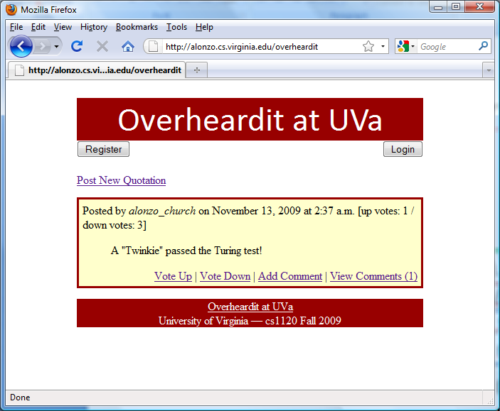
overheardit.stories.views.index
In overheardit/stories/views.py:
Request to database, produces
Python list of Story objects
def index(request):
latest_story_list = Story.objects.all().order_by('-upvotes')[:20]
return render_to_response('stories/index.html', \
{'latest_story_list' : latest_story_list, \
'user' : request.user})
Template for producing
html output page
Dictionary defining variables to
use in the template.
<style type="text/css">
...
<div id="header">Overheardit at UVa</div>
...
<div id="story"> Posted by <em>alonzo_church</em> on November 13, 2009 at 2:37 a.m. [up votes: 1 / down votes: 3]
<blockquote> A &quot;Twinkie&quot; passed the Turing test! </blockquote>
...

Slide 49
Charge
From Tim Berners-Lee’s “Answers for Young People”
http://www.w3.org/People/Berners-Lee/Kids.html
I think the main thing to remember is that any really powerful thing can be used for good or evil. Dynamite can be used to build tunnels or to make missiles. Engines can be put in ambulances or tanks. Nuclear power can be used for bombs or for electrical power. So the what is made of the Web is up to us. You, me, and everyone else.
Here is my hope: The Web is a tool for communicating. With the Web, you can find out what other people mean. You can find out where they are coming from. The Web can help people understand each other.
Think about most of the bad things that have happened between people in your life. Maybe most of them come down to one person not understanding another. Even wars.
Let’s use the web to create neat new exciting things.
Let’s use the Web to help people understand each other.
Do the Django tutorial by Sunday

