Slide 1
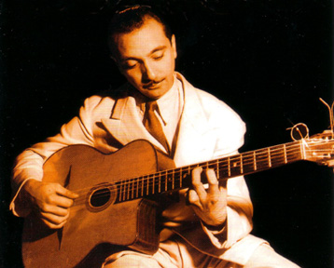
Lecture 34:
Djustifying Django
UVa cs1120
David Evans

Slide 2
Menu
Django Innards
Sign up for design reviews in class today
Exam 2 Review Session: tonight, 6-7:30 in Olsson 001
Wednesday, 5-6:30pm, Olsson 228E: Fireside chat with Wes Weimer and Kim Hazelwood

Slide 3
Projects and Teams
Project teams are posted on website
Everyone should be happy with their team – if you’re not happy, let me know today!
At the end of the project you will rate each of your teammates on:
Effort
Contribution
“Works well with others”
All team members are responsible for the success of the project

Slide 4
MTV Programming
Data
Presentation
Model
“View”
Template
How data is represented,
accessed, and manipulated
(defined by Python classes, automated by Django)
Python programs for implementing application logic
HTML templates for presenting output

Slide 5
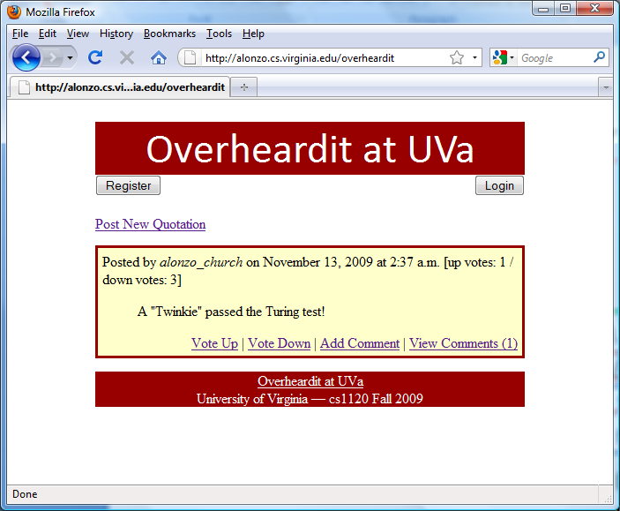
Web Application Data
Server
GET /overheardit HTTP/1.0
<html>
<head>
…
Contents
of file
Client (Browser)
HTTP protocol is stateless: each request is independent
For data to persist across requests, needs to be either:
stored on server (next: database)
or embedded in request (later: cookies, form fields)

Slide 6
Django Data Models
overheardit/stories/models.py:
class Story(models.Model):
body = models.CharField(max_length=500)
upvotes = models.IntegerField(default=0)
orig_poster = models.CharField(max_length=15)
post_date = models.DateTimeField('date published',
auto_now=True)
class variables: each instance gets its own copy (like an instance variable) that is assigned to real value or corresponding type

Slide 7
] python manage.py shell
Python 2.6.1 (r261:67517, Dec 4 2008, 16:51:00) ...
>>> from overheardit.stories.models import Story
>>> Story.objects.all()
[<Story: Brr! Its cold here.>, <Story: It is intuitively obvious that (lambda (n) ((lambda (f) (f f n)) (lambda (f k) (if (= k 1) 1 (* k (f f (- k 1))))))) is a familiar function.>]
>>> import datetime
>>> s = Story(body="I am the greatest!", upvotes=132, orig_poster="aph",
post_date=datetime.datetime.now())
>>> s.id
>>> s.save()
>>> s.id
3
>>> s.body
'I am the greatest!'
>>> s.body="I am the bestest!"
>>> s.save()
>>> s
<Story: I am the bestest!>
>>> Story.objects.all()
[<Story: Brr! Its cold here.>, <Story: It is intuitively obvious that (lambda (n) ((lambda (f) (f f n)) (lambda (f k) (if (= k 1) 1 (* k (f f (- k 1))))))) is a familiar function.>, <Story: I am the bestest!>]
s is a instance of the Story class
s.save() stores it in the database

Slide 8
SQL
Structured Query Language
Developed by IBM (San Jose lab) in 1970s
Standard language for interacting with databases
Database functions from PS5 were “inspired” by SQL
(table-select bids 'item-name (lambda (pitem) (string=? pitem "CLAS")))
SELECT * FROM bids WHERE itemname = "CLAS"

Slide 9
Creating Tables
(define bids
(make-new-table (list 'bidder-name 'item-name 'amount))
CREATE TABLE bids (
"id" integer NOT NULL PRIMARY KEY,
"bidder_name" NOT NULL varchar (50)
"item_name" NOT NULL varchar (50)
"amount" integer
);

Slide 10
Another language to learn?
No! Django (probably) automatically generates all the SQL you should need from Python code.

Slide 11
Django and Databases
overheardit/stories/models.py:
class Story(models.Model):
body = models.CharField(max_length=500)
upvotes = models.IntegerField(default=0)
orig_poster = models.CharField(max_length=15)
post_date = models.DateTimeField('date published', auto_now=True)
> python manage.py sqlall stories
BEGIN;
CREATE TABLE "stories_story" (
"id" integer NOT NULL PRIMARY KEY,
"body" varchar(500) NOT NULL,
"upvotes" integer NOT NULL,
"orig_poster" varchar(15) NOT NULL,
"post_date" datetime NOT NULL
)
;
COMMIT;

Slide 12
MTV Programming
Data
Presentation
Model
“View”
Template
How data is represented,
accessed, and manipulated
(defined by Python classes, automated by Django)
Python programs for implementing application logic
HTML templates for presenting output

Slide 13
View
class Story(models.Model):
body = models.CharField(max_length=500)
upvotes = models.IntegerField(default=0)
orig_poster = models.CharField(max_length=15)
post_date = models.DateTimeField('date published', auto_now=True)
overheardit/stories/views.py:
def index(request):
latest_story_list = Story.objects.all().order_by('-upvotes')[:20]
return render_to_response('stories/index.html',
{'latest_story_list' : latest_story_list,
'user' : request.user})})
SELECT * FROM stories_story
ORDER BY upvotes DESC
LIMIT 20
convert result (table)
to a QuerySet object

Slide 14
More Complex Sorting
convert the QuerySet into
a Python list of Story objects
def index(request):
latest_story_list = list(Story.objects.all()[:20])
latest_story_list.sort(lambda s1, s2: cmp(s1.upvotes – s1.downvotes,
s2.upvotes – s2.downvotes))
return render_to_response('stories/index.html',
{'latest_story_list' : latest_story_list,
'user' : request.user})

Slide 15
MTV Programming
Data
Presentation
Model
“View”
Template
How data is represented,
accessed, and manipulated
(defined by Python classes, automated by Django)
Python programs for implementing application logic
HTML templates for presenting output

Slide 16
Connecting Data and Presentation
def index(request):
latest_story_list = Story.objects.all().order_by('-upvotes')[:20]
return render_to_response('stories/index.html',
{'latest_story_list' : latest_story_list,
'user' : request.user})})
render_to_response is a Django procedure that takes two inputs:
- pathname to an HTML template
- dictionary that defines variables for use in the template
It processes the HTML template to produce the HTML output file, which will be sent back as the response.

Slide 17
Template: templates/stories/index.html
{% include "header.html" %}
<body id="backdrop">
<a href="/posts/newpost/">Post New Quotation</a>
{% if latest_story_list %}
{% for story in latest_story_list %}
<div id="space"></div>
<div id="story">
Posted by <em>{{story.orig_poster}}</em>
on {{story.post_date|date:"F j, Y"}}
[up votes: {{story.upvotes}}]
<blockquote>{{story.body}}</blockquote>
<div id="voting">
<a href="/posts/{{story.id}}/upvote/" method="post">Vote Up</a> |
<a href="/posts/{{story.id}}/addcomment/" method="post">Add Comment</a> |
{% load comments %}
{% get_comment_count for story as comment_count %}
<a href="/posts/{{story.id}}/" method="post">View Comments ({{comment_count}})</a>
</div>
</div>
{% endfor %}
{% else %}
<center><p>No stories are available.</p></center>
{% endif %}
{% include "footer.html" %}
Blue: in {% ... %}
Commands interpreted by
Django’s template processor
Green: in {{ ... }}
Variables from dictionary
passed as second parameter
Red: HTML
<div ...> ... </div>

Slide 18
Okay, so how do I change the colors?
templates/stories/style.html:
templates/stories/index.html:
#backdrop {
padding:0;
margin-left: 100px;
margin-right: 100px;
margin-top: 10px;
background-color:#ffffff;
font: calibri, helvetica, arial, sans-serif;
}
#header {
height:60px;
background-color:#980000;
margin:auto;
font: 300% calibri, helvetica, arial, sans-serif;
text-align: center;
color:#ffffff;
}
{% include "header.html" %}
...
templates/stories/header.html:
{% include “style.html" %}
<div id="space"></div>
<div id="header">
Overheardit at UVa
</div>
...
Defines the style of the
<div id=“header”> ...</div>
#FFFF00;
24-bit RGB colors like in PS1!
#RRGGBB
Hexadecimal: 0-F
FF = 255

Slide 19
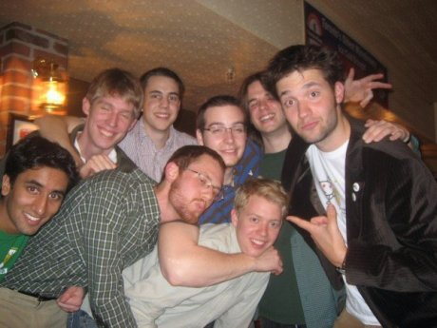
Wednesday’s Class
Steve Huffman (UVa CS 2005)
Co-founder (with Alexis Ohanian) of reddit
Before Wednesday’s class: visit and try reddit.com

Slide 20
Charge
Changing background images, colors and fonts is fun, but not the most important thing for your Project!
Focus on doing computationally interesting things with a clean, simple interface
Exam 2 Review Session: tonight, 6-7:30 in Olsson 001
Wednesday, 5-6:30pm, Olsson 228E: Fireside chat with Wes Weimer and Kim Hazelwood

