Slide 1
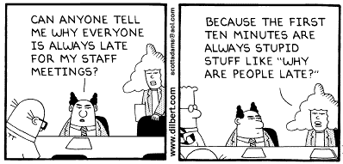
Class 36: Proofs about Unprovability
David Evans
University of Virginia cs1120

Slide 2
Story So Far
Much of the course so far:
Getting comfortable with recursive definitions
Learning to write programs that do (almost) anything (PS1-4)
Learning more expressive ways of programming (PS5-7)
Starting today and much of the rest of the course:
Getting un-comfortable with recursive definitions
Understanding why there are some things no program can do!

Slide 3
Computer Science/Mathematics
Computer Science (Imperative Knowledge)
Are there (well-defined) problems that cannot be solved by any procedure?
Mathematics (Declarative Knowledge)
Are there true conjectures that cannot be the shown using any proof?
Monday
Today

Slide 4
Mechanical Reasoning
Aristotle (~350BC): Organon
Codify logical deduction with rules of inference (syllogisms)
Every A is a P
X is an A
X is a P
Premises
Conclusion
Every human is mortal.
Gödel is human.
Gödel is mortal.

Slide 5
More Mechanical Reasoning
Euclid (~300BC): Elements
We can reduce geometry to a few axioms and derive the rest by following rules
Newton (1687): Philosophiæ Naturalis Principia Mathematica
We can reduce the motion of objects (including planets) to following axioms (laws) mechanically

Slide 6
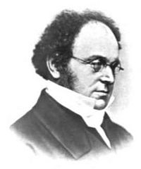
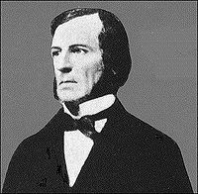
Mechanical Reasoning
1800s – mathematicians work on codifying “laws of reasoning”
Augustus De Morgan (1806-1871)
De Morgan’s laws
proof by induction
George Boole (1815-1864)
Laws of Thought

Slide 7
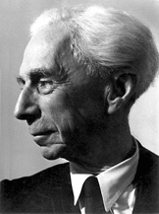
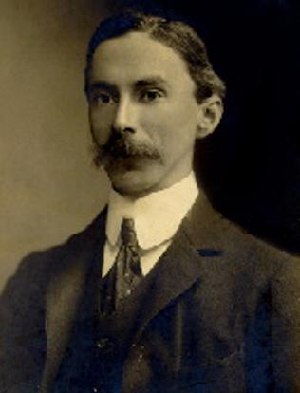
Bertrand Russell (1872-1970)
1910-1913: Principia Mathematica (with Alfred Whitehead)
1918: Imprisoned for pacifism
1950: Nobel Prize in Literature
1955: Russell-Einstein Manifesto
1967: War Crimes in Vietnam
Note: this is the same Russell who wrote In Praise of Idleness!

Slide 8
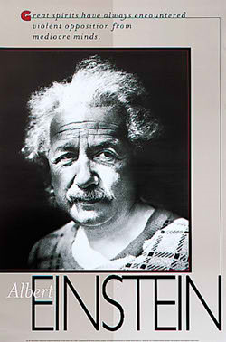
When Einstein said, “Great spirits have always encountered violent opposition from mediocre minds.” he was talking about Bertrand Russell.

Slide 9
All true statements about numbers

Slide 10
Perfect Axiomatic System
Derives all true
statements, and no false
statements starting from a
finite number of axioms
and following mechanical
inference rules.

Slide 11
Incomplete Axiomatic System
Derives
some, but not all true
statements, and no false
statements starting from a
finite number of axioms
and following mechanical
inference rules.
incomplete

Slide 12
Inconsistent Axiomatic System
Derives all true
statements, and some false
statements starting from a
finite number of axioms
and following mechanical
inference rules.
some false
statements

Slide 13
Principia Mathematica
Whitehead and Russell (1910– 1913)
Three Volumes, 2000 pages
Attempted to axiomatize mathematical reasoning
Define mathematical entities (like numbers) using logic
Derive mathematical “truths” by following mechanical rules of inference
Claimed to be complete and consistent
All true theorems could be derived
No falsehoods could be derived

Slide 14
Russell’s Paradox
Some sets are not members of themselves
e.g., set of all Jeffersonians
Some sets are members of themselves
e.g., set of all things that are non-Jeffersonian
S = the set of all sets that are not members of themselves
Is S a member of itself?

Slide 15
Russell’s Paradox
S = set of all sets that are not members of themselves
Is S a member of itself?
If S is an element of S, then S is a member of itself and should not be in S.
If S is not an element of S, then S is not a member of itself, and should be in S.

Slide 16
Ban Self-Reference?
Principia Mathematica attempted to resolve this paragraph by banning self-reference
Every set has a type
The lowest type of set can contain only “objects”, not “sets”
The next type of set can contain objects and sets of objects, but not sets of sets

Slide 17
Russell’s Resolution (?)
Set ::= Set_{n}
Set₀ ::= { x | x is an Object }
Set_{n} ::= { x | x is an Object or a Set_{n - 1} }
S: Set_{n}
Is S a member of itself?
No, it is a Set_{n} so, it can’t be a member of a Set_{n}

Slide 18
Epimenides Paradox
Epidenides (a Cretan):
“All Cretans are liars.”
Equivalently:
“This statement is false.”
Russell’s types can help with the set paradox, but not with these.

Slide 19
Gödel’s Solution
All consistent axiomatic formulations of number theory include undecidable propositions.
undecidable – cannot be proven either true or false inside the system.

Slide 20
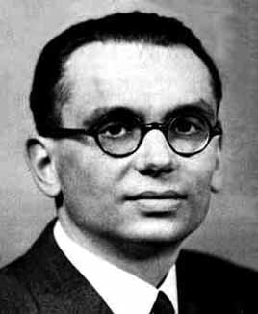
Kurt Gödel
Born 1906 in Brno (now Czech Republic, then Austria-Hungary)
1931: publishes Über formal unentscheidbare Sätze der Principia Mathematica und verwandter Systeme (On Formally Undecidable Propositions of Principia Mathematica and Related Systems)

Slide 21
1939: flees Vienna
Institute for Advanced Study, Princeton
Died in 1978 – convinced everything was poisoned and refused to eat

Slide 22
Gödel’s Theorem
In the Principia Mathematica system, there are statements that cannot be proven either true or false.

Slide 23
Gödel’s Theorem
In any interesting rigid system, there are statements that cannot be proven either true or false.

Slide 24
Gödel’s Theorem
All logical systems of any complexity are incomplete: there are statements that are true that cannot be proven within the system.

Slide 25
Proof – General Idea
Theorem: In the Principia Mathematica system, there are statements that cannot be proven either true or false.
Proof: Find such a statement

Slide 26
Gödel’s Statement
G: This statement does not
have any proof in the
system of Principia
Mathematica.
G is unprovable, but true!

Slide 27
Gödel’s Proof Idea
G: This statement does not have any proof in the system of PM.
If G is provable, PM would be inconsistent.
If G is unprovable, PM would be incomplete.
Thus, PM cannot be complete and consistent!

Slide 28
Gödel’s Statement
G: This statement does not have any proof in the system of PM.
Possibilities:
1. G is true ⇒ G has no proof
System is incomplete
2. G is false ⇒ G has a proof
System is inconsistent

Slide 29
Incomplete Axiomatic System
Pick one:
some false
statements
incomplete
Derives all true
statements, and some
false statements starting
from a finite number of
axioms and following
mechanical
inference rules.
Derives
some, but not all true
statements, and no false
statements starting from a
finite number of axioms
and following mechanical
inference rules.
Inconsistent Axiomatic System

Slide 30
Inconsistent Axiomatic System
Derives
all true
statements, and some false
statements starting from a
finite number of axioms
and following mechanical
inference rules.
some false
statements
Once you can prove one false statement,
everything can be proven! false ⇒ anything

Slide 31
Finishing The Proof
Turn G into a statement in the Principia Mathematica system
Is PM powerful enough to express G:
“This statement does not have any proof in the PM system.”
?

Slide 32
How to express “does not have any proof in the system of PM”
What does “have a proof of S in PM” mean?
There is a sequence of steps that follow the inference rules that starts with the initial axioms and ends with S
What does it mean to “not have any proof of S in PM”?
There is no sequence of steps that follow the inference rules that starts with the initial axioms and ends with S

Slide 33
Can PM express unprovability?
There is no sequence of steps that follows the inference rules that starts with the initial axioms and ends with S
Sequence of steps:
T₀, T₁, T₂, ..., T_{N}
T₀ must be the axioms
T_{N} must include S
Every step must follow from the previous using an inference rule

Slide 34
Can we express “This statement”?
Yes!
If you don’t believe me (and you shouldn’t) read the TNT Chapter in Gödel, Escher, Bach
We can write every statement as a number, so we can turn “This statement does not have any proof in the system” into a number which can be written in PM.

Slide 35
Gödel’s Proof
G: This statement does not have any proof in the system of PM.
If G is provable, PM would be inconsistent.
If G is unprovable, PM would be incomplete.
PM can express G.
Thus, PM cannot be complete and consistent!

Slide 36
Generalization
All logical systems of any complexity are incomplete:
there are statements that are true that cannot be proven within the system.

Slide 37
Practical Implications
Mathematicians will never be completely replaced by computers
There are mathematical truths that cannot be determined mechanically
We can write a program that automatically proves only true theorems about number theory, but if it cannot prove something we do not know whether or not it is a true theorem.

Slide 38
What does it mean for an axiomatic system to be complete and consistent?
Derives all true
statements, and no false
statements starting from a
finite number of axioms
and following mechanical
inference rules.

Slide 39
What does it mean for an axiomatic system to be complete and consistent?
It means the axiomatic system is weak.
Indeed, it is so weak, it cannot express:
“This statement has no proof.”

Slide 40
Charge
Monday
How to prove a problem has no solving procedure
Wednesday, Friday: enjoy your Thanksgiving!
Exam 2 is due Monday

