Slide 1
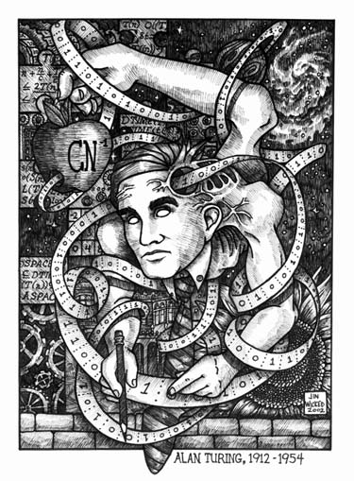
Lecture 38:
Modeling Computing
David Evans
University of Virginia cs1120 Fall 2009
http://www.cs.virginia.edu/cs1120

Slide 2
Menu
Exam 2 and Final
Noncomputability of Malware Detection
Modeling Computing
Turing’s Model
Universal Machines
Remember to send me your requested site name by midnight tonight if you want your site hosted at name.cs.virginia.edu.

Slide 3
Is-Malware Problem
Input: A string, s, representing a program.
Output: If s is malware, True; otherwise, False.
Is “Is-Malware” computable?

Slide 4
From Paul Graham’s “Undergraduation”:
My friend Robert learned a lot by writing network software when he was an undergrad. One of his projects was to connect Harvard to the Arpanet; it had been one of the original nodes, but by 1984 the connection had died. Not only was this work not for a class, but because he spent all his time on it and neglected his studies, he was kicked out of school for a year.
... When Robert got kicked out of grad school for writing the Internet worm of 1988, I envied him enormously for finding a way out without the stigma of failure.
... It all evened out in the end, and now he’s a professor at MIT. But you’ll probably be happier if you don’t go to that extreme; it caused him a lot of worry at the time.
3 years of probation, 400 hours of community service, $10,000+ fine

Slide 5
Morris Internet Worm (1988)
p = fingerd
Program used to query user status
Worm also attacked other programs
i = "nop⁴⁰⁰ pushl $68732f pushl $6e69622f movl sp,r10 pushl $0 pushl $0 pushl r10 pushl $3 movl sp,ap chmk $3b"
is_malware("p(i)") should evaluate to True
Worm infected several thousand computers (~10% of Internet in 1988)

Slide 6
Uncomputability Proof
Suppose we could define is_malware. Then we could define halts:
def halts(s):
return is_malware (remove_evil(s) +
''''''
do_evil()
'''''')
Can we make remove_evil?
Yes, just replace
all externally visible
actions (e.g., file writes)
in s with shadow actions.
Thus, is_malware is noncomputable.

Slide 7
Can Anti-Virus programs exist?
“The Art of Computer Virus Research and Defense”
Peter Szor, Symantec

Slide 8
“Solving” Noncomputable Problems
Since the problem is noncomputable, there is no procedure that (1) always gives the correct answer, and (2) always finishes.
Must give up one of these to “solve” undecidable problems
Giving up #2 is not acceptable in most cases
Must give up #1
Or change the problem: e.g., detect file infections during an execution

Slide 9
Actual is_malware Programs
Sometimes give the wrong answer
“False positive”: say P is a virus when it isn’t
“False negative”: say P is safe when it is
Database of known viruses: if P matches one of these, it is a virus
Clever virus authors can make viruses that change each time they propagate
Emulate program for a limited number of steps; if it doesn’t do anything bad, assume it is safe

Slide 10
How convincing is our Halting Problem proof?
paradox leads to a contradiction.
If we have halts, an algorithm that solves the Halting Problem, we can define paradox.
Therefore, halts does not exist.
def paradox():
if halts('paradox()'):
while True:
pass
This “proof” assumes Python exists and is means exactly what it should! Python is too complex to believe this: we need a simpler and more precise model of computation.

Slide 11
Should Python implementation convince us that Python exists?
def make_huge(n):
if n == 0: return [0]
return make_huge(n-1) + make_huge(n-1)
>>> len(make_huge(10))
1024
>>> len(make_huge(100))
File "C:/Users/David Evans/cs1120/huge.py", line 3, in make_huge
return make_huge(n-1) + make_huge(n-1)
File "C:/Users/David Evans/cs1120/huge.py", line 3, in make_huge
return make_huge(n-1) + make_huge(n-1)
...
File "C:/Users/David Evans/cs1120/huge.py", line 3, in make_huge
return make_huge(n-1) + make_huge(n-1)
MemoryError
No real interpreter can correctly implement the full semantics of Python!

Slide 12
Solutions
Option 1: Prove “Python” does exist
Show that some ideal interpreter could implement all the evaluation rules (but what is interpreting that ideal interpreter?)
Option 2: Find a simpler computing model
Define it precisely
Show that the Halting paradox procedure can be defined in this model
Note: our running time analyses also all depend on our computing model!

Slide 13
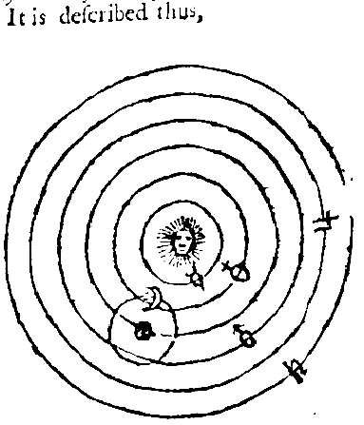
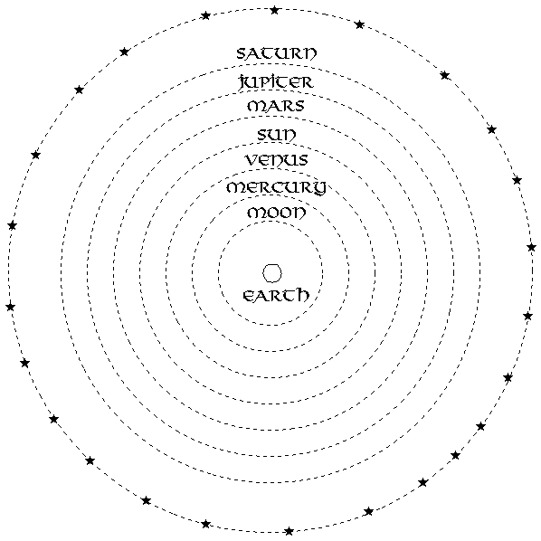
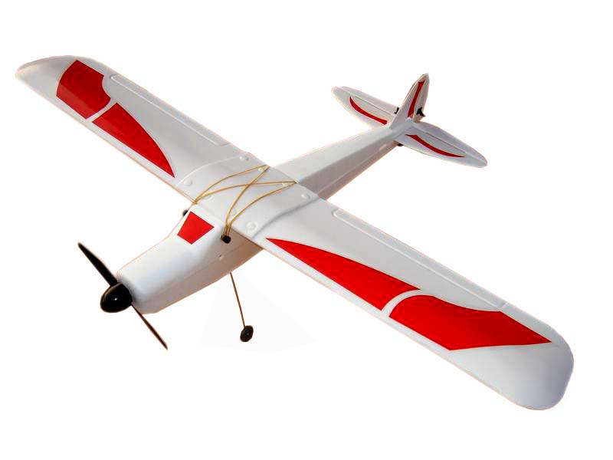
What makes a good model?
Copernicus
F = GM₁M₂ / R²
Ptolomy
Newton

Slide 14
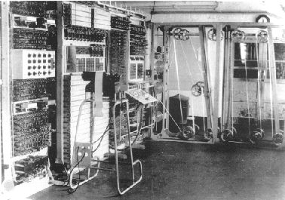
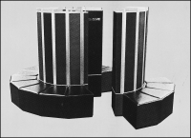
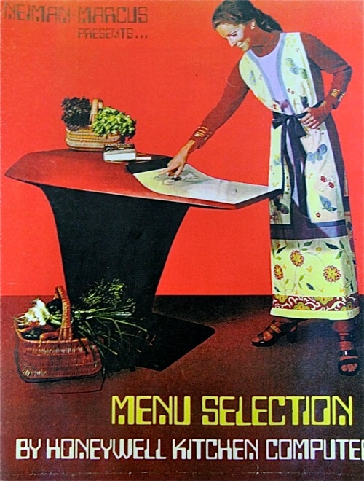
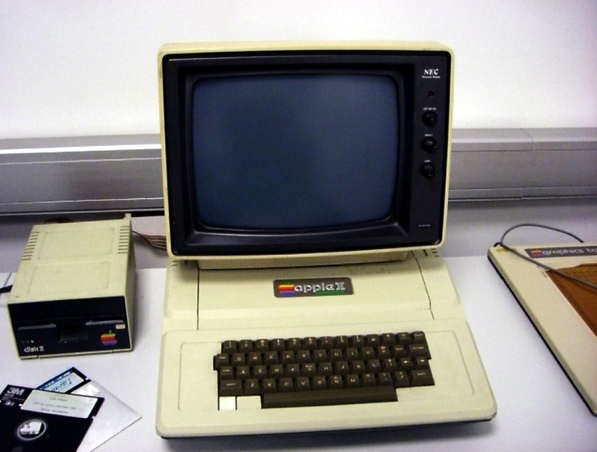
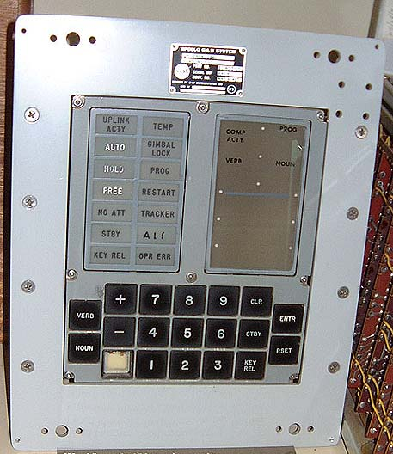
How should we model a Computer?
Turing invented the model we’ll use today in 1936. What “computer” was he modeling?
Colossus (1944)
Cray-1 (1976)
Apollo Guidance Computer (1969)
Palm Pre (2009)
Apple II (1977)
Flickr: louisvolant
Honeywell Kitchen Computer (1969)

Slide 15
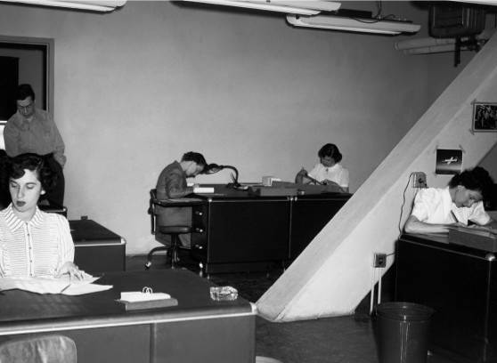
“Computers” before WWII

Slide 16
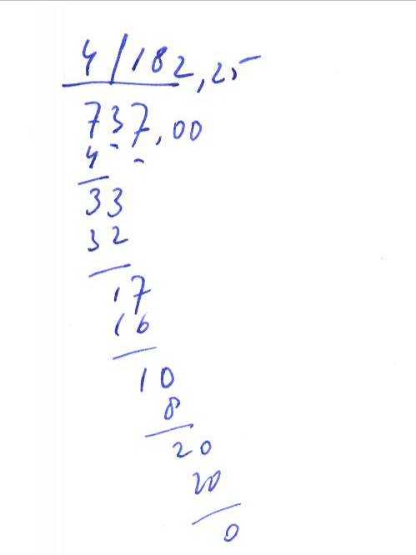
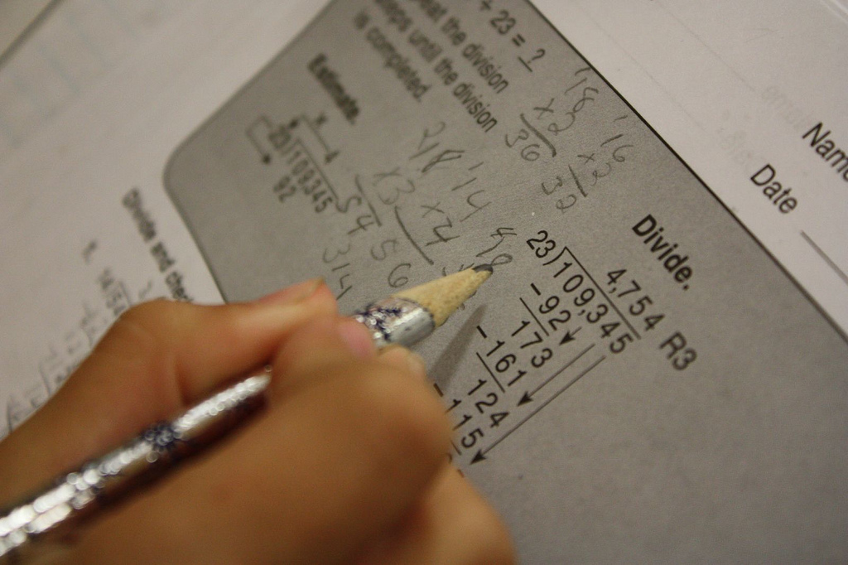
Mechanical Computing

Slide 17
Modeling Computers
Input
Without it, we can’t describe a problem
Output
Without it, we can’t get an answer
Processing
Need some way of getting from the input to the output
Memory
Need to keep track of what we are doing

Slide 18
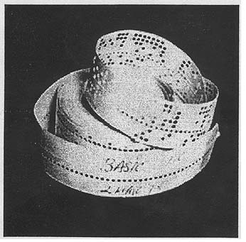
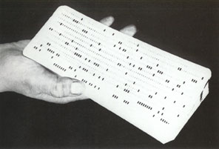
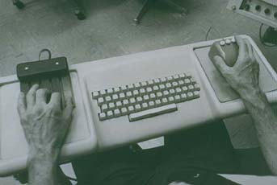
Modeling Input
Punch Cards
Altair BASIC Paper Tape, 1976
Engelbart’s mouse and keypad

Slide 19
Turing’s Model
“Computing is normally done by writing certain symbols on paper. We may suppose this paper is divided into squares like a child’s arithmetic book.”
Alan Turing, On computable numbers, with an application to the Entscheidungsproblem, 1936

Slide 20
Modeling Pencil and Paper
...
...
#
C
S
S
A
7
2
3
How long should the tape be?
Infinitely long! We are modeling a computer, not building one. Our model should not have silly practical limitations (like a real computer does).

Slide 21
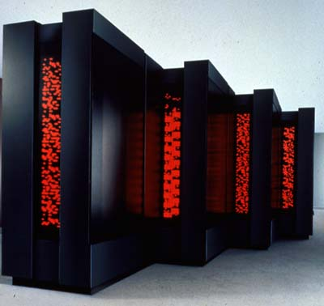
Modeling Output
Blinking lights are cool, but hard to model
Use the tape: output is what is written on the tape at the end
Connection Machine CM-5, 1993

Slide 22
Modeling Processing (Brains)
Look at the current state of the computation
Follow simple rules about what to do next

Slide 23
Modeling Processing
Evaluation Rules
Given an input on our tape, how do we evaluate to produce the output
What do we need:
Read what is on the tape at the current square
Move the tape one square in either direction
Write into the current square
0
0
1
1
0
0
1
0
0
0
Is that enough to model a computer?

Slide 24
Modeling Processing
Read, write and move is not enough
We also need to keep track of what we are doing:
How do we know whether to read, write or move at each step?
How do we know when we’re done?
What do we need for this?

Slide 25
Finite State Machines
1
0
0
2
1
Start
1
#
HALT

Slide 26
Hmmm…maybe we don’t need those infinite tapes after all?
not a paren
(
not a paren
2
1
Start
)
)
What if the
next input symbol
is ( in state 2?
#
ERROR
HALT

Slide 27
How many states do we need?
not a paren
(
not a paren
2
not a paren
1
Start
(
)
3
)
not a paren
)
#
(
ERROR
HALT
4
)
(

Slide 28
Finite State Machine
There are lots of things we can’t compute with only a finite number of states
Solutions:
“Infinite” State Machine
Hard to define, draw, and reason about
Add an infinite tape to the Finite State Machine

Slide 29
Modeling Processing (Brains)
Follow simple rules
Remember what you are doing
“For the present I shall only say that the justification lies in the fact that the human memory is necessarily limited.”
Alan Turing

Slide 30
FSM + Infinite Tape
Start:
FSM in Start State
Input on Infinite Tape
Pointer to start of input
Step:
Read one input symbol from tape
Write symbol on tape, and move L or R one square
Follow transition rule from current state
Finish:
Transition to halt state

Slide 31
Turing’s Model: Turing Machine
...
...
#
1
0
1
1
0
1
1
1
0
1
1
0
1
1
1
#
Infinite Tape: Finite set of symbols, one in each square
Can read/write one square each step
Input: #
Write: #
Move: ←
Controller:
Limited (finite) number of states
Follow rules based on current state and read symbol
Write one square each step, move left or right or halt, change state
Start
Input: 1
Write: 0
Move: ←
1
2
Input: 0
Write: #
Move: Halt
Input: 1
Write: 1
Move: →
Input: 0
Write: 0
Move: →
3

Slide 32
Charge
If you want us to host your site, remember to send me your site name before midnight tonight!
Wednesday:
Busy Beavers
Alternate Computing Models

