Slide 1
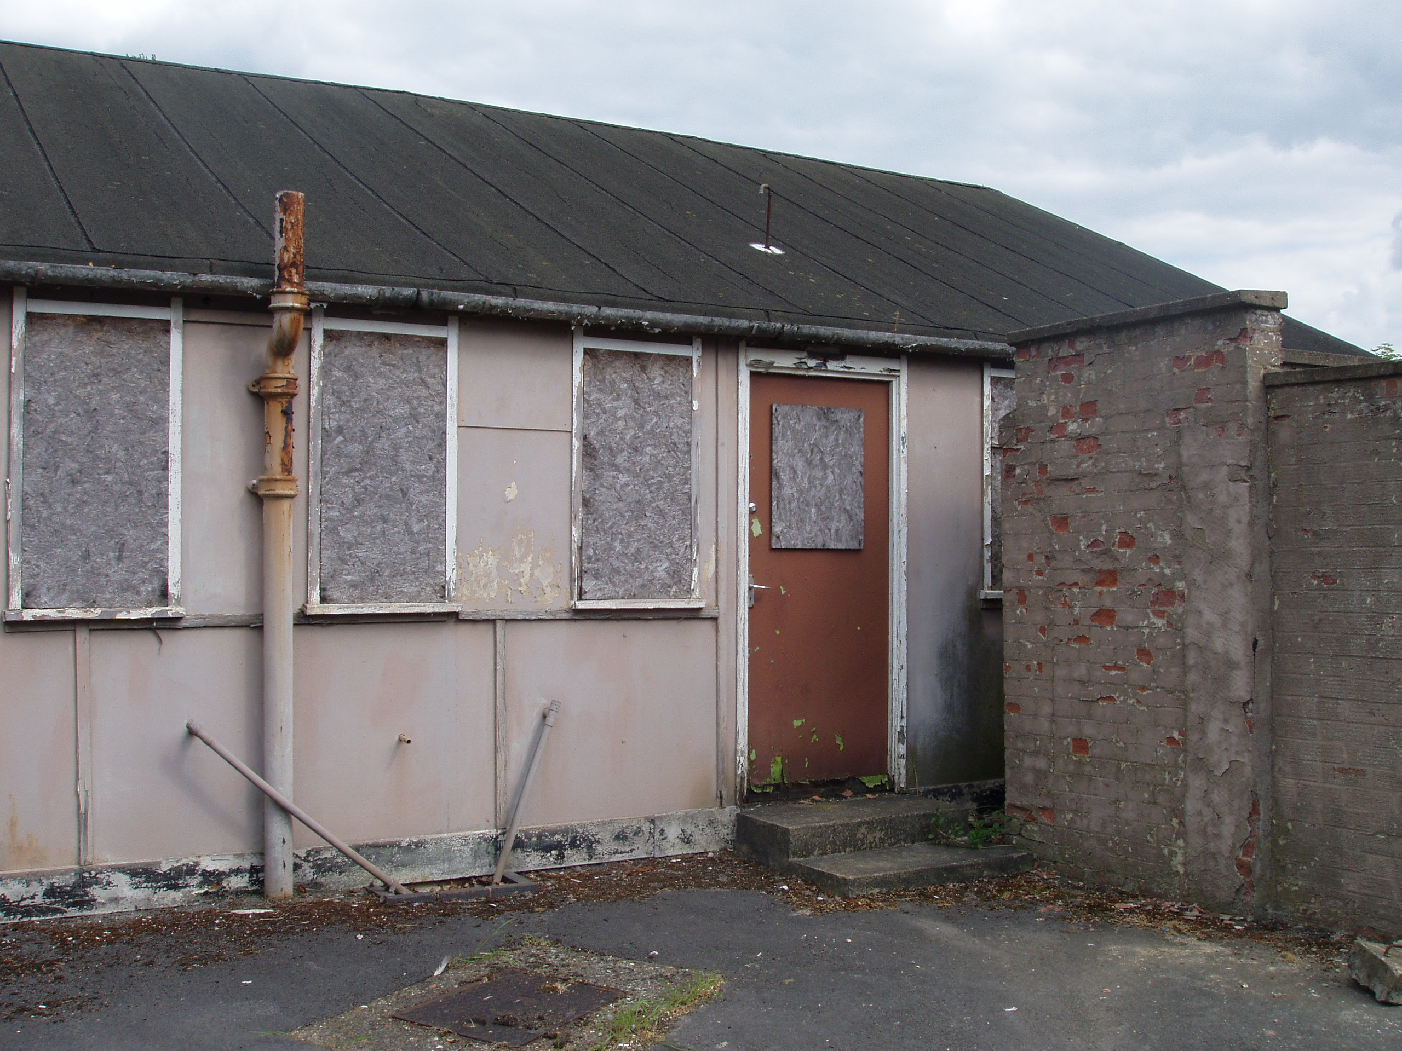
Class 39: Universality
cs1120 Fall 2009
David Evans
University of Virginia

Slide 2
Menu
Recap Turing Machine from last class
Halting Problem for Turing Machines:
Proof that the Halting Problem for TMs is noncomputable
Universal Turing Machines: one TM that can simulate every other TM
Church-Turing Thesis: all reasonable computing models are equivalent!
Lambda Calculus: an alternate computing model, equivalent to Turing Machine

Slide 3
Recap: Turing’s Model
...
...
#
1
0
1
1
0
1
1
1
0
1
1
0
1
1
1
#
Infinite Tape: Finite set of symbols, one in each square
Can read/write one square each step
Input: #
Write: #
Move: ←
Controller:
Limited (finite) number of states
Follow rules based on current state and read symbol
Write one square each step, move left or right or halt, change state
Start
Input: 1
Write: 0
Move: ←
1
2
Input: 0
Write: #
Move: Halt
Input: 1
Write: 1
Move: →
Input: 0
Write: 0
Move: →
3

Slide 4
Turing Machine State
Infinite Tape
z
z
z
z
z
z
z
z
z
z
z
z
z
z
z
z
z
z
z
z
z
z
TuringMachine ::= < Alphabet, Tape, FSM >
Alphabet ::= { Symbol* }
Tape ::= < LeftSide, Current, RightSide >
OneSquare ::= Symbol | #
Current ::= OneSquare
LeftSide ::= [ Square* ]
RightSide ::= [ Square* ]
Everything to left of LeftSide is #.
Everything to right of RightSide is #.
¬), #, R
), X, L
2: look for (
¬(, #, L
1
Start
(, X, R
#, 1, -
HALT
#, 0, -
Finite State Machine
Although we typically draw TMs as pictures, we could write them down as
strings in this language (which could be converted to whole numbers)

Slide 5
Enumerating Turing Machines
Now that we’ve decided how to describe Turing Machines, we can number them
TM-5023582376 = balancing parens
TM-57239683 = even number of 1s
TM-3523796834721038296738259873 = Universal TM
TM-3672349872381692309875823987609823712347823 = WindowsXP
Not the real numbers – they would be much much much much much bigger!

Slide 6
Halting Problem
Pythonic Halting Problem
TM Halting Problem
Input: a string describing a Python program, P
Output: if evaluating P would eventually finish, output True; otherwise, output False.
Input: a string describing a Turing Machine, M
Output: if M would eventually Halt, output True; otherwise, output False.

Slide 7
Halting Problem “Proof”
Pythonic Halting Problem
TM Halting Problem
HALTS(M) = TM that solves TM Halting Problem: input tape describes TM M, output tape: #1 if M halts, otherwise #0
PARADOX = TM that:
1. simulates HALTS(PARADOX)
2. Then, if tape is #1, loop forever;
if tape is #0, HALT
def paradox():
if halts('paradox()'):
while True:
pass
simulates? This proof assumes we can design a TM that simulates any other TM!

Slide 8
An Any TM Simulator
Input: < Description of some TM M, w >
Output: result of running M on w
M
Universal
Turing
Machine
Output
Tape
for running
TM-M
starting on tape w
w

Slide 9
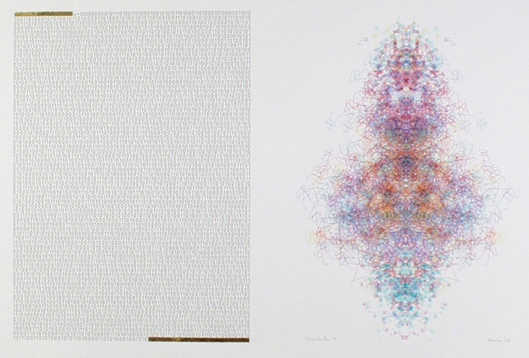
Manchester Illuminated Universal Turing Machine, #9
from http://www.verostko.com/manchester/manchester.html

Slide 10
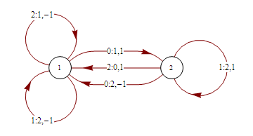
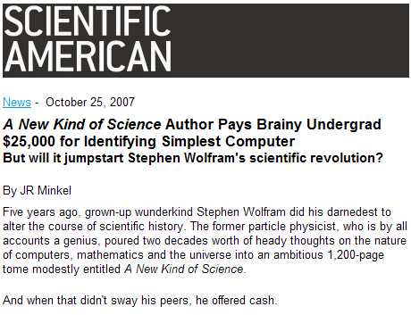
Universal Computing Machine
2-state, 3-symbol Turing machine proved universal by Alex Smith in 2007
Alex Smith,
University of Birmingham

Slide 11
What This Means
If you can:
Keep track of a finite state
Follow transition rules
Read and write to memory
you can simulate a universal Turing machine.
A Turing machine can simulate the world’s most powerful supercomputer
Thus, your cell phone can simulate the world’s most powerful supercomputer (it’ll just take a lot longer and will run out of memory)
No computer that can be simulated by a TM can solve the Halting Problem

Slide 12
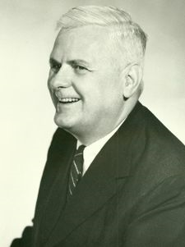
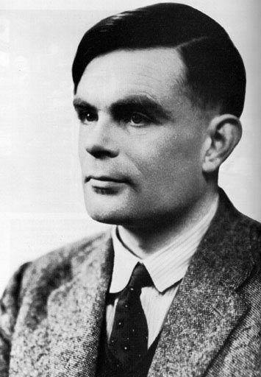
Church-Turing Thesis
All mechanical computers are equally powerful (except for practical limits like memory size, time, display, energy, etc.)
There exists some Turing machine that can simulate any mechanical computer
Any computer that is powerful enough to simulate a Turing machine, can simulate any mechanical computer
Alonzo Church, 1903-1995
Alan Turing, 1912-1954

Slide 13
Church’s Computing Model: Lambda Calculus
Developed in 1930s in attempt to formalize mathematics (similar to Bertrand Russell’s goals)
Became model of computing
Basis of LISP and Scheme

Slide 14
What is Calculus?
d/dx x^{n} = nx^{n-1} [Power Rule]
d/dx (f + g) = d/dx f + d/dx g [Sum Rule]
Calculus is a branch of mathematics that deals with limits and the differentiation and integration of functions of one or more variables...

Slide 15
Real Definition
A calculus is just a bunch of rules for manipulating symbols.
People can give meaning to those symbols, but that’s not part of the calculus.
Differential calculus is a bunch of rules for manipulating symbols. There is an interpretation of those symbols corresponds with physics, slopes, etc.

Slide 16
Lambda Calculus
Rules for manipulating strings of symbols
term = variable
| term term
| (term)
| λ variable . term
One main rule: β-reduction
((λx. M)N) ⇒ _{β} M
with all x’s in M replaced by N
Note: I have slightly altered the traditional syntax to make it more like Scheme.
This is a lot like Scheme, without primitives, special forms, mutation!

Slide 17
Lambda Calculus
Developed in 1930s in attempt to formalize mathematics (similar to Bertrand Russell’s goals)
Original attempt was inconsistent!
Kleene-Rosser Paradox:
k = λx .¬(x x)
(k k) = λx .¬(x x)k = ¬(k k)
Church’s solution: model computation not logic
(k k) is a nonterminating recursive definition, not a contradiction!
(k k) ⇒ ¬(k k) ⇒ ¬¬(k k) ⇒ ¬¬¬ (k k) ⇒ ...

Slide 18
Evaluating Lambda Expressions
redex: Term of the form ((λx. M)N)
Something that can be β-reduced
An expression is in normal form if it contains no redexes.
To evaluate a lambda expression, keep doing reductions until you get to normal form.

Slide 19
Some Simple Functions
I ≡ λx.x
C ≡ λx.(λy. yx)
((C I) I) = (((λx.(λy. yx)) (λx.x)) (λx.x))
→_{β} ((λy. y (λx.x)) (λx.x))
→_{β} (λx.x (λx.x))
→_{β} λx.x
≡ I

Slide 20
Power of Lambda Calculus
Is Lambda Calculus a universal language?
Can we compute any computable algorithm using Lambda Calculus?
Option 1: Prove it is not
Find some Turing Machine that cannot be simulated with Lambda Calculus
Option 2: Prove it is:
Show you can simulate every Turing Machine using Lambda Calculus
Since a Universal Turing Machine can simulate every other TM, it is enough to show we can simulate a Universal Turing Machine using Lambda Calculus

Slide 21
Simulating a Turing Machine
z
z
z
z
z
z
z
z
z
z
z
z
z
z
z
z
z
z
z
z
), X, L
Read/Write Infinite Tape
Lists
Finite State Machine
Numbers
Processing
Way to make decisions (if)
Way to keep going
¬), #, R
2: look for (
¬(, #, L
1
Start
(, X, R
#, 1, -
HALT
#, 0, -
Finite State Machine
Continued on Friday...

