Slide 1
Class 40: Alternate Computing Models
cs1120 Fall 2009
University of Virginia
David Evans

Slide 2
Reminders
To qualify for a presentation your team must send me an email containing the URL of your site (with some working basic functionality) before 4:59pm Sunday
Presentation time will be divided between qualifying teams
Teams will present in reverse order of qualification time
Non-presenting teams only turn in reports instead (before midnight Monday)
Final will be posted Monday, and due Friday (Dec 11)
If this scheduling causes you undue hardship, it may be possible to get an extension to Monday (Dec 14)
I will have extended extra office hours (either in my office or Small Hall) on Sunday afternoon, 1:30-5pm (groups that upload projects by Saturday will have priority)

Slide 3
Equivalent Model Computers?
z
z
z
z
z
z
z
...
term = variable
| term term
| (term)
| λ variable . term
¬), #, R
), X, L
2: look for (
¬(, #, L
1
can simulate?
Start
(, X, R
(λx. M)N ⇒ _{β} M
with xs replaced by N
#, 1, -
HALT
#, 0, -
can simulate?
Finite State Machine
Turing Machine
Lambda Calculus

Slide 4
Simulating a Turing Machine
z
z
z
z
z
z
z
z
z
z
z
z
z
z
z
z
z
z
z
z
), X, L
Read/Write Infinite Tape
Lists
Finite State Machine
Numbers
Processing
Way to make decisions (if)
Way to keep going
¬), #, R
2: look for (
¬(, #, L
1
Start
(, X, R
#, 1, -
HALT
#, 0, -
Finite State Machine

Slide 5
In search of the truth?
What does true mean?
True is something that when used as the first operand of if, makes the value of the if the value of its second operand:
(if T M N) → M

Slide 6
Don’t search for T, search for if
T ≡ λx (λy. x)
F ≡ λx (λ y. y))
if ≡ λp (λc (λa . (pc)a)
Just like in LazyScheme:
(define true (lambda (a b) a))
(define false (lambda (a b) b))
(define if (lambda (p c a) (p c a))

Slide 7
Simulating a Turing Machine
z
z
z
z
z
z
z
z
z
z
z
z
z
z
z
z
z
z
z
z
), X, L
Read/Write Infinite Tape
Lists
Finite State Machine
Numbers
Processing
Way to make decisions (if)
Way to keep going
¬), #, R
2: look for (
¬(, #, L
1
Start
(, X, R
#, 1, -
HALT
#, 0, -
Finite State Machine

Slide 8
Making Lists
(define (make-pair x y)
(lambda (selector) (if selector x y)))
(define (car-of-pair p) (p true))
(define (cdr-of-pair p) (p false))
cons ≡ λx.λy.(λz.(z x y))
car ≡ λx.(x T)
cdr ≡ λx.(x F)
null ≡ λx.T
null? ≡ λx. (x (λy .λz . F))
T ≡ λx (λy. x)

Slide 9
Simulating a Turing Machine
z
z
z
z
z
z
z
z
z
z
z
z
z
z
z
z
z
z
z
z
), X, L
Read/Write Infinite Tape
Lists
Finite State Machine
Numbers
Processing
Way to make decisions (if)
Way to keep going
¬), #, R
2: look for (
¬(, #, L
1
Start
(, X, R
#, 1, -
HALT
#, 0, -
Finite State Machine

Slide 10
What is 11?
eleven
elf
undici
十一
11
once
XI
onze
одиннадцать
أحد عش
イレブン

Slide 11
Meaning of Numbers
“11-ness” is something who’s successor is “12-ness”
“11-ness” is something who’s predecessor is “10-ness”
“Zero” is special. It has a successor “one-ness”, but no predecessor.

Slide 12
Meaning of Numbers
(pred (succ N)) → N
(succ (pred N)) → N
(succ (pred (succ N))) → (succ N)
(zero? zero) → T
(zero? (succ zero)) → F

Slide 13
Is this enough?
Can we define add with pred, succ, zero? and zero?
add ≡ λx . λy.
(if (zero? x) y (add (pred x) (succ y))

Slide 14
Can we define lambda terms that behave like zero, zero?, pred and succ?
Hint: The length of the list corresponds to the number value.

Slide 15
Making Numbers
0 ≡ null
zero? ≡ null?
pred ≡ cdr
succ ≡ λ x . (cons F x)
pred ≡ λx. (cdr x)

Slide 16
42 = λxy.(λz.z xy) λxy. y λxy.(λz.z xy) λxy. y
λxy.(λz.z xy) λxy. y λxy.(λz.z xy) λxy. y λxy.(λz.z xy) λxy. y λxy.(λz.z xy) λxy. y λxy.(λz.z xy) λxy. y λxy.(λz.z xy) λxy. y λxy.(λz.z xy) λxy. y λxy.(λz.z xy) λxy. y λxy.(λz.z xy) λxy. y λxy.(λz.z xy) λxy. y λxy.(λz.z xy) λxy. y λxy.(λz.z xy) λxy. y λxy.(λz.z xy) λxy. y λxy.(λz.z xy) λxy. y λxy.(λz.z xy) λxy. y λxy.(λz.z xy) λxy. y λxy.(λz.z xy) λxy. y λxy.(λz.z xy) λxy. y λxy.(λz.z xy) λxy. y λxy.(λz.z xy) λxy. y λxy.(λz.z xy) λxy. y λxy.(λz.z xy) λxy. y λxy.(λz.z xy) λxy. y λxy.(λz.z xy) λxy. y λxy.(λz.z xy) λxy. y λxy.(λz.z xy) λxy. y λxy.(λz.z xy) λxy. y λxy.(λz.z xy) λxy. y λxy.(λz.z xy) λxy. y λxy.(λz.z xy) λxy. y λxy.(λz.z xy) λxy. y λxy.(λz.z xy) λxy. y λxy.(λz.z xy) λxy. y λxy.(λz.z xy) λxy. y λxy.(λz.z xy) λxy. y λxy.(λz.z xy) λxy. y λxy.(λz.z xy) λxy. y λxy.(λz.z xy) λxy. y λxy.(λz.z xy) λxy. y λxy.(λz.z xy) λxy. y λx.T

Slide 17
Lambda Calculus is a Universal Computer
z
z
z
z
z
z
z
z
z
z
z
z
z
z
z
z
z
z
z
z
¬), #, R
), X, L
2: look for (
¬(, #, L
1
Read/Write Infinite Tape
Mutable Lists
Finite State Machine
Numbers to keep track of state
Processing
Way of making decisions (if)
Way to keep going
Start
(, X, R
#, 1, -
HALT
#, 0, -
Finite State Machine
We have this, but we cheated using ≡ to make recursive definitions!
Having names and definitions is much more complex than Lambda calculus.

Slide 18
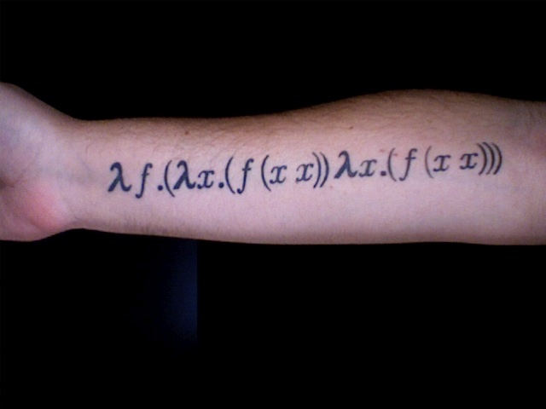
Way to Keep Going: The Y-Combinator
Y = λf (λx . (f (x x)) (λx . f (x x))
This finds the fixed point of any function!
(Y G) = (G (Y G))

Slide 19
Universal Computer
Lambda Calculus can simulate a Turing Machine
Everything a Turing Machine can compute, Lambda Calculus can compute also
Turing Machine can simulate Lambda Calculus (we didn’t prove this)
Everything Lambda Calculus can compute, a Turing Machine can compute also
Church-Turing Thesis: this is true for any other mechanical computer also

Slide 20
Computability in Theory and Practice (Intellectual Computability Discussion on TV Video)
http://video.google.com/videoplay?docid=1623254076490030585#
http://www.funny-videos.co.uk/videoAliGScienceVideo39.html

Slide 21
Ali G Problem
Input: a list of 2 numbers with up to d digits each
Output: the product of the 2 numbers
Is it computable?
Yes – a straightforward algorithm
solves it. Using elementary multiplication techniques we know
it is in O(d²)
Can real computers solve it?

Slide 22
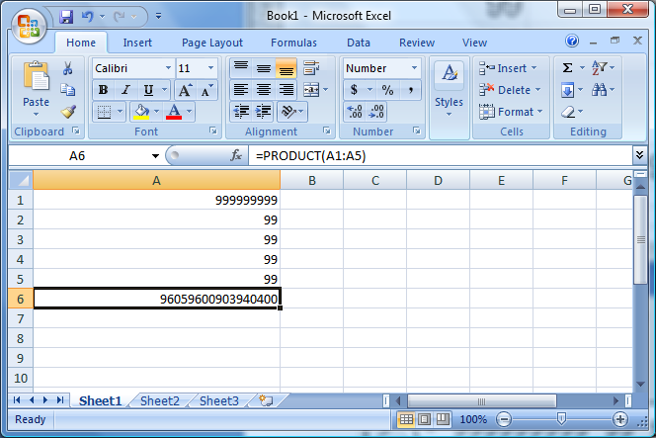
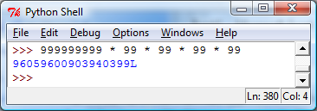

Slide 23
Ali G was Right!
Theory assumes ideal computers:
Unlimited, perfect memory
Unlimited (but finite) time
Real computers have:
Limited memory, time, power outages, flaky programming languages, etc.
There are many computable problems we cannot solve with real computer: the actual inputs do matter (in practice, but not in theory!)

Slide 24
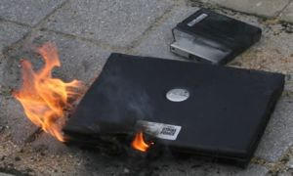
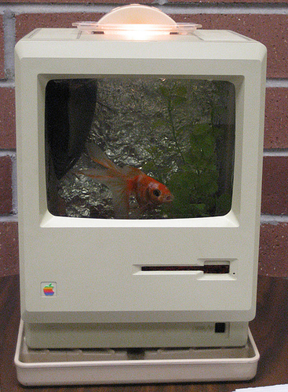
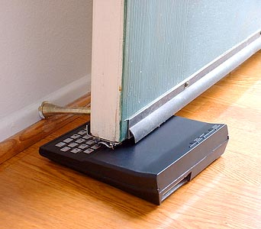
Things Real Computers Can Do That Turing Machines Cannot
Generate Heat
Provide an adequate habitat for fish
Stop a Door

Slide 25
Nondeterministic Turing Machine
At each step, instead of making one choice and following it, the machine can simultaneously try two choices.
If any path of choices leads to a halting state, that machine’s state is the result of the computation.
2
1
3

Slide 26
Ways to Think about Nondeterminism
Omnipotent: It can try all possible solutions at once to find the one that is right.
Omniscient: Whenever it has to make a choice, it always guess right.
Can a regular TM model a nondeterministic TM?
Yes, just simulate all the possible machines.

Slide 27
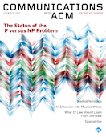
Can a nondeterministic TM solve problems in polynomial time (O(N^{k}) for some constant k) that cannot be solved in polynomial time by a regular TM?
Answer: Unknown! This is the most famous and important open question in Computer Science: P = NP?
Ways to answer this:
Write a polynomial time pegboard puzzle solver (or prove it can’t be done)
Write a polynomial time optimal photomosaic maker (or prove it can’t be done)
...

Slide 28
Course Summary: Three Main Themes
Recursive Definitions
Recursive procedures, recursive data structures, languages
Universality
Procedures are just another kind of data
A universal computing machine can simulate all other computing machines
Abstraction: giving things names and hiding details
Digital abstraction, procedural abstraction, data abstraction, objects

Slide 29
Things that are likely to be on the Final
Defining Procedures
How to define procedures to solve problems, recursive procedures
Functional and imperative style programming
Analyzing Procedures
Asymptotic run-time analysis, memory use
Interpreters
Understanding how interpreter defines meaning and running time of a language
Being able to change a language by modifying an interpreter
Computing Models
Proving a problem is computable or noncomputable
Is a computing model equivalent to a TM?
NYTimes article today that mentions my 2005 crypto final!

Slide 30
Charge
Sunday (4:59pm): to qualify for a presentation, you must have some basic functionality working
Monday: Project Presentations
or...Project Reports (for non-presenting teams)
Presentation time will be divided among the qualifying teams (if all teams qualify, less than 2 minutes!): time to explain your project and demo its most interesting functionality
Final Exam: will be posted Monday
I will have extended extra office hours (either in my office or Small Hall) on Sunday afternoon, 1:30-5pm (groups that upload projects by Saturday will have priority)

