Slide 1
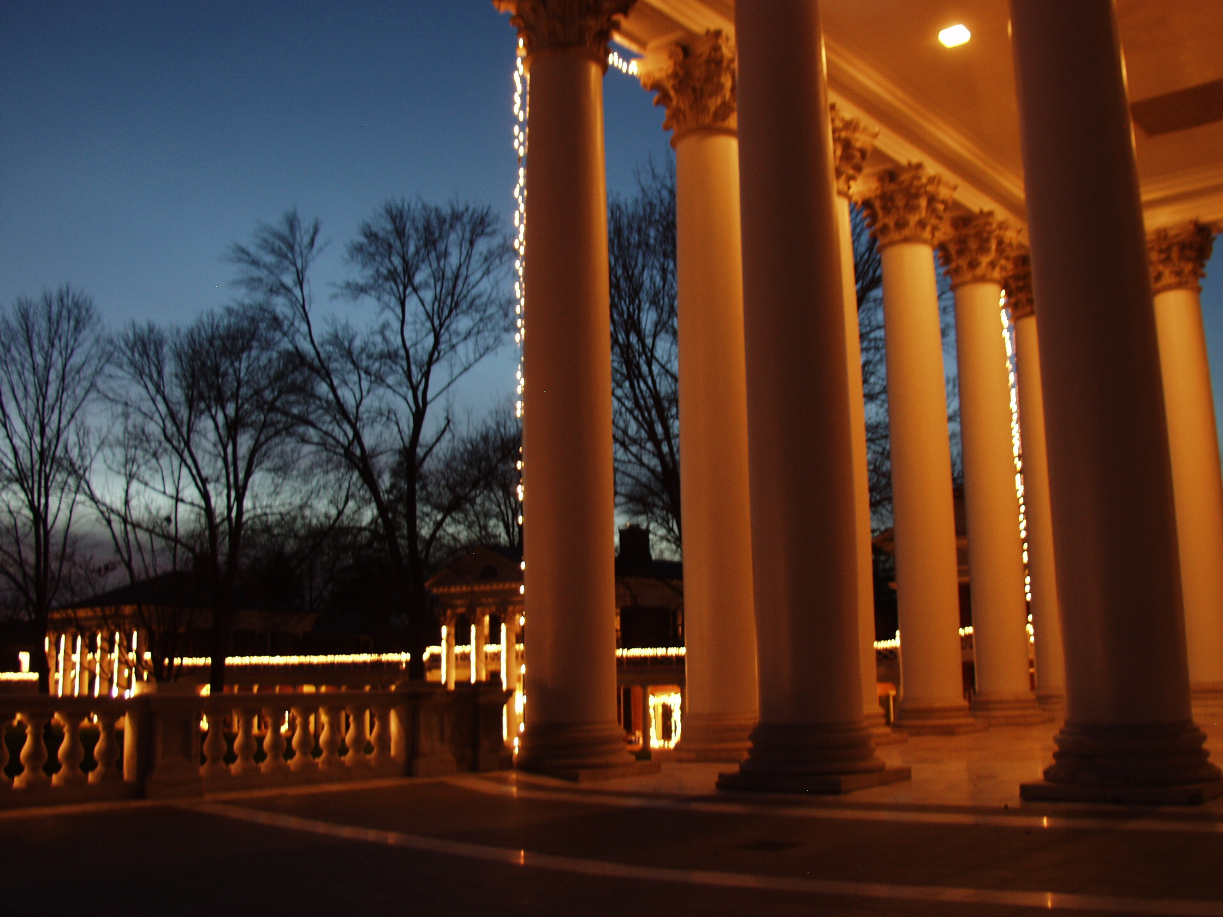
Class 41: Project Presentations
cs1120 Fall 2009
University of Virginia
David Evans

Slide 2
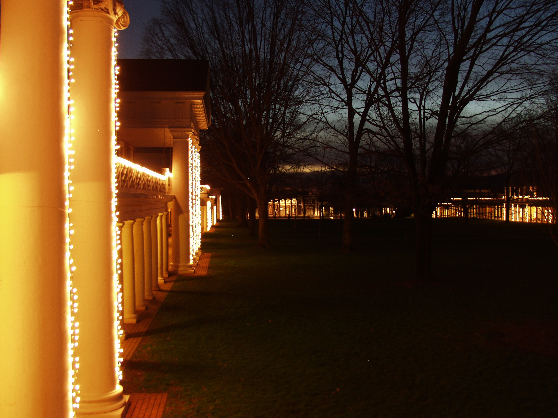
Lighting of the Lawn 7:30pm Tuesday
Never doubt that a small group of thoughtful,
committed people can change the world.
Indeed, it is the only thing that ever has.
Margaret Mead

Slide 3
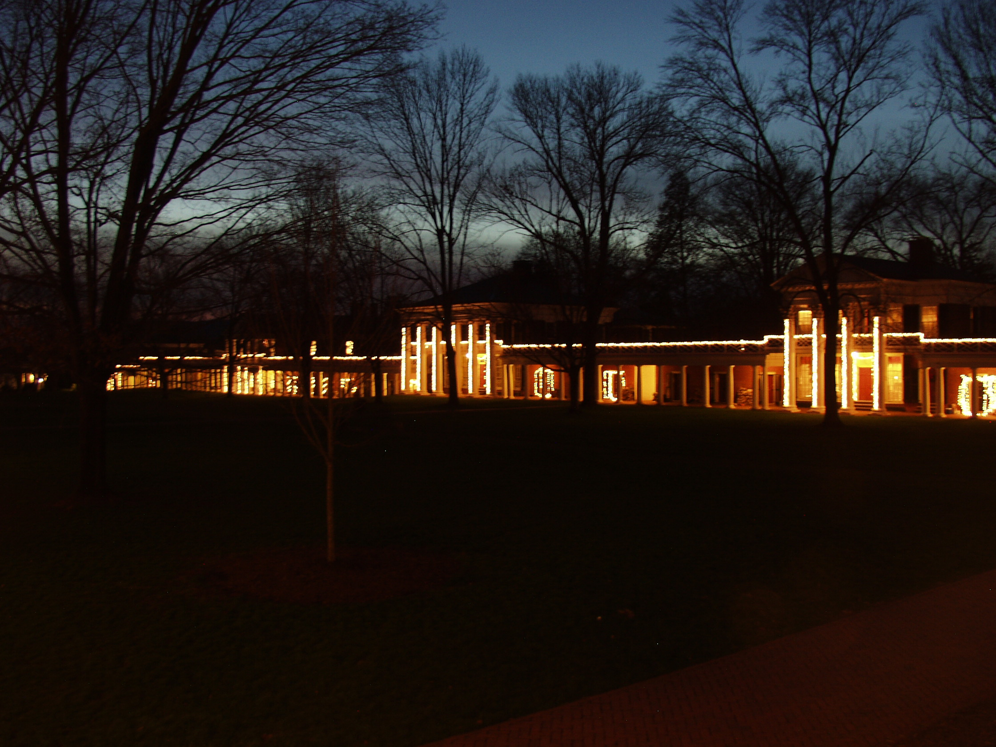
Charge
Change the World!
Caveat: before worrying about changing the world, remember to turn in your exam Friday!

Slide 4
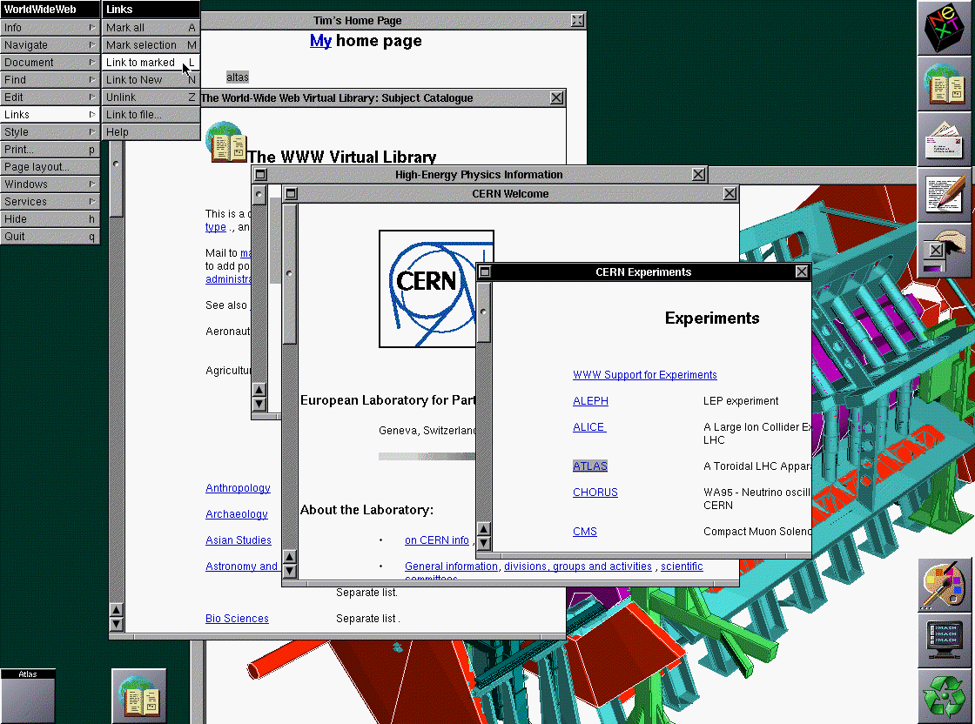
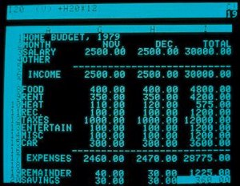
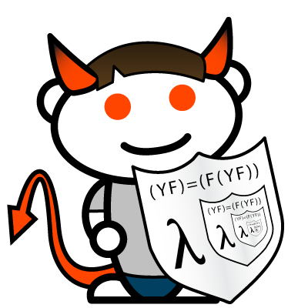
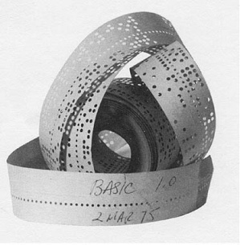
Small, Simple Programs that Changed the World
eBay (P. Omidyar)
VisiCalc
(Dan Bricklin and Bob Frankston)
WorldWideWeb
(Tim Berners-Lee)
Smalltalk
(Adele Goldberg, Alan Kay, Dan Ignalls)
?
Tetris
(Alexey Pazhitnov)
Reddit
(Steve Huffman)
Altair BASIC
(Bill Gates and Paul Allen)
(cs1120 Student)

Slide 5
Thank you!
One last contribution expected: submit an course improvement survey (this will be posted on the course site by tomorrow)

Slide 6
Project Presentations
Days on the Lawn (Josh Lesko)
HoosHungry (Casey Brown, Julie O'Brien, John Marion)
QuoteMyProfessor (Kiran Kumar, Muzzammil Zaveri, Omer Shahab, Qihan Zhang)
CVilleShopBuddy (Andrew Crute, Jonathan Burket, Trygve Loken)
HoosList (Agneez Kang, Meng Zho)
Football Projections (Belel Ait Oumeizne, Casey Bowling, Mark Varvaris, Travis Cook)
Rhapsody Ballet Ensemble (Lizzie Bendycki, Erika Crawford, Katie Mitchell, Stephanie Marshall)
Alpha Phi Omega Alumni (Ian Nathan)
Connect 4 (Steven Massetti, Stephen Holtz, and Tom Pisano
Omnomonster (Daniel Andrino and Richard McPherson) — Facebook food-finding app
Pong (John Anderson and Justin Holmes)

