Slide 1
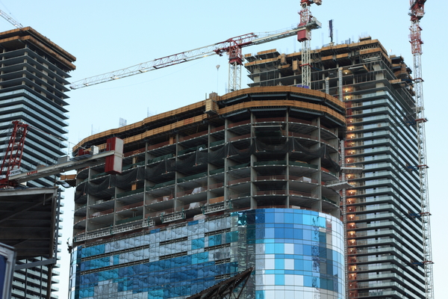
Class 5: Constructing Procedures
David Evans
cs1120 Fall 2009

Slide 2
Menu
Problem Set 1
Evaluation
Constructing Procedures
Returning Problem Sets Procedure
Return Problem Set 1 at end of class today

Slide 3
From Question 1/2:
(if (not "cookies") "eat" "starve")
Evaluation Rule 5: If. To evaluate an if expression:
Evaluate the predicate expression
If it evaluates to false, the value of the if expression is the value of the alternate expression. Otherwise, the value of the if expression is the value of consequent expression.
This means every non-false value is considered “true”.

Slide 4
Evaluate (not "cookies")
Evaluation Rule 3. Application.
a. Evaluate all the subexpressions
<primitive:not> “cookies”
The quotes really matter here!
Without them what would cookies evaluate to?
b. Apply the value of the first subexpression to the values of all the other subexpressions
Application Rule 1: To apply a primitive, just do it.
How do we evaluate an application of a primitive if we don’t know its pre-defined meaning?

Slide 5
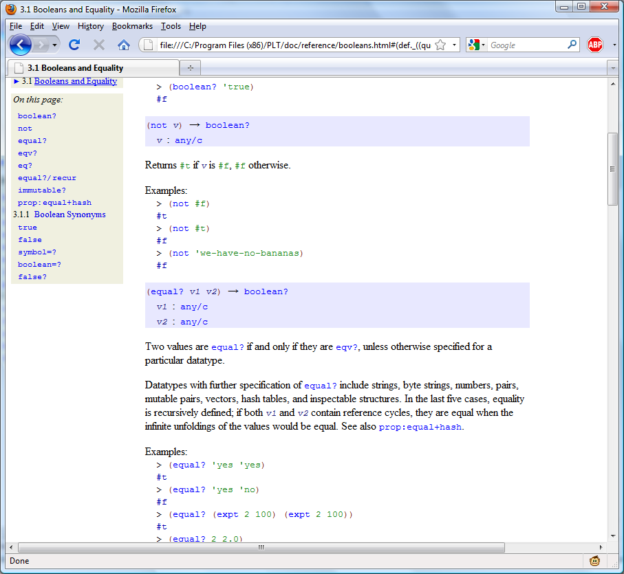

Slide 6
Defining not
not: Value → Boolean
not is a built-in procedure that takes one
input value and outputs a Boolean.
not returns #t if obj is false, and #f otherwise.
(define (not v)
(if v #f #t))

Slide 7
(if (not "cookies") "eat" "starve")
(not "cookies") => #f
So, value of the if expression is value of Expression₂
=> “starve”

Slide 8
brighter?
(define brighter? (lambda (color1 color2) (if (> (+ (get-red color1)
(get-green color1) (get-blue color1)
) (+ (get-red color2) (get-green
color2) (get-blue color2)) #t
#f)))
Maybe...but very hard to tell.
Your code should appear in a way that reveals its structure
Is this correct?

Slide 9
(define brighter?
(lambda (color1 color2)
(if (> (+ (get-red color1)
(get-green color1)
(get-blue color1))
(+ (get-red color2)
(get-green color2)
(get-blue color2))
#t #f)))
Use [Tab] in DrScheme to line up your code structurally!

Slide 10
Iffy Proposition
(if Expression #t #f) == Expression
Is this always true?
(if “cookies” #t #f)

Slide 11
Brighter brighter??
(define brighter?
(lambda (color1 color2)
(> (+ (get-red color1)
(get-green color1)
(get-blue color1))
(+ (get-red color2)
(get-green color2)
(get-blue color2)))))

Slide 12
Brighter brighter??
(define brightness
(lambda (color)
(+ (get-red color)
(get-green color)
(get-blue color))))
(define brighter?
(lambda (color1 color2)
(> (brightness color1)
(brightness color2)))

Slide 13
Believable brighter??
(make-color 255 255 0)
(make-color 255 1 255)

Slide 14
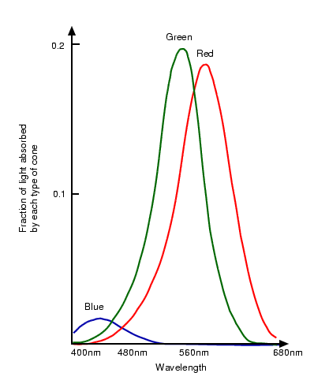
Color Absorbed
http://homepages.inf.ed.ac.uk/rbf/CVonline/LOCAL_COPIES/OWENS/LECT14/

Slide 15
Cognitive Scientist’s Answer
(define brightness
(lambda (color)
(+ (* 0.299 (get-red color))
(* 0.587 (get-green color))
(* 0.114 (get-blue color)))))
(define brighter?
(lambda (color1 color2)
(> (brightness color1)
(brightness color2)))

Slide 16
closer-color?
(define (closer-color? sample color1 color2)
(<
(+ (abs (- (get-red color1) (get-red sample)))
(abs (- (get-blue color1) (get-blue sample)))
(abs (- (get-green color1) (get-green sample))))
(+ (abs (- (get-red color2) (get-red sample)))
(abs (- (get-blue color2) (get-blue sample)))
(abs (- (get-green color2) (get-green sample))))
))

Slide 17
(+ (abs (- (get-red color1) (get-red sample)))
(abs (- (get-blue color1) (get-blue sample)))
(abs (- (get-green color1) (get-green sample))))
(define (closer-color? sample color1 color2)
(<
(+ (abs (- (get-red color2) (get-red sample)))
(abs (- (get-blue color2) (get-blue sample)))
(abs (- (get-green color2) (get-green sample))))
))

Slide 18
(lambda ( )
(+ (abs (- (get-red ) (get-red )))
(abs (- (get-blue ) (get-blue )))
(abs (- (get-green ) (get-green ))))
color1
sample
color1
sample
color1
sample
(define (closer-color? sample color1 color2)
(<
(+ (abs (- (get-red color2) (get-red sample)))
(abs (- (get-blue color2) (get-blue sample)))
(abs (- (get-green color2) (get-green sample))))
))

Slide 19
(define color-difference
(lambda (colora colorb)
(+ (abs (- (get-red ) (get-red )))
(abs (- (get-blue ) (get-blue )))
(abs (- (get-green ) (get-green ))))
colora
colorb
colora
colorb
colora
colorb
))
(define (closer-color? sample color1 color2)
(<
(color-difference color1 sample)
(+ (abs (- (get-red color2) (get-red sample)))
(abs (- (get-blue color2) (get-blue sample)))
(abs (- (get-green color2) (get-green sample))))
(color-difference color2 sample)
))

Slide 20
(define color-difference
(lambda (colora colorb)
(+ (abs (- (get-red colora) (get-red colorb)))
(abs (- (get-green colora) (get-green colorb)))
(abs (- (get-blue colora) (get-blue colorb))))))
(define (closer-color? sample color1 color2)
(< (color-difference color1 sample)
(color-difference color2 sample)))
What if you want to use square instead of abs?

Slide 21
(define color-difference
(lambda (cf)
(lambda (colora colorb)
(+ (cf (- (get-red colora) (get-red colorb)))
(cf (- (get-green colora) (get-green colorb)))
(cf (- (get-blue colora) (get-blue colorb)))))))
(define (closer-color? sample color1 color2)
(< (color-difference color1 sample)
(color-difference color2 sample)))

Slide 22
(define color-difference
(lambda (cf)
(lambda (colora colorb)
(+ (cf (- (get-red colora) (get-red colorb))
(cf (- (get-green colora) (get-green colorb))
(cf (- (get-blue colora) (get-blue colorb))))))))
(define (closer-color? sample color1 color2)
(< ((color-difference square) color1 sample)
((color-difference square) color2 sample)))

Slide 23
The Patented RGB RMS Method
/* This is a variation of RGB RMS error. The final square-root has been eliminated to */
/* speed up the process. We can do this because we only care about relative error. */
/* HSV RMS error or other matching systems could be used here, as long as the goal of */
/* finding source images that are visually similar to the portion of the target image */
/* under consideration is met. */
for(i = 0; i > size; i++) {
rt = (int) ((unsigned char)rmas[i] - (unsigned
char)image->r[i]);
gt = (int) ((unsigned char)gmas[i] - (unsigned char)
image->g[i];
bt = (int) ((unsigned char)bmas[i] - (unsigned
char)image->b[i];
result += (rt*rt+gt*gt+bt*bt);
}
Your code should never look like this! Use new lines and indenting to make it easy to understand the structure of your code! (Note: unless you are writing a patent. Then the goal is to make it as hard to understand as possible.)

Slide 24
The Patented RGB RMS Method
rt = rmas[i] - image->r[i];
gt = gmas[i] - image->g[i];
bt = bmas[i] - image->b[i];
result += (rt*rt + gt*gt + bt*bt);
Patent requirements:
new – must not be previously available
(ancient Babylonians made mosaics)
useful
nonobvious
~1/3 of you came up with this method!
(most of rest used abs instead, which works as well)

Slide 25
cs1120 PS Grading Scale
Gold Star – Excellent Work. You got everything we wanted out of this assignment.
Green Star – You got most things on this PS, but some answers could be better.
Silver Star – Some serious problems.
Red Star – Didn’t get much of what you should have out of this problem set.
What you turn in is much more important than passing the automatic tests.
PS1 Average: 

Slide 26
No upper limit
 - Double Gold Star: exceptional work! Better than I expected anyone would do.
- Triple Gold Star: Better than I thought possible (moviemosaic for PS1)
- Quadruple Gold Star: You have broken important new ground in CS which should be published in a major conference!
- Quintuple Gold Star: You deserve to win a Turing Award! (a fast, general way to make the best non-repeating photomosaic on PS1, or a proof that it is impossible)

Slide 27
Pledges on PS1
About ¼ of the class wrote:
“On my honor as a student, I have neither
given nor received aid on this assignment.”
I will do what I can to help my fellow classmates learn. Except when specifically instructed not to, this means when other students ask me for help, I will attempt to provide it. I will look at their answers and discuss what I think is good or bad about their answers. I will help others improve their work, but will not give them my answers directly. I will try to teach them what they need to know to discover solutions themselves.
From the Course Pledge you signed:

Slide 28
Meta-Lessons from PS1
Start early
Take advantage of Help Hours and Office Hours
Sunday 6-8:30 (Olsson 001)
Monday 12-1:30 (Small), 1:30-2:30 (236A), 4-6:30 (Small)
Tuesdays 10:30-11:30 (Wilsdorf Café); 2-3, 3:30-5, 7-8:30 (Small)
Wednesdays 6-8:30 (Olsson 001)
Read the PS1 comments

Slide 29
Pre-Charge
Problem Set 2: even more “fun” than PS1!
Partner assignments on web
Before Monday: read through Section 5.4
Monday:
Maybe a quiz to check you read the PS1 comments and reading assignments
Programming with Data: Pairs and Lists
All next week: Recursive Procedures

Slide 30
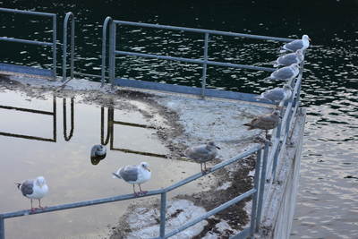
Returning Problem Sets Problem
Input: unordered set of cs1120 students
Output: cs1120 students in lexicographic order by UVa ID
What is a good algorithm for getting all of you in order by UVa ID?

Slide 31
