Slide 1
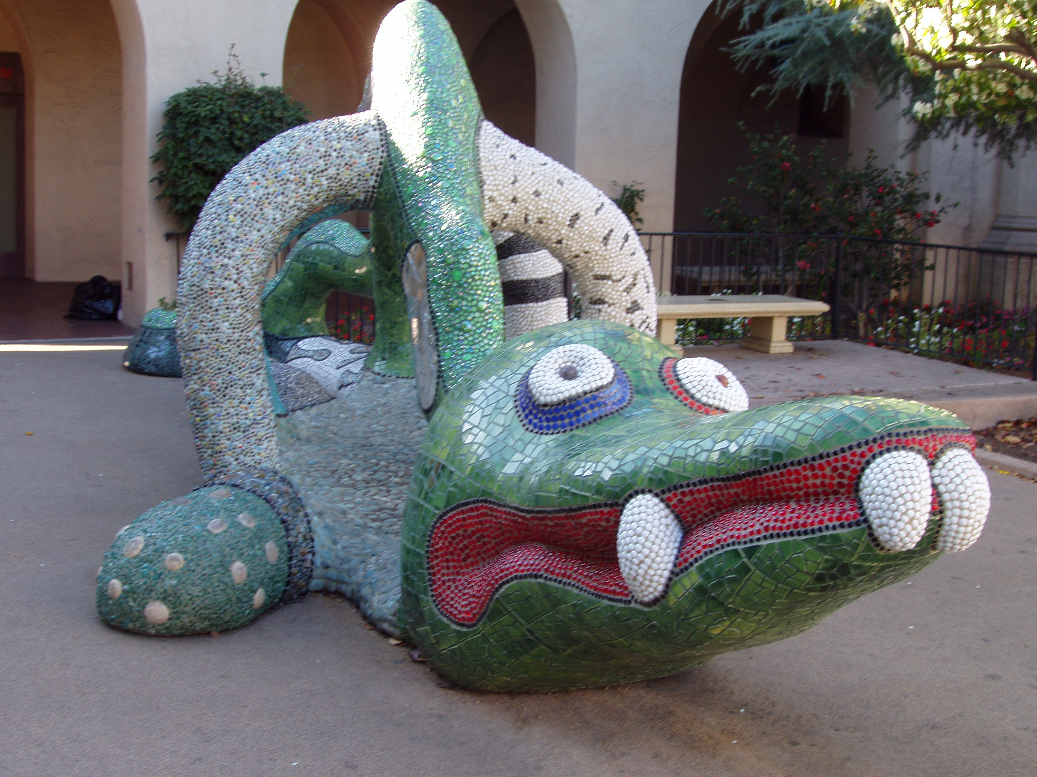
Class 7: List Procedures
David Evans
cs1120 Fall 2009

Slide 2
List Recap
A List is either:
(1) a Pair whose second part is a List
or (2) null
Pair primitives:
(cons a b) Construct a pair <a, b>
(car pair) First part of a pair
(cdr pair) Second part of a pair

Slide 3
List Examples
> null
()
> (cons 1 null)
(1)
> (list? null)
#t
> (list? (cons 1 2))
#f
> (list? (cons 1 null))
#t

Slide 4
More List Examples
> (list? (cons 1 (cons 2 null)))
#t
> (car (cons 1 (cons 2 null)))
1
> (cdr (cons 1 (cons 2 null)))
(2)

Slide 5
List Procedures
Be very optimistic! Since lists themselves are recursive data structures, most problems involving lists can be solved with recursive procedures.
Think of the simplest version of the problem, something you can already solve. This is the base case. For lists, this is usually when the list is null.
Consider how you would solve the problem using the result for a slightly smaller version of the problem. This is the recursive case. For lists, the smaller version of the problem is usually the cdr of the list.

Slide 6
list-trues
Define a procedure that takes as input a list, and produces as output the number of non-false values in the list.
(list-trues null) → 0
(list-trues (list 1 2 3)) → 3
(list-trues (list false (list 2 3 4))) → 1

Slide 7
list-trues
Be very optimistic! Since lists themselves are recursive data structures, most problems involving lists can be solved with recursive procedures.
Think of the simplest version of the problem, something you can already solve. This is the base case. For lists, this is usually when the list is null.
Consider how you would solve the problem using the result for a slightly smaller version of the problem. This is the recursive case. For lists, the smaller version of the problem is usually the cdr of the list.

Slide 8
list-trues
Be very optimistic! Since lists themselves are recursive data structures, most problems involving lists can be solved with recursive procedures.
Think of the simplest version of the problem, something you can already solve. This is the base case. For lists, this is usually when the list is null.
Consider how you would solve the problem using the result for a slightly smaller version of the problem. This is the recursive case. For lists, the smaller version of the problem is usually the cdr of the list.
(define (list-trues p)
(if (null? p)
0
))

Slide 9
list-trues
(define (list-trues p)
(if (null? p)
0
(+ (if (car p) 1 0)
(list-trues (cdr p)))))
Be very optimistic! Since lists themselves are recursive data structures, most problems involving lists can be solved with recursive procedures.
Think of the simplest version of the problem, something you can already solve. This is the base case. For lists, this is usually when the list is null.
Consider how you would solve the problem using the result for a slightly smaller version of the problem. This is the recursive case. For lists, the smaller version of the problem is usually the cdr of the list.

Slide 10
Quiz

Slide 11
list-sum
Define a procedure, list-sum, that takes a list of numbers as input and outputs the sum of the numbers in the input list.
(list-sum (list 1 2 3)) → 6
(list-sum null) → 0

Slide 12
list-length
Define a procedure, list-length, that takes a list as input and outputs the number of elements in the input list.
(list-length (list 1 2 3)) → 3
(list-length (list 1 (list 2 3))) → 2
(list-length null) → 0

Slide 13
Charge
We’ll repeat the Quiz on Friday if it seems too few people have done the readings well
Problem Set 2: Due Monday
It is much longer than PS1, don’t wait to get started
Help hours tonight in Olsson 001
Friday: Recursive Procedures Practice

