Slide 1
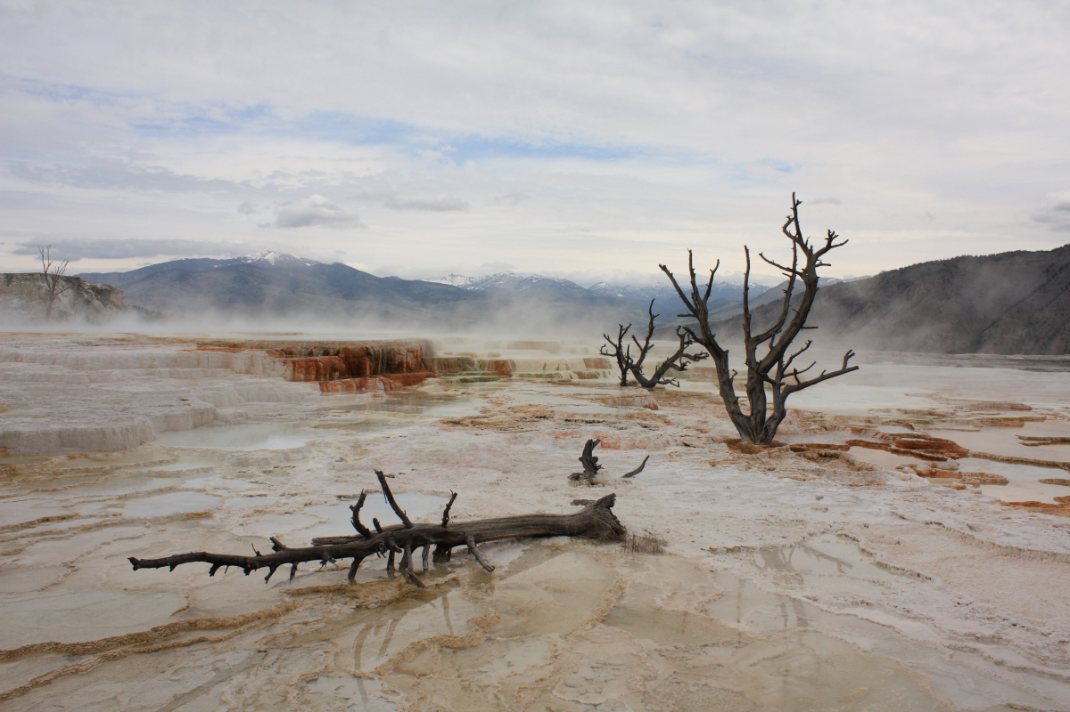
Class 8: Recursing on Lists
David Evans
cs1120 Fall 2009

Slide 2
Menu
Quiz Comments
List Procedures
is-list? (Exercise 5.11)
list-sum ⇒ list-product, deep-list-sum
Generalizing list procedures
find-closest
Monday: GEB Chapter 5

Slide 3
Quiz Comments
About 2/3 of you have read the GEB reading
I really hope everyone reads this!
We’ll talk about it in Monday’s class
Everyone should know the definition of a List (but only about ½ did)
A List is either:
null
or, a Pair whose second part is a List
This definition is very important: all of our List procedures depend on it!

Slide 4
Common, Incorrect List Definition
A List is a Pair whose second part is either null or a List.
If this is our List definition, there is no way to make a list with no elements.

Slide 5
Class Pace
(write-in)

Slide 6
Book Comments
Many people want answers to the exercises (13 people mentioned this)
We will do some in class
If you ask, I’m happy to provide hints/answers or comments on your answers
More diagrams, examples
Editing problems: please do send me anything specific you notice!

Slide 7
is-list?
Define a procedure is-list? that takes one input and outputs true if the input is a List, and false otherwise.
(is-list? (list 1 2 3)) → true
(is-list? (cons 1 (cons 2 null)))
→ true
(is-list? null) → true
(is-list? 3) → false
(is-list? (cons 1 (cons 2 3)))
→ false

Slide 8
is-list?: Easy Way
This is exactly what the built-in list? procedure does.
(define is-list? list?)

Slide 9
is-list? without using list?
null?: Value → Boolean
outputs true if input is null
pair?: Value → Boolean
outputs true if input is a Pair
(define (is-list? p)
(if (null? p)
true
(if (pair? p)
(is-list? (cdr p))
false)))
(define (is-list? p)
(or (null? p)
(and (pair? p) (is-list? (cdr p)))))

Slide 10
list-sum
Define a procedure, list-sum, that takes a list of numbers as input and outputs the sum of the numbers in the input list.
(list-sum (list 1 2 3)) → 6
(list-sum null) → 0

Slide 11
list-sum
(define (list-sum p)
(if (null? p)
0
(+ (car p) (list-sum (cdr p)))))
Okay, what about list-product?

Slide 12
deep-list-sum
(define (deep-list-sum p)
(if (null? p)
0
(+ (if (list? (car p))
(deep-list-sum (car p))
(car p))
(deep-list-sum (cdr p)))))
Okay, what about list-product?

Slide 13
Tracing deep-list-sum
(require (lib "trace.ss"))
(trace deep-list-sum)
|(deep-list-sum ((1 2) 3))
| (deep-list-sum (1 2))
| |(deep-list-sum (2))
| | (deep-list-sum ())
| | 0
| |2
| 3
| (deep-list-sum (3))
| |(deep-list-sum ())
| |0
| 3
|6
6
Use trace to see entrances and exits of procedure applications.

Slide 14
list-product
(define (list-product p)
(if (null? p)
1
(* (car p) (list-product (cdr p)))))
Okay, what about list-length?

Slide 15
list-length
(define (list-length p)
(if (null? p)
0
(+ 1 (list-length (cdr p)))))

Slide 16
Comparing List Procedures
(define (is-list? p)
(if (null? p)
true
(if (pair? p) (is-list? (cdr p)) false)))
(define (list-sum p)
(if (null? p)
0
(+ (car p) (list-sum (cdr p)))))
(define (list-product p)
(if (null? p)
1
(* (car p) (list-product (cdr p)))))
(define (list-length p)
(if (null? p)
0
(+ 1 (list-length (cdr p)))))

Slide 17
Base Cases
(define (is-list? p)
(if (null? p)
true
(if (pair? p) (is-list? (cdr p)) false)))
(define (list-sum p)
(if (null? p)
0
(+ (car p) (list-sum (cdr p)))))
(define (list-product p)
(if (null? p)
1
(* (car p) (list-product (cdr p)))))
(define (list-length p)
(if (null? p)
0
(+ 1 (list-length (cdr p)))))

Slide 18
Recursive Calls
(define (is-list? p)
(if (null? p)
true
(if (pair? p) (is-list? (cdr p)) false)))
(define (list-sum p)
(if (null? p)
0
(+ (car p) (list-sum (cdr p)))))
(define (list-product p)
(if (null? p)
1
(* (car p) (list-product (cdr p)))))
(define (list-length p)
(if (null? p)
0
(+ 1 (list-length (cdr p)))))
What does each do with the car of the list?

Slide 19
find-closest-number
Define a procedure find-closest-number that takes two inputs, a goal number, and a list of numbers, and produces the number in the list numbers list that is closest to goal:
> (find-closest-number 150 (list 101 110 120 157 340 588))
157
> (find-closest-number 12 (list 1 11 21))
11
> (find-closest-number 12 (list 95))
95

Slide 20
Find Closest Number
Be optimistic!
Assume you can define:
(find-closest-number goal numbers)
that finds the closest number to goal from the list of numbers.
What if there is one more number?
Can you write a function that finds the closest number to match from new-number and numbers?

Slide 21
Finding the Closest
Strategy:
If the first number is closer than the closest number of the rest of the numbers, use the first number.
Otherwise, use the closet number of the rest of the numbers.

Slide 22
Optimistic Function
(define (find-closest goal numbers)
(if (< (abs (- goal (car numbers)))
(abs (- goal
(find-closest-number
goal (cdr numbers)))))
(car numbers)
(find-closest-number
goal (cdr numbers))))

Slide 23
Defining Recursive Procedures
2. Think of the simplest version of the problem, something you can already solve.
If there is only one number, that is the best match.

Slide 24
The Base Case
(define (find-closest-number goal numbers)
(if (= 1 (length numbers))
(car numbers)
(if (< (abs (- goal (car numbers)))
(abs (- goal
(find-closest-number
goal (cdr numbers)))))
(car numbers)
(find-closest-number goal (cdr numbers))))
Same as before

Slide 25
Testing
(define (find-closest-number goal numbers)
(if (= 1 (length numbers))
(car numbers)
(if (< (abs (- goal (car numbers)))
(abs (- goal
(find-closest-number
goal (cdr numbers)))))
(car numbers)
(find-closest-number goal (cdr numbers))))
> (find-closest-number 150
(list 101 110 120 157 340 588))
157
> (find-closest-number 0 (list 1))
1
> (find-closest-number 0 (list ))
first: expects argument of type <non-empty list>; given ()

Slide 26
Charge
Problem Set 2: Due Monday
Help hours Sunday 6-8:30 in Olsson 001
Monday: Even more Recursiveness!
GEB Chapter 5

