Slide 1
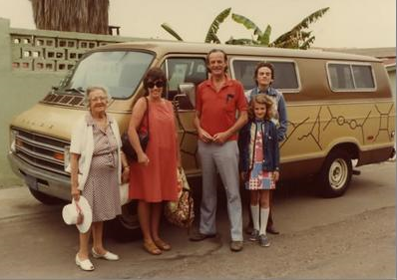
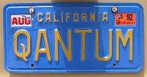
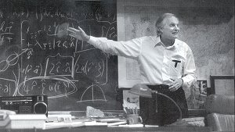
Lecture 9: Mostly Not About Matter, Music, and Mayhem
Richard Feynman’s van
cs1120 Fall 2009
David Evans
http://www.cs.virginia.edu/evans
Alan Alda playing Richard Feynman in QED

Slide 2
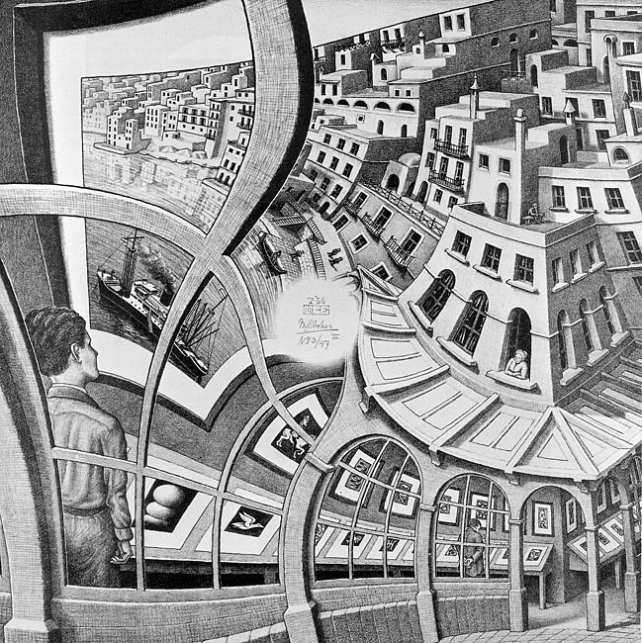
Menu
Finishing find-closest
Mapping on Lists
GEB Chapter V
Paper about figuring out what is in the white spot

Slide 3
Last class: find-closest-number
(define (find-closest-number goal p)
(if (null? (cdr p))
(car p)
(if (< (abs (- goal (car p)))
(abs (- goal (find-closest-number goal (cdr p)))))
(car p)
(find-closest-number goal (cdr p)))))

Slide 4
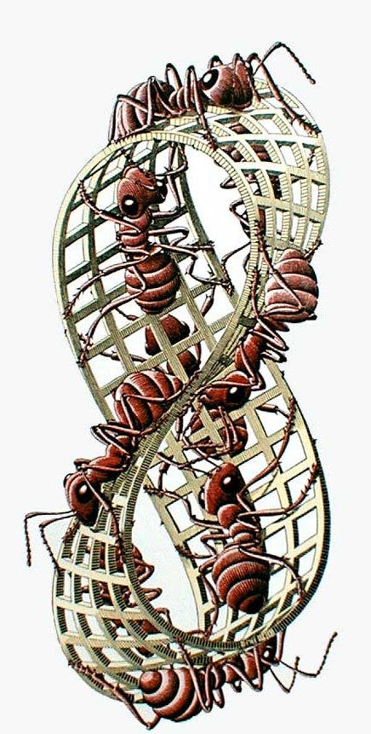
Avoiding Duplicate Work
(define (pick-closest goal a b)
(if (< (abs (- goal a)) (abs (- goal b))) a b))
(define (find-closest-number goal p)
(if (null? (cdr p))
(car p)
(pick-closest goal
(car p)
(find-closest-number goal (cdr p)))))

Slide 5
Generalizing find-closest-number
How would we implement
find-closest-number-without-going-over?
What about find-closest-word?
...
The “closeness” metric should be a procedure parameter

Slide 6
find-minimizer
(define (pick-minimizer f a b)
(if (< (f a) (f b)) a b))
(define (find-minimizer f p)
(if (null? (cdr p))
(car p)
(pick-minimizer f (car p)
(find-minimizer f (cdr p)))))
find-minimizer takes two inputs: a procedure and a list. Its output is the element
of the input list for which applying the procedure produces the lowest value.

Slide 7
Examples
> (find-minimizer (lambda (n) (abs (- 1120 n)))
(list 1130 1125 1203 1108))
1125
> (find-minimizer (lambda (n) (- n))
(list 1 2 4 8 16))
16
> (find-minimizer
(lambda (n) (if (<= n 1120) (- 1120 n) 99999))
(list 1130 1125 1203 1108))
1108

Slide 8
find-closest-number
(define (find-closest-number goal p)
(find-minimizer
(lambda (n) (abs (- goal n)))
p))

Slide 9
Seen Anything Like This?
(define (find-best-match sample tiles color-comparator)
(if (= (length tiles) 1)
(car tiles)
(pick-better-match
sample
(car tiles)
(find-best-match
sample
(cdr tiles)
color-comparator)
color-comparator))))
(define (pick-better-match
sample tile1 tile2
color-comparator)
(if (color-comparator sample
(tile-color tile1) (tile-color tile2))
tile1
tile2))

Slide 10
Better find-best-match
(define (find-best-match sample tiles color-differencer)
(find-minimizer
(lambda (tile)
(color-differencer tile sample))
tiles))
(define (color-difference colora colorb)
(+ (square (- (get-red colora) (get-red colorb)))
(square (- (get-green colora) (get-green colorb)))
(square (- (get-blue colora) (get-blue colorb)))))

Slide 11
GEB Chapter V
You could spend the rest of your life just studying things in this chapter (25 pages)!
Music Harmony
Stacks and Recursion
Theology
Language Structure
Number Sequences
Chaos
Fractals (PS3 out today)
Quantum Electrodynamics (later lecture)
DNA (later lecture)
Sameness-in-differentness
Game-playing algorithms (later lecture)

Slide 12
Fibonacci’s Problem
Filius Bonacci, 1202 in Pisa:
Suppose a newly-born pair of rabbits, one male, one female, are put in a field. Rabbits mate at the age of one month so that at the end of its second month a female can produce another pair of rabbits.
Suppose that our rabbits never die and that the female always produces one new pair (one male, one female) every month from the second month on.
How many pairs will there be in one year?

Slide 13
Rabbits
From http://www.mcs.surrey.ac.uk/Personal/R.Knott/Fibonacci/fibnat.html

Slide 14
Fibonacci Numbers
GEB p. 136:
These numbers are best defined recursively by the pair of formulas
FIBO (n) = FIBO (n – 1) + FIBO (n – 2) for n > 2
FIBO (1) = FIBO (2) = 1
Can we turn this into a Scheme procedure?

Slide 15
Defining FIBO
Be optimistic - assume you can solve it, if you could, how would you solve a bigger problem.
Think of the simplest version of the problem, something you can already solve.
Combine them to solve the problem.
These numbers are best defined recursively by the pair of formulas
FIBO (n) =
FIBO (n – 1)
+ FIBO (n – 2) for n > 2
FIBO (1) = FIBO (2) = 1

Slide 16
Defining fibo
;;; (fibo n) evaluates to the nth Fibonacci
;;; number
(define (fibo n)
(if (or (= n 1) (= n 2))
1 ;;; base case
(+ (fibo (- n 1))
(fibo (- n 2)))))
FIBO (1) = FIBO (2) = 1
FIBO (n) =
FIBO (n – 1)
+ FIBO (n – 2) for n > 2

Slide 17
Fibo Results
> (fibo 2)
1
> (fibo 3)
2
> (fibo 4)
3
> (fibo 10)
55
> (fibo 60)
Still working after 4 hours…
Why can’t our 4Mx Apollo Guidance Computer figure out how many rabbits there will be in 5 years?
To be continued...
(Chapter 7)

Slide 18
Recursive Transition Networks

Slide 19
(not quite as) FANCY NOUN:
begin
ORNATE NOUN
end
FANCY
NOUN
PREPOSITION
ORNATE NOUN:
begin
ARTICLE
ADJECTIVE
NOUN
end
“the strange bagels below the purple cow on the cloud”
Can we describe this using a BNF Grammar?

Slide 20
(not quite as) FANCY NOUN:
begin
ORNATE NOUN
end
FANCY
NOUN
PREPOSITION
FANCY-NOUN ::= ORNATE-NOUN
FANCY-NOUN ::= ORNATE-NOUN PREPOSITION FANCY-NOUN
PREPOSITION ::= below | on | above | under | ...

Slide 21
Recursive Transition Networks
ORNATE NOUN
begin
ARTICLE
ADJECTIVE
NOUN
end
ORNATE-NOUN ::= NOUN

Slide 22
Recursive Transition Networks
ORNATE NOUN
begin
ARTICLE
ADJECTIVE
NOUN
end
ORNATE-NOUN ::= NOUN
ORNATE-NOUN ::= ARTICLE ADJECTIVE NOUN

Slide 23
Recursive Transition Networks
ORNATE NOUN
begin
ARTICLE
ADJECTIVE
NOUN
end
ORNATE-NOUN ::= ARTICLE ADJECTIVE NOUN
ORNATE-NOUN ::= ARTICLE ADJECTIVE ADJECTIVE NOUN
ORNATE-NOUN ::= ARTICLE ADJECTIVE ADJECTIVE ADJECTIVE NOUN
ORNATE-NOUN ::= ARTICLE ADJECTIVE ADJECTIVE ADJECTIVE ADJECTIVE NOUN
ORNATE-NOUN ::= ARTICLE ADJECTIVE ADJECTIVE ADJECTIVE ADJECTIVE ADJECTIVE NOUN

Slide 24
Recursive Transition Networks
ORNATE NOUN
begin
ARTICLE
ADJECTIVE
NOUN
end
ORNATE-NOUN ::= ARTICLE ADJECTIVES NOUN
ADJECTIVES ::= ADJECTIVE ADJECTIVES
ADJECTIVES ::=

Slide 25
Recursive Transition Networks
ORNATE NOUN
begin
ARTICLE
ADJECTIVE
NOUN
end
ORNATE-NOUN ::= OPTARTICLE ADJECTIVES NOUN
ADJECTIVES ::= ADJECTIVE ADJECTIVES
ADJECTIVES ::= ε
OPTARTICLE ::= ARTICLE
OPTARTICLE ::= ε

Slide 26
BNF Grammar
ORNATE-NOUN ::= OPTARTICLE ADJECTIVES NOUN
ADJECTIVES ::= ADJECTIVE ADJECTIVES
ADJECTIVES ::= ε
OPTARTICLE ::= ARTICLE
OPTARTICLE ::= ε
FANCY-NOUN ::= ORNATE-NOUN
FANCY-NOUN ::= ORNATE-NOUN PREPOSITION
FANCY-NOUN
PREPOSITION ::= below | on | above | under | ...
ARTICLE ::= the | a | an
NOUN ::= bagel | cow | cloud | ...
This demonstrates that one RTN can be converted to a BNF. For a proof that all RTNs can be converted to BNFs, we would need to formalize the transformation as a systematic and general algorithm.

Slide 27
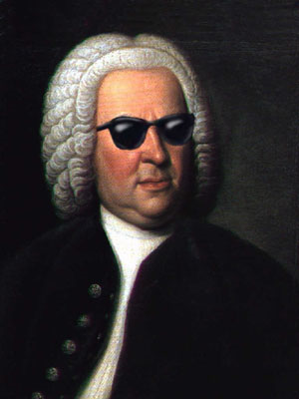
Music Harmony
Kleines Harmonisches Labyrinth
(Little Harmonic Labyrinth)
Not actually by Bach
(by Johann David Heinichen)

Slide 28
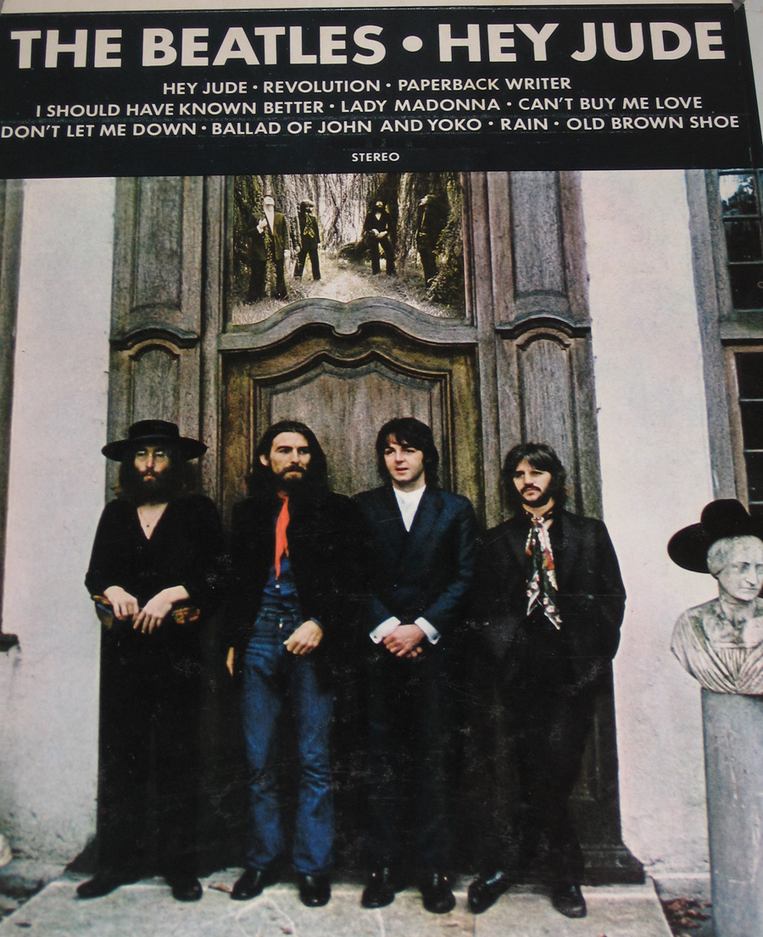
Hey Jude
John Lennon and
Paul McCartney, 1968

Slide 29
Hey Jude
V: C = 3/2 * F
V: C = 3/2 * F
IV: Bb = 4/3 * F
Pop
Push Fifth
Pop
Push Fifth
Push Fourth
Pop
Tonic: F = 1
Tonic: F
Tonic: F
Tonic: F
Tonic: Hey Jude, don’t make it
V: bad. take a sad song and make it
Tonic: better Re-
IV: member to let her into your
Tonic: heart, then you can
V: start to make it bet-
Tonic: -ter.
Link

Slide 30
V: C = 3/2 * F
V: C = 3/2 * F
IV: Bb = 4/3 * F
Verse ::=
Pop
Push Fifth
Pop
Push Fifth
Push Fourth
Pop
Tonic: F = 1
Tonic: F
Tonic: F
Tonic: F
V+V: Gm = 3/2 * 3/2 * F
-frain, don’t’ carry the
V: C = 3/2 * F
world up-on you shoul-
Bridge ::=
IV: Bb = 4/3 * F
Pain, Hey Jude re-
Pop
Push Fourth
Tonic: F = 1
And Anytime you feel the
Tonic: F
ders.
HeyJude ::= Verse VBBD VBBD Verse Verse Better Coda VBBD ::= Verse Bridge Bridge Dadada (ends on C)
Coda ::= F Eb Bb F Coda

Slide 31
Music
Almost All Music Is Like This
Pushes and pops the listener’s stack, but doesn’t go too far away from it
Repeats similar patterns in structured way
Keeps coming back to Tonic, and Ends on the Tonic
Any famous Beatles song that doesn’t end on Tonic?
“A Day in the Life” (starts on G, ends on E)

Slide 32
Charge
Challenge: Find a “pop” song with a 3-level deep (or higher) harmonic stack
PS3: due 23 Sept.
Be optimistic!
You know everything you need to finish it now, and it is longer than ps2, so get started now!
http://www.fractalwisdom.com

