Slide 1
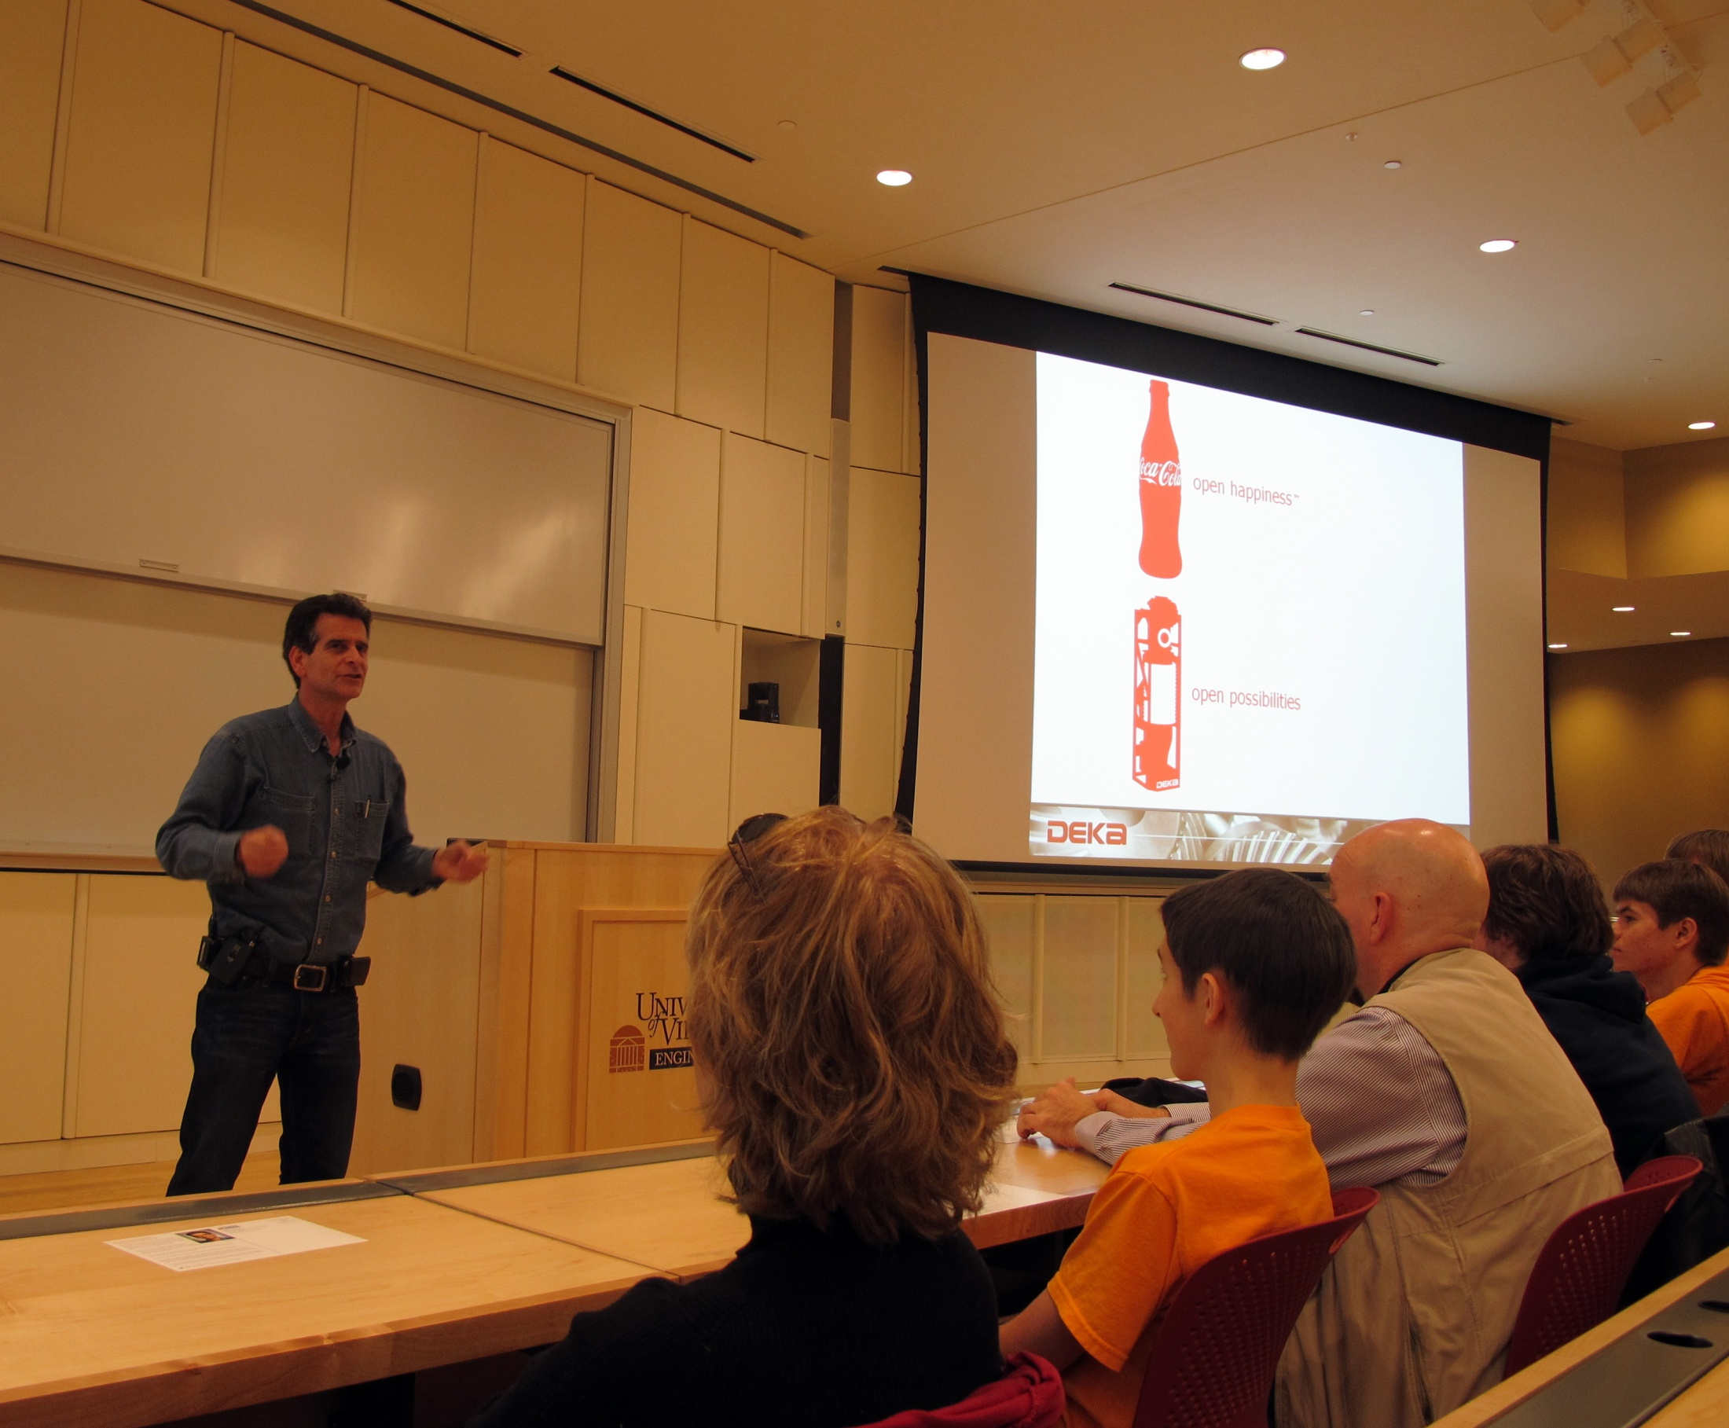
Class 37: Computability in Theory and Practice
cs1120 Fall 2011
David Evans
21 November 2011

Slide 2
Plan
Questions for Exam 2
Computability Practice
Universal Languages (including Java)
Philosophical Discussion on Computability in Theory and Practice

Slide 4
Inverse Problem
Input: strings p, q that each define Python procedures
Output: True if p and q are inverses (e.g., for all possible inputs x, p(q(x)) = x). Otherwise, False.

Slide 5
Inverse Problem is Noncomputable
If we had an algorithm, inverse(p, q) that solves the InverseProblem, we could use it to define an algorithm halts(s) that solves the HaltingProblem:

Slide 6
Inverse Problem is Noncomputable
If we had an algorithm, inverse(p, q) that solves the InverseProblem, we could use it to define an algorithm halts(s) that solves the HaltingProblem:
def halts(s):
inverse(“lambda x: x”,
“lambda x: begin(eval(s), x)”)
To make proof convincing: argue that this correctly defines halts
If s doesn’t finish the inputs are not inverses, hence inverse returns false (correct)
If s does finish, the inputs are inverses, hence inverse returns true (correct)

Slide 7
Python-Scheme-Equivalence Problem
Input: string s defines a Python program
Output: if there exists a Scheme program the defines the same function as s, output True. Otherwise, False.

Slide 8
Python-Scheme-Equivalence Problem
Input: string s that defines a Python program
Output: if there exists a Scheme program the defines the same function as s, output True. Otherwise, False.
Python-Scheme-Equivalence is Computable.
“Proof”:
def pythonSchemeEquivalence(s):
return True

Slide 9
Universal Programming Language
Definition: a programming language that can describe every algorithm.
Equivalently: a programming language that can simulate every Turing Machine.
Equivalently: a programming language in which you can implement a Universal Turing Machine.

Slide 10
Are Python, Scheme, Charme, Java, and Aazda Universal Programming Languages?

Slide 11
Yes!
Proof: implement a Turing Machine simulator in the language.
What do you need to simulate a TM?

Slide 12
Simulating a Turing Machine
z
z
z
z
z
z
z
z
z
z
z
z
z
z
z
z
z
z
z
z
), X, L
Read/Write Infinite Tape
Lists
Finite State Machine
Numbers
Processing
Way to make decisions (if)
Way to keep going
¬), #, R
2: look for (
¬(, #, L
1
Start
(, X, R
#, 1, -
HALT
#, 0, -
Finite State Machine

Slide 13
Can even simpler languages do this?

Slide 14
Lambda Calculus
Rules for manipulating strings of symbols
term = variable
| term term
| (term)
| λ variable . term
One main rule: β-reduction
((λx. M)N) ⇒ _{β} M
with all x’s in M replaced by N
Note: I have slightly altered the traditional syntax to make it more like Scheme.
This is a lot like Scheme, without primitives, special forms, mutation!

Slide 15
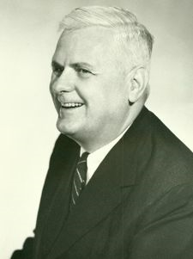
Church’s Computing Model: Lambda Calculus
Developed in 1930s in attempt to formalize mathematics (similar to Bertrand Russell’s goals)
Ran into similar paradoxes:
solution: model computing not mathematics!
Basis of LISP and Scheme
Alonzo Church, 1903-1995

Slide 16
Evaluating Lambda Expressions
redex: Term of the form ((λx. M)N)
Something that can be β-reduced
An expression is in normal form if it contains no redexes.
To evaluate a lambda expression, keep doing reductions until you get to normal form.
Why does Scheme/Charme need special forms to be universal,
but lambda calculus can do everything with “application”?

Slide 17
Simulating a Turing Machine
z
z
z
z
z
z
z
z
z
z
z
z
z
z
z
z
z
z
z
z
), X, L
Read/Write Infinite Tape
Lists
Finite State Machine
Numbers
Processing
Way to make decisions (if)
Way to keep going
¬), #, R
2: look for (
¬(, #, L
1
Start
(, X, R
#, 1, -
HALT
#, 0, -
Finite State Machine

Slide 18
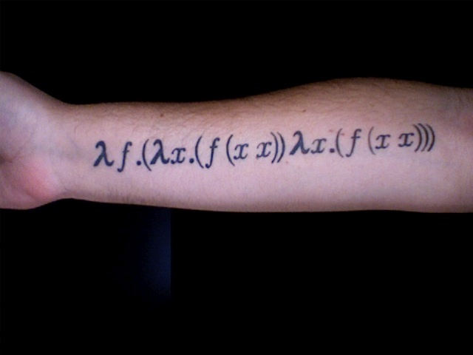
Way to Keep Going: The Y-Combinator
Y = λf (λx . (f (x x)) (λx . f (x x))
This finds the fixed point of any function!
(Y G) = (G (Y G))

Slide 19
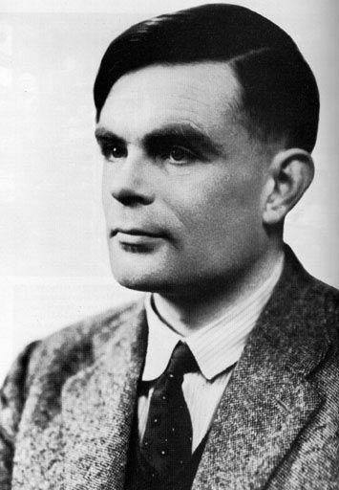
Church-Turing Thesis
All mechanical computers are equally powerful (except for practical limits like memory size, time, display, energy, etc.)
There exists some Turing machine that can simulate any mechanical computer
Any computer that is powerful enough to simulate a Turing machine, can simulate any mechanical computer
Alonzo Church, 1903-1995
Alan Turing, 1912-1954

Slide 20
All universal programming language are equivalent in power: they can all simulate a TM, which can carry out any mechanical algorithm.

Slide 21
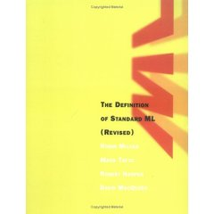
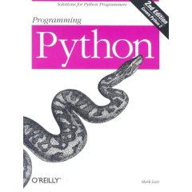
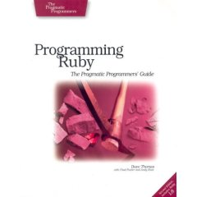
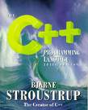
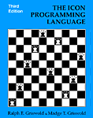
Why so many equally powerful programming languages?

Slide 22
Proliferation of Universal PLs
“Aesthetics”
Some people like :=, others prefer =.
Some people think whitespace shouldn’t matter (e.g., Java, Scheme), others think programs should be formatted like they mean (e.g., Python)
Some people like goto (BASIC, C) others like throw (Java, Python)
Expressiveness vs. Simplicity
Python is more expressive than Scheme
Expressiveness vs. “Truthiness”
How much you can say with a little code vs. how likely it is your code means what you think it does

Slide 23
Programming Language Design Space
high
x86
C
Scheme
(display “Hello!”)
Python
print ("Hello!")
Expressiveness
public class HelloWorld {
public static void main(String[] args) {
System.out.println ("Hello!");
}
}
strict typing,
static
Java
Ada
low
Spec#
more mistake prone
less mistake prone
“Truthiness”

Slide 24
Leading Philosopher on Computability in Theory and Practice
http://video.google.com/videoplay?docid=1623254076490030585#
http://www.funny-videos.co.uk/videoAliGScienceVideo39.html

Slide 25
Ali G Problem

Slide 26
Ali G Problem
Input: whole numbers x and y with up to d digits each (mostly nines)
Output: x × y
Theorist’s Question:
Is the Ali G Problem computable?

Slide 27
Multiplication is Computable

Slide 28
Ali G Problem
Input: whole numbers x and y with up to d digits each (mostly nines)
Output: x × y
Ali G’s Question:
Can real computers solve it for a given d?

Slide 29
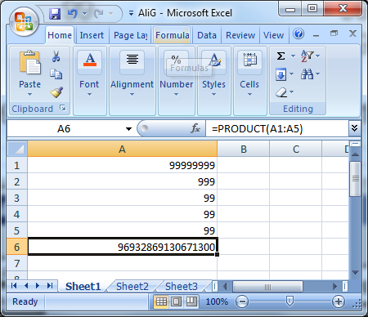

Slide 30
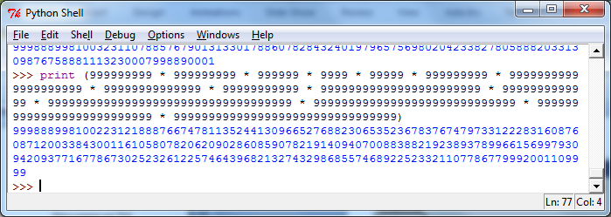

Slide 31
Ali G was Right!
Theory assumes ideal computers:
Unlimited, perfect memory
Unlimited (finite) time
Real computers have:
Limited memory, time, power outages, flaky programming languages, etc.
There are many decidable problems we cannot solve with real computer: the actual inputs do matter (in practice, but not in theory!)

Slide 32
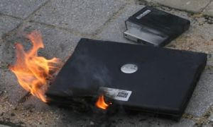
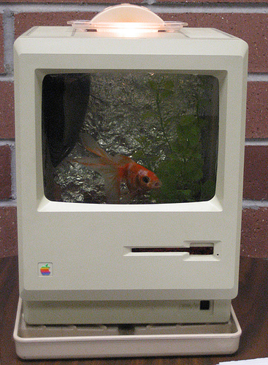
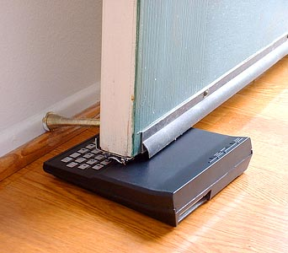
Things Real Computers Can Do That Turing Machines Cannot
Generate Heat
Provide an adequate habitat for fish
Stop a Door

Slide 33
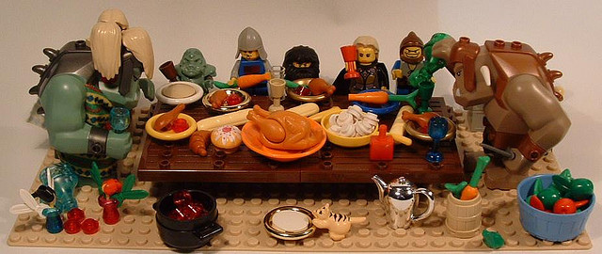
flickrcc: martha_chapa95
Happy Thanksgiving!
Don’t spend your Thanksgiving doing Exam 2! If you are well prepared, it should only take a few hours. If you’re spending longer then that on it, you are doing something wrong, or grossly misinterpreting the questions.

