Slide 1
Explicit Factor Models for Explainable Recommendation based on Phrase-level Sentiment Analysis
(July 2014)
Sammy Lahrime, Clara Na, Jay Rothenberger, Nikash Sethi

Slide 2
Introduction

Slide 3
Explainable Recommendation Systems
“How does it work?”
“Why was a certain product recommended?”

Slide 4
Explainable vs. Prediction Accuracy Algorithm Trade-off

Slide 5
Why are explainable recommendation systems better?
1) Greater Scrutability
2) Effectiveness & Efficiency
3) Persuasiveness
4) Satisfaction (i.e. better user experience)

Slide 6
Solution: The Best of Both Worlds… Highly Explainable and Highly Accurate?
The Explicit Factor Model

Slide 7
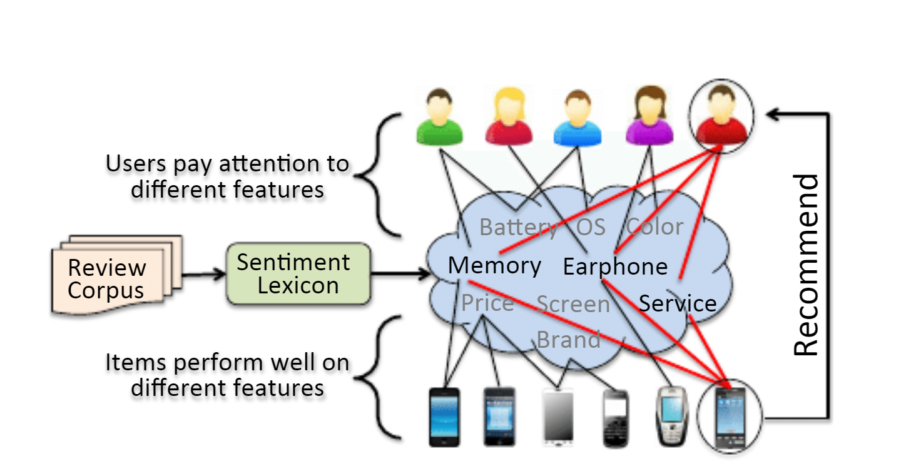
High Level Explicit Factor Model

Slide 8
Understanding FOS Triplet
Review example: “The battery life is short”,
Find the (F, O, S)...
F - Feature Word = “battery life”
O - Opinion Word = “short”
S - Sentiment = value [-1,1]

Slide 9
Related Works

Slide 10
Collaborative Filtering Techniques: Latent Factor Models
Singular Value Decomposition (SVD)
Non-negative Matrix Factor (NMF)
Max-Margin Matrix Factorization (MMMF)
Takeaway: Latent Factors are not transparent.

Slide 11
Different Levels of Sentiment Analysis
Review/Sentence Level Analysis, identifying the sentiment with respect to a certain product.
Phrase Level Analysis, identifying the sentiment with respect to extractive specific features of a product.

Slide 12
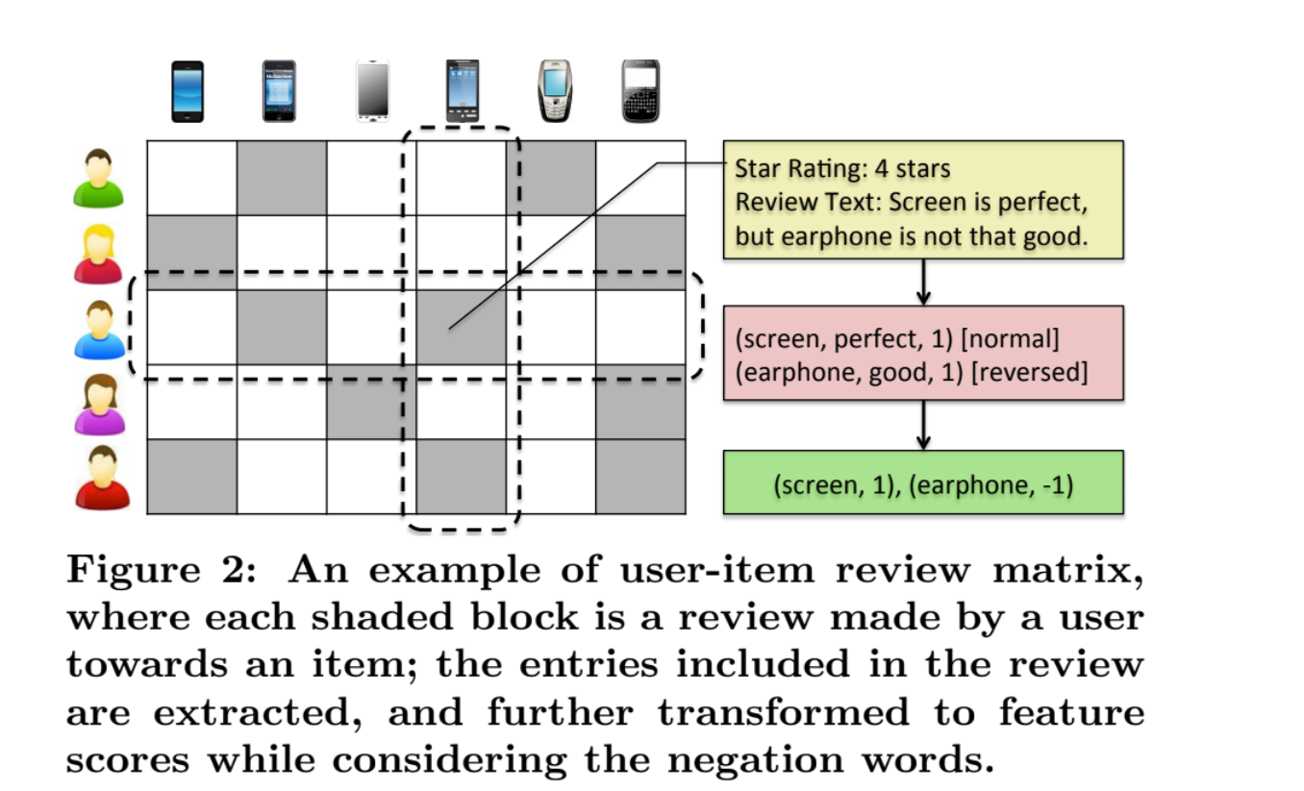
Constructing Our User-Item Review Matrix In a Nutshell

Slide 13
Framework

Slide 14
Framework Overview
Inputs: A textual review corpus, a user-items ratings matrix
A sentiment lexicon of (Feature, Opinion, Sentiment) triplets is constructed from the corpus
Feature values for items are extracted from Lexicon based on average sentiment
A user’s personal preferences towards a feature are also extracted from the Lexicon
Then decompose ratings matrix into item v.s. feature quality and user v.s. feature attention matrices.

Slide 15
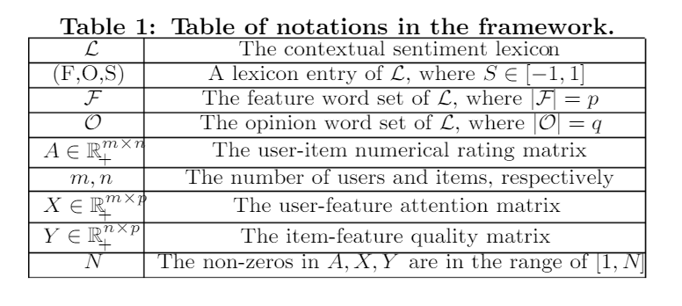
Relevant Matrices
x_{ij} = 1 + (N-1)(2/(1 + e^{-t}) - 1) or 0
y_{ij} = 1 + (N-1)/(1 + e^{-ks}) or 0
Where t is the number of times user i mentioned feature j, and k is the number of times item i is associated with feature j according to average sentiment s
An element in X is 0 if a user did not mention a feature
An element in Y is 0 if an item is not reviewed on a feature

Slide 16
Integrating Explicit and Implicit Features
Explicit features may not be enough to determine a rating.
To solve this r’ latent factors are added to the r explicit factors considered
First, explicit user-feature and item-feature relations are estimated as follows:
W
Where λ_{x} and λ_{y} are regularization coefficients

Slide 17
Assuming the ratings matrix is a representation of a user’s opinions about aspects of a product (hidden and explicit factors)
Next, decompose ratings matrix A into PQ^{T} where P = [U₁ H₁], Q = [U₂ H₂]
and H₁, H₂ are n x r’ and m x r’ dimensional positive real-valued matrices respectively representing the hidden/latent factors.
This is achieved by minimizing the square of the frobenius norm of the matrix difference as follows:
Where

Slide 18
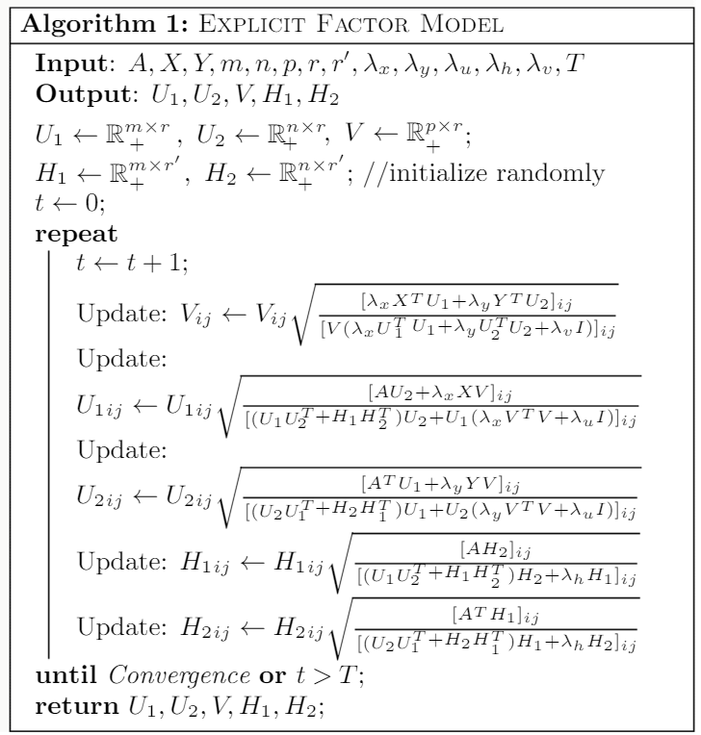
Training The Model
Intuitively, the algorithm minimizes a distance between the ratings matrix and the decomposed representation.

Slide 19
Personalized Recommendation
Given a solution to the training algorithm we can then estimate missing entries in X, Y, and A as follows:
X~ = U₁V^{T}, Y~ = U₂V^{T}, A~ = U₁U₂^{T} + H₁H₂^{T}
Then, a top-k recommendation to a user is calculated based on a rating R_{ij} for user i and item j
C_{i} is the set of k most cared about features for user i, and 0 ≤ α ≤ 1 is a parameter controlling tradeoff
For recommendation/disrecommendation feature c is selected where c = argmax/min_{c in Ci}(Y~_{jc})
(the most significant item feature)

Slide 20
Experiments

Slide 21
Offline Experiments
How well does the system capture what user’s care about and how they feel about them?
Considering the performance of individual components of the system
Online Experiments
How persuasive are these feature-level explanations in recommendations to users?
Considering the empirical, real-world performance of the system

Slide 22
Offline Experiments

Slide 23
Offline Experiments Overview:
Goal: Directly evaluate effectiveness of the EFM framework in offline settings
What data, and why?
How well does the sentiment lexicon capture item features and user focus?
How does the framework do on traditional recommendation tasks?
What is its performance on rating prediction and top-K recommendation tasks?
Notes:
Describe experimental setup, talk about sentiment lexicon, and talk about how framework does on traditional recommendation tasks

Slide 24
Experimental Setup: Datasets
Two datasets: one English, one Chinese – to see if framework works in different languages
Yelp -> Yelp10
From Yelp dataset challenge, reviews of Phoenix City Area businesses
49% of the users made only one review...needed more for these experiments
Solution: Yelp10 (only reviews from users with ≥10 reviews)
Dianping
Reviews of restaurants in major cities in China
≥20 reviews per user
Notes:
Two business review datasets in two languages, at least 10 reviews per user for yelp, at least 20 for dianping

Slide 25
Sentiment Lexicon Construction
Want to evaluate generated (Feature word, Opinion Word, Sentiment) triples
Focus on precision – only using top k features
Manual annotation after transforming polarity values -> binary values
Annotator agreement: 85.63% for feature “properness” and 82.26% for sentiment correctness
Lexicon construction yields ~100 high quality product features in both datasets
Example entries: (decor, cool, +), (price, high, -)
Assumption: different users care about different things.
Verified with fuzzy
k-means clustering...

Slide 26
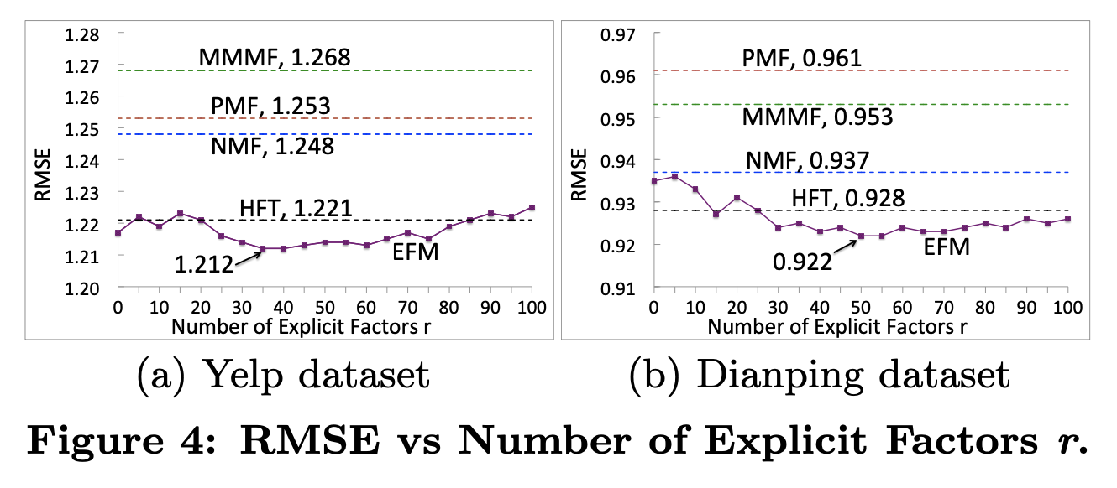
Rating Prediction (Estimating Rating Matrix)
Ratio of Explicit Factors r and Latent Factors r’
~30%-80% explicit factors gives improved results
r=35, RMSE=1.212 (best on Yelp)
r=50, RMSE=0.922 (best on Dianping)
SOTA baseline models:
NMF: Nonnegative Matrix Factorization
PMF: Probabilistic Matrix Factorization
MMMF: Max-Margin Matrix Factorization
HFT: Hidden Factors as Topics
Fix r + r’ = 100
r=0 for NFM, PFM, MMMF

Slide 27
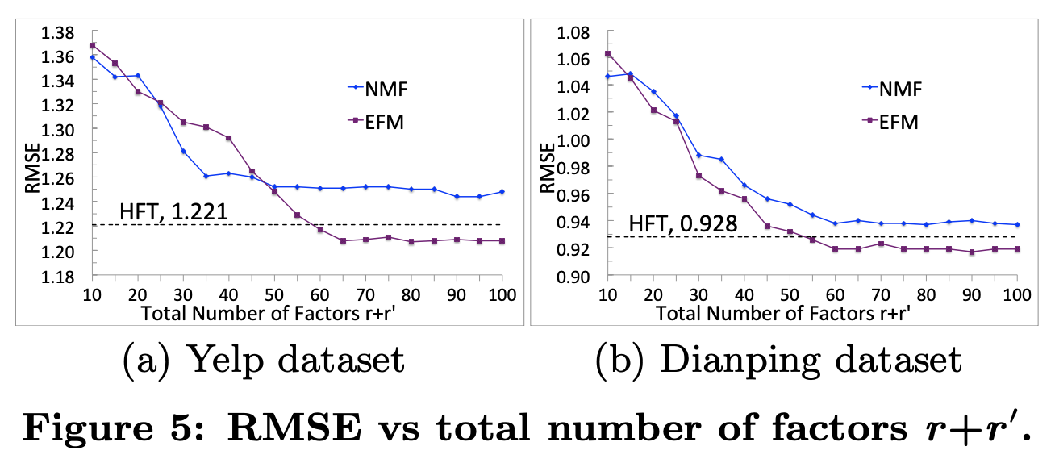
Rating Prediction (Estimating Rating Matrix)
Total Number of Factors
Need r+r’ large enough to outperform baselines, but further increase is less helpful
SOTA baseline models:
NMF: Nonnegative Matrix Factorization
PMF: Probabilistic Matrix Factorization
MMMF: Max-Margin Matrix Factorization
HFT: Hidden Factors as Topics
Fix explicit%=40%

Slide 28
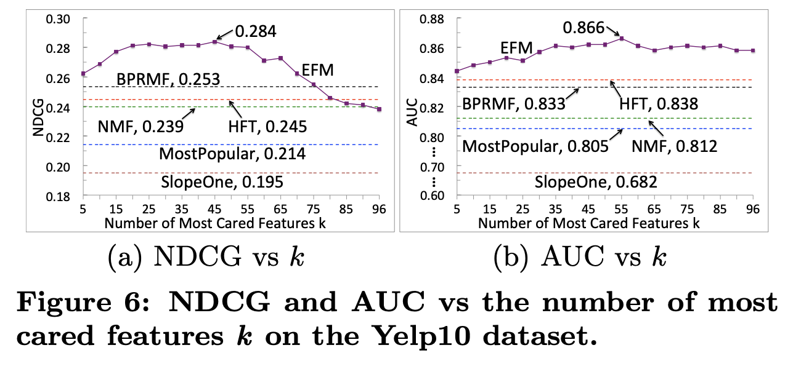
Top-K Recommendation
Number of Most Cared Features k
Increasing k increases performance, but too many features decreases it
Still – EFM usually outperforms baselines!
Best case: EFM outperforms BPRMF by 12.3% at k=45
SOTA baseline models:
MostPopular: non-personalized
SlopeOne: neighborhood-based
NFM: Nonnegative Matrix Factorization
BPRMF: Bayesian Personalized Ranking optimization for MF
HFT = Hidden Factors as Topics
Fix explicit%=40%, r+r’=65
K=5 for Yelp, K=10 for Dianping
Notes:
Repeat of previous Top-K slides for offline pdf view
K corresponds to min number of reviews per user on the datasets

Slide 29
Top-K Recommendation
Note: Optimal k much larger than expected…
Investigation -> this is due to synonyms/words with similar meanings. Can group into a handful of synonym clusters

Slide 30
Online Experiments

Slide 31
Online Experiments Overview:
Goal: Evaluate how persuasive EFM is to real world users
Does explanations influence shopper decisions?
Are feature-level recommendations the best aid to shoppers?
Do dis-recommendations with explanations prevent users from purchasing items that don’t meet their needs?

Slide 32
Online Experiment Setup
Testing on shoppers using e-commerce website JingDong
Recommending list of relevant phones
A/B testing of click-through rates
Feature-level vs. also viewed vs. control
Indicator for recommendations
Positive or negative indicator
A/B testing: with or without explanation

Slide 33
Online Experiment Results
Feature-Level Recommendations
Click-through-rate higher with feature-level recommendations
More effective at persuading users
Indicator for Recommendations
Presenting explanations of indicator improves persuasion / conversion
Dis-recommending products helps prevent users from adding to cart
User Group | Feature Level | Also Viewed | Control
CTR | 4.34% | 3.22% | 3.20%
User Group | Explanation | No Explan.
Add to Cart | 6.43% | 5.12%
Agreement | 19.73% | 11.89%
Disrec. Agree | 97.50% | 83.56%

Slide 34
Conclusion

Slide 35
Conclusion and Further Work
EFT gives personalized, explicit feature-level recommendations
Applicable because different users care about different features
First step toward high performing and explainable recommendation systems
Future research ideas:
Introduce more measures (sentiment, popularity, etc.) per feature
Besides persuasiveness, test transparency, user trust, satisfaction, etc.

Slide 36
fin.

