Slide 1
Learning to Collaborate: Multi-Scenario Ranking via Multi-Agent Reinforcement Learning
Paper by Jun Feng, Heng Li, Minlie Huang, Shichen Liu, Wenwu Ou, Zhirong Wang, Xiaoyan Zhu
Presentation by Joseph Banks, Edward Noe, and Julian Wilson

Slide 2
Introduction
Some large-scale online platforms and apps have many different scenarios that require ranking
Traditionally, this situation would necessitate using multiple independent ranking systems, each of which would have its own objective
Optimizing each individual ranking strategy separately has limitations:
Each strategy maximizes its own objective, potentially at the cost of the goals of other strategies
Independent optimization in one scenario only uses its own user data but ignores the context available in other scenarios
This paper proposes a new model to address this problem: Multi-Agent Recurrent Deterministic Policy Gradient (MA-RDPG)
Notes:
Many platforms have multiple ranking scenarios: multiple searches, advertisements, or recommendations
Traditionally, this has involved using multiple ranking systems, all acting independently
Each ranking system would have its own objective (click-through rate, conversion rate, gross merchandise volume, etc.)
However, this system of multiple independent rankers comes with drawbacks:
The objectives of each ranking system may conflict: improvement in the metrics of one ranking system may come at the cost of the performance of a different ranking system
Additionally, each ranking system only has access to a limited set of information, potentially missing out on important information available in the global context
This paper proposes a new model to address this problem: Multi-Agent Recurrent Deterministic Policy Gradient

Slide 3
Background
Learning to rank (L2R)
Ranking strategy is formed with samples of queries and ranked documents
Reinforcement learning
Agent gets observation o_{t} of the environment
Agent takes action a_{t} based on its policy function 𝜇
State of the environment changes to s_{t} and the environment sends reward r_{t} to the agent
Agent maximizes the expected cumulative discounted reward by altering its policy function
Multi-agent reinforcement learning
Multiple agents in the same environment
The agents can be fully competitive, fully cooperative or a mixture of the two
Notes:
The model presented in this paper in many way builds on existing models
Learning to rank models train ranking systems using a set of queries and a ranked list of relevant documents for each query TODO
Reinforcement learning involves the agent taking actions and receiving rewards
Reinforcement learning does not require a set of “correct answers”
Reinforcement learning process:
Agent observes the environment
Agent takes an action based on its policy function 𝜇
The state of the environment changes and the environment sends a reward to the agent
Agent maximizes the expected cumulative discounted reward by altering its policy function, based in part on the discount factor
Multi-agent reinforcement learning
Multiple agents performing the same series of steps as in reinforcement learning
Fully competitive: zero-sum game
Fully cooperative: all agents share the same goal
This paper explores a new fully cooperative multi-agent reinforcement learning model, which Joseph will explain

Slide 4
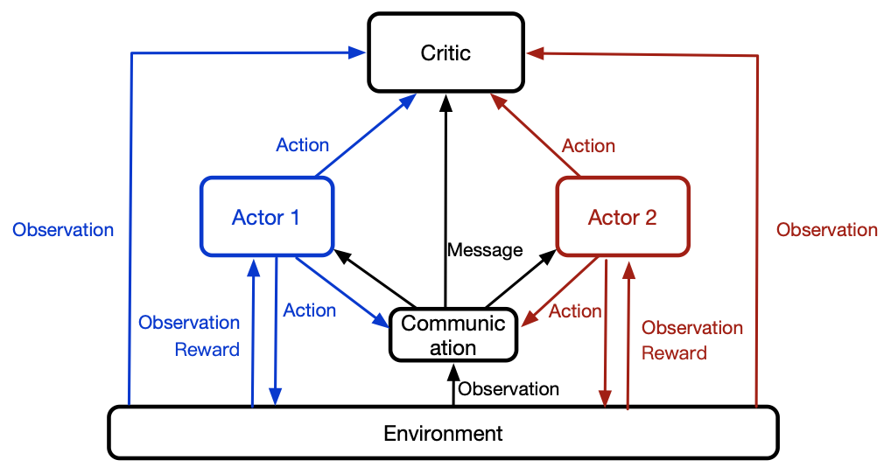
Method
Multi-Agent Recurrent Deterministic Policy Gradient (MA-RDPG)
Multi-Agent: multiple ranking strategies in different scenarios that each correspond to an agent
Sequential Decision: users and agents sequentially interact with each other
Fully Cooperative: agents cooperate with each other to maximize a shared metric
Partially Observable: the environment is only partially observable to each agent
Has three major components: private actors, communication component, and the centralized critic

Slide 5
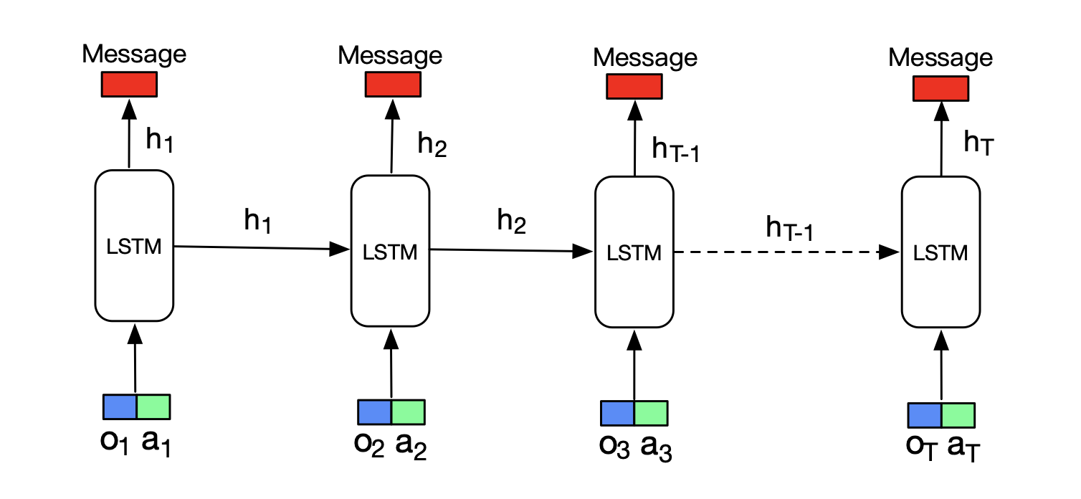
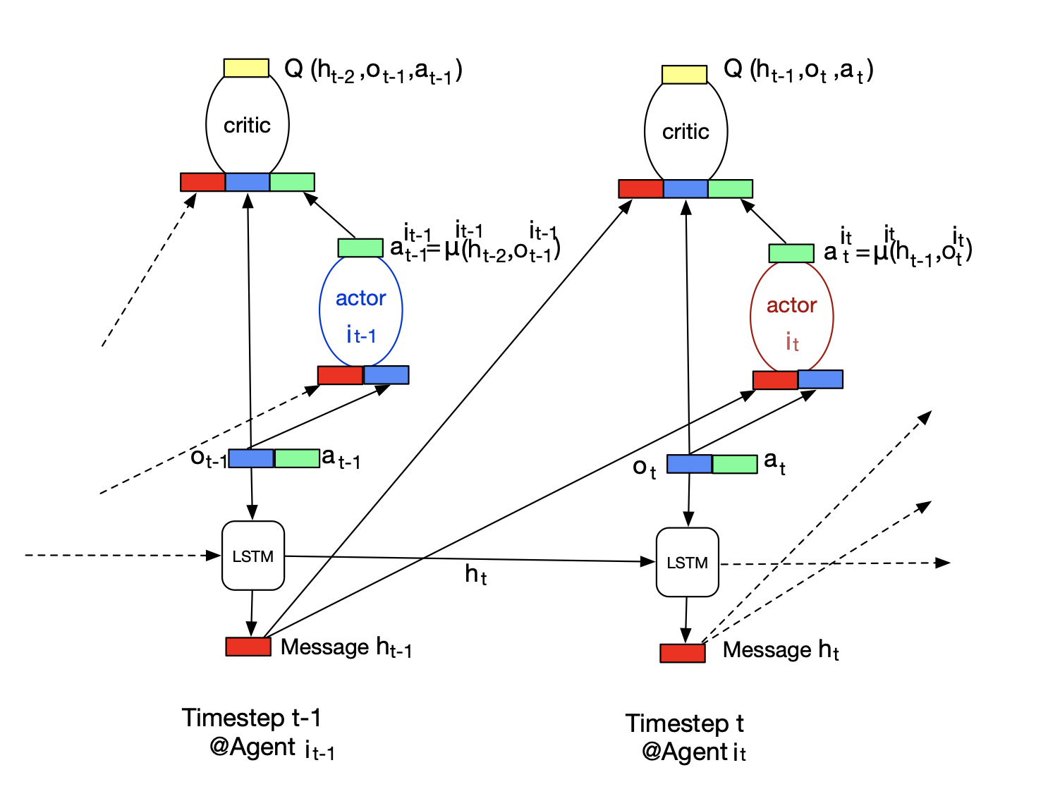
Model Details
Communication Component
LSTM architecture used
Takes in h_{t-1} , o_{t} , and a_{t}
Allows agents to approximate full environment state
Private Actors (𝜇)
Each agent has a private actor
Actor specifies a deterministic policy
Agent takes action (a_{t}) with its actor network
Network takes local observation (o_{t} ) and shared message (h_{t-1})
Centralized Critic (Q)
Estimates the action-value function to approximate total future rewards
All agents share the same goal
Takes in h_{t-1} , o_{t} , and a_{t}

Slide 6
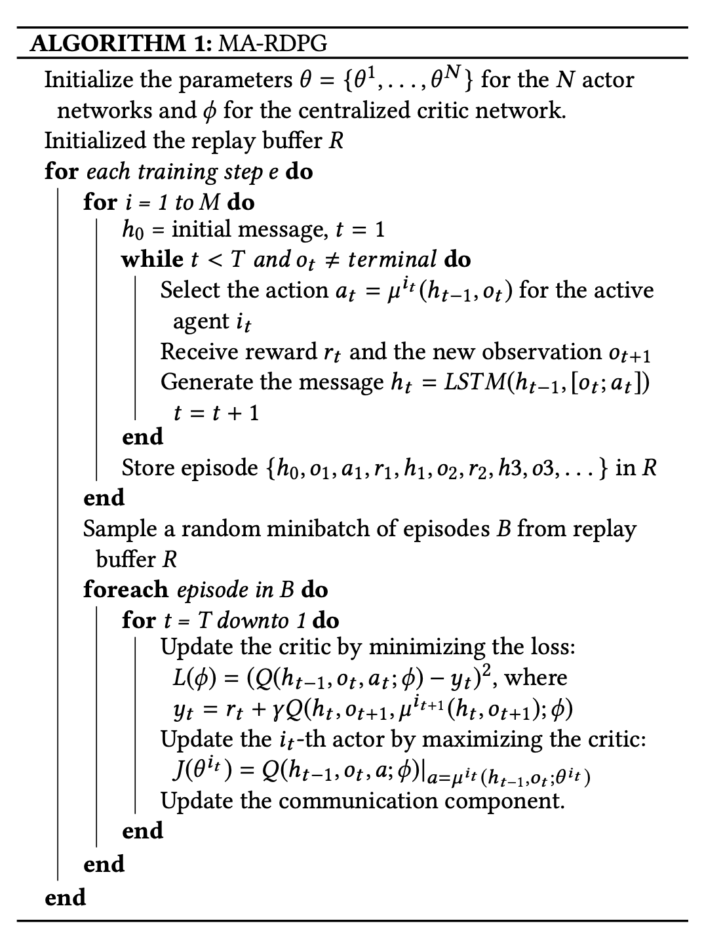
Training
Centralized Critic
Trained using Bellman equation
Minimizes
Where
Private Actor
Maximizing Centralized Critic with respect to its own parameters
Actor’s parameter gradients are given by
Communication Component
LSTM is trained by minimizing

Slide 7
Application
Used MA-RDPG on online E-commerce platform Taobao with 2 scenarios:
Main search
Makes up majority of user traffic,
3.5 billion page views per day
In-shop search
Search specific shop’s page
1.5 billion page view per day
Optimizing for Gross Merchandise Volume (GMV)

Slide 8
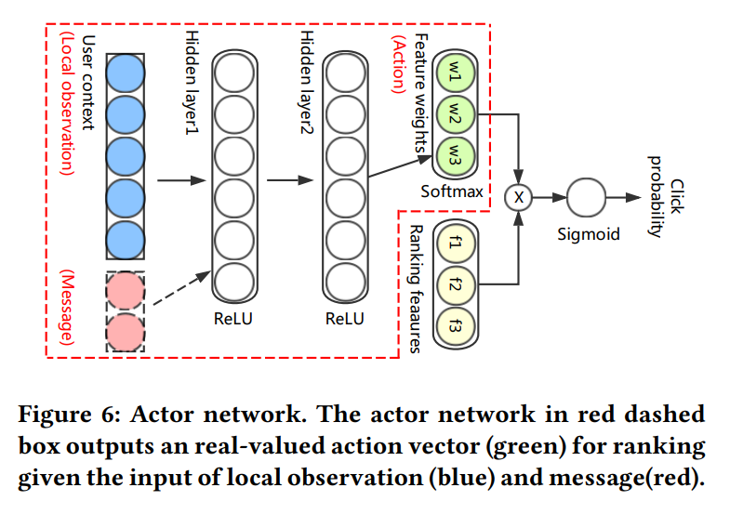
Experiment
Agents: main search and in-shop search
States: 52-dimension vector of local observations like age, gender, price of item user clicked on
Concatenated with historical observations to create messages
Ranking features: each item to be ranked has several features like Click Through Rate or Shop popularity
Actor network: outputs feature weight vector, inner product computed with ranking features to find click probability
Online learning:
User logs collected, used to train MA-RDPG, episodes stored, model parameters updated

Slide 9
Additional Experiment Parameters
Rewards for training:
Purchase: positive price of item bought
Click: 1
No purchase nor click: -1
User leaves page without buying anything: -5
Reward discount factor of 0.9
RMSProp used for learning parameters
Learning rate of 10^-3 for actor network
Learning rate of 10^-5 for critic network
Replay buffer size of 10^4
Minibatch size 100

Slide 10
Results
Baseline ranking algorithms:
Empirical Weight (EW): Feature weights adjusted by engineering experts
Learning to Rank (L2R): Similar learning process for feature weights but network does not consider message with historical observations and observation from other actors
Measured in relative improvement versus EW in both scenarios (GMV gap)
Run for seven days with 3% of users in test group

Slide 11
Results
MA-RDPG performs better than all baselines including L2R+L2R which is currently used
GMV of in-shop search is improved significantly while main search GVM remains about the same
Improving GMV in main hurts GMV in in-shop (in L2R+EW)

Slide 12
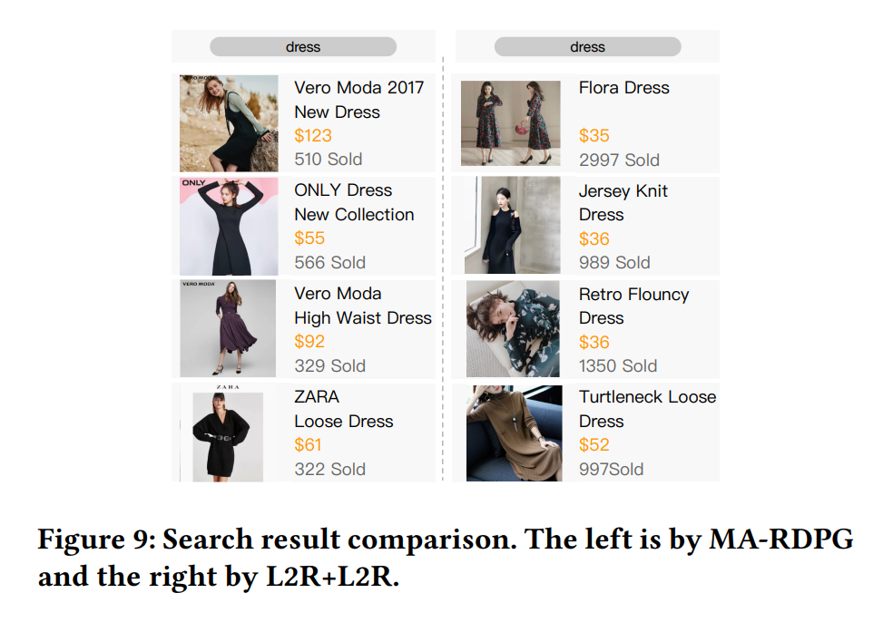
Case Study
Young woman clicks on some skirts which are expensive and have low conversion rates, then queries "dress" in main search.
MA-RDPG (left) returns items with lower sales, higher prices, from branded shops

Slide 13
Conclusion
Existing solutions to the multi-scenario ranking problem involve multiple independent ranking models
Independent ranking models can result in suboptimal performance because of limited information and different ranking systems having different goals
Through a shared critic and inter-agent communication, MA-RDPG aims to improve collaborative performance in multi-agent ranking
An experiment showed increases over existing baseline systems in terms of GMV
Notes:
Multi-scenario ranking is often addressed by simply using multiple independent ranking models
This can lead to suboptimal performance
Limited information is available to each ranker
Each ranker is attempting to optimize for a different goal
Multi-Agent Recurrent Deterministic Policy Gradient attempts to improve performance in multi-scenario ranking by optimizing for one goal shared by all agents
An experiment performed by the paper authors showed significant performance increases compared to strong baselines in terms of gross merchandise volume

