Slide 1
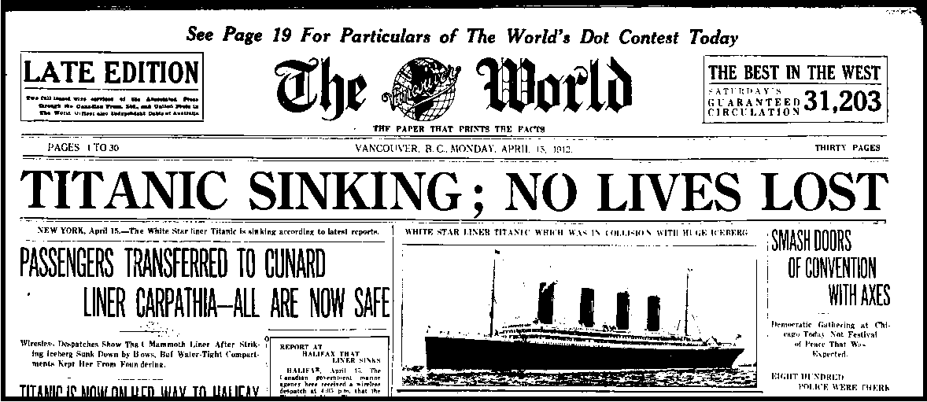
DRN: A Deep Reinforcement Learning Framework for News Recommendation
Presented By
Aldrick Johan, Keshav Ailaney, Wei Wang, and Matthew Bacon

Slide 2
Motivation
Due to an abundance of news content, users need personalized content recommendation
Prior attempts to solve this problem involved content based methods, collaborative filtering methods, and hybrid methods
However these methods have the following limitations:
Don’t adapt fast enough to match the news cycle
Only use click / no click labels for user feedback
Keep recommending similar items to users
The framework outlined in this paper solves these issues

Slide 3
Related Works
Prior News Recommendation algorithms
Content-based
Collaborative filtering
Hybrid
Reinforcement Learning
Contextual Multi-Armed Bandit models
Markov Decision Process models

Slide 4
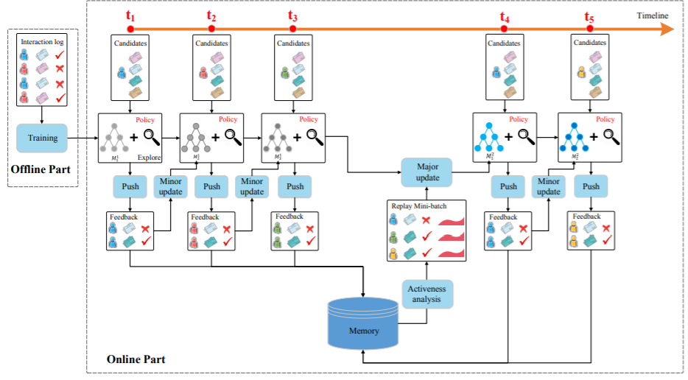
Model Framework
Deep Q Network-based Deep Reinforcement Learning framework
Trained from offline user logs
Used to predict the reward based on which articles are presented to the user
Recommends news using current user and news candidates as input
Improves over time based on user feedback

Slide 5
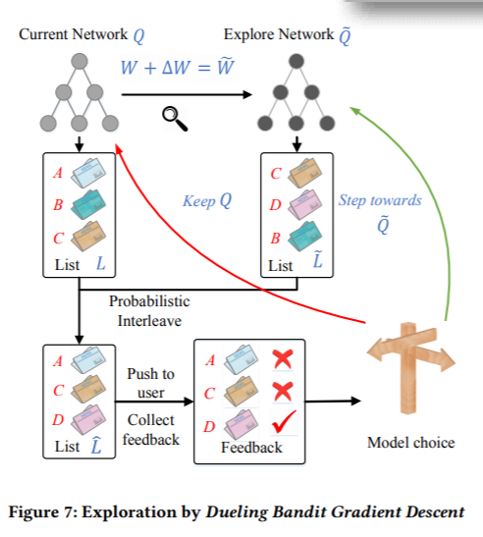
Model Updates
Minor Update
Occurs at each Timestamp
Dueling Bandit Gradient Descent exploration strategy
Alters the network slightly and compares the result
Major Updates
Based on feedback (clicks and user activeness)

Slide 6
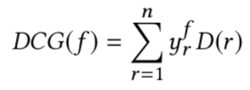
Evaluation Measures
Click Through Rate (CTR)
Precision@k
nDCG

Slide 7
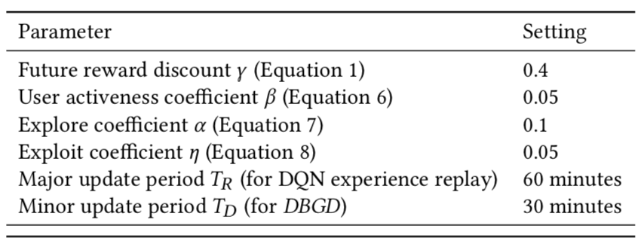
Experiment Setting
Parameter values:

Slide 8
Models
DN
Uses a dueling-structure Double Deep Q-Network without considering future reward
DDQN
Takes future reward into consideration
DDQN + U
Takes user activeness into consideration
DDQN + U + EG
Adds ϵ-greedy
DDQN + U + DBGD
Adds Dueling Bandit Gradient Descent
Baseline algorithms
Logistic Regression (LR)
Factorization Machines (FM)
Wide & Deep (W&D)
Linear Upper Confidence Bound (LinUCB)
Hidden Linear Upper Confidence Bound (HLinUCB)

Slide 9
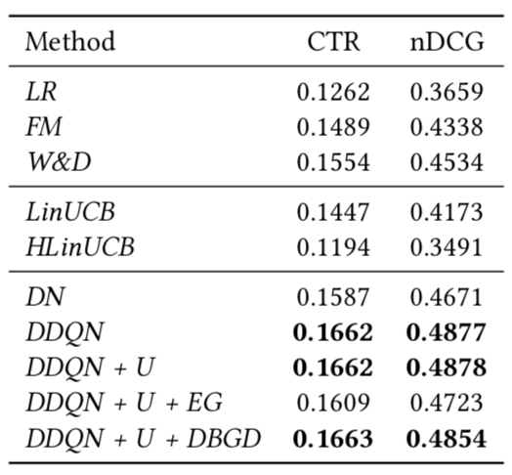
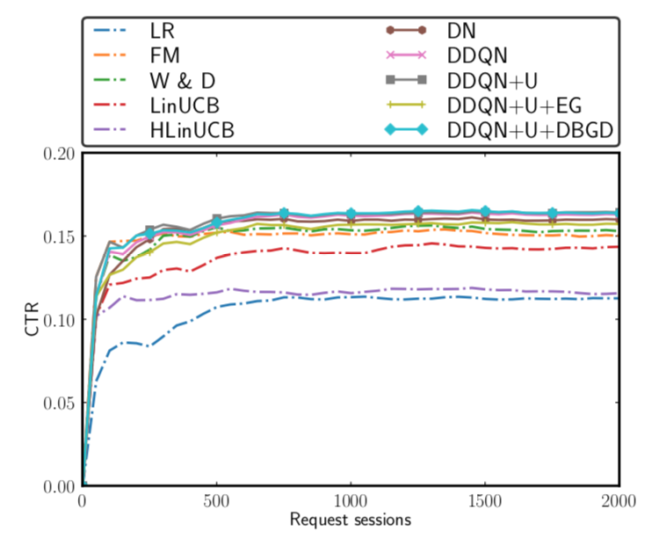
Offline Evaluation Results
Evaluation is completed on the offline dataset.
User activeness cannot be observed.
Exploration is limited.

Slide 10
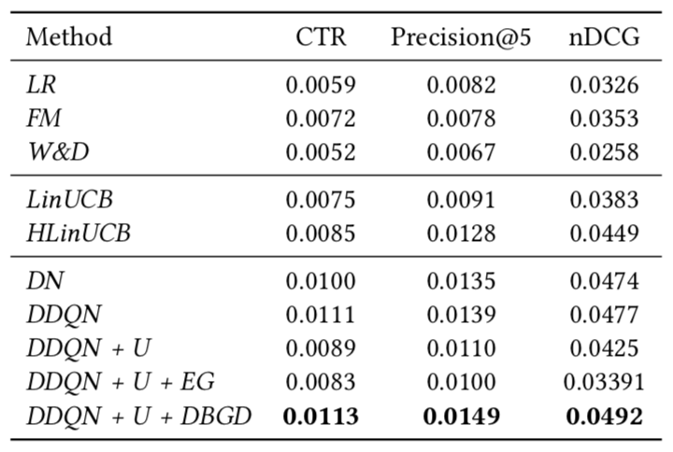
Online Evaluation Results
Models and baseline algorithms are deployed to a commercial news recommendations application for the online evaluation.
User activeness and exploration strategies have impacted the model performance.

Slide 11
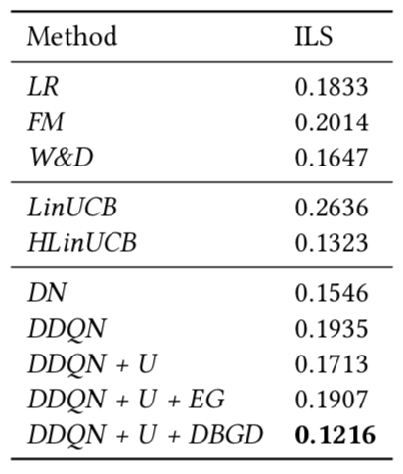
Online Evaluation Results
Recommendation diversity is calculated to determine the effectiveness of the exploration strategies.
Recommendation is measured with the intra-list similarity.

Slide 12
Conclusion
Summary
DQN-based reinforcement learning model
Consider user return as well as click/no click feedback
Dual bandit exploration strategy
Future Work
Models for each type of user (heavy users and one-time users)
Observe patterns between each type of user

Slide 13
Any Questions?

