Slide 1
Explainable recommendation via multi-task learning in opinionated text data (MTER)
Authors: Nan Wang, Hongning Wang, Yiling Jia, Yue Yin
Presented by: William Wong, Christopher Raley, Amar Kulkarni, Rohan Nair

Slide 2
Intro and Overview

Slide 3
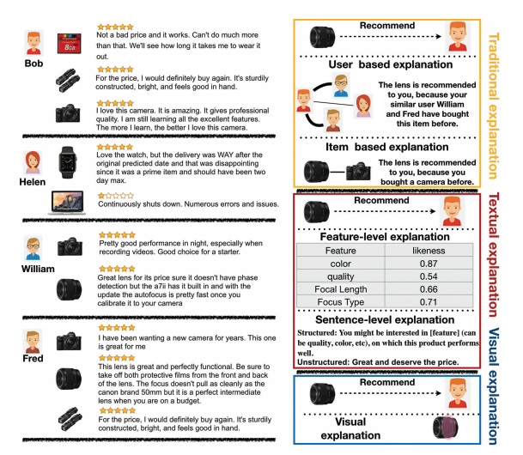
Explainable Recommendations
Help humans understand why items are recommended by algorithm
Improves transparency, persuasiveness, effectiveness, trustworthiness, and user satisfaction
Allows system designers to better refine recommendation models

Slide 4
Proposed Solution?
Multi-task learning solution for explainable recommendation
Two companion learning tasks integrated via joint tensor factorization
User preference modeling
Opinionated content modeling
Recommendations + opinionated feature-level textual explanations
Effectiveness and practicality verified through user studies

Slide 5
Proposed Solution? (cont.)
E2E optimization of performance metrics fails to capture complexity of the decision making process
Companion learning tasks target different aspects of user’s decision
Final assessment can be mutually explained by associated observations
Example output generated by MTER:
Amazon Recommendation: Superleggera/Dual/Layer/Protection/case
Explanation: Its grip is [firmer] [soft] [rubbery]. Its quality is [sound] [sturdy] [smooth]. Its cost is [original] [lower] [monthly]

Slide 6
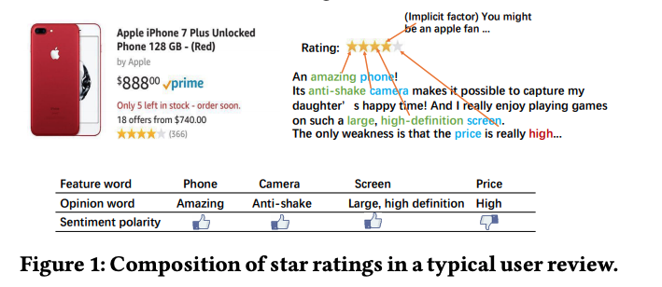

Slide 7
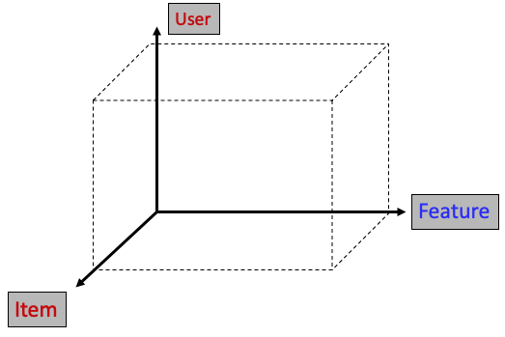
Modeling the Tasks: Item Recommendation
Constructed from feature-level sentiment analysis of reviews
X_{ijk} = to what extent user i appreciates item j’s feature k

Slide 8
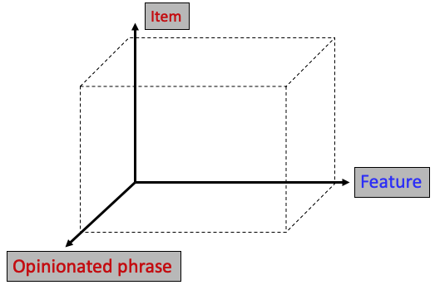
Modeling the Tasks: Opinionated Content Analysis
Two three-way tensors, both from user review content
Y^{I}_{ijk}= Opinionated comments across all users for item j’s feature k
Y^{U}_{ijk}= User i’s opinionated comments on item j’s feature k

Slide 9
Modeling the Tasks
Users, items, features, opinionated phrases mapped to shared latent space
Item recommendation: project items onto user factor space
Explanations: project features and opinionated phrases onto user/item space

Slide 10
Methodology - Preliminaries
User’s Feature-level opinions
Domain-specific sentiment Lexicon
Dataset variables and Latent factors
m, a - users
n, b - items
p, c - features
q, d - opinionated phrases
Domain Specific Lexicon
Feature
Opinion
Sentiment polarity (-1,1)
Each users review is mapped to a Lexicon entry
Notes:
To capture users’ detailed feature-level opinions, LExicon is used to get a tuple

Slide 11
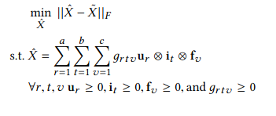
User Preference Modeling
Measure user appreciation of item
Normalize feature score and overall rating
Tucker decomposition for latent factorization
Use Bayesian Personalized Ranking in factorization
Notes:
Address limitation of mapping users and items to shared latent space
Include feature level preference and now require higher dimensional latent factorization
User Preference Modeling
- Predict relevance of a recommendation candidate
- feature-level preference modeling
- Use three-way tensor X in R m x n x p
- measures to what extent user i appreciates item j's feature k
- sentiment polarity labels < s_ijk >
- feature score <s_ijk> = sum s_ijk
- Overall rating matrix A, overall assessment of an item appended to tensor X
The following is an alteration of principal component analysis for three or more dimensional tensors
Latent factorization is done using Tucker decomp
To address the inability to optimize ranking loss, Bayesian Personalized Ranking is introduced into factorization of X

Slide 12
Opinionated Content Modeling
Approximate 4-way tensor as 2 3-way tensors to avoid sparsity
Only positive phrases are included in each tensor about each feature
Notes:
Based on previous section wee would need four way tensor for the four dataset variables
To avoid sparsity, create two three way tensors
Opinionated Content Modeling
- two three-way tensors
- relation among user, feature, and opinion phrase
- relation among item, feature, and opinion phrase
- opinion phrase with feature is dependent on user and item
- tensor Y in R m x p x q
- get all positive phrases that user has used to describe feature k across all items
- positive phrases only, to add warnings such as california data privacy warnings negative phrases can be used
- positive phrases about for item j, positive phases about feature k

Slide 13
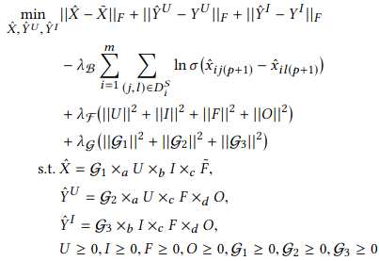
Joint Tensor Factorization
+
=
Notes:
Join Tensor Factorization
- Combine principal component matrices across tensors X and Yu and Yi
- Use L2 regularization
- Can be solved using SGD, but use mini-batch and adaptive gradient descent in order to avoid local optimum and run faster

Slide 14
Joint Tensor Factorization
Multi-Task Explainable Recommendation (MTER)
The marriage of high dimensional latent factorization and and 4-way tensor approximation
Use mini-batch SGD to solve the optimization problem
Gradient of Feature matrix is shared across all three decompositions

Slide 15
Experimentation
(Christopher)

Slide 16
Experiment Setup
Evaluate MTER based on two tasks
Personalized item recommendation
Opinionated textual explanations
Benchmark against 7 other algorithms
MostPopular (MP)
NMF
BPRMF
JMARS
EFM
MTER-SA
MTER-S
Data sets
Amazon (cellphones and accessories)
Yelp (restaurants)

Slide 17
Preprocessing
Issue: sparse data sets
Observation: ~15% of features are frequently covered in ~90% of reviews
Rest of the features are rarely covered
Use recursive filtering based on threshold values to obtain more refined datasets

Slide 18
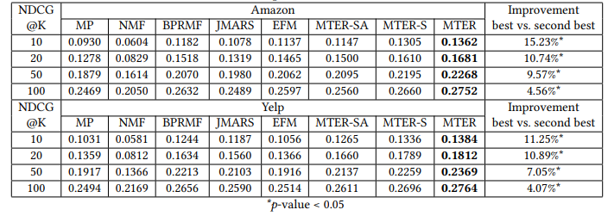
Item Recommendation Results
Evaluation based on Normalized Discounted Cumulative Gain (NDCG) to evaluate top-k recommendations

Slide 19
Opinionated Textual Explanation Results
Evaluate if MTER can predict an actual review’s content that a user would be providing for a given item
Features that a user pays attention to in an item
Detailed opinion phrases used to describe an item

Slide 20
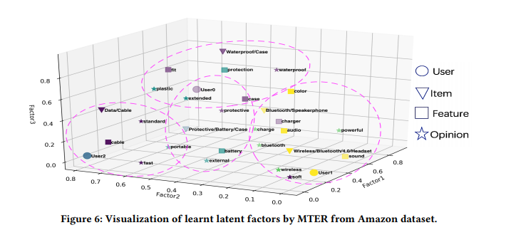
Qualitative Analysis of Learnt Factors
To further show the strength of MTER, we can observe a visualization of learnt factors

Slide 21
User Study

Slide 22
User Study
A/B test among the three models: BPR, EFM, MTER (researcher)
900 questionnaire results post-filtering; 150 per model for the Yelp and Amazon datasets. Participants recruited via Amazon MTurk
Five questions asked on a 1-5 scale (1 being worst, 5 being best)
Notes:
Bayesian Personalized Ranking (BPR),
Generally, are you satisfied with this recommendation?
Do you think you get some idea about recommended item?
Does the explanation help you know more about the recommended item?
Based on the recommended items, do you think you gain some insight of why our recommend this item to you?
Do you think explanations help you better understand our system, e.g., based on what we made the recommendation?

Slide 23
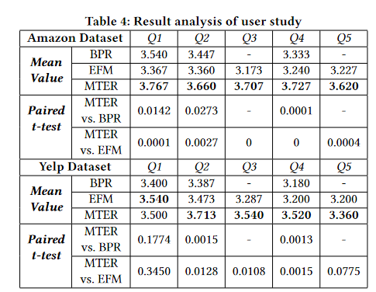
User Study Results
MTER had higher user scores on all questions except Q1/Yelp
“This clearly demonstrates real users’ desire in having such detailed explanations of the automatically generated recommendations... our proposed MTER algorithm is a step towards the destination.”

Slide 24
User Study Limitations
User study results are based on qualitative evaluation by the users based on preference
“Admittedly, this user study is simulation based, and it might be limited by the variance in participants’ understanding of selected reviews”
However, difficult to require participants to disclose their review history
Privacy concerns

Slide 25
Conclusion

Slide 26
Conclusion
Researchers’ Multi-Task Explainable Recommendation (MTER) offers a robust solution to explainable recommendations
Offline experiments and user study indicate effectiveness against leading models
Many future routes for research
Notes:
Deploying MTER in a real-world recommendation system for practical evaluation
Incorporating social network structures among users, product taxonomy among items
Using advanced text synthesis techniques for more complete + natural sentences for explanations

