Slide 1

Learning by Exploration
Qingyun Wu, Huazheng Wang, Hongning Wang
Department of Computer Science
University of Virginia

Slide 2
Outline of this tutorial
Motivation
Classical exploration strategies
Efficient exploration in complicated real-world environments
Exploration in non-stationary environments
Ethical considerations of exploration
Conclusion & future directions

Slide 3



















“Intelligent” systems
Check media feeds
Automated vehicles
Attend to emails
Find a restaurant
Online shopping
Entertainment
Career Development
Online Education
Digital Health

Slide 4
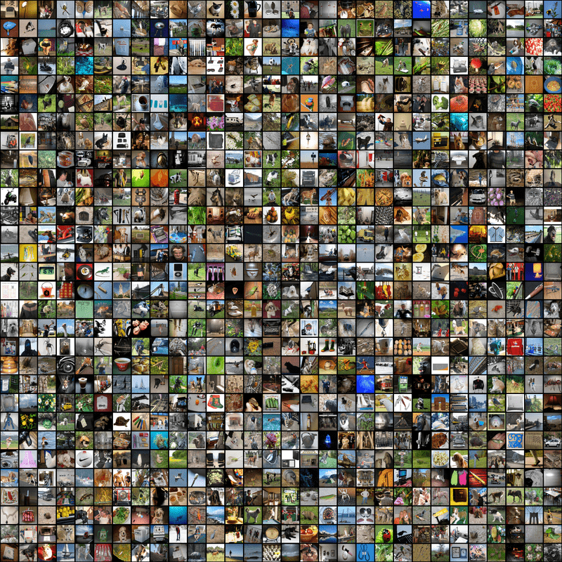
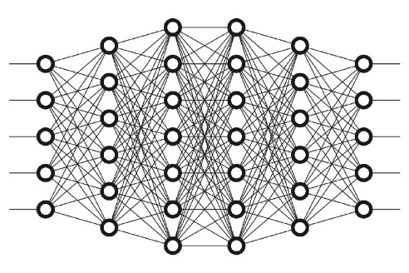
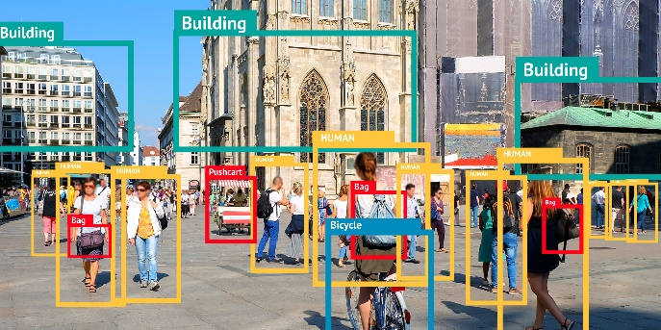
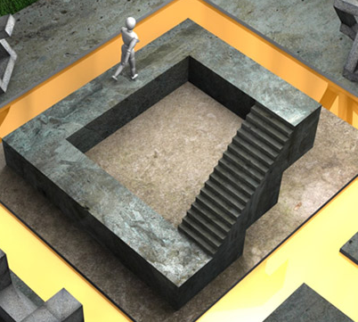
Supervised machine learning
Training
Inference
The agent only learns what is already in the data; it does not know what is not there!

Slide 5
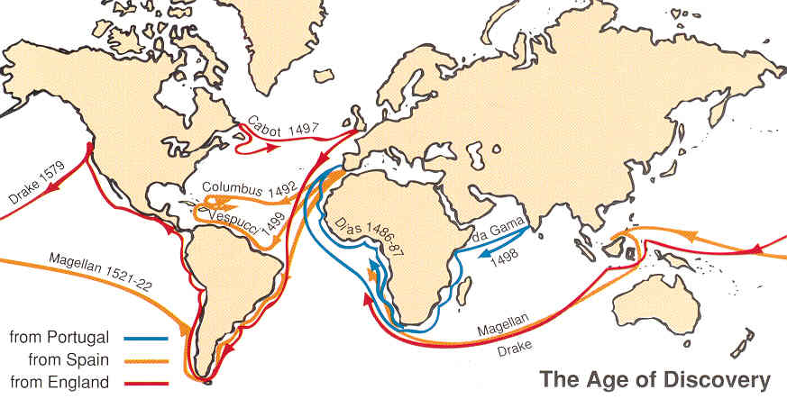
Learning by exploration

Slide 6


















Learning by exploration
Horror
Romance
Drama
Figure credit: Schnabel et al. 2016 ^{[SSSCJ16]}
Matthew effect: we still don’t know what we don’t know!

Slide 7


Learning by exploration is challenging
  Huge search space
    Exploration is costly

Slide 8

Learning by exploration is challenging
  One only gets answers to the questions she asked
  Bandit (implicit) feedback
Horror
Romance
Drama

Slide 9
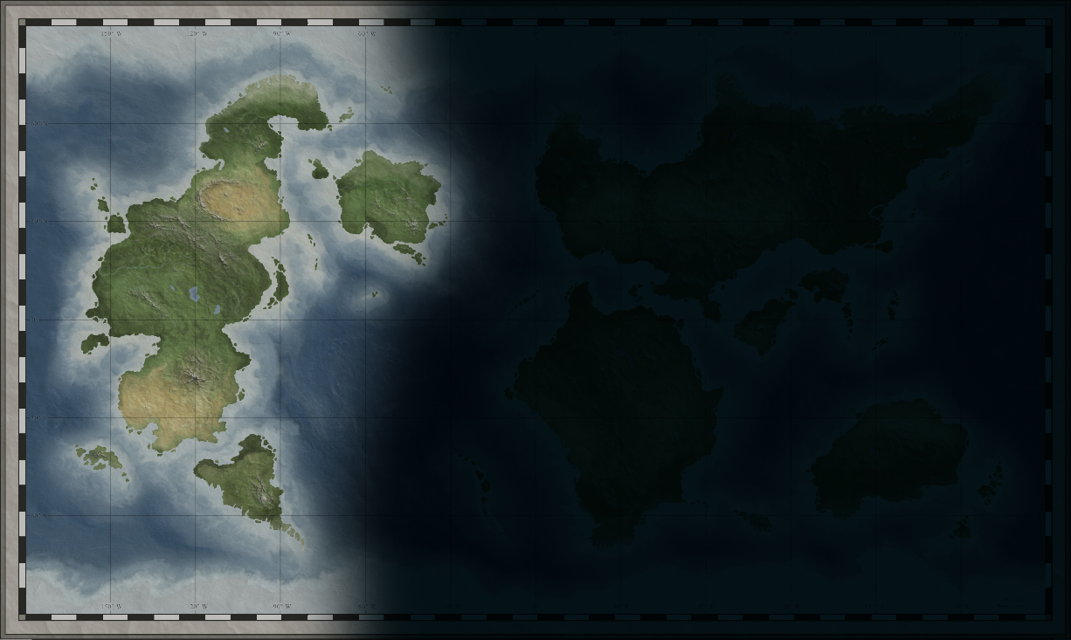
Learning by exploration is challenging
  One only gets answers to the questions she asked
  Bandit (implicit) feedback
  Efficient exploration is critical

Slide 10
Learning by exploration is challenging
  The problem space can be structured
    The observations might not be independent
Clustered, correlated responses?
Horror
Romance
Drama
Social influence?
Figure credit: Schnabel et al. 2016 ^{[SSSCJ16]}

Slide 11
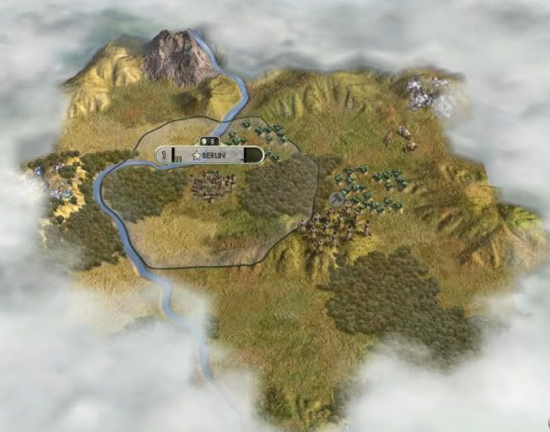
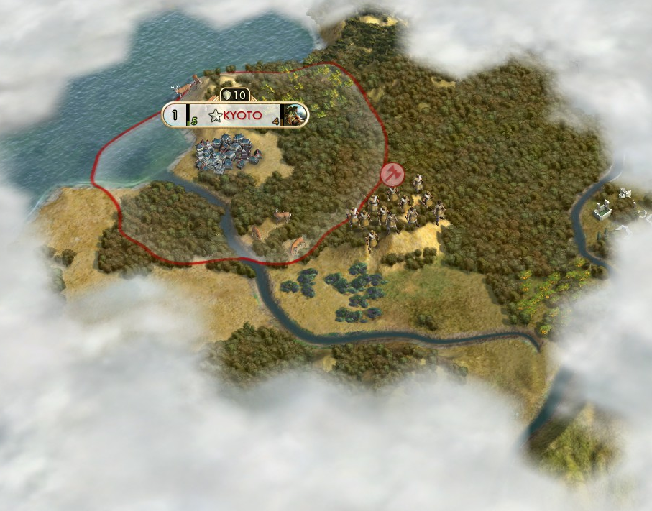
Learning by exploration is challenging
  The problem space is evolving over time
  A non-stationary learning environment
  Recognize outdated model is important

Slide 12
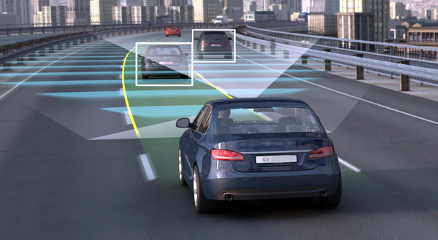

Learning by exploration is challenging
  There are also safety, privacy, and ethic concerns in exploration

Slide 13
Outline of this tutorial
Motivation
Classical exploration strategies
Efficient exploration in complicated real-world environments
Exploration in non-stationary environments
Ethical considerations of exploration
Conclusion & future directions

Slide 14

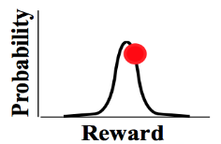
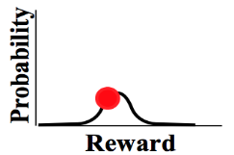
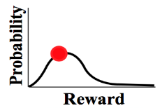


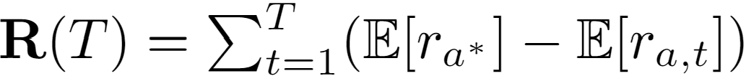





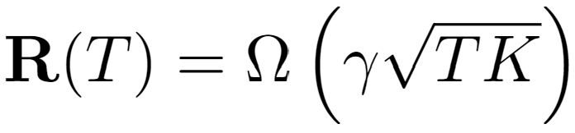

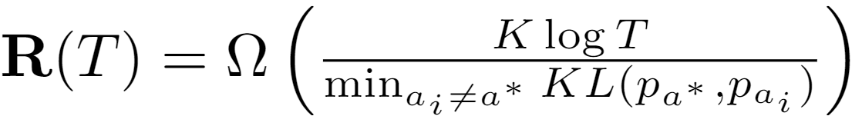
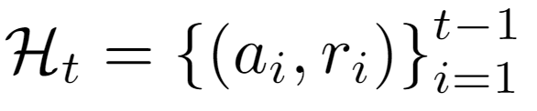
Problem formulation
Adversarial bandit is out of scope of this tutorial
(stochastic) Multi-arm bandit
…
Goal: maximize the accumulated reward over T rounds
Reward distribution
(Pseudo) Regret: expected loss due to not playing the best arm
…
Actions
Regret
Agent/learner/policy
Reward
Lower regret bound [LR85]:
Lower regret bound [Aue95]:
Time
History
Finite variance is required!
Sub-linear regret is preferred!
Difficulty of the problem

Slide 15











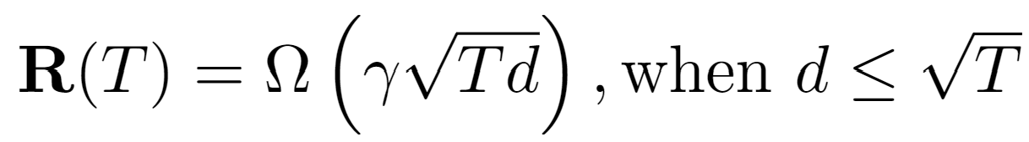
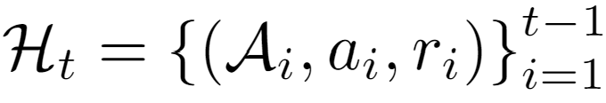
Problem formulation
In linear contextual bandit [LCLS10],
Contextual/structured bandit
…
Goal: maximize the accumulated reward over T rounds
Reward distribution
(Pseudo) Regret: expected loss due to not playing the best arm
…
Actions
Agent/learner/policy
Reward
Lower regret bound in linear contextual bandit [CLRS11]:
History

Slide 16





Problem formulation
Out of scope of this tutorial
Reinforcement learning [SB18]
State
Reward
Action

Slide 17
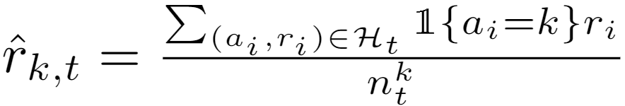
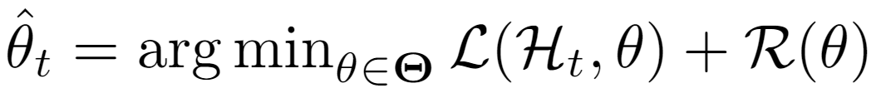
Problem formulation
In linear contextual bandit [LCLS10],
Ridge regression, closed form solution exists!
Key problems
  Reward estimation
  Arm selection
Reward
Action
Convergence matters!
Exploration matters!
Multi-arm bandit:
Contextual bandit:
Adaptive v.s., non-adaptive
Independent v.s., collaborative
Unconstrained v.s., constrained
Loss function Regularization

Slide 18
Classical exploration strategies
Random exploration
Optimism in the face of uncertainty
Posterior sampling
Perturbation-based

Slide 19

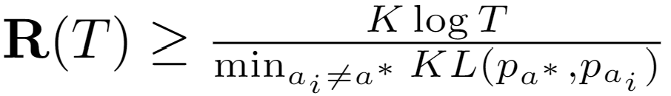

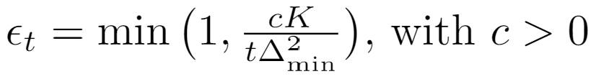






Random exploration
Lower regret bound of MAB:
Reward estimation in MAB:
Constant leads to linear regret!
$ε$-greedy [Aue02]
By setting , we have
Arm selection
Non-adaptive; often leads to sub-optimal performance in practice.

Slide 20

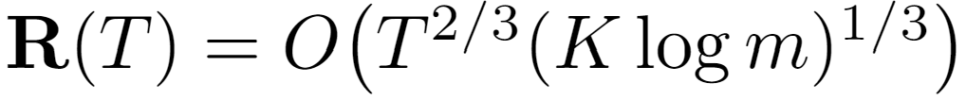


Random exploration
Epoch greedy [LZ08]
  Explore and then commit
Explore by one step
Size of hypothesis space, which makes the exploration adaptive
Length of epoch
Exploit by one epoch

Slide 21



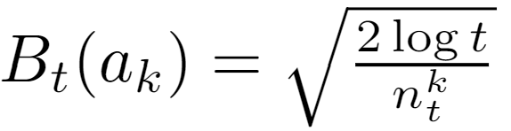



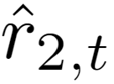
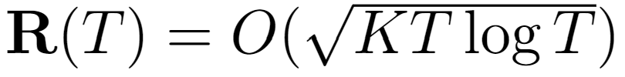
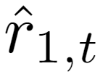
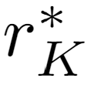


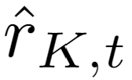
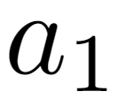



Optimism in the face of uncertainty
Chernoff-Hoeffding bound
Lower regret bound of MAB:
UCB1 [Aue02]
  Upper confidence bound based
Reward
Encourage underestimated arms
…

Slide 22
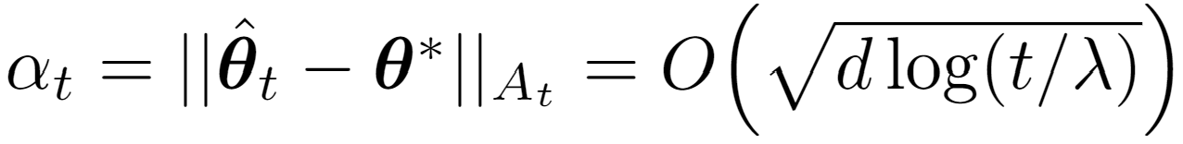
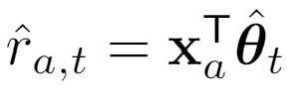
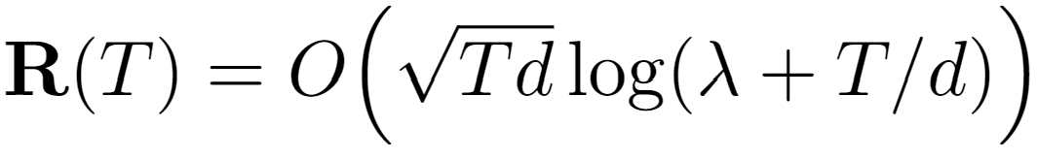
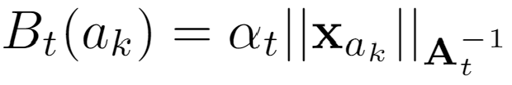
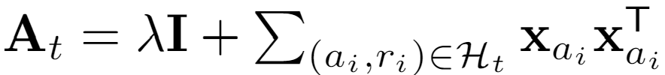


Optimism in the face of uncertainty
Lower regret bound in linear contextual bandit [CLRS11]:
In linear contextual bandit,
LinUCB [LCLS10]
  Upper confidence bound based
Confidence ellipsoid
Reward
Encourage underestimated arms
…
Closed form estimator

Slide 23



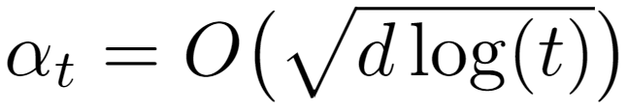
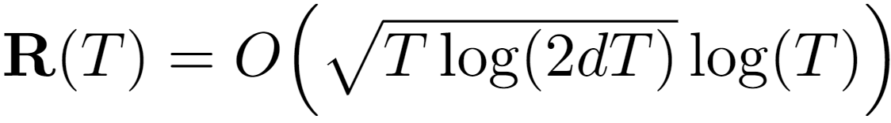

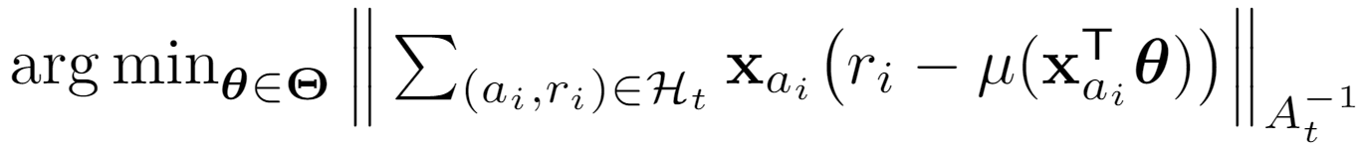
Optimism in the face of uncertainty
In generalized linear bandit,
In linear contextual bandit [LCLS10],
GLM-UCB [FCGS10]
  A generalized linear model
Link function, e.g.,
Confidence ellipsoid
Reward
Encourage underestimated arms
No closed form solution for
…
Using gradient descent to solve
where

Slide 24
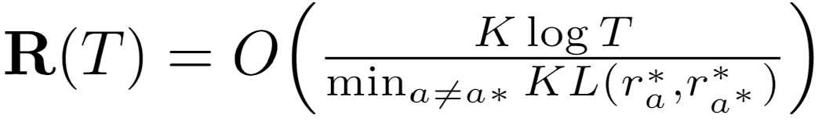
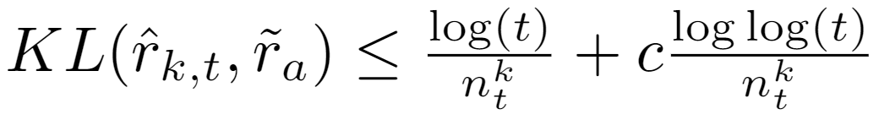
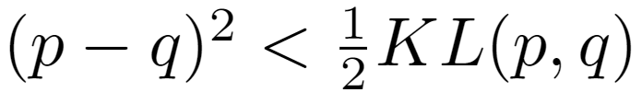

Optimism in the face of uncertainty
Lower regret bound of MAB:
KL-UCB [GC11]
  Compute upper confidence bound directly
Range of reward
A hyper-parameter
Reward
Encourage underestimated arms
Asymptotically optimal!
…
Intuition:
Pinsker's inequality

Slide 25
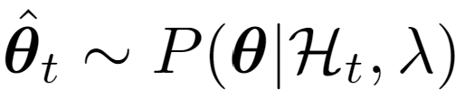
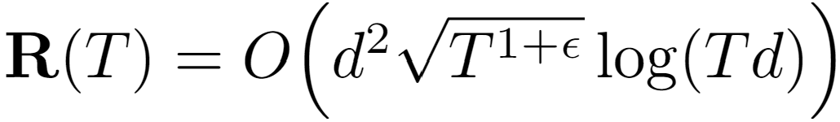

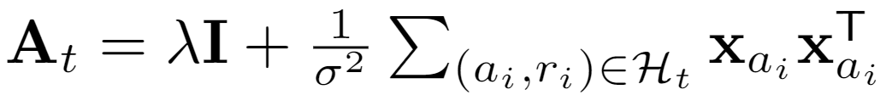

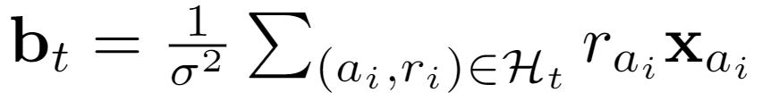
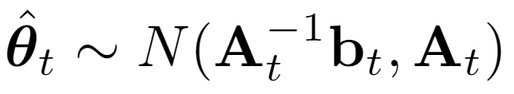
Posterior sampling
In linear contextual bandit [LCLS10],
Predictive distribution:
Thompson sampling [AG13]
Source of uncertainty
A Bayesian perspective of reward estimation:
prior
related to prior
Reward
…
Analytic form of posterior
Prior:

Slide 26
Posterior sampling
No formal regret known yet; and some analysis from Bayesian regret perspective
Thompson sampling [RVKOW18]
  No analytic posterior?
  Approximate posterior inference!
    Gibbs sampling
    Particle sampling
    Laplace approximation
    Bootstrapping

Slide 27
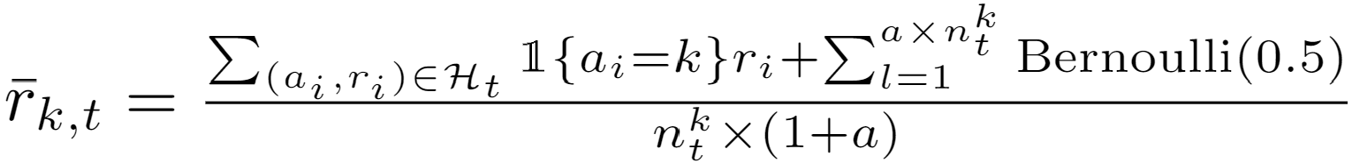
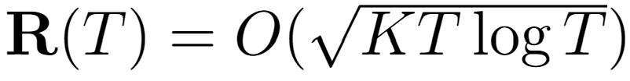

Perturbation-based
1) Concentrates at scaled and shifted mean reward;
2) It is an overestimation with a high probability.
Perturbed history exploration [KSGB19a]
Encourage underestimated arms
Reward
Encourage underestimated arms
…
…

Slide 28

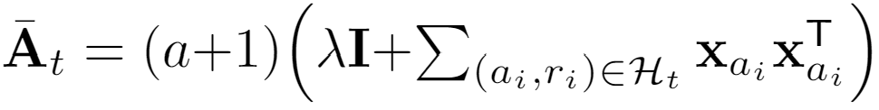


Perturbation-based
1) Concentrates at scaled and shifted mean reward;
2) It is an overestimation with a high probability.
Perturbed history exploration [KSGB19b]
    With a linear model?
Closed form estimator
00
Reward
…
…
Added reward variance

Slide 29






Perturbation-based
Adversary’s choice, could be adaptive
1) Perturbed adversary
Perturbed adversary [KMRWW18]
  How would a greedy solution perform?
2) Diversity
3) Conditional margin
Reward
Encourage underestimated arms
…
Closed form estimator

Slide 30
References I
[SSSCJ16] Schnabel, T., Swaminathan, A., Singh, A., Chandak, N., & Joachims, T. (2016, June). Recommendations as treatments: debiasing learning and evaluation. In Proceedings of the 33rd International Conference on International Conference on Machine Learning-Volume 48 (pp. 1670-1679).
[LR85] Lai, T. L., & Robbins, H. (1985). Asymptotically efficient adaptive allocation rules. Advances in applied mathematics, 6(1), 4-22.
[Aue95] Auer, P., Cesa-Bianchi, N., Freund, Y., & Schapire, R. E. (1995, October). Gambling in a rigged casino: The adversarial multi-armed bandit problem. In Proceedings of IEEE 36th Annual Foundations of Computer Science (pp. 322-331). IEEE.
[LCLS10] Li, L., Chu, W., Langford, J., & Schapire, R. E. (2010, April). A contextual-bandit approach to personalized news article recommendation. In Proceedings of the 19th international conference on World wide web (pp. 661-670).
[CLRS11] Chu, W., Li, L., Reyzin, L., & Schapire, R. (2011, June). Contextual bandits with linear payoff functions. In Proceedings of the Fourteenth International Conference on Artificial Intelligence and Statistics (pp. 208-214).
[SB18] Sutton, R. S., & Barto, A. G. (2018). Reinforcement learning: An introduction. MIT press.
[Aue02] Auer, P. (2002). Using confidence bounds for exploitation-exploration trade-offs. Journal of Machine Learning Research, 3(Nov), 397-422.
[LZ08] Langford, J., & Zhang, T. (2008). The epoch-greedy algorithm for multi-armed bandits with side information. In Advances in neural information processing systems (pp. 817-824).
[FCGS10] Filippi, S., Cappe, O., Garivier, A., & Szepesvári, C. (2010). Parametric bandits: The generalized linear case. In Advances in Neural Information Processing Systems (pp. 586-594).
[GC11] Garivier, A., & Cappé, O. (2011, December). The KL-UCB algorithm for bounded stochastic bandits and beyond. In Proceedings of the 24th annual conference on learning theory (pp. 359-376).

Slide 31
References II
[AG13] Agrawal, S., & Goyal, N. (2013, February). Thompson sampling for contextual bandits with linear payoffs. In International Conference on Machine Learning (pp. 127-135).
[RVKOW18] Russo, D. J., Van Roy, B., Kazerouni, A., Osband, I., & Wen, Z. (2018). A Tutorial on Thompson Sampling. Foundations and Trends® in Machine Learning, 11(1), 1-96.
[KSGB19a] Kveton, B., Szepesvári, C., Ghavamzadeh, M., & Boutilier, C. (2019, August). Perturbed-history exploration in stochastic multi-armed bandits. In Proceedings of the 28th International Joint Conference on Artificial Intelligence (pp. 2786-2793). AAAI Press.
[KSGB19b] Kveton, B., Szepesvari, C., Ghavamzadeh, M., & Boutilier, C. (2019). Perturbed-history exploration in stochastic linear bandits. arXiv preprint arXiv:1903.09132.
[KMRWW18] Kannan, S., Morgenstern, J. H., Roth, A., Waggoner, B., & Wu, Z. S. (2018). A smoothed analysis of the greedy algorithm for the linear contextual bandit problem. In Advances in Neural Information Processing Systems (pp. 2227-2236).

Slide 32
Outline of this tutorial
Motivation
Classical exploration strategies
Efficient exploration in complicated real-world environments
Exploration in non-stationary environments
Ethical considerations of exploration
Conclusion & future directions

Slide 33
Efficient exploration in complicated real-world environments
Collaborative bandit learning
Low rank structures
Warm-start exploration

Slide 34




Collaborative bandit learning
$N$ users, each user has his/her own $θ$
  Build independent LinUCB for each user?
  Cold start challenge in personalized systems
  Users are not independent
Leverage user dependency for efficient exploration
  Use existing user dependency information
  Discover dependency online (via clustering)

Slide 35

Collaborative bandit learning
GOBLin [CGZ13]
  Graph Laplacian based regularization upon ridge regression to model dependency
  Connected users are assumed to share similar model parameters
Graph $E$ is input. Regularization term:

Slide 36




Collaborative bandit learning
GOBLin [CGZ13]
  Graph Laplacian based regularization upon ridge regression to model dependency
  Encode graph Laplacian in context, formulate as a dN-dimensional LinUCB
Closed form estimator
Graph Laplacian

Slide 37












Collaborative bandit learning
CoLin [WWGW16]
  Social influence among users: content and opinion sharing in social network $W$
  Reward: weighted average of expected reward among friends
  A dN-dimensional LinUCB
in which
Closed form estimator
When $W$ is uniform, i.e, all users are uniformly connected to share:
Regret:
0.6 | 0.1 | 0.2 | 0.0
0.0 | 0.7 | 0.0 | 0.0
0.0 | 0.1 | 0.8 | 0.5
0.4 | 0.1 | 0.0 | 0.5

Slide 38



Online Clustering
Remove edge if
CLUB[GLZ14]
  Adaptively cluster users into groups by keep removing edges
  Threshold to remove edges is based on closeness of the users’ models
  Build LinUCB on each cluster
Regret: . Reduce regret from n (users) to m (clusters)
Closed form estimator

Slide 39







Low rank structures
Particle Thompson Sampling (PTS) [KBKTC15]
  Probabilistic Matrix Factorization framework
  Particle filtering for online Bayesian parameter estimation
  Thompson Sampling for exploration
Regret for discretized parameter space is $O(\frac{\log{T}}{d^{4}})$
  Elements in $u$ and $v$ belongs to
  $$\{d,2d,…,1\}$$
  Where $1/d$ is a integer
  n*m rank-1 problem
0.6 | ? | 0.2 | ?
0.5 | 0.7 | ? | 0.1
? | 0.1 | ? | ?
? | 0.1 | ? | 0.5
Generative Model

Slide 40

Low rank structures
Hidden LinUCB [WWW16]
  Matrix Factorization framework: user & item factors
  Alternating Least Squares for optimization
  Exploration considers uncertainty from two factors
Source of uncertainty in confidence bound estimation
Hidden feature (of an item): known to the environment, but unknown to the learner
Uncertainty of user preference $θ_{u}$ estimation
Uncertainty of hidden feature $v_{a}$ estimation

Slide 41

Warm-start exploration
Have some data $\{(x, r)\}$ at $t=0$ before the bandits start.
  E.g., from human annotations
Leverage historical data to warm start model, reduce the need of exploration
Key challenge: historical data could come from different distribution
  Historical data generated by $θ^{′}$ while environment is $θ^{∗}$

Slide 42
Warm-start exploration
Leverage historical data to warm start model, reduce the need of exploration
Adaptive Reweighting (ARROW-CB) [ZADLN19]
  Reweight historical data based on bandits’ observation
  Online model selection to pick the weight
Regret reduction when historical data and environment have similar distribution

Slide 43
Open questions
What is the problem-related (structure-related) regret lower bound
  Did current algorithms fully utilize the information in problem structure?
Efficient exploration for other structures in real-world problem
  E.g., sparse structure, ranking structure, etc.

Slide 44
References III
[CGZ13] Cesa-Bianchi, N., Gentile, C., & Zappella, G. (2013). A gang of bandits. In Advances in Neural Information Processing Systems (pp. 737-745).
[WWGW16] Wu, Q., Wang, H., Gu, Q., & Wang, H. (2016, July). Contextual bandits in a collaborative environment. In Proceedings of the 39th International ACM SIGIR conference on Research and Development in Information Retrieval (pp. 529-538).
[GLZ14] Gentile, C., Li, S., & Zappella, G. (2014, January). Online clustering of bandits. In International Conference on Machine Learning (pp. 757-765).
[GLKKZE17] Gentile, C., Li, S., Kar, P., Karatzoglou, A., Zappella, G., & Etrue, E. (2017, July). On context-dependent clustering of bandits. In International Conference on Machine Learning (pp. 1253-1262).
[LKG16] Li, S., Karatzoglou, A., & Gentile, C. (2016, July). Collaborative filtering bandits. In Proceedings of the 39th International ACM SIGIR conference on Research and Development in Information Retrieval (pp. 539-548).
[KBKTC15] Kawale, J., Bui, H. H., Kveton, B., Tran-Thanh, L., & Chawla, S. (2015). Efficient Thompson Sampling for Online￼ Matrix-Factorization Recommendation. In Advances in neural information processing systems (pp. 1297-1305).
[WWW16] Wang, H., Wu, Q., & Wang, H. (2016, October). Learning hidden features for contextual bandits. In Proceedings of the 25th ACM International on Conference on Information and Knowledge Management (pp. 1633-1642).
[ZADLN19] Zhang, C., Agarwal, A., Daumé III, H., Langford, J., & Negahban, S. N. (2019). Warm-starting contextual bandits: Robustly combining supervised and bandit feedback. arXiv preprint arXiv:1901.00301.

Slide 45
Outline of this tutorial
Motivation
Classical exploration strategies
Efficient exploration in complicated real-world environments
Exploration in non-stationary environments
Ethical considerations of exploration
Conclusion & future directions

Slide 46
Efficient exploration in complicated real-world environments
Collaborative bandit learning
Low rank structures
Warm-start exploration

Slide 47


Collaborative bandit learning
Multi-agent linear bandits: $N$ users, each user has his/her own $θ$
Build independent LinUCB for each user?
  Cold start challenge
  Users are not independent
Leverage user dependency for efficient exploration
  Use existing user dependency information
  Discover dependency online (via clustering)

Slide 48
Collaborative bandit learning
GOBLin [CGZ13]
  Connected users are assumed to share similar model parameters
  Graph Laplacian based regularization upon ridge regression to model dependency
Graph $E$ is input. Regularization term:

Slide 49



Collaborative bandit learning
GOBLin [CGZ13]
  Graph Laplacian based regularization upon ridge regression to model dependency
  Encode graph Laplacian in context, formulate as a dN-dimensional LinUCB
Graph Laplacian
Closed form estimator
Regret for empty graph:
Regret for complete graph:

Slide 50



Collaborative bandit learning
CoLin [WWGW16]
  Social influence among users: content and opinion sharing in social network $W$
  Reward: weighted average of expected reward among friends
  A dN-dimensional LinUCB
in which
Closed form estimator
Regret for empty graph ($W=I$):
Regret for $W=U$:
0.6 | 0.1 | 0.2 | 0.0
0.0 | 0.7 | 0.0 | 0.0
0.0 | 0.1 | 0.8 | 0.5
0.4 | 0.1 | 0.0 | 0.5
When $W$ is uniform, i.e, all users are uniformly connected to share:

Slide 51
Online Clustering
Remove edge if
Discover user dependency structure on the fly
CLUB[GLZ14]
  Adaptively cluster users into groups by keep removing edges
  Threshold to remove edges is based on closeness of the users’ models
  Build LinUCB on each cluster
Regret: . Reduce regret from n (users) to m (clusters)
Closed form estimator

Slide 52








Online Clustering
COFIBA [LKG16]:
  Collaborative filtering via user clustering & item clustering
  Each item cluster is associated with its own user clustering
  To remove an edge in user cluster: same as CLUB
  To remove an edge in item cluster: for the two items, user $i$ forms different neighboring user set $\{j\}$ based on

Slide 53

Online Clustering
CAB [GLKKZE17]:
  Context-dependent clustering
  For current user $i$ , find neighboring user set $\{j\}$ for every candidate item $x_{a}$
  Then aggregate the history rewards / predictions within the user cluster.

Slide 54

Low rank structures
Particle Thompson Sampling (PTS) [KBKTC15]
  Probabilistic Matrix Factorization framework
  Particle filtering for online Bayesian parameter estimation
  Thompson Sampling for exploration
Regret for discretized parameter space is $O(\frac{\log{T}}{Δ^{2}})$
  Elements in $U$ and $V$ belongs to
  $$\{d,2d,…,1\}$$
  where $1/d$ is a integer
  $Δ=d^{2}$ :gap between best/2nd best rewards
  n*m rank-1 problem
0.6 | ? | 0.2 | ?
0.5 | 0.7 | ? | 0.1
? | 0.1 | ? | ?
? | 0.1 | ? | 0.5
Generative Model

Slide 55

Low rank structures
Rank-1 bandits[KKSVW17]:
  $r_{ij}=U_{i,t}V_{j,t}$ | $U_{i,t},V_{j,t}∈[0, 1]$, $U_{t}, V_{t}$ are sampled from unknown distribution
In each stage, explore then eliminate
  Maintain (upper and lower) CBs of reward for each row and column
  Explore: randomly explore a (not bad) row and column
  Eliminate row / column if its UCB is worse than others’ LCB
Regret: $O(\frac{\log{T}}{Δ})$
0.6 | ? | 0.2 | ?
0.5 | 0.7 | ? | 0.1
? | 0.1 | ? | ?
? | 0.1 | ? | 0.5

Slide 56
Low rank structures
Hidden LinUCB [WWW16]
  Matrix Factorization framework: user & item factors
  Alternating Least Squares for optimization
  Exploration considers uncertainty from two factors
Source of uncertainty in confidence bound estimation
Hidden feature (of an item): known to the environment, but unknown to the learner
Uncertainty of user preference $θ_{u}$ estimation
Uncertainty of hidden feature $v_{a}$ estimation

Slide 57

Warm-start exploration
Have some offline data $\{(x, r)\}$ before the bandits start.
  E.g., from human annotations
Leverage historical data to warm start model, reduce the need of exploration
Key challenge: historical data could come from different distribution
  Historical data generated by $θ^{′}$ while environment follows $θ^{∗}$

Slide 58

Warm-start exploration
Leverage historical data to warm start model, reduce the need of exploration
Adaptive Reweighting (ARROW-CB) [ZADLN19]
  Based on $ε$-greedy algorithm
  Reweight historical data based on bandits’ observation
    $λ$ on historical data, $1−λ$ on bandits’ observation
  Online model selection to pick the weight $λ$
    Pre-defined $\left|Λ\right|$ (hyperparameter, set to 8 in the paper) candidates
Regret reduction when historical data and environment have similar distribution

Slide 59
Open questions
What is the problem-related (structure-related) regret lower bound
  E.g., user dependency structure, low rank, offline data
  Did current algorithms fully utilize the information in problem structure?
Efficient exploration for other structures in real-world problem
  E.g., sparse structure, ranking structure, etc.

Slide 60
References III
[CGZ13] Cesa-Bianchi, N., Gentile, C., & Zappella, G. (2013). A gang of bandits. In Advances in Neural Information Processing Systems (pp. 737-745).
[WWGW16] Wu, Q., Wang, H., Gu, Q., & Wang, H. (2016, July). Contextual bandits in a collaborative environment. In Proceedings of the 39th International ACM SIGIR conference on Research and Development in Information Retrieval (pp. 529-538).
[GLZ14] Gentile, C., Li, S., & Zappella, G. (2014, January). Online clustering of bandits. In International Conference on Machine Learning (pp. 757-765).
[GLKKZE17] Gentile, C., Li, S., Kar, P., Karatzoglou, A., Zappella, G., & Etrue, E. (2017, July). On context-dependent clustering of bandits. In International Conference on Machine Learning (pp. 1253-1262).
[LKG16] Li, S., Karatzoglou, A., & Gentile, C. (2016, July). Collaborative filtering bandits. In Proceedings of the 39th International ACM SIGIR conference on Research and Development in Information Retrieval (pp. 539-548).
[KBKTC15] Kawale, J., Bui, H. H., Kveton, B., Tran-Thanh, L., & Chawla, S. (2015). Efficient Thompson Sampling for Online￼ Matrix-Factorization Recommendation. In Advances in neural information processing systems (pp. 1297-1305).
[KKSVW17] Katariya, S., Kveton, B., Szepesvari, C., Vernade, C., & Wen, Z. (2017, April). Stochastic rank-1 bandits. In Artificial Intelligence and Statistics (pp. 392-401).
[WWW16] Wang, H., Wu, Q., & Wang, H. (2016, October). Learning hidden features for contextual bandits. In Proceedings of the 25th ACM International on Conference on Information and Knowledge Management (pp. 1633-1642).
[ZADLN19] Zhang, C., Agarwal, A., Daumé III, H., Langford, J., & Negahban, S. N. (2019). Warm-starting contextual bandits: Robustly combining supervised and bandit feedback. arXiv preprint arXiv:1901.00301.

Slide 61
Outline of this tutorial
Motivation
Classical exploration strategies
Efficient exploration in complicated real-world environments
Exploration in non-stationary environments
Ethical considerations of exploration
Conclusion & future directions

Slide 62












Exploration in non-stationary environments
Action
Exploitation + Exploration
Stationary assumption is commonly used
The learner is usually facing a non-stationary environment ☹
Reward
Expected Reward
Time
Non-stationary environments

Slide 63



Problem formulation
(stochastic) Multi-arm bandit
Non-stationary
…
…
Reward distribution
…
Real-time click-through-rate of 4 news articles collected from Yahoo user click log dataset
Actions
I need to be adaptive about potential changes in the environment
☹
Agent/learner/policy
Reward
☺
Regret
History is no longer helpful and may even be misleading in the player’s decision-making
Non-stationary environments
Time

Slide 64


Problem formulation
  Different types of non-stationary environments
    Piecewise stationary environments
    Gradually changing environments
Main focus of this tutorial
More difficult and less studied.
Expected Reward
Expected Reward
Time
Time
Non-stationary environments

Slide 65
Challenges
  Changes (when and how) are unknown to the learner
  (otherwise we can just restart the learner)
  Online learning setting and bandit feedback: incomplete knowledge
  (change detection in the offline batch setting has been extensively studied in statistics and control theory ^{[BN93]} )
Non-stationary environments

Slide 66
Approaches
  Passively adaptive approaches
Key idea: design a proper mechanism to forget old observations
Assumption: old observations are less relevant
  Actively adaptive approaches
Key idea: actively detect potential changes in the environment during online decision making
Assumption: abrupt changes, i.e., piece-wise stationary environment
Non-stationary environments
Notes:
Actively adaptive: Instead of blindly discount or forget past observations, the bandit learning algorithm should actively detect the change points (assuming abrupt change points)

Slide 67









Passively adaptive approaches
Discounted UCB and Sliding window UCB [GM08]
Discount the old observations
Only utilize the most recent $τ$ observations
Weighted linear bandit [RVC19]
  Discounted-UCB in the linear contextual bandit setting
Non-stationary environments

Slide 68
Passively adaptive approaches
Pros
  Simple: easy to implement and have almost no computation overhead
  Have provable theoretical guarantee in piece-wise non-stationary environment and environments with slow changes
Cons
  Passive: always assuming old observations are less relevant
  Not practical: very sensitive to hyper-parameters discount factor, sliding-window size
Non-stationary environments

Slide 69

Actively adaptive approaches
General framework
Statistics about the stationarity of the environment
Non-stationary environments

Slide 70
Non-stationarity detection with bandit feedback
Cumulative sum control chart (CUSUM) based detection
  AdTS [HMB15], CD-UCB [LLS18]
Generalized likelihood ratio test
  GLR-kl-UCB [BK19]
Online reward mean-shift detection
  WMD-UCB1 [YM09], M-UCB [CWKX19]
Confidence bound based detection
  dLinUCB [WIW18], DenBand [WWLW19]
Other
  Ada-ILTCB, Ada-greedy [LWAL18], Ada-ILTCB^{[+]} [CLLW19]
…
Non-stationary environments

Slide 71











CUSUM-based online change detection
CUSUM in the offline setting
Cumulative sum of log-likelihood ratio before and after change points:
Observed reward
0
Non-stationary environments

Slide 72



CUSUM-based online change detection
Tailored CUSUM in the Bernoulli bandit setting
CUSUM in CD-UCB [LLS18]
  Intuition:
Each arm needs to have at least M observations
Requirement on the minimum magnitude of changes on the reward
  has negative mean drift before the change point and positive after the change point
  Assumptions:
    Piecewise stationary with detectability assumption
    Bernoulli bandit
Detection threshold
Local restart: restart the related statistics for the changed arms
Non-stationary environments

Slide 73
Generalized likelihood ratio test based online change detection
CUSUM requires the pre-change and post-change environment parameters to be known to get the log-likelihood.
Unknown pre-change and/or post-change parameters -> Generalized Likelihood Ratio Test (GLRT)
  GLRT with Bernoulli reward -> GLR-klUCB [BK19]
  GLRT can achieve asymptotically optimal detection delay with sub-Gaussian reward assumption [Mai19]
Non-stationary environments

Slide 74


Online mean-shift detection
Monitored-UCB [CWKX19]
Compare running sample means over a sliding window
>b
Global restart: once a change is detected, restart the related statistics for all the arms
Need to periodically perform uniform arm selection (uniform exploration)
to ensure sufficient data can be gathered for all arms to perform CD
Arm selection between detected change points (except for the uniform exploration iterations): UCB1
Non-stationary environments

Slide 75


CB based online change detection
Utilizing the reward estimation confidence bound [WIW18, WWLW19]
    If the environment is stationary, the reward prediction residual should be within a confidence bound with high probability,
Predicted reward of bandit model m
Observed reward
Confidence bound of reward estimation
We can bound this to further exclude this possibility!
Unexpected outcome is caused by,
Something wrong in the observed reward: large noise
Something wrong in the predicted reward: the model is incorrect
Non-stationary environments

Slide 76








CB based online change detection
Prediction badness at interaction $i$:
Similar to the goodness of fit concept in chi-squared test
Badness of model m over a sliding time window:
a sliding time window to collect badness observations
Detection threshold:
Bad enough:
Good enough:
Change detected.
(abandon learner m)
When no learner is good enough, will also report a change.
(but do not abandon learner m)
Non-stationary environments

Slide 77










CB based online change detection
dLinUCB [WNW18]
Adaptively creates new learners
Monitors the prediction quality of each learner
Selects a learner according to each learner’s ‘badness’
.
.
…
badness
badness
Badness estimation update
Reward estimation update
…
…
Non-stationary environments

Slide 78











Detection of context-dependent changes
Change-sensitive arms
Expected Reward
Change-invariant arms
Time
Learner 1
Learner 2
DenBand [WWLW19]
Reuse the experiences learnt in old models for change-invariant arms
Reward estimation on change-invariant arms
Save unnecessarily exploration
…
…
Non-stationary environments

Slide 79
Empirical evaluations
Simulation-based evaluation
  Simulate the non-stationary environment
Evaluation on real-world datasets
  On real-world datasets that have non-stationarity
  (e.g. Yahoo! Front Page Today Module User Click Log Dataset)
Semi-simulation-based evaluation
  Real-world datasets (that do not have non-stationarity) + simulated changes
Non-stationary environments

Slide 80

Theoretical guarantee
Total number of changes up to time T in a
piecewise stationary environment
Total variation of reward distributions up to time T
Analyzed their solutions with different notations of regret in different non-stationary environments: interval regret, switching regret, dynamic regret
Non-stationary environments

Slide 81
Open questions
    Can we re-use related historical observations (e.g., recurring environment, or context-dependent changes) and what’s the benefit of it ?
How to handle gradually changing environment
Reinforcement learning in non-stationary environments
Non-stationary environments

Slide 82
References IV
[BN93] Basseville, M., & Nikiforov, I. V. (1993). Detection of abrupt changes: theory and application (Vol. 104). Englewood Cliffs: prentice Hall.
[GM08] Garivier, A., & Moulines, E. (2008). On upper-confidence bound policies for non-stationary bandit problems. arXiv preprint arXiv:0805.3415.
[RVC19] Russac, Y., Vernade, C., & Cappé, O. (2019). Weighted linear bandits for non-stationary environments. In Advances in Neural Information Processing Systems (pp. 12040-12049).
[YM09] Yu, J. Y., & Mannor, S. (2009, June). Piecewise-stationary bandit problems with side observations. In Proceedings of the 26th annual international conference on machine learning (pp. 1177-1184).
[HMB15] Hariri, N., Mobasher, B., & Burke, R. (2015, June). Adapting to user preference changes in interactive recommendation. In Twenty-Fourth International Joint Conference on Artificial Intelligence.
[WNW18] Wu, Q., Iyer, N., & Wang, H. (2018, June). Learning contextual bandits in a non-stationary environment. In The 41st International ACM SIGIR Conference on Research & Development in Information Retrieval (pp. 495-504).
[LWAL18] Luo, H., Wei, C. Y., Agarwal, A., & Langford, J. (2018, July). Efficient contextual bandits in non-stationary worlds. In Conference On Learning Theory (pp. 1739-1776).
[CWKX19] Cao, Y., Wen, Z., Kveton, B., & Xie, Y. (2019, April). Nearly optimal adaptive procedure with change detection for piecewise-stationary bandit. In The 22nd International Conference on Artificial Intelligence and Statistics (pp. 418-427).
[LLS18] Liu, Fang, Joohyun Lee, and Ness Shroff. “A change-detection based framework for piecewise-stationary multi-armed bandit problem.” Thirty-Second AAAI Conference on Artificial Intelligence. 2018.
[WWLW19] Wu, Q., Wang, H., Li, Y., & Wang, H. (2019, May). Dynamic Ensemble of Contextual Bandits to Satisfy Users' Changing Interests. In The World Wide Web Conference (pp. 2080-2090).
[CLLW19] Chen, Y., Lee, C. W., Luo, H., & Wei, C. Y. (2019). A new algorithm for non-stationary contextual bandits: Efficient, optimal, and parameter-free. arXiv preprint arXiv:1902.00980.
[BK19] Besson, L., & Kaufmann, E. (2019). The generalized likelihood ratio test meets klucb: an improved algorithm for piece-wise non-stationary bandits. arXiv preprint arXiv:1902.01575.
[Mai19] Maillard, O. A. (2019). Sequential change-point detection: Laplace concentration of scan statistics and non-asymptotic delay bounds.

Slide 83
Outline of this tutorial
Motivation
Classical exploration strategies
Efficient exploration in complicated real-world environments
Exploration in non-stationary environments
Ethical considerations of exploration
Conclusion & future directions

Slide 84
Ethical considerations of exploration
Privacy concerns in bandits
  Background: differential privacy (for continual release)
  Differential private stochastic and linear bandits
  Locally differential private bandits
Fairness concerns in bandits
  Weakly meritocratic fairness
  FairUCB

Slide 85
Ethical considerations of exploration
Privacy concerns in bandits
  Background: differential privacy (for continual release)
  Differential private stochastic and linear bandits
  Locally differential private bandits
Fairness concerns in bandits
  Weakly meritocratic fairness
  FairUCB
Safety concerns in bandits: exploration with constraints
  Regret constraint: conservative exploration [WSLS16, KGYR17]
  Side constraint: [AAT19, KB20]
  Will not cover the details due to time limit

Slide 86
Privacy concerns
“A Face Is Exposed for AOL Searcher No. 4417749” [BZH06]
“Robust De-anonymization of Large Datasets (How to Break Anonymity of the Netflix Prize Dataset)” [NS08]
In bandit setting: privacy for reward (and context) under extraction attacks
Philosophy: exploration reconciles the need for learning and the need for privacy protection

Slide 87


Differential privacy [Dwo06]
A randomized mechanism $A:X→Y$ is $(ε,δ)$-differentially private if for all neighboring inputs $X′$ and for all sets of outputs $O⊆Y$,
$$P\left(A\left(X\right)∈O\right)≤e^{ε}P\left(A\left(X^{′}\right)∈O\right)+δ$$
  $δ=0$: $ε$-DP
Intuition: cannot differentiate whether a data point is presented
Figure from [Ngu19]

Slide 88

Differential privacy for continual observation
Data stream has T examples, $r_{i}∈[0, 1]$
Goal: Privately output the sum of first k data $α_{k}$, $k∈[1.. T]$
Aggregate k data by tree representation $a_{i}..b_{i}$
Output private statistics of $\sum{α_{a_{i}..b_{i}}}$
Reward $r_{i}$
Private output

Slide 89




Tree-based aggregation [CSS10, DNPR10]
Represent sum of $r_{1}$to $r_{7}$ as $α_{1..4}+α_{5..6}+α_{7}$
  Separate into $logT$ partial sums
Every node is a private partial sum with noise $Lap\left(\frac{logT}{ε}\right)$: $\frac{ε}{logT}$-DP
  By composition theorem the total sum is $ε$-DP
Noise (error) in private sum is bounded by $O(\log^{1.5}T /ε)$
Sum of $r_{1}$ to $r_{4}$ with $Lap\left(\frac{logT}{ε}\right)$

Slide 90




Differentially private UCB1 [MT15]
Idea: keep the averaged reward ${\hat{r}}_{a_{t}}=\frac{1}{N_{a_{t}}}∑r_{N_{a_{t}}}^{a_{t}}$ private
  Post-processing invariant
Use tree based aggregation, add noise to $∑r_{N_{a_{t}}}^{a_{t}}$
  Arm selection strategy: $argmax{ \hat{r}}_{a_{t}}^{private}+CB\left(a_{t}\right)+O(\frac{\log^{1.5}N_{a_{t}}}{ε})$
    Additional confidence term for exploration in private setting
  Regret: $O(\frac{k\log^{2}T}{εΔ})$.
Reward $r_{i}$
Private recommendation

Slide 91

Differentially private LinUCB
Privacy for reward [NR18]
Use tree based aggregation, add noise to $b_{t}$
Arm selection strategy: $argmax {\hat{r}}_{a_{t}}^{private}+CB\left(a_{t}\right)+O(\frac{\log^{1.5}N_{a_{t}}log\frac{K}{δ} }{ε})$
Regret: $O(K\sqrt{T}\log{T}+\frac{\log^{2.5}T\sqrt{T} }{ε})$
Closed form estimator of LinUCB

Slide 92

Differentially private LinUCB
Privacy for both context and reward [SS18]
Use tree based aggregation, add noise to $A_{t}^{}$ and $b_{t}$
Arm selection strategy: $argmax {\hat{r}}_{a_{t}}^{private}+CB_{private}\left(a_{t}\right)$
Regret: $O(\frac{\log{T} }{Δ}+\frac{\log{T}\sqrt{(d\log{\frac{1}{δ})/ε}} }{Δ})$
Also showed a matched gap-dependent lower bound
  Constructing the lower bound based on definition of privacy for context
Closed form estimator of LinUCB

Slide 93


Local differential privacy
DP: user sent data to center, center add noise to the aggregated result
  Concerns: Data communication or even the center can be compromised
LDP: Data is randomized on the user side before sent to aggregator
LDP is a stronger privacy definition
  Larger cost / regret is expected
Private reward $r_{i}$
Private recommendation
Reward $r_{i}$

Slide 94

UCB with local differential privacy
LDP-UCB-Laplace [RZLS20]
  User sends noisy feedback $r_{t}+Lap(\frac{1}{ε})$ to the server
  Arm selection strategy: $argmax {{\hat{r}}_{a}}_{t}+CB\left(a_{t}\right)+\sqrt{\frac{32\log{t}}{ε^{2}N_{a_{t}}}}$
    Additional confidence term for exploration in private setting
  Regret: $O(\frac{k\log{T}}{ε^{2}Δ})$.

Slide 95


Fairness concerns
Machine Bias – an important topic
  Research of bias in data , model, algorithm etc.
    E.g., discriminatory treatment of subpopulations
  The need to explore
Fairness guarantee during online decision making (bandits)

Slide 96

Weakly meritocratic fairness [JKMNR16]
Fairness definition: if reward $r_{a}^{∗}≥r_{b}^{∗}$ then $\operatorname{Pr}\left(pull a\right)≥Pr⁡(pull b)$
A fair bandits should never favor a worse arm at any round
  Prefect strategy is fair: $\operatorname{Pr}\left(pull a^{∗}\right)=1$ -- but we don’t which arm is perfect at the beginning
  Uniformly random is fair: $\operatorname{Pr}\left(pull a\right)=\frac{1}{K} ∀a$ -- Linear regret
  Somewhere in between?
Reward
…

Slide 97

FairUCB [JKMR16]
Idea: uniformly pull arm within the first confidence interval chain
  Start from the largest UCB, find overlapped confidence intervals
Guaranteed fairness at every step with high probability
Regret:
Reward
…

Slide 98

Open questions
Regret Lower Bound for bandits with privacy guarantee
  What is the minimum noise and regret to achieve $ε$-DP/LDP?
Calibrate privacy and fairness with problem-dependent structure
  Collaborative Bandits
  Low-rank structure
Other fairness definition for exploration

Slide 99
References V
[BZH06] Barbaro, M., Zeller, T., & Hansell, S. (2006). A face is exposed for AOL searcher no. 4417749. New York Times, 9(2008), 8.
[NS08] Narayanan, A., & Shmatikov, V. (2008, May). Robust de-anonymization of large sparse datasets. In 2008 IEEE Symposium on Security and Privacy (sp 2008) (pp. 111-125). IEEE.
[Dwo06] Dwork, C. (2006, July). Differential privacy. In Proceedings of the 33rd international conference on Automata, Languages and Programming-Volume Part II (pp. 1-12). Springer-Verlag.
[Ngu19] Nguyen, A (2019). Understanding Differential Privacy.Towards Data Science. towardsdatascience.com/understanding-differential-privacy-85ce191e198a.
[CSS10] Chan, T. H., Shi, E., & Song, D. (2010, July). Private and continual release of statistics. In International Colloquium on Automata, Languages, and Programming (pp. 405-417). Springer, Berlin, Heidelberg.
[DNPR10] Dwork, C., Naor, M., Pitassi, T., & Rothblum, G. N. (2010, June). Differential privacy under continual observation. In Proceedings of the forty-second ACM symposium on Theory of computing (pp. 715-724).
[MT15] Mishra, N., & Thakurta, A. (2015, July). (Nearly) optimal differentially private stochastic multi-arm bandits. In Proceedings of the Thirty-First Conference on Uncertainty in Artificial Intelligence (pp. 592-601).
[TD16] Tossou, A. C., & Dimitrakakis, C. (2016, March). Algorithms for differentially private multi-armed bandits. In Thirtieth AAAI Conference on Artificial Intelligence.
[SS18] Shariff, R., & Sheffet, O. (2018). Differentially private contextual linear bandits. In Advances in Neural Information Processing Systems (pp. 4296-4306).

Slide 100
References VI
[NR18] Neel, S., & Roth, A. (2018, July). Mitigating Bias in Adaptive Data Gathering via Differential Privacy. In International Conference on Machine Learning (pp. 3720-3729).
[RZLS20] Ren, W., Zhou, X., Liu, J., & Shroff, N. B. (2020). Multi-Armed Bandits with Local Differential Privacy. arXiv preprint arXiv:2007.03121.
[JKMR16] Joseph, M., Kearns, M., Morgenstern, J. H., & Roth, A. (2016). Fairness in learning: Classic and contextual bandits. In Advances in Neural Information Processing Systems (pp. 325-333).
[JKMNR16] Joseph, M., Kearns, M., Morgenstern, J., Neel, S., & Roth, A. (2016). Fair algorithms for infinite and contextual bandits. arXiv preprint arXiv:1610.09559.
[WSLS16] Wu, Y., Shariff, R., Lattimore, T., & Szepesvári, C. (2016, June). Conservative bandits. In International Conference on Machine Learning (pp. 1254-1262).
[KGYR17] Kazerouni, A., Ghavamzadeh, M., Yadkori, Y. A., & Van Roy, B. (2017). Conservative contextual linear bandits. In Advances in Neural Information Processing Systems (pp. 3910-3919).
[AAT19] Amani, S., Alizadeh, M., & Thrampoulidis, C. (2019). Linear stochastic bandits under safety constraints. In Advances in Neural Information Processing Systems (pp. 9256-9266).
[KB20] Khezeli, K., & Bitar, E. (2020). Safe Linear Stochastic Bandits. In AAAI (pp. 10202-10209).

Slide 101
Outline of this tutorial
Motivation
Classical exploration strategies
Efficient exploration in complicated real-world environments
Exploration in non-stationary environments
Ethical considerations of exploration
Conclusion & future directions

Slide 102

Conclusions
Learning by exploration
Efficiency matters
Accuracy matters
Training
Inference
Exploration matters
Knowing what we do not know

Slide 103

Future research directions
Going beyond linear models
  How about deep models?
Reward
Action
Convergence matters!
Exploration matters!
Some preliminary studies exist: [ZLG19, AFB14]

Slide 104

Future research directions
Online deployment
  Policy update driven by every interaction in real-time
Reward
Action
Convergence matters!
Exploration matters!
Some recent work: [WHCW19, KSL16, MWLS20]

Slide 105











Future research directions
Learning under adversarial contexts
  Privacy breach under extraction attacks
Exploration reconciles the need for learning and the need for privacy protection
[CKNFS11, Kor10]

Slide 106

Future research directions
Learning under adversarial contexts
  Robustness under poisoning attacks
Action
Action
Feedback
Feedback
Action
Feedback
Randomness in exploration hardens the model against adversary; dependence structure among users improves privacy utility trade-off.

Slide 107





Future research directions
Incentivize the exploration
  No regret under information gap
Latent factors
Semantic features
{Romance, Cameron}
Explanations?
{Drama, Damon}
{Drama, Korean}

Slide 108
References VII
[ZLG19] Zhou, D., Li, L., & Gu, Q. (2019). Neural Contextual Bandits with Upper Confidence Bound-Based Exploration. arXiv preprint arXiv:1911.04462.
[AFB14] Allesiardo, R., Féraud, R., & Bouneffouf, D. (2014, November). A neural networks committee for the contextual bandit problem. In International Conference on Neural Information Processing (pp. 374-381). Springer, Cham.
[WHCW19] Wang, Y., Hu, J., Chen, X., & Wang, L. (2019). Distributed bandit learning: Near-optimal regret with efficient communication. arXiv preprint arXiv:1904.06309.
[KSL16] Korda, N., Szorenyi, B., & Li, S. (2016, June). Distributed clustering of linear bandits in peer to peer networks. In International Conference on Machine Learning (pp. 1301-1309).
[MWLS20] Mahadik, K., Wu, Q., Li, S., & Sabne, A. (2020, June). Fast distributed bandits for online recommendation systems. In Proceedings of the 34th ACM International Conference on Supercomputing (pp. 1-13).
[CKNFS11] Calandrino, J. A., Kilzer, A., Narayanan, A., Felten, E. W., & Shmatikov, V. (2011, May). " You might also like:" Privacy risks of collaborative filtering. In 2011 IEEE symposium on security and privacy (pp. 231-246). IEEE.
[Kor10] Korolova, A. (2010, December). Privacy violations using microtargeted ads: A case study. In 2010 IEEE International Conference on Data Mining Workshops (pp. 474-482). IEEE.

Slide 109











Acknowledgement
IIS-1553568
IIS-1618948

Slide 110
Back-up slides
Simulation-based evaluation
  Simulate the non-stationary environment
Semi-simulation-based evaluation
  Real-world datasets (that do not have non-stationarity) + simulated changes
Evaluation on real-world datasets
  On real-world datasets that have non-stationarity
Non-stationary environments

Slide 111
Empirical evaluations
Simulation-based evaluation
  Simulate the non-stationary environment
Semi-simulation-based evaluation
  Real-world datasets (that do not have non-stationarity) + simulated changes
Evaluation on real-world datasets
  On real-world datasets that have non-stationarity
Non-stationary environments

Slide 112

Empirical evaluations
Yahoo! Today Module
dLinUCB
LinUCB
adTS
WMDUCB1
Figure 4. Real time CTR ratio in 10 days on Yahoo dataset
Non-stationary environments

Slide 113

Empirical evaluations
LastFM dataset
Simulate a non-stationary environment by attaching different users’ observations[]
Change Points
Non-stationary environments

Slide 114




Empirical evaluations
Figure 5. Word cloud of tags from high reward actions in the four identified environments by dLinUCB on LastFM dataset.
Non-stationary environments

Slide 115






Empirical evaluations
Learner 1
Learner 2
Change-invariant actions
Change-invariant actions
change sensitive actions
change sensitive actions
Figure 5. Word cloud of tags from high reward actions in the four identified environments by dLinUCB on LastFM dataset.
Non-stationary environments

