Slide 1
Learning to Extract Cross-Session Search Tasks
Hongning Wang¹, Yang Song², Ming-Wei Chang², Xiaodong He², Ryen W. White² and Wei Chu³
¹Department of Computer Science
University of Illinois at Urbana-Champaign
Urbana IL, 61801 USA
wang296@illinois.edu
²Microsoft Research, Redmond WA
³Microsoft Bing, Bellevue WA, 98004 USA
{yangsong,minchang,xiaohe,ryenw,wechu}@microsoft.com

Slide 2
Long-Term Search Task Extraction
Task: an atomic information need that may result in one or more queries
An impression
t_{ϕ} = 30 minutes
In-session search tasks [Lucchese et al. WSDM’11,
Liao et al. WWW’12]
booking hotels
finding flight tickets
Notes:
Most of time, in order to finish a complex task, users have to issue a series of queries, where they select, filter and synthesize information from multiple sources. In order to comprehensively and accurately understand user intent, it is necessary for us to take longitudinal view to segment and associate user’s non-consecutive behaviors into a more semantically coherent unit. And we call such unit “search task.”

Slide 3
Motivating Example of Long-term Task
Go beyond 30 minutes boundary
5/29/2012 Session 1
5/29/2012 14:06:04 | bank of america
5/29/2012 14:11:49 | sas
5/29/2012 14:12:01 | sas shoes
5/30/2012 Session 1
5/30/2012 10:19:34 | credit union
5/30/2012 Session 2
5/30/2012 12:25:19 | 6pm.com
5/30/2012 12:49:21 | coupon for 6pm
5/29/2012 Session 1
5/29/2012 14:06:04 | bank of america
5/29/2012 14:11:49 | sas
5/29/2012 14:12:01 | sas shoes
5/30/2012 Session 1
5/30/2012 10:19:34 | credit union
5/30/2012 Session 2
5/30/2012 12:25:19 | 6pm.com
5/30/2012 12:49:21 | coupon for 6pm
Over 15% tasks across session boundaries [Jones et al. CIKM’ 08]

Slide 4
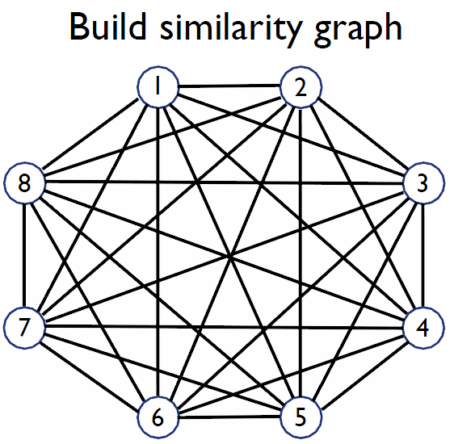
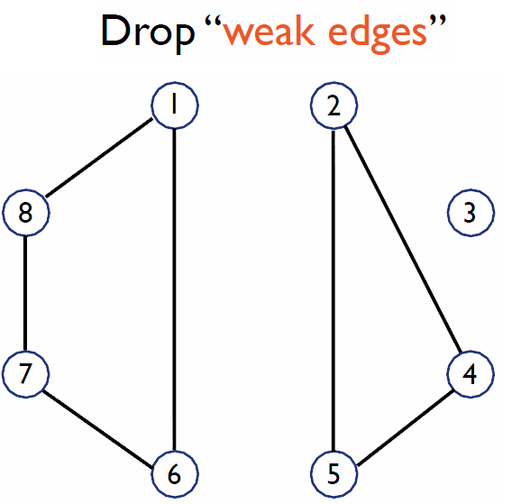
Extract Search Tasks
[Jones et al. CIKM’ 08,
Lucchese et al. WSDM’ 11,
Kotov et al. SIGIR’ 11,
Liao et al. WWW’11]
Step 1: learn query similarities
Prepare human annotation
Train pairwise classification model
Features: QueryTimeGap, WordsInCommon, WordsEditDistance…
Step 2: cluster queries into tasks
Expensive to acquire
Structure is lost

Slide 5
Best Link as Latent Structure
Our Contribution
Illustration of hidden task structure
Latent!
q₀
q₁
q₁
q₂
q₂
q₃
q₃
q₄
q₄
q₅
q₅
q₆
q₆

Slide 6
Best Link as Latent Structure
Our Contribution
bestlink SVM
A linear model parameterized by
space of task partitions
space of best-links
feature vector
q₀
q₁
q₂
q₃
q₄
q₅
q₆
Notes:
We define a feature vector to describe the quality of task partition together with the latent bestlink structure.
Query clustering problem becomes a searching problem in the whole space of task partitions and best-link structures, which clearly distinguish bestlink SVM from existing binary classification based solution.

Slide 7
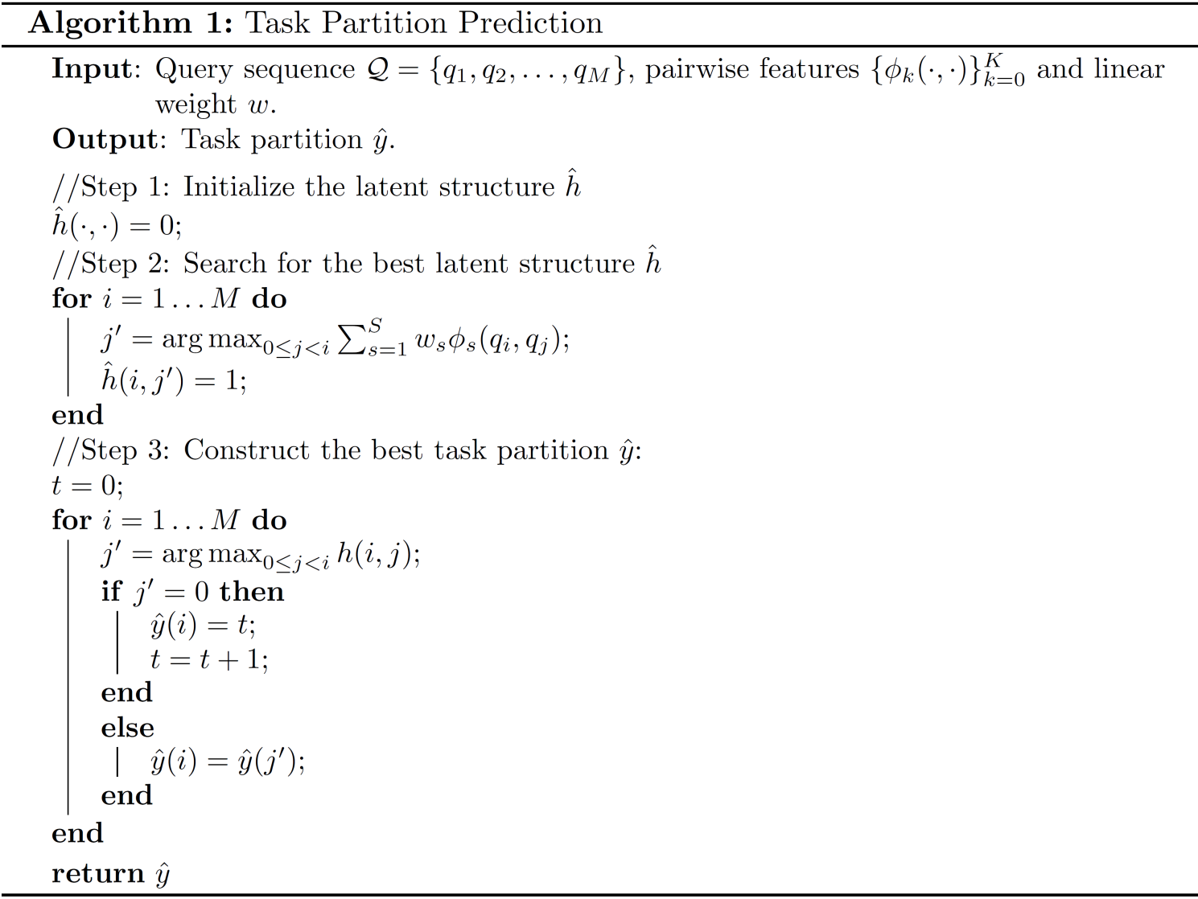
Identify the Latent Structure
Exact inference
Find best link for each query
Propagate task label through best links
q₀
q₁
q₁
q₂
q₂
q₃
q₃
q₄
q₄
q₅
q₅
q₆
q₆

Slide 8
Pairwise Similarity Features
Query-based features (9)
Query term cosine similarity
Query string edit distance
URL-based features (14)
Jaccard coefficient between clicked URL sets
Average ODP category similarity
Session-based features (3)
Same session
# of sessions in between
q₀
q₁
q₂
q₃

Slide 9
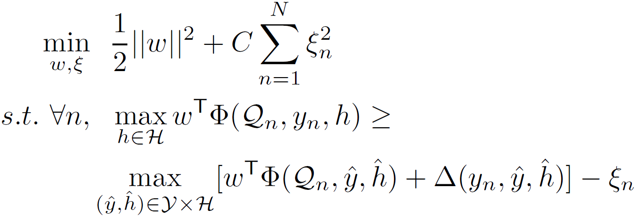
Solving bestlink SVM
Optimizing latent structure SVMs
Solver: [Chang et al. ICML’10]
Margin
# queries
# annotated tasks
(dis)agreement on the best links

Slide 10
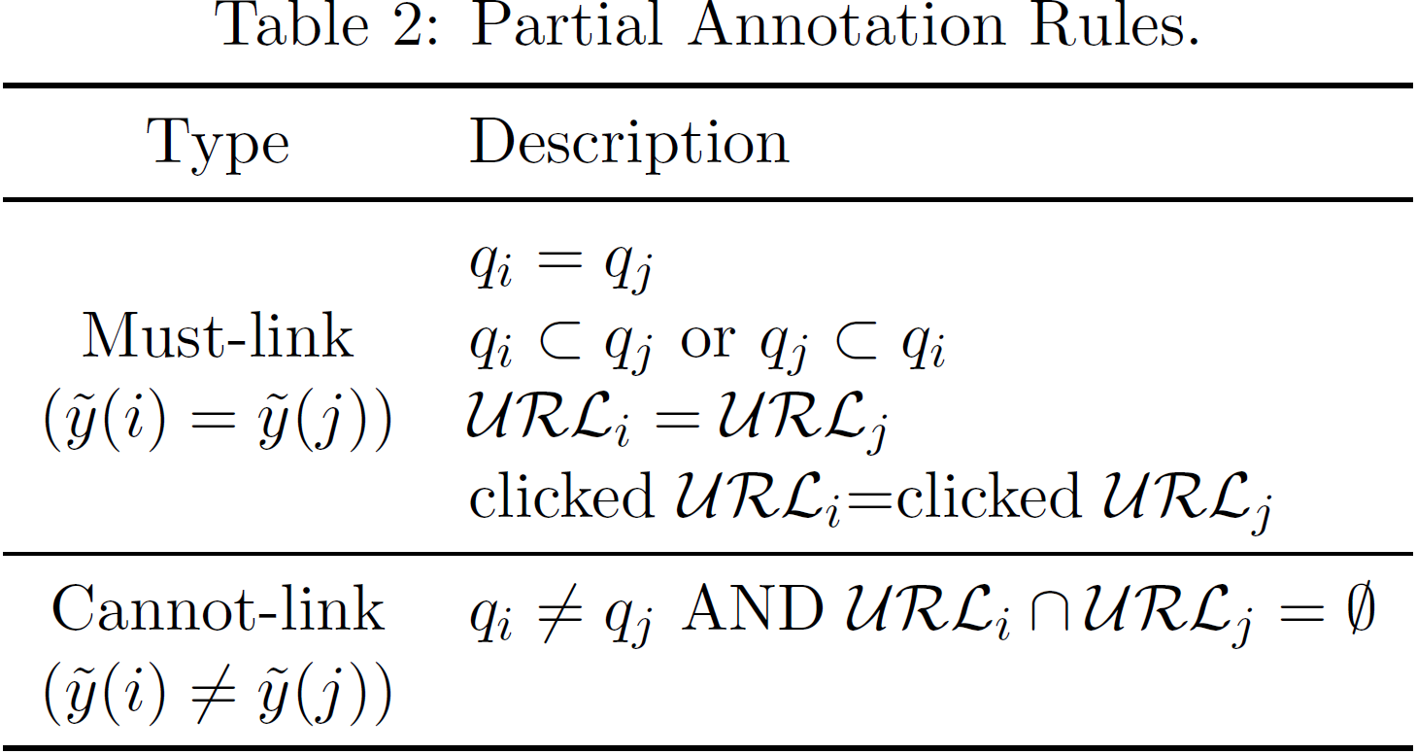
Weak Supervision Signals
Our Contribution
Formalize the weak supervision
Must-links and cannot-links
Margin
# queries
# connected components

Slide 11
Summary of Solution
Our Contribution
Heuristic constraints
Structural knowledge
Identical queries
Sub-queries
Identical clicked URLs
best link => transitive reasoning among queries
Latent structure
Semi-supervised
Structural Learning

Slide 12
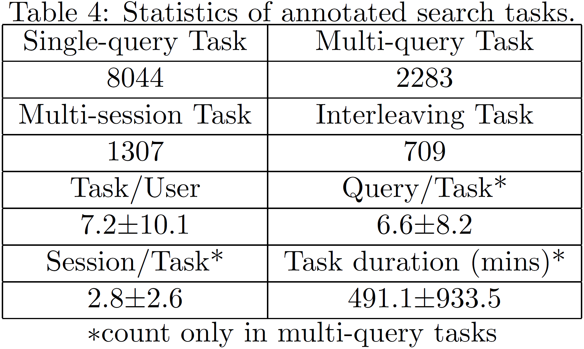
Experimental Results
Query Log Dataset
Bing.com: May 27, 2012 – May 31, 2012
Human annotation
3 editors (inter-agreement: 0.68, 0.73, 0.77)

Slide 13
Search Task Extraction Methods
Baselines
QC_wcc/QC_htc [Lucchese et al. WSDM’ 11]
Post-processing for binary same-task classification
Adaptive-clustering [Cohen et al. KDD’02]
Binary classification + single-link agglomerative clustering
Cluster-SVM [Finley et al. ICML’05]
All-link latent structural SVM

Slide 14
Measuring Extraction Results
Performance metrics
Pairwise measure [Jones et al. CIKM’ 08, Kotov et al. SIGIR’ 11]
Precision
Recall
Cluster-alignment measure [Luo, EMNLP’05]
Set-precision
Set-recall
F-score
Normalized mutual information [Cai et al. IJCAI’09]
Alignment between clustering results based on Jaccard coefficient between two sets

Slide 15
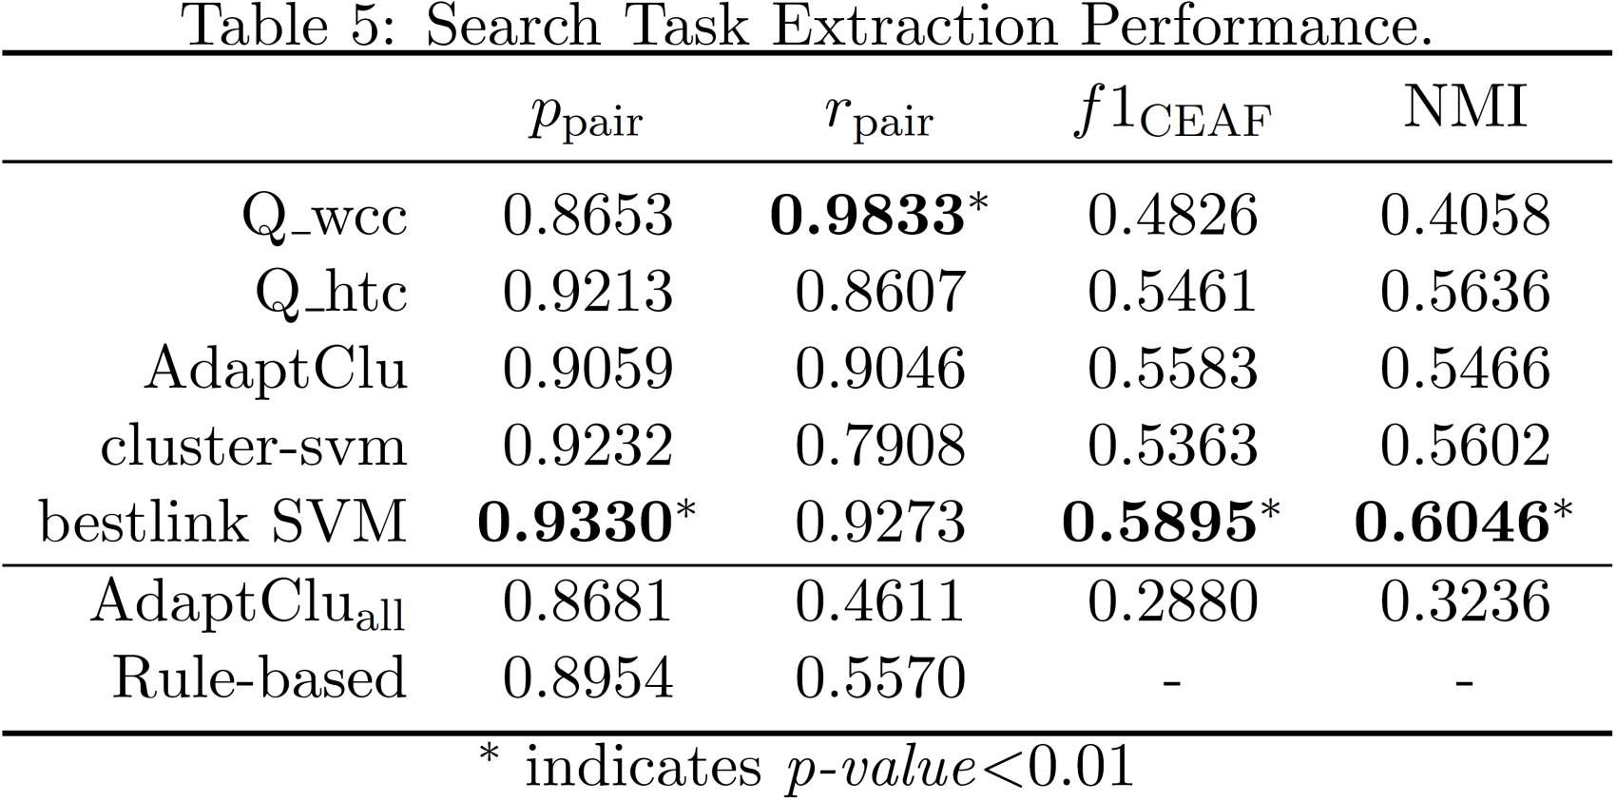
Search Task Extraction
Evaluation of search task extraction methods
Different post-processing
all-link v.s.
best-link

Slide 16
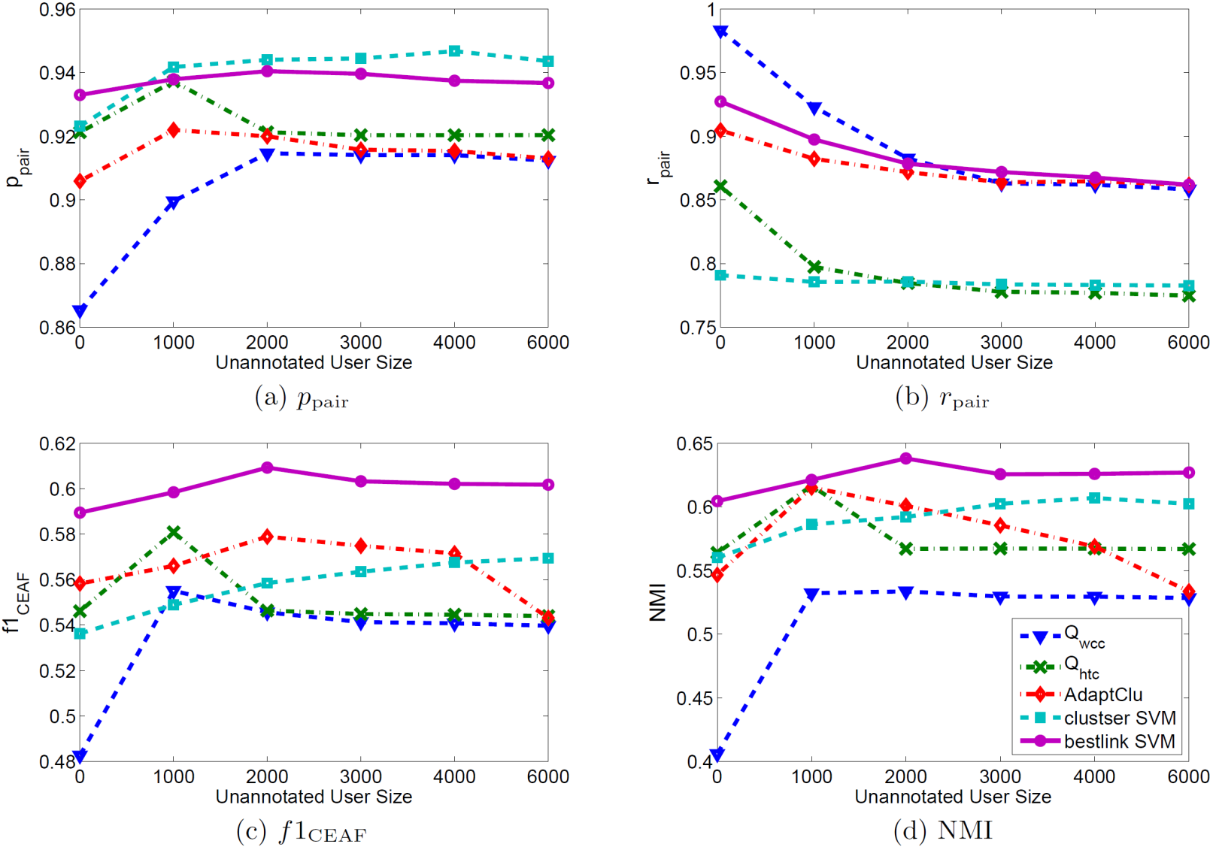
Search Task Extraction
Effectiveness of weakly supervised data

Slide 17
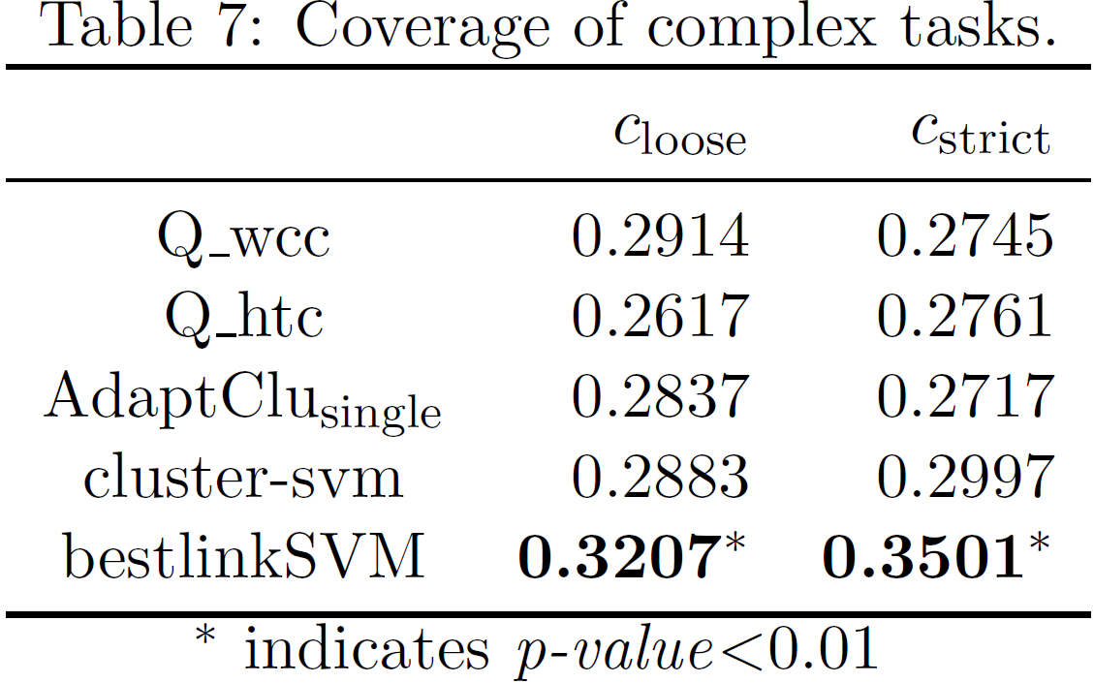
Weakly Supervised Search Task Extraction
Performance on “complex tasks”
Strict complex task (357)
No must-link can be applied
Loose complex task (1540)
At least one pair of queries cannot be connected
via must-links

Slide 18
Conclusion & Future Work
Extracting cross-session search tasks
Structural clustering – bestlink SVM
Weak supervision signals
Deep analysis of user’s in-task behavior
User modeling
Taxonomy of search tasks
Task success prediction

Slide 19
References
C. Lucchese, S. Orlando, R. Perego, F. Silvestri, and G. Tolomei. Identifying task-based sessions in search engine query logs. WSDM’11, pages 277–286. ACM.
A. Kotov, P. N. Bennett, R. W. White, S. T. Dumais, and J. Teevan. Modeling and analysis of cross-session search tasks. SIGIR2011, pages 5–14, ACM.
R. Jones and K. L. Klinkner. Beyond the session timeout: automatic hierarchical segmentation of search topics in query logs. CIKM’08, pages 699–708. ACM.
Z. Liao, Y. Song, L.-w. He, and Y. Huang. Evaluating the effectiveness of search task trails. WWW’12, pages 489–498. ACM.
W. W. Cohen and J. Richman. Learning to match and cluster large high-dimensional data sets for data integration. SIGKDD’02, pages 475–480. ACM.
T. Finley and T. Joachims. Supervised clustering with support vector machines. ICML’05, pages 217–224. ACM.
X. Luo. On coreference resolution performance metrics. HLT/EMNLP’05, pages 25–32.
D. Cai, X. He, X. Wang, H. Bao, and J. Han. Locality preserving nonnegative matrix factorization. In IJCAI'09, pages 1010–1015, 2009.

Slide 20
Learning to Extract Cross-Session Search Tasks
bestlink SVM
Latent!
q₀
q₁
q₁
q₂
q₂
q₃
q₃
q₄
q₄
q₅
q₅
q₆
q₆
Thank you!
Q&A

Slide 21
What is a user search task?
An atomic information need that may result in one or more queries
An impression
t_{ϕ} = 30 minutes
WWW2013 program
flight to RIO

Slide 22
Task as an alternative to session
Session is too coarse
A user may have one or more information need within a session
Interleaved tasks could be performed
E.g., checking conference schedule while finding flight tickets
In-session search tasks [Lucchese et al. WSDM’ 11,
Liao et al. WWW’11]
WWW2013 program
flight to RIO

Slide 23
Latent Structure for Search Tasks
What is a proper structure for search tasks
all-link?
best-link?
bank of america
credit union
sas
6pm.com
sas shoes
coupon for 6pm

Slide 24
Best Link as Latent Structure
Our Contribution
bestlink SVM
A linear model parameterized by
space of task partitions
space of best-links
feature vector
q₀
q₁
q₂
q₃
q₄
q₅
q₆

Slide 25
Best Link as Latent Structure
Our Contribution
bestlink SVM
A linear model parameterized by
bestlink structure
Feature representation
q₀
q₁
q₂
q₃

Slide 26
Solving bestlink SVM
Exact inference revisit
Latent variable completion inference
Loss-augmented inference

Slide 27
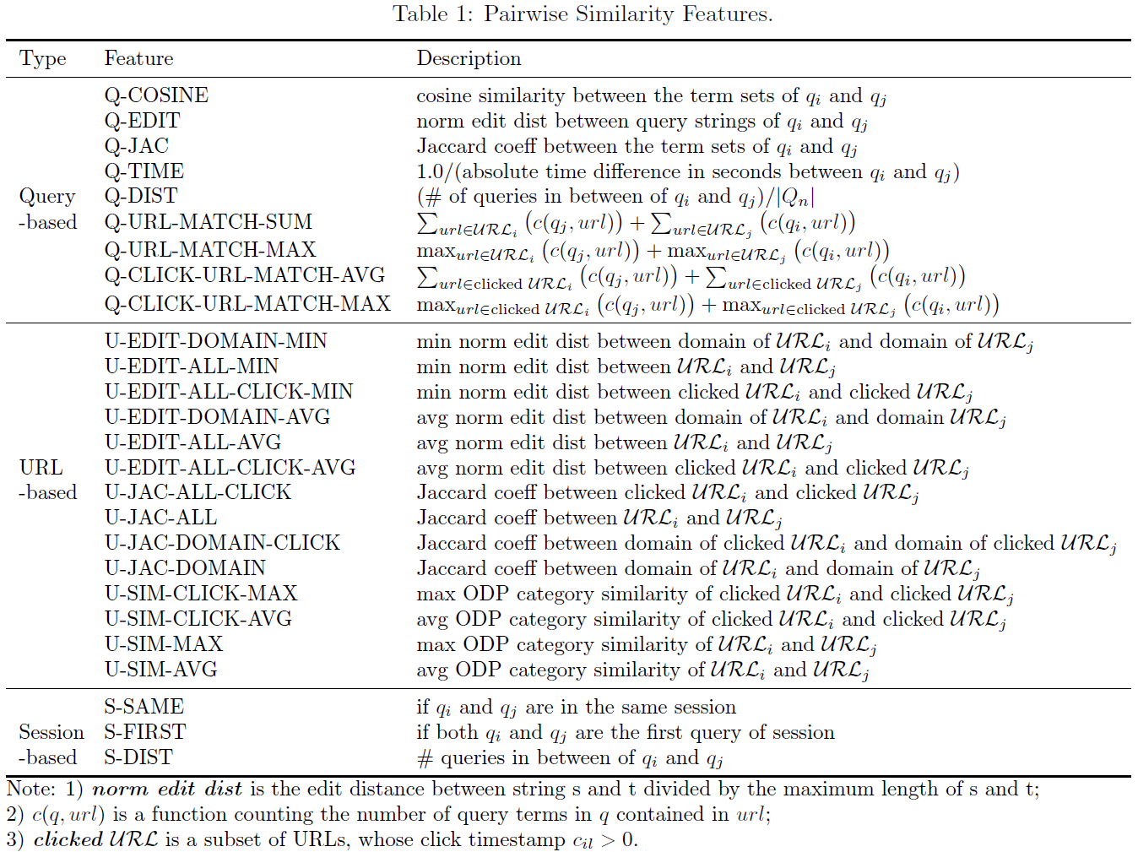
Pairwise Similarity Features
9
14
3

Slide 28
Weak Supervision Signals
Heuristics help
5/30/2012 Session 1
5/30/2012 9:12:14 | airline tickets
5/29/2012 9:20:19 | rattlers
5/29/2012 9:42:21 | charlize theron snow white
5/30/2012 Session 2
5/30/2012 21:13:34 | charlize theron
5/30/2012 21:13:54 | charlize theron movie opening
5/31/2012 Session 1
5/31/2012 8:56:39 | sulphur springs school district
5/31/2012 9:10:01 | airline tickets
5/30/2012 Session 1
5/30/2012 9:12:14 | airline tickets
5/29/2012 9:20:19 | rattlers
5/29/2012 9:42:21 | charlize theron snow white
5/30/2012 Session 2
5/30/2012 21:13:34 | charlize theron
5/30/2012 21:13:54 | charlize theron movie opening
5/31/2012 Session 1
5/31/2012 8:56:39 | sulphur springs school district
5/31/2012 9:10:01 | airline tickets
5/30/2012 Session 1
5/30/2012 9:12:14 | airline tickets
5/29/2012 9:20:19 | rattlers
5/29/2012 9:42:21 | charlize theron snow white
5/30/2012 Session 2
5/30/2012 21:13:34 | charlize theron
5/30/2012 21:13:54 | charlize theron movie opening
5/31/2012 Session 1
5/31/2012 8:56:39 | sulphur springs school district
5/31/2012 9:10:01 | airline tickets
Sub-query
Same-query
Sub-query

Slide 29
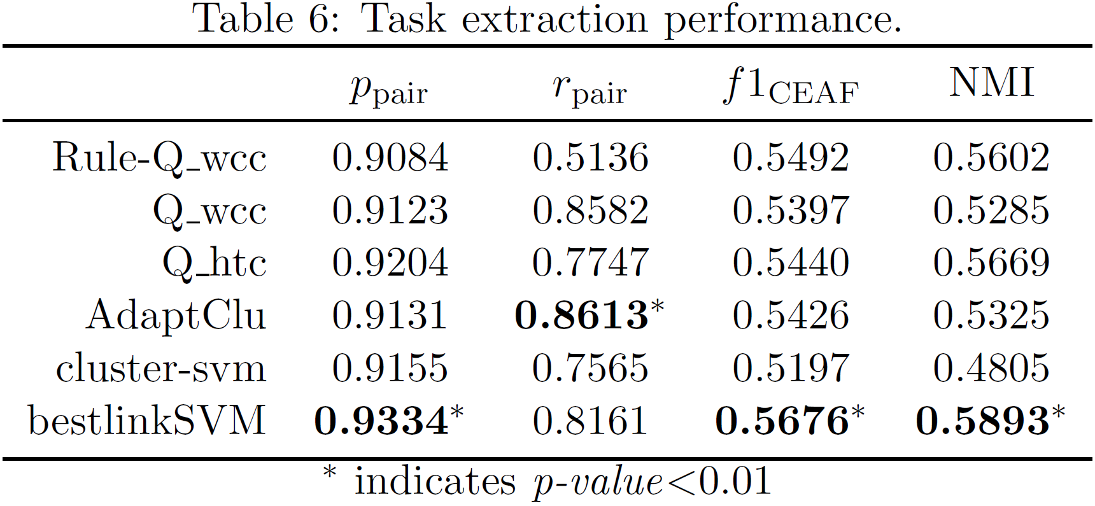
Weakly Supervised Search Task Extraction
Models trained only on weak supervision

Slide 30
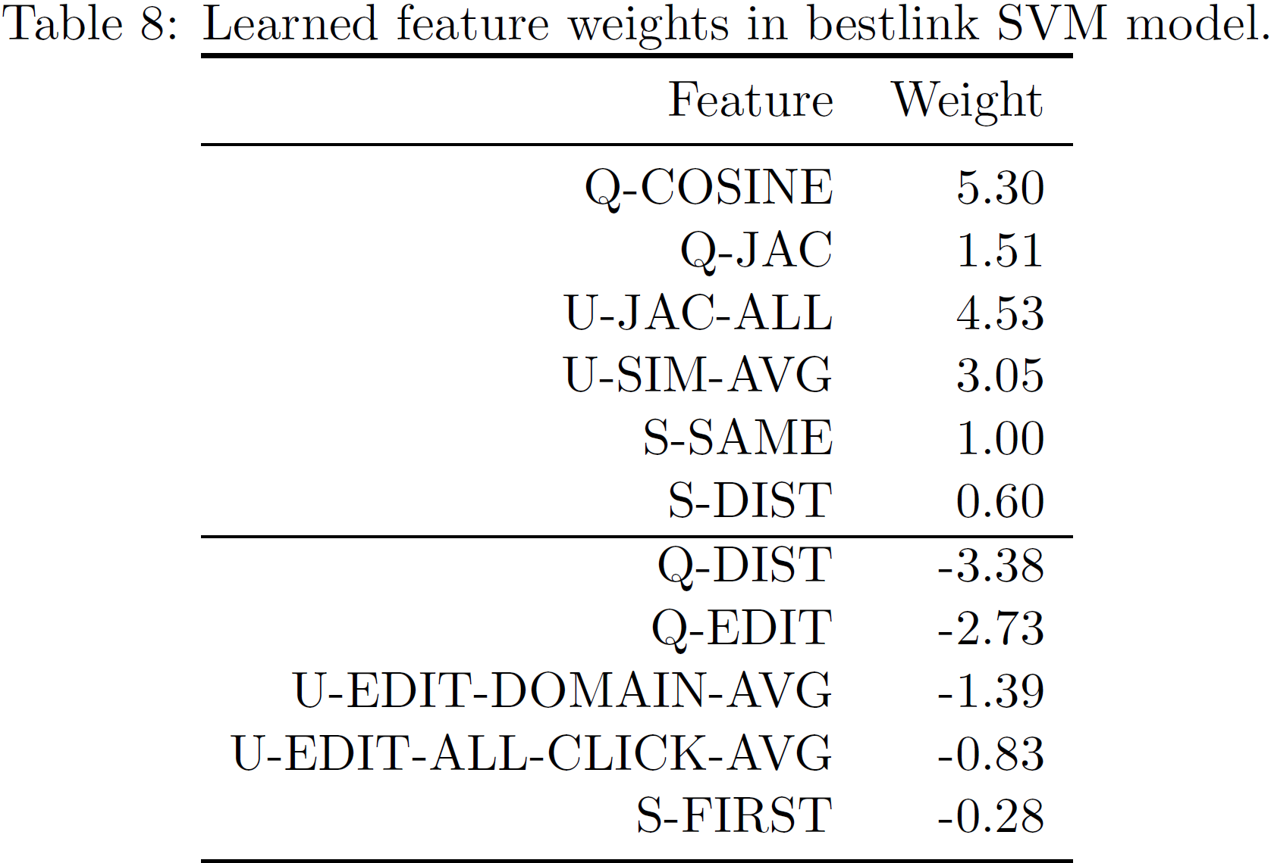
Analysis of pairwise features in task extraction
Top 2 positive/negative features under each type of pairwise similarity features

Slide 31
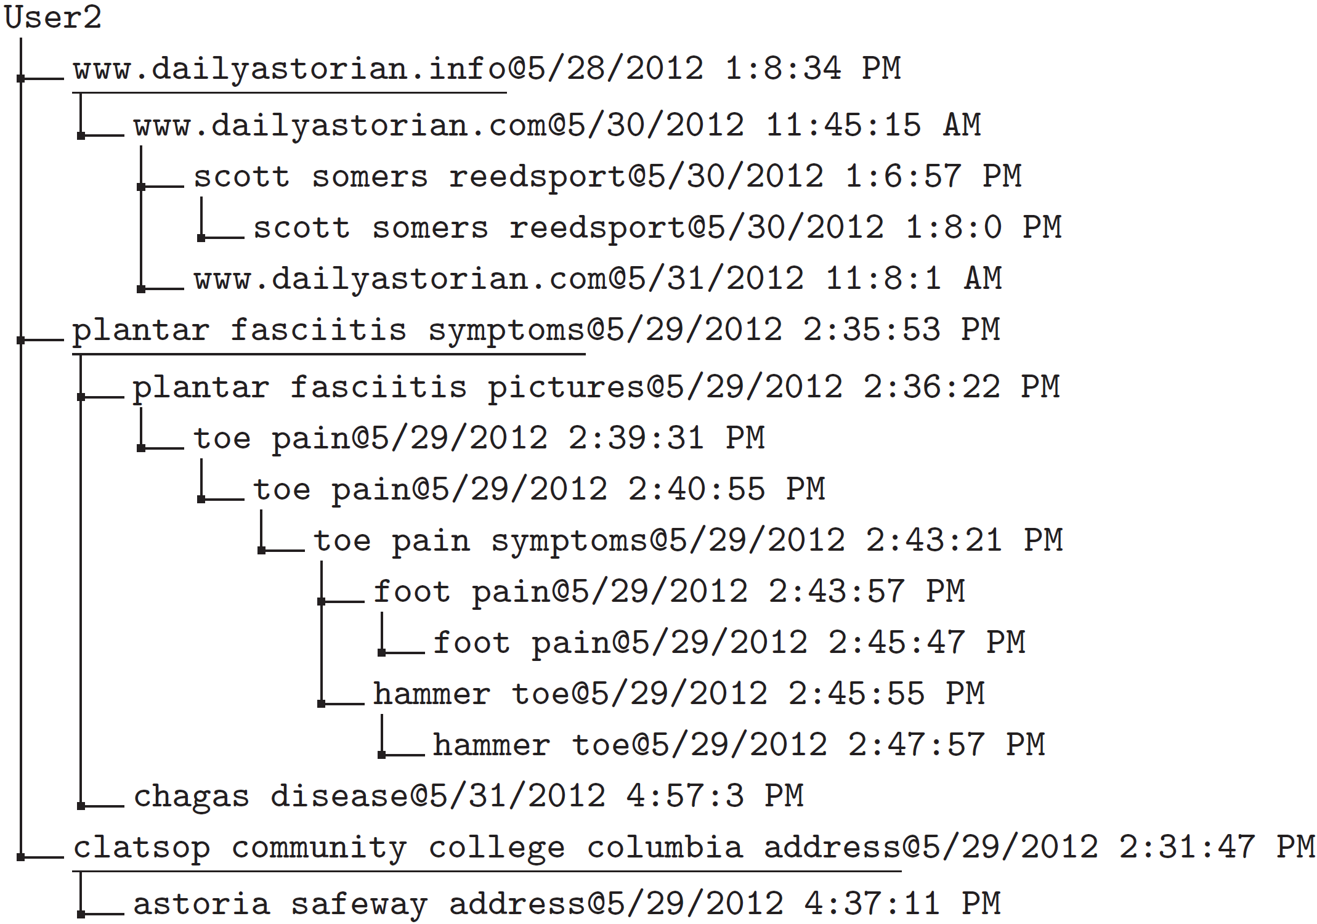
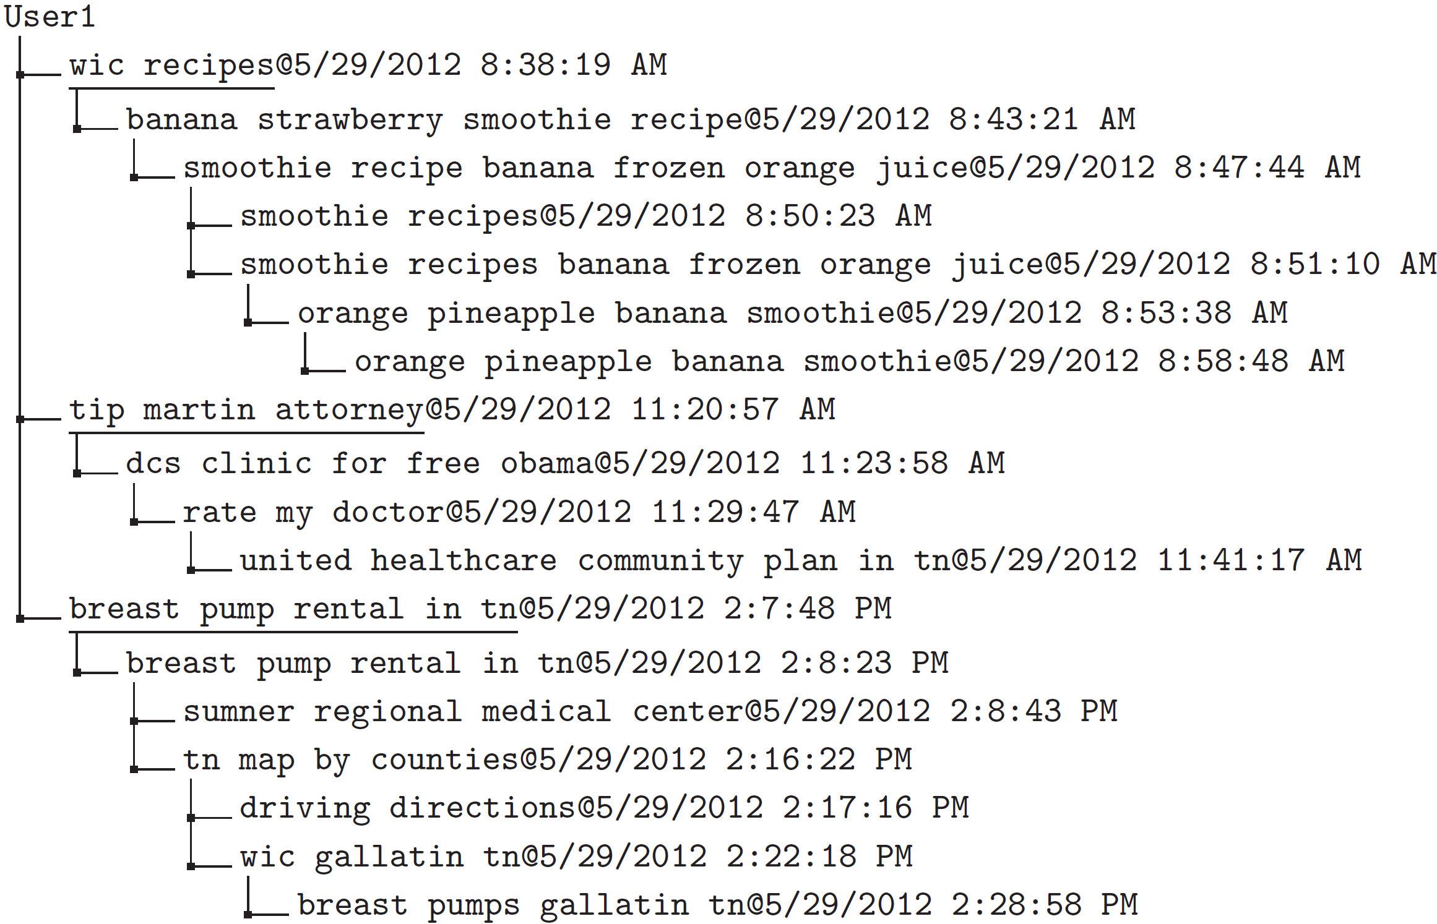
Analysis of Identified Tasks
Illustration of latent task structure

Slide 32
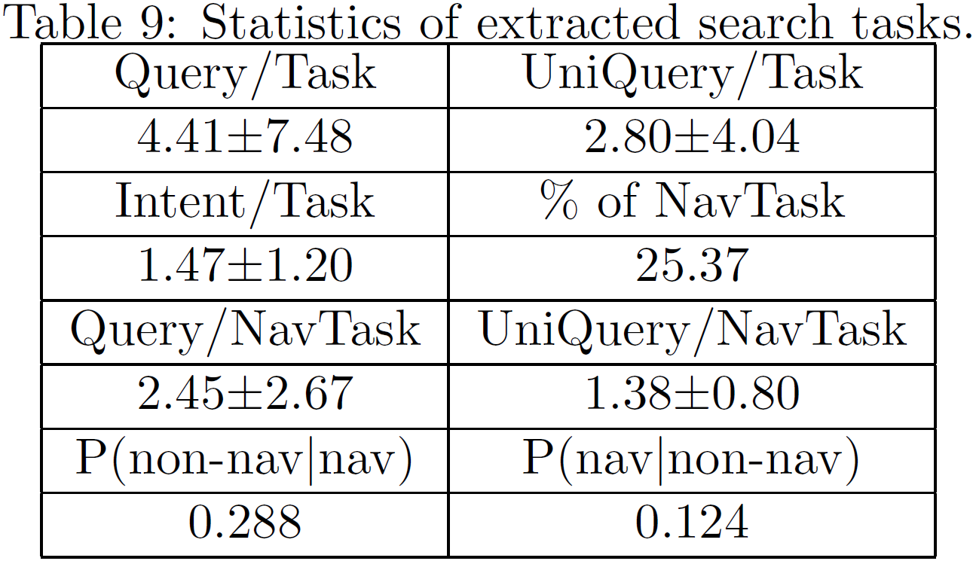
Analysis of Identified Tasks
Statistics of search tasks revisit
Proprietary classifier: query => intents

