Slide 1





Fulcrum: a Simplified Control and Access Mechanism toward
Flexible and Practical In-situ Accelerators
This work was supported in part by CRISP,
one of six centers in JUMP,
a Semiconductor Research Corporation (SRC) program
Marzieh Lenjani, Patricia Gonzalez, Elaheh Sadredini, Shuangchen Li,
Yuan Xie, Ameen Akel, Sean Eilert, Mircea R. Stan, Kevin Skadron

Slide 2




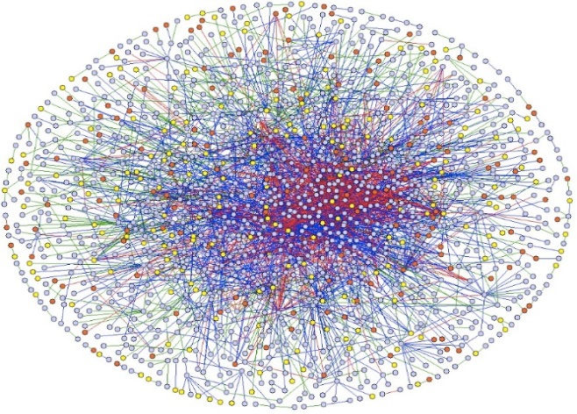
Motivation:
Many of Modern Applications Are Memory-intensive
Memory-intensive = Few computations per each memory access
Notes:
In fulcrum we target memory-intensive applications because many of modern applications are memory-intensive. By memory-intensive we means that the application perform only few computation on most of the values that it loads from memory or store in memory.

Slide 3




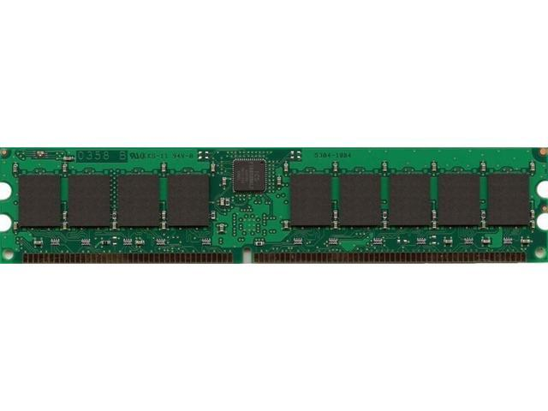
The High-Level Problem:
The High Cost of Data Movement
Moving data from memory to L1
  Consumes > 1000 X more energy than an addition operation
  Has ~ 100 X higher latency than an addition
    [1]. Han, Song, et al. "EIE" ISCA 2016.
Energy
Execution time
  Data movement dominates the execution time and energy consumption
Notes:
Prior works have shown that the energy consumption and execution time of transferring data between memory and processor is much higher than the cost of actual computation. Therefore when the number of computation per memory access is low, data movement dominates the total energy consumtion and execution time.

Slide 4


High-Level Goals
An accelerator for reducing the cost of data movement
  Processing data inside memory (evaluated for DRAM)
Supporting both accelerator mode and memory mode
  Compute Express Link (CXL) integration
Minimizing hardware overhead to keep capacity high
Flexible enough to support key kernels
  Dense and sparse linear algebra : Deep learning, graph processing
  Sort, Bitmap, FilterByPredicate, FilterByKey: Database
  KNN: Recommender systems
Fulcrum
  Fulcrum processes big data using a tiny but flexible processing unit near data
Notes:
So, Our high-level goal in Fulcrum is to reduce the cost of data movement by processing data inside the memory instead of transferring data to processor . Fulcrum is not memory-technology dependent but in this project we have focused on DRAM-based Fulcrum because DRAM provides a good balance between capacity and latency.
Fulcrum acts as as an accelerator for memory-intensive parts of the applications and we wanted it to have the power budget of PCIe based accelerators but have the memory access latency in orders of DIMM modules for the cases that the host CPU or other devices need to access to the data stored or generated by Fulcrum. Therefore we chose to integrate Fulcrum with a new interconnection standard called Compress Express Link that meet these requirements.
We wanted to keep capacity high by avoiding significant hardware overhead . However at the same time we wanted fulcrum to be flexible enough to support key kernels such as dense and sparse linear algebra that appear in many of modern applications such as deep learning graph processing scientific computing and etc
Database operations such as sort, bitmap, sort and that are useful for recommender systems
And kernels such as k nearest neighbors . So we aimed to have tiny processing element inside memory that support key kernels

Slide 5
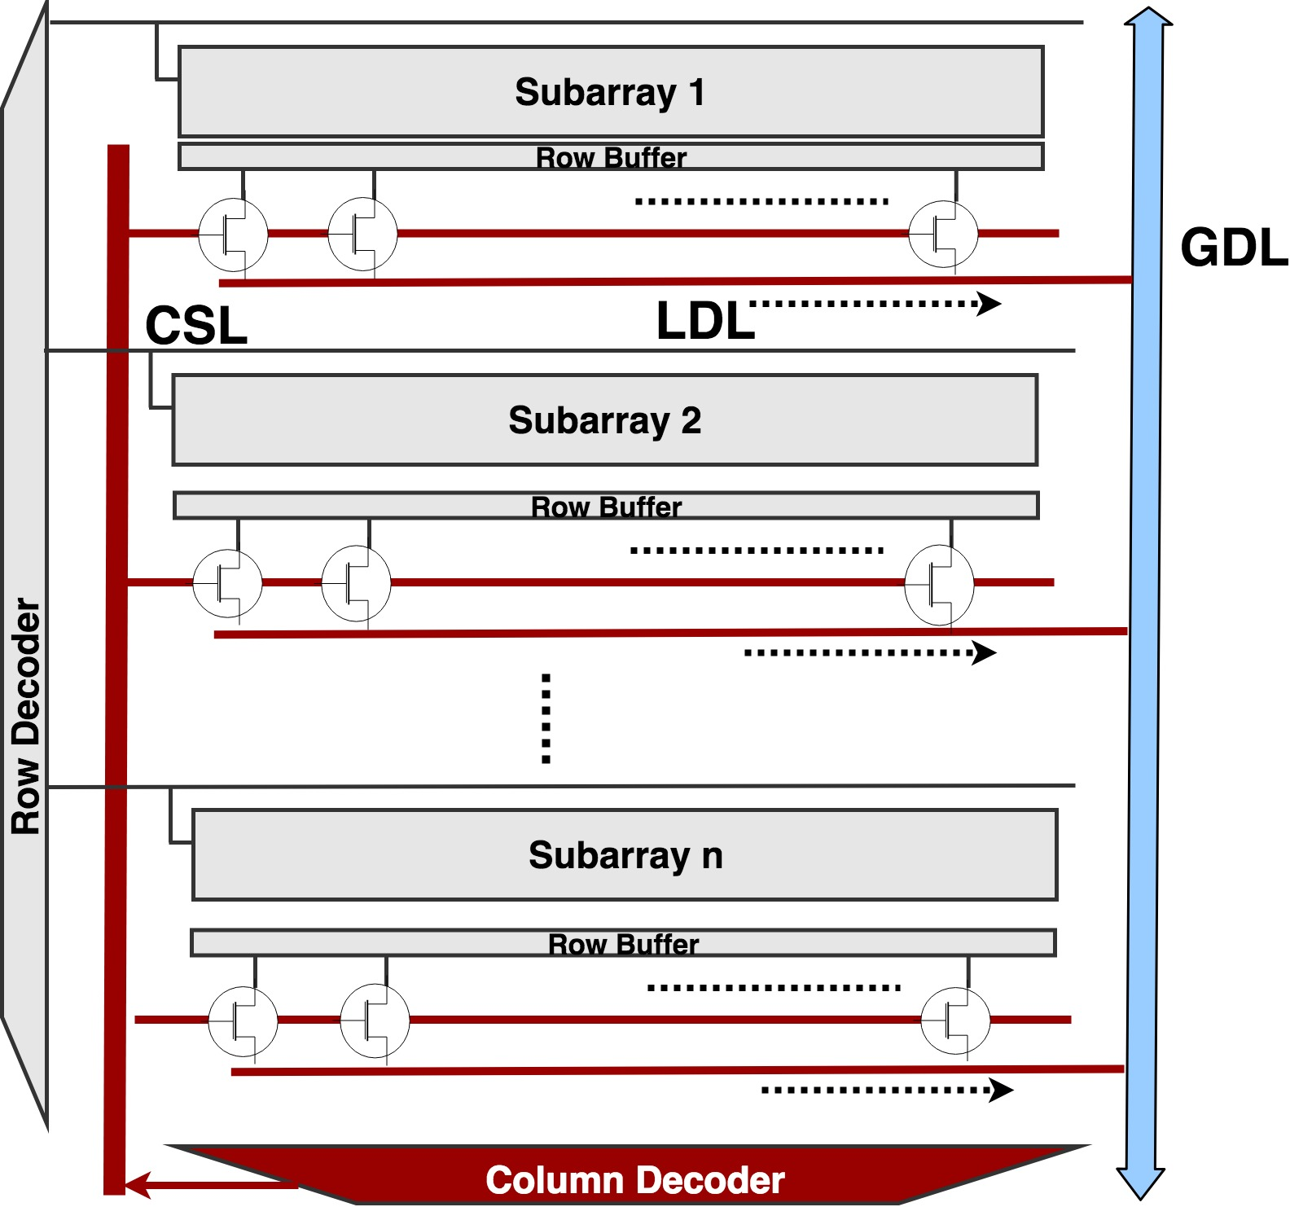
Background
Memory
  Partitions (Vaults)
  Layers
    Multiple (4/8) memory layers
    A logic layer
    Connected by TSV
Each memory layer has many banks
Each bank has many subarrays
  Subarrays are connected by GDL
  Each memory access moves data along multiple buses
Notes:
So let’s talk about memory a little bit. Memory is designed in multi-level hierarchy. For example 3D memories have one logic layer and many memory layers, Memory layers are connected through a shared bus called TSVs. Each memory layer has many banks and each bank has many subarrays. Subarrays are connected through a address bus called column selection line (CSL) and a data bus called global data line (GDL). When we access data we read an entire row for example 64 word form the subarray at once and store in a buffer called row buffer . We send the address of a wor don TSVs . The address get decode at the edge of each bank and will be sent through these CSLs and then we receive data through TSVs and GDLs. So for each memory access, addresses and data should move along these buses and that is why memory accesses is so costly.

Slide 6
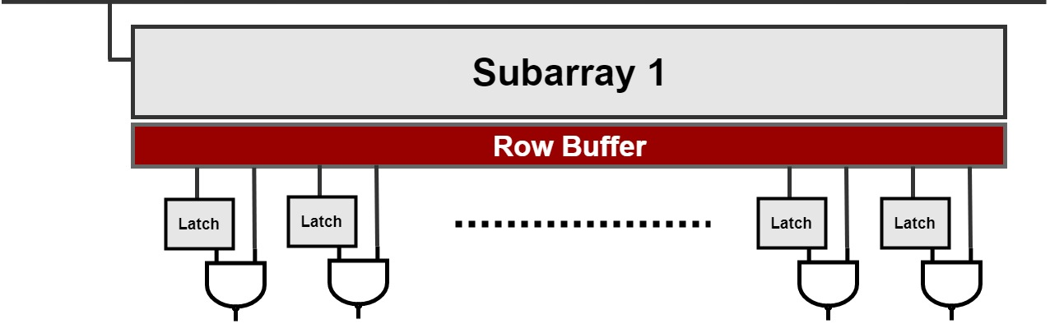
Where to Process the Data?
In the logic layer?
At the edge of each bank?
In each subarray?
  What are the tradeoffs?
Notes:
The Question here is that if we want to process data inside memory in which of these level we should place our processing units. In the logic layer? At the edge of each bank or in each subarray? And what are trade offs for processing at each of these levels.

Slide 7
In-situ Computing = Processing Data in Subarrays
Pros: ☺
  1: Higher parallelism
    Massive subarray-level parallelism
      8192 subarrays
  2: Lower access latency
  3: Lower energy consumption
Cons: ☹
  1: Inefficiency of logic in DRAM layers
    Slow logic in DRAM technologies
  2: Hardware overhead per subarray
Notes:
We refer to processing at subarray-level as in-situ computing and it has several advantages and disadvantages. For example, because we have many subarrays, by processing in each subarray, we will enjoy the massive subarray-level paralleliisem. Also it is obvious that the latency and energy consumption of accessing data at subarray level is much lower that latency and energy consumption of any other level of processing in memory
But unfortunately for in-situ computing we have to place our processing units in DRAM layers and technology size in DRAM is larger than processors so our processing unit will larger, slower and consume more energy
And also because we have many subarrays any hardware overhead will be multiplied by number of subarrays.

Slide 8
Prior In-situ Approaches (DRAM-based)
Support only bitwise operations
  Ambit [Seshadri et al.]
  DRISA [Li et al.]
  What are the limitations?
Notes:
Due to these disadvantages prior works only support bitwise logic operations to limit the hardware overhead and this results into several limitations.

Slide 9
Main Limitation: Inflexibility
High overhead for non-bitwise operations
  E.g., 32-bit addition and multiplication
No support for data dependency
  E.g., reduction and prefix sum (scan)
No support for operations based on a condition
  E.g., Sort and SPMV
Notes:
The main limitation of prior in-situ approaches is inflexibility. First, since prior works only support bitwise operations they have to emulate 32-bit addition and multiplication by multiple bitwise operation and for each bitwise operation they need a row activation which is very costly. Our evaluation shows that the energy consumption of these row activation is even higher that energy consumption of accessing data from the logic layer and nullifies the benefit of in-situ computing compared to in-logic layer computing. We might be to add extra row off latches to resolve this problem for integer addition but it is very challenging to resolve the issue for multiplication and floating point operations.
A recent paper in ISCA 2019 (duality cache from university of Michigan ) try to solve this problem by laying out data horizontally for SRAM-based in-situ approaches. However, horizontal layout increases the cost of updating data as we need to update multiple rows of data and it only suits read-only data such as deep learning weight matrices
Second since prior work perform a row-wide parallel operation on entire row they can not support operation with data dependency along the row buffer. As a result they can not support reduction or prefix sum along the row buffer
Third, Since row-wide parallel bitwise operations perform the same operation on the entire row buffer, it can not support operation based on a condition which is a requirement for kernels such as sort or sparse linear algebra

Slide 10
Limitation 2: No Support for Interleaving
Interleaving1: subarray-interleaving
Subarray1
SA
SA
SA
SA
Subarray2
SA
SA
SA
SA
Subarray3
  Two logically adjacent bits are sensed in different subarrays
Notes:
The second limitation of prior in-situ works is ignoring interleaving. In current DRAM structure we have two types of interleaving. The first interleaving type is called subarray interleaving. Since the size of each sense amplifier is larger than the size of memory cells, in current DRAM half of the memory cells in arrow are sensed in the upper row buffer and half of them are sensed in the lower row buffer. Therefore, two logically adjacent bits are not physically adjacent.

Slide 11
Limitation 2: No Support for Interleaving
Interleaving2: mat interleaving
    Every 4 bits of a word comes from a different mat
  Logically adjacent bits are not physically adjacent
Notes:
The second type of interleaving is mat interleaving. In DRAM a word is distributed among mats and every four bits of a word is coming from a different mat. So, again bits that are logically adjacent are not physically adjacent and we can not perform computation on them.

Slide 12
Limitation 3: Inefficient Interconnections
No support for sharing values
  Required in many applications such GEMV
No support for Inter-subarray data movement
  Required in many applications such as Sort
No support for independent column selection
  Column selection peripheral logics are shared
  Narrow and shared buses are bottlenecks for data movement
Notes:
The third limitation is inefficient interconnection. Current interconnections in DRAM are designed for memory access and are not optimized for computation. First, although we have shared buses but there is no broadcasting mechanism . Second for transferring data from one subarray to another we have to use this narrow GDL buses and finally all subarrays share one address bus for selecting a column from their row buffer, So in fact there is no true subarray parallelism because we can not different column in different subarray

Slide 13
Goals:
1. Practical Flexibility
2. Resolving Interleaving
3. Efficient Interconnection
Notes:
So we had three goals in this project. First, providing practical flexibility. Second, reuniting bits so that bits become physical adjacent and third, optimizning interconnection for computation based on applications’s requirements

Slide 14

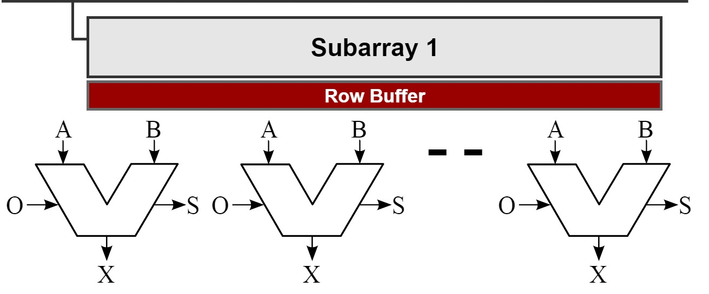
Tradeoffs
Row activations vs hardware overhead
Parallelism vs hardware overhead
  Observation: single-word ALUs enable
  new operations and optimizations
Notes:
In selecting a solution for achieving these goals we have different tradeoffs to consider
We talked about the tradeoff between the energy consumption of multiple row activations vs hardware overhead of row-wide ALUs. And unfortunately if we choose the second option the size of these LS become 52 tmes larger than the size of subarray.
We realized that there is also another tradeoff between parallelism and hardware overhead. We can choose to process only one word of row buffer to limit the hardware overhead but we lose some papalism. The interesting observation for us here was that not only the single-word ALU limits the hardware overhead, it also provides more flexibility and enables new optimizations and operations.

Slide 15
Selecting a Control and Access Mechanism for the Single-word ALU
How about traditional control and access mechanism?
Example: C[:]=A[:]+B[:]
RA=RA+1
RB=RB+1
RC=RC+1
Read RA, X1
Read RB, X2
X3=X2+X1
Store X3, RC
i=i+1
If (i< 1000000) Jump 1
Address generation
Read by address
The actual computation
Write by address
Iteration control
  Traditional control and access mechanisms impose overhead
Notes:
To provide flexibility for Single-word ALUs we need a control and access mechanism to select a word from the row buffer and feed it to the ALU. The first solution that comes to mind is to use the traditional control and access mechanism of classic processors. However, these mechanism impose significant overhead, for example for adding two vectors , for each element of the vector, we need to generate the address and access data by address and these address and data should be placed on shared buses and we need iteration control instructions

Slide 16
How Do Traditional Processors Tolerate the Overhead?
Traditional processors tolerate the overhead by:
  High frequency
  Enough resource (billions of transistors) for
    Deep pipelining and forwarding
    Out of ordering
    Branch prediction
Why cannot an in-situ processor tolerate this?
  Low frequency of logic in DRAM
  Limited hardware resource
  The overhead is not negligible for in-situ computing unlike far-memory processors,
Notes:
But far memory processors have enough resource to tolerate these overheads. they have billions of transistor to implement o3, pipelining, forwarding , branch prediction and etc and high frequency
But unfortunately for in-situ computing with low frequency and hardware constraints we can not tolerate this overhead.

Slide 17
Key Ideas
Notes:
To resolve these issues we had several key ideas

Slide 18
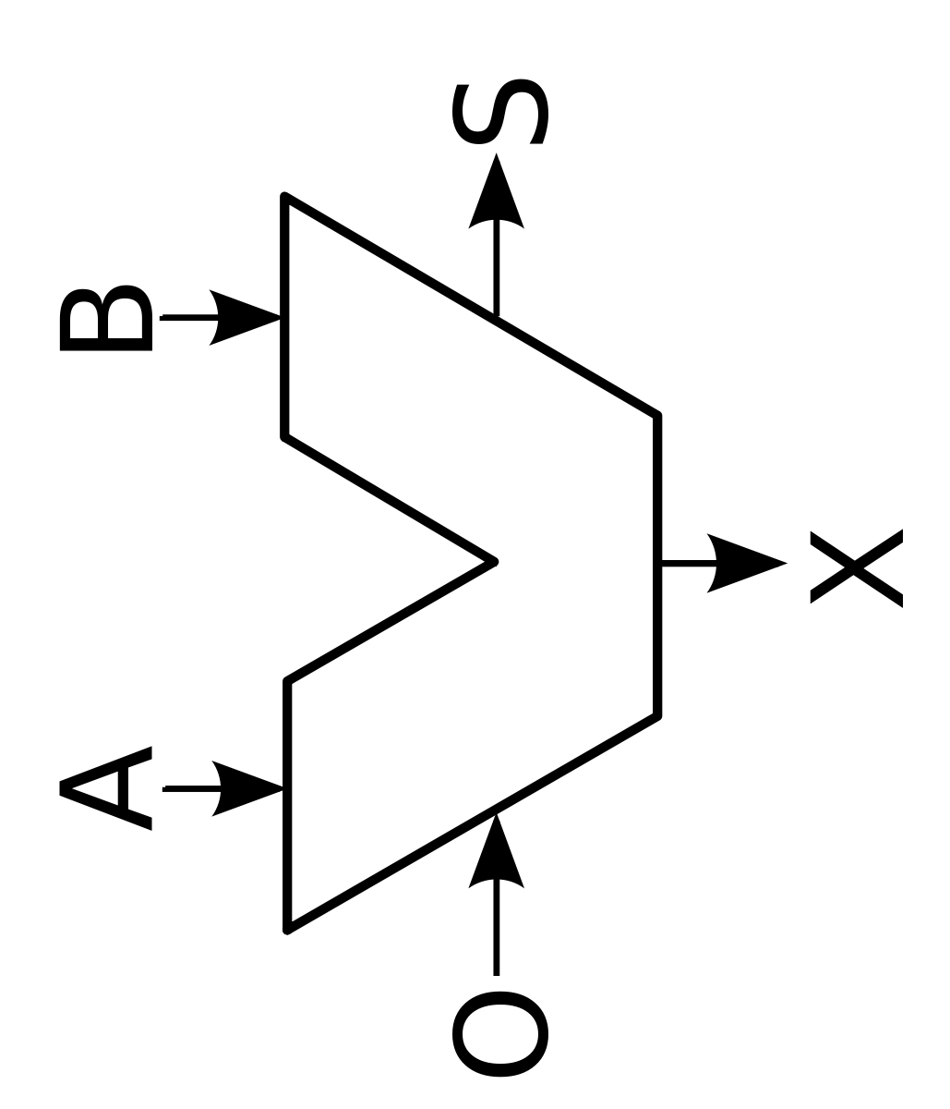
Key Idea1: Single-word ALUs
One ALU per two subarrays
Subarray 1
Subarray 2
  Fewer row activations and limited hardware overhead
Notes:
The first idea , as we discussed was to use a single-Word ALU and only one ALU per two subarrays to limit the hardware overhead and reduce the row activations.

Slide 19
Key Idea2: A Simple Shift-based Access Mechanism
A simple shift-based access mechanism
  C[:]= A[:]+ B[:]
Traditional control and access mechanisms
RA=RA+1
RB=RB+1
RC=RC+1
Read RA, X1
Read RB, X2
X3=X2+X1
Store X3, RC
i=i+1
If (i< 1000000) Jump 1
Please see our paper for the exact format of Fulcrum’s instructions
Fulcrum
Shift_Read a[i], shift_Read b[i], Shift_Write c[i] , c[i]=a[i]+b[i]
Notes:
Th second idea is to use a simple shift based access mechanism. To implement this idea we proposed these structures called walkers. Each walker is a row of latches that captures and entire row at once. In each cycle we shift a one hot encoded value that selects one word from the walker and place it on a local bus and send it to the ALU. Therefore instead accessing data by addresses we will have a simple instruction that sequentially access data by shift.

Slide 20
Key Idea3: A Simple Control Unit
Determining next instruction and the direction of shifts
  Based on the outcome of the previous operation
Notes:
But simple sequential shifting is not flexible enough and can not support operation based on a condition. So our third idea is to use a simple controller. We have a 4-entry instruction buffer where we store our pre-decoded signals Our controller simply determines the next instruction and the direction of shifts based on the outcome of the previous operation

Slide 21
Key Idea4: Reuniting Interleaved Bits
Subarray1
One processing unit per two subarrays
  Resolves subarray interleaving
Slight modification in mat-interleaving circuits
  Collects all bits at the side of the subarray
SA
SA
SA
SA
Subarray
2
SA
SA
SA
SA
Subarray3
  Unlike reuniting an entire interleaved row,
  reuniting one word is practical
Notes:
The next idea is to reunite the interleaved bits. So we talked about two types of interleaving. Subarray interleaving and mat interleaving. Since we use only one ALU per two subarray, the subarray interleaving is resolved automatically. But for resolving mat interleaving we proposed slight modification in current mat interleaving circuits. We connect these helper flip flops and form a pipeline through which we shift and pump all bits to the edge of the subarray and reunite all bits. This is one of the optimizations that is enabled by processing only one word of the subarray because reuniting the entire row buffer is not practical.

Slide 22
Key Idea5: Optimizing Interconnections
Adding broadcasting capability
  Enabling efficient data sharing
Enabling independent column selection
  Using one-hot-encoded shift registers
Employing a prior work
  Optimizing inter-subarray data movement
    LISA [Chang et al. HPCA 2016]
Subarray1
SA
SA
SA
SA
Subarray
2
SA
SA
SA
SA
Subarray3
  Our modified interconnections unlock the benefit of in-situ computing
Notes:
Our last idea is to optimize and customize interconnection for computation based on applications requirement. We observed that many kernels can benefit form broadcasting, so we simply added broadcasting capabilities to current shared busses. To enable independent column selection in subarrays, as I briefly explained, we are using a one-hot- encoded value for selecting a word form walker and do not need to send the address through the address decoded and column selection lines. And finally for transferring data from one subarray to another we employed a prior work that connects subarrays and transfer an entire row from one subarray to another at once. So, the take away is that the traditional interconnection of memory turns to a bottleneck for processing in memory and we reolved these bottleneck by slight modifications in the interconnection.

Slide 23
Examples of Mapped Applications
Notes:
A we promised we mapped several important kernels our simple design to show the flexibility of our design

Slide 24
Database (a Billion $ Market)
Evaluated Kernels:
Sort, Bitmap, FilterByKey, FilterByPredicate, Bitwise
Notes:
We also mapped several database kernel to our simple. design

Slide 25
A Simple Example
A[:]+B[:]=C[:]

Slide 26
Example: A[:]+B[:]=C[:]
A simplified illustration (some architectural details are omitted for clarity)
Pair Subarray 1
A[5] | A[4] | A[3] | A[2] | A[1] | A[0]
+
B[5] | B[4] | B[3] | B[2] | B[1] | B[0]
 |  |  |  |  | C[0]

Slide 27
Example: A[:]+B[:]=C[:]
A simplified illustration (some architectural details are omitted for clarity)
Pair Subarray 1
A[5] | A[4] | A[3] | A[2] | A[1] | A[0]
+
B[5] | B[4] | B[3] | B[2] | B[1] | B[0]
 |  |  |  | C[1] | C[0]

Slide 28




Dense and Sparse Linear Algebra
(a Billion $ Market)
Deep learning
Data analytics
Graph processing
Recommender systems
Notes:
For example we mapped dense and sparse matrix vector multiplication and sparse and dense matrix matrix multiplication and I guess everyone agrees that these kernels are very important because appear in many applications such as deep learning , data analytics , graph processing and recommender systems

Slide 29
Example: Sparse Matrix Vector Multiplication
A simplified illustration (some architectural details are omitted for clarity)
Pair Subarray 1
Shift
Compare
Val=0.1 | Indx=9 | Val=0.2 | Indx=7 | Val=0.5 | Indx=3
Wait
Pair Subarray 2
Compare
Val=0.1 | Indx=15 | Val=0.3 | Indx=7 | Val=0.1 | Indx=6
Pair Subarray 3
Wait
Val=0.1 | Indx=15 | Val=0.3 | Indx=7 | Val=0.1 | Indx=4
Compare
Indx=3
Notes:
As an example here I show How Fulcrum perform sparse matrix vector multiplication. So, we map each row of the matrix to one subarray and we store column index of non zero values next to non-zero values. Then we broadcast the index of each element of the vector. In each subarray we compare the column index with the broadcasted index. IF there is a match or if the column index is less than the broadcasted index then we issue a shift, otherwise we wait.

Slide 30
Example: Sparse Matrix Vector Multiplication
A simplified illustration
Multiply, shift and accumulate
Pair Subarray 1
Val=0.1 | Indx=9 | Val=0.2 | Indx=7 | Val=0.5 | Indx=3
*
+
Pair Subarray 2
Wait
Val=0.1 | Indx=15 | Val=0.3 | Indx=7 | Val=0.1 | Indx=6
Pair Subarray 3
wait
Val=0.1 | Indx=15 | Val=0.3 | Indx=7 | Val=0.1 | Indx=4
Val=0.3
30
Notes:
In next cycle for the matched index we perform multiplication and accumulation on non-zero values, and for the row with the column index less than the broadcasted index, we only shift the non-zero value and for the other row we wait

Slide 31
Example: Sparse Matrix Vector Multiplication
A simplified illustration (some architectural details are omitted for clarity)
What happens when a Walker finishes its data?
The walker needs to load a new row
Pair Subarray 1
Wait
Compare
Val=0.1 | Indx=9 | Val=0.2 | Indx=7 | Val=0.5 | Indx=3
Wait
Pair Subarray 2
Compare
Val=0.1 | Indx=15 | Val=0.3 | Indx=7 | Val=0.1 | Indx=6
Pair Subarray 3
Shift
Val=0.1 | Indx=15 | Val=0.3 | Indx=7 | Val=0.1 | Indx=4
Compare
Indx=4
Notes:
And we repeat this for the next element of the vector. When a walker is fully accessed (The one hot encoded value has reached its end) the walker need to load a new row

Slide 32
A challenge: Walkers Need to Load a Row at Different Times
A simplified illustration
Pair Subarray 1
Fully accessed Walker
Val=0.1 | Indx=9 | Val=0.2 | Indx=7 | Val=0.5 | Indx=3
Pair Subarray 2
Val=0.1 | Indx=15 | Val=0.3 | Indx=7 | Val=0.1 | Indx=6
Pair Subarray 3
Val=0.1 | Indx=15 | Val=0.3 | Indx=7 | Val=0.1 | Indx=4
Notes:
There is a challenge her. Since we are exploiting broadcasting, our subarrays should work in lock-step. However, different walker may finish their data at different time,

Slide 33

A challenge: Walkers Need to Load a Row at Different Times
A simplified illustration
Loading …
Pair Subarray 1
Val=0.1 | Indx=9 | Val=0.2 | Indx=7 | Val=0.5 | Indx=3
Wait for pair subarray 1
Pair Subarray 2
Val=0.1 | Indx=15 | Val=0.3 | Indx=7 | Val=0.1 | Indx=6
Pair Subarray 3
Wait for pair subarray 1
Val=0.1 | Indx=15 | Val=0.3 | Indx=7 | Val=0.1 | Indx=4
Notes:
Because of the lock-step computation and broadcasting, when one pair subarray is loading a new row, all other pair subarrays have to wait. This degrades performance.

Slide 34
Solution: Walker Renamer
Overlapping computation and loading
Loading to Walker B
Wait!!!, The (4-entry) instruction buffer is programmed to process Walker B. How do we switch to processing Walker B?
Pair Subarray 1
Processing Walker A
Val=0.1 | Indx=15 | Val=0.3 | Indx=12 | Val=0.1 | Indx=10
Val=0.1 | Indx=9 | Val=0.2 | Indx=7 | Val=0.5 | Indx=3
  Walker renamer overlaps computation and loading a row
Notes:
However, since we have three walkers we can use spare walkers and overlap computation and loading a new row.
Therefore when Walker A is fully accessed, the computation
can continue by processing Walker B because it is already loaded. However, the ALPU’s
instruction buffer is programmed to process Walker A. Here
Walker renaming can help. So, for each Walker we added a 2-bit latch that determines to which Walker we should switch and rename when the Walker is fully accessed. So in this example,
when Walker A is fully accessed, Walker B will be renamed
to Walker A so that computation can continue with the same
ALPU instruction.

Slide 35
Example: Query Processing
SELECT * FROM Customers
WHERE Income>30000 and (Age > 18 or Country=US);
Name | Age | Country | Income
AAAAA | 5 | US | 0
BBBBBB | 15 | Mexico | 40000
CCCCCC | 20 | China | 20000
DDDDDDD | 30 | US | 40000
Notes:
So, here I show how we perform query processing using Fulcrum. In this example we have table with four colums , name, Age, country. and Income and we wanted to select entries that their income is greater than 30000 and their age is greater than 18 or their country is US

Slide 36
Example: Query Processing
SELECT * FROM Customers
WHERE Income>30000 and (Age > 18 or Country=US);
Income
0
40000
20000
40000
Country
US
Mexico
China
US
Bitmap
using Fulcrum
Bitmap
using Fulcrum
A=1001
D=1010
C=1101
Bitwise OR using Fulcrum
C= A | B
Age
5
15
20
30
Out=1000
Bitwise AND using Fulcrum
out= C & D
Bitmap
using Fulcrum
B= 1100
Notes:
To enable query processing we introduced an operation called bitmap that check a condition on values and if the condition is met it shift a 1 to the output otherwise it shifts a zero and this way we form a bitmap from a table where each bit determines whether a condition is met or not. Then we perform bitwise logical operation on these bit map and generate a final bitmap which is the output of our query.

Slide 37
Evaluation

Slide 38
In-logic Layer Components
Components
  One ARM Cortex-A35 per vault
  A 128 KB buffer for buffering shared values
Core
Core
Core
Core
128 KB buffer
Core
Core
Core
Core
Core
Core
Core
Core
Core
Core
Core
Core

Slide 39
In-logic Layer Components
Examples of roles of In-logic layer Components
  Interacting with vault controller
    Generating commands for setting ALPU’s registers and instruction buffer
    Sending broadcast values
      E.g., vector in SPMV
    Collecting the partial results
      E.g., Collecting activation vectors in LSTM
  Reducing the partial results
    E.g., reducing partial reduced values in scan
  Performing specific functions on intermediate results
    E.g., non-linear functions in DNN

Slide 40
Methodology
In-house simulator for Fulcrum
  Frequency =164 MHZ
Performance evaluation
  NVIDIA P100 GPUs with 12 GB, HMB2 (549 GB/s)
  An Ideal Models of GPU (External memory bandwidth =183 GB/s)
    Zero computation overhead
      Measuring data movement using performance counters
  A prior work (DRISA)
Energy evaluation
  Integrating profiler and GPU-Watch for the baseline
  CACTI-3DD and RTL evaluation
Notes:
Our RTL and CACTI-3DD evaluations show that
Fulcrum can work at a frequency of 199 MHZ, in 22nm technology.
We added slack of 21.5% (to incorporate the delay
penalty of logic in DRAM technology ) and evaluated
Fulcrum with 164 MHZ.
For performance evaluation we modeled Fulcrum and evaluated against three methods, First, a server-class GPU, NVIDIA P100 with 3 stacks of HBM2 memory, To have a fairer comparison and to abstract away from architectural overheads we also evaluated against an ideal model of the Gpu where we assumed zero computation cost and only included the data movement overhead and also we compared against a prior work DRISA, for energy evaluations we integrated NVIDIA profiler with GPUWATCH and for energy evaluation of Fulcrum we used a combination of CACTI-#DD and RTL evaluations.

Slide 41
Energy Consumption
Fulcrum reduces the total energy consumption, on average, by 97%
Notes:
So, the main benefit of in-sit computing is reducing the energy consumption . This figure is showing the breakdown of energy consumption for control, computation and movement and compare these energies in GPU vs float and Integer fulcrum. The Y –access in showing the energy consumption normalized to total energy consumption of GPU. As we expected Fulcrum reduces the energy consumption by 97%. Reduction in Control and movement was expected for Fulcrum but we expected to have higher energy consumption for the computation part but our result showed other than matrix matrix multiplication, Fulcrum redcue the energy consumption of computation part as well. So, we realized this is because for memory intensive application most of the time computation elements are idle and their energy consumption is their leakage. So, since Fulcrum’s computation parts have less idle time, Fulcrum reduces the energy consumption of computation parts as well. However, For a kernel such as matrix matrix multiplication, where GPU keeps the computation parts active using blocking techniques, Fulcrum’s energy consumption in computation parts is higher than GPU’s compution energy consumption

Slide 42
Speedup
Fulcrum outperforms a server-class GPU (NVIDIA P100),
on average, by 23.4 X and up to 76 X
Notes:
We also evaluated speedup against a server-class GPU NVIDIA P100. Here the y axis is showing throughput, normalized to GPU, so higher is better. Our evaluations shows up to 76 times speedup for Bitmap kernel and on average it provides 23 times sppedup

Slide 43
Speedup per Stack
Fulcrum delivers, on average, 19 X speedup per stack (up to 178.9 X), compared to the ideal model
Notes:
Nvidia P100 has three stacks of HBM2 memory, so a fairer comparison is speedup per stack. So, in this figure, the y axis shows throughput per stack for four methods. The first bar is showing speedup per stack of the ideal model, the second bar is DRISA, which is a prior work that emulate 32-bit operations using bitwise operations , the third bar is NVIDIA P100 and the last bad is Fulcrum. So this figure shows that Fulcrum provides up to 178 times speedup per stack compared to the ideal model. It also shows that comparing to prior prior in-situ approaches Fulcrum can support more kernels. For example, DRISA can not support sort, filtering sparse operation and etc. Also this figure shows that not only is more flexible than prior in-situ approaches , it also provides performance improvement fr the kernels that prior can support. For example matrix vector multiplication or matrix matrix multiplication Fulcrum provides 3 orders of magnitude speedup and this is because several reasons. Fo each operation takes hundreds of cycles and each cycle for these approach is row cycle around 50 ns compared to fulcrum that its cycle is around 6 ns. And third because DRISA has to copy shared data in all subarrays while we use broadcasting

Slide 44
Power Consumption
Integer/Float Fulcrum reduces power consumption by 74 /72%
Notes:
We also evaluated power consumption of Float Fulcrum and integer Fulcrum and compared it against GPU. They Y axis in this Figure is power consumption, so the lower the better. And it shows that Flrcum reduces power consumption by more than 70 percent

Slide 45
Performance Under Different Power Budget
Even under restricted power budget, Fulcrum provide 6X speedup,
on average over the server-class GPU
Notes:
So power budget of any accelerator is very important and it will be determined by the choice of Integration. For example PCIe and CXL can provdes power budget of more than 60 watt but DIM or 3D integration will provide power budget of 10 watt. The cooling solution also affects the power budget, So we evaluated our performance under different power budget and our results show that even under restricted power budget of 10 watt Fulcrum provides on average 6 times speedup. It also shows that for most applicaions increasing power budget from 40 to 60 do not improve performance because we could not increase our frequency beyond 164 MHz.

Slide 46
Area Evaluation
An 4-entry 8GB integer Fulcrum, 8 layers
  51.74mm2 (54mm2 ).
A 4-entry 8GB float Fulcrum, 8 layers
  55.26mm2 (63.3mm2 ).
Notes:
A high capacity accelerator is desirable as it can support
applications with large footprints. Therefore we targeted an
8GB accelerator with eight layers (1GB per layer). Our evaluation shows
that an 8GB integer Fulcrum, with 4 entries of the instruction
buffer, is achievable by eight layers, with reasonable die size of 51.74mm2 while the original DRAM die size is 34 mm.

Slide 47
More Evaluations in Our Paper
The effect of application’s characteristic on speedup
The effect of sparsity rate
The effect of broadcasting
The effect of LISA movement

Slide 48
Future Works
SRAM/EDRAM/NVM/3D monolithic-based Fulcrum
Software stack
Notes:
So we hope future works adapt and evaluate Fulcrum for other memory technologies such as SRAM,…
For programming Fulcrum, we currently using the low-level instruction of our instruction buffer. An expert programmer can develop a library of key kernels and then non-expert users can call these libraries, similar to that machine learning user are using cuda libraries without knowing cuda. But in the future we hope to develop a high-level programing language for fulcrum or at least a software stack that maps dataflow of the program to key kernels.

Slide 49
Conclusion
In-situ computing mitigate the cost of data movement
Prior in-situ approaches were not flexible enough
Practical flexibility and optimizations
  Efficient 32-bit addition and multiplication
  Data dependency along the row buffer
  Operation based on a condition
  Reuniting interleaved bits
  Optimized interconnections
Fulcrum
Fulcrum is tiny but powerful enough to support important kernels
Notes:
So, in short Fulcrum reduces the cost of data movement by in-situ processing
But prior in-situ approaches were not flexible to support key kernels
So, in Fulcrum, we tried to propose practical solutions for increasing flexibility and efficiently while trying to keep capacity high and avoiding significant hardware overhead.
To this end we added support for 32-bit addition and multiplication, data dependency along the row buffer, and operation based on a predicate. We also proposed practical solutions for reuniting interleaved bits and practical optimizations in interconnection.
O we believe Fulcrum is tiny but powerful enough to support important kernels.

Slide 50
Thank you

Slide 51
Back up Slides

Slide 52
Input Size
Large memory footprint
  Enables exploiting subarray-level parallelism
    Partitioning data among 8192 subarrays
Examples:
  AXPY : 1000000000
  Bitmap: 1000000000
  GEMM: (25600,19200)x (25600,19200)
  GEMV: (25600,19200)x (19200,1)
Notes:
So, fulcrum benefit applications with large footprint that allow partionig data among subarrays and allow subarray-level parallisem

Slide 53
The Effect of Application’s Characteristic
Input size
Computation intensity and memory dependency
Sparsity
Notes:
Fulcrun’s performance and energy benefit depends on applications characteristics such as input size, sparsity rate and computation intensity

Slide 54
Computation Intensity
High DRAM_read_per_computation is the most important factor
Notes:
We also evaluated the effect of performance metrics that we collected form the NVIDIA profiler and realized that applications with Hhigh DRAM_REA_PER_COMPUTATIOn benefit the most from Fulcrum

Slide 55
Effect of Sparsity on Fulcrum’s EDP Benefit
Fulcrum suits applications with moderate sparsity rate
Notes:
Also for sparse our evaluation shows that applications with density of higher that 3% benfit more from Fulcrum, which is density o deep learning applications and problems in statistcs

Slide 56
The Effect of Broadcasting
Broadcasting benefits many applications
Notes:
Find a new visulaization way

Slide 57
The Effect of LISA Movement
LISA intra-subarray movement benefits few applications
Notes:
Find a new visulaization way

Slide 58
Software and Layout Optimizations
Exploiting two operations per element
Minimizing inter-subarray data movement
Overlapping broadcasting and computation
Optimized layout
  Non-zero values next to each column index
    Only one-walker is being read at a time
    =>we can use walker renaming to hide variable processing time of each walker
Issues multiplication and addition per each cycle and uses the result of previous multiplication as one of the the inputs of the addition
Notes:
More discussion on that, add some figure

Slide 59
Further Applications for Fulcrum

Slide 60
Fulcrum for Other Purposes
Fulcrum as a computation pruner
Error detection with Fulcrum

Slide 61
Implementation Details

Slide 62
Walkers
Area and energy optimizations
  Latches vs registers
    Lower area overhead
  Sequential column selection vs shifting
    Lower energy consumption
    Lower area overhead
One-hot-encoded latches vs column decoder
  Lower area overhead

Slide 63
Instruction Buffer
4-enties/8-entries
  Each entry 44 bit
Stores pre-decoded signals
  Semi-general-purpose

Slide 64
Controller
Three counters
  6-bit counters
    Detecting a fully-accessed Walker (fully read or written).
  A 4-bit counter for counting the wait time
    Reading from the subarray and be stored in a Walker
    Writing a Walker to the subarray
  Three 11-bit row counters
    Initialized to the row address of the beginning of the data
    Will be compared against the end of the data in the subarray
2-bit Walker renaming latch
  Enabling having fewer instructions
Notes:
Explain renaming as the meat

Slide 65
Prior Works

Slide 66
Prior Works
Processing in memory (PIM)
  Round 1:
    IRAM, MICRO 1997
      [Patterson, et.al. , “A case for intelligent RAM”]
    Active Pages, ISCA 1998
      [ Oskin, et.al., Active Pages: A Computation Model for Intelligent Memory”]
    FlexRAM, International Conference on Computer Design 1999
      [Kang, et.al., “FlexRAM: Toward an Advanced Intelligent Memory System”]
    V-IRAM, MICRO 2003
      [Kozyraki, et.al. ,“Scalable Vector processors For embedded Systems”]
  Round 2:
    TOP-PIM, HPDC 2014
      [Zhang, et.al., "TOP-PIM: throughput-oriented programmable processing in memory“ ]
    TOM, ISCA 2016
      [Hsieh, et.al., "Transparent offloading and mapping (TOM): Enabling programmer-transparent near-data processing in GPU systems" ]
    DRISA, MICRO 2017
      [Li, , et.al., "DRISA: A dram-based reconfigurable in-situ accelerator”]
    Ambit, MICRO 2017
      [Seshadri, et. al., "Ambit: In-memory accelerator for bulk bitwise operations using commodity DRAM technology“

Slide 67
In-memory: Round 1

Slide 68
Alleviating the Cost of Data Movement
Processing in memory (PIM)
  Round 1:
    IRAM, MICRO 1997
      [Patterson, et.al. , “A case for intelligent RAM”]
    Active Pages, ISCA 1998
      [ Oskin, et.al., Active Pages: A Computation Model for Intelligent Memory”]
    FlexRAM, International Conference on Computer Design 1999
      [Kang, et.al., “FlexRAM: Toward an Advanced Intelligent Memory System”]
    V-IRAM, MICRO 2003
      [Kozyraki, et.al. ,“Scalable Vector processors For embedded Systems”]
  Round 2:
    TOP-PIM, HPDC 2014
      [Zhang, et.al., "TOP-PIM: throughput-oriented programmable processing in memory“ ]
    TOM, ISCA 2016
      [Hsieh, et.al., "Transparent offloading and mapping (TOM): Enabling programmer-transparent near-data processing in GPU systems" ]
    DRISA, MICRO 2017
      [Li, , et.al., "DRISA: A dram-based reconfigurable in-situ accelerator”]
    Ambit, MICRO 2017
      [Seshadri, et. al., "Ambit: In-memory accelerator for bulk bitwise operations using commodity DRAM technology“

Slide 69
Motivations for Round 1
Assumption1: surplus capacity ( can be replaced by processors)
  “The required minimum memory size,…, has been growing at only about half to three-quarters the rate of DRAM chip capacity. “ IRAM, Micro 1999
Assumption2: fast logic in DRAM chips
  “within a few years logic in DRAM chips will be as fast as microprocessor logic [Bowman, IRAM workshop 1997]

Slide 70
Over-Optimistic Assumptions in Round 1
Assumption1: surplus capacity (can be replaced by processors)
  Did not hold true
Assumption2: fast logic in DRAM chips
  Did not hold true
  Most of the assumptions were over-optimistic

Slide 71
Lesson Learned from Round 1:
A traditional core is impractical
  A simple processor is 25 times larger than a subarray
  Overheads:
    Complex control: Decoding, scheduling, and pipeline control
    Complex access: Random address-based access to caches and register files
A parallel (row-wide) complex ALU is impractical
    A row-wide ALU is 52 times larger than a subarray
Subarray
  We need to keep capacity high by
  limiting hardware overhead of processing units

Slide 72
In-memory: Round 2

Slide 73
Alleviating the Cost of Data Movement
Processing in memory (PIM)
  Round 1:
    IRAM, MICRO 1997
      [Patterson, et.al. , “A case for intelligent RAM”]
    Active Pages, ISCA 1998
      [ Oskin, et.al., Active Pages: A Computation Model for Intelligent Memory”]
    FlexRAM, International Conference on Computer Design 1999
      [Kang, et.al., “FlexRAM: Toward an Advanced Intelligent Memory System”]
    V-IRAM, MICRO 2003
      [Kozyraki, et.al. ,“Scalable Vector processors For embedded Systems”]
  Round 2:
    TOP-PIM, HPDC 2014
      [Zhang, et.al., "TOP-PIM: throughput-oriented programmable processing in memory“ ]
    TOM, ISCA 2016
      [Hsieh, et.al., "Transparent offloading and mapping (TOM): Enabling programmer-transparent near-data processing in GPU systems" ]
    DRISA, MICRO 2017
      [Li, , et.al., "DRISA: A dram-based reconfigurable in-situ accelerator”]
    Ambit, MICRO 2017
      [Seshadri, et. al., "Ambit: In-memory accelerator for bulk bitwise operations using commodity DRAM technology“

Slide 74
Motivations for Round2
3D integration is feasible now
  Complex controller and SRAM in the logic layer
Data-intensive applications
  Drives the demand for processing in memory (PIM)

Slide 75
Round2
Approach 1
  In-situ computing
Approach 2
  In-logic layer computing

Slide 76
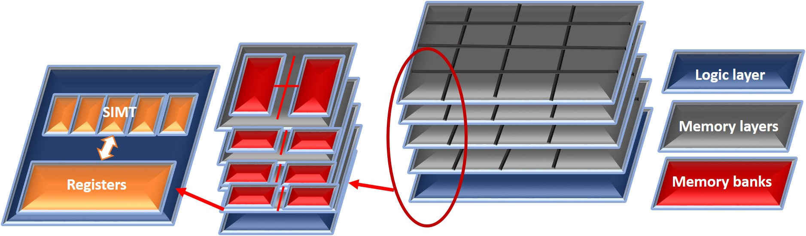
Round 2
Approach 2:
  Light GPGPUs in the Logic layer [Hsieh, et.al.][Zhang, et.al.]
Notes:
To reduce the cost of data movement prior works have proposed two main approaches: In-situ computing where we perform computation on the row buffer and therefore there is no need to move data ot of the subarray. Since there are many subarrays and many banks, in-situ computing provide significant parallisem The other approach is to put a light gpgpu in the logic layer. We still need to send data out of subarrays, banks and vaults but we do not need to send the data out of memory.

