Slide 1

An Overflow-free Quantized Memory Hierarchy in General-purpose Processors
Marzieh Lenjani , Patricia Gonzalez ,
Elaheh Sadredini , M Arif Rahman, Mircea R. Stan
Notes:
Hello eveyone, I am Marzieh, I am presenting my paper: An Overflow-free Quantized Memory Hierarchy in General-purpose Processors
1

Slide 2
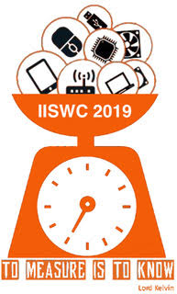

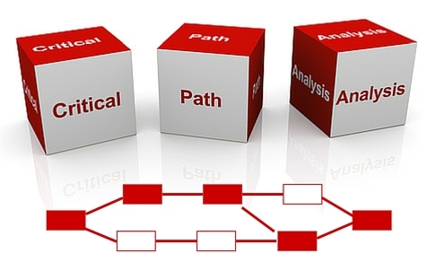
Characterization for design optimizations

Slide 3
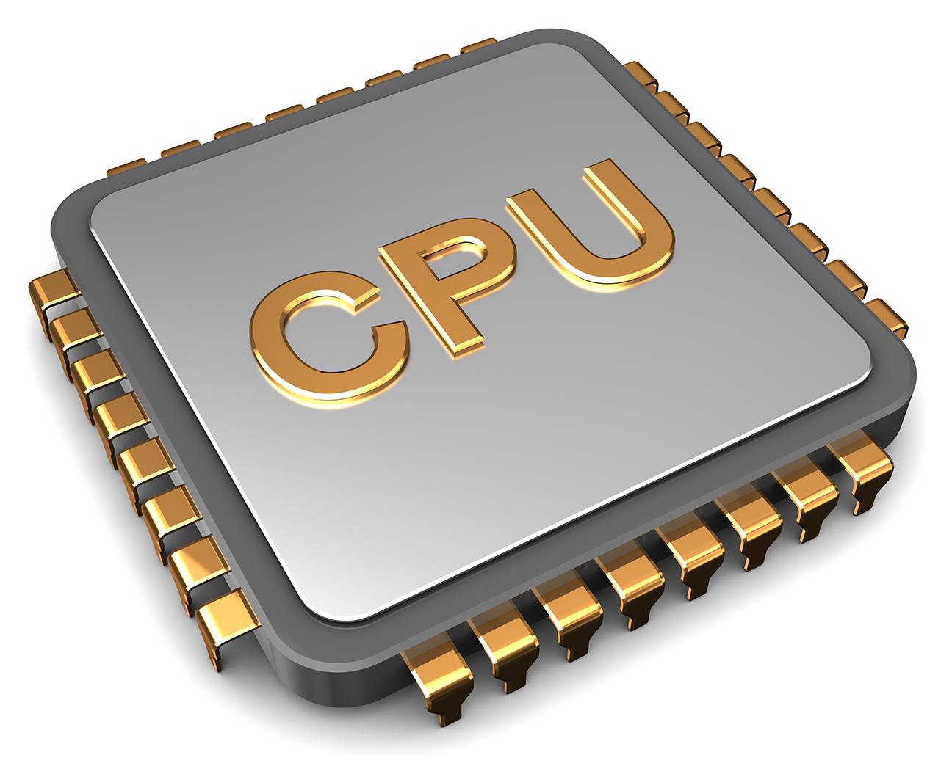
How about summarizing characterizations into an abstraction?
@characteristics
<…, …, ….>
OS and MMU

Slide 4


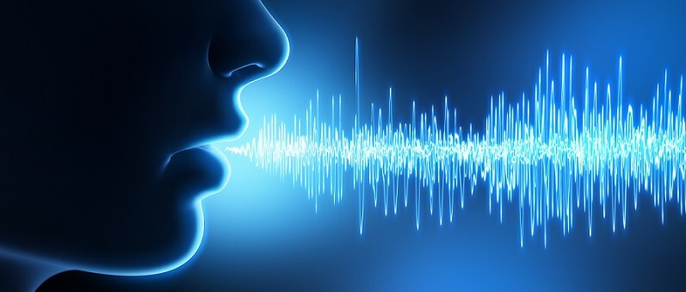

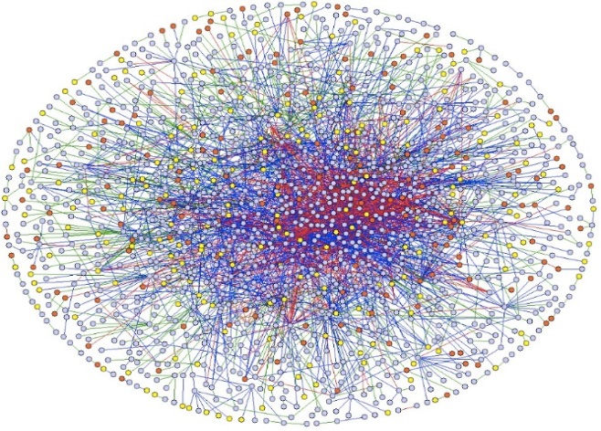
Characteristics as abstractions for memory-intensive application
  What is different about memory-intensive applications?
  Few computations per loaded datum
Notes:
Our work targets memory-intensive applications, because many of the modern applications are memory intensive
For example …..
So the question is what is different about memory-intensive applications
The main difference is that there few computations per loaded datum in memory-intensive applications

Slide 5
Cost of data movement in memory-intensive applications
Cost of each data movement >> Cost of each computation
[1]. Han, Song, et al. "EIE" ISCA 2016.
Memory-intensive application
  Few computations per data movement
>1000x more energy
Memory to L1
An ADD operation
>100x more latency
  Data movement dominates the
  execution time and energy consumption

Slide 6
Outline
Reducing the cost of data movement
  Approach1: Cache compression
  Approach2: Truncating LSBs
  Approach3: Quantization
Quantization in general-purpose processors
Characteristics as abstractions
Evaluation
Conclusion
Notes:
Here is the outlie of this talk. First, I will talk about high cost of data movement in modern processors, and then explain how approximate computing can solve this and then introduce two major approach in approximate computing, then I will talk about the goal of this

Slide 7
Approach1: Cache compression
Memory
LLC
Compressor/
decompressor
L2
Processor
A compressed cache block
A cache block

Slide 8
Compressor/decompressor obliviously looks for value locality
Memory
LLC
Compressor/
decompressor
L2
Processor
A compressed cache block
A cache block
  Problem1: Complex compression/decompression

Slide 9
Metadata per block
Compressor/
decompressor
A compressed cache block
A cache block
Metadata overhead
  Problem2: Significant metadata overhead

Slide 10
Variable block size
B3
Pointer to B2
Pointer to B2
B2
Pointer to B1
B1
L3:Data array
L3:Tag array
L2
  Problem3: Complex address translation

Slide 11
Low value locality
High variation in LSB
  Low value locality
Complex structures
  Low value locality
Sign
Exponent (8 bits)
Mantissa ( 23 bits)
Struct element{
float Price;
bool type;
float yield}
price
type
Unused
yield
87.89
True
XXXXXXX
0.2
  Problem4: Low compression ratio

Slide 12
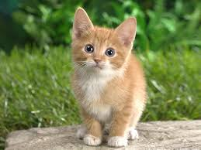
Approach2: Truncating LSBs
Approximate computing
  Many applications can tolerate imprecise variables
    [Example: image classification]
Model
Cat✓
Dog ×
  Tolerate imprecise variables ➔ Shorter variables
  ➔ Less data movement
Notes:
But we have approximate application which tolerate imprecise inputs. So, if we can tolerate imprecise inputs, lets eliminate some bits and make the variables shorter which results to having less data and

Slide 13
Approach2: Truncating LSBs
Omitting Least Significant Bits (OLSB) [Jain et al., MICRO 2016]
  Complies with the exponent-mantissa format of the floating point standard
Sign
Exponent (8 bits)
Mantissa ( 23 bits)
Sign
Exponent (8 bits)
Mantissa (14 bits)
Eliminated bits
The shorter variable
Notes:
So, prior works propose to eliminate least significant bits from mantissa to shorten the variables and they still follow the mantissa and exponent format format from the floating point format

Slide 14
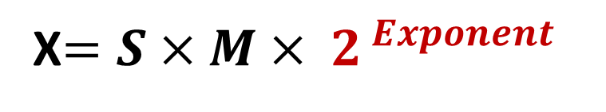
Problem 1: High cost with exponent
Keeps the exponent intact to reduce error
1 bit
7 bits
4 bits
High error
X$=S{×M× 2}^{ Exponent}$
1 bit
8 bits
3 bits
High overhead
12 bits variables
Notes:
But this approach has two problems. The first problem is that it has to keep the exponent almost intact because eliminating even one bits resultsa high error
And by having 8 bit for exponent, for short variable such as 12 bits variables, the overhead of 8 bits will be more 60 %

Slide 15
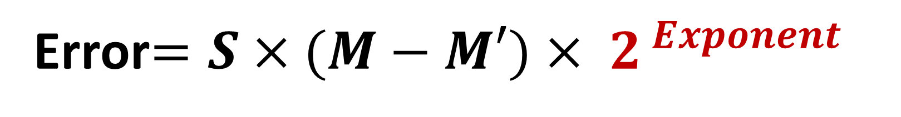
Problem 2: Exponent’s impact on error
Sign
Exponent (8 bits)
Mantissa (14 bits)
Mantissa (14 bits)
HIGH
Error$=S{×(M−M′)× 2}^{ Exponent}$
HIGH
Exponent =+127
Error=(M-M’)× 10⁺³⁴
LOW
Exponent =-126
Error= =(M-M’) × 10⁻⁴³
LOW
  Error grows with the magnitude of value
Notes:
The second problem is that because error depends on the exponent part, if exponent is large error is high and if expnent is small error is low, so , our error will be highly unpredictable

Slide 16
Traditional reason for the exponent-mantissa format
0
-3.4 × 10³⁸
1.2 × 10⁻³⁸
3.4 × 10³⁸
Minimum
Minimum positive
Maximum
Advantage: supporting a wide range of values
Notes:
We know that The traditiona reason for having exponent is to support a wide range of value from + and – 3.4 by 10 raised to 38 and having minimum positive of 1.2 by 10 raised by -38

Slide 17
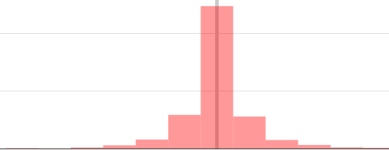
Approach3: Quantization
Converting floating point numbers
to short integers
Error=∆=fixed
Range of Values
Error=∆=fixed
Error=∆=fixed
Error=∆=fixed
Error=∆=fixed
Error=∆=fixed
∆=0.25
1.25
2.0
2.75
-3
-2
-1
0
+1
+2
+3
111
110
101
000
+001
+010
+011
Shorter bit-width and limited error
Notes:
So, we start to think about other approximation methods like Quantization. So what is quantization? Quantization can convert floating point numbers to integers. Assuming a limited range, quantization divides the ranges into few steps and and as assign an integer index to steps and a result represent values with few bits.

Slide 18
Problem : Overflows
Minimum
Maximum
Values outside the supported range cause overflows
Notes:
We know that The traditiona reason for having exponent is to support a wide range of value from + and – 3.4 by 10 raised to 38 and having minimum positive of 1.2 by 10 raised by -38

Slide 19
Quantization is getting
very popular
Notes:
The question here is that whether keeping the exponent and mantissa format is necessary or not

Slide 20

Where to use quantization?
Applications that can tolerate overflows
Accelerators:
  Can exploit non-standard bit-width (e.g. 4-bit, 12-bit, 18-bit)

Slide 21
How about overflow-free quantization in general-purpose processors?
Notes:
The question here is that whether keeping the exponent and mantissa format is necessary or not

Slide 22
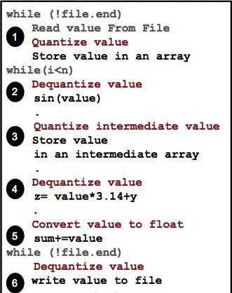
Quantization for general-purpose processors
Software-based Implementation
  Can not exploit non-standard bit-width
    (e.g. 4-bit, 12-bit, 17-bit)
  Significant Programmer’s effort
  Significant performance overhead
    For conversions
  Prone to bugs and overflows

Slide 23
Key observation
Significant portion of values lie within a narrow range
There are only few outliers outside the range
Notes:
So, we observed that real applications operates on a limited range and conclude that the maybe this Mantissa and exponent format is not necessary

Slide 24
Key observations
Deep learning
Financial apps
Financial apps
Signal processing
Significant portion of values
lie within a narrow range
There are only few outliers outside the range
Notes:
So, we observed that real applications operates on a limited range and conclude that the maybe this Mantissa and exponent format is not necessary

Slide 25
Quantization + overflow handling
can benefit a wide range of applications
Quantization + overflow handling
can be employed in
general-purpose processors

Slide 26
Goals:
1. Support for overflow-free quantization in general-purpose processors
2. Hardware-accelerated conversions
3. Minimal programmer’s effort
4. Flexible bit-width

Slide 27
Key mechanisms
Converting an array of values to a quantized bitstream
Representing values within the range with few bits
  Fixed bit-width, e.g., 4 bits
Assigning an outlier indicator with same bit-width
  E.g., “1111”
Replacing outliers with the indicator in the quantized bitstream
Storing the real value of outliers in a different dedicated space

Slide 28
How to avoid overflows?
@quant <3, 0.25, 1.5>
float price [1000];
Processor
Memory
L2
Multiple
de-quantized
blocks
A quantized block
L1
Converter
  1. Computation: Convert to float before computation
  2. Conversion: Retrieve outliers from the dedicated space
Notes:
So, The goal of this work is to provide a hardware support for quantization in general purpose processors. We want to minimize programmer’s effort, so tha tprogrammers only need to annotate the array that contains approximate values and corresponding quantization parametes. Then our converter module quantize and dequantized cache blocks when blocks move between a upper level cache and a lower level cache

Slide 29
Quantization looks like cache compression
@quant <3, 0.25, 1.5>
float price [1000];
Processor
Memory
L2
Multiple
de-quantized
blocks
A quantized block
L1
Converter
  How to avoid cache compression problems?
Notes:
So, The goal of this work is to provide a hardware support for quantization in general purpose processors. We want to minimize programmer’s effort, so tha tprogrammers only need to annotate the array that contains approximate values and corresponding quantization parametes. Then our converter module quantize and dequantized cache blocks when blocks move between a upper level cache and a lower level cache

Slide 30
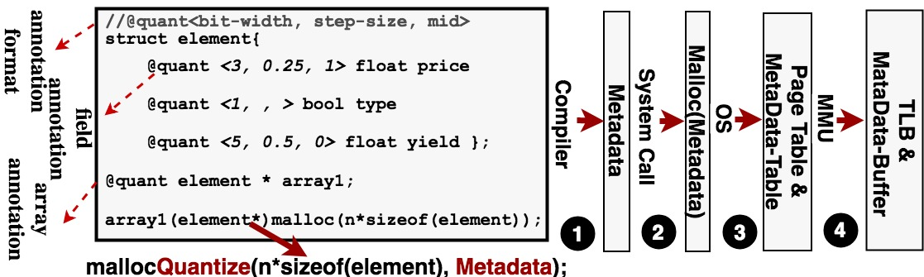
A high-level abstraction can help
  MMU transfers quantization parameters,
  array’s boundaries, and layout to hardware

Slide 31
How do quantization parameters help?
@quant <3, 0.25, 1.5>
float price [1000];
A low-overhead compressor/decompressor
  Quantizer/dequantize
  Simple arithmetic-based conversions
    Instead of Obliviously looking for value locality

Slide 32
How do array’s boundaries help?
Keep the metadata for the whole array
  Vs. keeping metadata per block (per page)

Slide 33
How does layout help?
Higher compression ratio for arrays of structure
Struct element{
float Price;
bool type;
float yield}
price
type
Unused
yield
87.89
True
XXXXXXX
0.2
9
bits
1
bits
4
bit

Slide 34
Address translation using precomputed (offline-computed) values
Precomputed values for low-overhead address translation
  Reciprocate of the number of quantized words that fit in a block
  Accumulated quantized bit-width of variables in a structure
B3
B2
B1

Slide 35
Evaluation
Notes:
The question here is that whether keeping the exponent and mantissa format is necessary or not

Slide 36
Quantization vs LSB truncation
3.5
Quantization provides 3.5 times lower relative error

Slide 37
Quantization vs LSB truncation
16
Quantization provides 16 times lower absolute error

Slide 38
Quantization vs LSB truncation
For a specified error,
quantization requires fewer bits

Slide 39
Quantization vs OLSB
  Up to 31% performance improvement over OLSB

Slide 40
Quantization vs OLSB
  Up to 31% performance improvement over OLSB

Slide 41
Performance Evaluation
Performance improvement increases as the number of cores increases

Slide 42
Performance Evaluation
Performance improvement increases as the number of cores increases

Slide 43
Quantization vs cache compression
  Latency of access to the decoupled tag and data array nullifies the higher compression rate by Qnt+Comp

Slide 44
Conclusion
Most values lie within a narrow range
  No need to have exponent and mantissa format except for outliers
General-purpose processors can exploit quantization
Quantization can be a low-overhead compression technique
  Simpler compressor/decompressor
  Less metadata
  Low-overhead address translation
  Higher compression ratio
    For floating point variables and arrays of structures

