Slide 1
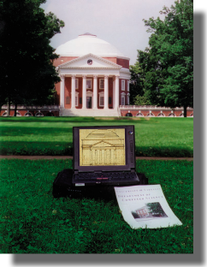
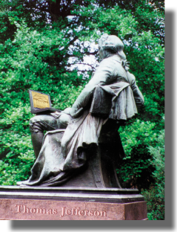
Applied Algorithms and Optimization
Gabriel Robins
Department of
Computer Science
University of Virginia
www.cs.virginia.edu/robins

Slide 2
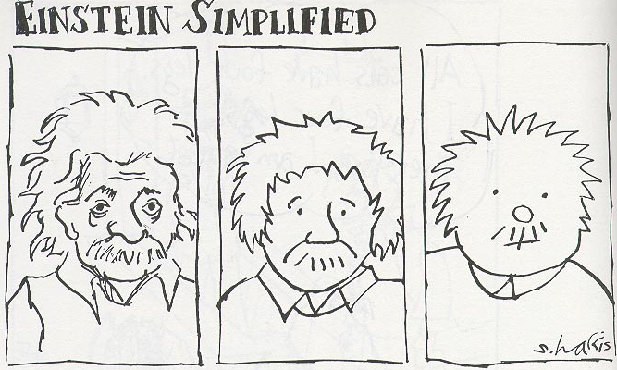
“Make everything as simple as possible, but not simpler.”
- Albert Einstein (1879-1955)

Slide 3
Algorithms
Solution
exact
approximate
Speed
fast
Short & sweet
Quick & dirty
slow
Slowly but surely
Too little, too late

Slide 4
Complexity

Slide 5
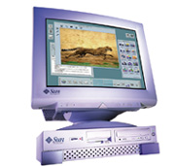
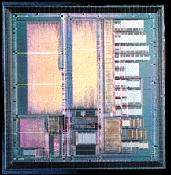
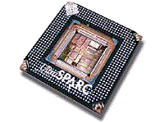
VLSI Design
Design
Specification
Functional
Design
Logic
Design
Requirements
e.g., “secure
communication”
Data
encryption
C(M) = M^{p} mod N
Z = x + y w
Physical
Layout
Fabrication
Physical
Layout
Structural
Design
x
y
z
w

Slide 6
Placement
& Routing

Slide 7
Trends in Interconnect
time

Slide 8
Steiner Trees
2
3

Slide 9
Steiner Trees
Steiner Trees

Slide 10
Iterated 1-Steiner Algorithm
Q: Given pointset S, which point p minimizes |MST(S ∪ p)| ?
Algorithmic idea: Iterate!
Theorem: Optimal for ≤ 4 points
Theorem: Solutions cost < 3/2 • OPT
Theorem: Solutions cost ≤ 4/3 • OPT for “difficult” pointsets
In practice: Solution cost is within 0.5% of OPT on average

Slide 11
Group Steiner Problem
Theorem: o(log # groups) • OPT approximation is NP-hard
Theorem: Efficient solution with cost = O((# groups)^{ε}) • OPT ∀ ε>0

Slide 12
Graph Steiner Problem
Algorithm: “Loss-Contracting” polynomial-time approximation
Theorem: 1 + (ln 3)/2 ≈ 1.55 · OPT for general graphs
Theorem: 1.28 · OPT for quasi-bipartite graphs
Currently best-known; won the 2007 SIAM Outstanding Paper Prize

Slide 13
Bounded Radius Trees
Algorithm:
Input:
points / graph
any ε > 0
Output: tree T with
radius(T) ≤ (1+ε) • OPT
cost(T) ≤ (1+2/ε) • OPT

Slide 14
Low-Degree Spanning Trees
MST 1: cost = 8
max degree = 8
MST 2: cost = 8
max degree = 4
Theorem: max degree 4
is always achievable in 2D
Theorem: max degree 14
is always achievable in 3D

Slide 15
Low-Skew Trees

Slide 16
Circuit Testing
B
A
Theorem: # leaves / 2 probes are necessary
Theorem: # leaves / 2 probes are sufficient
Algorithm: linear time

Slide 17
Improving Manufacturability
Theorem: extremal density windows all lie on Hanan grid
Algorithms: efficient fill analyses and generation for VLSI
Enabled startup company: Blaze DFM Inc. - www.blaze-dfm.com

Slide 18
Landmine Detection

Slide 19
Moving-Target TSP
Origin

Slide 20
Moving-Target TSP
2
3
1
4
Theorem: “waiting” can never help
Algorithms: • efficient exact solution for 1-dimension
• efficient heuristics for other variants

Slide 21
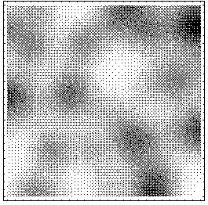
Robust Paths

Slide 22
Minimum Surfaces

Slide 23




Evolutionary Trees
time
Notes:
Over time, Descend from relationship..Tree, leaf,
closer in the tree,more in common
superficially..correct, consistent w/ similarity
because of the relationship..

Slide 24
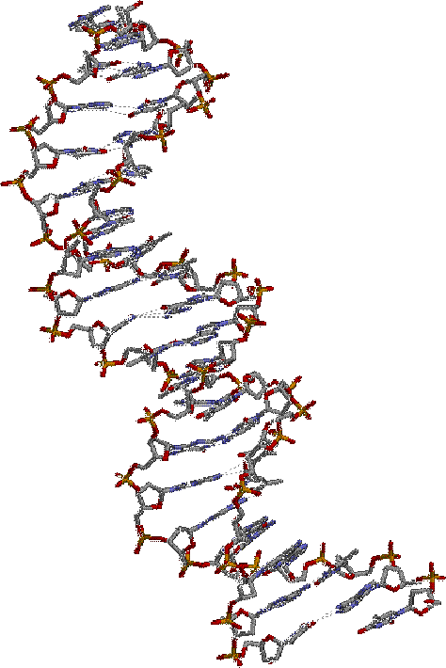
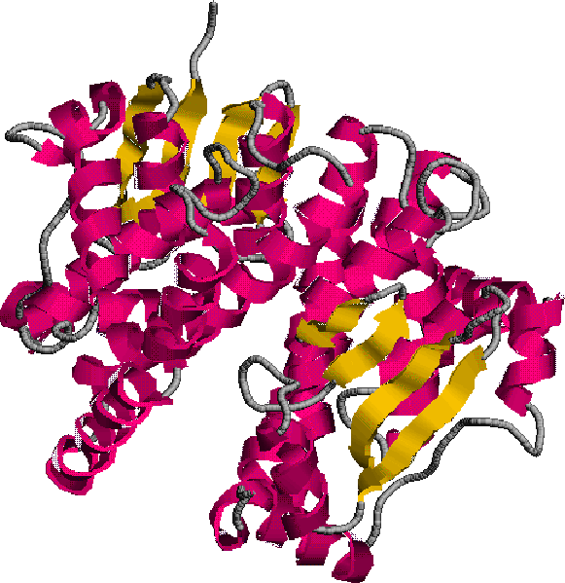
Biological
Sequences
Polymerase Chain
Reaction (PCR)
DNA
protein

Slide 25
Discovering New Proteins
herpesEC
????
herpesEC
crnvHH2
crnvHH2
cmvHH3
humRSC
cmvHH3
humRSC
humfMLF
humfMLF
humIL8
ratANG
humIL8
ratG10d
ratANG
ratG10d
bovLOR1
chkGPCR
bovLOR1
chkGPCR
RBS11
RBS11
humSSR1
gpPAF
humSSR1
ratODOR
gpPAF
ratODOR
dogRDC1
dogRDC1
musdelto
musP2u
musdelto
musP2u
humC5a
chkP2y
humC5a
chkP2y
humTHR
ratBK2
humTHR
ratBK2
ratRTA
ratRTA
humMRG
humMRG
ratLH
ratLH
bovOP
bovOP
humMAS
humMAS
humEDG1
humEDG1
ratCGPCR
ratCGPCR
ratNPYY1
ratPOT
ratNPYY1
ratPOT
ratNK1
humACTH
ratNK1
humACTH
flyNK
humMSH
flyNK
humMSH
flyNPY
musEP3
flyNPY
musEP3
musGIR
musGIR
humTXA2
humTXA2
ratCCKA
ratCCKA
ratNTR
dogAd1
ratNTR
dogAd1
musEP2
musEP2
musTRH
humD2
musTRH
humD2
musGnRH
dogCCKB
musGnRH
dogCCKB
humA2a
humA2a
musGRP
musGRP
ratV1a
hamA1a
ratV1a
hamA1a
bovETA
ratD1
bovETA
hamB2
ratD1
hamB2
bovH1
hum5HT1a
bovH1
hum5HT1a
humM1
humM1

Slide 26
Primer Selection Problem
    Input: set of DNA sequences
    Output: minimal set of covering primers
Theorem: NP-complete
Theorem: Ω(log # sequences)•OPT within P-time
Heuristic: Ο(log # sequences)•OPT solution

Slide 27
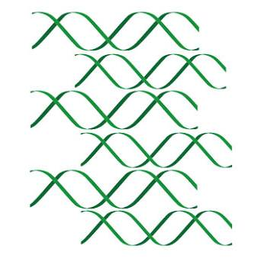
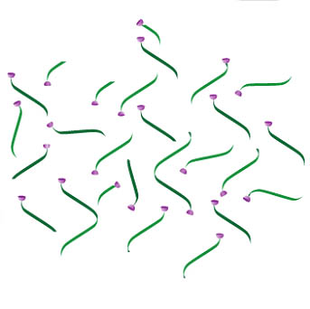
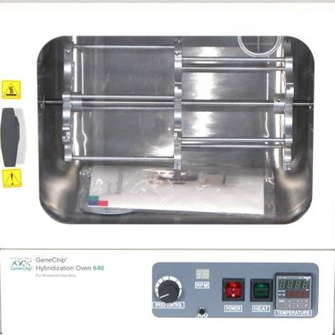
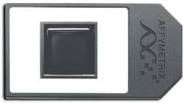
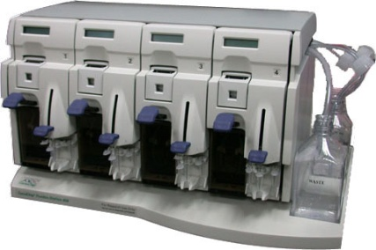

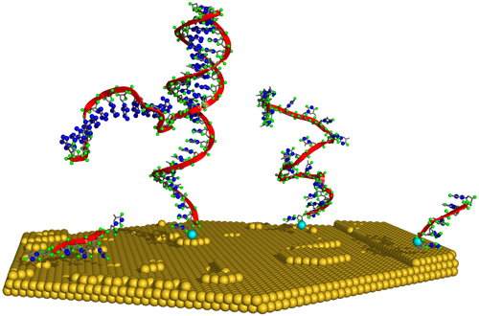
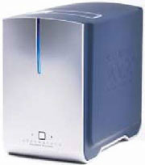
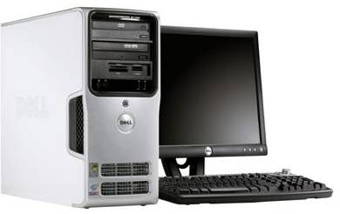
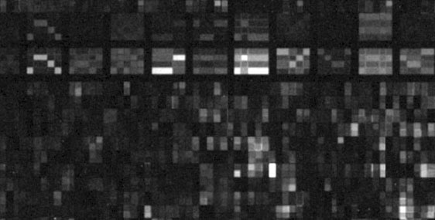

Genome Tiling Microarrays
Algorithms: efficient DNA replication timing analyses
Papers in Science, Nature, Genome Research

Slide 28
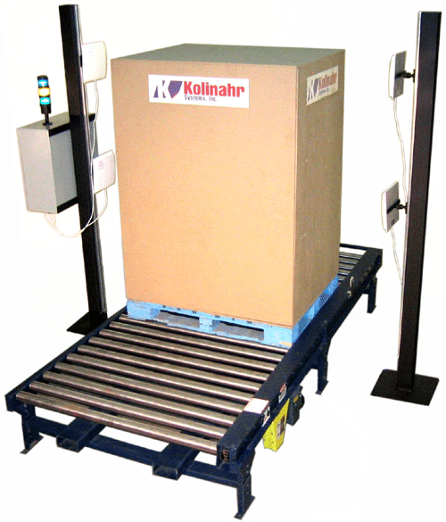

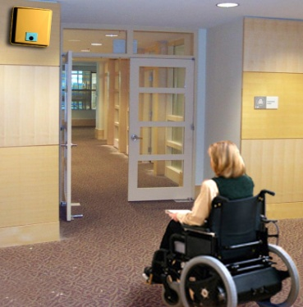
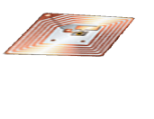



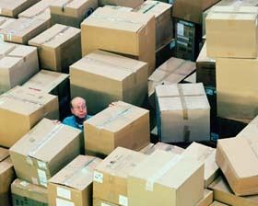




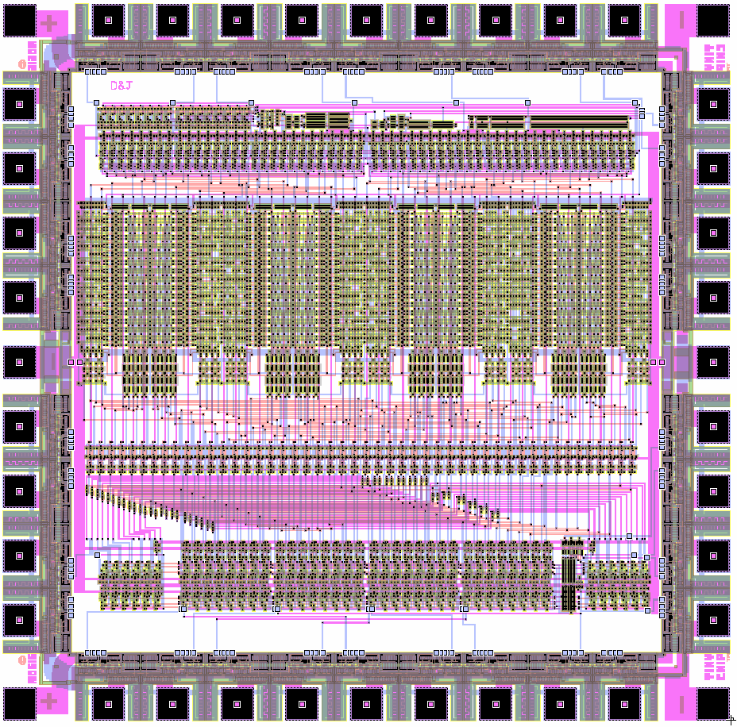


Radio-Frequency Identification
Multi Tags
1 Tag: 75%
2 Tags: 94%
3 Tags: 98%
4 Tags: 100%
Tagging Bulk
Materials
Generalized
“Yoking Proofs”
Physically
Unclonable
Functions
Inter-Tag Communication

Slide 29
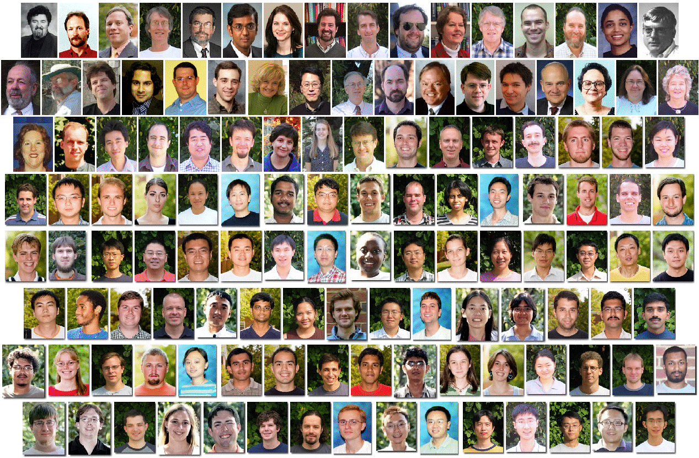
UVa Computer Science

Slide 30
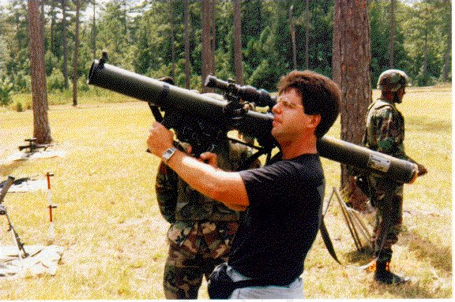
“Gabe aiming to solve a tough problem”
for details see www.cs.virginia.edu/robins/dssg

Slide 31
Lets Collaborate!
What I offer:
  Practical problems & ideas
  Experience & mentoring
  Infrastructure & support
What I need:
  PhD students
  Dedication & hard work
  Creativity & maturity
Goal: your success!

Slide 32
Proof: Low-Degree MST’s

Slide 33
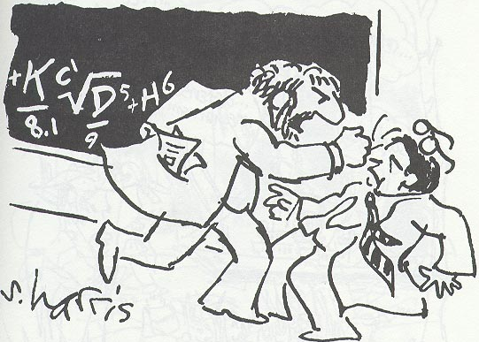
“You want proof? I’ll give you proof!”

Slide 34
Proof: Low-Degree MST’s
6
5
Input: pointset P
Find: MST(P)
2
Perturb region 5-8 points,
  yielding pointset P’
3
1
Compute MST’ over P’
4
Output: MST’ over P
7
8
Idea: |MST’(P)| = |MST(P)|
Theorem: max MST degree ≤ 4

Slide 35
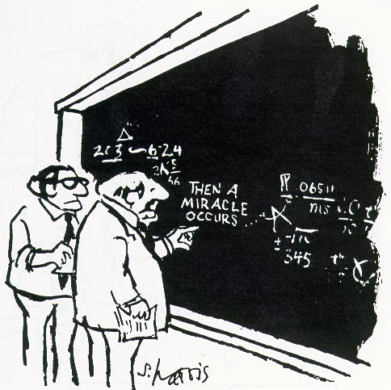
“I think you should be
more explicit here
in step two.”

Slide 36
Low-Degree MST’s in 3D
Partition space:
6 square pyramids
8 triangular pyramids
Input: 3D pointset P
Find: MST(P)
Perturb boundary points
  to yield pointset P’
Compute MST’ over P’
Output: MST’ over P
Idea: |MST’(P)| = |MST(P)|
Theorem: max MST degree in 3D is ≤ 6 + 8 = 14
Theorem: lower bound on max MST degree in 3D is ≥ 13

Slide 37
On the flight deck
of the nuclear aircraft
carrier USS Eisenhower
out in the Atlantic ocean

Slide 38
On the bridge of the nuclear aircraft carrier USS Eisenhower

Slide 39
At the helm of the SSBN nuclear missile submarine USS Nebraska

Slide 40
Refueling a B-1 bomber in mid-air from a KC-135 tanker

Slide 41
Aboard an M-1 tank at the National Training Center, Fort Erwin

Slide 42
At U.S. Strategic Command Headquarters, Colorado Springs

Slide 43
Pentagon meeting with U.S. Secretary of Defense Bill Perry

Slide 44
Patch of the Defense Science Study Group (DSSG)

Slide 45
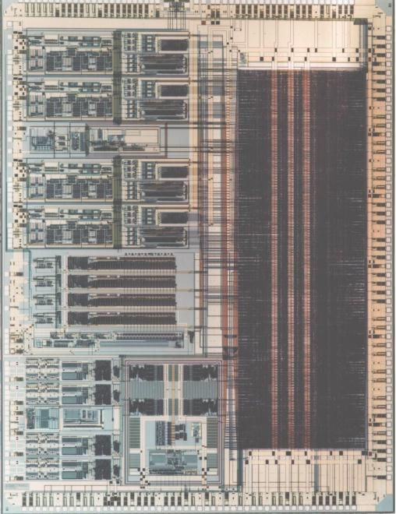

Slide 46
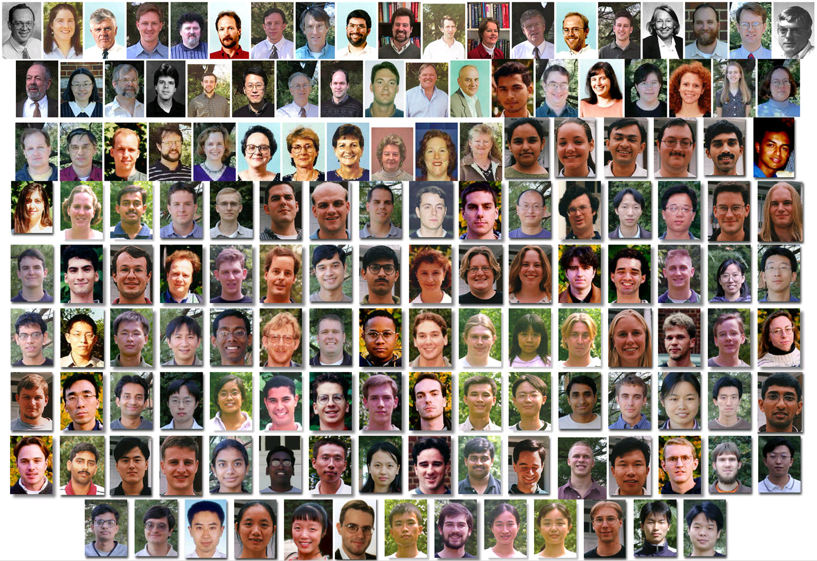
UVa Computer Science

Slide 47
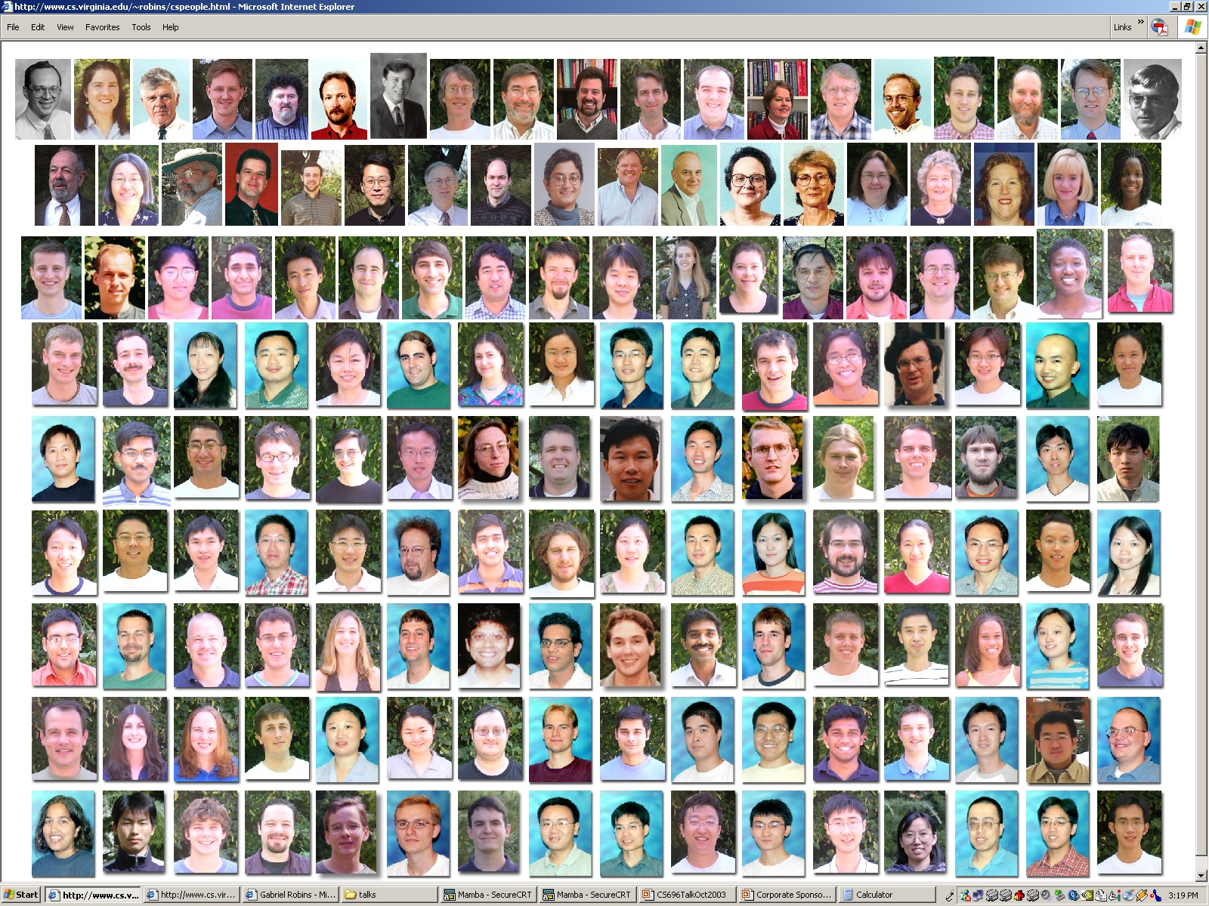
UVa Computer Science

Slide 48
Density Analysis
Theorem: extremal
density windows all
lie on Hanan grid
Input:
n×n layout
k rectangles
w×w window
Algorithms:
O(n²) time
O(k²)
Output: all
extremal density
w×w windows

