Slide 1
Ruminations on the
History of Video Game Design
CS 4730 – Computer Game Design
Fall 2011

Slide 2
My Background
Education
  BS with Honors, Wake Forest University
  MS, NC State University
  PhD, NC State University
Teaching specialties
  Software Engineering, Databases, Web Technologies, Java Programming
Research in Software Reliability
Yeah… none of that matters here…

Slide 3
My Gaming CV
Game Systems Owned
  Early: C-64, Intellivision
  Nintendo: NES, SNES, N64, Gamecube, Wii, Game Boy, GB Color, GBA, GBA SP, GB Micro, DS, DS Lite
  Sega: Game Gear, Dreamcast
  Sony: PSX, PS2, PSP
  Microsoft: Xbox, 360
  PC: Started with a 486 25Mhz; now a good gaming rig

Slide 4
Achievement Unlocked
1995 Blockbuster Store Champion
First issues of Nintendo Power and EGM
Independent study on medieval themes in games
Papers on symbolism in Zelda, HCI of Steel Battalion
First game owned? Congo Bongo (C-64)
Toughest game beaten? Ninja Gaiden (NES)
Most recent game beaten? Portal 2 (coop w/ Weimer)
Most recent purchase? Skyward Sword and Skyrim
Most recent game played? Spell Tower (iOS)

Slide 5
Why bring this up?
I am a gamer – and have been a gamer a long time
The things I want to talk about today come from years of playing games, talking about games, reading about games, and designing my own games
But – we’re on even playing field here, so please chime in!

Slide 6
The Stage of History
I grew up during some important times in gaming that affect how I view games now
BTW – the average gamer today is 37 years old
We come from different gaming pasts
What was your first system?

Slide 7
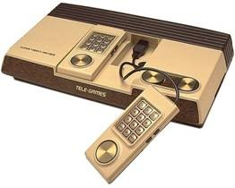
Sears Super Video Arcade

Slide 8
The Stage of History
From 1979 through 1983, the video game industry was booming
New consoles practically every year
  Atari 2600, Atari 5200, ColecoVision, Intellivision (and all its clones), Odessey, Vectrex
Startups were appearing all the time, pushing new titles consistently

Slide 9
The World of Balance
In 1982, Atari was clearing $2B and was recognized as the fastest growing US company EVER
Microcomputers were starting to appear with reasonable prices
  Like the C64 and the TRS80

Slide 10
The World of Ruin
However, it was too much of a good thing
Many of the games that came out were just terrible
The publishers had little to no control over the content
  In fact, this is when Activision was founded as an offshoot of Atari because Atari wouldn’t pay royalties based on sales

Slide 11
The World of Ruin
So many games came out that retailers ran out of shelf space
Games were discounted or sent back to publishers, who couldn’t pay the retailers for the unsold copies
Atari then published the “worst game ever”
E.T.
Not only was it bad – it was also a movie license!

Slide 12
The World of Ruin
By 1984, Atari had filed for bankruptcy
It was at this point that the emerging dominance in the new electronic entertainment market moved from the US to Japan
To a company known for making playing cards
Nintendo

Slide 13

The Nintendo Seal of Quality

Slide 14
Now You’re Playing With Power
The NES was introduced in 1985 and took over the US market in 1987
It’s safe to say that the NES saved the video game industry
This is partially due to the more meticulous nature in which Nintendo reviewed games before approving them
Also consider the franchises that were born during this time frame

Slide 15
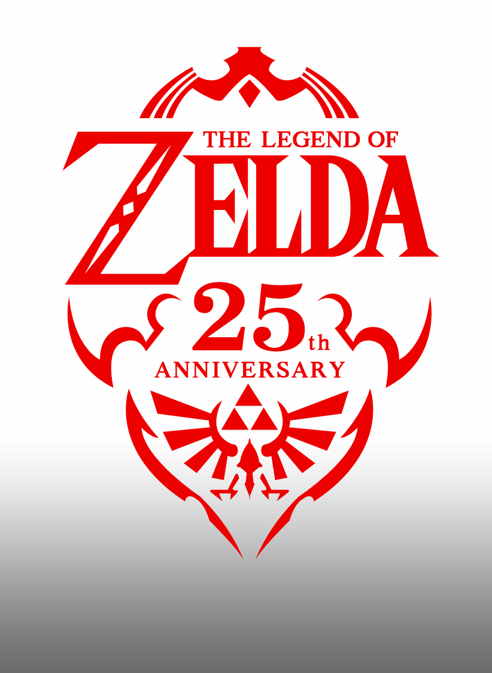
It’s dangerous to go alone…

Slide 16
The Rest of the Story
The stories just kept coming…
SNES vs. Genesis
  Remember “blast processing”?
GameBoy
  The emergence of Tetris
Sega begins to bow out
  SegaCD, 32X, Saturn, Dreamcast
The rise of new players
  Sony and Microsoft enter the market

Slide 17
History in your Hands
But let’s talk about the history of gaming by looking at how we played the games

Slide 18

Sears Super Video Arcade

Slide 19
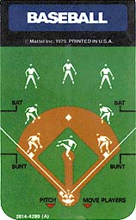
Game Overlays

Slide 20
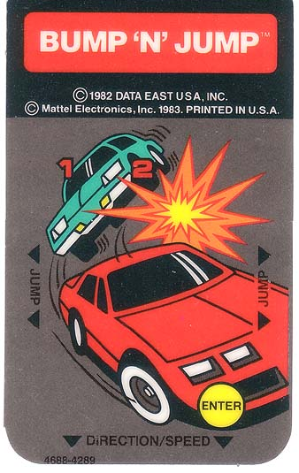
Game Overlays

Slide 21
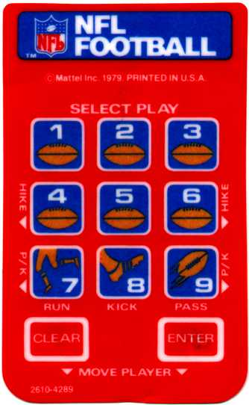
Game Overlays

Slide 22
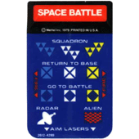
Game Overlays

Slide 23
The Evolution of the Controller

Slide 24
Your Homework
Play a game that came out around the time of or before you were born for a full hour
What gameplay aspects of this game do you really notice?
What mechanics?
Can you identify the descendants of these mechanics in today's games?

Slide 25
Ruminations on the
History of Video Game Design
CS 4730 – Computer Game Design
Fall 2011

Slide 26
What games did you play?

Slide 27
The Counterargument
Why did I ask you to do this?
Well, I want to have a conversation about the evolution of particular gameplay concepts
Hopefully discuss “what is fun”
The conversation basically revolved around “it's really hard to go back and play an early game... just for fun”
Thoughts on my premise here?

Slide 28
Games I hoped you might play
Intellivision – Bump ‘n Jump
Arcade – Pac-Man, Galaga, Space Invaders
NES – Zelda, Zelda 2, SMB, SMB3, Castlevania (I, II, III), Ninja Gaiden, Tetris, Final Fantasy, Dragon Warrior, Double Dribble, RC Pro Am
SNES – SMW, Zelda 3, FF2, FF3, Secret of Mana, StarFox, Mario Kart, Super Metroid
SMS – Alex Kid
Genesis – Sonic, Madden

Slide 29
Frame of Reference
I wanted you to play games so that you can evaluate where games have gone today
Can you go back and play old games for fun?
Is nostalgia a factor?
Let’s consider some games that would still be good today

Slide 30
My favorite examples
Tetris
Mega Man (1-3, 9)
Pokémon
Castlevania: Symphony of the Night
Final Fantasy
Super Mario Bros. 3
… we could keep going

Slide 31
But…
What do you think?
Did you have fun?
Or was it just “too old” for you?

Slide 32
Game Mechanics
What did you see in these games?

Slide 33
Game Mechanics
Run and jump
Power ups
1ups
Exploration
Inventory additions
Subscreen
Upgrade purchases
“Metroidvania” mechanic

Slide 34
Simple is Beautiful
Can you describe a game fully in one sentence?
I argue that some of the greatest games fit this rule
There are probably exceptions, but I think it’s a good general rule

Slide 35
Too Simple?
Of course not every game has to be simple
Of course not every game has to be bite sized
The key – understand your audience
  “Younger” gamer
  Teen/College gamer
  Adult gamer
  On-the-go gamer
  Party gamer

Slide 36
A Game’s Profile
Audience
Purpose of game
Expected gaming environment
Overall game length
Average game play session length
“Bite size” game session length
Does the profile “work?”

Slide 37
Examples to Consider
Rock Band
Peggle
Grand Theft Auto: Liberty City Stories
New Super Mario Bros.
World of Warcraft
Mario Party
Madden
Devil May Cry

Slide 38
An Interesting Design Concept
The “30 seconds of fun”
How does this manifest itself in games?
Halo?
Gears of War?
Planet Puzzle League?
Bejeweled?
Super Mario Bros. 3?

Slide 39
“Bite-sized Gaming”
This was an early concept, that went out of style through the N64/PSX era, but has made a HUGE resurgence
Why? What’s changed?

Slide 40
“Bite-sized Gaming”
Find some examples of this in today’s games

Slide 41
Levels to Learn From
http://www.vgmaps.com/Atlas/SuperNES/SecretOfMana-Gaia%27sNavel%28Exterior%29.png
http://www.vgmaps.com/Atlas/SuperNES/MegaManX-ChillPenguin.png
http://www.vgmaps.com/Atlas/Genesis/SonicTheHedgehog2-EmeraldHillZone-Act1.png
http://www.vgmaps.com/Atlas/NES/LegendOfZelda-FirstQuest-Level-1%28Eagle%29.png
http://www.vgmaps.com/Atlas/NES/LittleNemo-TheDreamMaster-Dream1-MushroomForest.png

