Slide 1
Pair Programming in the Classroom
Mark Sherriff
University of Virginia
June 28, 2013
Some material courtesy of Laurie Williams, NCSU
Tapestry 2013

Slide 2
Overview
What exactly is Pair Programming?
The Case for Pair Programming
The Costs
Guidelines for a successful pairing experience
Myths and Legends
Resources

Slide 3
Pair Programming Definition
"Pair programming is a style of programming in which two programmers work side-by-side at one computer, continuously collaborating on the same design, algorithm, code, or test." – Laurie Williams

Slide 4
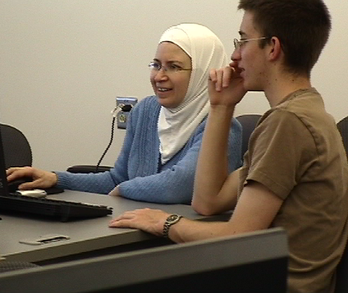
The Roles
The Driver
The person with "control" of the computer
Does the bulk of the typing
The Navigator
Actively follows along with the driver with comments
Can take over at any time

Slide 5
Partners vs. Pair Programming
How is Pair Programming different than just having partner assignments?
Mentality of how to approach the assignment
Partnering:
"You go do this part and I’ll go do this part and then we’ll put it back together."
Pair Programming:
"Let’s first do this part together, then we’ll tackle the rest."

Slide 6
Partners vs. Pair Programming
The distinction matters!
It matters to:
Instructors
Teaching Assistants / Tutors
Students
Call it framing, perception, spin… whatever
It’s all about attitude!

Slide 7
It’s All About Attitude
How do you get the attitude going?
It has to start with the instructor
TAs / other staff have to buy in and help enforce
Needs to be an environment that can support teaching and facilitating the technique
Closed lab sessions
In-class group coding exercises

Slide 8
Why Pair Programming?
Pair programming students tend to:
Make it through the first class
Perform comparably or better on exams and projects
Perform just fine in future solo programming
Stick with computer science

Slide 9
Why Pair Programming?
An instant support system
We have found that pairing cuts down on a large number of the "trivial" questions (syntax, assignment clarification, etc.) and a fair number of the more complex questions (debugging, etc.)
We have been able to reduce the number of TAs for some courses
Instructor office hours are much quieter, and the instructor can spend more time with students that need more help

Slide 10
Why Pair Programming?
Sometimes it is a numbers game
In a lab of 40 students…
having 20 pairs makes it easier for TAs to get to everyone
20 assignments are easier/faster to grade than 40
Our main CS1 course has over 500 students every Spring…

Slide 11
All for the low, low price of…!
What’s the cost?
Pair management
How do we assign pairs effectively for every assignment so it’s not too much overhead?
Pair evaluation
How can students report pair issues to the staff?
Grading
How do you "split" grades up between partners?

Slide 12
Pair Creation
First question: Do you assign partners or do you let students pick their own partners?
This has become a TOUGH question for me!
Tried both with CS1 and CS2 courses
Current opinion:
It’s not a CS1 vs. CS2 question
It’s a familiarity with other students question
Problems not with material, but with the different majors

Slide 13
Pair Management and Evaluation
Auto-Assign Pair Creation
PairEval – http://www.realsearchgroup.org/pairlearning/
CATME – http://www.catme.org
Data needed for each of these to auto-create pairs varies
Self-Reported Pairs
Google Forms

Slide 14
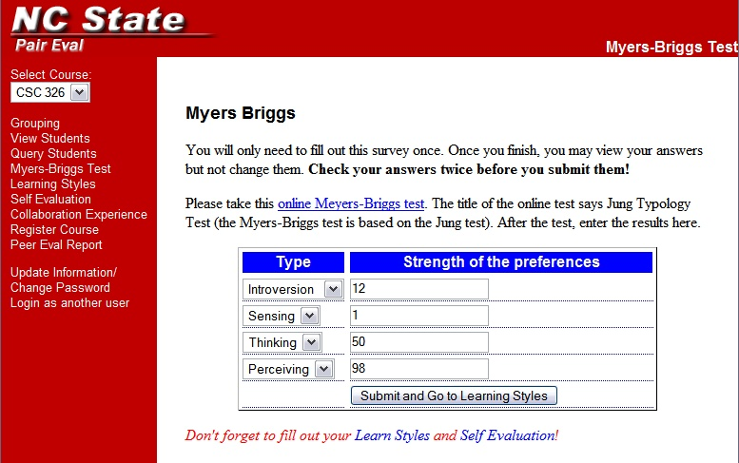
PairEval

Slide 15
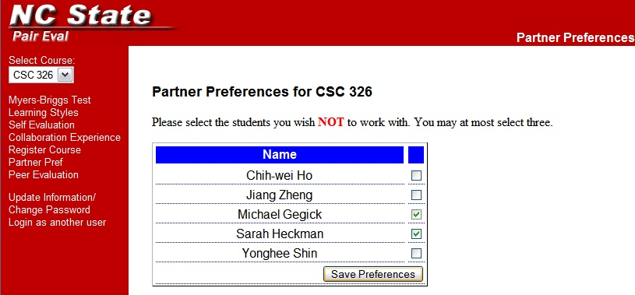
PairEval

Slide 16
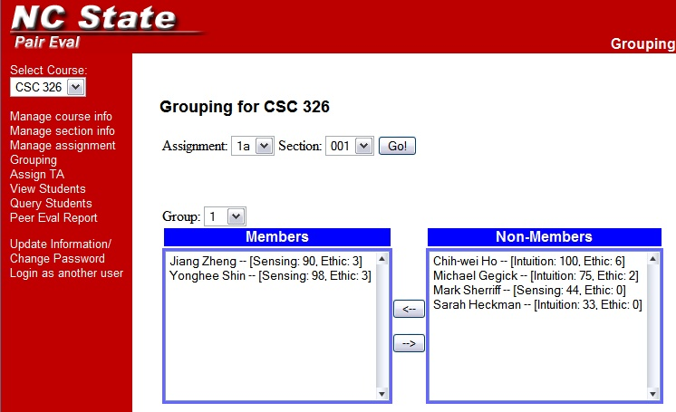
PairEval
Optionally, use student information to help form groups. Closer work Ethics and more diverse Sensing and Intuition students make for more compatible pairs.
Select a group number
Move students into and out of groups

Slide 17
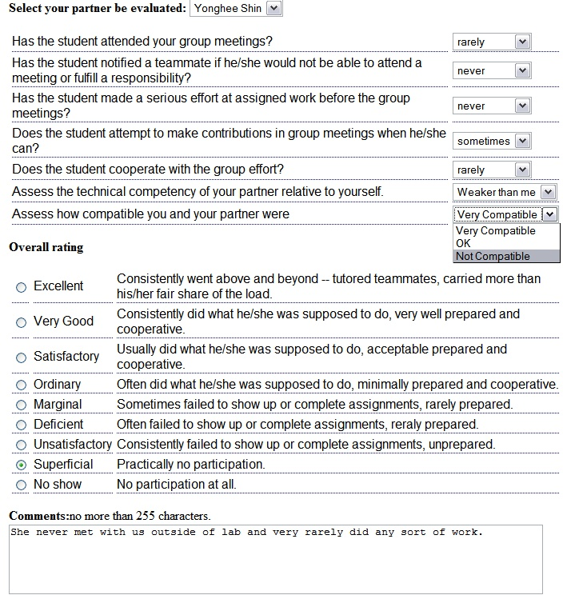
PairEval

Slide 18
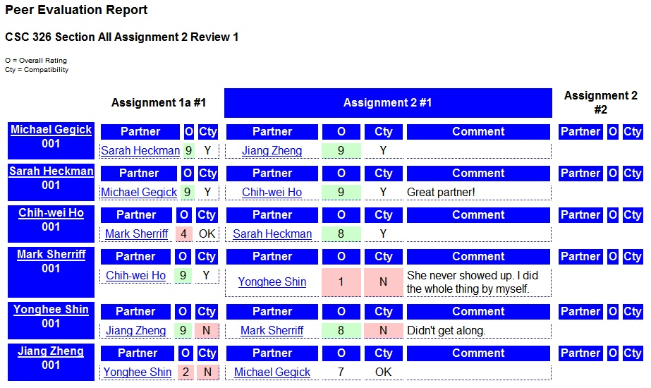
PairEval

Slide 19
Pair Evaluation
With or without a tool like PairEval, it boils down to a few questions:
Did the pair get along?
Did you get the work done?
Do you feel like you “did your fair share?”
More data is nice/interesting, but this is all you really need
Reliable feedback system is needed

Slide 20
Pair Evaluation and Grading
If there’s no problem… then great!
If there is…
If possible, ask the students one at a time: “If 100% effort is you doing exactly what you should have been doing, what percentage did you actually do?”
95% of the time, this works!
For the other 5%, you have to use your best judgement

Slide 21
The Biggest Cost
Training!
Instructors, TAs, and students need to be taught how to do effective pair programming in a controlled environment!
The controlled environment could be a closed lab or lecture-lab system.
We’ll do a training exercise at the end if there’s time.

Slide 22
But we don’t have a closed lab?
CS1:
Assigned pairs not advisable (partner-split mentality!)
Use for in-lab work only
CS2:
Proceed with caution for assigned pairs for first assignemnt
Works better after first month or so
At least bond in lab + some outside work
CS2+:
After at least one paired class
Bonding still beneficial, outside work fine

Slide 23
Getting Involved
Instructors and Teaching Assistants have to take an active role in lab
Must monitor and approach pairs if they seem to be dysfunctional
Should "strongly encourage" drivers and navigators to switch
Instructors also must understand that some pairings are just not going to work
Don’t let it discourage you!

Slide 24
How Many Pairings Fail?
Class | Very compatible | OK | Not compatible
CS1 | 64% | 32% | 4%
SE-P1 | 60% | 33% | 7%
SE-P2 | 56% | 35% | 9%
OO | 76% | 15% | 9%
Total | 60% | 33% | 7%

Slide 25
Problem Pairs
Will problem pairs happen? Yes.
Particular cases:
The “I don’t care” student
The special needs student
The absent student
The “liberal arts vs. engineering” student
These problems are not pair programming related, but pair programming can make these come to the surface more often

Slide 26
Guidelines To Follow
Strict tardiness / absence policy must be followed for pair activities to guard against lazy partners.
Loss of partner, points, and bad evaluation
There must be a reporting mechanism for students to provide feedback on partners
PairEval, CATME, or a simple Google Form
"If you could rate your effort based on 100%.."

Slide 27
Guidelines To Follow
Assignments should be a bit more challenging
"Softball" assignments tend to be finished by a single person without consulting their partner
The environment for pairing must be conducive to pairing

Slide 28
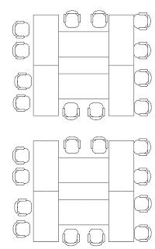
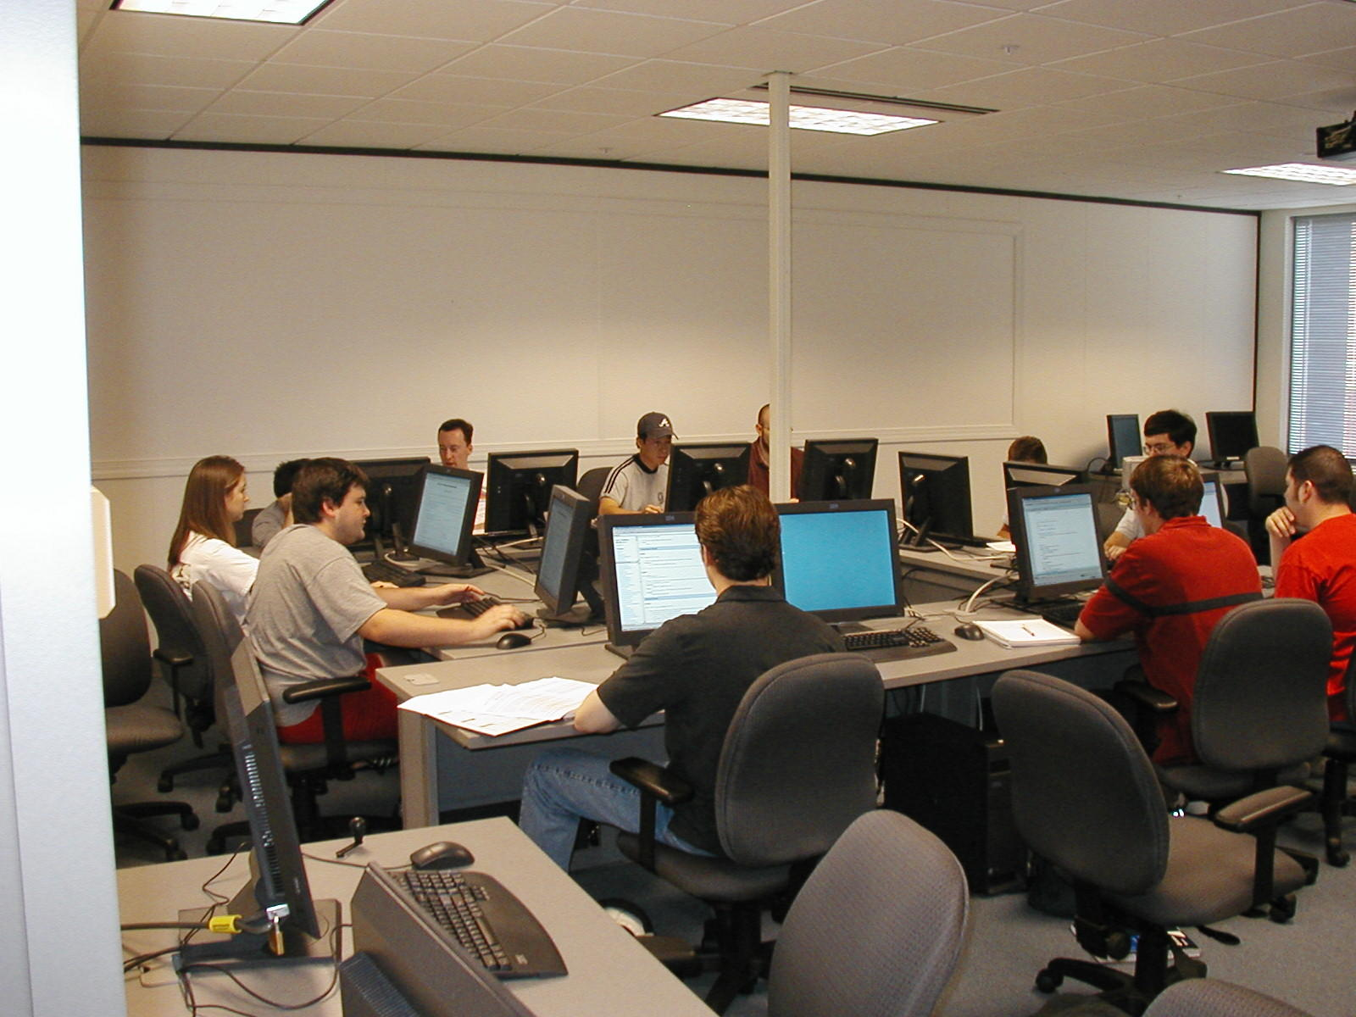
Lab Setup

Slide 29
Guidelines To Follow
Don’t go overboard!
Everything in moderation ☺
Pairing isn’t for every assignment
There must be a balance (in work and in grade)
Pairing is not random!
Thought must go into pairs
Students should ideally get new partners for every assignment

Slide 30
Pair Rotation
Reassign several times per semester
Good for students
Get to meet new people, learn about working with new people
If they don’t like their partner, they know they will get a new one soon
Good for instructor
Multiple forms of feedback
Natural handling of dysfunctional pairs

Slide 31
Myths and Legends
Myth: Half the students will learn
"In the first course, students need some time to absorb the ideas themselves."
"My inclination is to allow more group work starting in the second course."
"We want to be sure that each student writes enough code him/herself to learn the introductory concepts."
"I am against pair-programming in introductory courses, where students need to develop strong programming skills themselves."

Slide 32
Myths and Legends
In fact, all the students learn pretty well…
Studies at NCSU and SDSU showed that exam scores were comparable or improved for all students in introductory classes
Also, the percentage of students whose grade in CS2 went down by over 1/3 of a grade dropped once pairing was used in CS1
Williams, L., Layman, L., Lab Partners: If They’re Good Enough for the Sciences, Why Aren’t They Good Enough for Us?, Conference on Software Engineering Education and Training (CSEE&T ’07)

Slide 33
Myths and Legends
By falling for this myth, you’re perpetuating another one
“All computer scientist work by themselves in cubicles struggling to code.”
We all know that creating software is HIGHLY collaborative!
Why give the wrong impression in the first class they take!?

Slide 34
Myths and Legends
Myth: Cheating will increase
"With loose rules about who partners are, people will just pass code around. There has to be structure!"
"Old partners may feel obliged to help their former teammates."

Slide 35
Myths and Legends
Think about it a little differently…
When we provide partners, students now have a support system they can turn to
Anecdotal evidence from students indicated that the stress of feeling alone and isolated made them consider cheating
Two people now have to agree on cheating!
Well… there are exceptions to this one…
Moss is still a valuable tool
Tapestry 2011

Slide 36
Other Guidelines and Myths
Any others to add?
Tapestry 2011

Slide 37
Introduction to Pair Design
Design Activity

Slide 38
Resources
http://www.realsearchgroup.org/pairlearning
http://www.ncwit.org/pairprogramming
My email: sherriff@virginia.edu
Tapestry 2011

