Slide 1
AMD’s ATI GPU Radeon R700 (HD 4xxx) series
Elizabeth Soechting
David Chang
Jessica Vasconcellos
CS 433
Advanced Computer Architecture
May 7, 2008

Slide 2
General
Fetch
SIMD
Memory
Multithread
General
Pipeline
Cores
Interconnect
Radeon R700 series GPUs have three levels:
Value
Mainstream
Performance
Marketed for:
Blu-ray movies and HD content play
Improved video game visuals
AMD concentrated on improving efficiency of components in this GPU

Slide 3
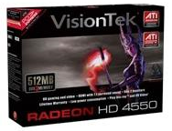
General
Fetch
SIMD
Memory
Multithread
General
Pipeline
Cores
Interconnect
Value GPUs are
ATI Radeon HD 4550
ATI Radeon HD 4350
Price range is $40-$90
http://base0.googlehosted.com/base_media?q=FroogleCatalog_CNETI685882.jpg&size=4&dhm=ecf00013&hl=en

Slide 4
General
Fetch
SIMD
Memory
Multithread
General
Pipeline
Cores
Interconnect
Mainstream GPUs are
ATI Radeon HD 4600
Price range is $70-$100
Has 5 models
4 have single-slot fansink cooling solution
1 has passive-cooling solution
http://ep.yimg.com/ip/I/yhst-57023568947563_2050_632724819

Slide 5
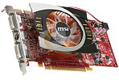
General
Fetch
SIMD
Memory
Multithread
General
Pipeline
Cores
Interconnect
Performance GPUs are
ATI Radeon HD 4890
ATI Radeon HD 4870
ATI Radeon HD 4850
ATI Radeon HD 4830
ATI Radeon HD 4770
Price range is $100-$250
http://images17.newegg.com/is/image/newegg/14-127-432-TS?$S180W$

Slide 6
General
Fetch
SIMD
Memory
Multithread
General
Pipeline
Cores
Interconnect
All Radeon R700 4000 series GPUs are equip with
DirectX 10.1
HD resolution
HDMI with 7.1 digital surround sound support
PCI Express 2.0
55-nm based GPU

Slide 7
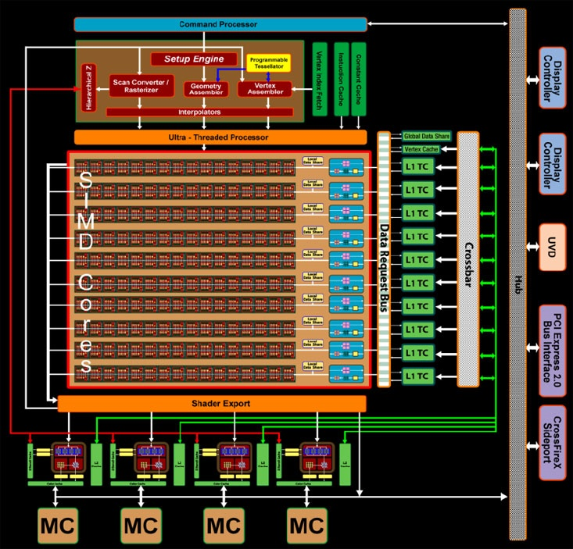
Fetch
SIMD
Memory
Multithread
General
Pipeline
Cores
Interconnect
ATI RV770
GPU block diagram
Instruction cache
http://www.bit-tech.net/hardware/graphics/2008/09/02/ati-radeon-4850-4870-architecture-review/comments

Slide 8
Fetch
Fetch
SIMD
Memory
Multithread
General
Pipeline
Cores
Interconnect
Instruction Cache
Part of the setup processes
Next to Constants cache
Through to the SIMD cores via the Ultra-Threaded Processor

Slide 9
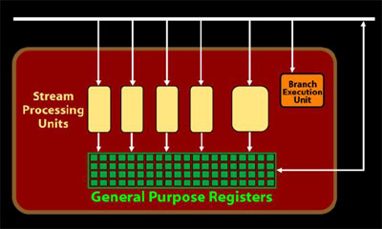
Pipeline
Fetch
SIMD
Memory
Multithread
General
Pipeline
Cores
Interconnect
An RV770 shader processor

Slide 10
Pipeline
Fetch
SIMD
Memory
Multithread
General
Pipeline
Cores
Interconnect
Design is based on “very long instruction word” idea
Started in Radeon HD 2900 XT

Slide 11
Pipeline
Fetch
SIMD
Memory
Multithread
General
Pipeline
Cores
Interconnect
Although the general ideas are known, the details of the pipeline are Company Secrets
Because most bottlenecks occurs during the pipeline
A effective pipeline is extremely valuable

Slide 12
Pipeline
Fetch
SIMD
Memory
Multithread
General
Pipeline
Cores
Interconnect
Execution units are similar to past models (R600) other than
16KB data stores
Register overflow
Realignment of texturing hardware
Dedicated branch execution units and texture address processors

Slide 13
Pipeline
Fetch
SIMD
Memory
Multithread
General
Pipeline
Cores
Interconnect
Changes to the actual pipeline are:
Clocking architecture
quarter data-rate command clock
Better error detection
New data mask algorithm
DRAM support interface improvements

Slide 14
Pipeline
Fetch
SIMD
Memory
Multithread
General
Pipeline
Cores
Interconnect
Each shader processor is made up of 5 stream processors each with different functionality
4 units handle the instructions
Floating point MAD
Floating point Multiply
Floating point add
Integer add
Dot product
Each of these can be handled in one clock cycle

Slide 15
Pipeline
Fetch
SIMD
Memory
Multithread
General
Pipeline
Cores
Interconnect
5th unit in each shader processor
Cannot compute dot products
Cannot compute integer ADD
Cannot compute double precision

Slide 16
Pipeline
Fetch
SIMD
Memory
Multithread
General
Pipeline
Cores
Interconnect
5 unit in each shader processor
Can handle a larger variety of instructions such as
integer multiply
Integer division
bit shifting
transcendental commands like
SIN, COS, LOG
All of the shader operations are done with 32-bit precision.

Slide 17
Pipeline
Fetch
SIMD
Memory
Multithread
General
Pipeline
Cores
Interconnect
Most operations are simple so they can be handled by the 4 units
more complicated calculations can be handled with the more complicated units

Slide 18
Pipeline
Fetch
SIMD
Memory
Multithread
General
Pipeline
Cores
Interconnect
AMD discussed the chip's ability to handle fast integer bit shift operations
important for
video processing
encoding
compression algorithms
this is implemented into all 800 of Radeon’s stream processing units

Slide 19
Pipeline
Fetch
SIMD
Memory
Multithread
General
Pipeline
Cores
Interconnect
The branch execution unit is also present inside the Radeon chip
Has the same flow control and conditional operations

Slide 20
Fetch
SIMD
Memory
Multithread
General
Pipeline
Cores
Interconnect
ATI RV770
GPU shader processor
http://www.bit-tech.net/hardware/graphics/2008/09/02/ati-radeon-4850-4870-architecture-review/comments

Slide 21
Pipeline
Fetch
SIMD
Memory
Multithread
General
Pipeline
Cores
Interconnect
Processing units are up to twice as fast as R670’s units
Are multi-sample anti-aliasing enabled
Have 64-bit color modes when anti-aliasing is disabled

Slide 22
Pipeline
Fetch
SIMD
Memory
Multithread
General
Pipeline
Cores
Interconnect
64 ops per clock for each SIMD core
160 texture fetches per clock cycle
128 – bit precision for all operations

Slide 23
Pipeline
Fetch
SIMD
Memory
Multithread
General
Pipeline
Cores
Interconnect
Collectively, the actual performance is actually four times the base clock.
For the Radeon HD 4870 the base clock is 900MHz
With the speedup, effective clock rate is 3.6GHz

Slide 24
Pipeline
Fetch
SIMD
Memory
Multithread
General
Pipeline
Cores
Interconnect
Each of the ten texture units can handle
four addresses
16 Floating Point 32 samples
four Floating Point 32 filters per clock
AMD says that it has increased
The Floating point 32 filter rate by 2.5x
the Floating point 64 filter rate by 1.25x
the Texture cache bandwidth by 2x

Slide 25
SIMD Organization
Fetch
SIMD
Memory
Multithread
General
Pipeline
Cores
Interconnect
AMD has changed its texturing architecture
Moved away from completely decoupled texture samples
Now they are aligned with the SIMD cores
Each texture unit has its own L1 texture cache
so each SIMD core can store data that is unique to that core

Slide 26
SIMD Organization
Fetch
SIMD
Memory
Multithread
General
Pipeline
Cores
Interconnect
This results in more effective memory space
Not sure of the specific size of the L1 texture cache’s size
AMD says it has doubled the storage space (per L1) which equates to a five-fold increase chip-wide.

Slide 27
SIMD Organization
Fetch
SIMD
Memory
Multithread
General
Pipeline
Cores
Interconnect
Improved efficiency of die space
Improved capacitor layout and supplementary power connector placement

Slide 28
SIMD Organization
Fetch
SIMD
Memory
Multithread
General
Pipeline
Cores
Interconnect
Shader Model 4.1
Has a 'unified' architecture.
same shader units can handle both vertex and pixel processing, as well as geometry shaders
Organized so there is no situations where a shader unit is unused
(if there's no bandwidth bottleneck and the CPU can keep up)

Slide 29
SIMD Organization
Fetch
SIMD
Memory
Multithread
General
Pipeline
Cores
Interconnect
each SIMD core is either in single or double precision mode
Double precision complies with IEEE 754 precision requirements
Double precision workloads are handled on all 5 processors in each shader unit
Switching between single and double precision is difficult

Slide 30
SIMD Organization
Fetch
SIMD
Memory
Multithread
General
Pipeline
Cores
Interconnect
AMD in their own tests increased
texturing performance per mm² by 70%
SIMD core’s performance per mm² by around 40%
The changes aren’t obvious from looking at the GPU

Slide 31
Number of Cores
Fetch
SIMD
Memory
Multithread
General
Pipeline
Cores
Interconnect
The shader processors are split down into ten SIMD cores, each with 16 shader processors per SIMD.
Each SIMD array also has four texture units with an L1 cache

Slide 32
Number of Cores
Fetch
SIMD
Memory
Multithread
General
Pipeline
Cores
Interconnect
Each SIMD array has 80 cores and a 16KB cache (local data store).
16KB cache allows each shader processing unit inside each SIMD to communicate with each other without having to use texture cache space
Improves communication between SIMD cores because SIMD cores can access the high-speed data request bus.

Slide 33
Number of Cores
Fetch
SIMD
Memory
Multithread
General
Pipeline
Cores
Interconnect
Total of 800 stream processors
AMD redesigned the stream processing units and increased from 320 to 800 units.

Slide 34
Memory Hierarchy
Fetch
SIMD
Memory
Multithread
General
Pipeline
Cores
Interconnect
The memory controller was redesigned from previous models
Shader processors have increased 2.5X so total register space has also increased by 2.5x
AMD has improved bandwidth and transistor efficiency
Something they have failed at in the past

Slide 35
Memory Hierarchy
Fetch
SIMD
Memory
Multithread
General
Pipeline
Cores
Interconnect
Redesigned L2 texture cache design
Radeon’s R700 texture caches are assigned to memory channels
There are four memory channels each with its own L2 texture cache

Slide 36
Memory Hierarchy
Fetch
SIMD
Memory
Multithread
General
Pipeline
Cores
Interconnect
As mentioned before, each texture unit has its own L1 texture cache
had doubled the storage space for each L1 which is a 5x increase chip-wide

Slide 37
Memory Hierarchy
Fetch
SIMD
Memory
Multithread
General
Pipeline
Cores
Interconnect
AMD has also improved the chip's vectored I/O performance (random reading and writing) by a factor of 2
GPUs can compute these at a rate of 16 64-bit or eight 128-bit exports per clock.
These operations take a lot of bandwidth so speeding these up, can leave bandwidth for other ops.

Slide 38
Memory Hierarchy
Fetch
SIMD
Memory
Multithread
General
Pipeline
Cores
Interconnect
Fully associative multi-level texture cache
Each of these texture caches is connected to a memory crossbar
data is allocated dynamically across the four memory controllers
to maintain good locality of reference.
Fully associative texture Z/stencil cache
Double-sided hierarchical Z/stencil buffer
Memory read/write cache for improved stream output performance

Slide 39
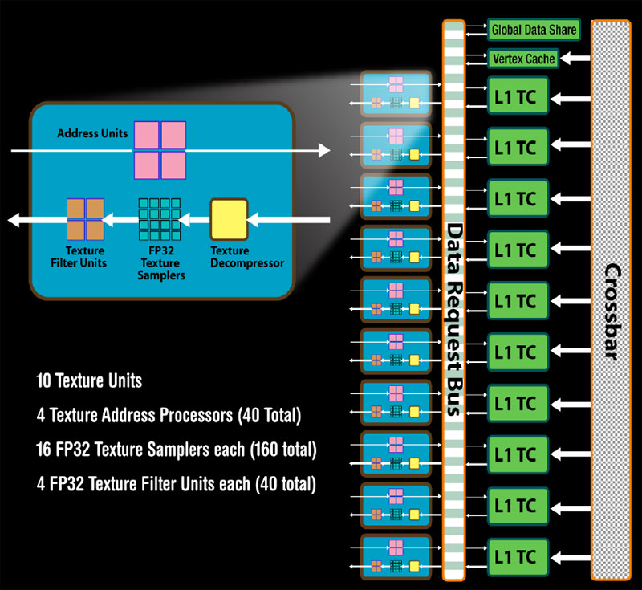
Fetch
SIMD
Memory
Multithread
General
Pipeline
Cores
Interconnect
http://images.bit-tech.net/content_images/2008/09/ati-radeon-4850-4870-architecture-review/tex.jpg

Slide 40
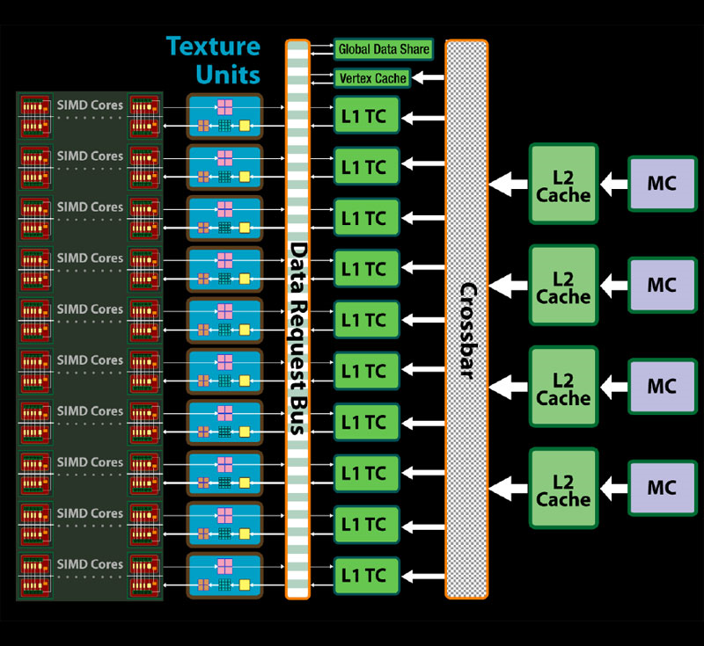
Fetch
SIMD
Memory
Multithread
General
Pipeline
Cores
Interconnect
http://images.bit-tech.net/content_images/2008/09/ati-radeon-4850-4870-architecture-review/cache.jpg

Slide 41
Memory Hierarchy
Fetch
SIMD
Memory
Multithread
General
Pipeline
Cores
Interconnect
One than one shared cache is needed for such a large GPU.
there are global data stores for larger tasks than cannot be handled in one SIMD
There is enough bandwidth available inside the chip to move data between caches on other chips

Slide 42
Memory Hierarchy
Fetch
SIMD
Memory
Multithread
General
Pipeline
Cores
Interconnect
The four memory controllers are each associated with a L2 cache
hub is connected directly to lower-bandwidth interfaces like
PCI-Express
the display controllers
UVD video engine
CrossFireX interconnect
Total bandwidth improvement for new GPUs is about 10%

Slide 43
Memory Hierarchy
Fetch
SIMD
Memory
Multithread
General
Pipeline
Cores
Interconnect
AMD increased texture fetch bandwidth
up to 480GB/sec if only using L1 texture caches
up to 384GB/sec if using L1 and L2 caches.
AMD has added a register overflow
prevent shader processors from stalling often when they’re waiting for data return from another part of the GPU

Slide 44
Memory Hierarchy
Fetch
SIMD
Memory
Multithread
General
Pipeline
Cores
Interconnect
ATI has changed the memory layout
no longer a horseshoe
now laid out in an L-shape
GPU uses eight 64MB Qimonda 1.0ns GDDR3 memory chips
total of 512MB of on-board memory
Chips have been rotated by 90 degrees on new GPUs
more space in between the DRAMs and the power phases

Slide 45
Memory Hierarchy
Fetch
SIMD
Memory
Multithread
General
Pipeline
Cores
Interconnect
AMD stayed with 256-bit memory interface on Radeon R700.
Adding bus width increases
the required number of pins
the size of the chip
AMD wanted to avoid the increases

Slide 46
On-Chip Interconnect
Fetch
SIMD
Memory
Multithread
General
Pipeline
Cores
Interconnect
Data transfer at115GB/sec
On a 256-bit memory bus
Data request bus can access vertex texture cache
CI Express 2.0 x16 bus interface

Slide 47
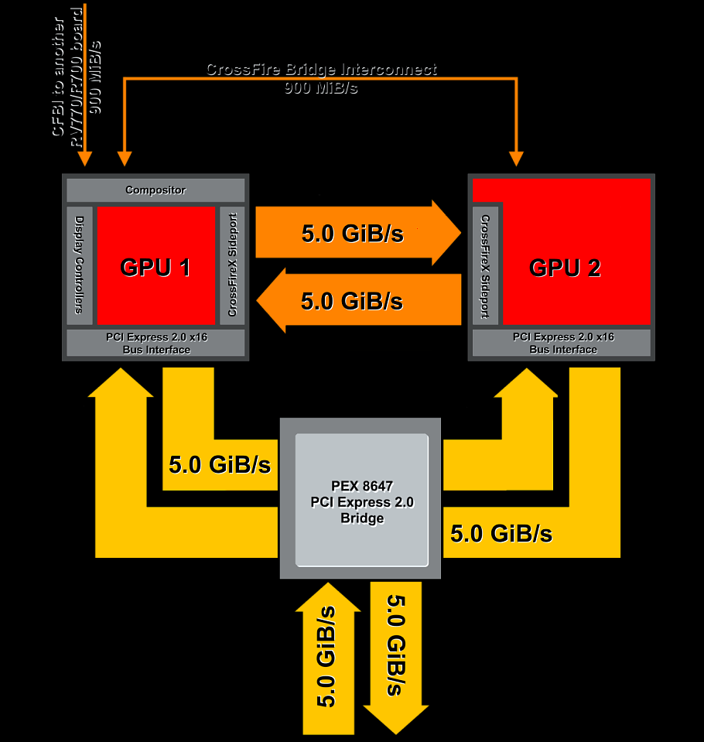
Fetch
SIMD
Memory
Multithread
General
Pipeline
Cores
Interconnect
http://upload.wikimedia.org/wikipedia/en/6/69/R700_interconnect.png

Slide 48
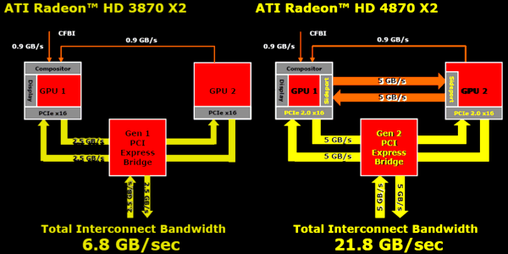
Fetch
SIMD
Memory
Multithread
General
Pipeline
Cores
Interconnect
http://ixbtlabs.com/articles3/video/spravka-r7xx-p6.html

Slide 49
On-Chip Interconnect
Fetch
SIMD
Memory
Multithread
General
Pipeline
Cores
Interconnect
Built-In CrossfireX Technology
enables two or more discrete graphics processors to work together to improve system performance
Can scale up performance using up to 4 GPUs

Slide 50
On-Chip Interconnect
Fetch
SIMD
Memory
Multithread
General
Pipeline
Cores
Interconnect
CrossfireX Sideports
The new ATI Radeon HD 4870 X2 (most advanced model) has sideports
allows direct data-exchange between GPUs
by-passes the bridge and motherboard

Slide 51
On-Chip Interconnect
Fetch
SIMD
Memory
Multithread
General
Pipeline
Cores
Interconnect
AMD hasn’t changed the way power is delivered to the card
75W of the board’s power is supplied via the PCI-Express interconnect
retain backwards compatibility

Slide 52
Multithreading Organization
Fetch
SIMD
Memory
Multithread
General
Pipeline
Cores
Interconnect
Unified Superscalar Shader Architecture
Dynamic load balancing and resource allocation for vertex, geometry, and pixel shaders
Common instruction set and texture unit access supported for all types of shaders
Dedicated branch execution units and texture address processors

Slide 53
Multithreading Organization
Fetch
SIMD
Memory
Multithread
General
Pipeline
Cores
Interconnect
Dynamic Geometry Acceleration High performance vertex cache
Programmable tessellation unit
Accelerated geometry shader path for geometry amplification
Memory read/write cache for improved stream output performance

