Slide 1
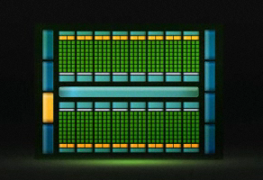
Fermi
A Complete GPU Compute Architecture by NVIDIA
Tamal Saha, Abhishek Rawat, Minh Le
{ts4rq, ar8eb, ml4nw}@virginia.edu

Slide 2
GPU Computing
Unprecedented FP performance
Ideal for data parallel applications
Programmability
Nov 2006: G80
Jun 2008: GT200
Sep 2009: Fermi
1999:
GPU

Slide 3
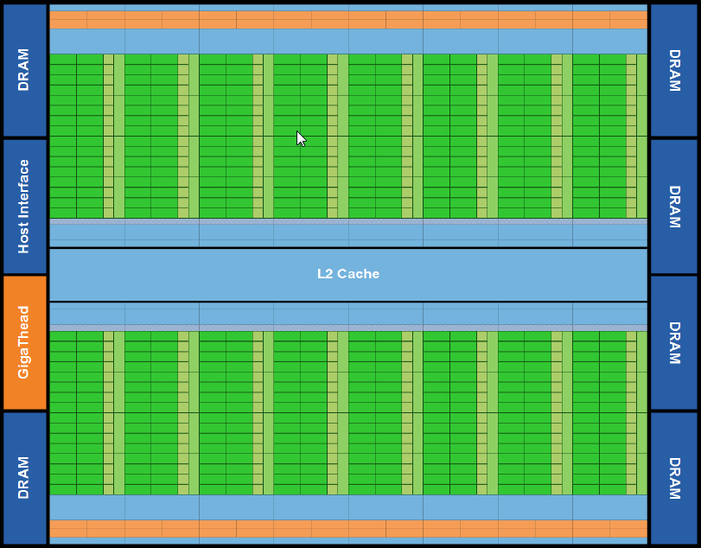
Overview
3G Streaming Multiprocessor
3 bn transistors
512 CUDA cores
384(6 * 64)-bit memory interface

Slide 4
Top Innovations in Fermi
Improve Double Precision Performance – 256 FMA ops/clock
ECC support – 1st time in a GPU
True Cache Hierarchy – L1 cache, shared memory and global memory
More Shared Memory – 3x more than GT200; configurable
Faster Context Switching – under 25 µs
Faster Atomic Operations – 20x faster than GT200

Slide 5
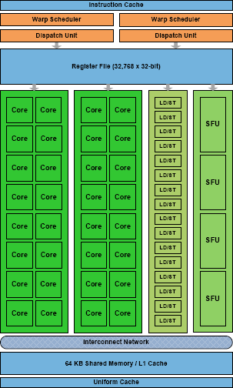
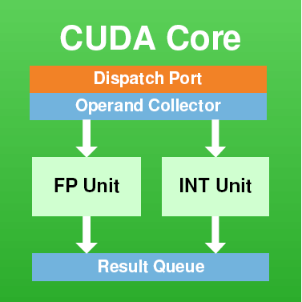
High Performance CUDA Cores
512 CUDA cores
32 Cores/SM
16 SM
4x more core/SM than GT200

Slide 6
Dual Warp Scheduler
Each SM has
2 warp scheduler
2 instruction dispatch unit
Dual – issue in each SM
Most instructions can be dual issued
Exception: Double Precision
Warp Scheduler | Warp Scheduler
Inst Dispatch Unit | Inst Dispatch Unit
… | …
Warp 8 inst 11 | Warp 9 inst 11
Warp 2 inst 42 | Warp 3 inst 33
Warp 14 inst 95 | Warp 15 inst 95
: | :
Warp 8 inst 12 | Warp 9 inst 12
Warp 14 inst 96 | Warp 3 inst 34
Warp 2 inst 43 | Warp 15 inst 96
time

Slide 7
Load/Store Units
16 load/store units/SM
Source and destination address calculated by load/store unit

Slide 8
Improved Arithmetic Capability
Full IEEE 754-2008 support
16 double precision FMA ops/SM
8x the peak double precisi0on floating point performance over GT200
4 Special Functional Units(SFU)s/SM for transcendental instructions, such as, sin, cosine, reciprocal and square root.

Slide 9
Parallel Thread eXecution ISA
Fermi is the first architecture to support PTX 2.0.
PTX 2.0 greatly improves GPU programmability, accuracy, and performance.
Primary goals of PTX 2.0
stable ISA that can span multiple GPU generations.
provide a machine-independent ISA for C, C++, Fortran, and other compiler targets.
provide a common ISA for optimizing code generators and translators which map PTX to specific target machines.

Slide 10
ISA Improvements
Full IEEE 754-2008 32-bit and 64-bit precision.
support for Fused Multiply-Add for all FP precision (prior generations used MAD for single precision FP).
support for subnormal numbers, and all four rounding modes (nearest, zero, positive infinity and negative infinity).
Unified Address Space
1 TB continuous address space for local (thread private), shared (block shared) and global address spaces.
unified pointers can be used to pass objects in any memory space.

Slide 11
ISA Improvements (cont..)
Full support for object oriented C++ code, not just procedural C code.
Full 32-bit integer path with 64-bit extensions.
Load/store ISA supports 64-bit addressing for future growth.
Improved Conditional Performance through Predication.

Slide 12
ISA Improvements (cont..)
Optimized for OpenCL and DirectCompute.
Shares key abstractions like threads, blocks, grids, barrier synchronization, per-block shared memory, global memory, and atomic operations.
new append, bit-reverse and surface instructions.
Improved efficiency of “atomic” integer instructions. (5x-20x times prior generations)
atomic instructions handled by special integer units attached to L2 cache controller.

Slide 13
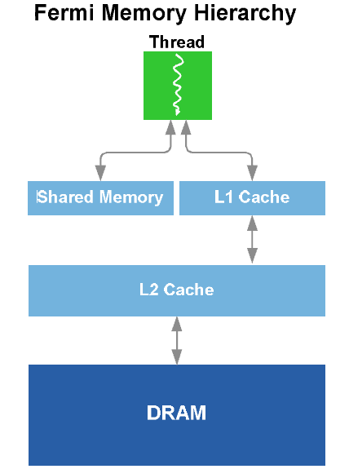
Parallel Datacache
64 KB on-chip configurable memory/SM
16 KB L1 cache + 48 KB Shared memory
48 KB L1 cache + 16 KB Shared memory
3x more Shared memory than GT200.
Unified L2

Slide 14
Configurable Shared Memory & L1 Cache
64 KB on-chip memory/SM
16 KB L1 cache + 48 KB Shared memory
OR
48 KB L1 cache + 16 KB Shared memory
3x more Shared memory than GT200.
Significant performance gain for existing apps using Shared memory only
Apps using software managed cache can be stream lined to use hardware managed cache

Slide 15
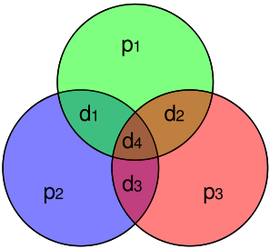
Error Correcting Code
Single error correction – Double error detection
DRAM
Chip’s register files
Shared memories
L1 and L2 cache

Slide 16
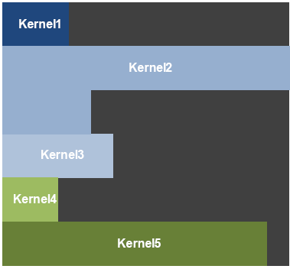
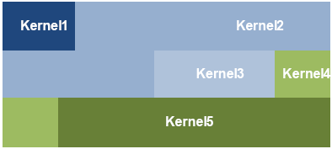
GigaThread Thread Scheduler
Two-level thread scheduler.
Chip level: thread blocks => SMs
SM level: Warps (32 threads) => execution unit
24,576 simultaneously active threads
10x faster app context switching ( < 25 μs )
Concurrent Kernel Execution
time
Serial Kernel Execution
time
Concurrent Kernel Execution

Slide 17
So, what’s next?
The Relatively Small Size of GPU Memory
Inability to do I/O directly to GPU Memory
Managing application level parallelism

Slide 18
Q?

Slide 19
References
http://www.nvidia.com/object/fermi_architecture.html
Fermi Compute Architecture White Paper - http://www.nvidia.com/content/PDF/fermi_white_papers/NVIDIA_Fermi_Compute_Architecture_Whitepaper.pdf
The Top 10 Innovations in the New NVIDIA Fermi Architecture, and the Top 3 Next Challenges by Dave Patterson, Co-author of Computer Architecture: A Quantitative Approach

Slide 20
Thank You

