Slide 1
A Systematic Methodology to Compute the Architectural Vulnerability Factors for a High-Performance Microprocessor
Saad Arrabi
2/24/2010
CS 8501

Slide 2
Outline
Definition of soft errors
Motivation of the paper
Goals of this paper
ACE and un-ACE bits
Results
Conclusion and comments

Slide 3
Mechanism of Soft Errors
Cosmic ray interactions with atmosphere
Protons bombard O2 and N2
Shower of secondary particles
charged and neutral
Cascade of interactions
Illustration credit: S. Swardy / U. Chicago / NASA
Notes:
Cosmic rays: mostly protons, and remaining made up of mostly alpha
collide mainly with oxygen and nitrogen
This is an artist’s interpretation

Slide 4
Soft errors
Sometimes they cause a spike in current in the transistors
Transient faults, permanent faults
Trend in the future with transistors getting smaller
Rays that lead to errors and ones that don’t

Slide 5
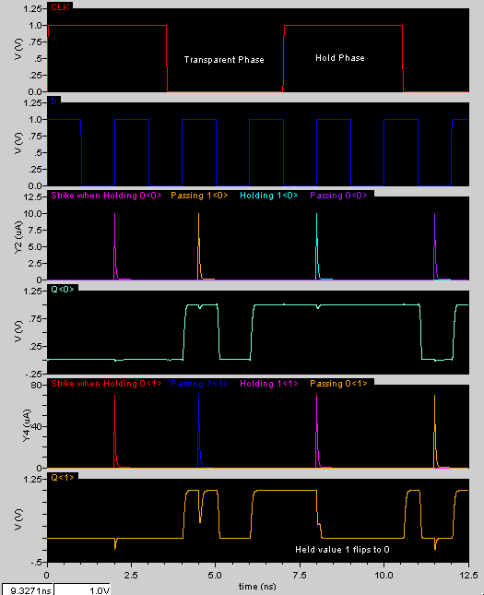
Latch/ SRAM
Transient simulation
of a particle strike
Notes:
This shows two sets of transient simulations with two different strengths of the particle strike.
the peak current depends on the energy of the striking particle

Slide 6
Motivation
Techniques to prevent soft errors exist
Expensive in performance and cost
You don’t want to over do it
Sun is documented to having lost a major customer to IBM from this phenomena [3].
Things will get tougher with time
Multi bit upset
Lower voltage

Slide 7
Goals of the paper
Reduce cost of the soft error protection
Know the required cost of protection early in the design process
Give good estimates for AVF while still being conservative
Provide a systematic method that can be expanded in the future

Slide 8
Terminologies
*AVF: architectural vulnerability factor
*ACE: architecturally correct execution
*FIT: Error(Fault) in Time
*SDC: silent data corruption
MTBF: Mean Time Between Failures
DUE: detected unrecoverable errors
FDD: first-level dynamically dead
TDD: Transitively dynamically dead
* Focus of the paper

Slide 9
Un-ACE bits
Microarchitectural Un-ACE Bits
Idle or Invalid State.
Mis-speculated State.
Predictor Structures.
Ex-ACE State.
Architectural Un-ACE Bits
NOP instructions.
Performance-enhancing instructions.
Predicated-false instructions.
Dynamically dead instructions. (FDD & TDD)
Logical masking.
Opcode | Valid bits | invalid
Validity | instruction
Which branch is predicted
Unused instruction or data
NOP | Un-ACE bits
Prefetch | Address
False | Result

Slide 10
Methodology
Using performance simulator
Adding window analysis to follow ACE and un-ACE instructions
Check the validity by micro benchmarks
Typical methods are fault injection models
Require RTL model
Slow and later in the design process

Slide 11
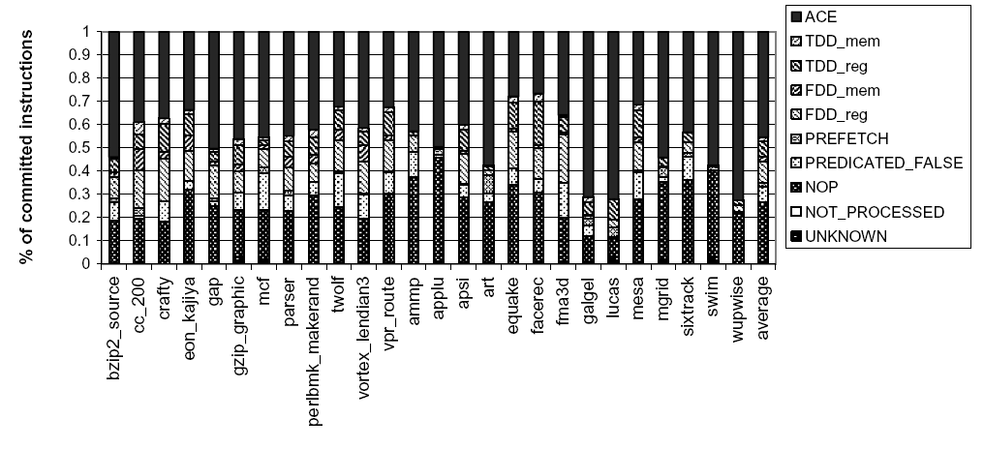
Results

Slide 12
Results

Slide 13
Results

Slide 14
Result

Slide 15
Conclusions and comments
Reduce the estimation of AVF
Done through performance simulator, so early in the design process and application oriented
Details is limited by the simulator details
Identify the AFV of different parts rather average
Less accurate that error injection models
Is the way they tested their accuracy good enough?
Why being so conservative?
Is performance will be included in the future

Slide 16
The End
Questions?
Some slides are courtesy of Nishant George

