Slide 1
McPAT: An Integrated Power, Area, and Timing Modeling Framework for Multicore and Manycore Architectures
S. Li et al. in MICRO’09
Runjie Zhang
Dec.3

Slide 2
Motivation
“Tools both limit and drive research directions”
New demands
Multicore/manycore
Evaluate power, timing and area
Different source of power dissipation
Deep-submicron

Slide 3
Related Work
Wattch:
Enabling a tremendous surge in power-related research
Orion:
Combined Wattch’s core power model with a router power model
CACTI:
First tool in rapid power, area, and timing estimation
Notes:
Wattch: widely-used processor power estimation tool. Calculates dynamic power dissipation from switching events obtained from an architectural simulation. It uses some models from CACTI
Orion is a tool for modeling power in NoC

Slide 4
What’s wrong with previous work?
Wattch
No timing and area models
Only models dynamic power consumption
Use simple linear scaling model
Orion2
No short circuit power or timing
“Incomplete”
CACTI
???

Slide 5
Contributions
First integrated power, area, and timing modeling framework
Model all three types of power dissipation
Complete, integrated solution for multithreaded and multicore processor power
Deep-submicron tech. that no longer linear

Slide 6
Overview

Slide 7
Integrated Approach
Power | Dynamic: Similar to Wattch Short Circuit: IEEE TCAD’00 Leakage: MASTAR & Intel
Timing | CACTI with extension
Area | CACTI Empirical modeling for complex logic

Slide 8
Hierarchical Approach

Slide 9
Architecture Level
Core | Divided into several main units: e.g. IFU, EXU, LSU, OOO issue/dispatch unit
NoC | Signal links and routers
On-Chip Caches | Coherent cache
Memory Controller | 3 main hardware structure Empirical model for physical interface (PHY)
Clocking | PLL and clock distribution network Empirical model for PLL power

Slide 10
Circuit Level
Wires | Short wires as one-section Pi-RC model Long wires as a buffered wire model
Arrays | Based on CACTI with extensions
Logic | Highly regular: CACTI Less regular: Model from Intel, AMD and Sun Highly customized: Empirical, from Intel and Sun
Clock Distribution Network | Separate circuit model Global, Domain, and Local

Slide 11
Validation
Notes:
4 processors, include in-order and OOO, single-threaded and multithreaded processor
Peak power

Slide 12
Validation
 | Average error | 1st Contributor Error / % in total pwr
Niagara | 1.47W / 23% | 74% / 1%
Niagara2 | 1.87W / 26% | 47% / 5%
Alpha 21364 | 3.4W / 26% | 45% / 3%
Xeon Tulsa | 4.2W / 17% | 29% / 3%
Notes:
What is the definition of biggest contributor?
The biggest contributor in Niagara2 is not I/O power

Slide 13
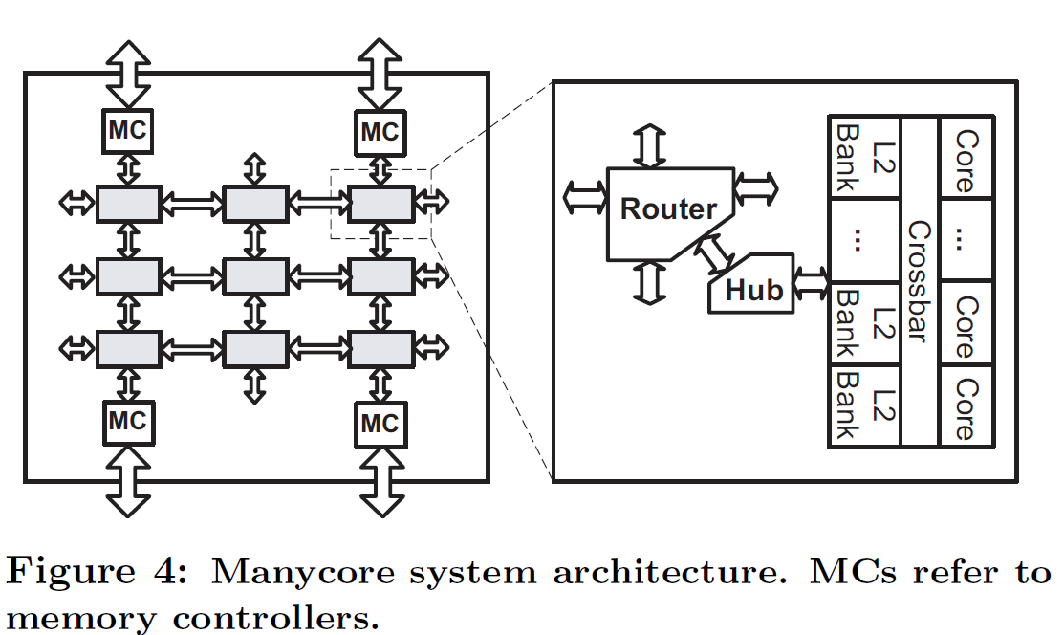
Scaling & Clustering
New generation:
Double # of cores
Keep the same micro-architecture

Slide 14
Parameters and Benchmarks

Slide 15
Area and Power

Slide 16
Performance and Efficiency

Slide 17
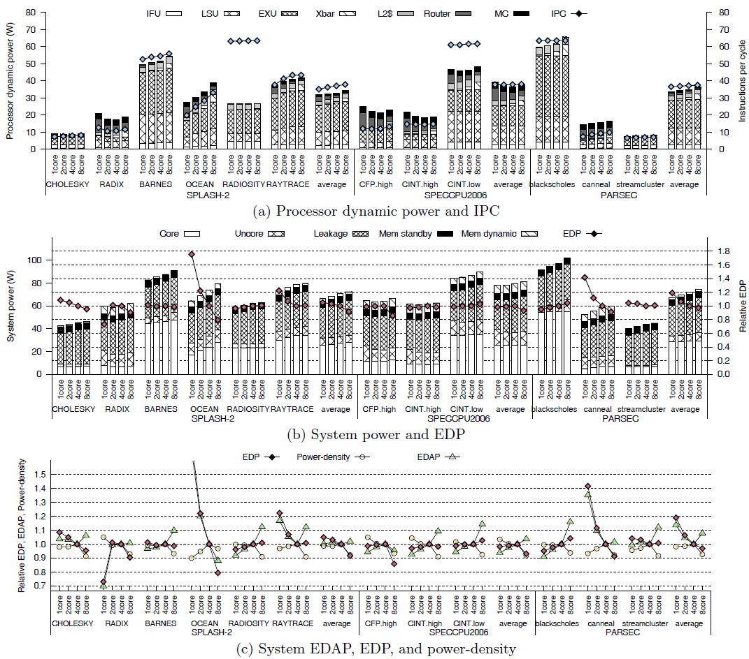
Performance and Efficiency

Slide 18
In-order vs. OOO with M5

