Slide 1


Auditing Information Leakage for Distance Metrics
PASSAT 2011, Boston, MA Oct11, 2011
Yikan Chen
David Evans
www.securecomputation.org
TexPoint fonts used in EMF.
Read the TexPoint manual before you delete this box.: AAAAAA

Slide 2


Motivating Scenario
Server
Client
?
……….
?
How to determine whether it is safe to release the response?

Slide 3
From the Attacker’s View
Hamming distance between X and Q
Smallest-Entropy Strategy
[Neuwirth, 1982]

Slide 4

Contribution
Target: class of distance functions
An efficient query auditor to estimate maximum information leakage
Technique for single bit information auditing

Slide 5
Strategy
Determine # of secrets consistent with all queries
  For a special class of functions:
  Reduce to 0-1 integer programming
Too expensive to compute exhaustively
  Use heuristics [find a meaningful bound]
Assumption
  clients are authenticated by the server
  clients cannot share information with each other

Slide 6


Additively Decomposable Functions
Definition
A function, f (A, B), where A, B , is additively decomposable if:
Hamming distance
Edit distance
Ins,del and sub
Chebyshev distance
Lee distance
Squared Euclidean distance
Manhattan distance

Slide 7
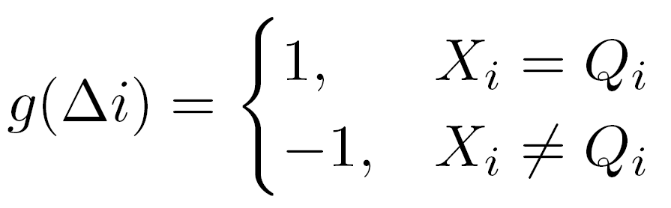
Influence Function
Influence function for any sequence X’:
: changes made on ith bit of X
For additively decomposable functions, for each bit is independent and for any consistent sequence over a set of queries:
Hamming distance:

Slide 8
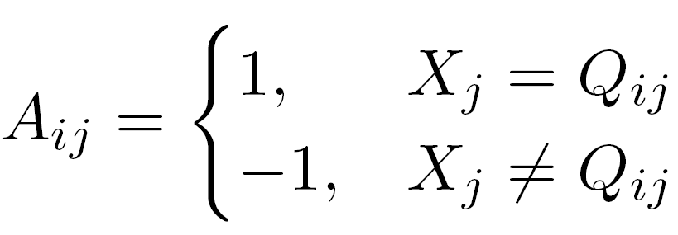
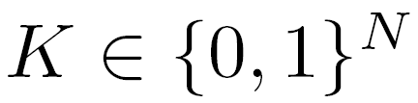
Reduction for Hamming Distance
Convert a Hamming distance sequence leakage problem to:
AK=0
where
Example:
X=1111 Q₁=1100 Q₂=1110
find the number of possible 0-1 solutions for K

Slide 9
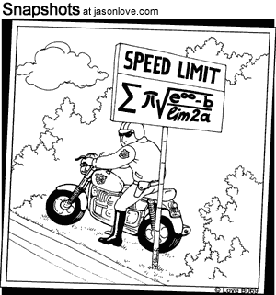
Computing Number of Solutions
Exact methods: exponential growth
  Exhaustive Search
  Gröbner Basis ([Bertsimas, 2000])
Lower bound is good enough!
  Divide-and-merge algorithm

Slide 10

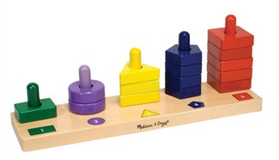

Divide-and-merge Algorithm
Find # of 0-1 solutions for the equation set:
AK=0
X, {Q_{i}}
  Divide and exhaustive search
    Divide matrix A into small blocks
    Analyze each output exhaustively
  Sort and select
    Sort output
    Select best combinations
  Merge
    Merge adjacent blocks

Slide 11














X=11111111 Q₁=01001000 Q₂=00111100
A=
r = 3
AK=0
Complexity
linear to N
linear to r²

Slide 12
Evaluation
Implementation experiment settings
  Matlab R2010b, 4 GB RAM 2.13 GHz CPU
Experiment settings
  Averaging from 5 experiments
  Scalability
  Tightness
  Real Application Performance (Iris Recognition)

Slide 13
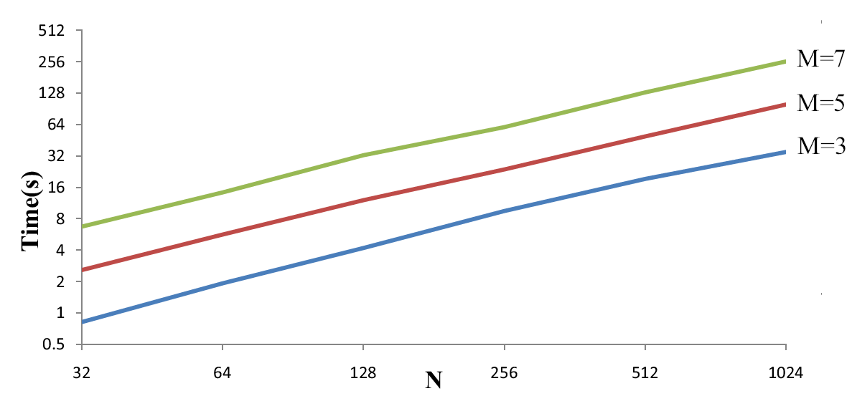
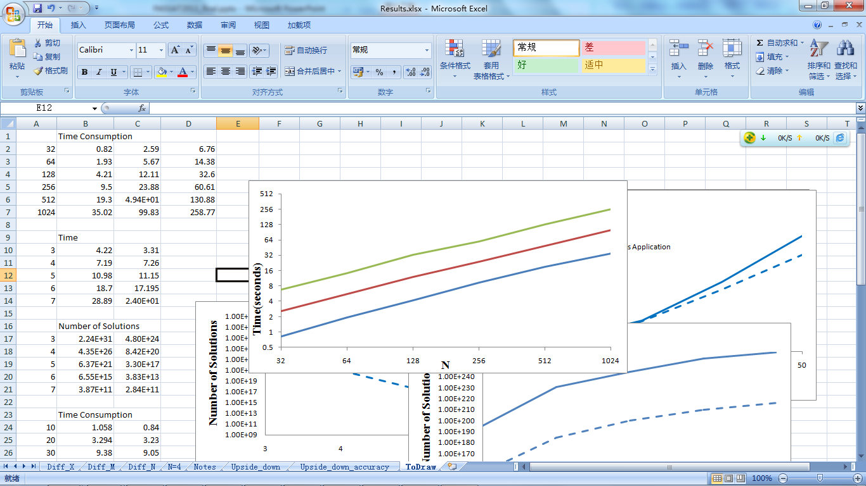
Evaluation
M: #queries
Scalability
Notes:
r=50

Slide 14
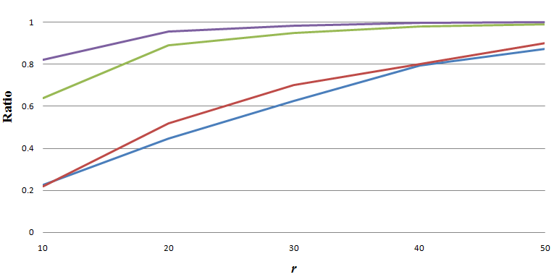
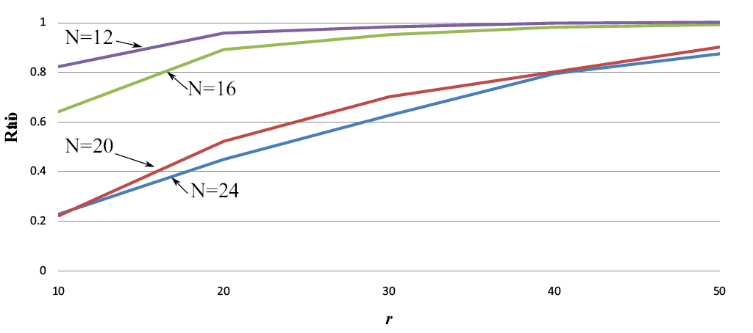
Evaluation
Tightness
See the paper for detailed results and performance on iris application
Notes:
M=3

Slide 15
Related Work
Estimating Information Leakage
  No auditor ([Goodrich, Oakland 2009])
  Weak auditor ([Wang, Wang et al., CCS 2009])
Differential Privacy
  Add noise to protect secret information ([Dwork, ICALP 2006])
Auditing Aggregate Queries
  Auditing SUM, MEAN or MAX queries over a set of private entries in a database ([Elshiekh, 2008],[Nabar et al., VLDB 2006], [Wang, Li et al., CCS 2009])

Slide 16
Summary
Query auditor for the server
  Fast
  Performance adjustable
  Single-bit leakage (see paper)
Challenges
  Non-additive decomposable functions
  Secure two-party computation protocol

Slide 17

Thanks!
www.securecomputation.org

Slide 18
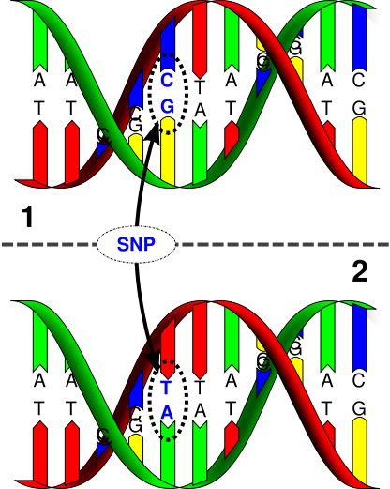
Single Bit Information Leakage
Motivation
  One bit leakage can also be crucial:
  SNP (single nucleotide polymorphism)
Assumptions
  The client knows nothing
  Any single bit information is leaked only when this bit is 100% determined

Slide 19

Single Bit Information Leakage
Straightforward idea
AK=0
Bit fully determined = corresponding k_{i} can only be 1
Check if there is a non-zero solution when k_{i}=0
Make it quicker……
Build pre-computed libraries containing all possible combinations
Libraries can be pre-computer since they are not related to sequence length (N), X and Q
Without libraries:
checks
With libraries:
checks

