Slide 1
Hierarchical clustering
Hongning Wang
CS@UVa

Slide 2
Today’s lecture
Hierarchical clustering algorithm
  Bottom-up: agglomerative
  Distance between clusters
  Complexity analysis

Slide 3
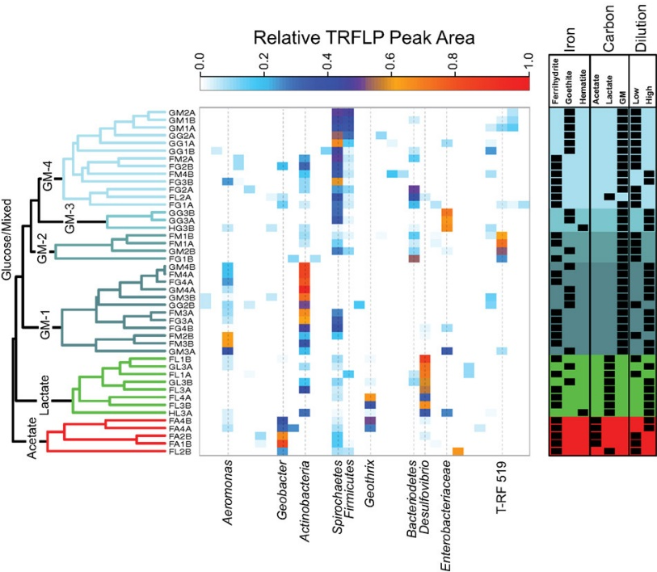
Hierarchical clustering
Build a tree-based hierarchical taxonomy from a set of instances
  Dendrogram – a useful tool to summarize similarities
After cutting, each connected component will be a cluster

Slide 4







Agglomerative hierarchical clustering
Pairwise distance metric between instances
0 | 1 | 2 | 2 | 3 | 3 | 4
 | 0 | 2 | 2 | 3 | 3 | 4
 |  | 0 | 2 | 3 | 3 | 4
 |  |  | 0 | 3 | 4 | 4
 |  |  |  | 0 | 2 | 3
 |  |  |  |  | 0 | 2
 |  |  |  |  |  | 0

Slide 5
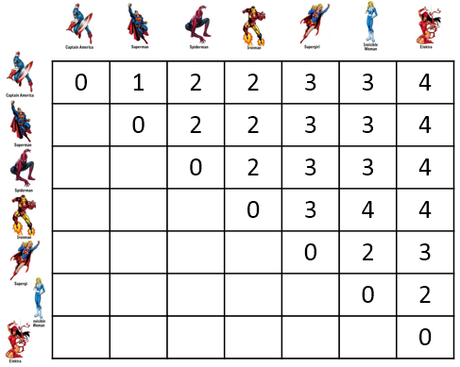
Agglomerative hierarchical clustering
Every instance is in its own cluster when initialized
Repeat until one cluster left
  Find the best pair of clusters to merge and break the tie arbitrarily
Enumerate all the possibilities!
How to compare distance between an instance and a cluster of instances?
?

Slide 6
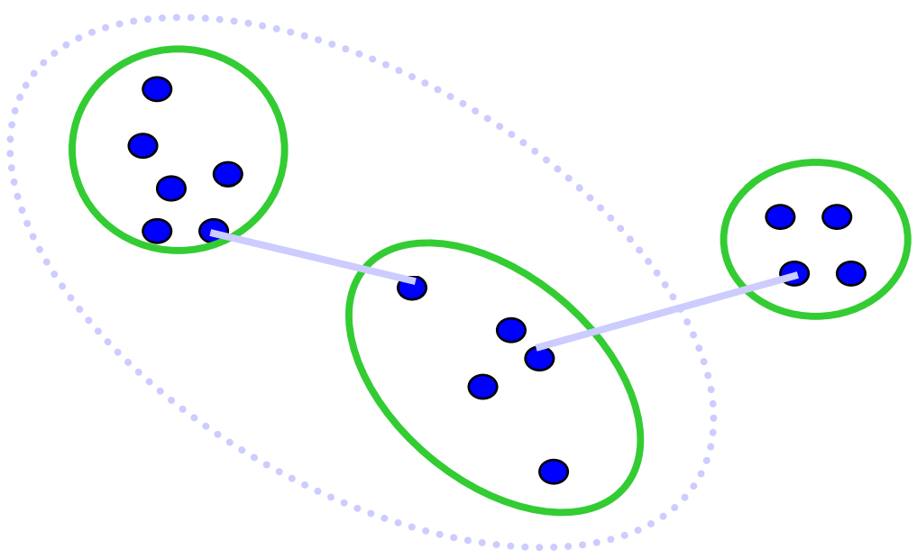
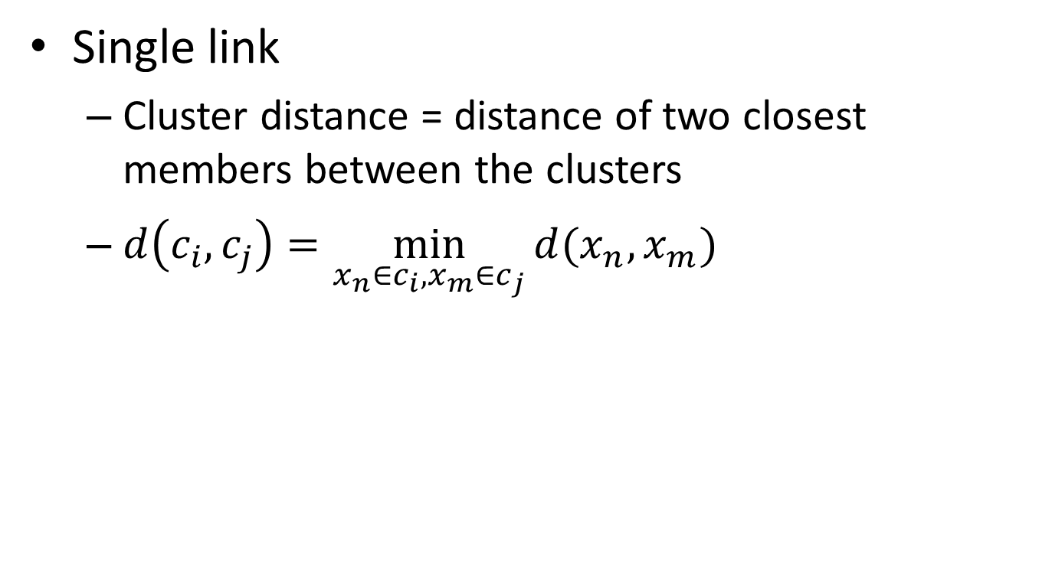
Distance measure between clusters
Single link
  Cluster distance = distance of two closest members between the clusters
  $d\left(c_{i},c_{j}\right)=\min_{x_{n}∈c_{i},x_{m}∈c_{j}}{d(x_{n},x_{m})}$
Tend to generate scattered clusters

Slide 7
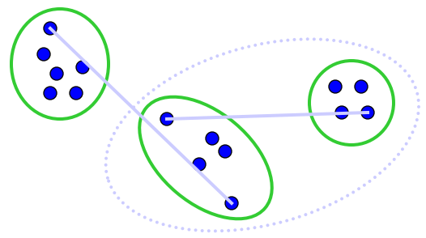
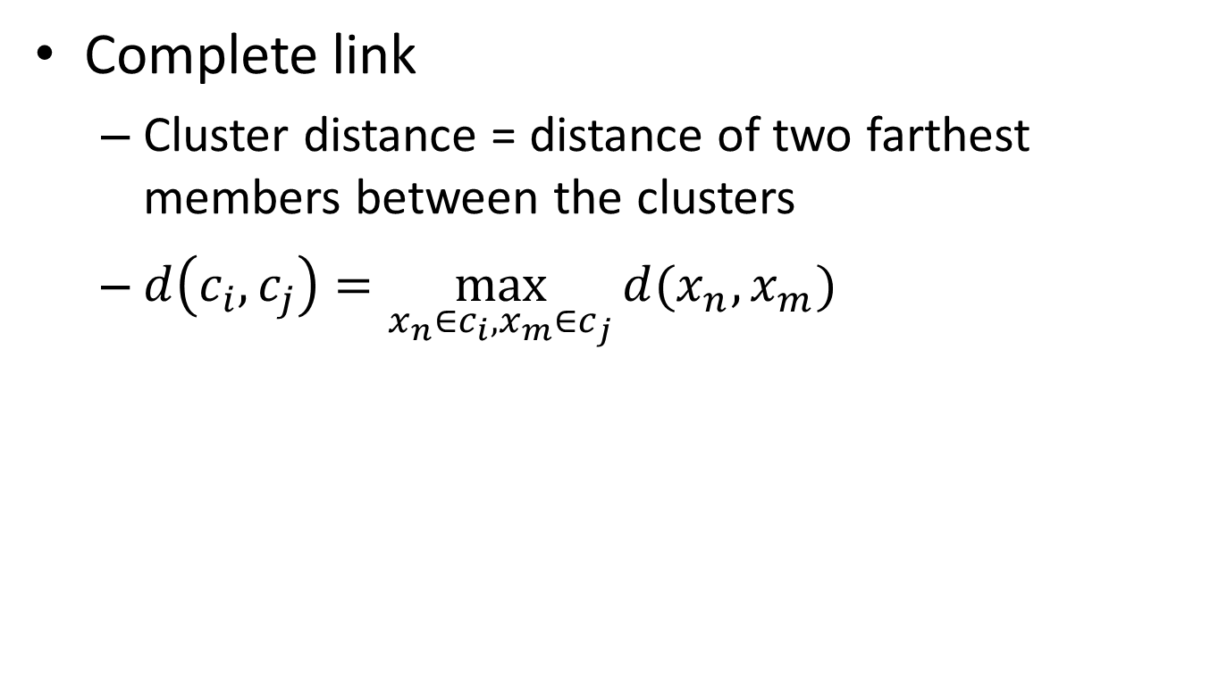
Distance measure between clusters
Complete link
  Cluster distance = distance of two farthest members between the clusters
  $d\left(c_{i},c_{j}\right)=\max_{x_{n}∈c_{i},x_{m}∈c_{j}}{d(x_{n},x_{m})}$
Tend to generate tight clusters

Slide 8
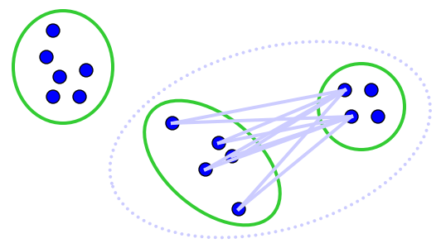
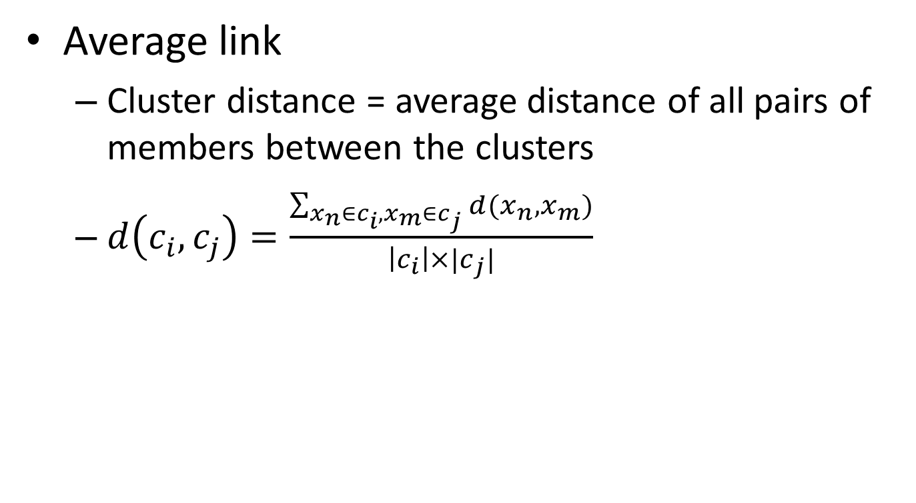
Distance measure between clusters
Average link
  Cluster distance = average distance of all pairs of members between the clusters
  $d\left(c_{i},c_{j}\right)=\frac{\sum_{x_{n}∈c_{i},x_{m}∈c_{j}}{d(x_{n},x_{m})}}{\left|c_{i}\right|×|c_{j}|}$
Mostly popularly used measure, robust against noise

Slide 9
Agglomerative hierarchical clustering
Every instance is in its own cluster when initialized
Repeat until one cluster left
  Find the best pair of clusters to merge and break the tie arbitrarily

Slide 10
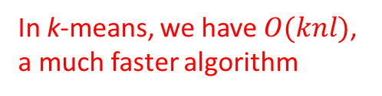
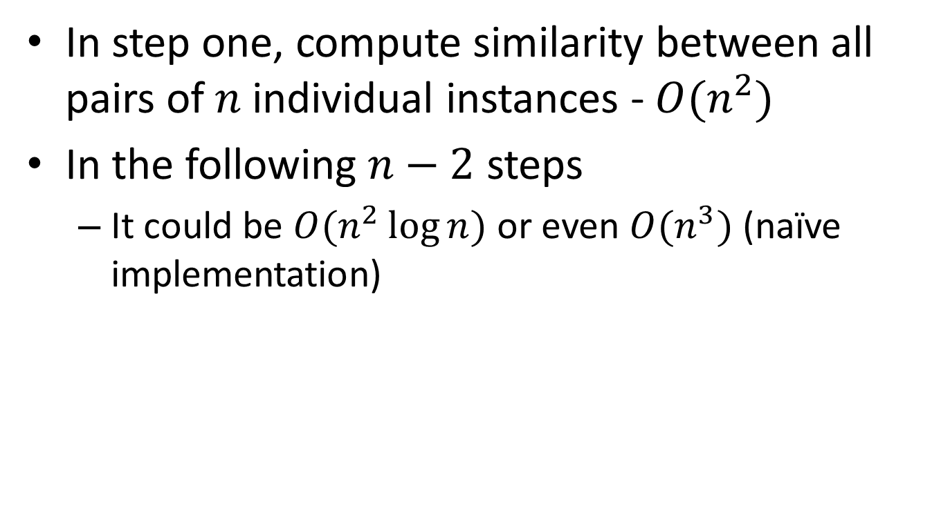
Complexity analysis
In step one, compute similarity between all pairs of $n$ individual instances - $O(n^{2})$
In the following $n−2$ steps
  It could be $O(n^{2}\log{n})$ or even $O(n^{3})$ (naïve implementation)
  In k-means, we have $O(knl)$, a much faster algorithm

Slide 11
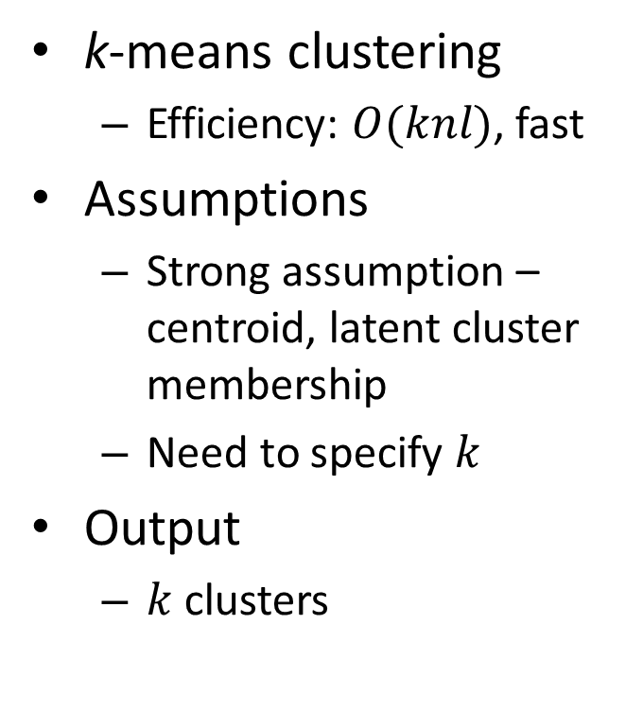
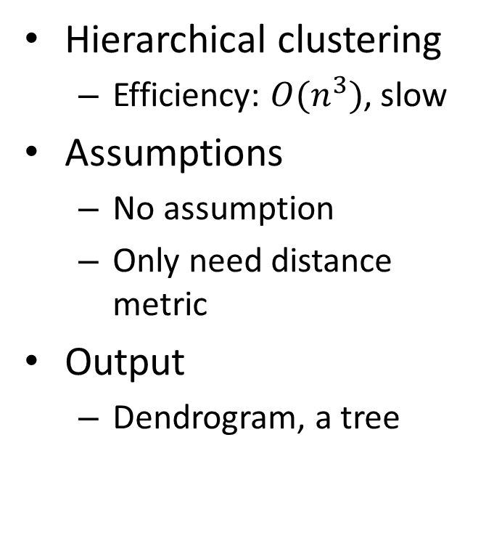
Comparisons
Hierarchical clustering
  Efficiency: $O(n^{3})$, slow
Assumptions
  No assumption
  Only need distance metric
Output
  Dendrogram, a tree
k-means clustering
  Efficiency: $O(knl)$, fast
Assumptions
  Strong assumption – centroid, latent cluster membership
  Need to specify $k$
Output
  $k$ clusters

Slide 12
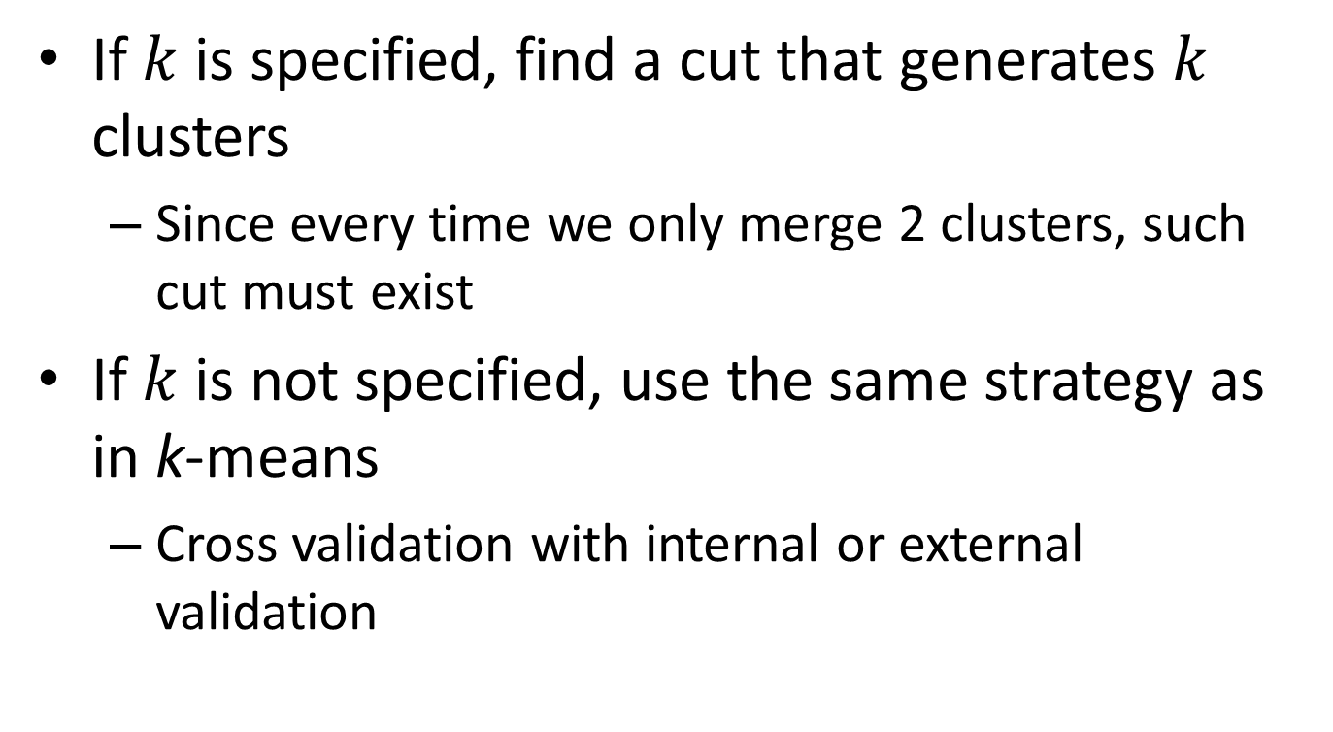
How to get final clusters?
If $k$ is specified, find a cut that generates $k$ clusters
  Since every time we only merge 2 clusters, such cut must exist
If $k$ is not specified, use the same strategy as in k-means
  Cross validation with internal or external validation

Slide 13
What you should know
Agglomerative hierarchical clustering
  Three types of linkage function
    Single link, complete link and average link
  Comparison with k-means

Slide 14
Today’s reading
Introduction to Information Retrieval
  Chapter 17: Hierarchical clustering
    17.1 Hierarchical agglomerative clustering
    17.2 Single-link and complete-link clustering
    17.3 Group-average agglomerative clustering
    17.5 Optimality of HAC

