Slide 1
Text Clustering
Hongning Wang
CS@UVa

Slide 2
Today’s lecture
Clustering of text documents
  Problem overview
    Applications
  Distance metrics
  Two basic categories of clustering algorithms
  Evaluation metrics

Slide 3
Clustering v.s. Classification
Assigning documents to its corresponding categories
How to label it?

Slide 4
Clustering problem in general
Discover “natural structure” of data
  What is the criterion?
  How to identify them?
  How to evaluate the results?

Slide 5
Clustering problem in general
Clustering - the process of grouping a set of objects into clusters of similar objects
  Basic criteria
    high intra-cluster similarity
    low inter-cluster similarity
  No (little) supervision signal about the underlying clustering structure
  Need similarity/distance as guidance to form clusters

Slide 6







What is the “natural grouping”?
Clustering is very subjective!
Distance metric is important!
group by gender
group by source of ability
group by costume

Slide 7
Clustering in text mining
Access
Serve for IR applications
Sub-area of DM research
Mining
Filter
information
Discover knowledge
Text clustering
Add
Structure/Annotations
Based on NLP/ML techniques
Organization

Slide 8
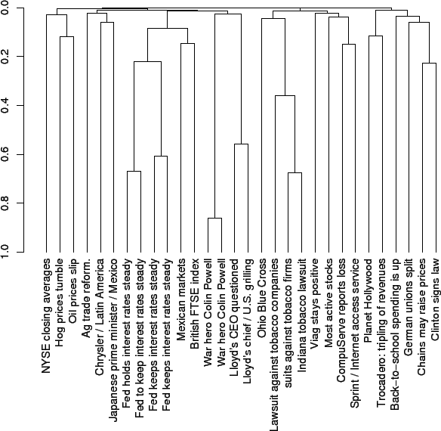
Applications of text clustering
Organize document collections
  Automatically identify hierarchical/topical relation among documents

Slide 9
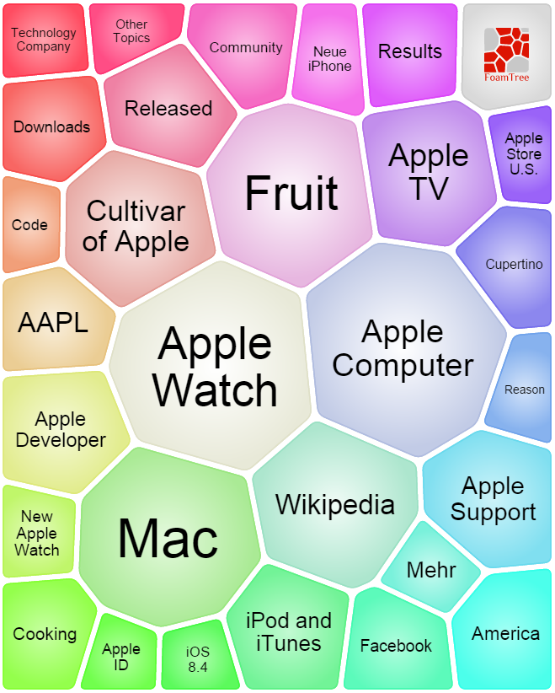
Applications of text clustering
Grouping search results
  Organize documents by topics
  Facilitate user browsing
http://search.carrot2.org/stable/search

Slide 10
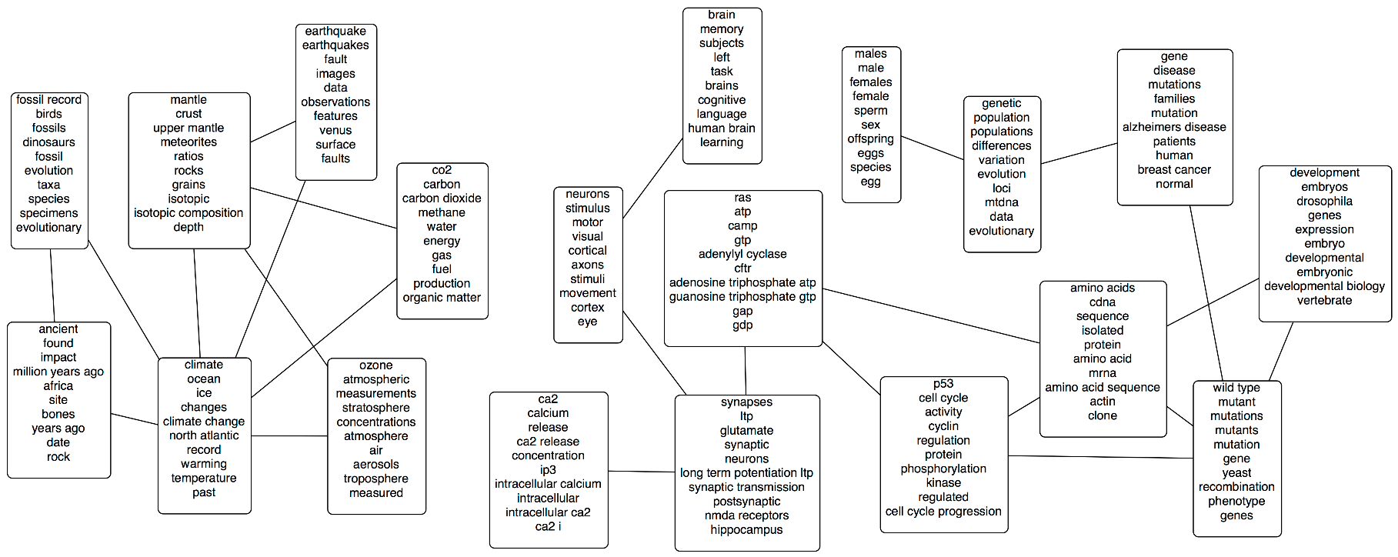
Applications of text clustering
Topic modeling
  Grouping words into topics
Will be discussed later separately

Slide 11
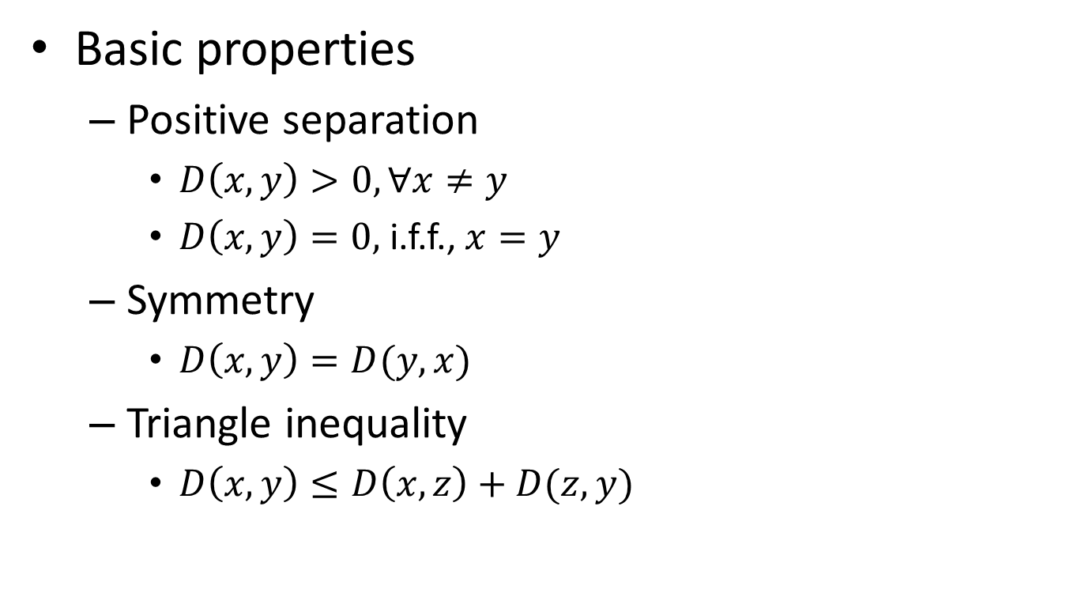
Distance metric
Basic properties
  Positive separation
    $D\left(x,y\right)>0, ∀x≠y$
    $D\left(x,y\right)=0,$i.f.f., $x=y$
  Symmetry
    $D\left(x,y\right)=D(y,x)$
  Triangle inequality
    $D\left(x,y\right)≤D\left(x,z\right)+D(z,y)$

Slide 12
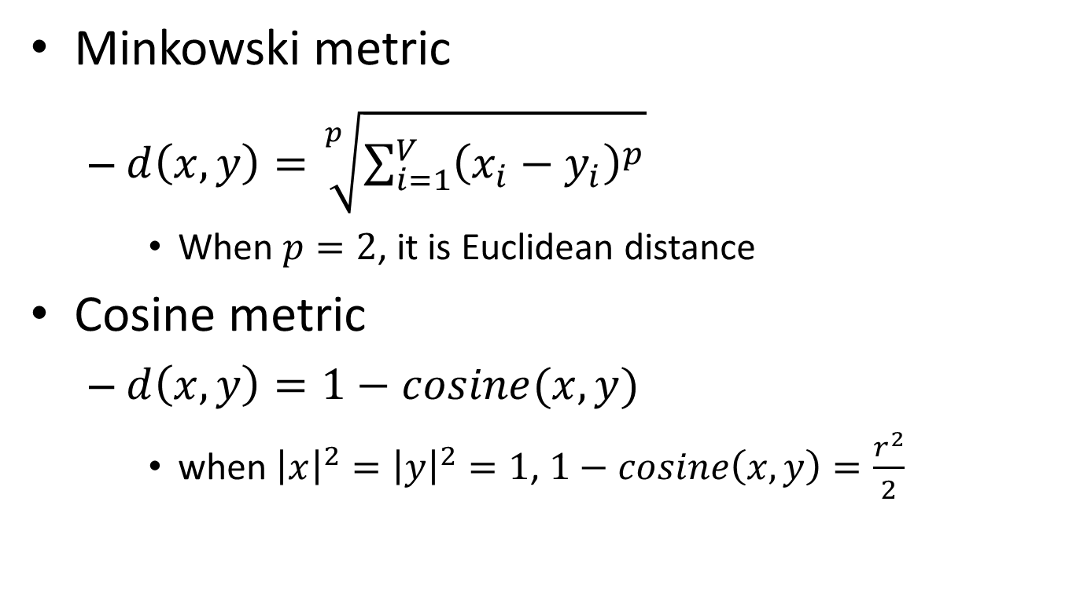
Typical distance metric
Minkowski metric
  $d\left(x,y\right)=\sqrt[p]{\sum_{i=1}^{V}{{\left(x_{i}−y_{i}\right)}^{p}}}$
    When $p=2$, it is Euclidean distance
Cosine metric
  $d\left(x,y\right)=1−cosine(x,y)$
    when ${\left|x\right|}^{2}={\left|y\right|}^{2}=1$, $1−cosine\left(x,y\right)=\frac{r^{2}}{2}$

Slide 13
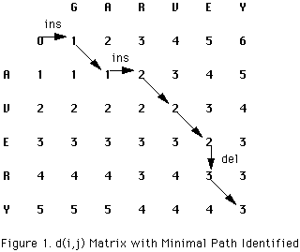
Typical distance metric
Edit distance
  Count the minimum number of operations required to transform one string into the other
    Possible operations: insertion, deletion and replacement
Can be efficiently solved by dynamic programming

Slide 14
Typical distance metric
Edit distance
  Count the minimum number of operations required to transform one string into the other
    Possible operations: insertion, deletion and replacement
  Extent to distance between sentences
    Word similarity as cost of replacement
      “terrible” -> “bad”: low cost
      “terrible” -> “terrific”: high cost
    Preserving word order in distance computation
Lexicon or distributional semantics

Slide 15
Clustering algorithms
Partitional clustering algorithms
  Partition the instances into different groups
  Flat structure
    Need to specify the number of classes in advance

Slide 16
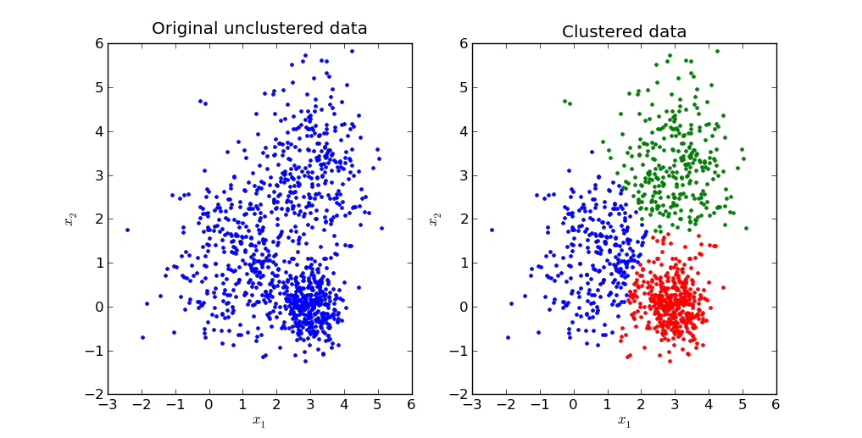
Clustering algorithms
Typical partitional clustering algorithms
  k-means clustering
    Partition data by its closest mean

Slide 17
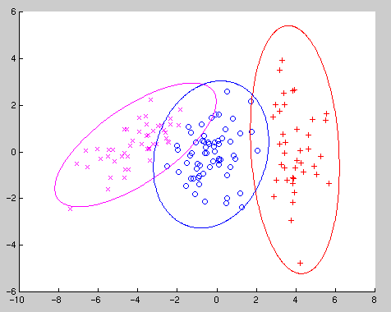
Clustering algorithms
Typical partitional clustering algorithms
  k-means clustering
    Partition data by its closest mean
  Gaussian Mixture Model
    Consider variance within
    the cluster as well

Slide 18
Clustering algorithms
Hierarchical clustering algorithms
  Create a hierarchical decomposition of objects
  Rich internal structure
    No need to specify the number of clusters
    Can be used to organize objects

Slide 19
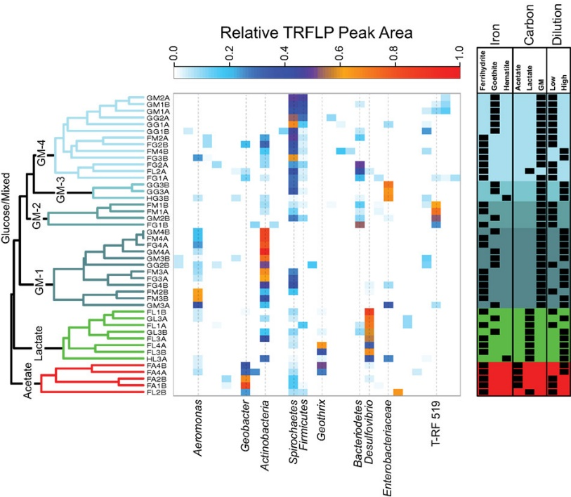
Clustering algorithms
Typical hierarchical clustering algorithms
  Bottom-up agglomerative clustering
    Start with individual objects as separated clusters
    Repeatedly merge closest pair of clusters
Most typical usage: gene sequence analysis

Slide 20
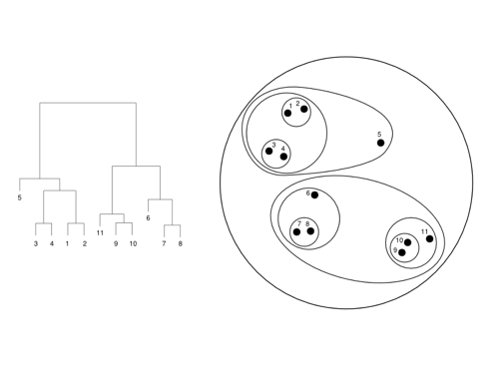
Clustering algorithms
Typical hierarchical clustering algorithms
  Top-down divisive clustering
    Start with all data as one cluster
    Repeatedly splitting the remaining clusters into two

Slide 21
Desirable properties of clustering algorithms
Scalability
  Both in time and space
Ability to deal with various types of data
  No/less assumption about input data
  Minimal requirement about domain knowledge
Interpretability and usability

Slide 22
Cluster validation
Criteria to determine whether the clusters are meaningful
  Internal validation
    Stability and coherence
  External validation
    Match with known categories

Slide 23
Recap: clustering problem in general
Clustering - the process of grouping a set of objects into clusters of similar objects
  Basic criteria
    high intra-cluster similarity
    low inter-cluster similarity
  No (little) supervision signal about the underlying clustering structure
  Need similarity/distance as guidance to form clusters

Slide 24
Recap: clustering algorithms
Partitional clustering algorithms
  Partition the instances into different groups
  Flat structure
    Need to specify the number of classes in advance

Slide 25
Recap: clustering algorithms
Hierarchical clustering algorithms
  Create a hierarchical decomposition of objects
  Rich internal structure
    No need to specify the number of clusters
    Can be used to organize objects

Slide 26
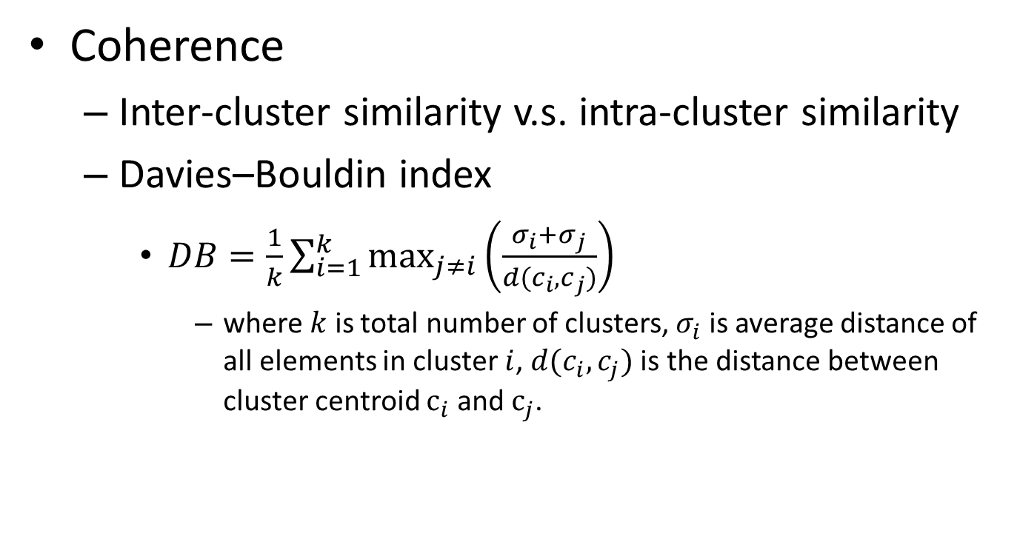
Internal validation
Coherence
  Inter-cluster similarity v.s. intra-cluster similarity
  Davies–Bouldin index
    $DB=\frac{1}{k}\sum_{i=1}^{k}{\max_{j≠i}\left(\frac{σ_{i}+σ_{j}}{d(c_{i}, c_{j})}\right)}$
      where $k$ is total number of clusters, $σ_{i}$ is average distance of all elements in cluster $i$, $d(c_{i}, c_{j})$ is the distance between cluster centroid $c_{i}$ and $c_{j}$.
Evaluate every pair of clusters
We prefer smaller DB-index!

Slide 27
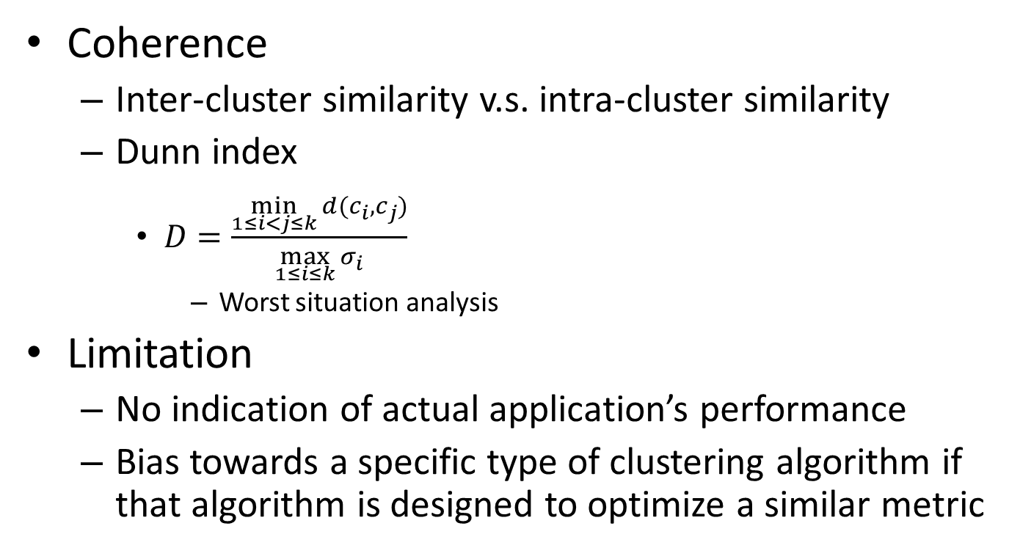
Internal validation
Coherence
  Inter-cluster similarity v.s. intra-cluster similarity
  Dunn index
    $D=\frac{\min_{1≤i<j≤k}{d(c_{i}, c_{j})}}{\max_{1≤i≤k}{σ_{i}}}$
      Worst situation analysis
Limitation
  No indication of actual application’s performance
  Bias towards a specific type of clustering algorithm if that algorithm is designed to optimize a similar metric
We prefer larger D-index!

Slide 28
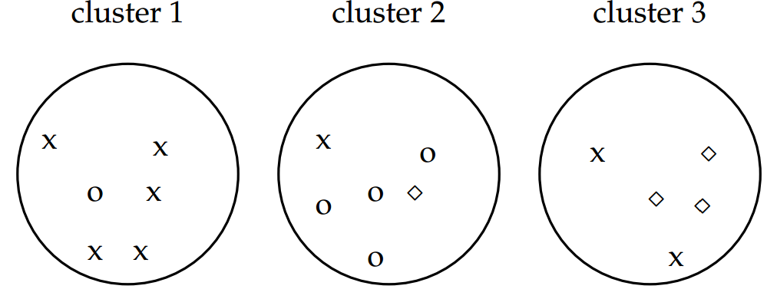
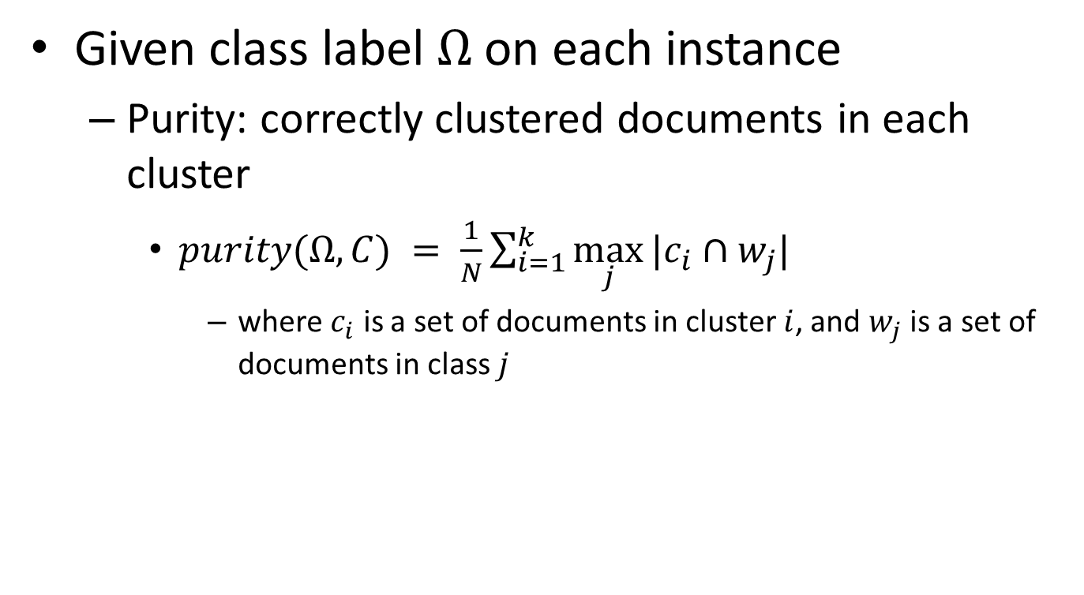


External validation
Required, might need extra cost
Given class label $Ω$ on each instance
  Purity: correctly clustered documents in each cluster
    $purity(Ω,C) = \frac{1}{N}\sum_{i=1}^{k}{\max_{j}{|c_{i}∩w_{j}|}}$
      where $c_{i}$ is a set of documents in cluster $i$, and $w_{j}$ is a set of documents in class $j$
Not a good metric if we assign each document into a single cluster
$$purity(Ω,C) =$$
$$\frac{1}{17}\left(5+4+3\right)$$

Slide 29
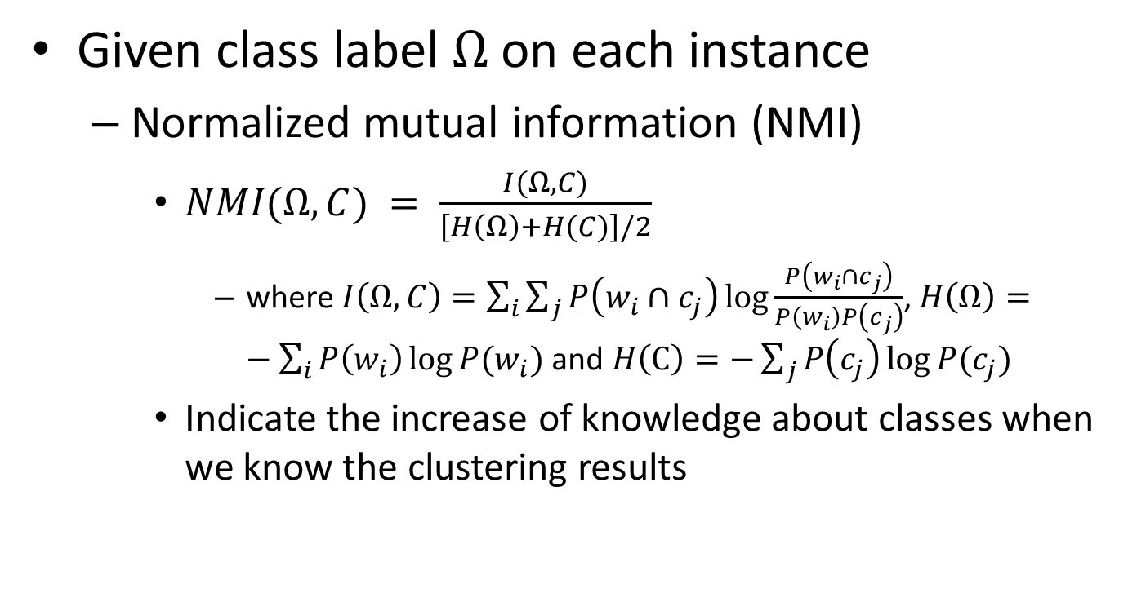
External validation
Given class label $Ω$ on each instance
  Normalized mutual information (NMI)
    $NMI(Ω,C) = \frac{I(Ω,C)}{\left[H\left(Ω\right)+H(C)\right]/2}$
      where $I\left(Ω,C\right)=\sum_{i}{\sum_{j}{P\left(w_{i}∩c_{j}\right)\log{\frac{P\left(w_{i}∩c_{j}\right)}{P\left(w_{i}\right)P\left(c_{j}\right)}}}}$, $H\left(Ω\right)=−\sum_{i}{P\left(w_{i}\right)\log{P(w_{i})}}$ and $H\left(C\right)=−\sum_{j}{P\left(c_{j}\right)\log{P(c_{j})}}$
    Indicate the increase of knowledge about classes when we know the clustering results
Normalization by entropy will penalize too many clusters

Slide 30
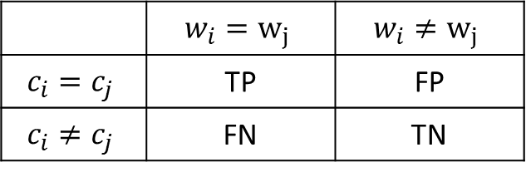
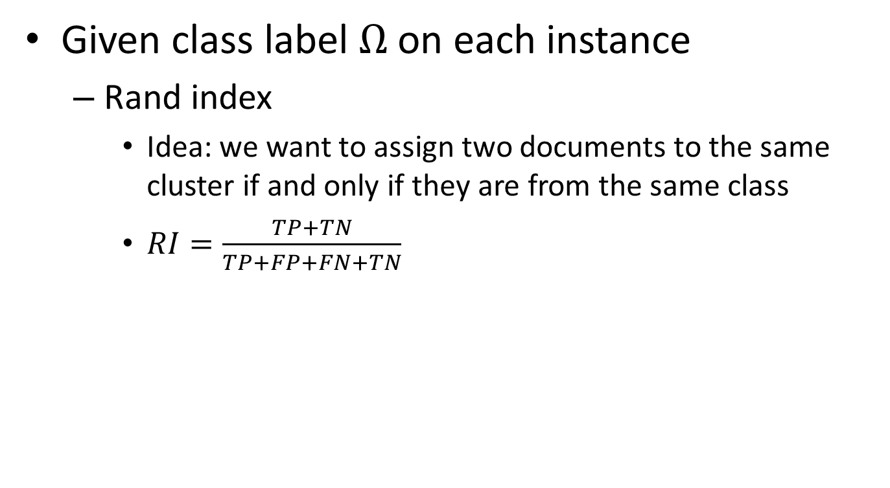
External validation
Given class label $Ω$ on each instance
  Rand index
    Idea: we want to assign two documents to the same cluster if and only if they are from the same class
    $RI=\frac{TP+TN}{TP+FP+FN+TN}$
Essentially it is like classification accuracy
 | $$w_{i}=w_{j}$$ | $$w_{i}≠w_{j}$$
$$c_{i}=c_{j}$$ | TP | FP
$$c_{i}≠c_{j}$$ | FN | TN
Over every pair of documents in the collection

Slide 31

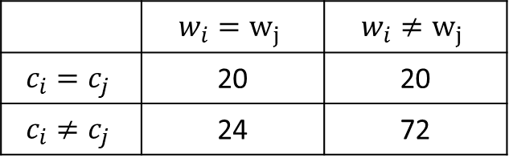

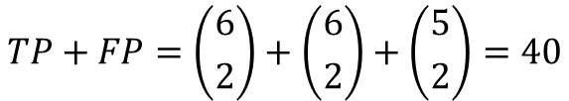
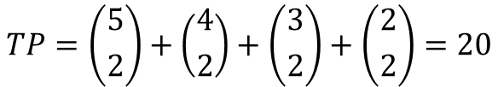
External validation
Given class label $Ω$ on each instance
  Rand index
 | $$w_{i}=w_{j}$$ | $$w_{i}≠w_{j}$$
$$c_{i}=c_{j}$$ | 20 | 20
$$c_{i}≠c_{j}$$ | 24 | 72
$$TP+FP=\left({6 \atop 2}\right)+\left({6 \atop 2}\right)+\left({5 \atop 2}\right)=40$$
$$TP=\left({5 \atop 2}\right)+\left({4 \atop 2}\right)+\left({3 \atop 2}\right)+\left({2 \atop 2}\right)=20$$

Slide 32
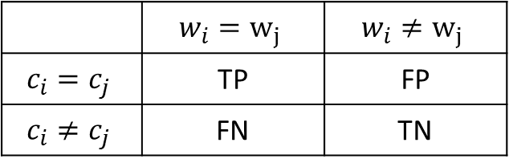

External validation
Given class label $Ω$ on each instance
  Precision/Recall/F-measure
    Based on the contingency table, we can also define precision/recall/F-measure of clustering quality
 | $$w_{i}=w_{j}$$ | $$w_{i}≠w_{j}$$
$$c_{i}=c_{j}$$ | TP | FP
$$c_{i}≠c_{j}$$ | FN | TN

Slide 33
What you should know
Unsupervised nature of clustering problem
  Distance metric is essential to determine the clustering results
Two basic categories of clustering algorithms
  Partitional clustering
  Hierarchical clustering
Clustering evaluation
  Internal v.s. external

Slide 34
Today’s reading
Introduction to Information Retrieval
  Chapter 16: Flat clustering
    16.2 Problem statement
    16.3 Evaluation of clustering

