Slide 1
Vector Space Model
Hongning Wang
CS@UVa

Slide 2
Today’s lecture
How to represent a document?
  Make it computable
How to infer the relationship among documents or identify the structure within a document?
  Knowledge discovery

Slide 3
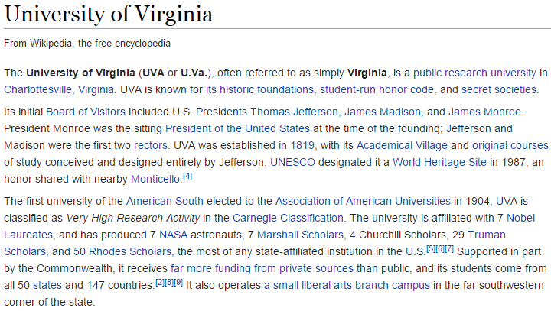
How to represent a document
Represent by a string?
  No semantic meaning
Represent by a list of sentences?
  Sentence is just like a short document (recursive definition)

Slide 4
Recap: what to read?
Applications
Algorithms
Web Applications,
Bioinformatics…
Machine Learning
Pattern Recognition
Statistics
Optimization
ICML, NIPS, UAI
Text Mining
Library & Info
Science
Data Mining
KDD, ICDM, SDM
NLP
ACL, EMNLP, COLING
Information Retrieval
SIGIR, WWW, WSDM, CIKM
Find more on course website for resource

Slide 5
Vector space model
Represent documents by concept vectors
  Each concept defines one dimension
  k concepts define a high-dimensional space
  Element of vector corresponds to concept weight
    E.g., d=(x₁,…,x_{k}), x_{i} is “importance” of concept i in d
Distance between the vectors in this concept space
  Relationship among documents

Slide 6
An illustration of VS model
All documents are projected into this concept space
Finance
|D₂-D₄|
D₂
D₄
D₃
Sports
D₅
D₁
Education

Slide 7
What the VS model doesn’t say
How to define/select the “basic concept”
  Concepts are assumed to be orthogonal
How to assign weights
  Weights indicate how well the concept characterizes the document
How to define the distance metric

Slide 8
What is a good “Basic Concept”?
Orthogonal
  Linearly independent basis vectors
    “Non-overlapping” in meaning
  No ambiguity
Weights can be assigned automatically and accurately
Existing solutions
  Terms or N-grams, a.k.a., Bag-of-Words
  Topics
We will come back to this later

Slide 9
Bag-of-Words representation
Term as the basis for vector space
  Doc1: Text mining is to identify useful information.
  Doc2: Useful information is mined from text.
  Doc3: Apple is delicious.
 | text | information | identify | mining | mined | is | useful | to | from | apple | delicious
Doc1 | 1 | 1 | 1 | 1 | 0 | 1 | 1 | 1 | 0 | 0 | 0
Doc2 | 1 | 1 | 0 | 0 | 1 | 1 | 1 | 0 | 1 | 0 | 0
Doc3 | 0 | 0 | 0 | 0 | 0 | 1 | 0 | 0 | 0 | 1 | 1

Slide 10
Tokenization
Break a stream of text into meaningful units
  Tokens: words, phrases, symbols
  Definition depends on language, corpus, or even context
Input: It’s not straight-forward to perform so-called “tokenization.”
Output(1): 'It’s', 'not', 'straight-forward', 'to', 'perform', 'so-called', '“tokenization.”'
Output(2): 'It', '’', 's', 'not', 'straight', '-', 'forward, 'to', 'perform', 'so', '-', 'called', ‘“', 'tokenization', '.', '”‘

Slide 11
Tokenization
Solutions
  Regular expressions
    [\w]+: so-called -> ‘so’, ‘called’
    [\S]+: It’s -> ‘It’s’ instead of ‘It’, ‘’s’
  Statistical methods
    Explore rich features to decide where the boundary of a word is
      Apache OpenNLP (http://opennlp.apache.org/)
      Stanford NLP Parser (http://nlp.stanford.edu/software/lex-parser.shtml)
    Online Demo
      Stanford (http://nlp.stanford.edu:8080/parser/index.jsp)
      UIUC (http://cogcomp.cs.illinois.edu/curator/demo/index.html)
We will come back to this later

Slide 12
Bag-of-Words representation
 | text | information | identify | mining | mined | is | useful | to | from | apple | delicious
Doc1 | 1 | 1 | 1 | 1 | 0 | 1 | 1 | 1 | 0 | 0 | 0
Doc2 | 1 | 1 | 0 | 0 | 1 | 1 | 1 | 0 | 1 | 0 | 0
Doc3 | 0 | 0 | 0 | 0 | 0 | 1 | 0 | 0 | 0 | 1 | 1
Assumption
  Words are independent from each other
Pros
  Simple
Cons
  Basis vectors are clearly not linearly independent!
  Grammar and order are missing
The most frequently used document representation
  Image, speech, gene sequence

Slide 13
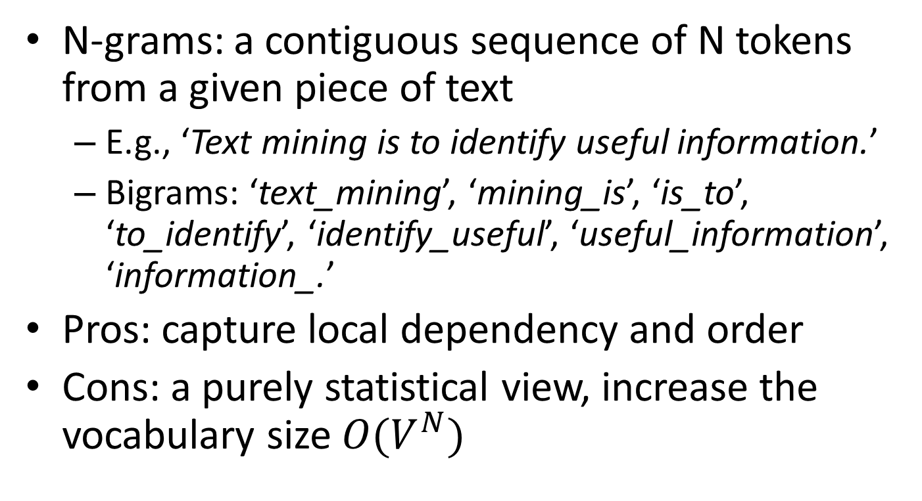
Bag-of-Words with N-grams
N-grams: a contiguous sequence of N tokens from a given piece of text
  E.g., ‘Text mining is to identify useful information.’
  Bigrams: ‘text_mining’, ‘mining_is’, ‘is_to’, ‘to_identify’, ‘identify_useful’, ‘useful_information’, ‘information_.’
Pros: capture local dependency and order
Cons: a purely statistical view, increase the vocabulary size $O(V^{N})$

Slide 14
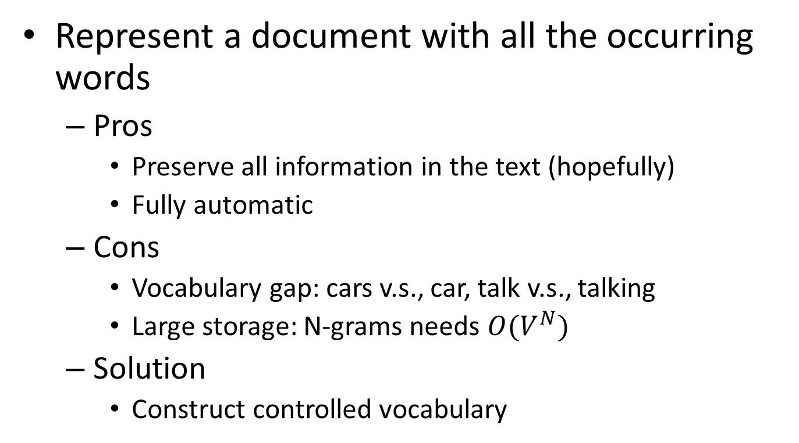
Automatic document representation
Represent a document with all the occurring words
  Pros
    Preserve all information in the text (hopefully)
    Fully automatic
  Cons
    Vocabulary gap: cars v.s., car, talk v.s., talking
    Large storage: N-grams needs $O(V^{N})$
  Solution
    Construct controlled vocabulary

Slide 15
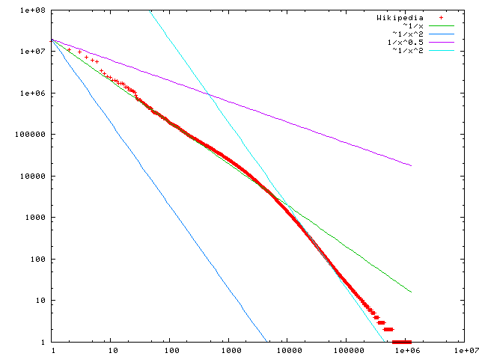

A statistical property of language
Zipf’s law
  Frequency of any word is inversely proportional to its rank in the frequency table
  Formally
    $f\left(k;s,N\right)=\frac{1/k^{s}}{\sum_{n=1}^{N}{1/n^{s}}}$
    where $k$ is rank of the word; $N$ is the vocabulary size; $s$ is language-specific parameter
  Simply: $f\left(k;s,N\right)∝1/k^{s}$
Discrete version of power law
Word frequency
In the Brown Corpus of American English text, the word "the" is the most frequently occurring word, and by itself accounts for nearly 7% of all word occurrences; the second-place word "of" accounts for slightly over 3.5% of words.
Word rank by frequency
A plot of word frequency in Wikipedia (Nov 27, 2006)

Slide 16
Pop-up Quiz
In a large Spanish text corpus, if we know the most popular word’s frequency is 145,872, what is your best estimate of its second most popular word’s frequency?

Slide 17
Zipf’s law tells us
Head words take large portion of occurrences, but they are semantically meaningless
  E.g., the, a, an, we, do, to
Tail words take major portion of vocabulary, but they rarely occur in documents
  E.g., sesquipedalianism
The rest is most representative
  To be included in the controlled vocabulary

Slide 18
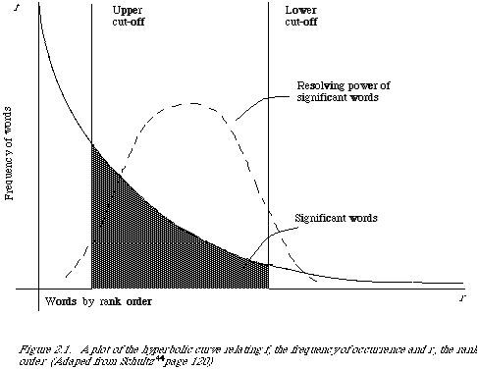
Automatic document representation
Remove non-informative words
Remove rare words

Slide 19
Normalization
Convert different forms of a word to a normalized form in the vocabulary
  U.S.A. -> USA, St. Louis -> Saint Louis
Solution
  Rule-based
    Delete periods and hyphens
    All in lower cases
  Dictionary-based
    Construct equivalent class
      Car -> “automobile, vehicle”
      Mobile phone -> “cellphone”
We will come back to this later

Slide 20
Stemming
Reduce inflected or derived words to their root form
  Plurals, adverbs, inflected word forms
    E.g., ladies -> lady, referring -> refer, forgotten -> forget
  Bridge the vocabulary gap
  Solutions (for English)
    Porter stemmer: patterns of vowel-consonant sequence
    Krovetz stemmer: morphological rules
  Risk: lose precise meaning of the word
    E.g., lay -> lie (a false statement? or be in a horizontal position?)

Slide 21
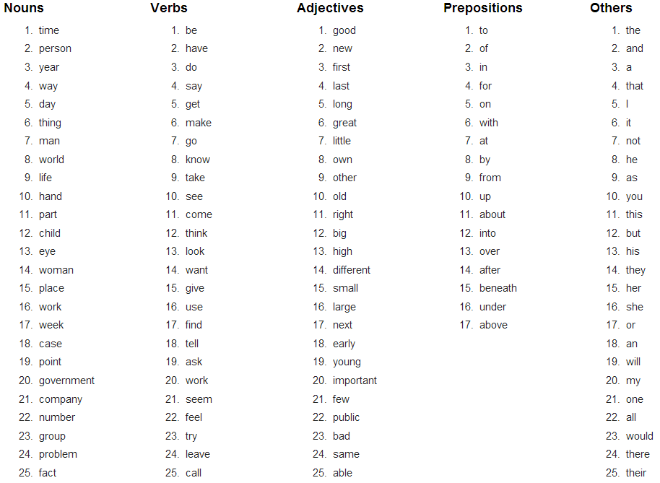
Stopwords
Useless words for document analysis
  Not all words are informative
  Remove such words to reduce vocabulary size
  No universal definition
  Risk: break the original meaning and structure of text
    E.g., this is not a good option -> option
    to be or not to be -> null
The OEC: Facts about the language

Slide 22
Recap: bag-of-words representation
 | text | information | identify | mining | mined | is | useful | to | from | apple | delicious
Doc1 | 1 | 1 | 1 | 1 | 0 | 1 | 1 | 1 | 0 | 0 | 0
Doc2 | 1 | 1 | 0 | 0 | 1 | 1 | 1 | 0 | 1 | 0 | 0
Doc3 | 0 | 0 | 0 | 0 | 0 | 1 | 0 | 0 | 0 | 1 | 1
Assumption
  Words are independent from each other
Pros
  Simple
Cons
  Basis vectors are clearly not linearly independent!
  Grammar and order are missing
The most frequently used document representation
  Image, speech, gene sequence

Slide 23
Recap: a statistical property of language
Discrete version of power law
Word frequency
Word rank by frequency
A plot of word frequency in Wikipedia (Nov 27, 2006)

Slide 24
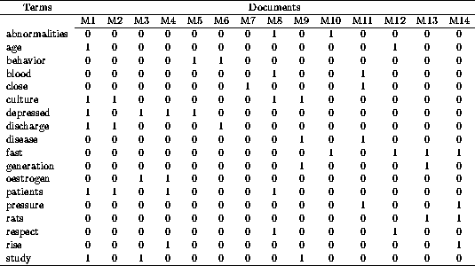
Constructing a VSM representation
Naturally fit into MapReduce paradigm!
Mapper
D1: ‘Text mining is to identify useful information.’
Tokenization:
D1: ‘Text’, ‘mining’, ‘is’, ‘to’, ‘identify’, ‘useful’, ‘information’, ‘.’
Stemming/normalization:
D1: ‘text’, ‘mine’, ‘is’, ‘to’, ‘identify’, ‘use’, ‘inform’, ‘.’
N-gram construction:
D1: ‘text-mine’, ‘mine-is’, ‘is-to’, ‘to-identify’, ‘identify-use’, ‘use-inform’, ‘inform-.’
Stopword/controlled vocabulary filtering:
D1: ‘text-mine’, ‘to-identify’, ‘identify-use’, ‘use-inform’
Reducer
Documents in a vector space!

Slide 25
How to assign weights?
Important!
Why?
  Corpus-wise: some terms carry more information about the document content
  Document-wise: not all terms are equally important
How?
  Two basic heuristics
    TF (Term Frequency) = Within-doc-frequency
    IDF (Inverse Document Frequency)

Slide 26
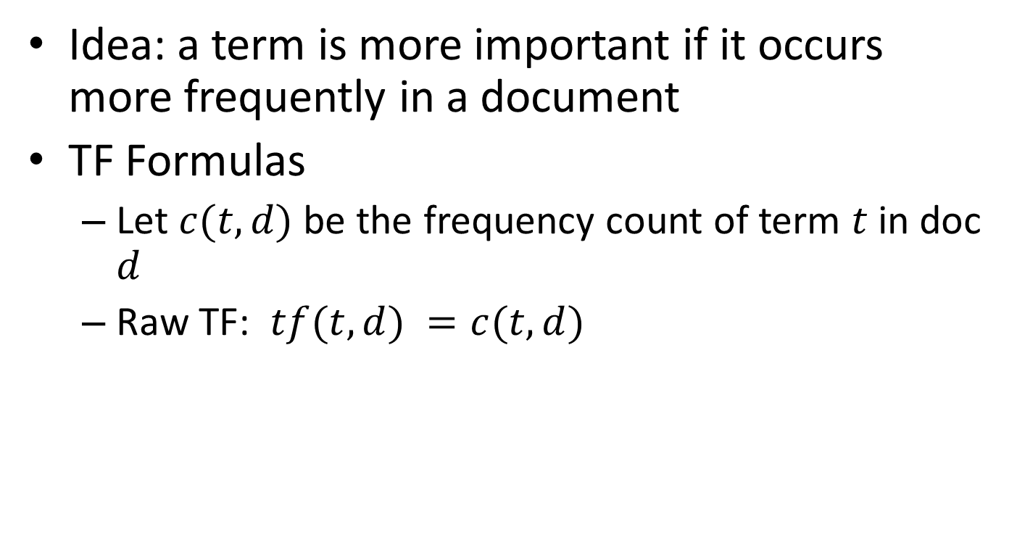
Term frequency
Idea: a term is more important if it occurs more frequently in a document
TF Formulas
  Let $c(t,d)$ be the frequency count of term $t$ in doc $d$
  Raw TF: $tf(t,d) =c(t,d)$
Which two documents are more similar to each other?
Doc A: ‘good weather’,10
Doc B: ‘good weather’,2
Doc C: ‘good weather’,3

Slide 27
TF normalization
Two views of document length
  A doc is long because it is verbose
  A doc is long because it has more content
Raw TF is inaccurate
  Document length variation
  “Repeated occurrences” are less informative than the “first occurrence”
  Information about semantic does not increase proportionally with number of term occurrence
Generally penalize long document, but avoid over-penalizing
  Pivoted length normalization

Slide 28


TF normalization
Maximum TF scaling
  $tf\left(t,d\right)=α+(1−α)\frac{c(t,d)}{\max_{t}{c(t,d)}}$, if $c\left(t,d\right)>0$
  Normalize by the most frequent word in this doc
Norm. TF
1
$$α$$
Raw TF

Slide 29
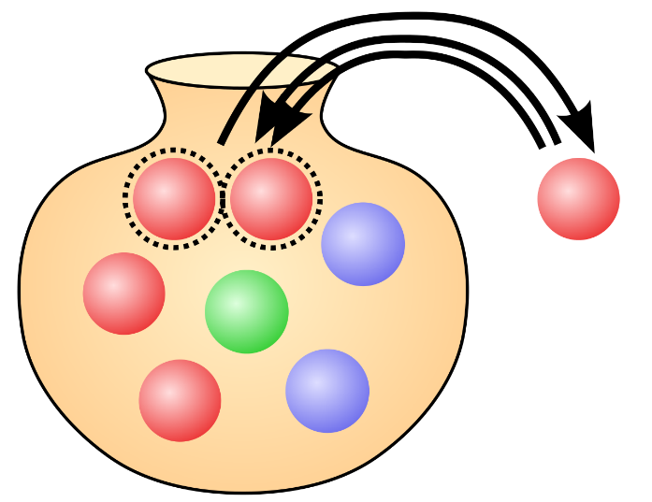

TF normalization
Sub-linear TF scaling
  $tf\left(t,d\right)=\left\{\begin{aligned}1+\log{c\left(t,d\right)}, if c\left(t,d\right)>0 \\ 0, otherwise\end{aligned}\right.$
Norm. TF
Polya Urn Model
Raw TF

Slide 30
Document frequency
Idea: a term is more discriminative if it occurs only in fewer documents

Slide 31

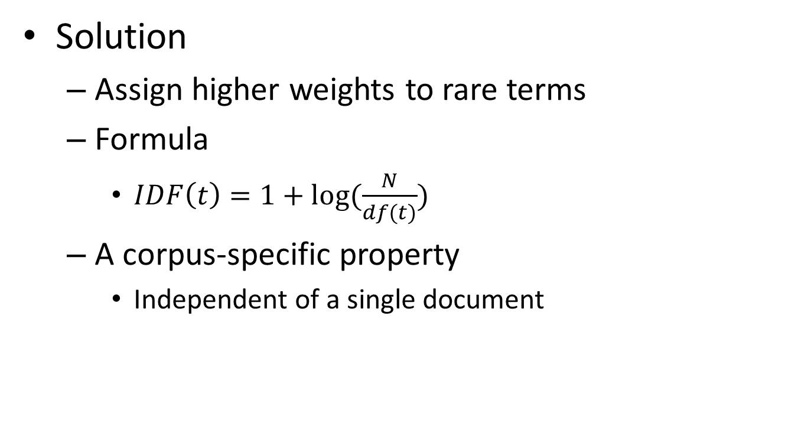
Inverse document frequency
Solution
  Assign higher weights to rare terms
  Formula
    $IDF\left(t\right)=1+log⁡(\frac{N}{df(t)})$
  A corpus-specific property
    Independent of a single document
Non-linear scaling
Total number of docs in collection
Number of docs containing term $t$

Slide 32
Pop-up Quiz
If we remove one document from the corpus, how would it affect the IDF of words in the vocabulary?
If we add one document from the corpus, how would it affect the IDF of words in the vocabulary?

Slide 33
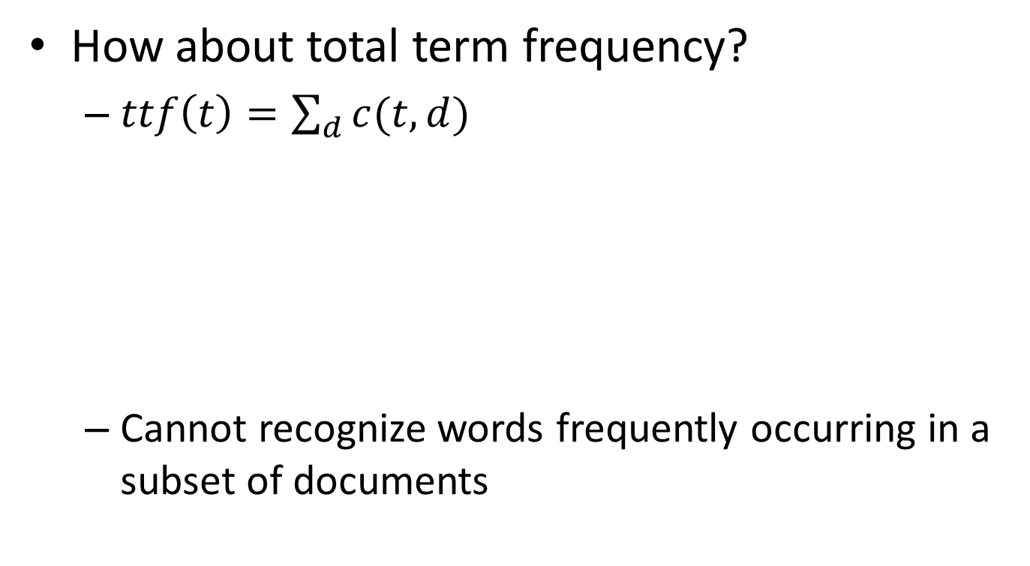
Why document frequency
How about total term frequency?
  $ttf\left(t\right)=\sum_{d}{c(t,d)}$
  Cannot recognize words frequently occurring in a subset of documents
Table 1. Example total term frequency v.s. document frequency in Reuters-RCV1 collection.
Word | ttf | df
try | 10422 | 8760
insurance | 10440 | 3997

Slide 34
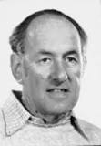
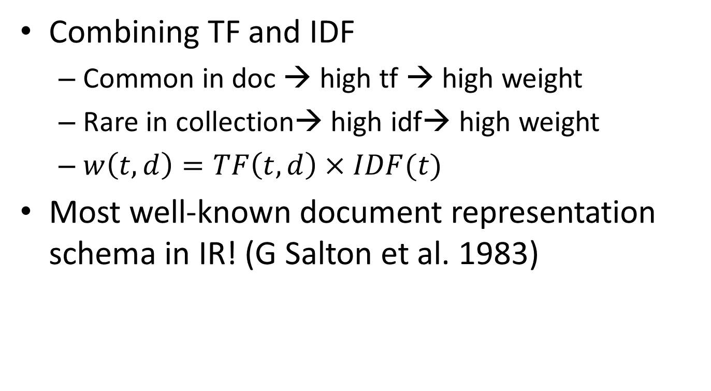
TF-IDF weighting
Combining TF and IDF
  Common in doc → high tf → high weight
  Rare in collection→ high idf→ high weight
  $w\left(t,d\right)=TF\left(t,d\right)×IDF(t)$
Most well-known document representation schema in IR! (G Salton et al. 1983)
“Salton was perhaps the leading computer scientist working in the field of information retrieval during his time.” - wikipedia
Gerard Salton Award
– highest achievement award in IR

Slide 35
How to define a good similarity metric?
Euclidean distance?
Finance
TF-IDF space
D₂
D₄
D₃
Sports
D₆
D₅
D₁
Education

Slide 36
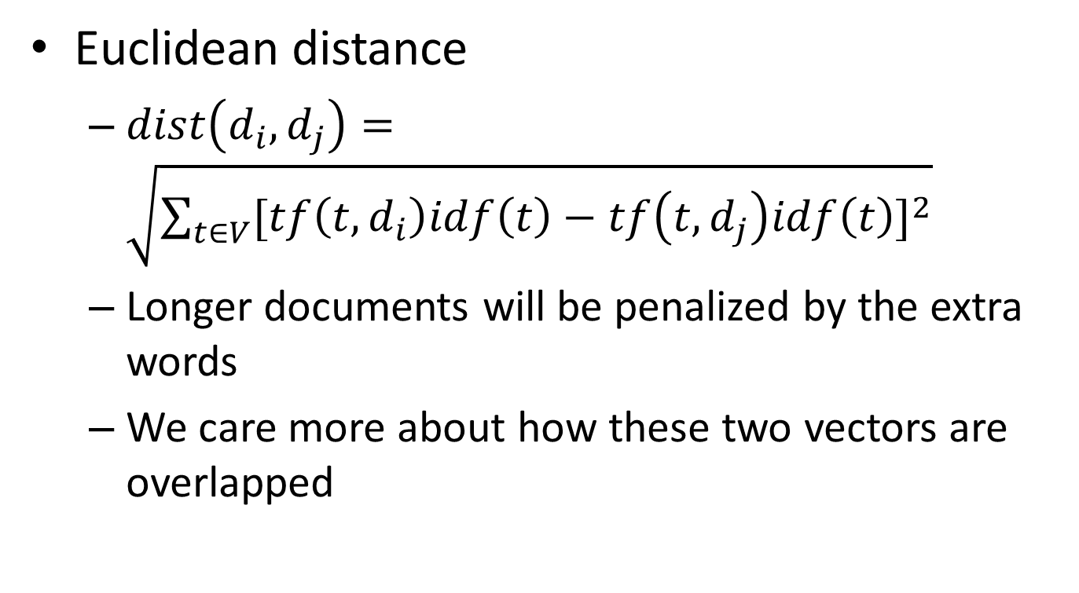
How to define a good similarity metric?
Euclidean distance
  $dist\left(d_{i},d_{j}\right)=\sqrt{\sum_{t∈V}{{[tf\left(t,d_{i}\right)idf\left(t\right)−tf\left(t,d_{j}\right)idf\left(t\right)]}^{2}}}$
  Longer documents will be penalized by the extra words
  We care more about how these two vectors are overlapped

Slide 37
From distance to angle
Angle: how vectors are overlapped
  Cosine similarity – projection of one vector onto another
Finance
TF-IDF space
D₁
The choice of angle
The choice of Euclidean distance
D₂
D₆
Sports

Slide 38

Cosine similarity
TF-IDF vector
Angle between two vectors
  $cosine\left(d_{i},d_{j}\right)=\frac{V_{d_{i}}^{T}V_{d_{j}}}{{\left|V_{d_{i}}\right|}_{2}×{\left|V_{d_{j}}\right|}_{2}}$
  Documents are normalized by length
Unit vector
Finance
D₂
TF-IDF space
D₁
D₆
Sports

Slide 39
Advantages of VS model
Empirically effective!
Intuitive
Easy to implement
Well-studied/mostly evaluated
The Smart system
  Developed at Cornell: 1960-1999
  Still widely used
Warning: many variants of TF-IDF!

Slide 40
Common Misconceptions
Vector space model is bag-of-words
Bag-of-words is TF-IDF
Cosine similarity is superior to Euclidean distance

Slide 41
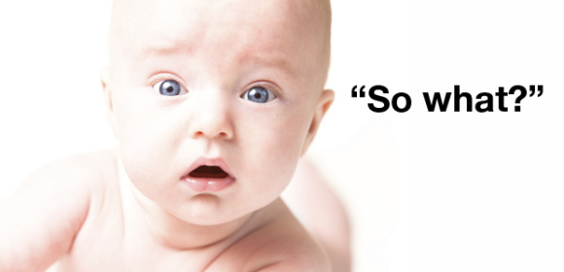
Disadvantages of VS model
Assume term independence
Lack of “predictive adequacy”
  Arbitrary term weighting
  Arbitrary similarity measure
Lots of parameter tuning!

Slide 42
What you should know
Basic ideas of vector space model
Procedures of constructing VS representation for a document
Two important heuristics in bag-of-words representation
  TF
  IDF
Similarity metric for VS model

Slide 43
Today’s reading
Introduction to information retrieval
  Chapter 2.2: Determining the vocabulary of terms
  Chapter 6.2: Term frequency and weighting
  Chapter 6.3: The vector space model for scoring
  Chapter 6.4: Variant tf-idf functions

