Slide 1
Support Vector Machines
Hongning Wang
CS@UVa

Slide 2
Today’s lecture
Support vector machines
  Max margin classifier
  Derivation of linear SVM
    Binary and multi-class cases
  Different types of losses in discriminative models
  Kernel method
    Non-linear SVM
  Popular implementations

Slide 3





Review: Bayes risk minimization
Risk – assign instance to a wrong class
  $y^{∗}=argmax_{y}P(y|X)$
*Optimal Bayes decision boundary
$$p(X,y)$$
We have learned multiple ways to estimate this, e.g. Naïve Bayes, kNN, Logistic regression
$$\hat{y}=0$$
$$\hat{y}=1$$
$$p\left(X | y=0\right)p(y=0)$$
$$p\left(X | y=1\right)p(y=1)$$
$$X$$
False negative
False positive

Slide 4
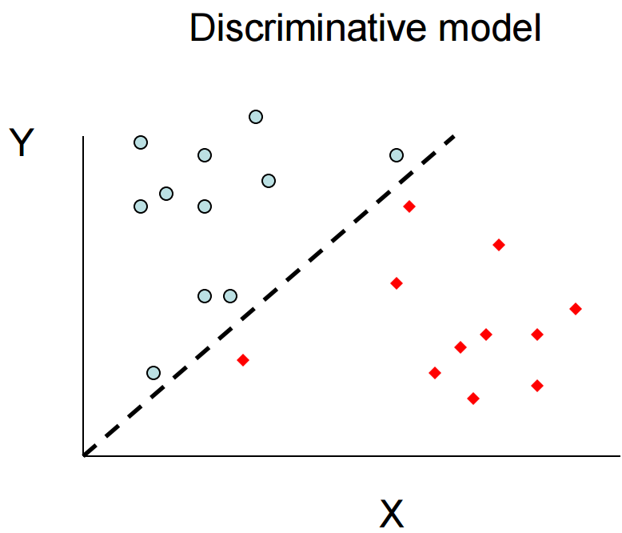
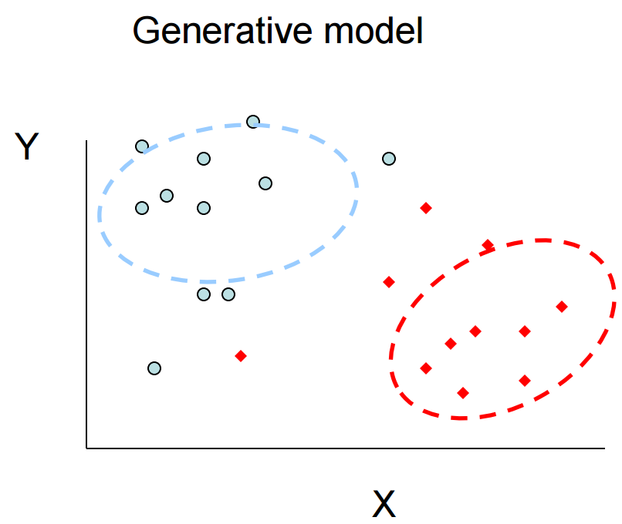

Discriminative v.s. generative models
All instances are considered for probability density estimation
$$y=f(x)$$
More attention will be put onto the boundary points

Slide 5





Logistic regression for classification
Decision boundary for binary case
  $\hat{y}=\left\{\begin{aligned}1, p\left(y=1 | X\right)>0.5 \\ 0, otherwise\end{aligned}\right.$
  $\hat{y}=\left\{\begin{aligned}1, w^{T}x>0 \\ 0, otherwise\end{aligned}\right.$
$$p\left(y=1 | X\right)=\frac{1}{1+\exp{(−w^{T}X)}}>0.5$$
i.f.f.
$$\exp\left(−w^{T}X\right)<1$$
i.f.f.
$$w^{T}X>0$$
A linear model!
How about directly estimating this?

Slide 6




Which linear classifier do we prefer?
Choose the one with maximum separation margin
Linear classifier $y=sgn\left(w^{T}x\right)$
Y
$$f\left(x\right)=w_{0}^{T}x$$
$$f\left(x\right)=w_{1}^{T}x$$
Instances are linearly separable
$$f\left(x\right)=w_{2}^{T}x$$
X

Slide 7









Parameterize the margin
Margin = $\min_{i}{\frac{y_{i}w^{T}x_{i}}{\sqrt{w^{T}w}}}$
Distance from a point to a line
$$\frac{|w^{T}x|}{\sqrt{w^{T}w}}$$
Since $y=sgn\left(w^{T}x\right)$
Y
$$w_{}^{T}x>0$$
The distance can be written as
$$\frac{yw^{T}x}{\sqrt{w^{T}w}}$$
$$w_{}^{T}x=0$$
$$w_{}^{T}x<0$$
X

Slide 8


Max margin classifier
$w^{∗}=\underset{w}{argmax}{\min_{i}{\frac{y_{i}w^{T}x_{i}}{\sqrt{w^{T}w}}}}$
$$s.t. ∀i, y_{i}w^{T}x_{i}≥0$$
Y
$$w_{}^{T}x>0$$
Distance can be written as
$$\frac{yw^{T}x}{\sqrt{w^{T}w}}$$
$$w_{}^{T}x=0$$
$$w_{}^{T}x<0$$
X

Slide 9
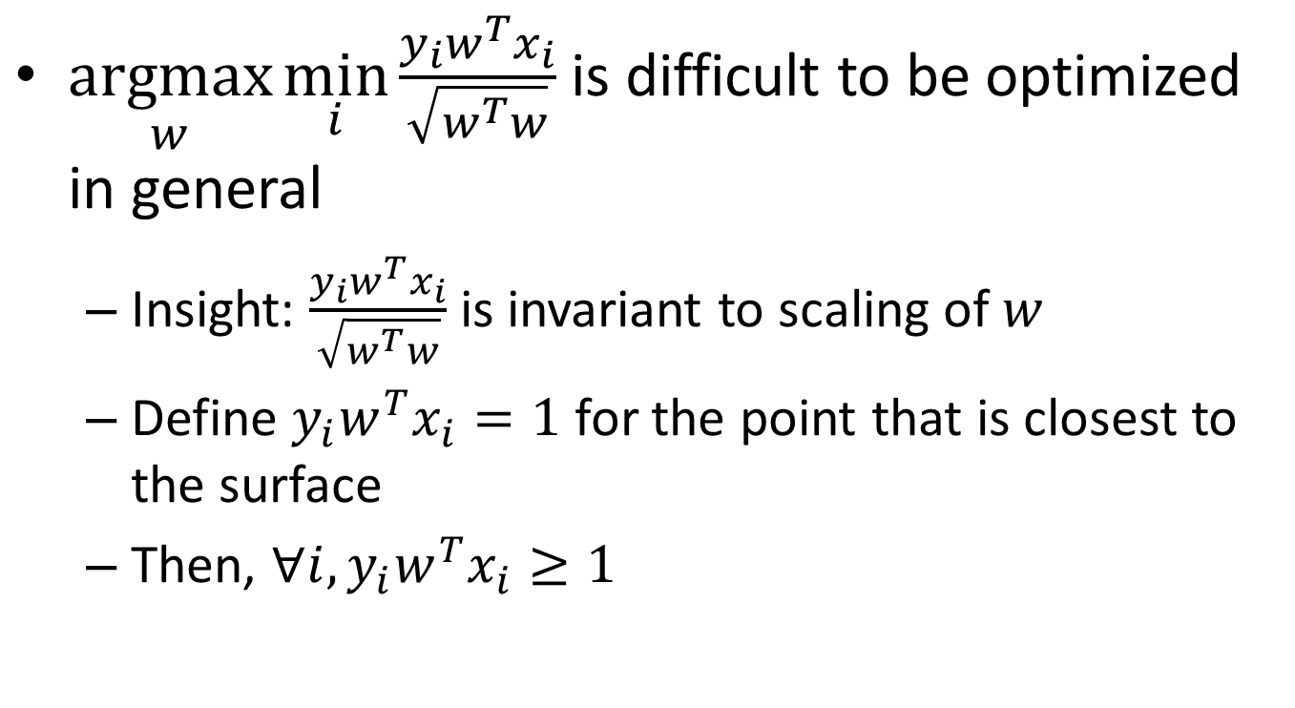
Max margin classifier
$\underset{w}{argmax}{\min_{i}{\frac{y_{i}w^{T}x_{i}}{\sqrt{w^{T}w}}}}$ is difficult to be optimized in general
  Insight: $\frac{y_{i}w^{T}x_{i}}{\sqrt{w^{T}w}}$ is invariant to scaling of $w$
  Define $y_{i}w^{T}x_{i}=1$ for the point that is closest to the surface
  Then, $∀i,y_{i}w^{T}x_{i}≥1$

Slide 10






Max margin classifier
$$argmax_{w}\frac{1}{\sqrt{w^{T}w}}$$
$$argmin_{w}w^{T}w$$
Quadratic programming!
Easy to solve!
$$s.t. ∀i,y_{i}w^{T}x_{i}≥1$$
Y
$$w_{}^{T}x=0$$
That’s why it is called Support Vector Machines
Active constraints
No contribution in deciding the decision boundary
Support vectors
Inactive constraints
Classification confidence $\min_{i}y_{i}w^{T}x_{i}$
X

Slide 11






What if the instances are not linearly separable?
Maximize the margin while minimizing the number of errors made by the classifier?
Linear classifier $y=sgn\left(w^{T}x\right)$
trade-off parameter
manually set
Y
$$f\left(x\right)=w_{2}^{T}x$$
$$argmin_{w}w^{T}w+C\#error$$
$$f\left(x\right)=w_{1}^{T}x$$
$$s.t. ∀i,y_{i}w^{T}x_{i}≥1$$
No longer a QP!
No idea how to optimize!
X

Slide 12
Recap: max margin classifier
$w^{∗}=\underset{w}{argmax}{\min_{i}{\frac{y_{i}w^{T}x_{i}}{\sqrt{w^{T}w}}}}$
$$s.t. ∀i, y_{i}w^{T}x_{i}≥0$$
Y
$$w_{}^{T}x>0$$
Distance can be written as
$$\frac{yw^{T}x}{\sqrt{w^{T}w}}$$
$$w_{}^{T}x=0$$
$$w_{}^{T}x<0$$
X

Slide 13
Recap: max margin classifier
$$argmin_{w}w^{T}w$$
Quadratic programming!
Easy to solve!
$$s.t. ∀i,y_{i}w^{T}x_{i}≥1$$
Y
$$w_{}^{T}x=0$$
That’s why it is called Support Vector Machines
Active constraints
No contribution in deciding the decision boundary
Support vectors
Inactive constraints
Classification confidence $\min_{i}y_{i}w^{T}x_{i}$
X

Slide 14
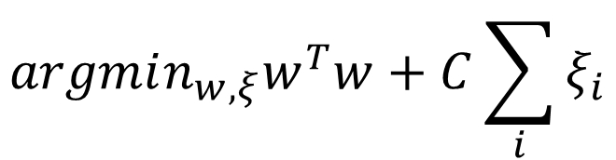





Soft-margin SVM
Relax the constraints and penalize the misclassification error
Linear classifier $y=sgn\left(w^{T}x\right)$
Y
$$argmin_{w,ξ}w^{T}w+C\sum_{i}{ξ_{i}}$$
Separable cases $ξ=0$
$$f\left(x\right)=w_{1}^{T}x$$
$$s.t. ∀i,y_{i}w^{T}x_{i}≥1−ξ_{i}$$
$$ξ_{i}≥0$$
$$ξ_{2}$$
$$ξ_{1}$$
Introduce slack variables
Still a QP!
Easy to optimize!
X

Slide 15
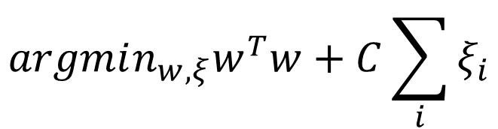

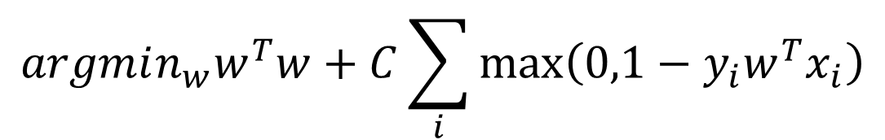

What kind of loss is SVM optimizing?
$$argmin_{w,ξ}w^{T}w+C\sum_{i}{ξ_{i}}$$
$$s.t. ∀i,y_{i}w^{T}x_{i}≥1−ξ_{i}$$
$$ξ_{i}≥0$$
$$argmin_{w}w^{T}w+C\sum_{i}{\max\left(0,1−y_{i}w^{T}x_{i}\right)}$$

Slide 16

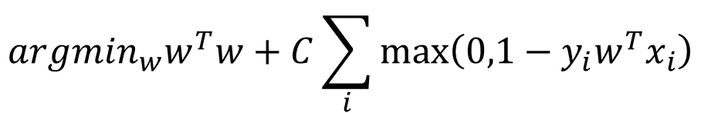


What kind of error is SVM optimizing?
Hinge loss
regularization
classification loss
$$argmin_{w}w^{T}w+C\sum_{i}{\max\left(0,1−y_{i}w^{T}x_{i}\right)}$$
$$E(x,y)$$
0/1 loss
1
Hinge loss
$$argmin_{w}w^{T}w+C\#error$$
-1
0
1
$$yw^{T}x$$

Slide 17
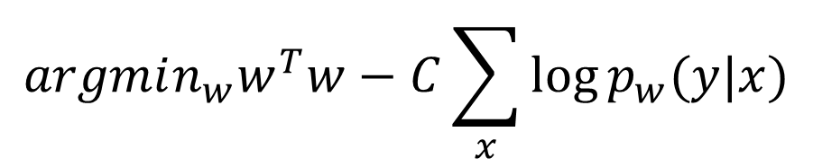



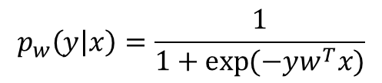
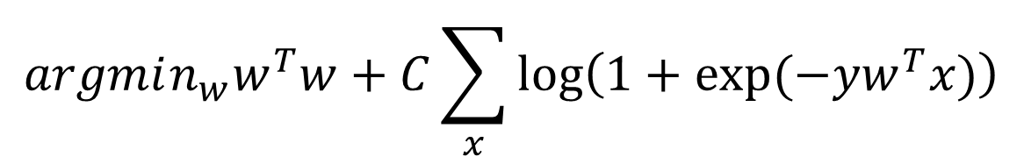
Think about logistic regression
Optimized by maximum a posterior estimator
  $argmax_{w}\sum_{x}{\log{p_{w}(y|x)}}−\frac{w^{T}w}{2σ^{2}}$
Note: $y=\{−1,+1\}$
$$argmin_{w}w^{T}w−C\sum_{x}{\log{p_{w}(y|x)}}$$
Note: $C=2σ^{2}$
$$p_{w}\left(y | x\right)=\frac{1}{1+\exp{(−yw^{T}x)}}$$
$$argmin_{w}w^{T}w+C\sum_{x}{\log\left(1+\exp{(−yw^{T}x)}\right)}$$
Regularization
Logistic loss

Slide 18
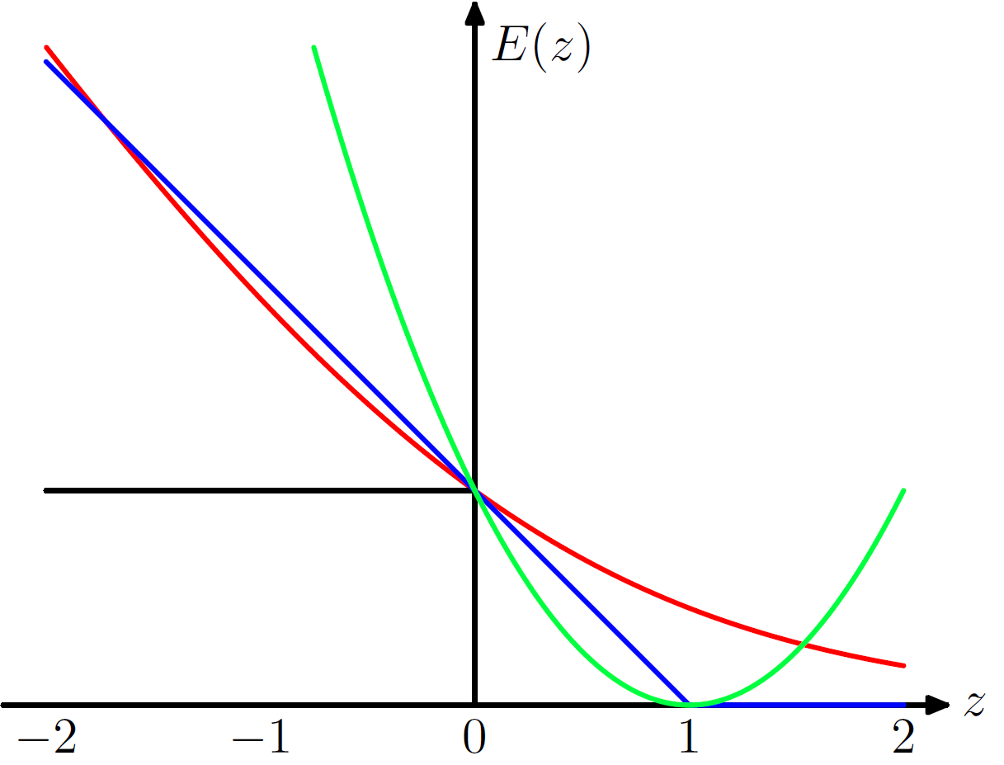

Different types of classification loss
Discriminative classifiers aim at optimizing those losses
Hinge loss: SVM
Symmetric loss for false positive and false negative!
Logistic loss: Logistic Regression
Square loss: linear regression, Least square SVM
0/1 loss: no classifier yet
$$=yw^{T}x$$
Pattern Recognition and Machine Learning, p337

Slide 19





What about multi-class classification?
One v.s. All
  Simultaneously learn a set of classifiers
$$w_{2}^{T}x=0$$
  Classification decision: $y=argmax_{y}w_{y}^{T}x$
Y
$$w_{0}^{T}x=0$$
We need to make sure the scales are consistent across classes
Classification confidence
How about this region?
$$w_{y}^{T}x−\max_{\tilde{y}≠y}{w_{\tilde{y}}^{T}x}$$
$$w_{1}^{T}x=0$$
difference between the most confusing classes
X

Slide 20
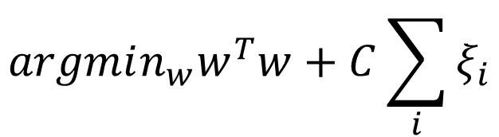


What about multi-class classification?
One v.s. All
  Simultaneously learn a set of classifiers
For binary classification, we have:
$$argmin_{w}w^{T}w+C\sum_{i}{ξ_{i}}$$
$$s.t. ∀i,y_{i}w^{T}x_{i}≥1−ξ_{i}$$
$$ξ_{i}≥0$$
Generalize it!

Slide 21
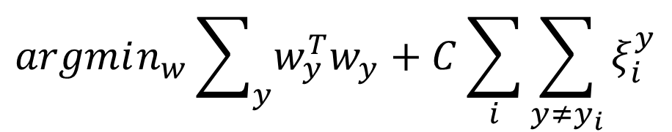

What about multi-class classification?
One v.s. All
  Simultaneously learn a set of classifiers
$$argmin_{w}\sum_{y}{w_{y}^{T}w_{y}}+C\sum_{i}{\sum_{y≠y_{i}}{ξ_{i}^{y}}}$$
$$s.t. ∀i,y≠y_{i},w_{y_{i}}^{T}x_{i}≥w_{y}^{T}x_{i}+1−ξ_{i}^{y}$$
$$ξ_{i}^{y}≥0$$
Scale the margin by the rest classes

Slide 22
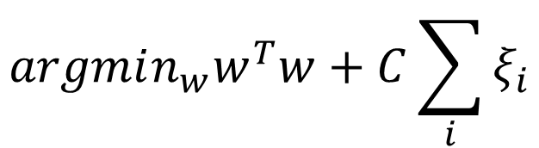

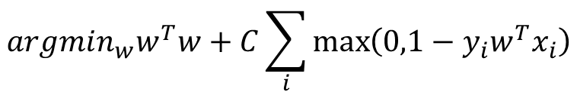

Parameter estimation
A constrained optimization problem
  Can be directly optimized with gradient-based method
    Chapelle, Olivier. "Training a support vector machine in the primal." Neural Computation 19.5 (2007): 1155-1178.
$$argmin_{w}w^{T}w+C\sum_{i}{ξ_{i}}$$
$$s.t. ∀i,y_{i}w^{T}x_{i}≥1−ξ_{i}$$
$$ξ_{i}≥0$$
$$argmin_{w}w^{T}w+C\sum_{i}{\max\left(0,1−y_{i}w^{T}x_{i}\right)}$$
piece-wise linear

Slide 23
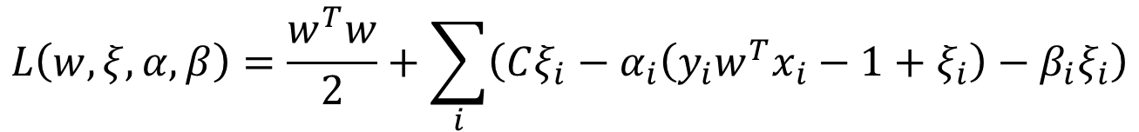
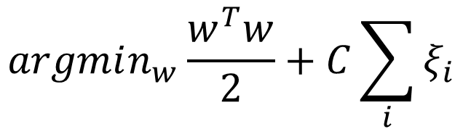



Dual form of SVM
Just to simplify the follow-up derivations
A constrained optimization problem
$$argmin_{w}\frac{w^{T}w}{2}+C\sum_{i}{ξ_{i}}$$
Primal
Lagrangian multipliers
$$s.t. ∀i,y_{i}w^{T}x_{i}≥1−ξ_{i}$$
$$α_{i}$$
$$ξ_{i}≥0$$
$$β_{i}$$
Lagrangian dual
$$L\left(w,ξ,α,β\right)=\frac{w^{T}w}{2}+\sum_{i}{\left(Cξ_{i}−α_{i}\left(y_{i}w^{T}x_{i}−1+ξ_{i}\right)−β_{i}ξ_{i}\right)}$$
$$s.t. ∀i,α_{i}≥0,β_{i}≥0$$

Slide 24
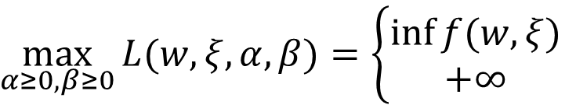

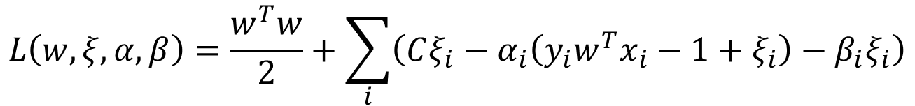
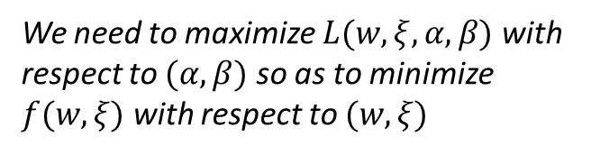

Dual form of SVM
Lagrangian dual
$$L\left(w,ξ,α,β\right)=\frac{w^{T}w}{2}+\sum_{i}{\left(Cξ_{i}−α_{i}\left(y_{i}w^{T}x_{i}−1+ξ_{i}\right)−β_{i}ξ_{i}\right)}$$
$$s.t. ∀i,α_{i}≥0,β_{i}≥0$$
Lemma
$\max_{α≥0,β≥0}{L(w,ξ,α,β)}=\left\{\begin{aligned}\inf{f(w,ξ)} \\ +∞\end{aligned}\right.$
if $(w,ξ)$ is feasible
otherwise
We need to maximize $L(w,ξ,α,β)$ with respect to $(α,β)$ so as to minimize $f(w,ξ)$ with respect to $(w,ξ)$

Slide 25
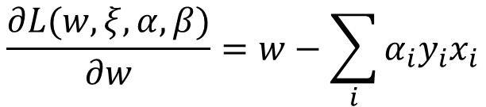


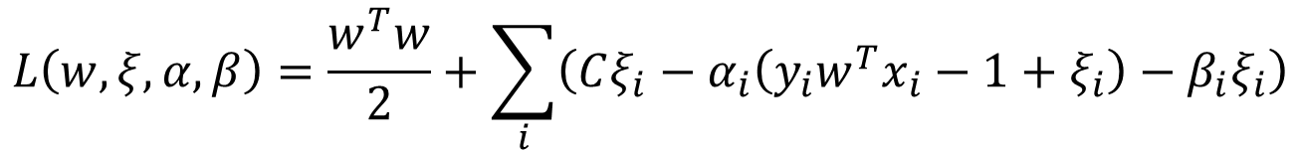
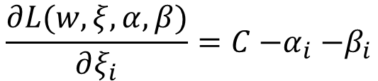
Dual form of SVM
Lagrangian dual
$$L\left(w,ξ,α,β\right)=\frac{w^{T}w}{2}+\sum_{i}{\left(Cξ_{i}−α_{i}\left(y_{i}w^{T}x_{i}−1+ξ_{i}\right)−β_{i}ξ_{i}\right)}$$
$$s.t. ∀i,α_{i}≥0,β_{i}≥0$$
Set it to zero
take them back to dual form
$$\frac{∂L(w,ξ,α, β)}{∂w}=w−\sum_{i}{α_{i}y_{i}x_{i}}$$
$$w=\sum_{i}{α_{i}y_{i}x_{i}}$$
$$\frac{∂L(w,ξ,α, β)}{∂ξ_{i}}=C{−α}_{i}−β_{i}$$
$$α_{i}+β_{i}=C$$

Slide 26
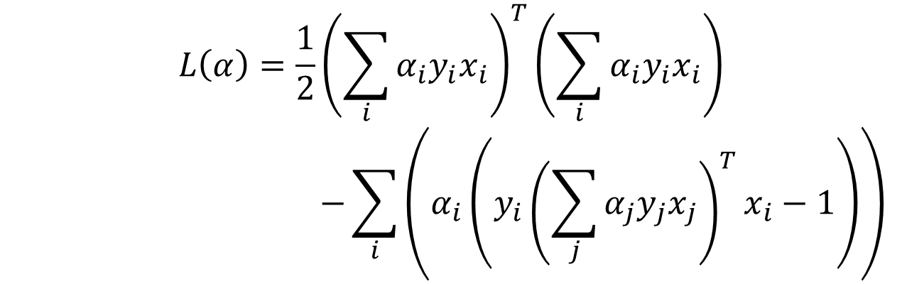

Dual form of SVM
Lagrangian dual
$$L\left(α\right)=\frac{1}{2}{\left(\sum_{i}{α_{i}y_{i}x_{i}}\right)}^{T}\left(\sum_{i}{α_{i}y_{i}x_{i}}\right)$$
$$−\sum_{i}{\left(α_{i}\left(y_{i}{\left(\sum_{j}{α_{j}y_{j}x_{j}}\right)}^{T}x_{i}−1\right)\right)}$$
$$s.t. ∀i,{0≤α}_{i}≤C$$

Slide 27
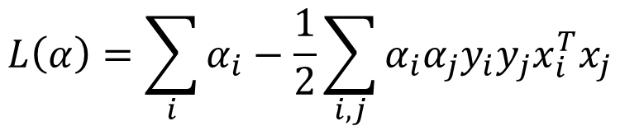


Dual form of SVM
Lagrangian dual
In dual form, we need to maximize it!
$$L\left(α\right)=\sum_{i}{α_{i}}−\frac{1}{2}\sum_{i,j}{α_{i}{α_{j}y}_{i}y_{j}x_{i}^{T}x_{j}}$$
$$s.t. ∀i,{0≤α}_{i}≤C$$
QP again!
Easy to optimize!
Complementary slackness
In the optimal solution: $α_{i}\left(y_{i}w^{T}x_{i}−1+ξ_{i}\right)=0$
which means $α_{i}=0$ if the constraint is satisfied (correct classification)
$α_{i}>0$ if the constraint is not satisfied (misclassification)

Slide 28
Recap: what about multi-class classification?
One v.s. All
  Simultaneously learn a set of classifiers
$$w_{2}^{T}x=0$$
  Classification decision: $y=argmax_{y}w_{y}^{T}x$
Y
$$w_{0}^{T}x=0$$
We need to make sure the scales are consistent across classes
Classification confidence
How about this region?
$$w_{y}^{T}x−\max_{\tilde{y}≠y}{w_{\tilde{y}}^{T}x}$$
$$w_{1}^{T}x=0$$
difference between the most confusing classes
X

Slide 29
Recap: dual form of SVM
Just to simplify the follow-up derivations
A constrained optimization problem
$$argmin_{w}\frac{w^{T}w}{2}+C\sum_{i}{ξ_{i}}$$
Primal
Lagrangian multipliers
$$s.t. ∀i,y_{i}w^{T}x_{i}≥1−ξ_{i}$$
$$α_{i}$$
$$ξ_{i}≥0$$
$$β_{i}$$
Lagrangian dual
$$L\left(w,ξ,α,β\right)=\frac{w^{T}w}{2}+\sum_{i}{\left(Cξ_{i}−α_{i}\left(y_{i}w^{T}x_{i}−1+ξ_{i}\right)−β_{i}ξ_{i}\right)}$$
$$s.t. ∀i,α_{i}≥0,β_{i}≥0$$

Slide 30
Recap: dual form of SVM
Lagrangian dual
In dual form, we need to maximize it!
$$L\left(α\right)=\sum_{i}{α_{i}}−\frac{1}{2}\sum_{i,j}{α_{i}{α_{j}y}_{i}y_{j}x_{i}^{T}x_{j}}$$
$$s.t. ∀i,{0≤α}_{i}≤C$$
QP again!
Easy to optimize!
Complementary slackness
In the optimal solution: $α_{i}\left(y_{i}w^{T}x_{i}−1+ξ_{i}\right)=0$
which means $α_{i}=0$ if the constraint is satisfied (correct classification)
$α_{i}>0$ if the constraint is not satisfied (misclassification)

Slide 31



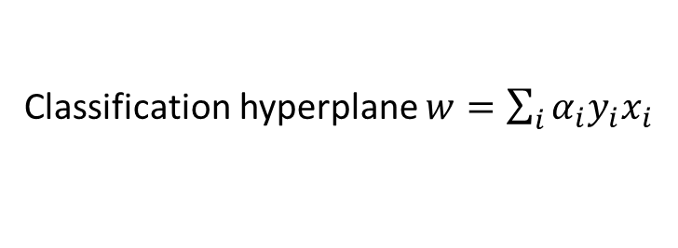


Sparsity in dual SVM
Only a few $αs$ can be non-zero
Classification hyperplane $w=\sum_{i}{α_{i}y_{i}x_{i}}$
Y
That’s why it is called Support Vector Machines
$$w_{}^{T}x=0$$
Active constraints $α>0$
No contribution in deciding the decision boundary
Support vectors
Inactive constraints
$$α=0$$
$$α_{i}\left(y_{i}w^{T}x_{i}−1+ξ_{i}\right)=0$$
X

Slide 32
Why dual form SVM?
Primal SVM v.s. dual SVM
  Primal: QP in feature space
  Dual: QP in instance space
  If we have a lot more features than training instances, dual optimization will be more efficient
  More importantly, the kernel trick!

Slide 33




Non-linearly separable cases
Non-linear mapping to linearly separable case
$$x_{2}$$
$$x_{2}=x_{1}^{2}$$
$$x_{1}$$
$$x_{1}$$
Polynomial mapping

Slide 34




Non-linearly separable cases
Non-linear mapping to linearly separable case
$$x_{2}$$
$$θ$$
polar coordinates
$$x_{1}$$
$$r$$

Slide 35

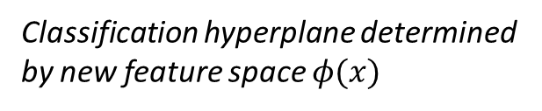



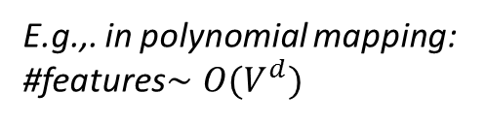
Non-linearly separable cases
Explore new features
  Use features of features of features….
Classification hyperplane determined by new feature space $φ(x)$
$$x_{2}$$
$$(x_{1},x_{2})$$
feature mapping $φ(x)$
$$x_{1}$$
$$φ\left(x\right)=\left(x_{1},x_{2},x_{1}^{2},x_{2}^{2},x_{1}x_{2},…,\exp\left(x_{1}x_{2}\right)\right)$$
E.g.,. in polynomial mapping: #features$∼O(V^{d})$
Feature space explodes very quickly!

Slide 36

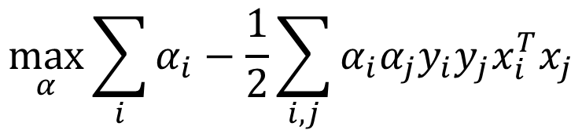


Rethink about dual form SVM
$$\max_{α}{\sum_{i}{α_{i}}−\frac{1}{2}\sum_{i,j}{α_{i}{α_{j}y}_{i}y_{j}x_{i}^{T}x_{j}}}$$
$$s.t. ∀i,{0≤α}_{i}≤C$$
What we need is only the inner product between instances!
Take order 2 polynomial as an example:
$$φ\left(a,b\right)=(a^{2},b^{2},\sqrt{2}ab)$$
If we take the feature mapping first and then compute the inner product:
$$φ{\left(a_{1},b_{1}\right)}^{T}φ\left(a_{2},b_{2}\right)=a_{1}^{2}a_{2}^{2}+b_{1}^{2}b_{2}^{2}+2a_{1}a_{2}b_{1}b_{2}$$
If we compute the inner product first:
No need to take feature mapping at all!
$${\left[{\left(a_{1},b_{1}\right)}^{T}\left(a_{2},b_{2}\right)\right]}^{2}=a_{1}^{2}a_{2}^{2}+b_{1}^{2}b_{2}^{2}+2a_{1}a_{2}b_{1}b_{2}$$

Slide 37
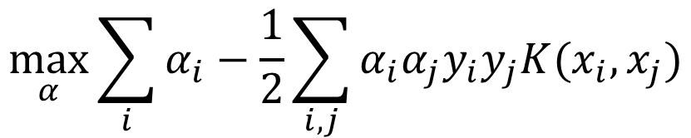
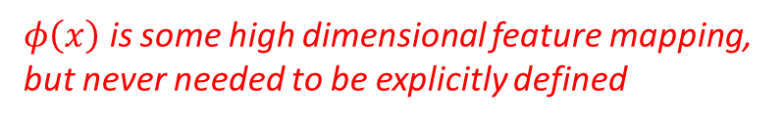

Rethink about dual form SVM
Kernel SVM
  Kernel function
$$\max_{α}{\sum_{i}{α_{i}}−\frac{1}{2}\sum_{i,j}{α_{i}{α_{j}y}_{i}y_{j}K(x_{i},x_{j})}}$$
$$s.t. ∀i,{0≤α}_{i}≤C$$
$$K\left(x_{i},x_{j}\right)=φ{\left(x_{i}\right)}^{T}φ(x_{j})$$
$φ\left(x\right)$ is some high dimensional feature mapping, but never needed to be explicitly defined

Slide 38


Rethink about dual form SVM
Kernel SVM
  Decision boundary
    $f\left(x\right)=w^{T}φ\left(x\right)=\sum_{i}{α_{i}y_{i}φ{\left(x_{i}\right)}^{T}φ\left(x\right)}$
    $$=\sum_{i}{α_{i}y_{i}K(x_{i},x})$$
$$\max_{α}{\sum_{i}{α_{i}}−\frac{1}{2}\sum_{i,j}{α_{i}{α_{j}y}_{i}y_{j}K(x_{i},x_{j})}}$$
$$s.t. ∀i,{0≤α}_{i}≤C$$
We still don’t need this explicit feature mapping!
Similarity between a testing case and support vectors!

Slide 39
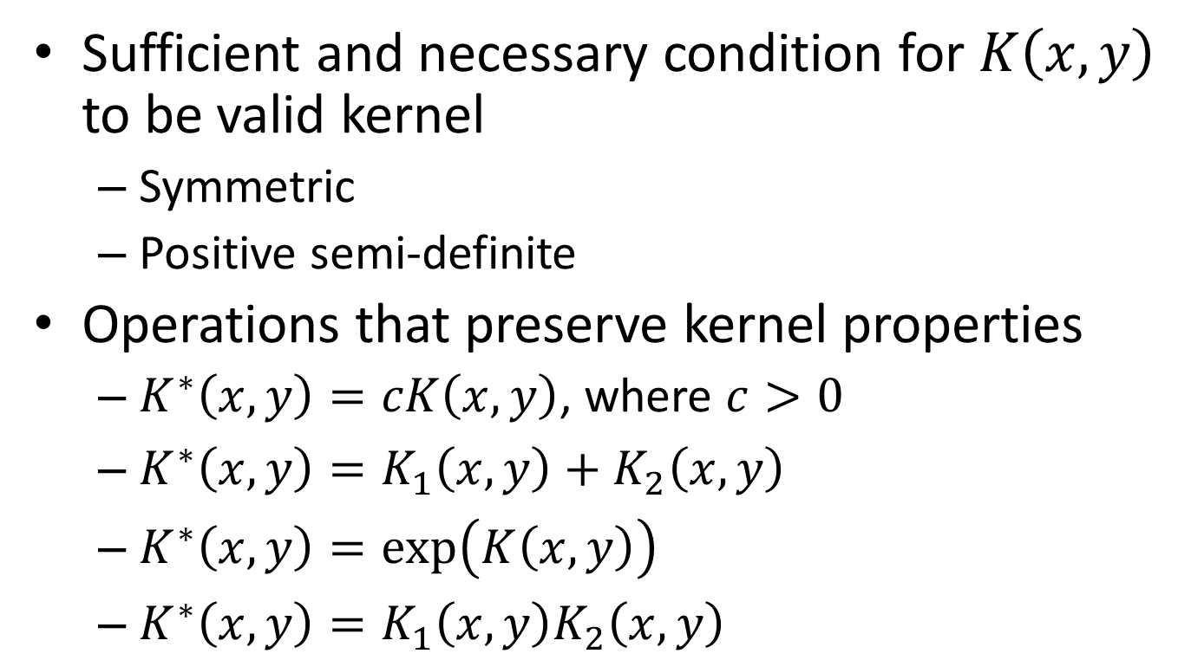
How to construct a kernel
Sufficient and necessary condition for $K\left(x,y\right)$ to be valid kernel
  Symmetric
  Positive semi-definite
Operations that preserve kernel properties
  $K^{∗}\left(x,y\right)=cK\left(x,y\right)$, where $c>0$
  $K^{∗}\left(x,y\right)=K_{1}\left(x,y\right)+K_{2}\left(x,y\right)$
  $K^{∗}\left(x,y\right)=\exp\left(K\left(x,y\right)\right)$
  $K^{∗}\left(x,y\right)=K_{1}\left(x,y\right)K_{2}\left(x,y\right)$
Just like the requirement for a distance metric

Slide 40
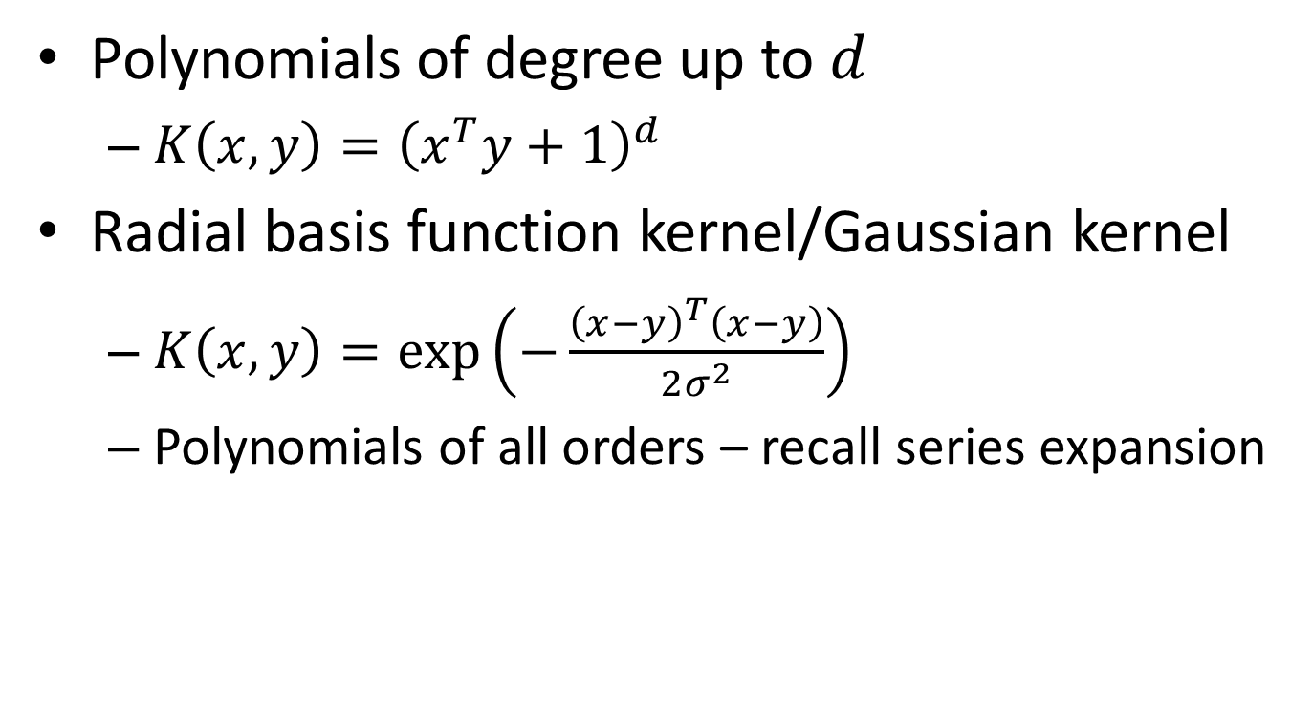
Common kernels
Polynomials of degree up to $d$
  $K\left(x,y\right)={\left(x^{T}y+1\right)}^{d}$
Radial basis function kernel/Gaussian kernel
  $K\left(x,y\right)=\exp\left(−\frac{{\left(x−y\right)}^{T}\left(x−y\right)}{2σ^{2}}\right)$
  Polynomials of all orders – recall series expansion

Slide 41


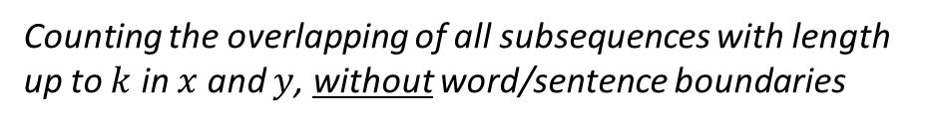


Special kernels for text data
String kernel
  $x$ and $y$ are two text sequences
  $K\left(x,y\right)=\sum_{k}{\sum_{u∈A^{k}}{\sum_{i:u=x[i]}{\sum_{j:u=y[j]}{1}}} }$
    where A is an finite alphabet of symbols
k-mers kernel (length k substrings)
All character sequence of length $k$
All occurrences of sequence $u$ in $y$
All occurrences of sequence $u$ in $x$
Insight of string kernel:
Counting the overlapping of all subsequences with length up to $k$ in $x$ and $y$, without word/sentence boundaries
Lodhi, Huma, et al. "Text classification using string kernels." The Journal of Machine Learning Research 2 (2002): 419-444.

Slide 42
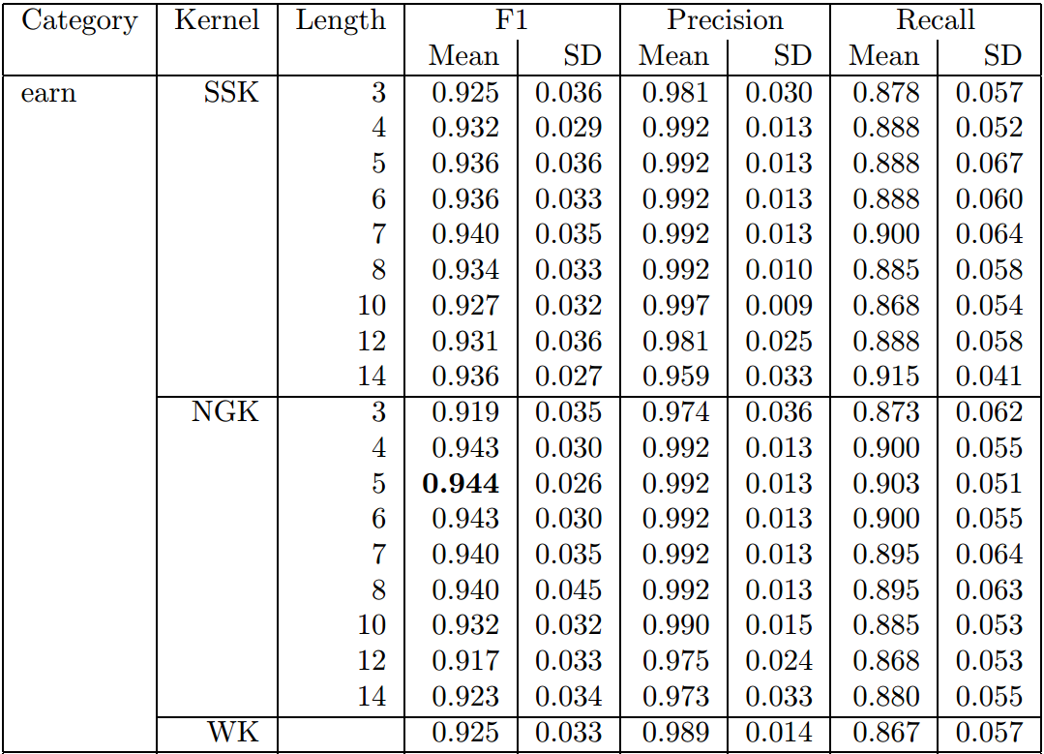
Special kernels for text data
String kernel v.s. Ngram kernel v.s. word kernel
SVM classification performance on Reuters categories

Slide 43
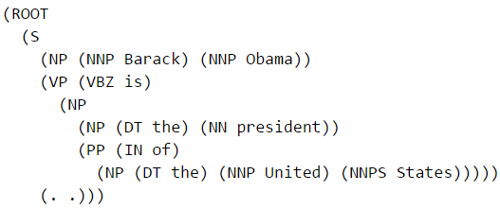
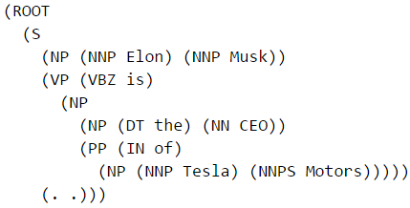
Special kernels for text data
Tree kernel
Similar?
Barack Obama is the president of the United States.
Elon Musk is the CEO of Tesla Motors.
Almost identical in their dependency parsing tree!

Slide 44
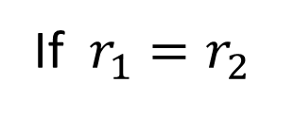


Special kernels for text data
Can be relaxed to allow subsequent computation under unmatched nodes
Tree kernel
  $K\left(x,y\right)=\left\{\begin{aligned}0 \\ 1+K\left(x[r_{1}],y[r_{2}]\right)\end{aligned}\right.$
If $r_{1}=r_{2}$
otherwise
Search through all the sub-trees starting from root node $r$
Culotta, Aron, and Jeffrey Sorensen. "Dependency tree kernels for relation extraction." Proceedings of the ACL. P423-429, 2004.

Slide 45


Special kernels for text data
Can be relaxed to allow subsequent computation under unmatching nodes
Tree kernel
  $K\left(x,y\right)=\left\{\begin{aligned}0 \\ 1+K\left(x[r_{1}],y[r_{2}]\right)\end{aligned}\right.$
If $r_{1}=r_{2}$
otherwise
Search through all the sub-trees starting from root node $r$
Relation classification performance

Slide 46
Recap: rethink about dual form SVM
Kernel SVM
  Decision boundary
    $f\left(x\right)=w^{T}φ\left(x\right)=\sum_{i}{α_{i}y_{i}φ{\left(x_{i}\right)}^{T}φ\left(x\right)}$
    $$=\sum_{i}{α_{i}y_{i}K(x_{i},x})$$
$$\max_{α}{\sum_{i}{α_{i}}−\frac{1}{2}\sum_{i,j}{α_{i}{α_{j}y}_{i}y_{j}K(x_{i},x_{j})}}$$
$$s.t. ∀i,{0≤α}_{i}≤C$$
We still don’t need this explicit feature mapping!
Similarity between a testing case and support vectors!

Slide 47
Recap: special kernels for text data
String kernel
  $x$ and $y$ are two text sequences
  $K\left(x,y\right)=\sum_{k}{\sum_{u∈A^{k}}{\sum_{i:u=x[i]}{\sum_{j:u=y[j]}{1}}} }$
    where A is an finite alphabet of symbols
k-mers kernel (length k substrings)
All character sequence of length $k$
All occurrences of sequence $u$ in $y$
All occurrences of sequence $u$ in $x$
Insight of string kernel:
Counting the overlapping of all subsequences with length up to $k$ in $x$ and $y$, without word/sentence boundaries
Lodhi, Huma, et al. "Text classification using string kernels." The Journal of Machine Learning Research 2 (2002): 419-444.

Slide 48
Recap: special kernels for text data
Tree kernel
Similar?
Barack Obama is the president of the United States.
Elon Musk is the CEO of Tesla Motors.
Almost identical in their dependency parsing tree!

Slide 49
Recap: special kernels for text data
Can be relaxed to allow subsequent computation under unmatching nodes
Tree kernel
  $K\left(x,y\right)=\left\{\begin{aligned}0 \\ 1+K\left(x[r_{1}],y[r_{2}]\right)\end{aligned}\right.$
If $r_{1}=r_{2}$
otherwise
Search through all the sub-trees starting from root node $r$
Relation classification performance

Slide 50
Popular implementations
General SVM
  SVM^{light} (http://svmlight.joachims.org)
  libSVM (http://www.csie.ntu.edu.tw/~cjlin/libsvm)
  SVM classification and regression
  Various types of kernels

Slide 51
Popular implementations
Linear SVM
  LIBLINEAR (http://www.csie.ntu.edu.tw/~cjlin/liblinear)
  Just for linear kernel SVM (also logistic regression)
  Efficient optimization by dual coordinate descent

Slide 52

Popular implementations
LIBLINEAR v.s. general SVM
Fan, Rong-En, et al. "LIBLINEAR: A library for large linear classification." The Journal of Machine Learning Research 9 (2008): 1871-1874.

Slide 53
What you should know
  The idea of max margin
Support vector machines
    Linearly separable v.s. non-separable cases
    Slack variable and dual form
    Kernel method
      Different types of kernels
    Popular implementations of SVM

Slide 54
Today’s reading
Introduction to Information Retrieval
  Chapter 15: Support vector machines and machine learning on documents
  Chapter 14: Vector space classification
    14.4 Linear versus nonlinear classifiers
    14.5 Classification with more than two classes

