Slide 1
Probabilistic Topic Models
Hongning Wang
CS@UVa

Slide 2
Outline
General idea of topic models
Basic topic models
Probabilistic Latent Semantic Analysis (pLSA)
Latent Dirichlet Allocation (LDA)
Variants of topic models
Summary

Slide 3
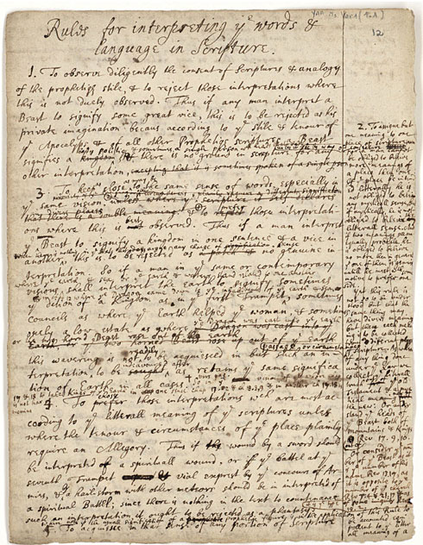
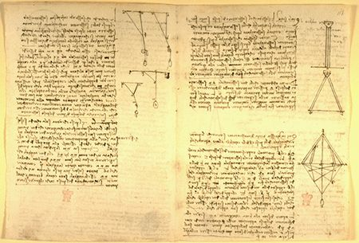
What is a “topic”?
Representation: a probabilistic distribution over words.
retrieval 0.2
information 0.15
model 0.08
query 0.07
language 0.06
feedback 0.03
……
Topic: A broad concept/theme, semantically coherent, which is hidden in documents
e.g., politics; sports; technology; entertainment; education etc.

Slide 4
Document as a mixture of topics
government 0.3 response 0.2 ...
[ Criticism of government response to the hurricane primarily consisted of criticism of its response to the approach of the storm and its aftermath, specifically in the delayed response ] to the [ flooding of New Orleans. … 80% of the 1.3 million residents of the greater New Orleans metropolitan area evacuated ] …[ Over seventy countries pledged monetary donations or other assistance]. …
Topic θ₁
city 0.2 new 0.1 orleans 0.05 ...
Topic θ₂
…
How can we discover these topic-word distributions?
Many applications would be enabled by discovering such topics
Summarize themes/aspects
Facilitate navigation/browsing
Retrieve documents
Segment documents
Many other text mining tasks
donate 0.1 relief 0.05 help 0.02 ...
Topic θ_{k}
is 0.05 the 0.04 a 0.03 ...
Background θ_{k}

Slide 5
General idea of probabilistic topic models
Topic: a multinomial distribution over words
Document: a mixture of topics
A document is “generated” by first sampling topics from some prior distribution
Each time, sample a word from a corresponding topic
Many variations of how these topics are mixed
Topic modeling
Fitting the probabilistic model to text
Answer topic-related questions by computing various kinds of posterior distributions
e.g., p(topic|time), p(sentiment|topic)

Slide 6
Simplest Case: 1 topic + 1 “background”
B
d
Assume words in d are from
two topics:
1 topic + 1 background
General Background
English Text
Text mining
paper
the 0.03
a 0.02
is 0.015
we 0.01
...
food 0.003
computer 0.00001
…
text 0.000006
…
θ_{B}
θ_{d}
the 0.031
a 0.018
…
text 0.04
mining 0.035
association 0.03
clustering 0.005
computer 0.0009
…
food 0.000001
…
How can we “get rid of” the
common words from the topic
to make it more discriminative?
Background Topic: p(w|θ_{B})
Document Topic: p(w|θ_{d})

Slide 7
The Simplest Case: One Topic + One Background Model
Assume p(w|θ_{B}) and λ are known
λ = mixing proportion of background topic in d
Background words
λ
P(w|θ_{B})
w
Topic choice
P(Topic)
Document d
Topic words
1-λ
P(w|θ )
w
Expectation Maximization

Slide 8
How to Estimate θ?
the 0.2
a 0.1
we 0.01
to 0.02
…
text 0.0001
mining 0.00005
…
Observed
words
Known
Background
p(w|θ_{B})
λ=0.7
ML
Estimator
Unknown
topic p(w|θ) for “Text mining”
…
text =?
mining =?
association =?
word =?
…
λ=0.3
Suppose we know
the identity/label of each word ...
But we don’t!

Slide 9
We guess the topic assignments
Assignment (“hidden”) variable: z_{i} ∈{1 (background), 0(topic)}
z_{i}
1
1
1
1
0
0
0
1
0
...
Suppose the parameters are all known, what’s a reasonable guess of z_{i}?
- depends on λ
- depends on p(w|θ_{B}) and p(w|θ)
the
paper
presents
a
text
mining
algorithm
the
paper
...
E-step
M-step
θ_{B} and θ are competing for explaining words in document d!
Initially, set p(w| θ) to some random values, then iterate …

Slide 10
An example of EM computation
Expectation-Step:
Augmenting data by guessing hidden variables
Maximization-Step
With the “augmented data”, estimate parameters
using maximum likelihood
Assume λ=0.5

Slide 11
Outline
General idea of topic models
Basic topic models
Probabilistic Latent Semantic Analysis (pLSA)
Latent Dirichlet Allocation (LDA)
Variants of topic models
Summary

Slide 12
Discover multiple topics in a collection
Generalize the two topic mixture to k topics
warning 0.3 system 0.2..
Topic coverage in document d
?
Topic θ₁
?
aid 0.1 donation 0.05 support 0.02 ..
Topic θ₂
?
θ₁
π_{d,1}
“Generating” word w
in doc d in the collection
?
?
θ₂
…
π_{d,2}
1 - λ_{B}
statistics 0.2 loss 0.1 dead 0.05 ..
?
π_{d, k}
W
?
θ_{k}
Topic θ_{k}
?
λ_{B}
Parameters:
Global: ${\{θ_{k}\}}_{k=1}^{K}$
Local:
Manual: $λ_{B}$
is 0.05 the 0.04 a 0.03 ..
?
θ_{B}
Background θ_{B}
?
?
$${\{π_{d,k}\}}_{d,k=1}^{K}$$

Slide 13
Probabilistic Latent Semantic Analysis ^{[Hofmann 99a, 99b]}
Topic: a multinomial distribution over words
Document
Mixture of k topics
Mixing weights reflect the topic coverage
Topic modeling
Word distribution under topic: p(w|θ)
Topic coverage: p(π|d)

Slide 14
EM for estimating multiple topics
the 0.2
a 0.1
we 0.01
to 0.02
…
E-Step:
Predict topic labels
using Bayes Rule
Known
Background
p(w | θ_{B})
Observed Words
Unknown
topic model
p(w|θ₁)=?
“Text mining”
…
text =?
mining =?
association =?
word =?
…
M-Step:
ML Estimator
based on
“fractional
counts”
…
Unknown
topic model
p(w|θ₂)=?
“information retrieval”
…
information =?
retrieval =?
query =?
document =?
…

Slide 15
Parameter estimation
E-Step:
Word w in doc d is generated
from topic j
from background
Posterior: application of Bayes rule
M-Step:
Re-estimate
mixing weights
word-topic distribution
Sum over all docs
in the collection
Fractional counts contributing to
using topic j in generating d
generating w from topic j

Slide 16
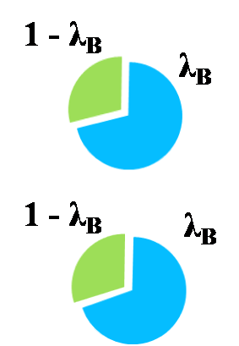
How the algorithm works
c(w,d)(1 - p(z_{d,w} = B))p(z_{d,w}=j)
c(w,d)p(z_{d,w} = B)
π_{d1,1} ( P(θ₁|d₁) )
π_{d1,2} ( P(θ₂|d₁) )
Topic coverage
c(w, d)
aid
7
d₁
price
5
Initial value
oil
6
π_{d2,1} ( P(θ₁|d₂) )
π_{d2,2} ( P(θ₂|d₂) )
aid
8
d₂
price
7
oil
5
Initial value
P(w| θ)
Topic 1
Topic 2
Initializing π_{d, j} and P(w| θ_{j}) with random values
Iteration 1: E Step: split word counts with different topics (by computing z’ s)
Iteration 1: M Step: re-estimate π_{d, j} and P(w| θ_{j}) by adding and normalizing the splitted word counts
Iteration 2: E Step: split word counts with different topics (by computing z’ s)
Iteration 2: M Step: re-estimate π_{d, j} and P(w| θ_{j}) by adding and normalizing the splitted word counts
Iteration 3, 4, 5, …
Until converging
aid
price
Initial value
oil

Slide 17
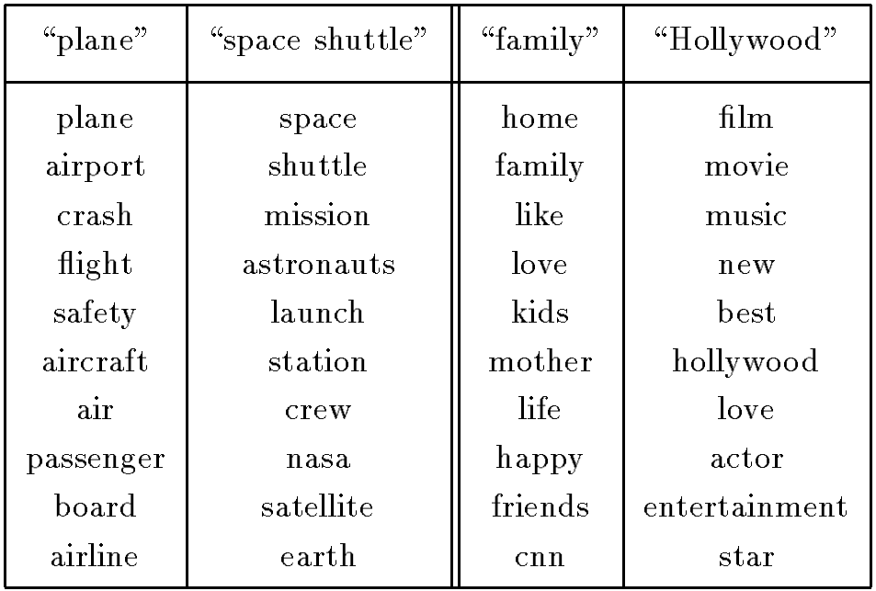
Sample pLSA topics from TDT Corpus ^{[Hofmann 99b]}

Slide 18
pLSA with prior knowledge
What if we have some domain knowledge in mind
We want to see topics such as “battery” and “memory” for opinions about a laptop
We want words like “apple” and “orange” co-occur in a topic
One topic should be fixed to model background words (infinitely strong prior!)
We can easily incorporate such knowledge as priors of pLSA model

Slide 19
Maximum a Posteriori (MAP) estimation
Prior can be placed on π as well (more about this later)
Topic coverage in document d
warning 0.3 system 0.2..
Topic θ₁
θ₁
π_{d,1}
“Generating” word w
in doc d in the collection
Topic θ₂
aid 0.1 donation 0.05 support 0.02 ..
θ₂
π_{d,2}
1 - λ_{B}
…
π_{d, k}
statistics 0.2 loss 0.1 dead 0.05 ..
θ_{k}
W
Topic θ_{k}
λ_{B}
θ_{B}
is 0.05 the 0.04 a 0.03 ..
Background θ_{B}
Parameters:
λ_{B}=noise-level (manually set)
θ’s and π’s are estimated with Maximum A Posteriori (MAP)

Slide 20
MAP estimation
Choosing conjugate priors
Dirichlet prior for multinomial distribution
What if μ=0? What if μ=+∞?
A consequence of using conjugate prior is that the prior can be converted into “pseudo data” which can then be “merged” with the actual data for parameter estimation
Pseudo counts of w from prior θ’
+μp(w|θ’_{j})
+μ
Sum of all pseudo counts

Slide 21
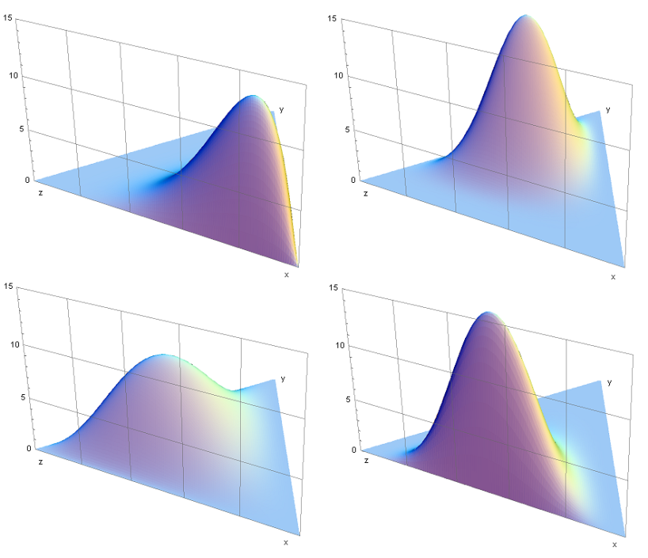
Some background knowledge
Conjugate prior
Posterior distribution in the same family as prior
Dirichlet distribution
Continuous
Samples from it will be the parameters in a multinomial distribution
Gaussian -> Gaussian
Beta -> Binomial
Dirichlet -> Multinomial

Slide 22
Prior as pseudo counts
Observed Doc(s)
the 0.2
a 0.1
we 0.01
to 0.02
…
Known
Background
p(w | B)
MAP
Estimator
Unknown
topic model
p(w|θ₁)=?
“Text mining”
…
text =?
mining =?
association =?
word =?
…
Suppose,
we know
the identity
of each
word ...
…
Pseudo Doc
Unknown
topic model
p(w|θ₂)=?
“information retrieval”
…
information =?
retrieval =?
query =?
document =?
…
text
Size = μ
mining

Slide 23
Deficiency of pLSA
Not a fully generative model
Can’t compute probability of a new document
Topic coverage p(π|d) is per-document estimated
Heuristic workaround is possible
Many parameters ➔ high complexity of models
Many local maxima
Prone to overfitting

Slide 24
Latent Dirichlet Allocation ^{[Blei et al. 02]}
Make pLSA a fully generative model by imposing Dirichlet priors
Dirichlet priors over p(π|d)
Dirichlet priors over p(w|θ)
A Bayesian version of pLSA
Provide mechanism to deal with new documents
Flexible to model many other observations in a document

Slide 25
LDA = Imposing Prior on PLSA
pLSA:
Topic coverage π_{d,j} is specific to each “training document”, thus can’t be used to generate a new document
Topic coverage in document d
{π_{d,j} } are free for tuning
π_{d,1}
“Generating” word w
in doc d in the collection
θ₁
θ₂
W
π_{d,2}
LDA:
Topic coverage distribution {π_{d,j} } for any document is sampled from a Dirichlet distribution, allowing for generating a new doc
π_{d, k}
θ_{k}
{π_{d,j} } are regularized
Magnitudes of α and β
determine the variances of the prior,
thus also the concentration of prior
(larger α and β ➔ stronger prior)
In addition, the topic word distributions {θ_{j} } are also drawn from another Dirichlet prior

Slide 26
pLSA v.s. LDA
pLSA
Core assumption
in all topic models
pLSA component
LDA
Regularization
added by LDA

Slide 27
LDA as a graphical model ^{[Blei et al. 03a]}
α
distribution over topics
for each document
(same as π_{d} on the previous slides)
Dirichlet priors
θ ^{(d)}
θ ^{(d)} ∼ Dirichlet(α)
β
topic assignment
for each word
distribution over words for
each topic
(same as θ _{j} on the previous slides)
z_{i}
z_{i} ∼ Discrete(θ ^{(d)} )
φ ^{(j)}
φ ^{(j)} ∼ Dirichlet(β)
T
word generated from
assigned topic
w_{i}
w_{i} ∼ Discrete(φ ^{(zi)} )
N_{d}
D
Most approximate inference algorithms aim to infer
from which other interesting variables can be easily computed

Slide 28
Approximate inferences for LDA
Deterministic approximation
Variational inference
Expectation propagation
Markov chain Monte Carlo
Full Gibbs sampler
Collapsed Gibbs sampler
Most efficient, and quite popular, but can only work with conjugate prior

Slide 29
Collapsed Gibbs sampling [Griffiths & Steyvers 04]
Using conjugacy between Dirichlet and multinomial distributions, integrate out continuous random variables
Define a distribution on topic assignment z
With fixed assignment of z

Slide 30
Collapsed Gibbs sampling ^{[Griffiths & Steyvers 04]}
All the other words beside z_{i}
Sample each z_{i} conditioned on z_{-i}
Implementation: counts can be cached in two sparse matrices; no special functions, simple arithmetic
Distributions on Φ and Θ can be analytic computed given z and w
Word-topic distribution
Topic proportion

Slide 31
Gibbs sampling in LDA
iteration
1

Slide 32
Gibbs sampling in LDA
iteration
1 2

Slide 33
Gibbs sampling in LDA
iteration
1 2
words in d_{i} assigned with topic j
Count of instances where w_{i} is
assigned with topic j
Count of all words
assigned with topic j
words in d_{i} assigned with any topic

Slide 34
Gibbs sampling in LDA
iteration
1 2
What’s the most likely topic for w_{i} in d_{i}?
How likely would d_{i} choose topic j?
How likely would topic j
generate word w_{i} ?

Slide 35
Gibbs sampling in LDA
iteration
1 2

Slide 36
Gibbs sampling in LDA
iteration
1 2

Slide 37
Gibbs sampling in LDA
iteration
1 2

Slide 38
Gibbs sampling in LDA
iteration
1 2

Slide 39
Gibbs sampling in LDA
iteration
1 2 … 1000

Slide 40
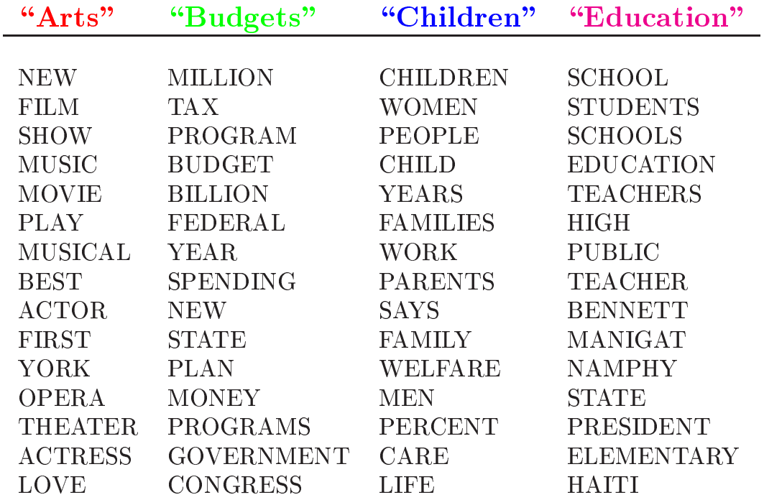
Topics learned by LDA

Slide 41
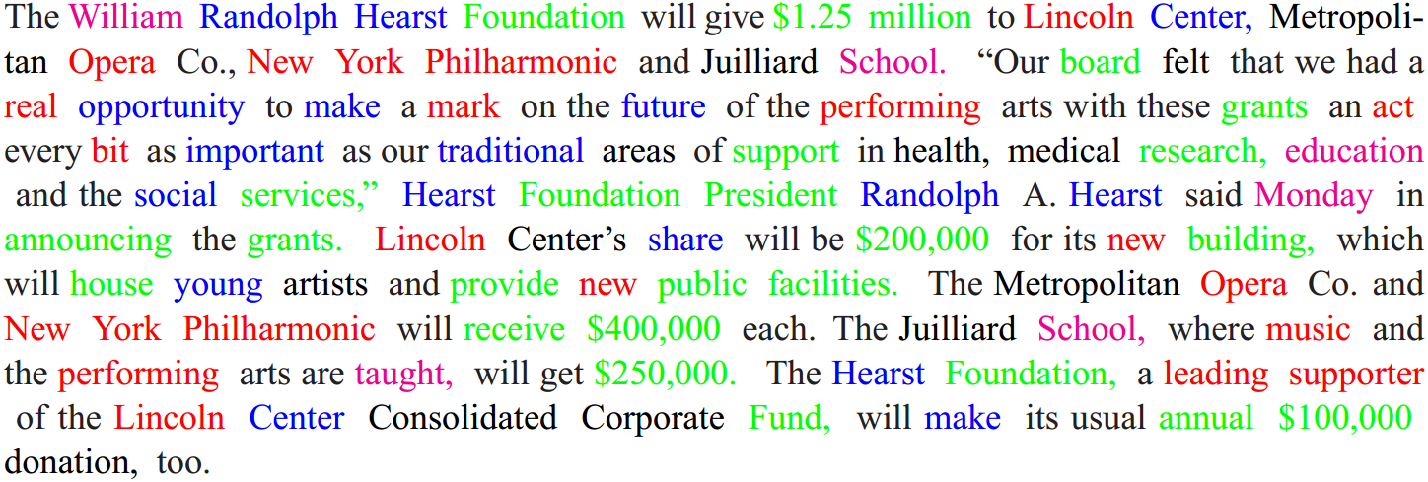
Topic assignments in document
Based on the topics shown in last slide

Slide 42
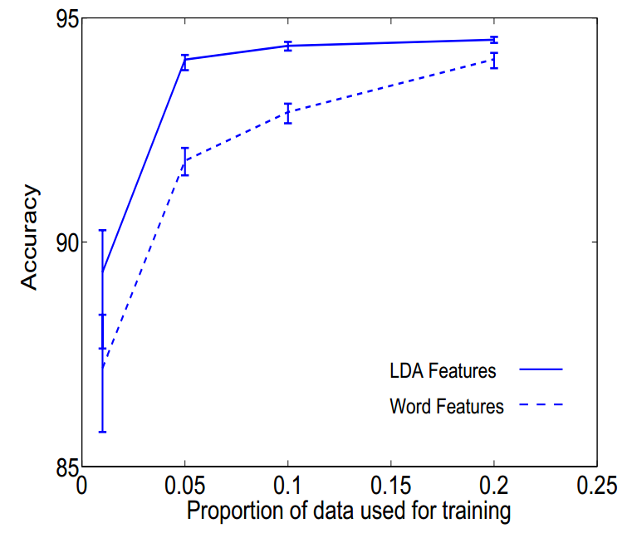
Application of learned topics
Document classification
A new type of feature representation

Slide 43
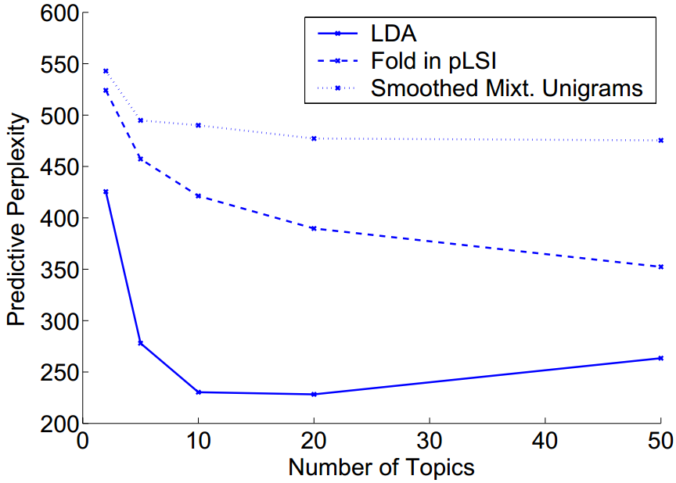
Application of learned topics
Collaborative filtering
A new type of user profile

Slide 44
Outline
General idea of topic models
Basic topic models
Probabilistic Latent Semantic Analysis (pLSA)
Latent Dirichlet Allocation (LDA)
Variants of topic models
Summary

Slide 45
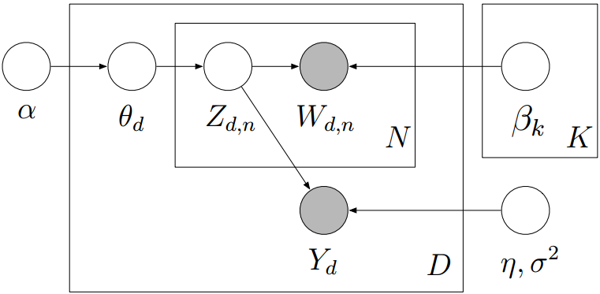
Supervised Topic Model ^{[Blei & McAuliffe, NIPS’02]}
A generative model for classification
Topic generates both words and labels

Slide 46
Sentiment polarity of topics
Sentiment polarity learned from classification model

Slide 47
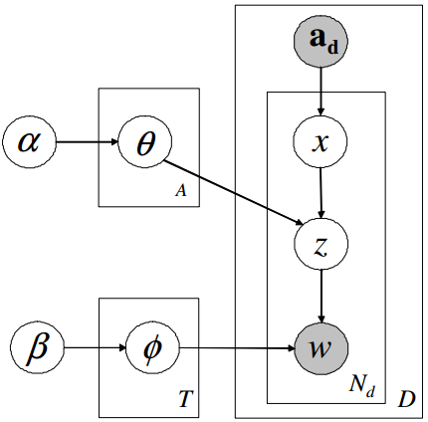
Author Topic Model ^{[Rosen-Zvi UAI’04]}
Authorship determines the topic mixture
Each author chooses his/her topic to contribute in the document

Slide 48
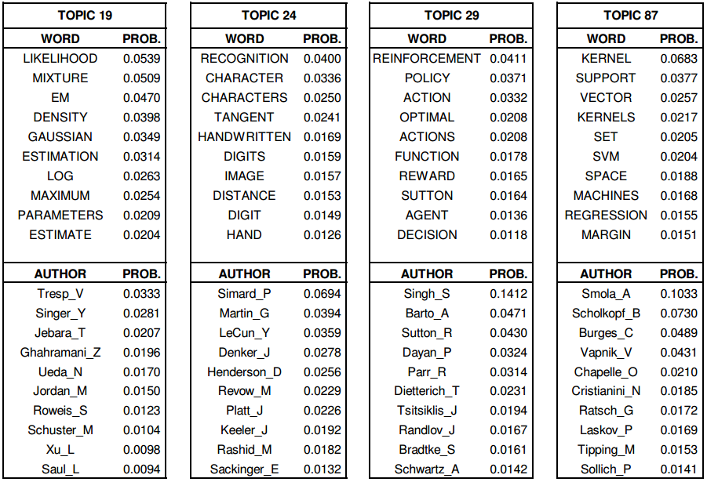
Learned association between words and authors

Slide 49
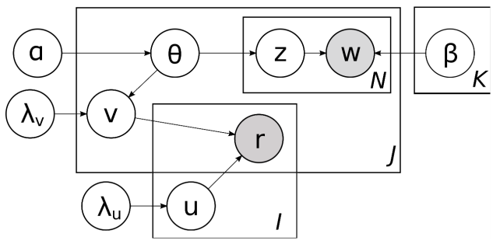
Collaborative Topic Model ^{[Wang & Blei,KDD’11]}
Collaborative filtering in topic space
User’s preference over topics determines his/her rating for the item
Topics for the item, shifted with random noise
User profile over topical space

Slide 50
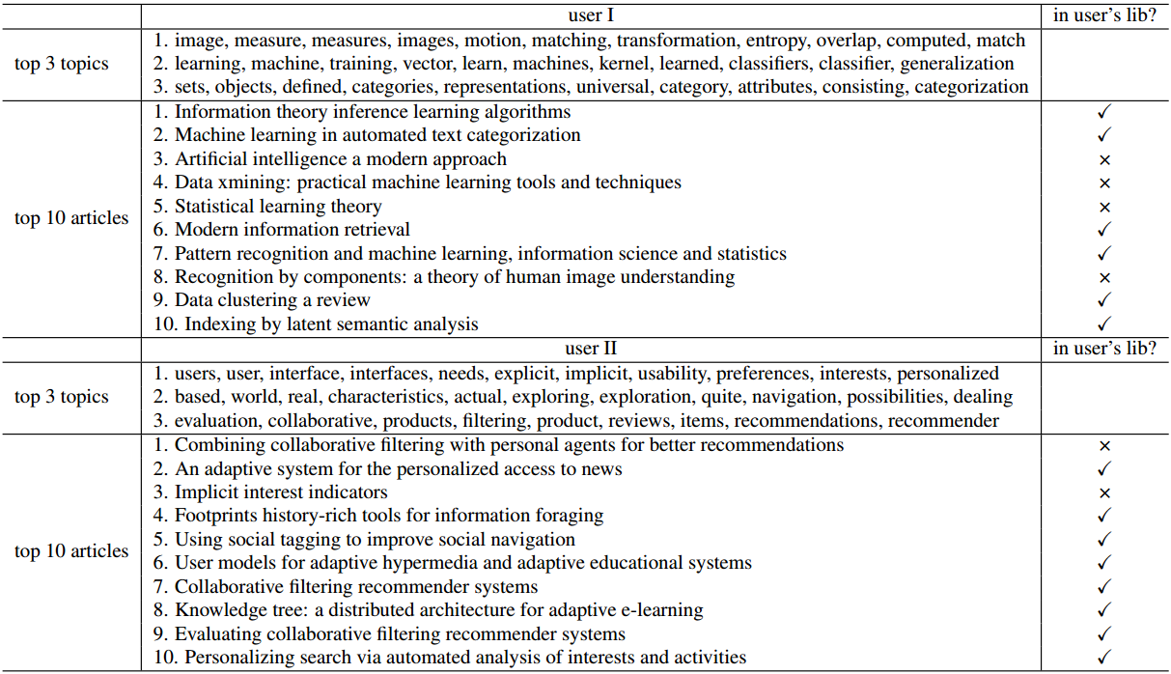
Topic-based recommendation

Slide 51
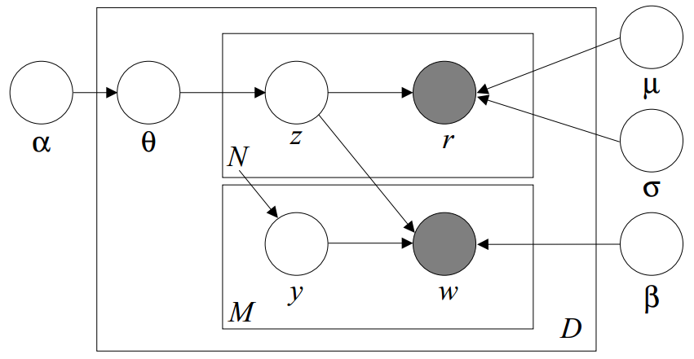
Correspondence Topic Model ^{[Blei SIGIR’03]}
Simultaneously modeling the generation of multiple types of observations
E.g., image and corresponding text annotations
Correspondence part (can be described with different distributions)
LDA part

Slide 52
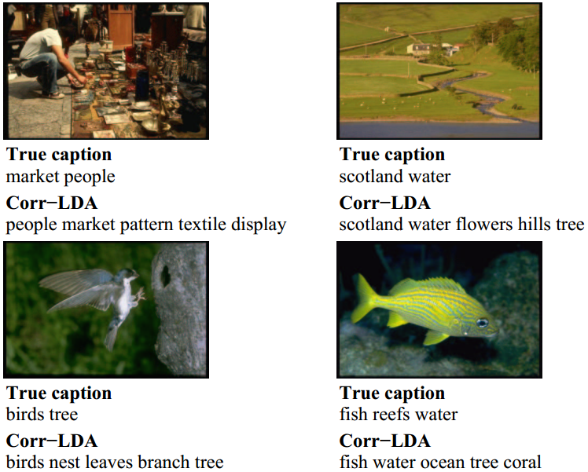
Annotation results

Slide 53
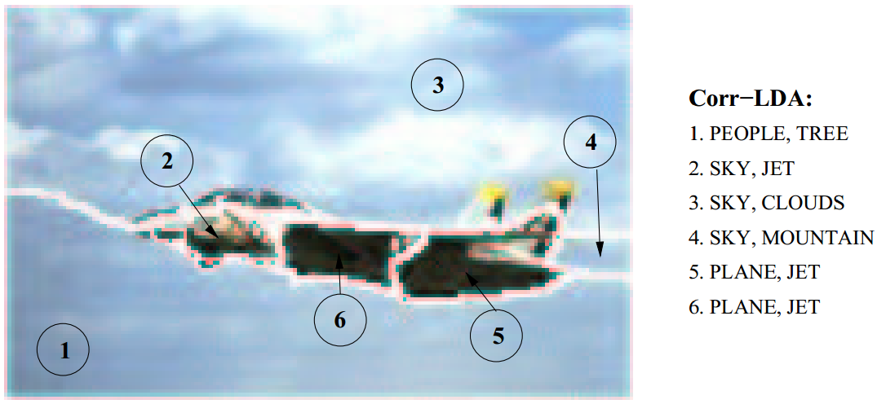
Annotation results

Slide 54
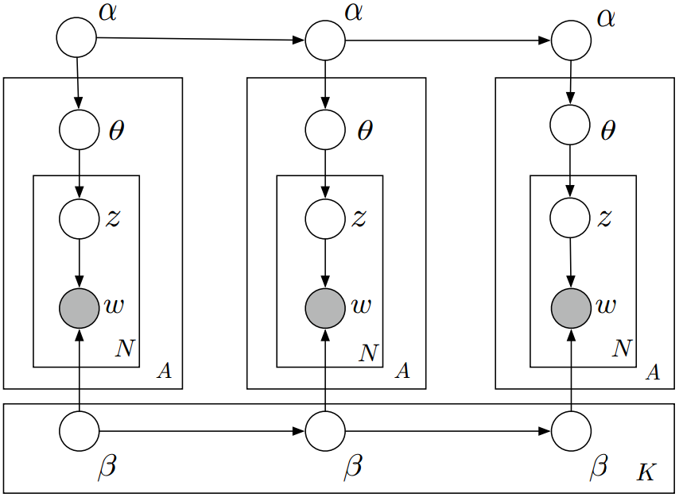
Dynamic Topic Model ^{[Blei ICML’06]}
Capture the evolving topics over time
Markov assumption about the topic dynamics

Slide 55
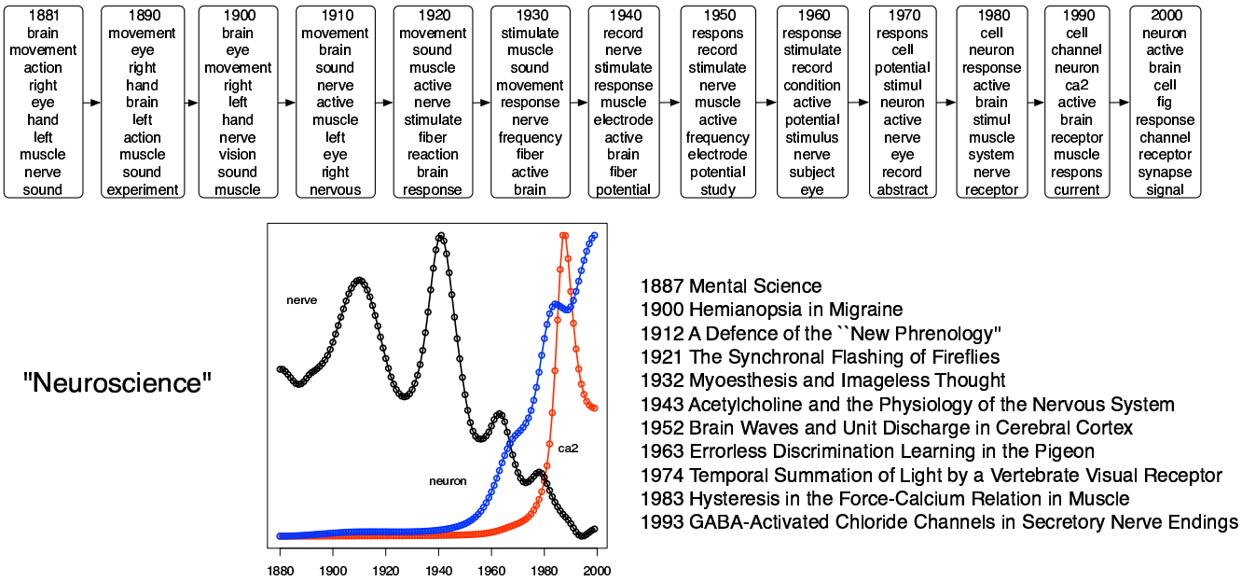
Evolution of topics

Slide 56
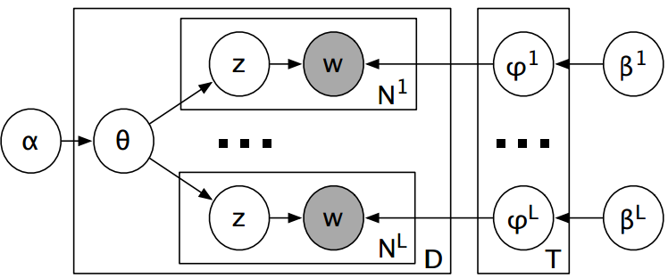
Polylingual Topic Models ^{[Mimmo et al., EMNLP’09]}
Assumption: topics are universal over languages
Correspondence between documents are known
E.g., news report about the same event in different languages

Slide 57
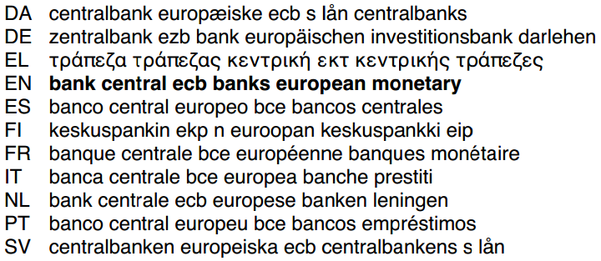
Topics learned in different languages

Slide 58
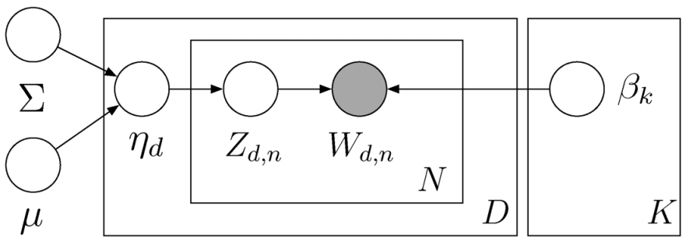
Correlated Topic Model [Blei & Lafferty, Annals of Applied Stat’07]
Non-conjugate priors to capture correlation between topics
Gaussian as the prior for topic proportion (increase the computational complexity)

Slide 59
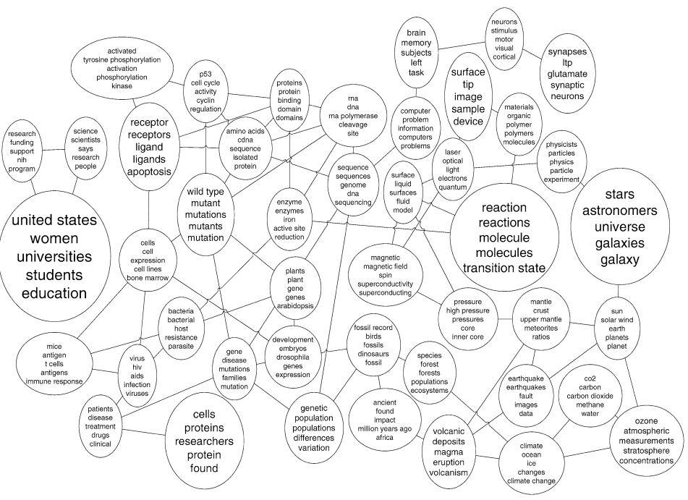
Learned structure of topics

Slide 60
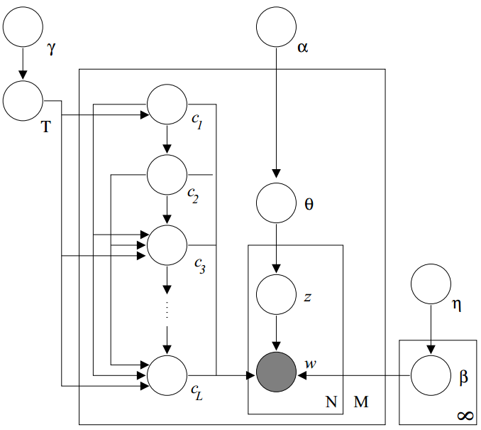
Hierarchical Topic Models ^{[Blei et al. NIPS’04]}
Nested Chinese restaurant process as a prior for topic assignment

Slide 61
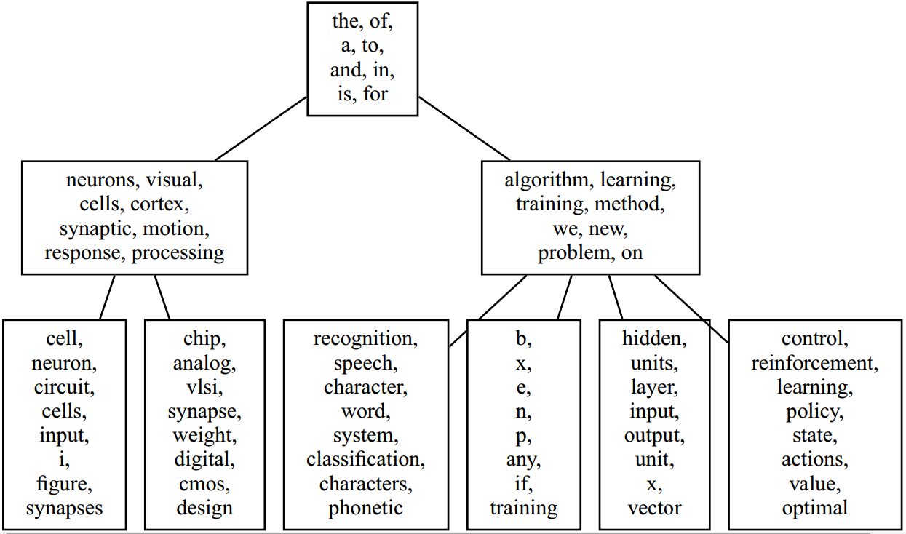
Hierarchical structure of topics

Slide 62
Outline
General idea of topic models
Basic topic models
Probabilistic Latent Semantic Analysis (pLSA)
Latent Dirichlet Allocation (LDA)
Variants of topic models
Summary

Slide 63
Summary
Probabilistic Topic Models are a new family of document modeling approaches, especially useful for
Discovering latent topics in text
Analyzing latent structures and patterns of topics
Extensible for joint modeling and analysis of text and associated non-textual data
pLSA & LDA are two basic topic models that tend to function similarly, with LDA better as a generative model
Many different models have been proposed with probably many more to come
Many demonstrated applications in multiple domains and many more to come

Slide 64
Summary
However, all topic models suffer from the problem of multiple local maxima
Make it hard/impossible to reproduce research results
Make it hard/impossible to interpret results in real applications
Complex models can’t scale up to handle large amounts of text data
Collapsed Gibbs sampling is efficient, but only working for conjugate priors
Variational EM needs to be derived in a model-specific way
Parallel algorithms are promising
Many challenges remain….

