Slide 1
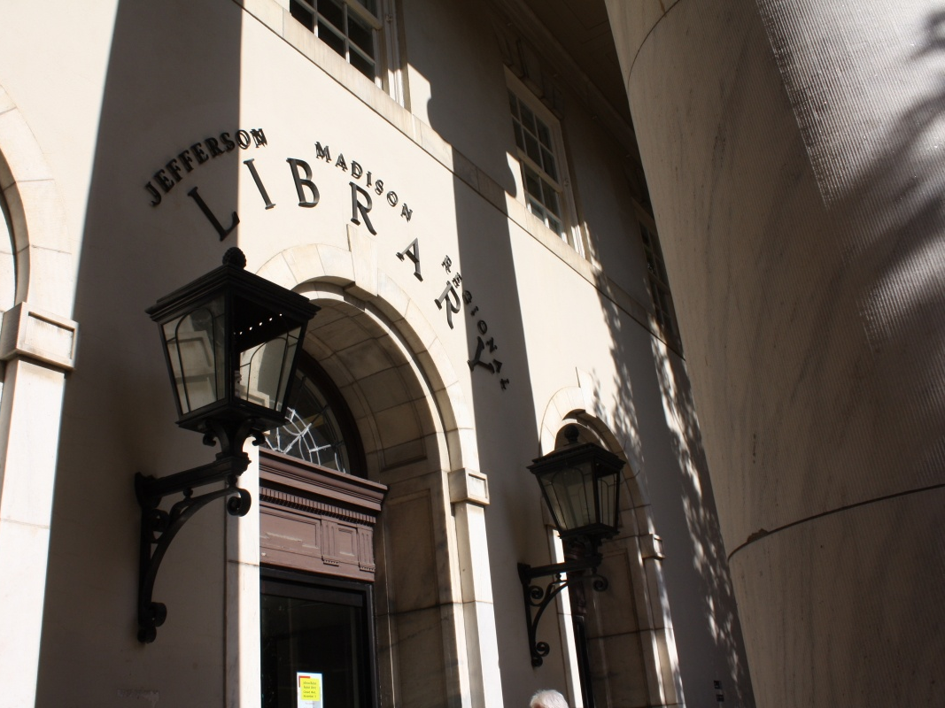
What Every Librarian Should Know about Computer Security
David Evans
University of Virginia
11 Nov 2009

Slide 2
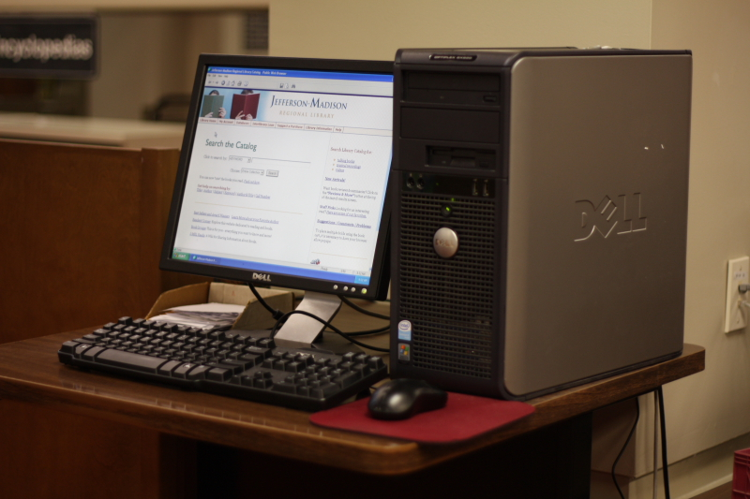
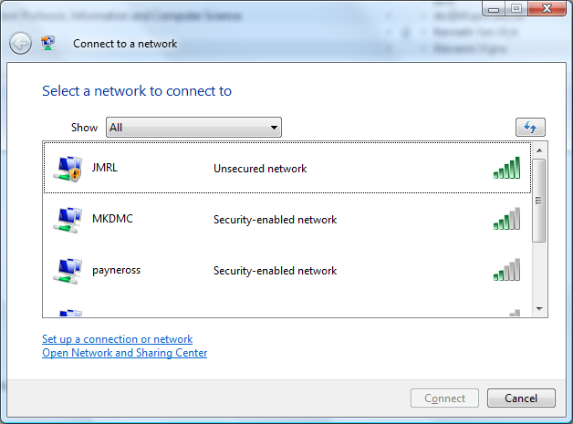
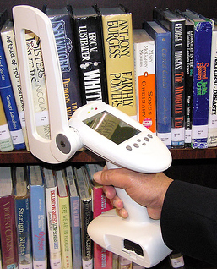
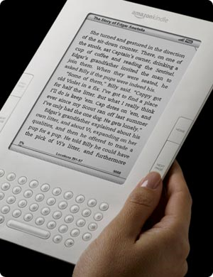
Public Computers
Open Wireless Networks
Digital
Rights
Management
RFID

Slide 3
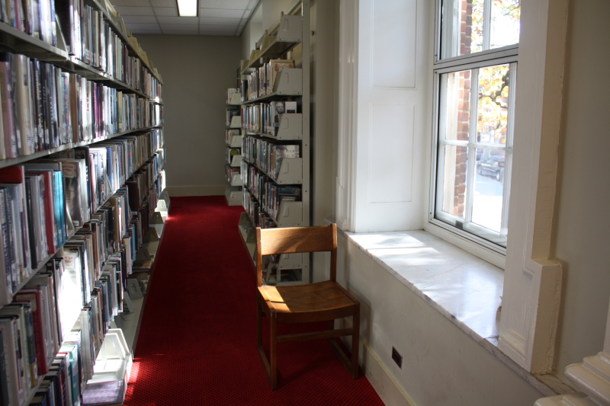
Caveat
I would rather be exposed to the inconveniences attending too much liberty than to those attending too small a degree of it.
  Thomas Jefferson, to Archibald Stuart, 1791

Slide 4
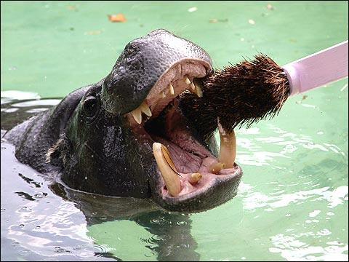
Public Computers
dentalhealthblog.com

Slide 5
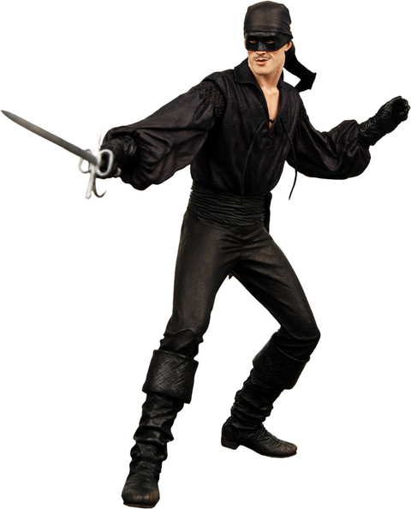
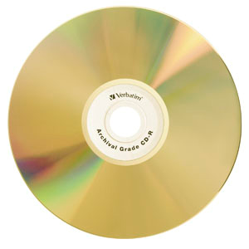
Installing a Rootkit
Evil Rootkit

Slide 6
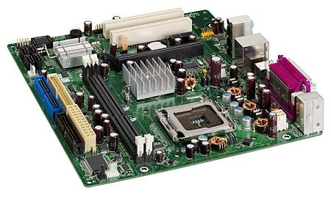
Rootkits
Applications
Applications
Web Browser
Web Browser
Operating System Kernel (Windows)
Operating System Kernel (Windows)
World’s Best Anti-Virus Software
World’s Best Anti-Virus Software
Rootkit
Computer
Computer
Processor
Processor

Slide 7
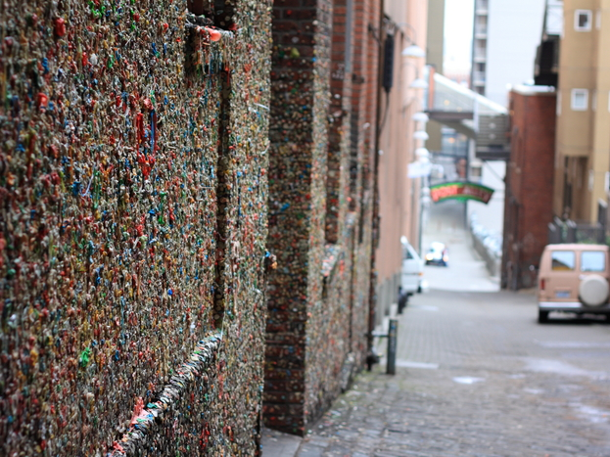
What’s the worst that could happen?

Slide 8
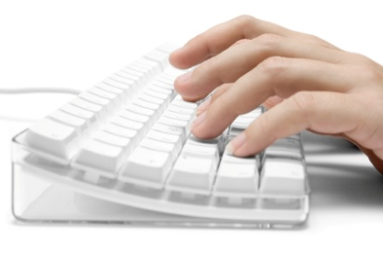
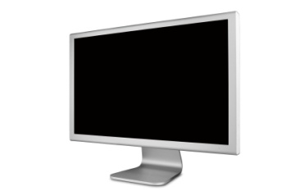
Rootkit Account Collector
site: www.bank.com
username: Alice
password: w#on%erlnD
balance: $50324.23
Applications
Web Browser
evilhacker.com
Operating System Kernel (Windows)
World’s Best Anti-Virus Software
Rootkit
keylogger
screenscraper
Hardware

Slide 9
Open Wireless

Slide 10
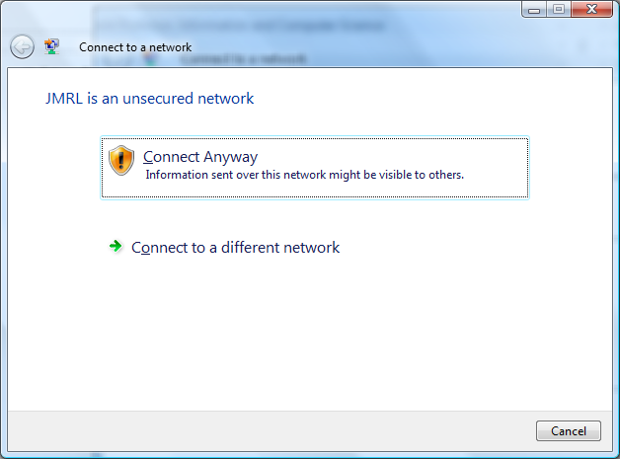

Slide 11
Overly Open Wireless?
Library
Unsecured network
JMRL
Unsecured network

Slide 12
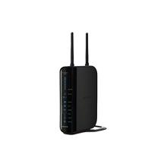
Rogue Access Points
“I am ‘Library’ send me your traffic.”

Slide 13
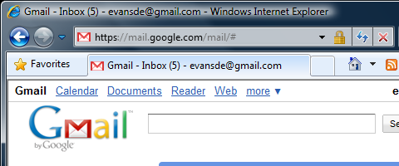
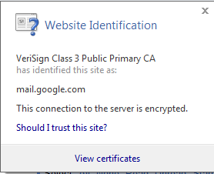
End-to-End Security Can Help
gmail.com
Decrypt
Laptop
Encrypt
Wireless Access Point

Slide 14
Solutions?
None of these risks have easy solutions
Any solution would impose inconvenience on non-malicious users
“Good news”:
  Logging users provides some deterrent: library card is tied to real identity
  Lots of easier ways for miscreants to obtain user accounts at scale
Raise user awareness of risks

Slide 15
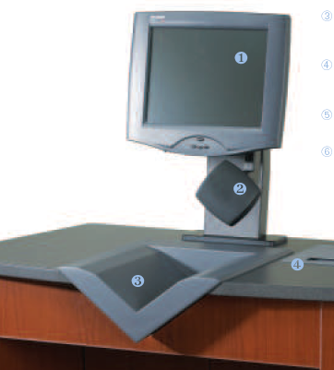
RFID

Slide 16
Objective #10: By June 2014, present the Library Board with a plan to migrate J-MRL to radio-frequency identification (RFID) technology.
from Jefferson-Madison Regional Library Five-Year Plan
(July 2009-June 2014)

Slide 17
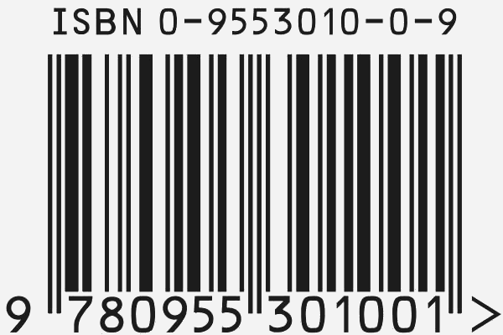
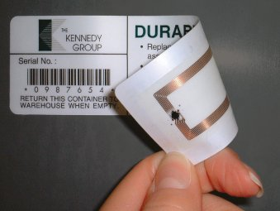
 | Optical Barcode | EPC Gen 2 RFID
Identities | 8-12 digits (book identity) | 64-128 bits (item identity)
Reading | Optical Scanner | Wireless Reader
Tag Cost | Ink, Paper ($0.00001?) | Circuit, Antenna ($0.05)

Slide 18
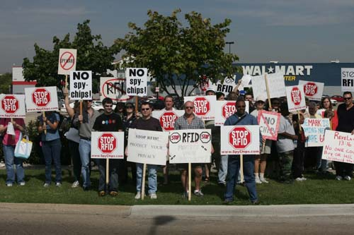
Protest at Texas Wal-Mart
Photo by Bill Bryant

Slide 19
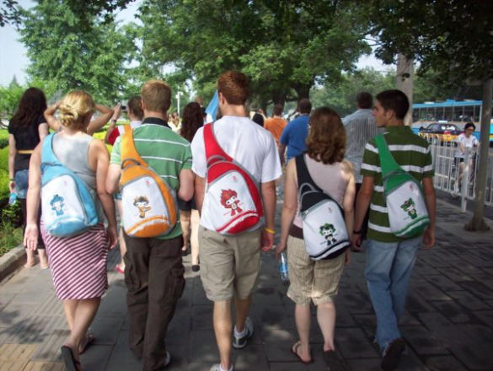
Warrantless Searching
The Grapes of Wrath
Alice’s Adventures in Wonderland
Diary of Anne Frank
The Satanic Verses
Lolita

Slide 20
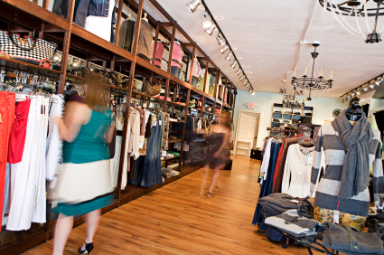
Profiling/Tracking

Slide 21
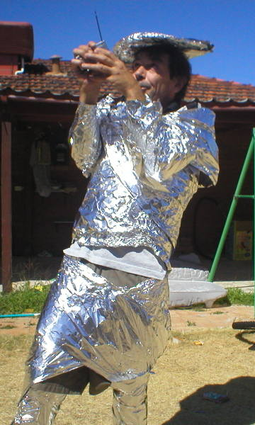
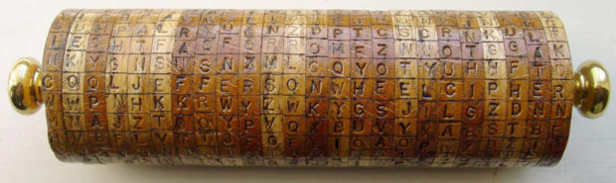
Solutions
Encryption
Only reader machine in library can identify books
Book tag response includes random values, so is not repeated

Slide 22
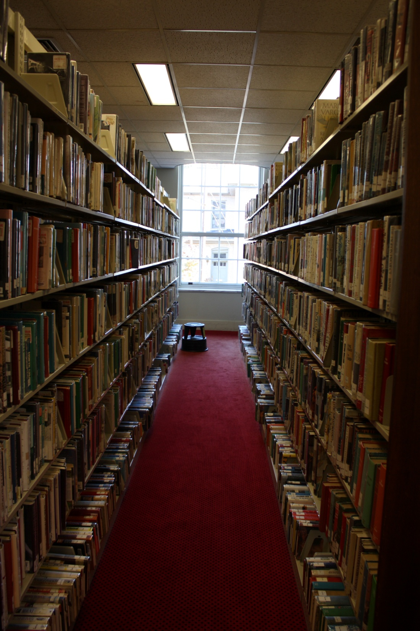
Horseless Carriages,
Fabless Chipmakers, and
Bookless Libraries?

Slide 23
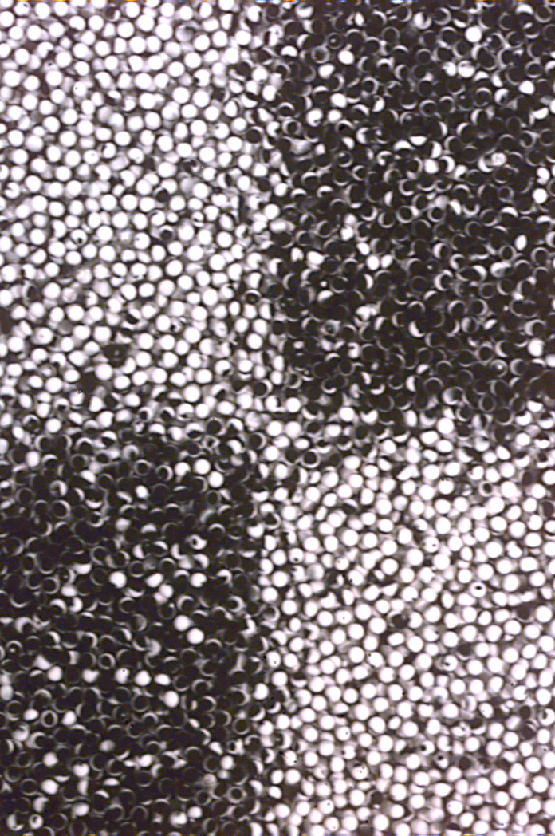
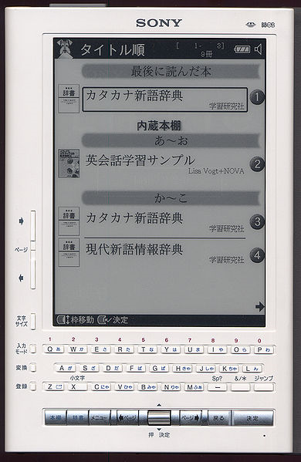
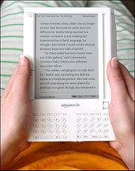
Electronic Paper
Sony Librié 2005
Amazon Kindle 2007
Invented at Xerox PARC (1970)

Slide 24
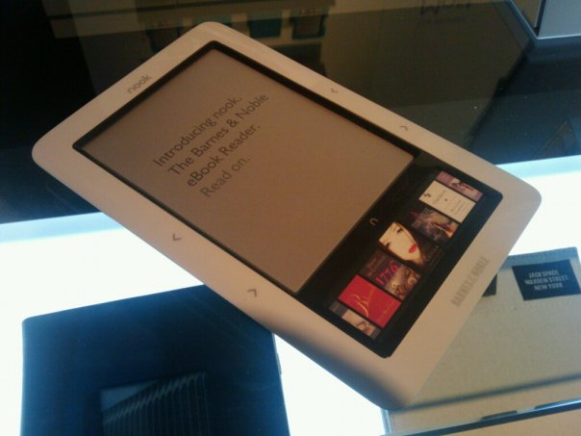
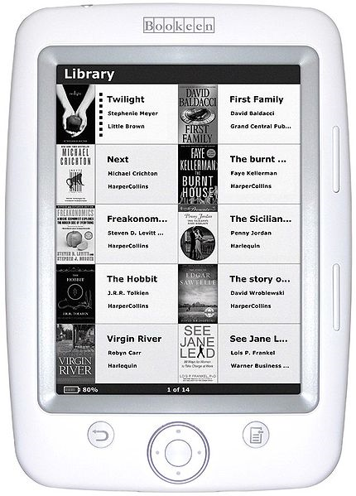
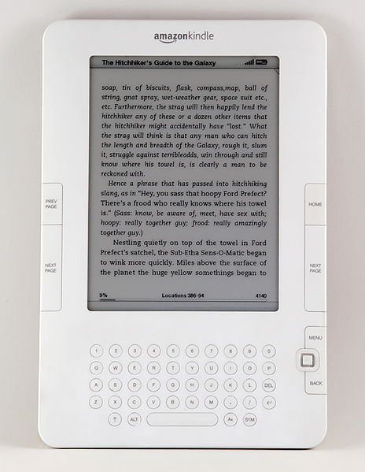
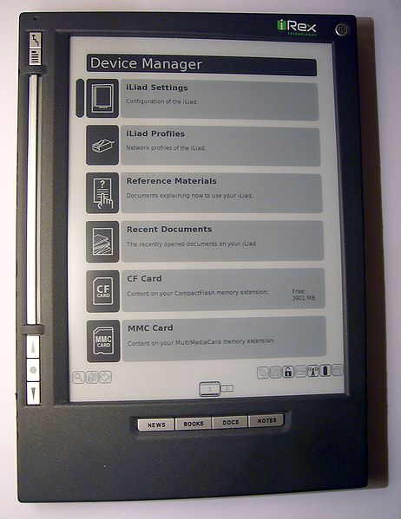
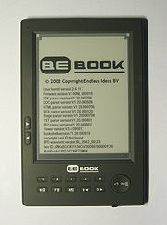
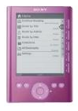
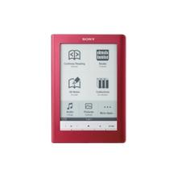
eBooks in 2009
nook (Barnes and Noble)
Amazon Kindle 2
Bookeen Cybook Opus
iRex Illiad

Slide 25
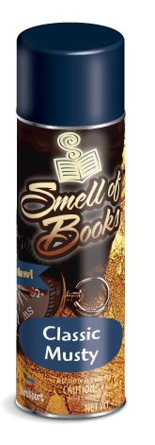
“We did research, and found that the smell is mostly glue – glue and maybe mildew. We joked that maybe we should have a spritzer on the Kindle that would send out that smell.”
Jeff Bezos (Amazon.com)
http://smellofbooks.com/

Slide 26
Bookless Libraries
“Lending” eBooks
  Digital Rights Management
Browsing eBooks
  Proximity Digital Rights?
Archiving electronic data
Space!

Slide 27
Recommendations
Short term:
  Risks of openness are worth it!
  Be vigilant, make visitors aware of risks (?)
  Notices at public machines and around library for wireless showing your SSID (network name)
Long term:
  Be careful and cautious with RFID privacy
  View “bookless” libraries as an opportunity

Slide 28
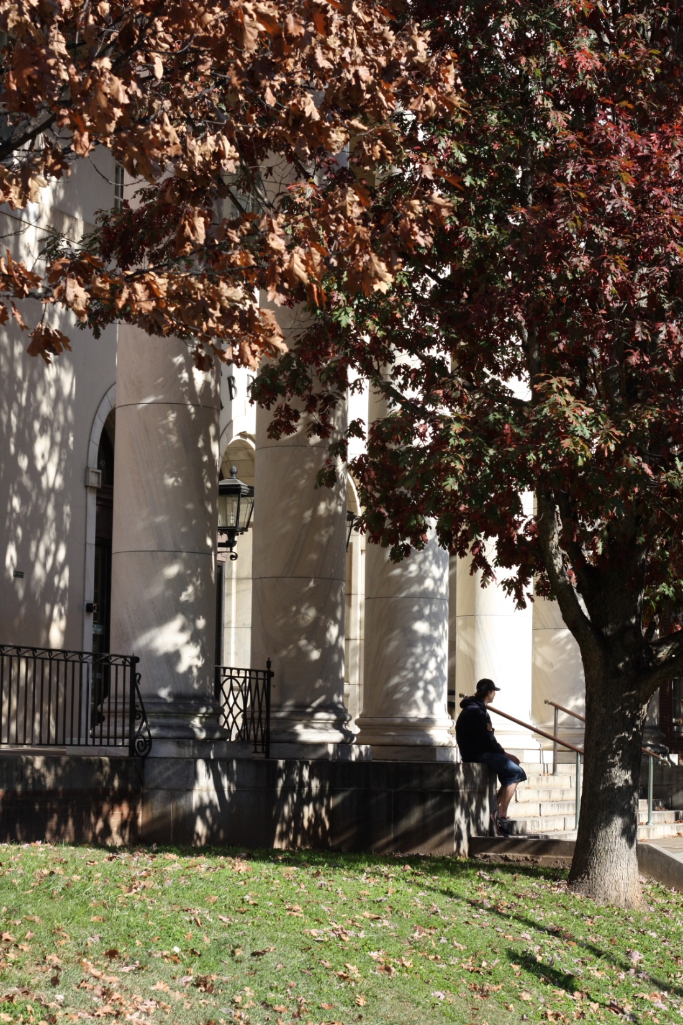
Thank you!
David Evans
evans@virginia.edu
www.cs.virginia.edu/evans

