Slide 1
Class 1: Computers
Introduction to Computing: Explorations in Language, Logic, and Machines
Class 1:
Introduction
cs1120 Spring 2016
David Evans
University of Virginia

Slide 2
How many computers are there in this room?

Slide 4
Today’s Plan
What is a Computer?
Story of the Course (Expectations)
Computer Science

Slide 5
What’s a Computer?

Slide 6
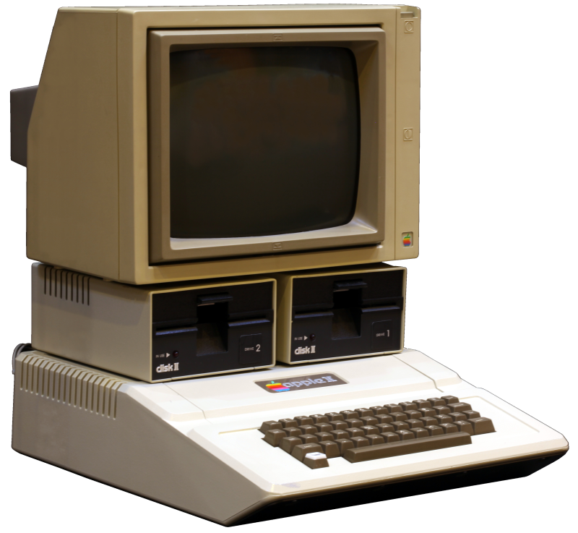
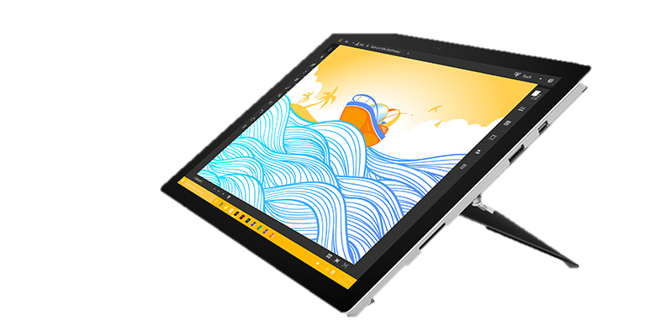
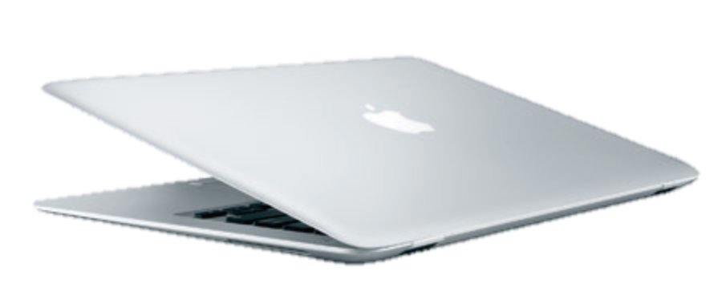
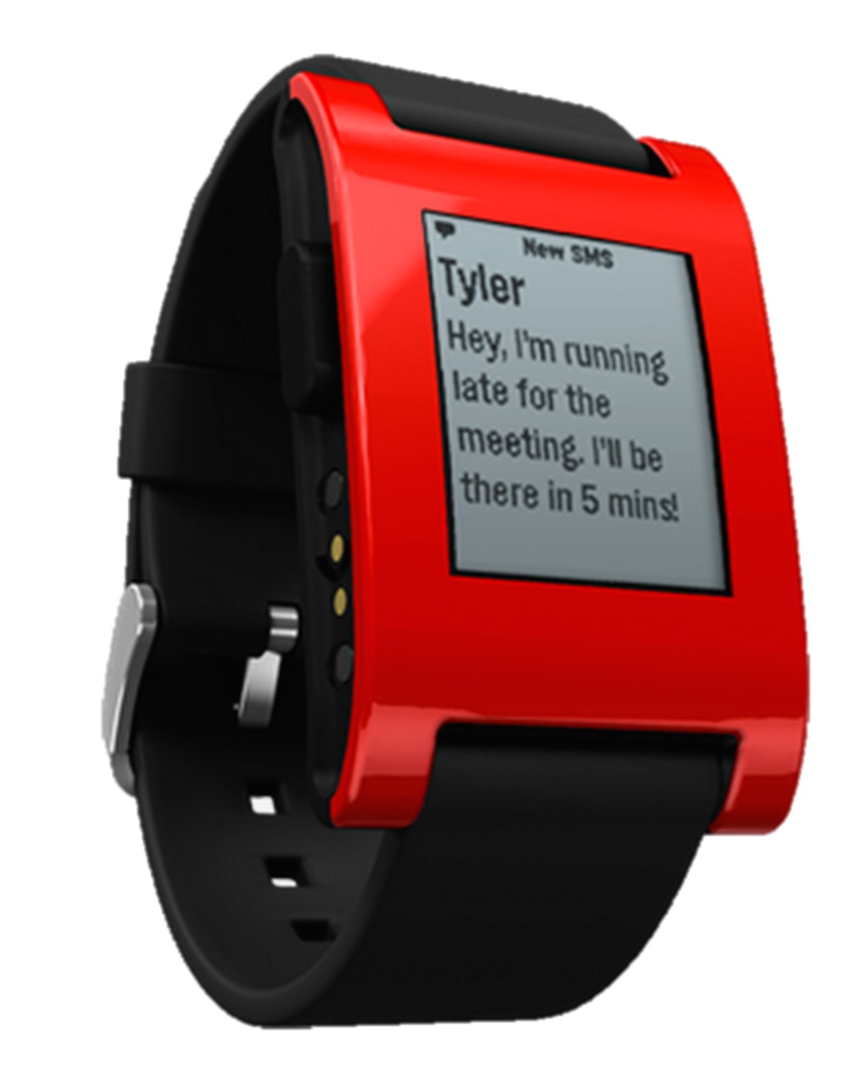
Apple II (1977)
Cray-1 (1976)
Surface (2016)
MacBook Air (2008)
Palm Pre (2009)
Pebble (2014)

Slide 7
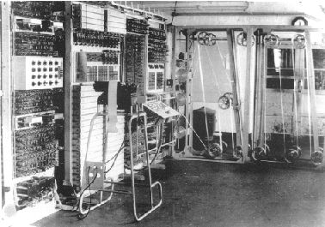
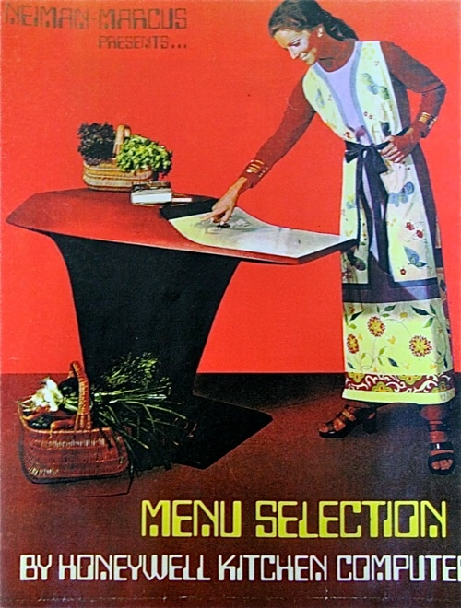
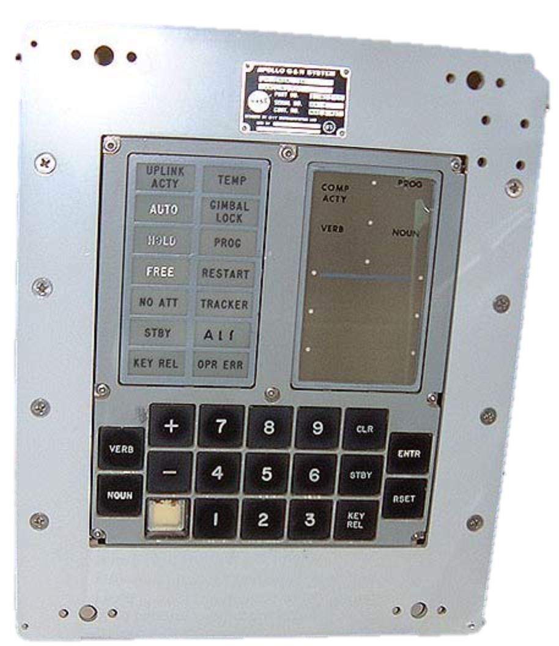
Colossus (1944)
Apollo Guidance Computer (1969)
Honeywell Kitchen Computer (1969)
($10,600 “complete with two-week programming course”)

Slide 8
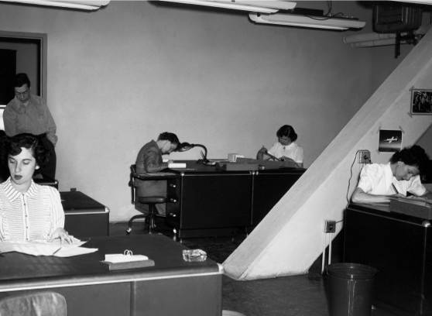
Pre-WWII “Computers”

Slide 9
How should we define a computer?
Webster’s Definition

Slide 10
What All Computers Need
Processing
Input
Output
Without it, we can’t describe a problem
Without it, we can’t get an answer
Way to get from input to output

Slide 11
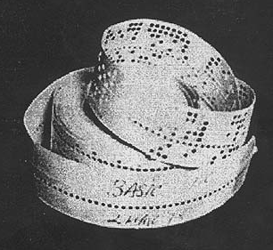
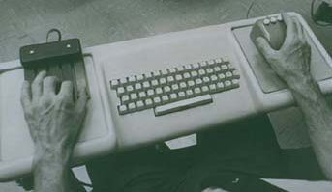
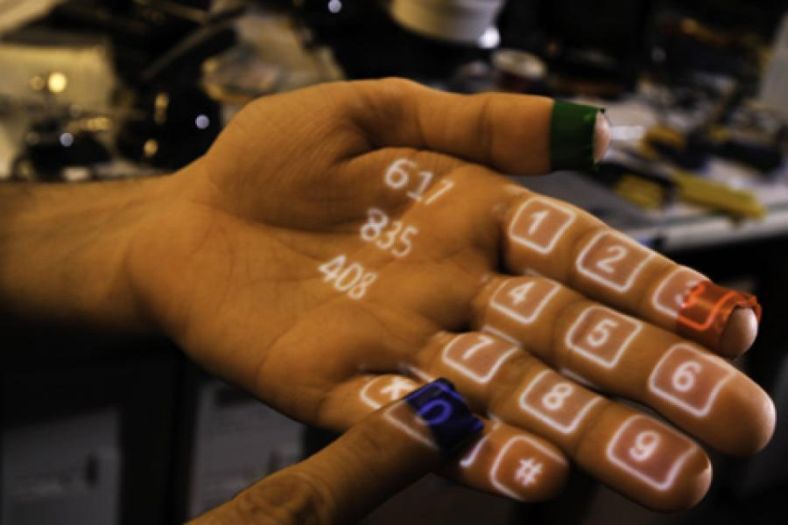
Input
Voice (“2001”)
Altair BASIC Paper Tape (1976)
Engelbart’s mouse and keypad (1968)
Multitouch (2009)
0100101011010101101010110101011010101…

Slide 12
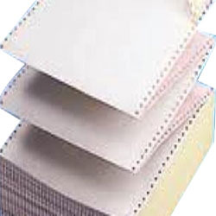
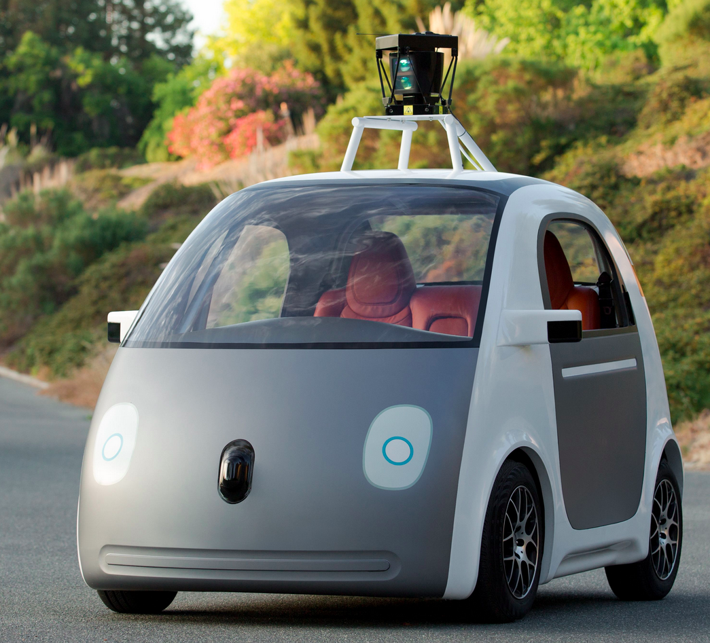
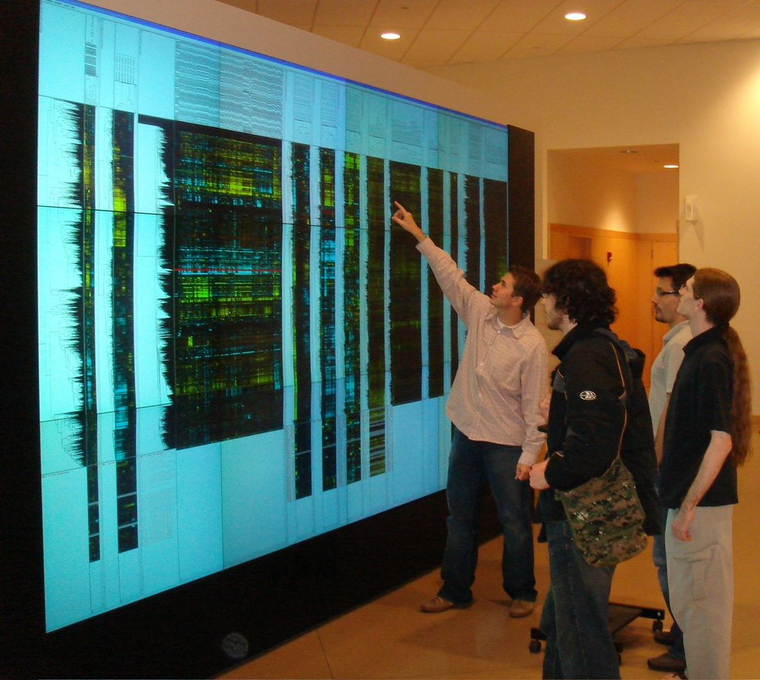
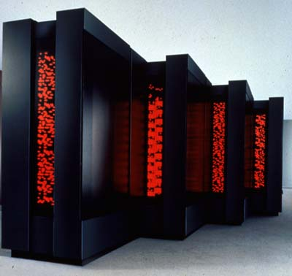
Output
Princeton’s Scalable Display Wall (2006)
Connection Machine CM-5 (1993)
0100101011010101101010110101011010101…

Slide 13
Processing
Processing
Input
Output

Slide 14
Processing
Look at the current state of the computation
Follow simple, mechanical rules about what to do next
Later in the course, we will learn Alan Turing’s formal model (and others), and use it to reason about what computers can and cannot do.

Slide 15
What’s so special about computers?

Slide 16
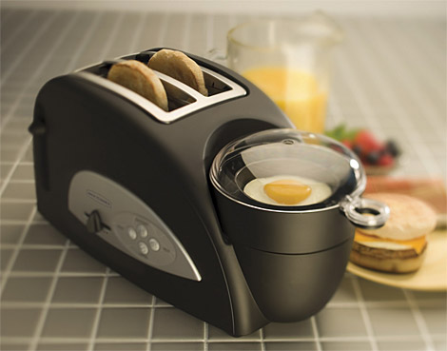
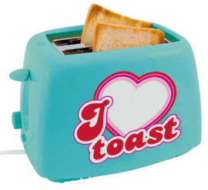
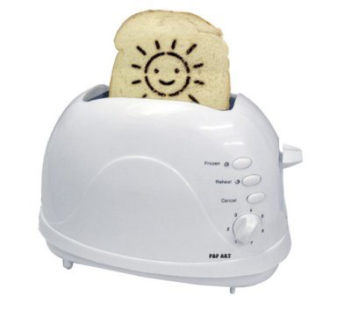
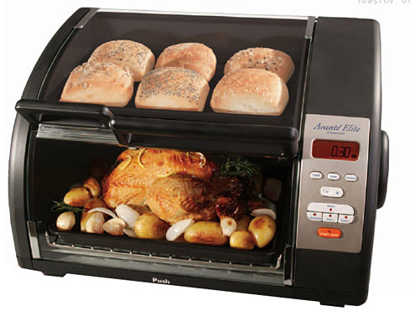
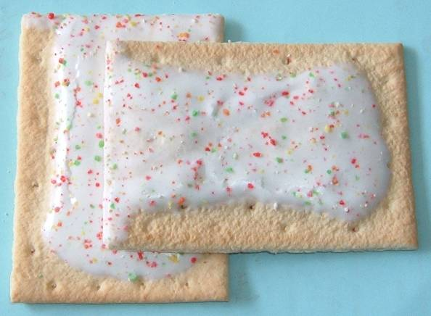
Toaster Science?

Slide 18
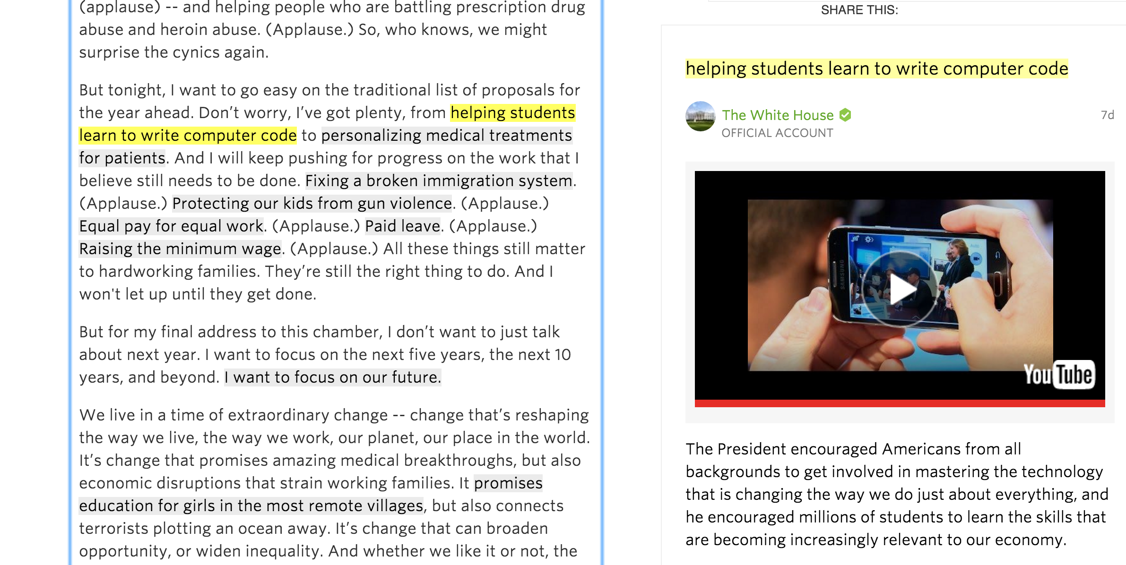
https://www.whitehouse.gov/the-press-office/2016/01/12/remarks-president-barack-obama-%E2%80%93-prepared-delivery-state-union-address

Slide 19
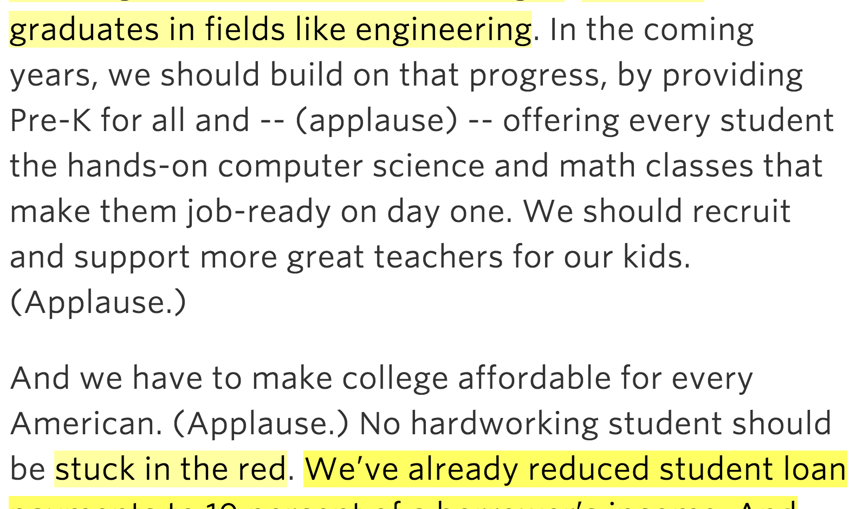
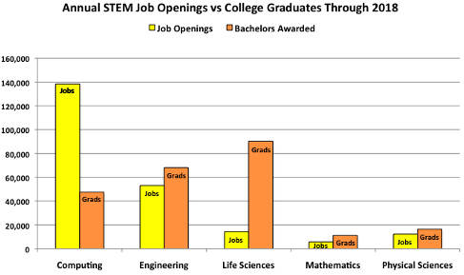

Slide 20
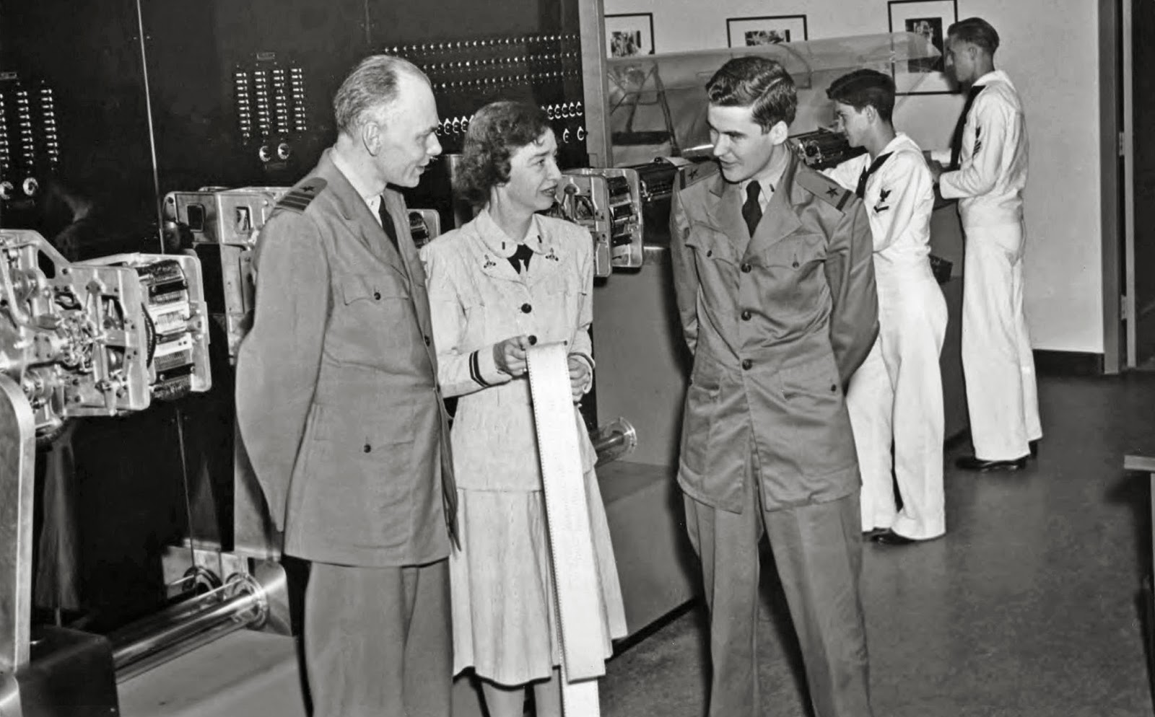
“Nobody believed that I had a running compiler and nobody would touch it. They told me computers could only do arithmetic.”
Admiral Grace Hopper (1906-1992)

Slide 21
Computers and Programs
A computer is a machine that can execute a program.
Processing
Input
Output
A universal computer is a machine that can execute any program.
Program
The “program” is just another part of the input! (The output can also be a program!)

Slide 22
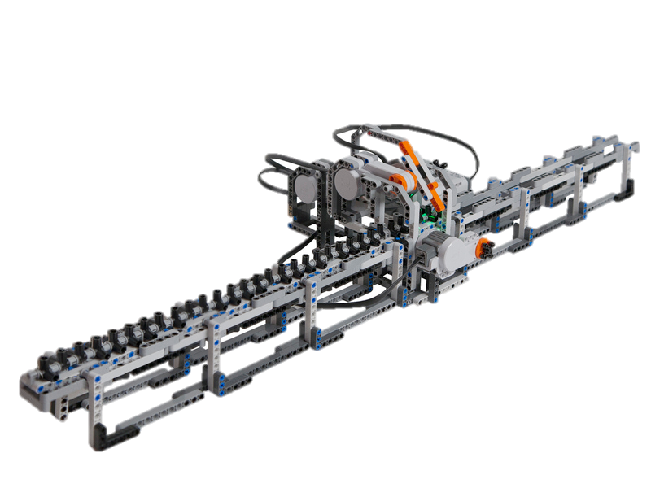
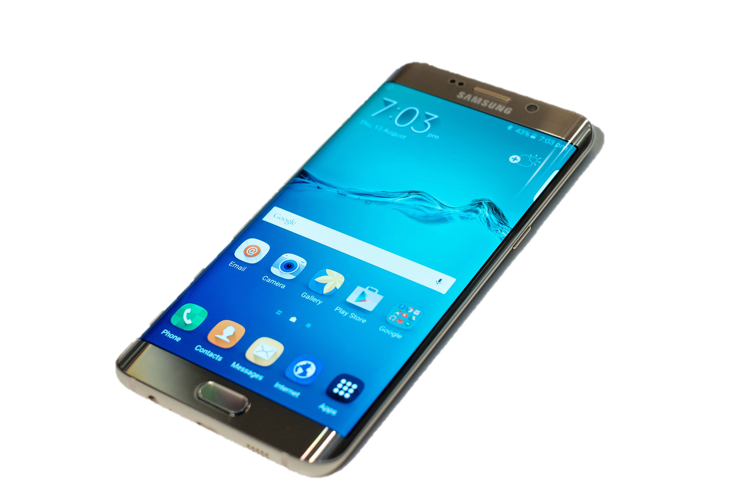
Universality of Computation
Samsung Galaxy (2015)
All of these computers are deeply equivalent!
Lego Turing Machine
Solve the same problems
Execute the same programs
Programmed the same way
Lots of practical differences
Surface (2016)
Apollo Guidance Computer (1969)
Pebble (2014)
This should seem odd and off-putting to you now! We will formalize this and understand it more deeply as the class progresses.

Slide 23
(Somewhat Self-Indulgent) Story of the Class

Slide 24
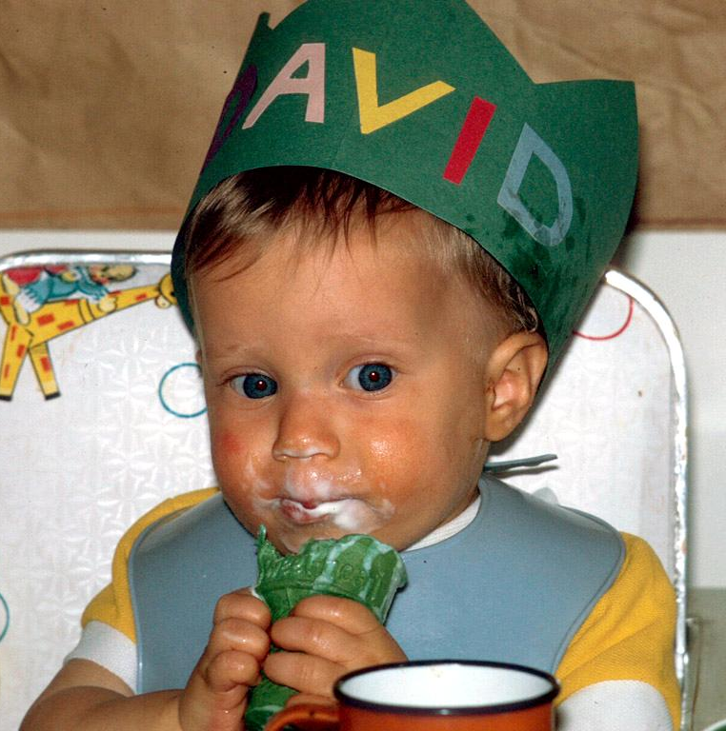
Sampled various professions with limited success (1970s)

Slide 25
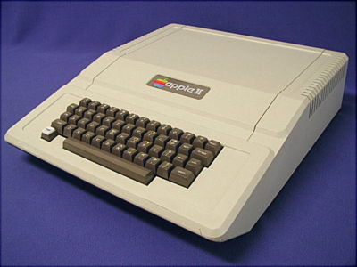
Started Playing with Computers (1978)
Gerry Sussman’s 6.001 course (1989)

Slide 26
Joined UVA (1999)

Slide 27
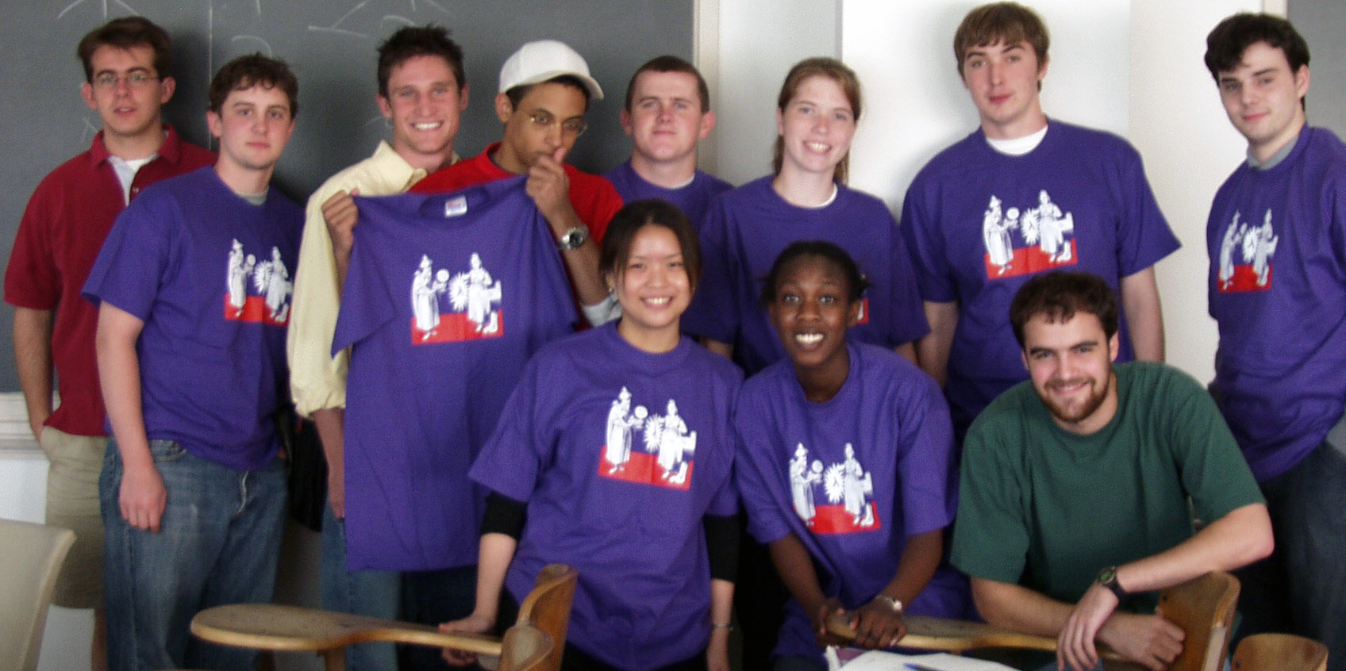
cs200 Spring 2002
http://www.cs.virginia.edu/evans/cs200-spring2002/
Notes:
https://about.me/portmanwills
https://www.youtube.com/watch?v=CXIUbADvzDM
https://www.linkedin.com/in/jeffctaylor
http://www.martindale.com/Katie-J-Winstanley/25213020-lawyer.htm
https://www.linkedin.com/in/katie-mcknight-4106517

Slide 28
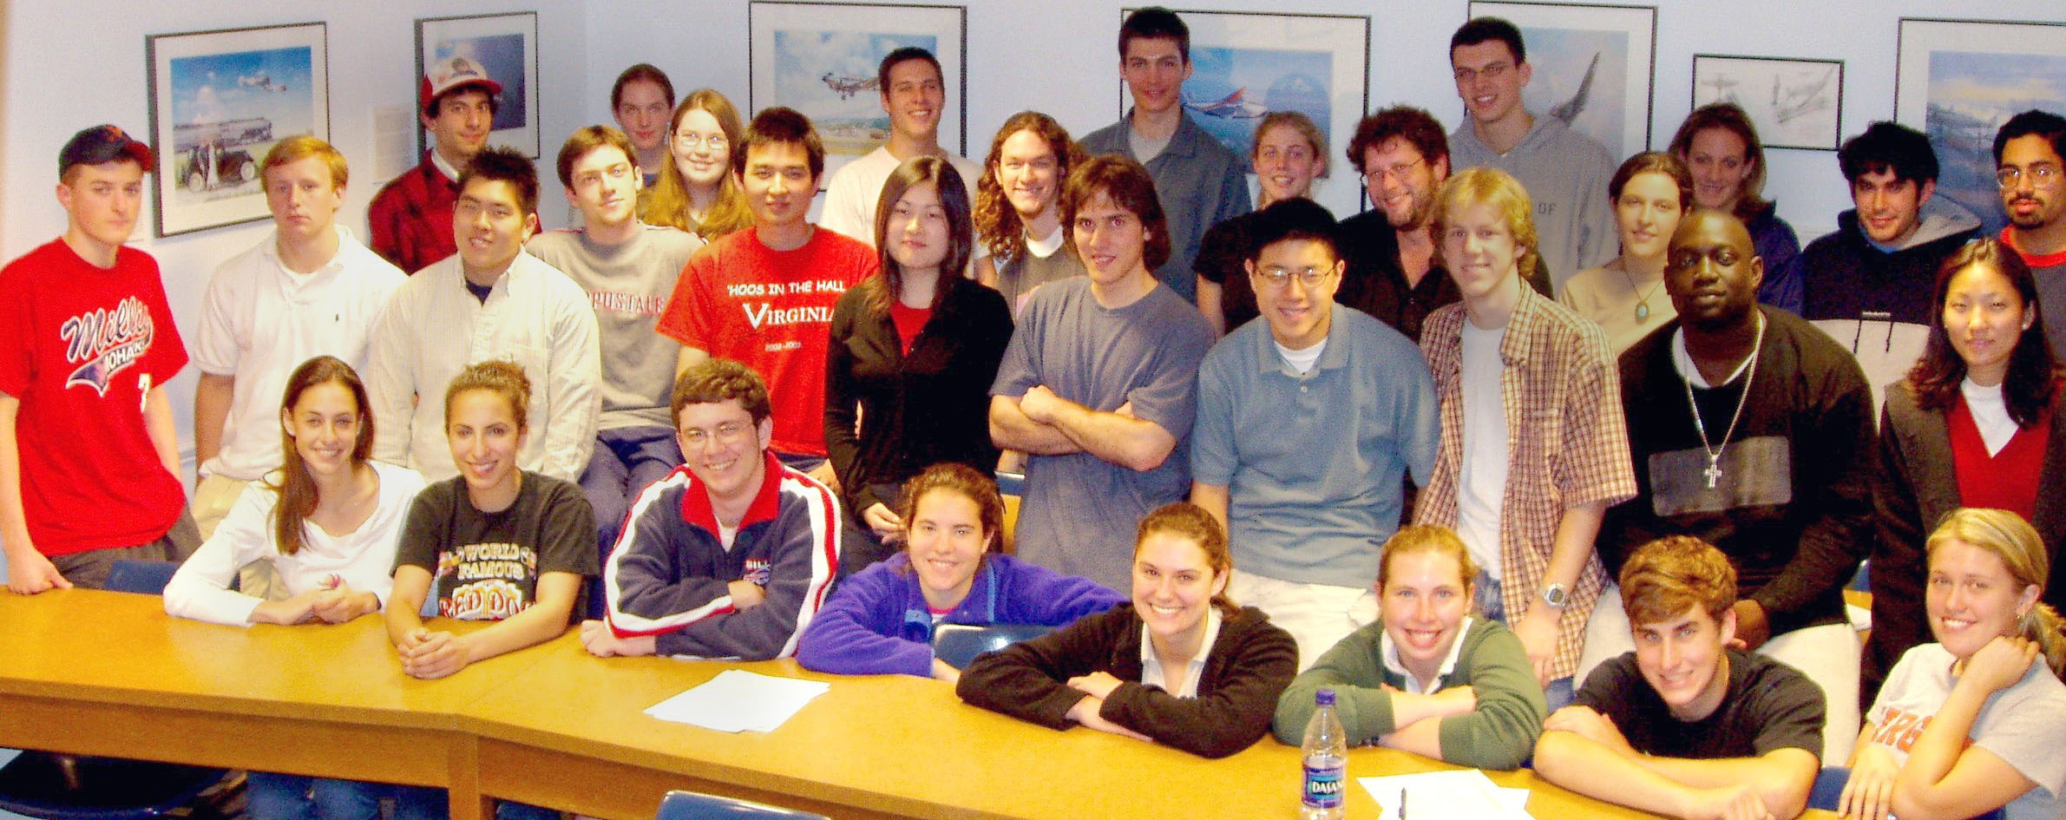
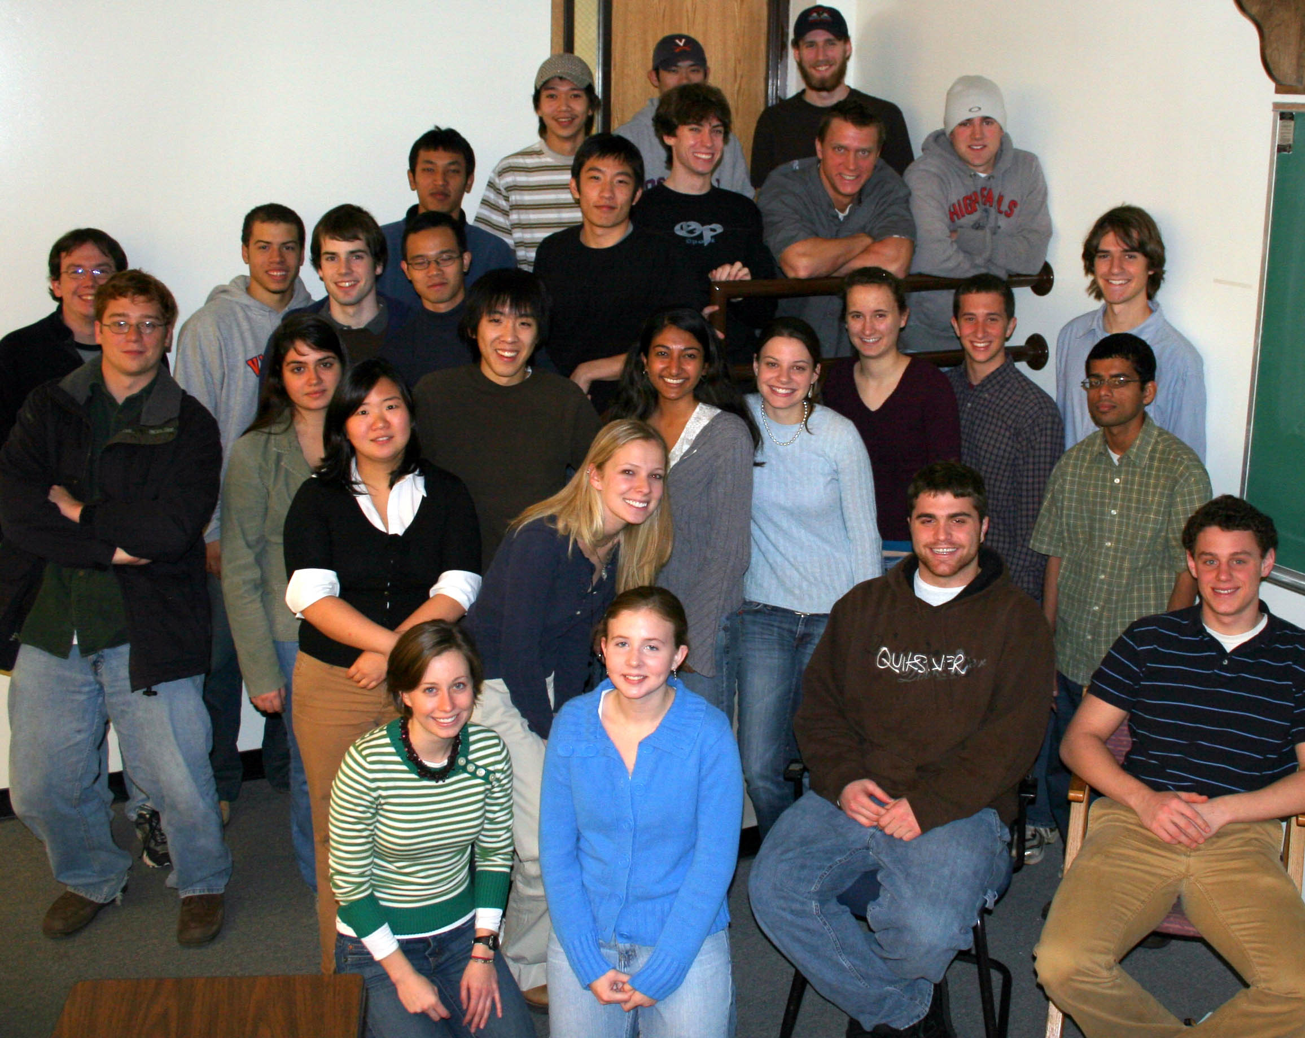
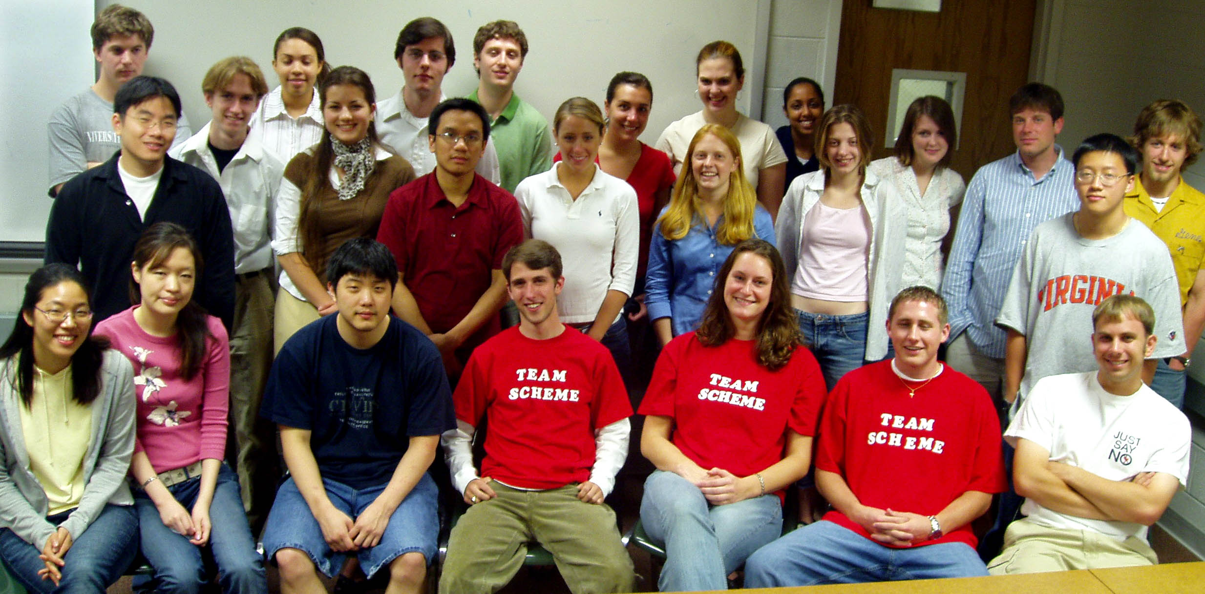
2003
2004
2005

Slide 29
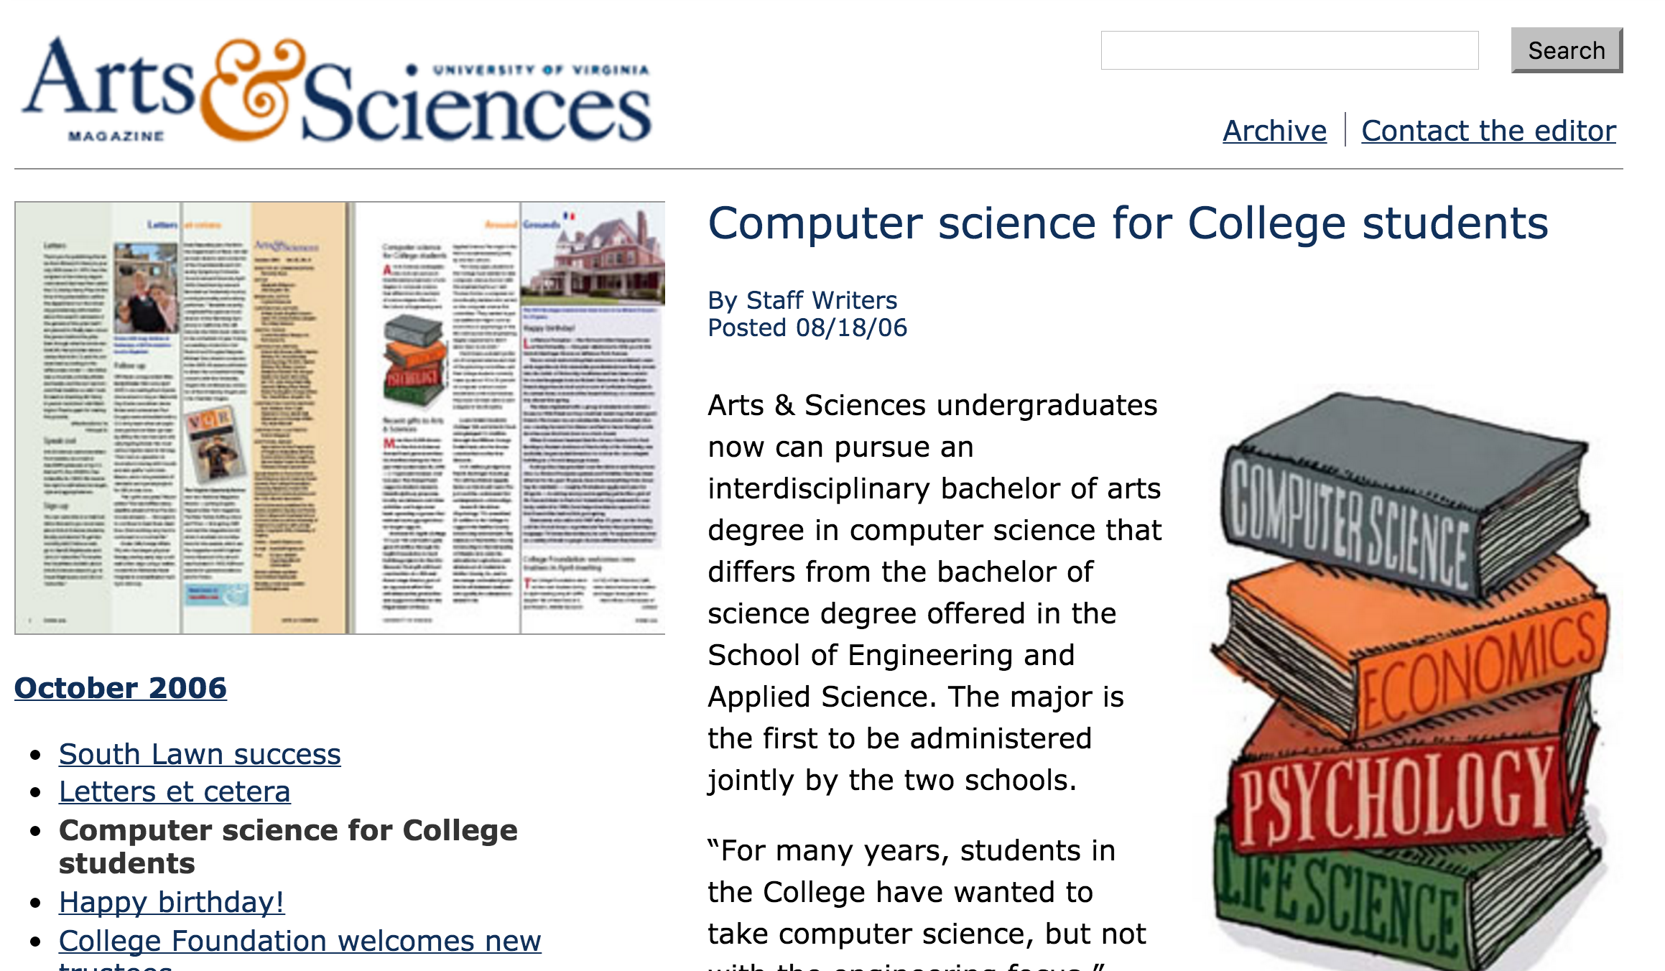

Slide 30
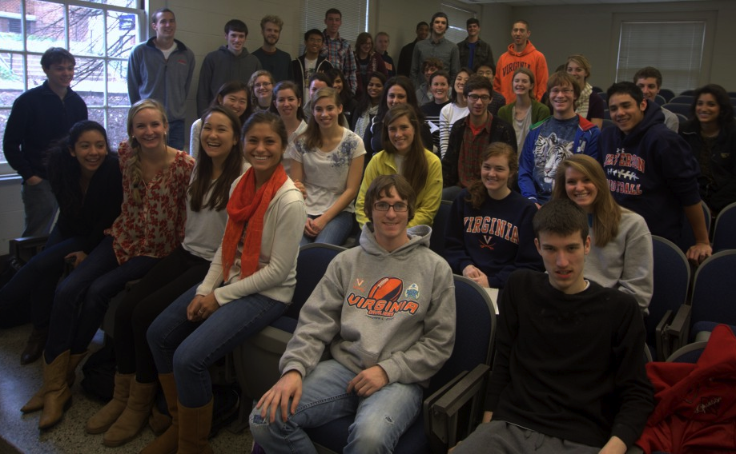
cs1120 Fall 2011 (49 students)

Slide 31
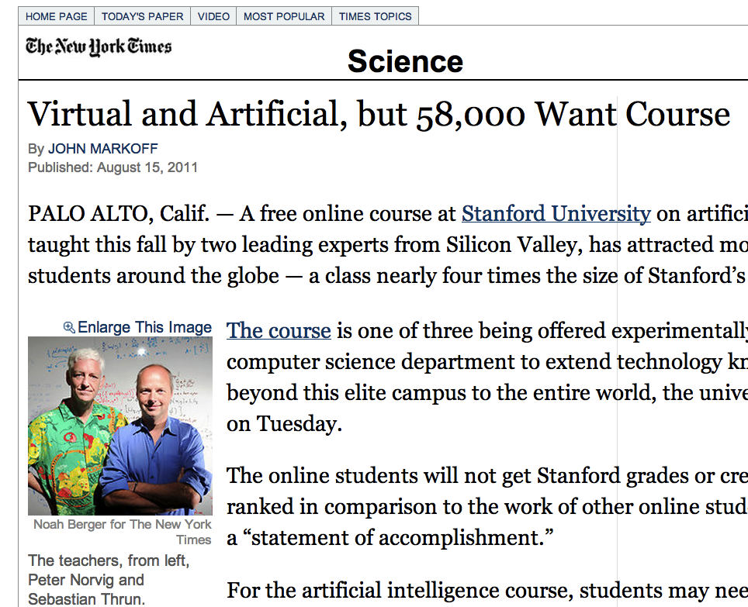
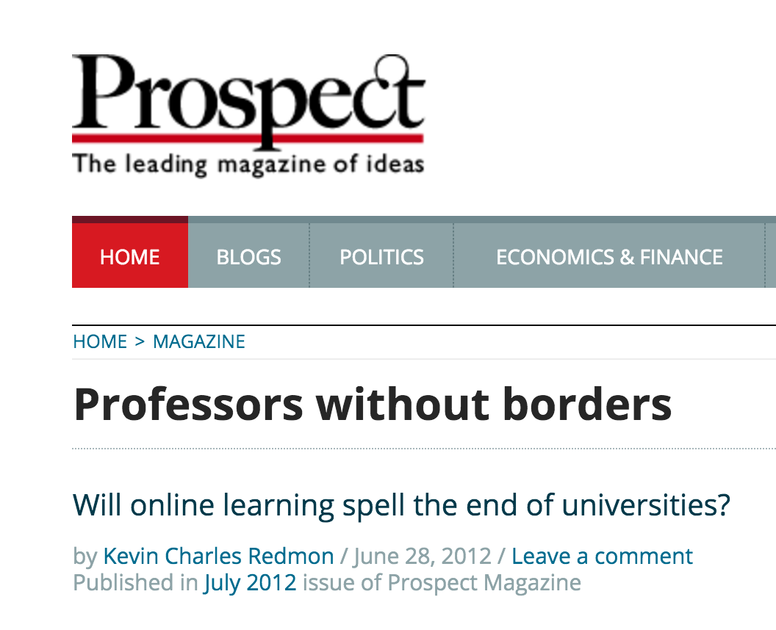

Slide 32
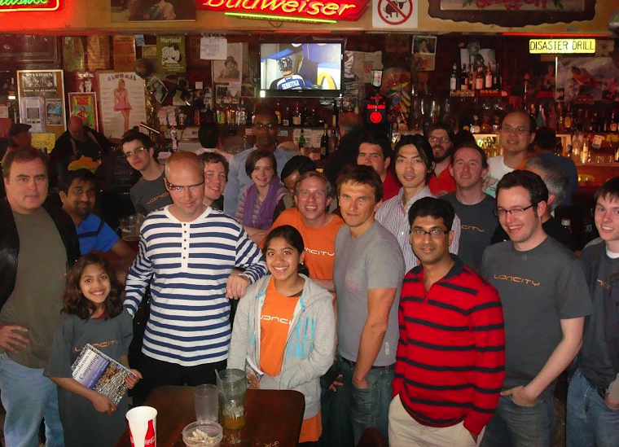
Udacity cs101 Palo Alto Graduation Party
Udacity cs101 Launch (Feb 2012)

Slide 33
You will do most of the Udacity cs101 course as part of this course
Frees up class time for other things
For learning,
not grading
Main assignments will not be from Udacity course

Slide 34
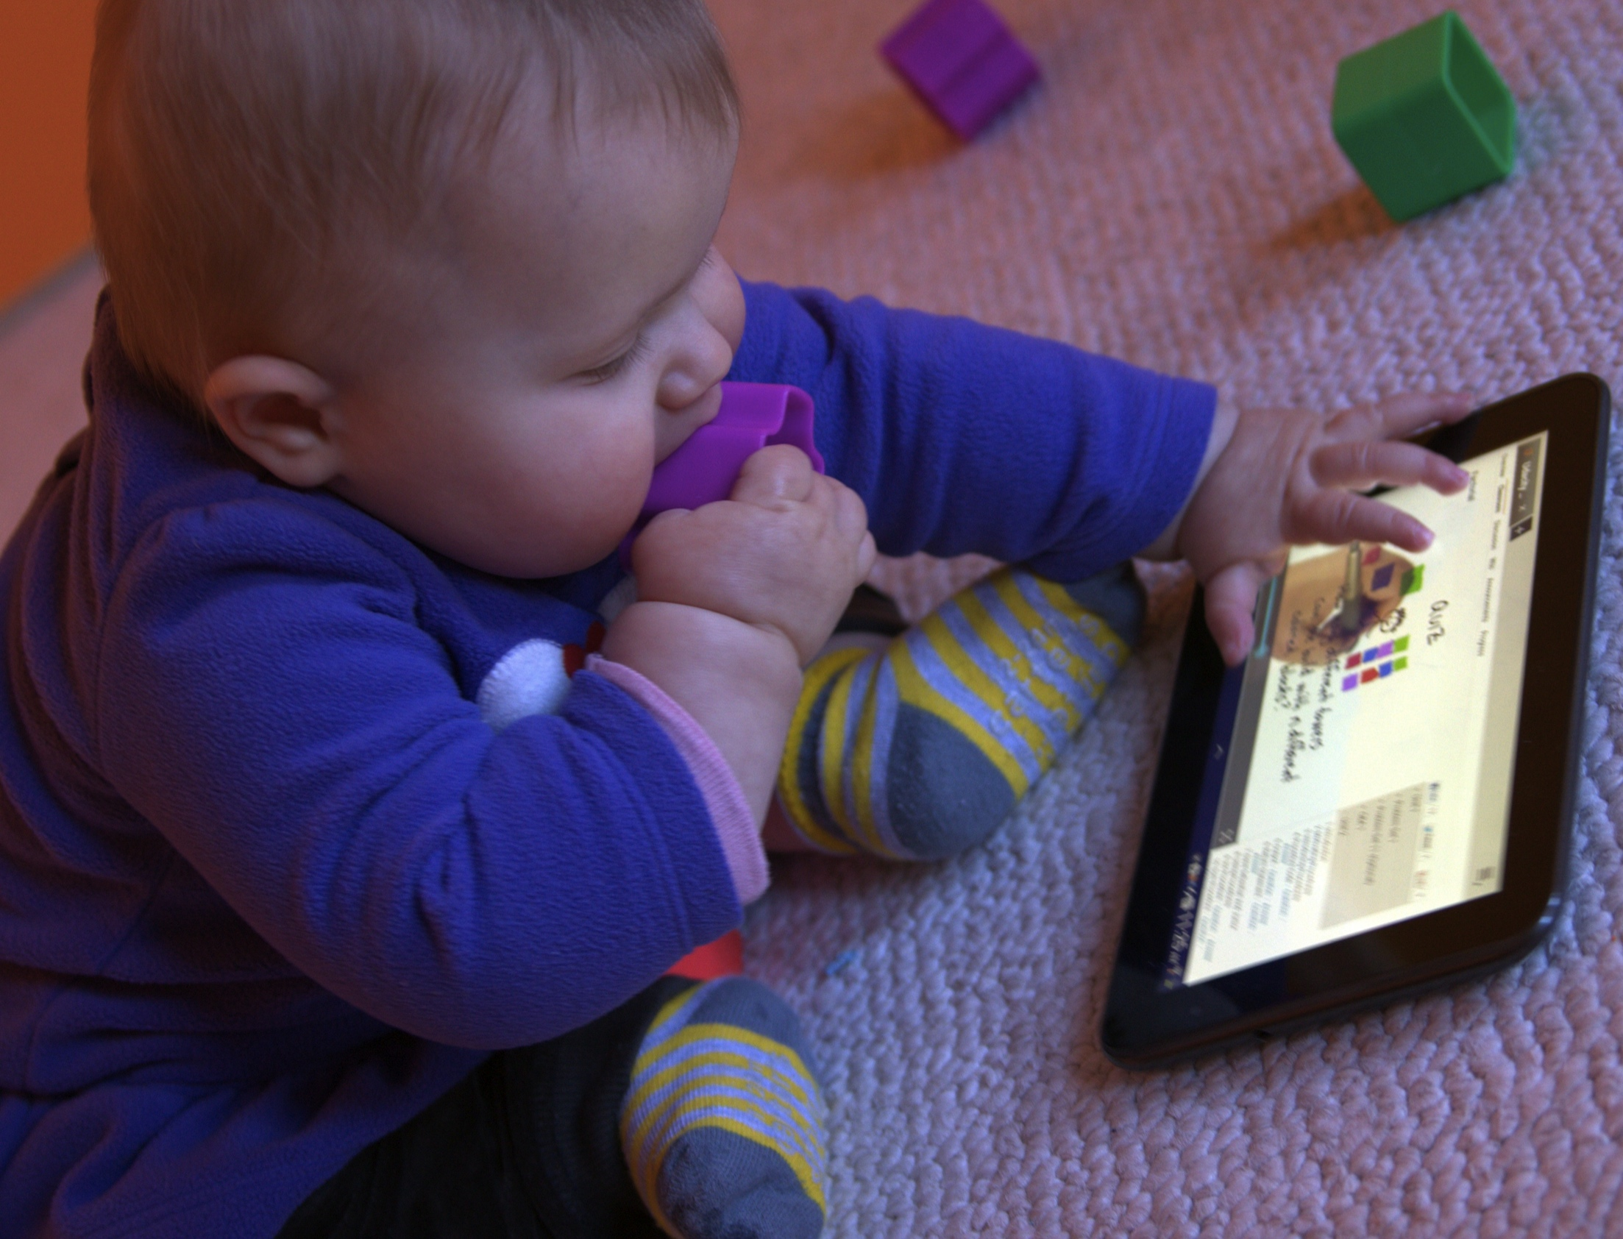
What have I learned about in-person teaching from teaching on-line courses?

Slide 35
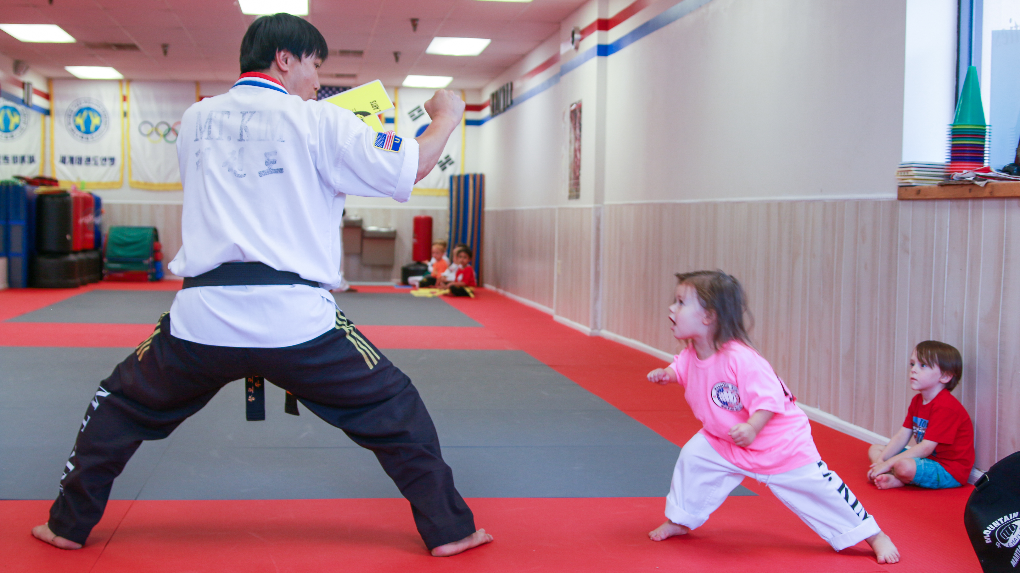

Slide 36
 | Montessori School | Tae Kwon Do
Instruction | Self-directed | Structured, Group
Greater Purpose | World peace | Self-Empowerment, Self-Defense
Grading | Personal observations | Belt exams
Form of Address | “Miss Ashley” | “Master Instructor”
Incentives | Intrinsic satisfaction | Stickers!
Dress Code | Pajamas okay | Robe and Belt
Bonus Activities | Outdoor play, Music | Board-breaking, Sparring

Slide 37
Progressive Assignments
Concepts, ideas and skills in this class build on previous ones
Can’t move on to the next level until you satisfactorily complete the previous one
Target schedule for completing levels – but opportunities for additional attempts if you are not ready/successful first time
See syllabus for details. Haven’t tried this before, will adjust as needed.

Slide 38
Computer Science

Slide 39
Charge
Read the course notes: several things to do by tomorrow night!
I have office hours tomorrow (Thursday) at 11am (also time to talk briefly now)

