Slide 1
Class 2: Language
Introduction to Computing: Explorations in Language, Logic, and Machines
cs1120 Spring 2016
David Evans
University of Virginia

Slide 2
Plan
Today:
Computer Science
Class Expectations
Language – Recursive Definitions
Wednesday: bring laptop if you can (talk to me if not)
Resolve how many computers in the room
White Belt Test opportunity
Get started on Project 1
I will post comments on Registration Surveys and answers to your questions soon!

Slide 3
Computer Science

Slide 4
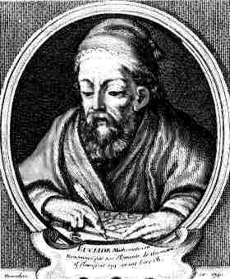
Mathematics is about declarative knowledge: “what is”
“If now CD divides AB, since it also divides itself, then CD is a common divisor of CD and AB” (Euclid’s Elements)

Slide 5
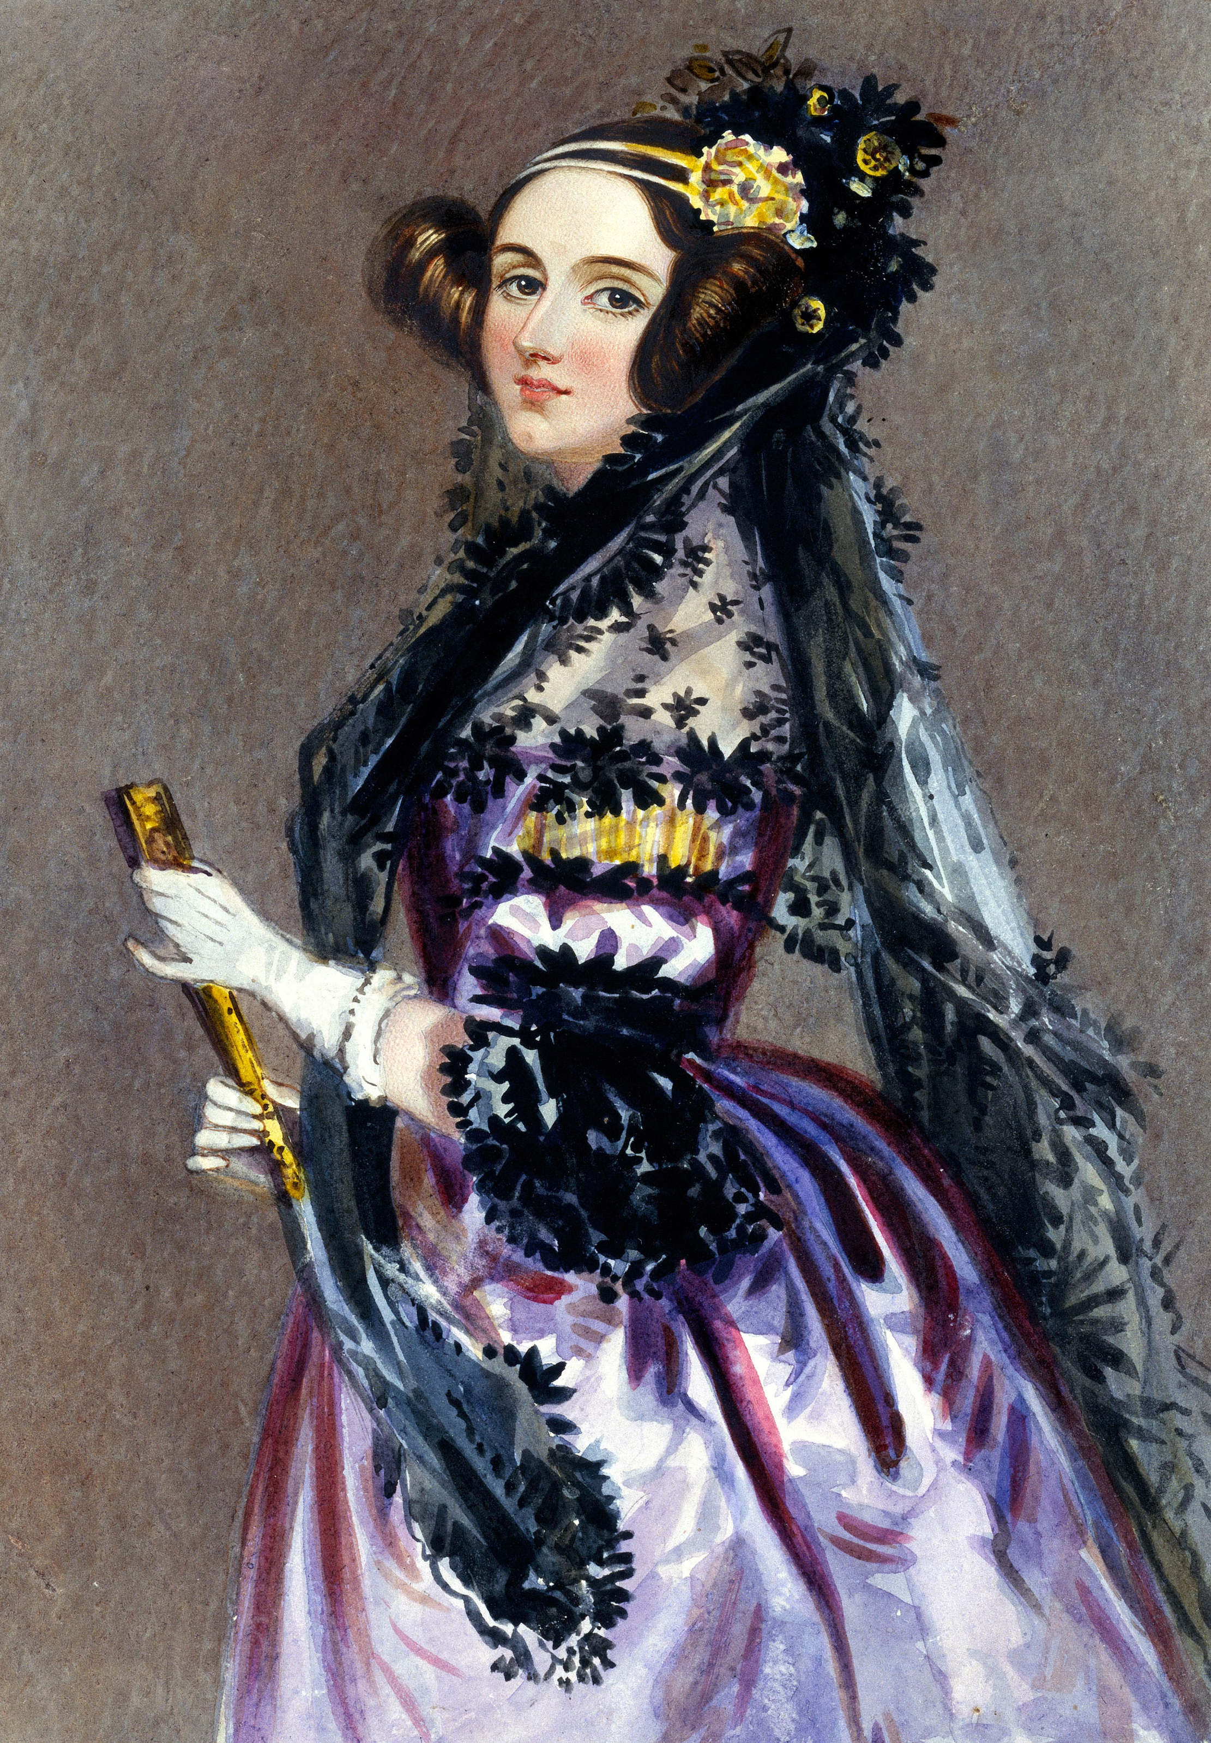
Mathematics is about declarative knowledge: “what is”
“If now CD divides AB, since it also divides itself, then CD is a common divisor of CD and AB” (Euclid’s Elements)
Computer Science is about imperative knowledge: “how to”
“There is in fact nothing in it, but you think there must be some grand mystery hidden under that word inflected! Whenever from any point without a given line, you draw a long to any point in the given line, you have inflected a line upon a given line.” (Ada Lovelace, explaining Euclid)

Slide 6
Computer Science
“How to” knowledge:
Ways of describing information processes (computations)
Ways of predicting properties of information processes
Ways of executing information processes
Language
Logic
Machines

Slide 7
Computer Science
“How to” knowledge:
Ways of describing information processes (computations)
Ways of predicting properties of information processes
Ways of executing information processes
Roughly to scale for cs1120:
Language
Logic
Machines

Slide 8
Why Learning Computer Science is Hard
New way of thinking
Both abstract and concrete
Dynamic (how to, not what is)
Finite, but quadrillions are common
Everything is connected
Everything builds on previous ideas
Need to understand lots of new things at once

Slide 9
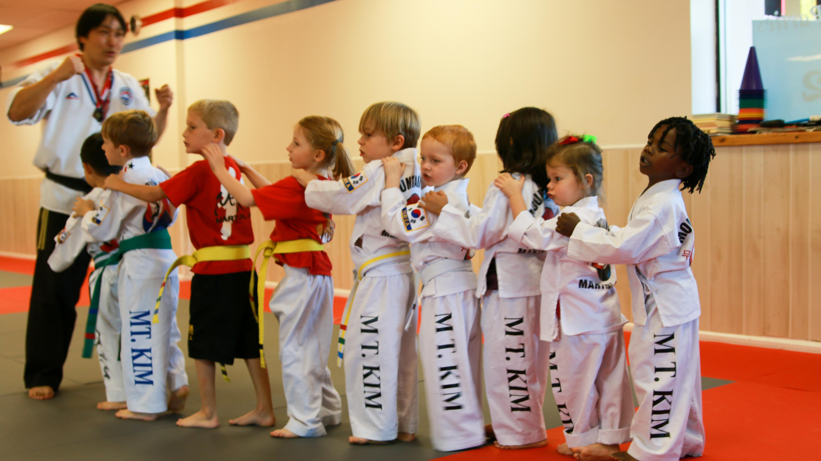
Expectations

Slide 10
This generation of students got into “UVA” by doing exactly and precisely what teacher wants. If teacher is vague about what he wants, they work a lot harder to figure out what they want and whether or not it is good. The vaguer the directions, the more likely the opportunity for serendipity to happen. It drives them nuts!
Harvard Professor John Stilgoe
(on "60 Minutes", 4 January 2004)

Slide 11
“Typical” cs1120 Grades
Overall Class
Students entering with no programming experience
Everyone should get at least an A in this class
Average over past semesters I have taught it

Slide 12
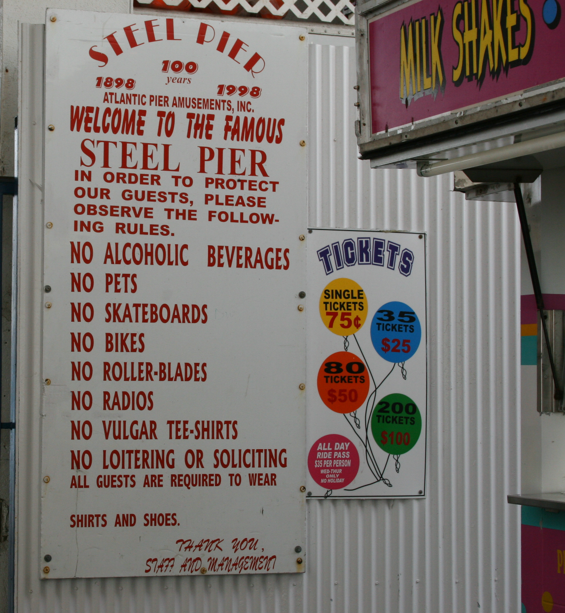
The assignments are suggestions
If you have a better idea, convince me, and you should do that instead.

Slide 13
Background Expected
Language
Reasonable reading and writing in English
Understanding of subject, verb and object
Math
Numbers, add, subtract, multiply, divide
Exponentiation, logarithms (we will review)
Logic: and, or, not
Computer Literacy: read and write email, browse web
If I ever appear to expect anything else, stop me!

Slide 14
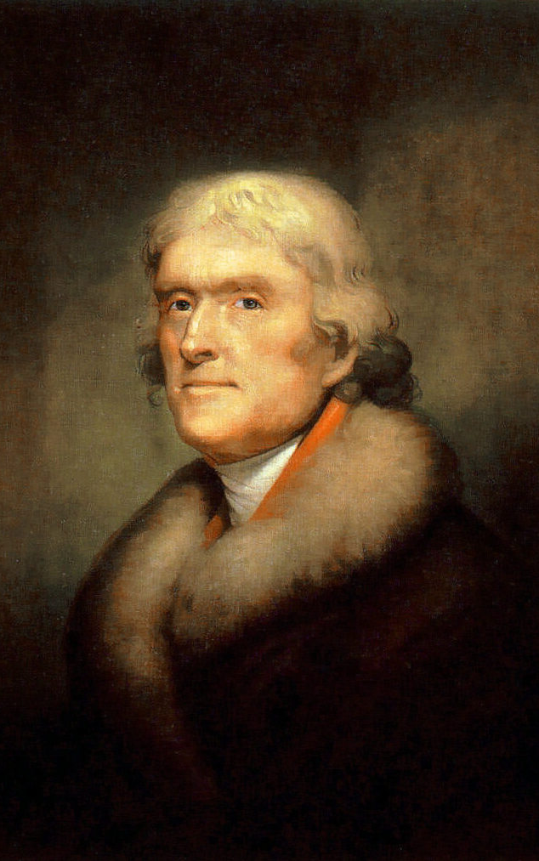
What I Expect of You
You are a “Jeffersonian Student”
Believe knowledge is powerful
Interested in lots of things, ahead of your time
Want to use what you learn to do good things
Care more about what you learn than grades and degree requirements

Slide 15
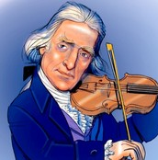
Note: this does not mean Jefferson was lazy!
http://www.wm.edu/about/history/tjcollege/tjcollegelife/:
Thomas Jefferson enrolled in the College of William and Mary on March 25, 1760, at the age of sixteen. … By the time he came to Williamsburg, the young scholar was proficient in the classics and able to read Greek and Latin authors in the original… He was instructed in natural philosophy (physics, metaphysics, and mathematics) and moral philosophy (rhetoric, logic, and ethics). A keen and diligent student, he displayed an avid curiosity in all fields and, according to family tradition, he frequently studied fifteen hours a day.

Slide 16
What Everyone Should Expect of You:
You will treat your classmates with respect and kindness
You will ask for help
In class, office hours, on-line (slack, course site, email)
You will be curious and share
Scheduled office hours:
Tuesday (Dave, 3:30pm, Rice 507)
Wednesday (Yuchi, 4-5pm, Rice 514)
Thursday (Dave, 11am, Rice 507)
Friday (Yuchi, after class)
You will actively participate in and positively contribute to the class community

Slide 17
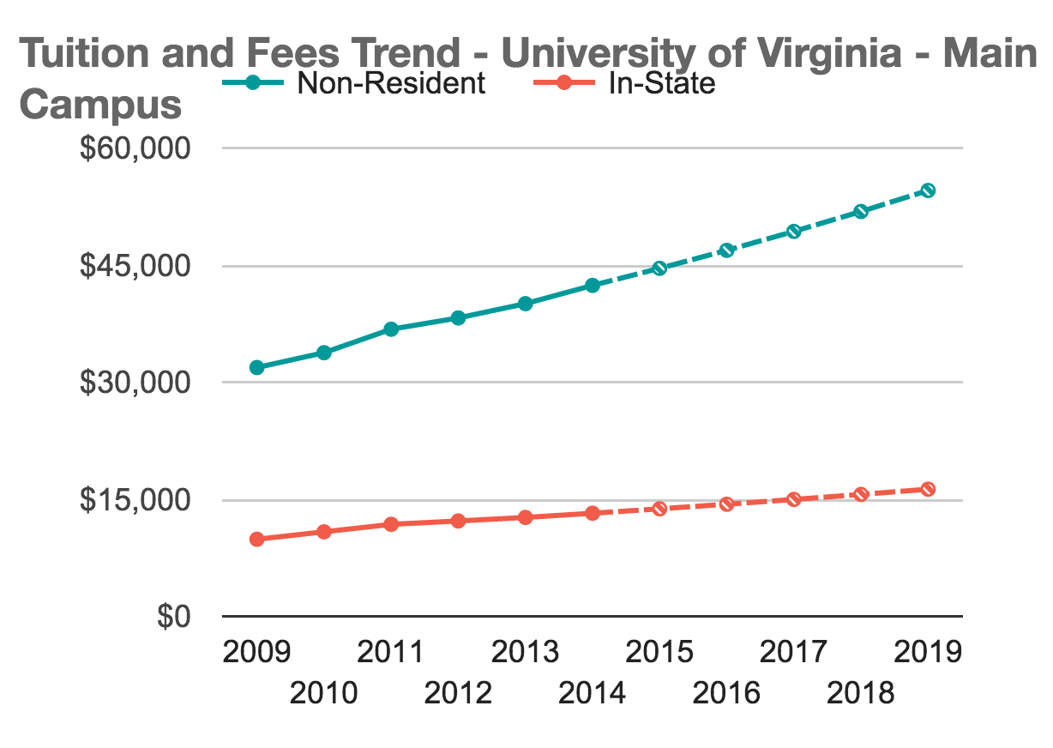
Otherwise…save your tuition!

Slide 18
Honor
Honor
Image: Queerbubbles - CC BY-SA

Slide 19
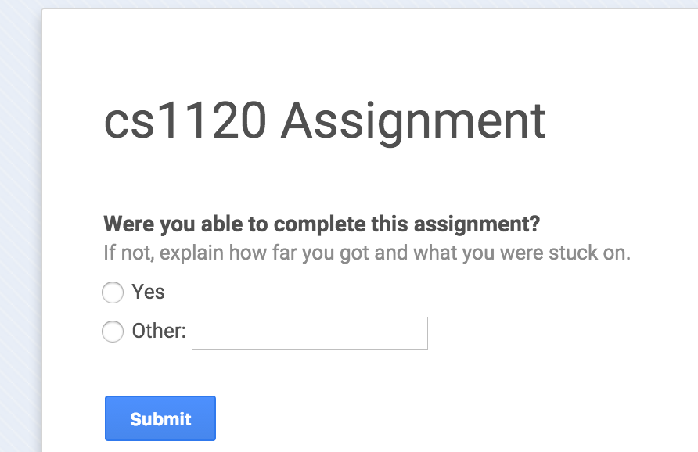

Slide 20
What is Language?

Slide 21
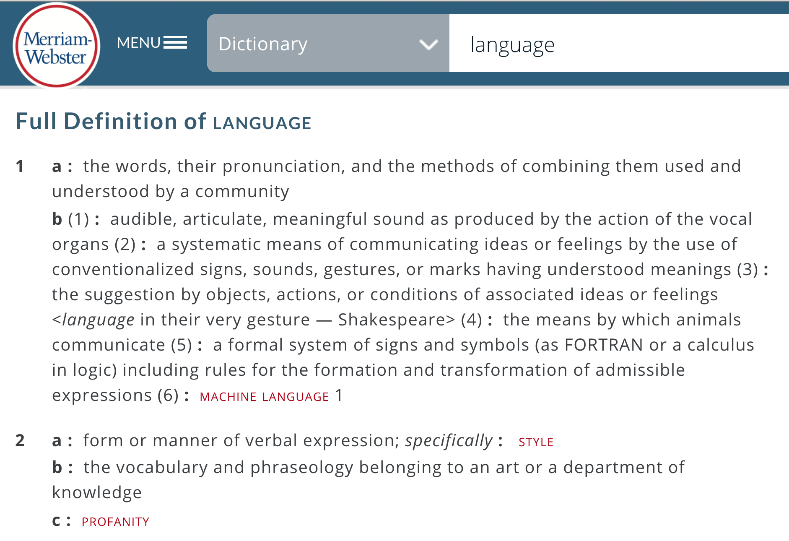
A systematic means of communicating ideas or feelings by the use of conventionalized signs, sounds, gestures, or marks having understood meanings.

Slide 22
Linguist’s Definition [Charles Yang]
A description of pairs (S, M), where S stands for sound, or any kind of surface forms, and M stands for meaning.
A theory of language must specify the properties of S and M, and how they are related.

Slide 23
A language is:
a set of surface forms (usually strings of characters), and
a way to map any surface form
in the language to a meaning
Caveat: computer scientists often use language to mean just a set of surface forms.

Slide 24
What are languages made of?
Primitives (all languages have these)
The simplest surface forms with meaning
Means of Combination (all languages have these)
Ways to make new surface forms from ones you already have
Means of Abstraction (all powerful languages have these)
Ways to use simple surface forms to represent complicated ones

Slide 25
Does English have these?
Primitives
Words (?)
“hippopotomonstrosesquipedaliophobia” is not a primitive
Morphemes – smallest units of meaning
e.g., anti- (“opposite”)

Slide 26
Does English have these?
Means of combination
e.g., Sentence ::= Subject Verb Object
Precise rules, but not the ones you learned in grammar school
“Nine and a half turtles wearing orange aprons with watermelons on them began to simultaneously yodel as the conductor stepped on the kitchen table.”

Slide 27
Does English have these?
Means of abstraction
Pronouns: she, he, it, they, which, etc.
Often confusing since they don’t always mean the same thing, it depends on where they are used.
The “these” in the slide title is an abstraction for the three elements of language introduced 3 slides ago.
The “they” in the confusing sentence is an abstraction for pronouns.

Slide 28
Charge
White Belt Test Wednesday:
(No board-breaking, see notes for details)
Bring laptop (if possible) to class Wednesday: get started on Project 1

