Slide 1
Class 4: Primitives, Computers, and Python
Introduction to Computing: Explorations in Language, Logic, and Machines
cs1120 Spring 2016
David Evans
University of Virginia

Slide 2
Plan and Schedule
Upcoming schedule:
Before Monday’s class:
Udacity cs101 Lesson 2: How to Repeat and Lesson 2: Problem Set
Coursebook 3.1 and 3.2
Due Friday: Project 1
Discuss White Belt Exam
Primitives
Computer Definition
Variables
Python
How to efficiently return exams?
If there are no questions
about cs101 Lesson 2 (on slack or in office hours), I will assume everyone understands everything it covers and spend class time on other things!

Slide 3
White Belt Exam
21 people advanced!
13 have more opportunities:
Good answers for questions you didn’t answer well
One new question (on notes)
Turn in by class Monday
There is no “failing”, just “not passing yet”.
See notes for details!

Slide 4
Primitives
Smallest units of meaning:
meaning of the whole can be derived from its parts
primitives cannot be divided into smaller parts without losing meaning

Slide 5
Primitives
Smallest units of meaning:
meaning of the whole can be derived from its parts
primitives cannot be divided into smaller parts without losing meaning
What are the primitives in “primitives”?

Slide 6
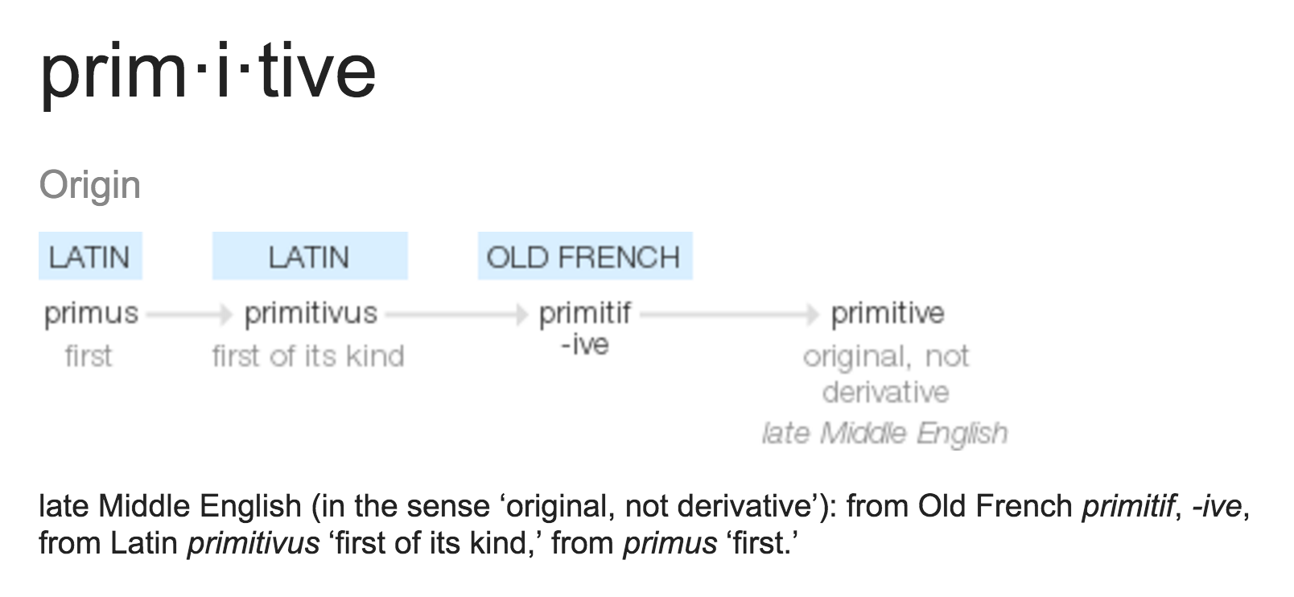

Slide 7
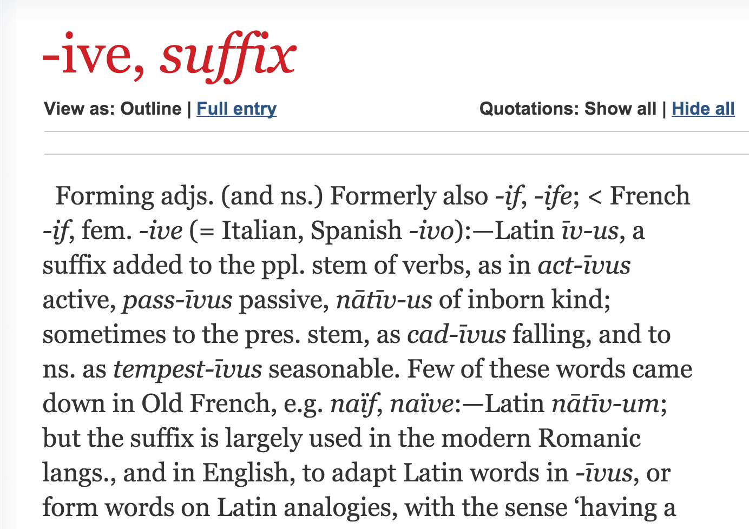
Is –ive really a primitive?

Slide 8
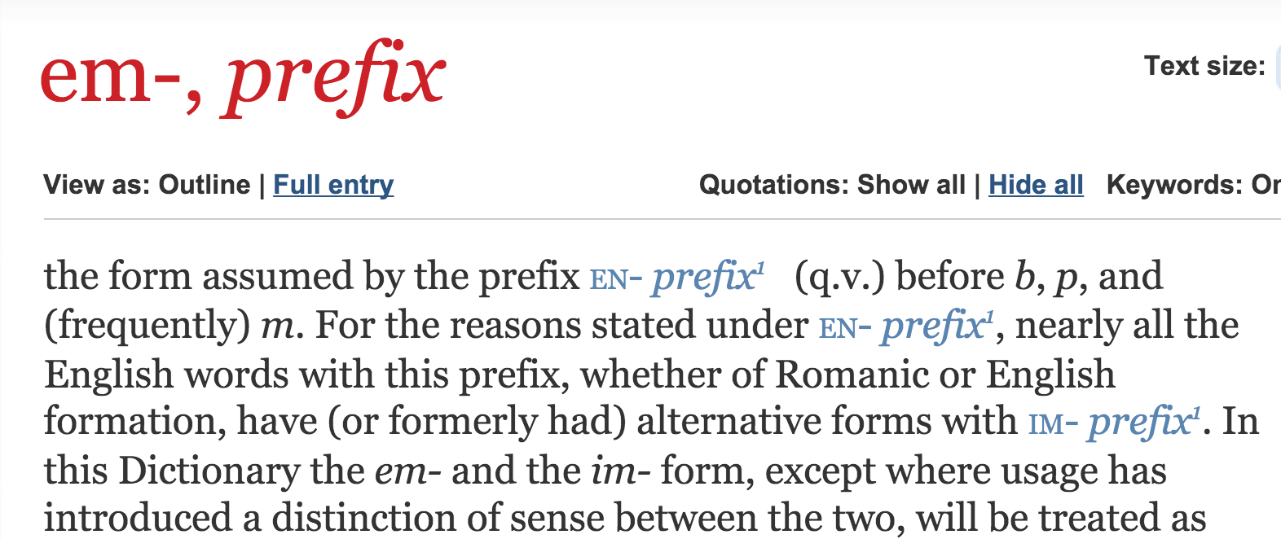
What does embarrel mean?

Slide 9
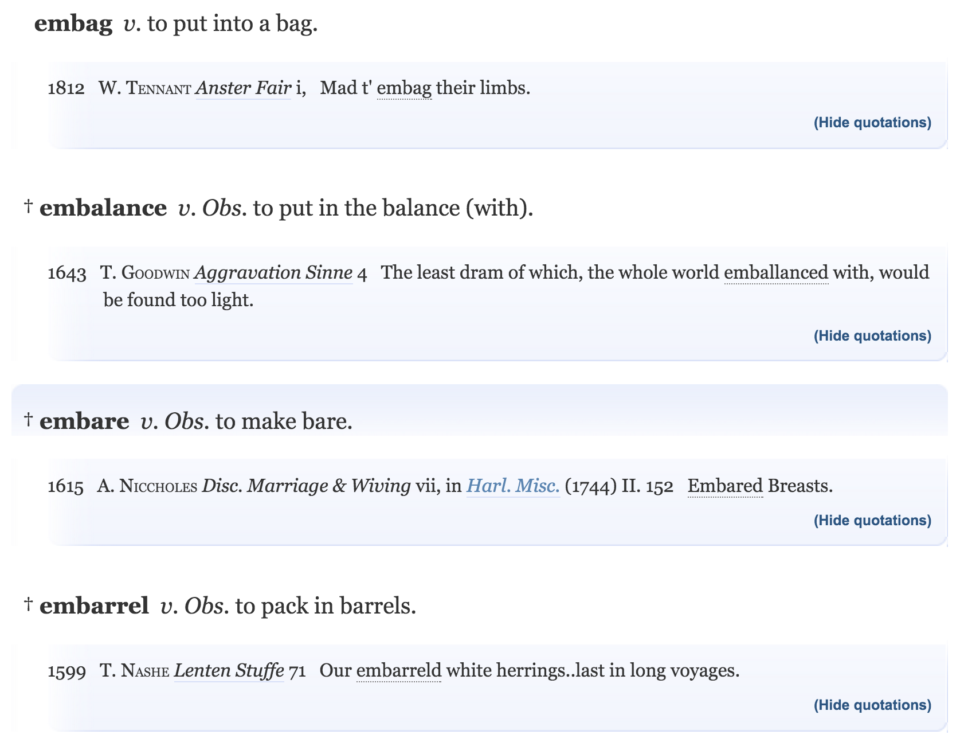

Slide 10
Primitives
Smallest units of meaning:
meaning of the whole can be derived from its parts
primitives cannot be divided into smaller parts without losing meaning
In programming languages, deciding what the primitives are is much easier than in English!

Slide 11
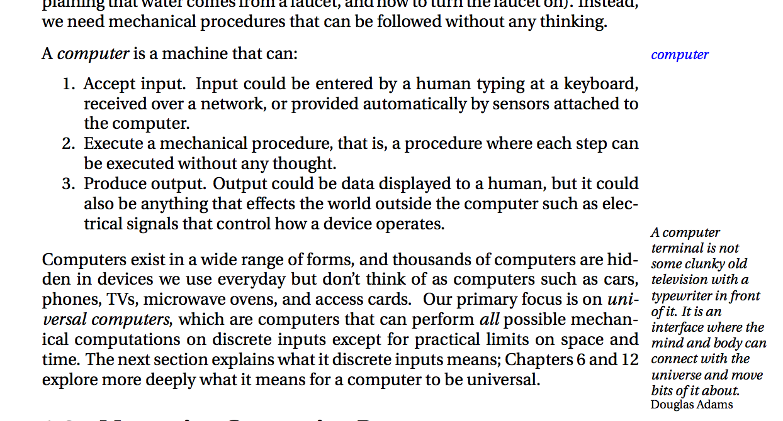
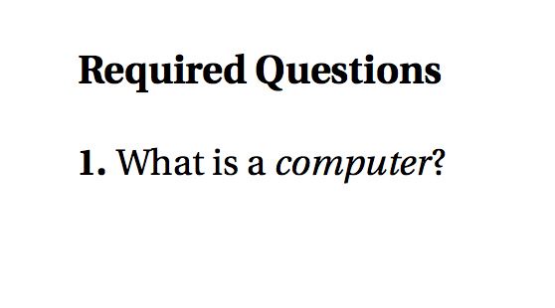
Defining a Computer
Coursebook
White Belt Exam
Class 1 Notes

Slide 12
Defining a Computer
Coursebook
White Belt Exam
Things you will see on exams will mostly be things you see in many other places!
It should be clear what I think is most important, and you should not be surprised by what is on exams.
Class 1 Notes

Slide 13
Defining a Computer
Coursebook
White Belt Exam
I will attempt to provide good, clear definitions. But, I don’t want you to memorize them!
Class 1 Notes

Slide 14
Class 1:

Slide 15
What’s in your smartphone?

Slide 16
From https://www.ifixit.com/Teardown/Samsung+Galaxy+S5+Teardown/24016

Slide 17
Chips in a Galaxy S5
Qualcomm Snapdragon 801
Cost: $18 (better deals if you buy >1M)
How many computers on this chip?

Slide 18
Snapdragon 801: How Many Computers?
4 general purpose cores
2.5 GHz
1 Hexagon Processor for signal processing
Also a full computer – can run any program,
but designed to do signal processing efficiently

Slide 19
Class 1:

Slide 20
Note: this is a newer 810 model (couldn’t find good picture of 801), but mostly similar.

Slide 21
GPU: Graphics Processing Unit
Adreno 330 GPU:
120 computers!

Slide 22
Snapdragon 801: How Many Computers?
4 general purpose cores
1 Hexagon Processor for signal processing
~5 other special processors
120 GPU cores
Note: not even counting software computer simulators!

Slide 23
Why so many?
“It is very possible that ... one machine would suffice to solve all the problems that are demanded of it from the whole country.”
Charles Darwin, 1946 (grandson of famous one)

Slide 24
Why so many?
“It is very possible that ... one machine would suffice to solve all the problems that are demanded of it from the whole country.”
Charles Darwin, 1946 (grandson of famous one)

Slide 25
Python Programming

Slide 26
Charge
Return White Belt Exams
If you did not pass (DNP), read instructions on today’s notes!
Before Monday’s class:
Udacity cs101 Lesson 2: How to Repeat and Lesson 2: Problem Set
Coursebook 3.1 and 3.2
Due Friday: Project 1
If there are no questions
about cs101 Lesson 2 (on slack or in office hours), I will assume everyone understands everything it covers and spend class time on other things!

