Slide 1
Class 5: Meaning of Everything!
Introduction to Computing: Explorations in Language, Logic, and Machines
cs1120 Spring 2016
David Evans
University of Virginia

Slide 2
Plan
Upcoming schedule:
Due Friday: Project 1
Evaluation rules:
Meaning of any Python code
Procedural Abstraction
See instructions on notes for how to turn in Project 1.
Add date is Friday – make sure you are officially registered for class!

Slide 3
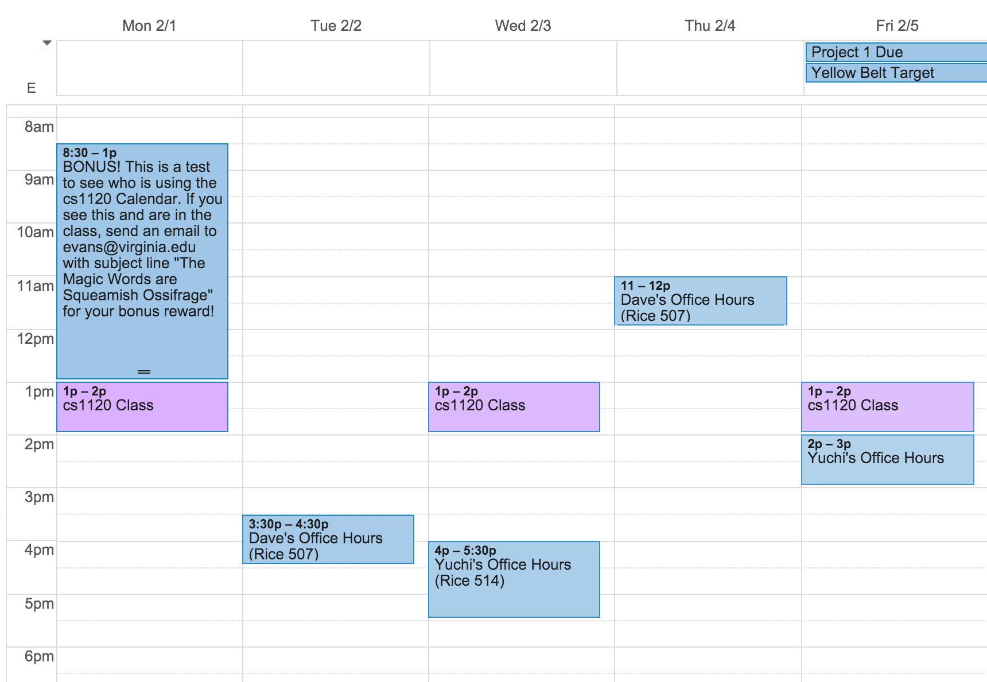
Please incorporate the cs1120 calendar into your calendar!

Slide 4
Project 1, Questions 1 and 2
How do we know the value of a Python expression?
Notes:
2/1/16
3
3

Slide 5
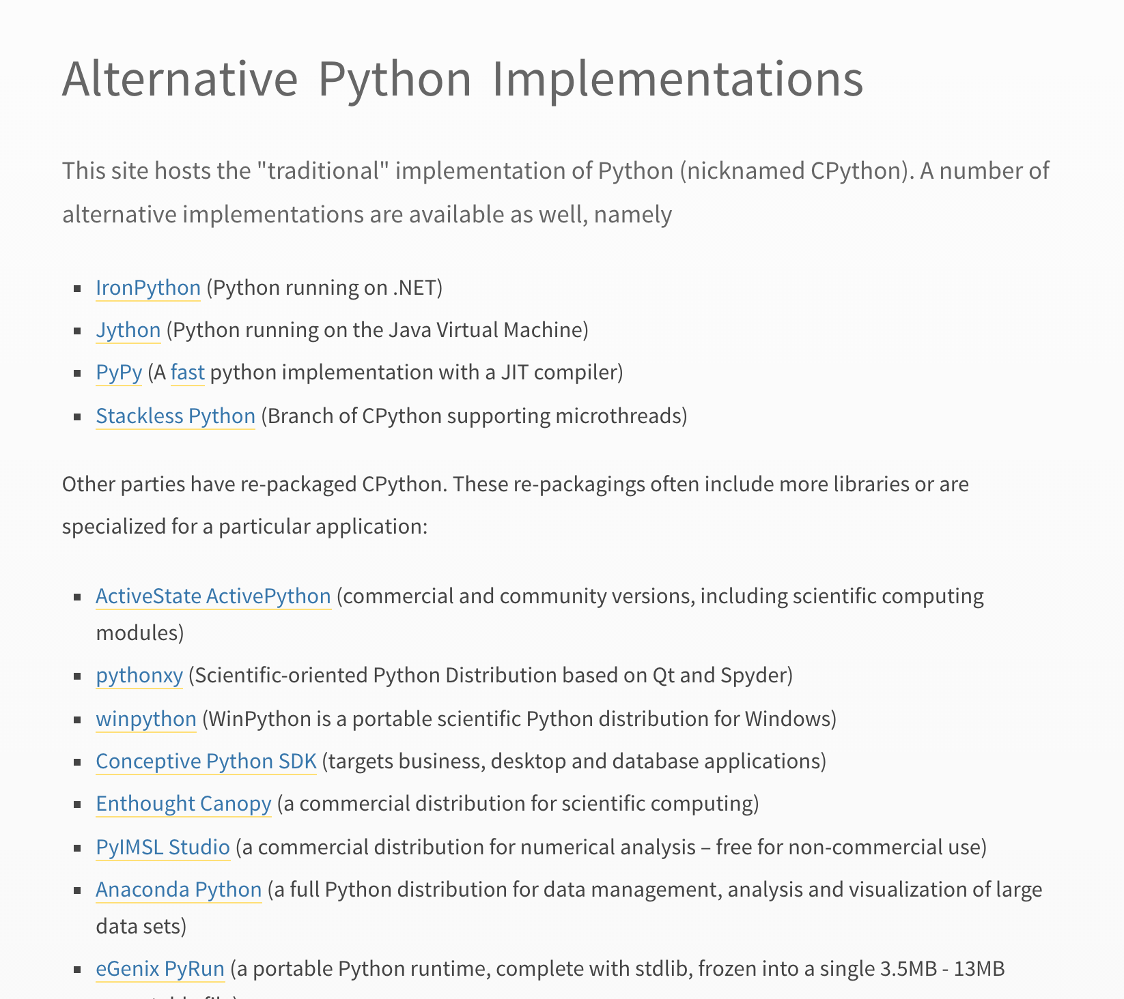
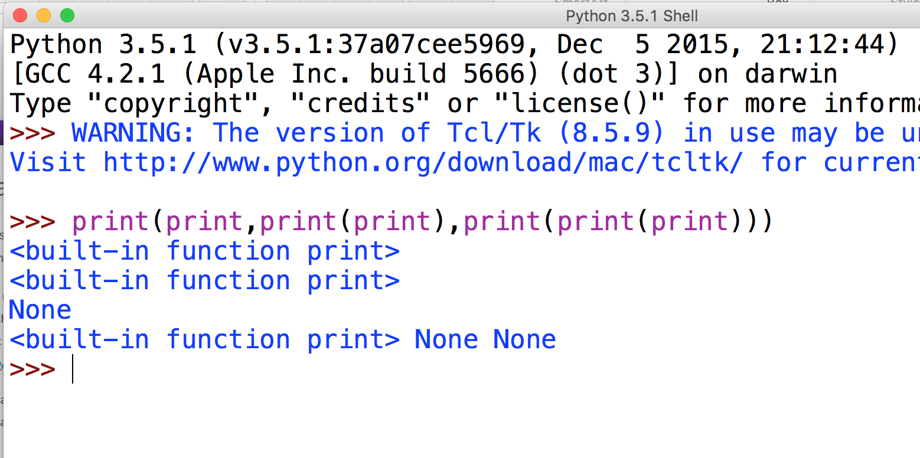

Slide 6
Rules of Evaluation
Rules of Evaluation are precise rules for determining the meaning of every surface form in the language
Have we seen anything like this before?

Slide 7
Rules of Evaluation
Rules of Evaluation are precise rules for determining the meaning of every surface form in the language
Class 2:

Slide 8
Rules of Evaluation
Rules of Evaluation are precise rules for determining the meaning of every surface form in the language
How many rules do we need?

Slide 9
Rules of Evaluation
Rules of Evaluation are precise rules for determining the meaning of every surface form in the language
How many rules do we need?

Slide 10
From Class 2:

Slide 11
Primitives in Python

Slide 12
Primitives in Python
Number Literals
Built-in Constants
Built-in Operators
Built-in Functions

Slide 13
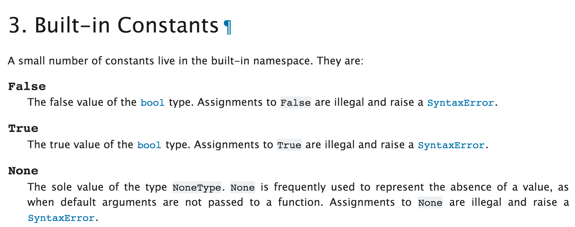
https://docs.python.org/3.5/library/constants.html

Slide 14
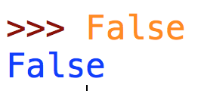
https://docs.python.org/3.5/library/constants.html
“The meaning of False is false.”

Slide 15
https://docs.python.org/3.5/library/constants.html
Foreshadowing note: False is a primitive in Python, but later in the semester we’ll learn a language where False is not a primitive!
“The meaning of False is false, and you can’t change it!”

Slide 16
https://docs.python.org/3/reference/lexical_analysis.html#literals

Slide 17
https://docs.python.org/3/reference/lexical_analysis.html#literals
Integer ::= DecimalInteger
DecimalInteger ::= NonZeroDigit Digits
NonZeroDigit ::= 1 | 2 | 3 | 4 | 5 | 6 | 7 | 8 | 9
Digit ::= 0 | NonZeroDigit
Digits ::= Digits Digit
Digits ::= ɛ (empty)

Slide 18
Meaning of Every Integer
Integer ::= DecimalInteger
DecimalInteger ::= NonZeroDigit Digits
NonZeroDigit ::= 1 | 2 | 3 | 4 | 5 | 6 | 7 | 8 | 9
Digit ::= 0 | NonZeroDigit
Digits ::= Digits Digit
Digits ::= ɛ (empty)

Slide 19
Integer ::= DecimalInteger
DecimalInteger ::= NonZeroDigit Digits
Digits ::= Digits Digit
Digits ::= ɛ (empty)
NonZeroDigit ::= 1 | 2 | 3 | 4 | 5 | 6 | 7 | 8 | 9
Digit ::= 0 | NonZeroDigit
Digit ::= 0 0
Digit ::= NonZeroDigit Value(NonZeroDigit)
NonZeroDigit ::= 1 1
NonZeroDigit ::= 2 2
…
NonZeroDigit ::= 9 9

Slide 20
Integer ::= DecimalInteger
DecimalInteger ::= NonZeroDigit Digits
Digits ::= Digits Digit
Digits ::= ɛ
NonZeroDigit ::= 1 | 2 | …
Digit ::= 0 | NonZeroDigit
Digit ::= 0 0
Digit ::= NonZeroDigit Value(NonZeroDigit)
NonZeroDigit ::= 1 1
NonZeroDigit ::= 2 2
…
NonZeroDigit ::= 9 9
Digits ::= ɛ
Digits ::= Digits Digit

Slide 21
Digit ::= 0 0
Digit ::= NonZeroDigit Value(NonZeroDigit)
NonZeroDigit ::= 1 1
NonZeroDigit ::= 2 2
…
NonZeroDigit ::= 9 9
Digits ::= ɛ 0
Digits ::= Digits Digit (Value(Digits) × 10) + Value(Digit)
DecimalInteger ::= NonZeroDigit Digits

Slide 22
Charge
Upcoming Office Hours:
Tuesday, 3:30-4:30pm (Dave, Rice 507)
Wednesday, 4-5pm (Yuchi, Rice 514)
Thursday, 11am-noon (Dave, Rice 507)
Friday, 2-3pm (Yuchi, after class)
Due Friday: Project 1

