Slide 1
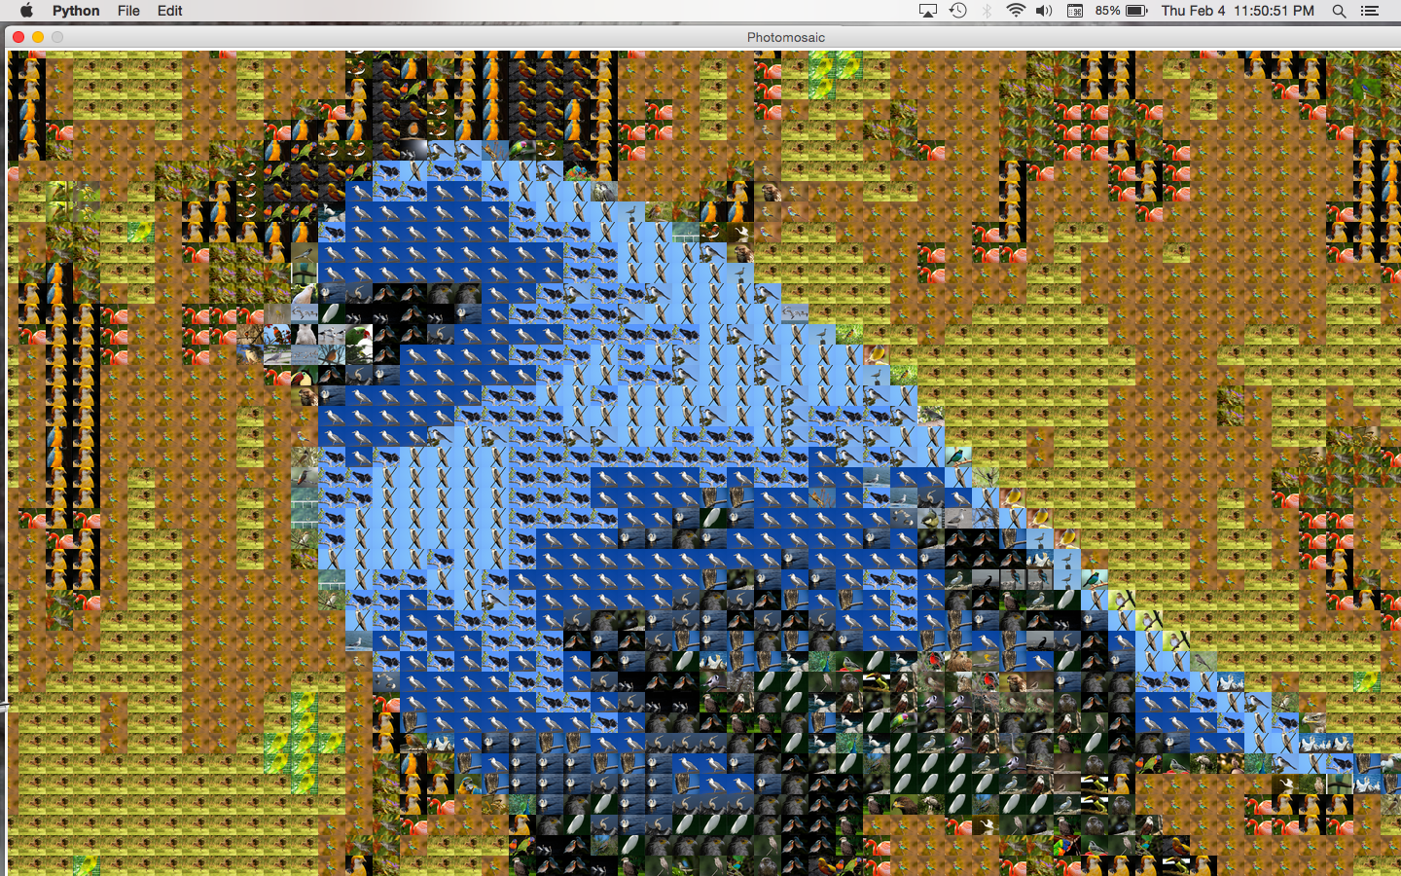
Class 7: Grammars and Semantics
Introduction to Computing: Explorations in Language, Logic, and Machines
cs1120 Spring 2016
David Evans
University of Virginia
Birdmosiac by Lindsay McMillan

Slide 2
Plan
Add date is today – make sure you are officially registered for class!
Project 1 Due Now
By Wednesday: cs101 Lesson 3
See notes/calendar for upcoming schedule
Today:
Binary Numbers, Languages
Parsing and Meaning

Slide 3
Questions about Grammars
Given grammar G, what language does it produce?
Given grammar G with starting nonterminal S
and surface form t, how can G produce t from S?
Given grammar G with meaning rules, starting nonterminal S, and surface form t, what is the value of t?

Slide 4
Parsing
Given grammar G with starting nonterminal S
and surface form t, how can G produce t from S?
3 + 4 * 5

Slide 5
SyntaxError means the Python interpreter was not able to parse the code.

Slide 6
Semantics
Given the parse tree for a surface form t, what is the value of t?
3 + 4 * 5

Slide 7
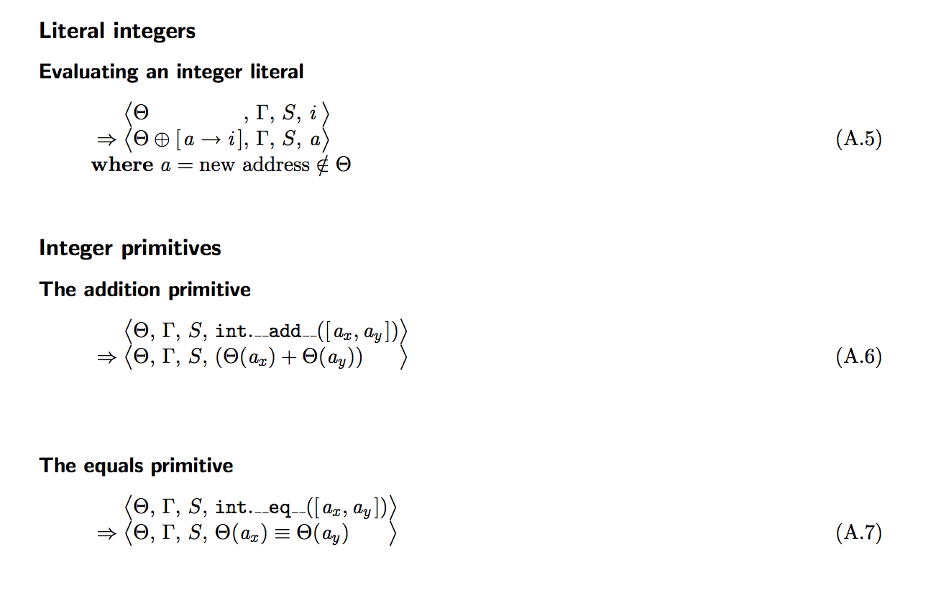
Formal Semantics
Don’t worry! You will not be expected to be able to read or write notations like this!

Slide 8
https://docs.python.org/3/reference/lexical_analysis.html#literals

Slide 9
https://docs.python.org/3/reference/lexical_analysis.html#literals
Integer ::= BinInteger
BinInteger ::= 0b BinDigit⁺
BinDigit ::= 0 | 1

Slide 10
https://docs.python.org/3/reference/lexical_analysis.html#literals
Integer ::= BinInteger
BinInteger ::= 0b BinDigits
BinDigits ::= BinDigits BinDigit
BinDigits ::= BinDigit
BinDigit ::= 0 | 1

Slide 11
Value of Binary Numbers
0b1
0b10

Slide 12
0b1111

Slide 13
Expressiveness of BinDigits
BinDigits ::= BinDigits BinDigit
BinDigits ::= BinDigit
BinDigit ::= 0
BinDigit ::= 1
Are they any strings of 0s and 1s that cannot be produced by this grammar?
How useful is the language described by these rules?

Slide 14
BinDigits ::= BinDigits BinDigit
BinDigits ::= BinDigit
BinDigit ::= 0
BinDigit ::= 1

Slide 15
National Security Agency’s Data Center in Utah
1 Yottabyte?

Slide 16
National Security Agency’s Data Center in Utah
1 byte = 8 bits
kilobyte = 1kB = 1000 bytes ∼ 2¹⁰ bytes
megabyte = 1MB = 1000 kB ∼ 2²⁰ bytes
gigabyte = 1GB = 1000 MB ∼ 2³⁰ byte
terabyte = 1TB = 1000 GB ∼ 2⁴⁰ bytes
petabyte = 1PB = 1000 TB ∼ 2⁵⁰ bytes
exabyte = 1EB = 1000 PB ∼ 2⁶⁰ bytes
zettabyte = 1ZB = 1000 EB ∼ 2⁷⁰ bytes
yottabyte = 1YB = 1000 ZB ∼ 2⁸⁰ bytes
~50 PB – all writing produced by humanity for all time
5 EB – all words ever spoken by humans

Slide 17
1 byte = 8 bits
kilobyte = 1kB = 1000 bytes ∼ 2¹⁰ bytes
megabyte = 1MB = 1000 kB ∼ 2²⁰ bytes
gigabyte = 1GB = 1000 MB ∼ 2³⁰ byte
terabyte = 1TB = 1000 GB ∼ 2⁴⁰ bytes
petabyte = 1PB = 1000 TB ∼ 2⁵⁰ bytes
exabyte = 1EB = 1000 PB ∼ 2⁶⁰ bytes
zettabyte = 1ZB = 1000 EB ∼ 2⁷⁰ bytes
yottabyte = 1YB = 1000 ZB ∼ 2⁸⁰ bytes
4TB Drive
~ $100 (retail)
At $10/TB, it would cost $10T to store a yottabyte!

Slide 18
Why on earth would the NSA want to store a yottabyte?!??

Slide 19
Meaning (in Decimal) of BinLiteral

Slide 21
Charge
Try Test example on Notes on your own
Upcoming Office Hours:
Tuesday, 3:30-4:30pm (Dave, Rice 507)
Wednesday, 4-5pm (Yuchi, Rice 514)
Thursday, 11am-noon (Dave, Rice 507)
Friday, 2-3pm (Yuchi, after class)

