Slide 1
Class 8: Procedure Practice
Introduction to Computing: Explorations in Language, Logic, and Machines
cs1120 Spring 2016
David Evans
University of Virginia
Patriotic Trees by Masha Prokhorenko

Slide 2
Plan
If you have not yet completed the White Belt level, make sure to do so by Wednesday! (Email me or talk after class about your options.)
Procedures and Functions
Project 1
Wednesday: finish cs101 Lesson 3 before class
(Not expected to do last two problems in Lesson 3: Problem Set)

Slide 3
Project 1: is_brighter
“function”, “procedure” or both?

Slide 4
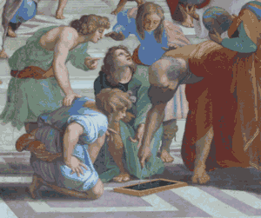
What is a “function”?
(in mathematics)

Slide 5
What is a “function”?
(in Python)

Slide 6
What is a “function”?
Anything you make with
def name(…):
...
Can you make a Python function that is not a mathematical function?
(in Python)

Slide 7
is_brighter (Version 1)

Slide 8
is_brighter (Version 1)

Slide 11
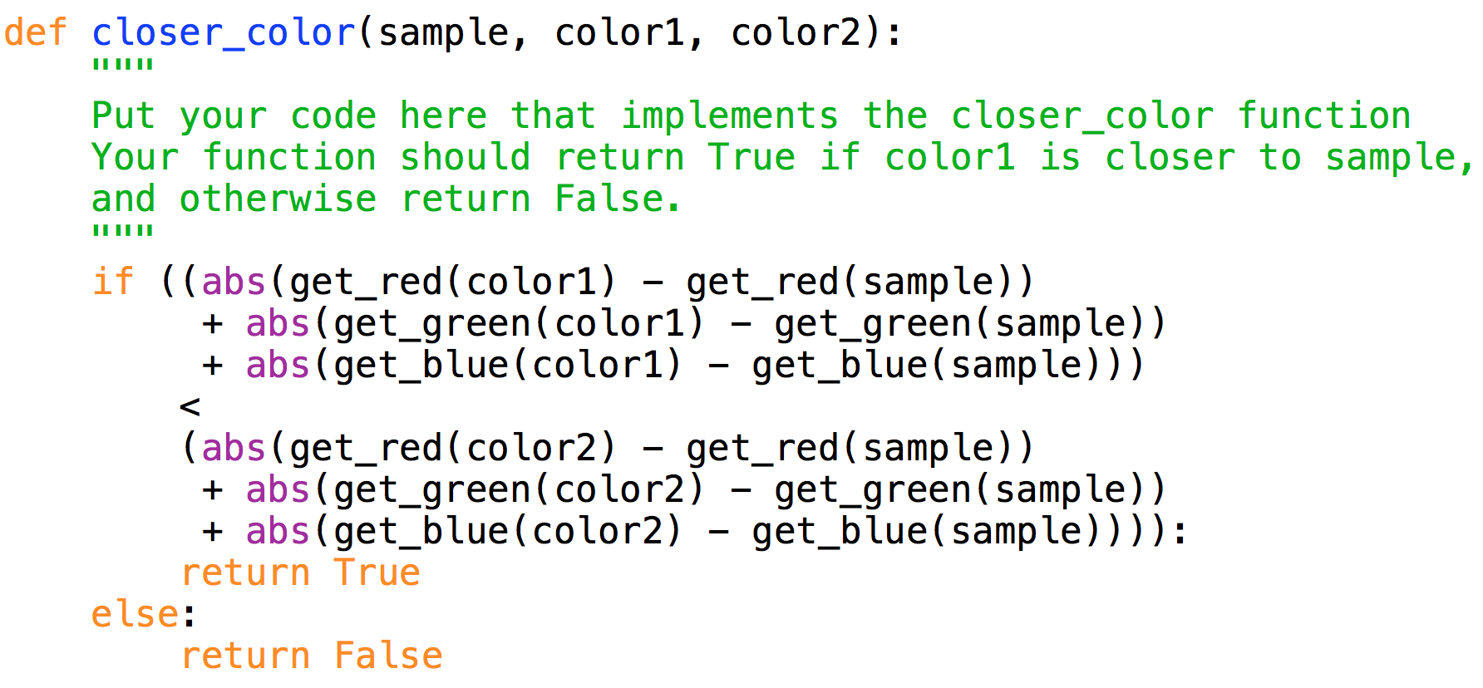
closer_color (Version 1)

Slide 12
closer_color (Version 1)

Slide 13
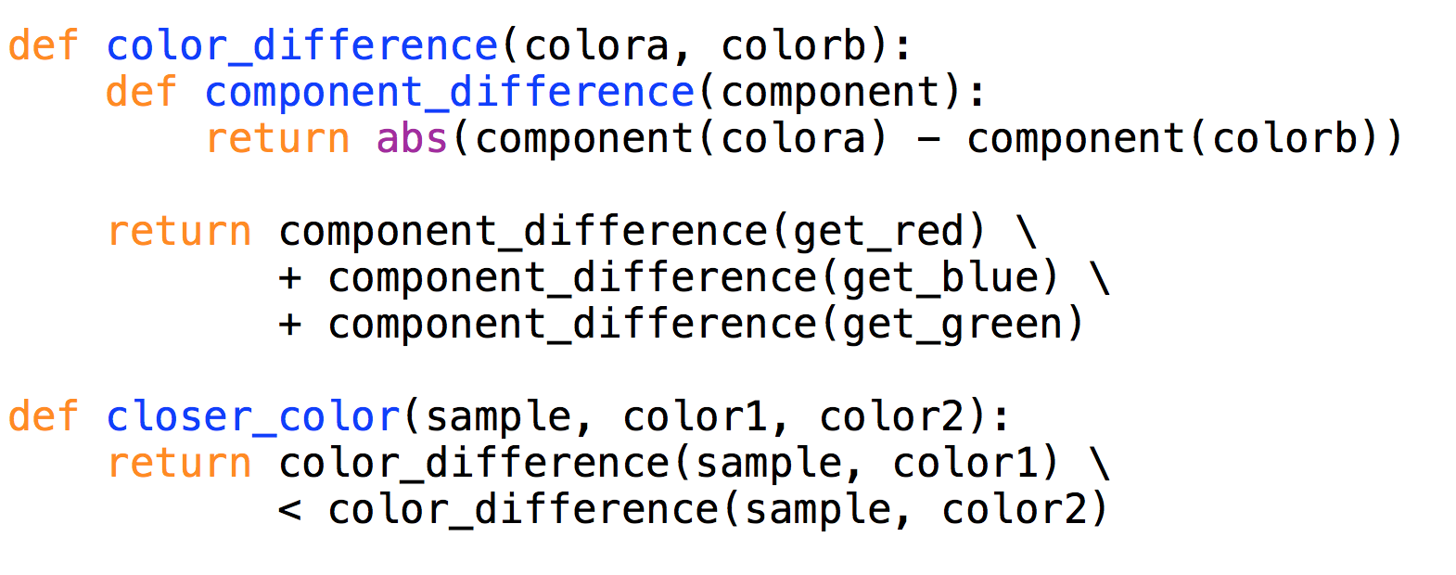

Slide 14
Projects Grading Scale
Gold Star – Excellent Work
Green Star – Got most things I wanted No Star – Some serious problems
If you got a Gold Star, you have earned you Yellow Belt!
Average: 

Slide 15
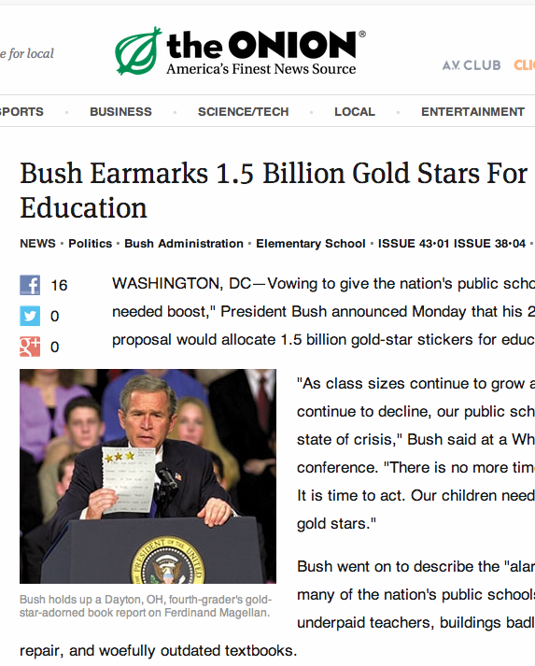
Unbounded Expectations!
 - exceptional work
- better than I
thought possible
- breakthrough!
- deserve a
Turing Award!

Slide 16
Charge
Finish Udacity cs101 Lesson 3
Get started on Project 2
Upcoming Office Hours:
Tuesday, 3:30-4:30pm (Dave, Rice 507)
Wednesday, 4-5pm (Yuchi, Rice 514)
Thursday, 11am-noon (Dave, Rice 507)
Friday, 2-3pm (Yuchi, after class)

