Slide 1
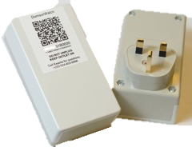
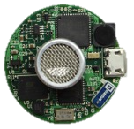
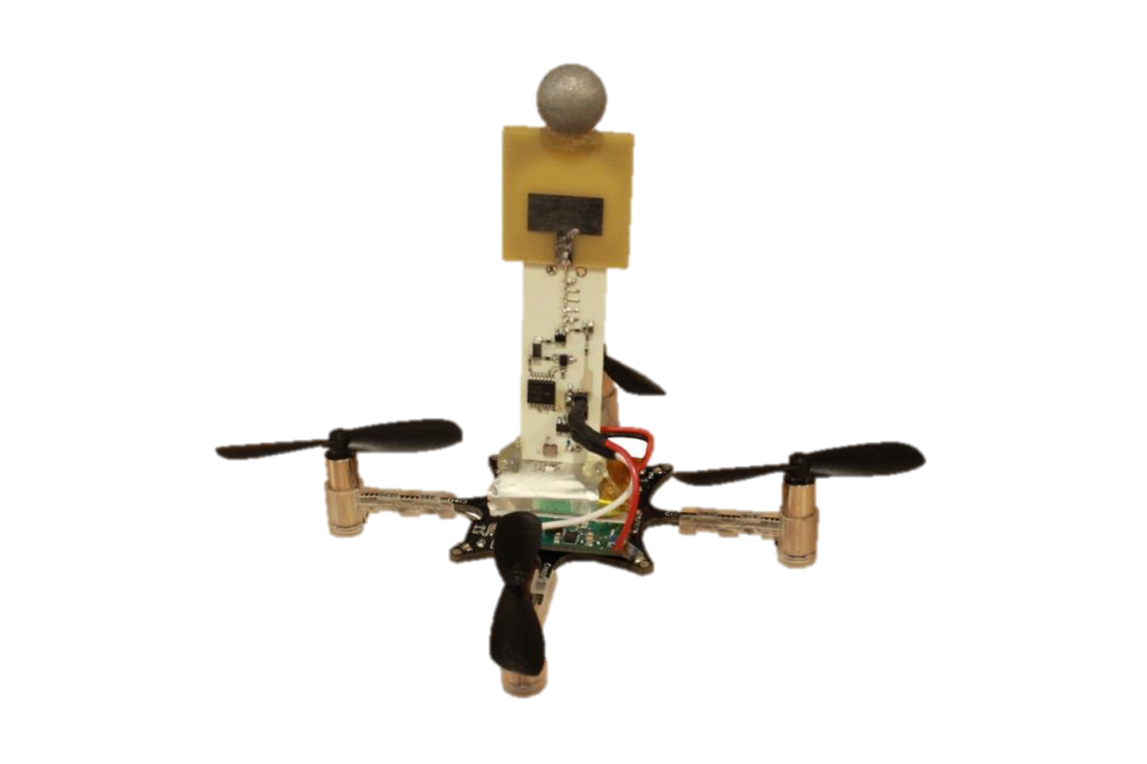
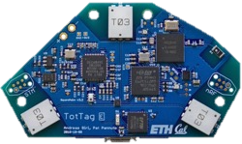
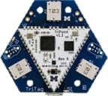
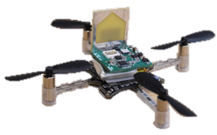
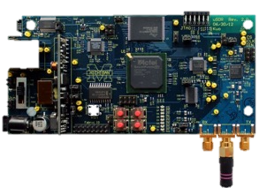
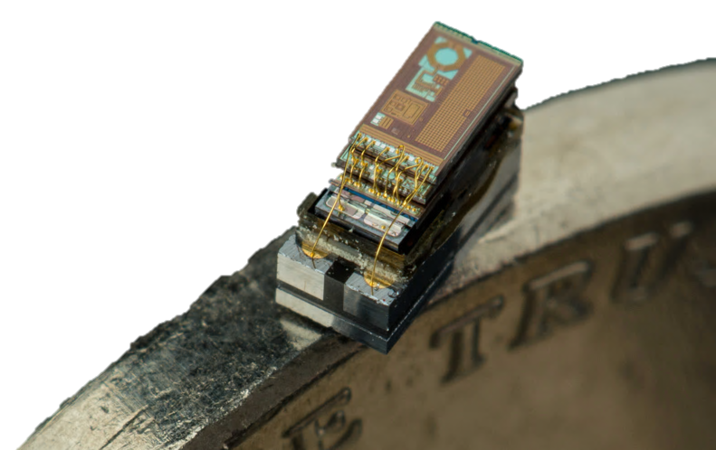
Wireless for the Internet of Things
CS/ECE 4501
Spring 2023
UVA
[Pannuto, Ghena, Campbell]

Slide 2
Today’s Goals
Give you a flavor of what you will learn this semester
Let you know what to expect in this class
Answer your questions

Slide 3
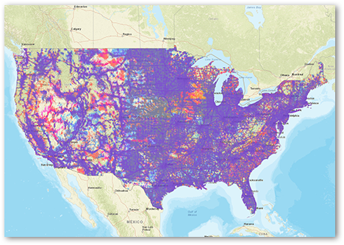
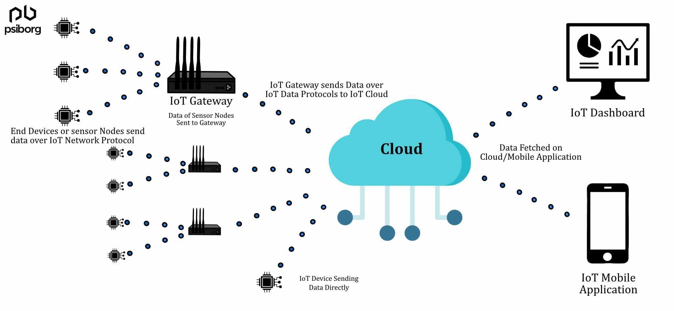
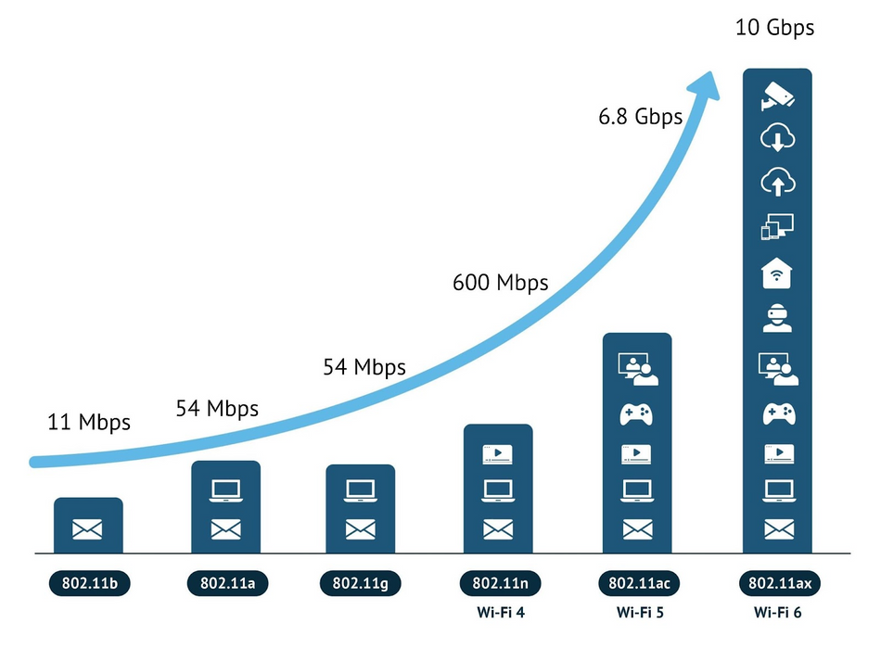
Wireless: a defining technology of the last 30+ years
LTE Coverage
Do you own a computer that isn’t wireless? Do you know of any computers without wireless?
WiFi

Slide 4
What does this slide say?

Slide 5
What does this slide say?

Slide 6
And this one?

Slide 7
What about now?

Slide 8
👍♋■ ⮹□◆ ❒♏♋♎ ⧫♒♓⬧ ⬧●♓♎♏✍

Slide 9
APOVLQIZNLCLSMNFPURPCVUAIOQVCPQJLXPENXPPQWJKCI

Slide 10
class wireless we labs in projects . learn this with and

Slide 11
niektóre protokoły bezprzewodowe są lepsze niż inne
Notes:
Anyone speak Polish?

Slide 12
How do you know what this slide says?

Slide 13
Computers face many of the same communication challenges we do
Layers for human communication
Visual or audio signals (and others)
Signal vs. noise
Symbols and sounds
Alphabet
Language
Grammar
Computers use layers for communication as well.
This class: what are the layers?
Importantly: why those layers?

Slide 14
Perspective of this course
This class is about wireless protocols
For a specific domain: the Internet of Things
So we’ll spend some amount of time discussing the Internet of Things and embedded systems

Slide 15
What is the IoT anyway?
Perhaps another good place to start
Let’s define “Internet of Things”
Notes:
Write properties that define IoT

Slide 16
Discussion: what is the Internet of Things?
Name a few Internet of Things devices
What are the qualities that designate those devices at “IoT”?

Slide 17
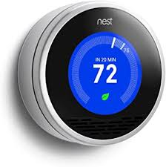
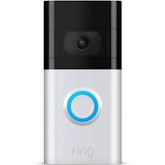
Discussion: what is the Internet of Things?
Name a few Internet of Things devices
What are the qualities that designate those devices at “IoT”?

Slide 18
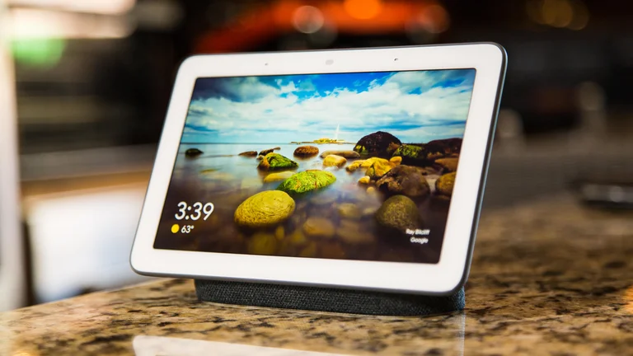
Thought experiment on capabilities
What if the Nest thermostat was powered by…
a desktop: 8-core x86-64 processor, 32 GB RAM, 1 TB SSD
a laptop?
an iPad?
Would that still count as IoT?
Why don’t we see “desktop IoT” in practice?
“Google Nest Hub”

Slide 19
Thought experiment on energy
IoT devices include a mix of batteries, wall power, (and energy-harvesting)
Why do we put so much focus on systems with batteries?
Why do they need batteries?

Slide 20
The two hardest things in embedded systems / IoT are power and communication
This class is about wireless technologies
For resource-constrained systems, such as the IoT
We will focus on the tradeoffs between technologies
How they balance differing constraints
Power, spectrum, complexity, etc.
And the technical foundations of these designs and differences

Slide 21
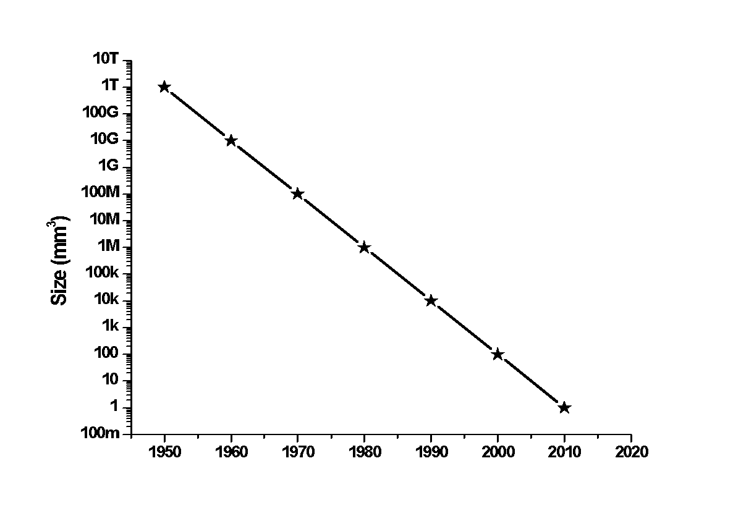
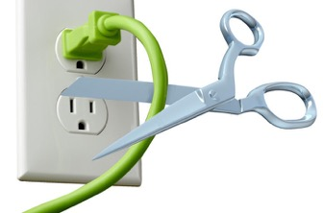
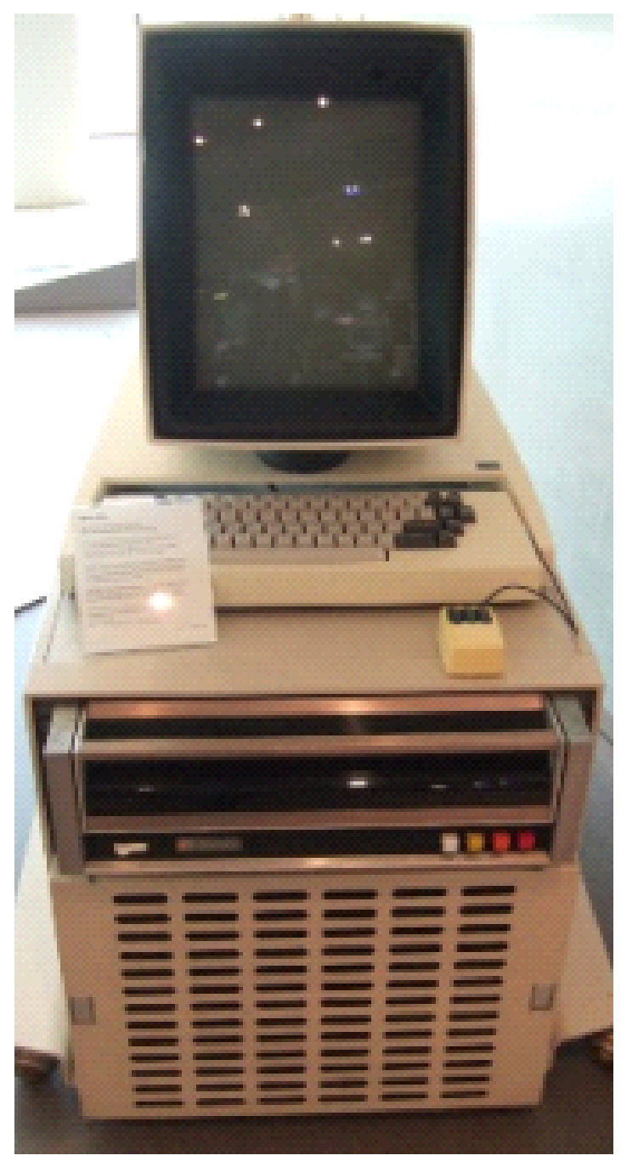
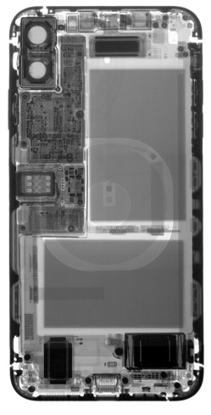
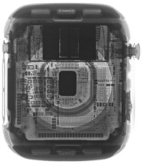
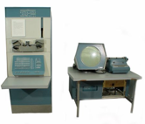
Energy is the defining constraint of emerging technologies
Mainframe
Computer
Workstation
By volume, the emerging computing classes are mostly energy storage
Volume is shrinking cubically
Laptop
Mini Computer
Battery
IoT/Wearable
Personal Computer
Smartphone
Notes:
Defining feature of modern computing classes is the amount of energy storage required to allow their operation
Clip art: http://www.ctecsolar.com/cut-cord-electric-company/
X-rays: iFixit teardowns

Slide 22
Internet of Things
“Expanding the reach of digital world”
Key features
Computation
Local to the device
With some capability for arbitrary compute and storage
Connectivity
Almost certainly wireless
Likely Internet, possibly local
Interaction
Sensing or Actuation
Secondary features
Low energy
(Relatively) Low cost

Slide 23
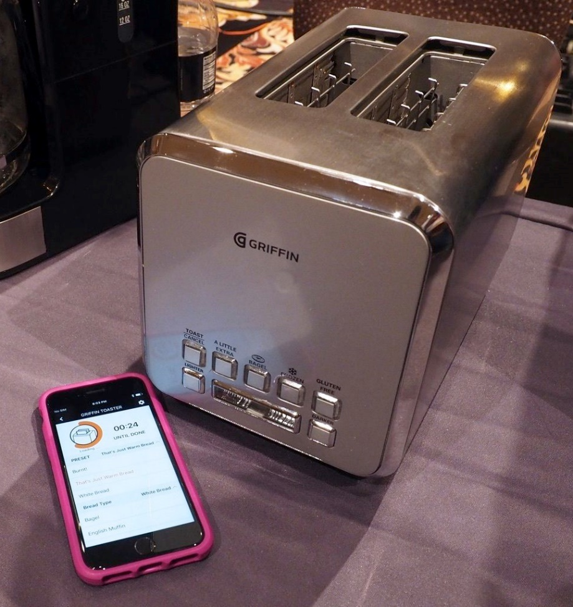
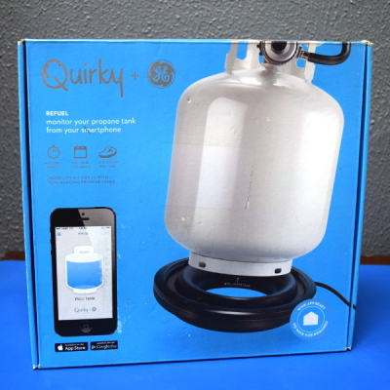
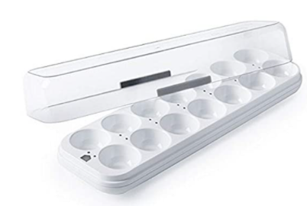
Warning: Internet of Crap

Slide 24
Internet of Insecure Crap
Mirai botnet (2016)
Takes control of up to 600,000 insecure connected devices
IP-attached cameras, DVRs, routers, printers
Used to DoS websites

Slide 25
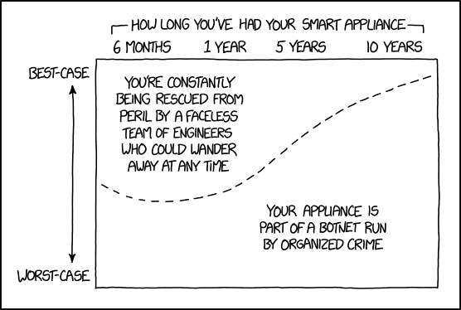
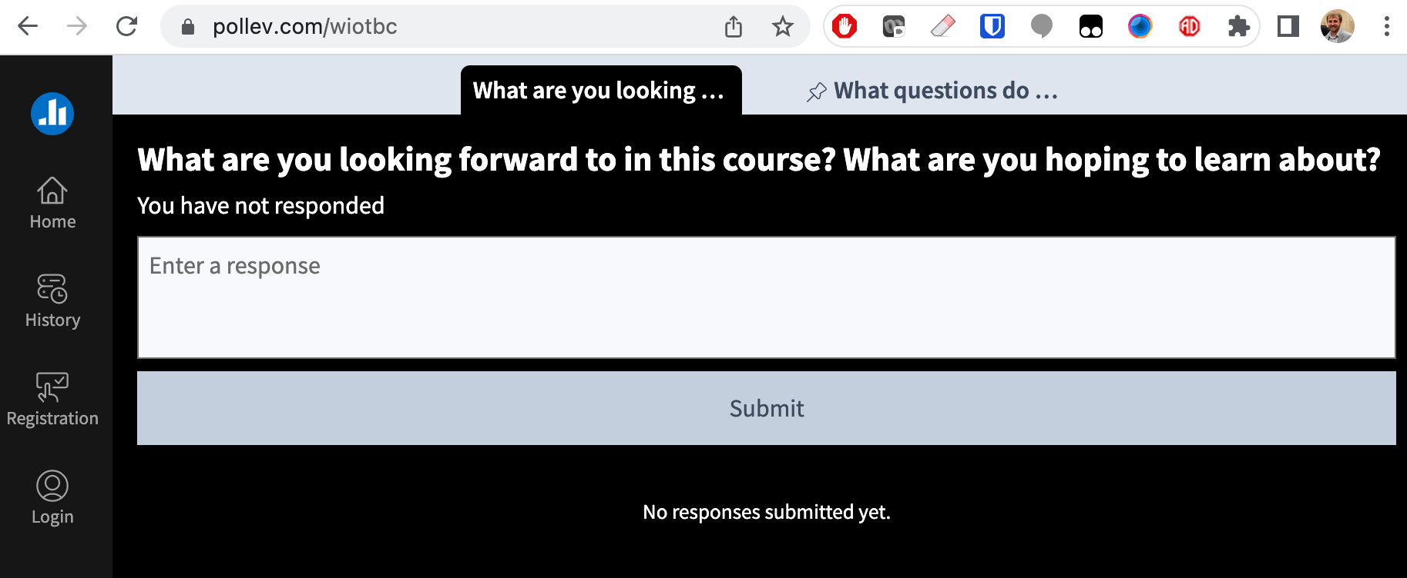
word cloud + xkcd
pollev.com/wiotbc
https://xkcd.com/1966/

Slide 26
Introductions: Brad Campbell
Assistant prof. in CS & ECE depts.
Moved to Charlottesville and joined UVA in 2017
Grew up in Michigan, Ph.D. from University of Michigan
Office in Link Lab (241 Olsson)
A couple things I enjoy
Living a half hour from Shenandoah
Riding my scooter to work
New restaurants
Running (kinda)

Slide 27
Introductions: Nabeel Nasir
PhD Student in CS
Works in the Link Lab
From Kerala, a small coastal state in the south of India
Master’s from IIT Bombay
2 years at Adobe, 8 months at EnLite Research (an IoT startup)
Random stuff I like:
Ping Pong
Hiking, National Parks!
Watching soccer. Big Tottenham Hotspur fan!

Slide 28
CS/ECE 4501 Wireless for the Internet of Things
You will learn the most influential wireless protocols used by IoT devices
Ex: BLE, Zigbee, LoRa, WiFi, Thread, Matter
Technically, this is a networking course focused on wireless networks
Things we won’t cover
Digital wireless communication and the physical layer (take ECE 4784)
Transceiver hardware design (take ECE 4501-Low Power Wireless Transceivers for IoT)
Internet networking and TCP/IP (take CS/ECE 4457)
This is an experience- and design-oriented course
Experience comes from labs and assignments
Design comes from final project
Lectures give you the foundation to understand what you are doing and how to make design decisions
Minute-Quizzes keep you honest on lecture material

Slide 29
Quick Logistics
Most content is on the course website
https://www.cs.virginia.edu/~bjc8c/class/cs4501-s23/
Assignments & grades on Canvas
This is an advanced course
Target is upper-level undergraduate students
This is also a new / experimental course
Please bear with us, there will likely be hiccups along the way
We will use Gradescope to submit assignments
We will use Slack for discussion

Slide 30
Co-teaching
We are teaching this course together
Splitting the teaching responsibilities
We will take lead on different topics/assignments
Our goals
To help you learn about wireless protocols
To support you throughout the semester
Please let us know how we can help you
SDAC accomodations

Slide 31
Highlights from the syllabus
Note: you need to read the actual syllabus!
In class:
Mondays: Lecture and discussion about IoT communication technology
Wednesdays: In-class labs
Assignments will extend the labs
One in-class exam about 2/3 through the course
Homeworks are practice for the exam
Final project
All labs (almost) and assignments, plus final project in teams of 3

Slide 32
Asking questions
In class
Office hours!
Both instructors plus TAs
Slack
Post questions
Answer each other’s questions
Information from the course staff
Post private info just to course staff

Slide 33
Collaboration policy Labs: Yes, please!
Labs are highly collaborative
You cannot talk to each other too much, help each other out in the labs
One Rule: Hands on your own keyboards
Don’t copy/paste stuff
Don’t do things for someone else, explain how to do it
(As a team) write up your pre-labs, post-lab reports with all your own work

Slide 34
Collaboration policy Assignments + Final project: in your teams
Assignments and final project are done with your team
Your team can talk to others, but don’t write anything down or look at anything they have written down

Slide 35
Collaboration policy Homework + Exam: individual
These are done on your own
You can talk to others, but don’t write anything down or look at anything they have written down
You are encouraged to study for the exam together

Slide 36
Labs
Semi-guided efforts of getting wireless communication working on real hardware
Wireshark
Bluetooth
802.15.4
WiFi
LoRa
Designed to be completed in class
Reports or lab deliverables due one week after lab

Slide 37
Pre-Labs
Absolutely essential to success in lab
Lab time is limited (just 75 minutes!)
Must have pre-lab complete before lab to make lab successful
Pre-labs are due by the start of lab, no exceptions, no make-ups

Slide 38
Assignments
Assignments build upon the labs
Example activities in assignments:
Continue building a wireless device
Deploy a device somewhere to collect data
Analyze the performance of your device
Form networks with your wireless devices
Typically due two weeks after the relevant lab

Slide 39
Final Project
Larger project that integrates various wireless protocols you have learned
More open-ended than the assignments
We will provide a few ideas
Or your group can pursue your own idea
More details later in the semester
Our final exam slot (May 4) will be a demo/project share day

Slide 40
Hey, what about that mini-quiz thing you snuck in there?
Lecture will begin with a "minute-quiz”
These will be (very) short and will cover material from the prior lecture, or possibly pre-lab, lab, post-lab, homework or other assignment
You should not need to study or worry about these – if you were there and paying attention, you'll be prepared
Grading
Half points for just completing the quiz
Half points based on correct answers
Only need 75% of points over the semester for full credit

Slide 41
Interlude
You have two minutes for everyone in the room to tell me your birthday (month and day)
Verbally
I have to be able to understand each birthday
If you hear me say your birthday then your job is complete
Take one minute to strategize

Slide 42
How to succeed in this course
Attendance is required
In-class labs and team work requires you be physically here
Reach out to us if you are struggling or need help
We want you to succeed
Be prepared to write embedded C code
But, this isn’t an embedded programming class
Establish a strategy for collaborating in your group
Labs and assignments will often have multiple roles

Slide 43
pollev.com/wiotbc
What percentage of your grade is labs + assignments?

Slide 44
Example C code
// Locate the index of the segment within the buffer with the given identifier.
int find_segment(uin8_t* buf, int len, uint8_t identifier, int* pos) {
int index = 0;
while ((index+2) <= len) {
uint8_t segment_length = buf[index];
uint8_t segment_id = buf[index + 1];
if (segment_id == identifier) {
*pos = index;
return 0;
}
index += (int) segment_length;
}
return -1;
}

Slide 45
Questions?
Note: HW1 due next week
Meant to be a review
Still somewhat challenging

