Slide 1
Wireless for the Internet of Things BLE Connections
CS/ECE 4501
Spring 2023
UVA
[Pannuto, Ghena, Nasir]

Slide 2
Today’s Goals
Explore how connections work
What does the link layer look like?
How do higher layers interact to share data?
Investigate network questions about connections
Overview of additions in BLE 5.0

Slide 3
Recall: BLE advertisements lead to connections
Advertisement:
“I’m the Living Room Light”
Connection Request
Central
Connected (stops advertising)
Peripheral
“Set light brightness to 50%”
(note: this is highly simplified)
We’ll explore what happens here!
Notes:
Advertiser
Scanner
Central
Peripheral
https://community.nxp.com/t5/Wireless-Connectivity/A-view-on-Bluetooth-Low-Energy-stack-roles/m-p/380310

Slide 4
Outline
Connection PHY and Link Layer
Connection Investigations
GATT
BLE 5

Slide 5
BLE Connections: A 10,000ft view
Higher throughput than advertisements
Supports bi-directional communication
Half-duplex (“one person talks at a time”)
During a connection both devices act like servers
Can read/write fields available on other device
Roles – simple view
Peripheral: can be advertising/in connection
Central: scanning / in 1 or more connections
Not quite accurate: devices can have many roles simultaneously
Advertisement:
“I’m the Living Room Light”
Peripheral
Phone: Hey, please set brightness
to 75%.
Light: Sure thing!
Central
(write)
(read)
Phone: What’s the current color?
Light: It’s blue.
Notes:
Simple view
A peripheral is either advertising or in a connection
A central is scanning and in one or more connections
(Remember: actually false, devices can have many roles simultaneously)

Slide 6
Once connected, BLE has PHY options with more throughput
LE 1M (default)
Symbol rate: 1 Msym/s (Mega symbols / second)
BLE encodes 1 bit / symbol, so this is also 1 Mbit/s
LE 2M
2 Msym/s
LE Coded
1 Msym/s + Forward Error Correction (FEC)
S = 2 (2 symbols correspond to 1 bit)
½ effective data rate – 500 Kbit/s goodput (~2x range)
S = 8 (8 symbols correspond to 1 bit)
125 Kbits/s goodput (~4x range)
1
0
1
0
1
Each of these are symbols
FSK Example
Notes:
The mandatory symbol rate is 1 megasymbol per second (Msym/s), where 1 symbol represents 1 bit therefore supporting a bit rate of 1 megabit per second (Mb/s), which is referred to as the
LE 1M PHY. The 1 Msym/s symbol rate may optionally support error correction
coding, which is referred to as the LE Coded PHY. This may use either of two
coding schemes: S=2, where 2 symbols represent 1 bit therefore supporting a
bit rate of 500 kb/s, and S=8, where 8 symbols represent 1 bit therefore
supporting a bit rate of 125 kb/s. An optional symbol rate of 2 Msym/s may be
supported, with a bit rate of 2 Mb/s, which is referred to as the LE 2M PHY. The
2 Msym/s symbol rate supports uncoded data only. LE 1M and LE 2M are
collectively referred to as the LE Uncoded PHYs. Section 3.2.2 describes this
terminology in more detail
Binary frequency shift keying encodes digital data by selecting a central frequency known as the carrier and then shifting it up by a given frequency deviation to represent a 1 or
down by the same frequency deviation to represent a 0. The minimum size of the
frequency deviation that is permitted is specified in the Bluetooth® Core Specification and depends on the selected symbol rate, which is either 1 or 2 mega-symbols per second (Msym/s) in Bluetooth LE. For the 1 Msym/s symbol rate, a minimum frequency deviation of 185 kHz is specified, whereas for the faster symbol rate, the minimum frequency deviation is 370 kHz. These values were chosen carefully, to help make the recognition of encoded 1s and 0s in a signal reliable.

Slide 7
BLE uses 2.4 GHz ISM Band with Data and Advertisement Channels
Recall: Each BLE channel is 2 MHz wide, 40 channels (0-39)
3 channels for advertising (37, 38, 39)
37 channels for connections (0 - 36)
Notes:
Source: https://i0.wp.com/embeddedcentric.com/wp-content/uploads/2019/03/bluetooth_ble_spectrum.png?ssl=1

Slide 8
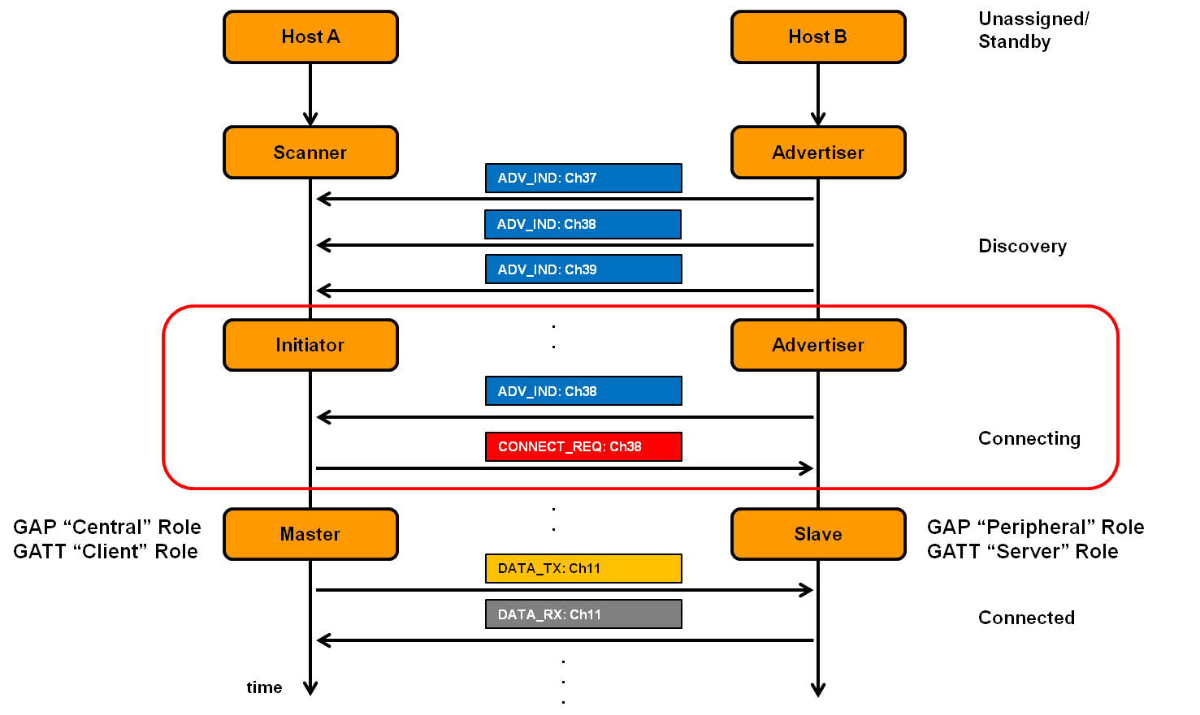
Connection Timeline
Peripheral advertises
Central sends a connection
request packet on advertising
channel just after receiving
advt
Peripheral stops advertising
Central and peripheral switch
to a data channel
Notes:
- Animate
- Change text to annotations

Slide 9
Choosing a data channel for communication
Why do you switch from advertising channel to data channel?
How to pick a channel out of the 37 data channels?
What if two pairs pick same channel?

Slide 10
Choosing a data channel for communication
Why do you switch from advertising channel to data channel?
For better reliability and to improve quality of service
How to pick a channel out of the 37 data channels?
Randomize for reduced chance of collision
What if two pairs pick same channel?
Higher chance of collision occurring
Some way to not be tied to the same data channel is needed

Slide 11
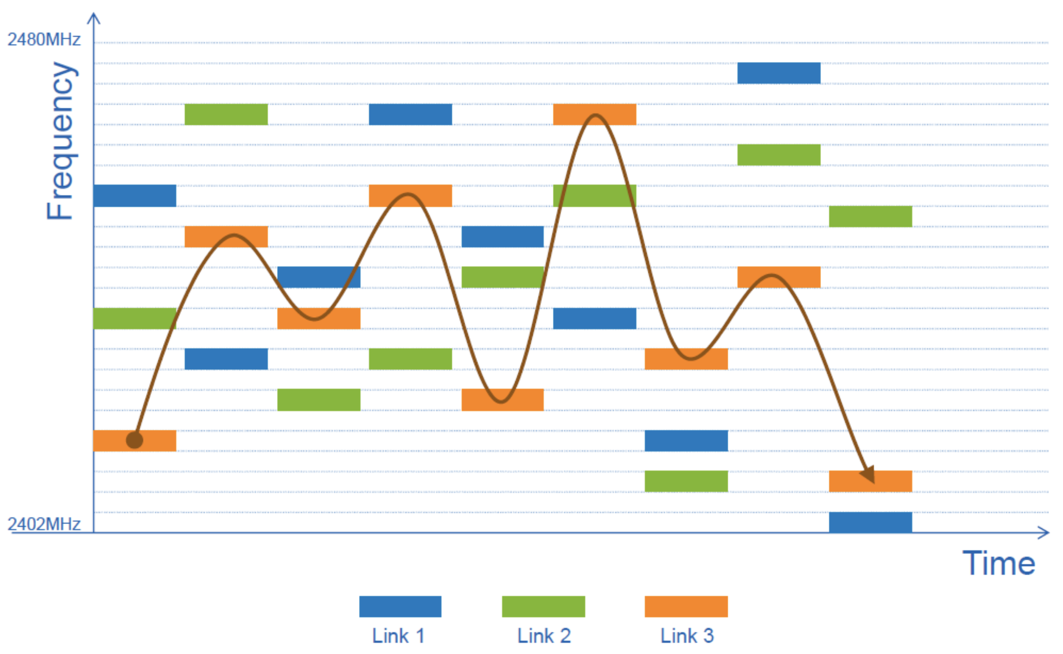
Connected devices hop through channels to improve reliability
BLE is a Frequency Hopping Spread Spectrum (FHSS) technology
Central and peripheral “hop” among data channels in a pre-agreed fashion
Why? To avoid bad channels and reduce collisions
Next hop channel c_{n+1} = (c_{n} + hop) mod 37
Exact channels used in hopping and in
what order might vary

Slide 12
How does the Central and Peripheral agree on things?
For a packet to be received:
Central and peripheral should be listening and sending on same data channel
For the hopping to be successful, both must:
Follow same hop sequence
Which channels to use and the order to follow
Hop at a given time schedule
Agree on when to schedule their first communication
Some synchronization is needed!

Slide 13
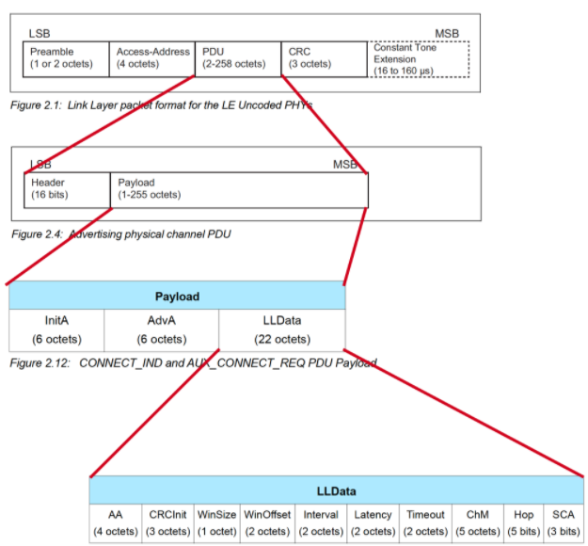
Send synchronization information in the Connection Request packet
Notes:
Note: CONNECT_IND is used in BLE 5.0, replaces CONNECT_REQ in BLE 4.x
https://www.silabs.com/documents/public/presentations/ew-2019-bluetooth-low-energy-beacon-next-generation.pdf

Slide 14
Connection request parameters examined
Specifies parameters of the connection
Peripheral must either agree or totally reject the connection
Peripheral can later propose a change to the connection parameters
Interval is how frequently connection events occur (7.5ms – 4s)
Notes:
Figure from video would be good

Slide 15
Steady-state connection timing
Connection Interval
Central to Peripheral
Peripheral to Central
Central to Peripheral
Peripheral to Central
Central to Peripheral
Peripheral to Central
Central to Peripheral
Peripheral to Central
Central to Peripheral
Peripheral to Central
Optional packets
Hop to next data channel
Some data can be exchanged at each interval
Might just be acknowledgements
Additional packets can be sent if there is a lot to transmit
Each interval is on the next channel in the hopping sequence
Peripheral can skip a number of intervals to save energy
Defined by the Latency connection request parameter

Slide 16
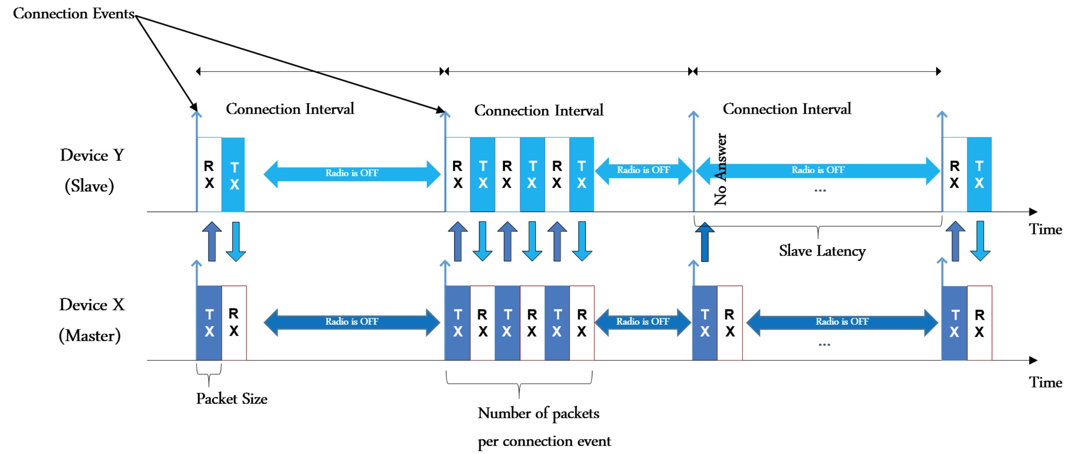
BLE connection “events” happen at periodic intervals
Hop to next data channel
(Peripheral)
(Central)
Notes:
Source: https://embeddedcentric.com/introduction-to-bluetooth-low-energy-bluetooth-5/
During a connection
Central sends a packet each “connection interval”
Peripheral immediately responds with a packet
Multiple packets may be exchanged this way until done
Repeat at next connection interval
Ending a connection
Either device sends termination packet
Timeout occurs on either device

Slide 17
How do you schedule the very first connection event?
WinSize and WinOffset specify start of the first connection event
First connection event: first exchange after CONNECT_REQ packet)
WinOffset: Time from now until first event
Analogy: “Hey let’s meet 2 hours from now”
WinSize: Flexible window of time to expect first transmission
Analogy: “I might be upto 15mins late”
Notes:
Figure from video would be good

Slide 18
WinSize, WinOffset, and Interval define TDMA schedule
Place an “anchor” point that defines the TDMA schedule for this device
Interval specifies duration between connection events starting at “anchor”
Central to Peripheral
Peripheral to Central
Central to Peripheral

Slide 19
How do you agree on hopping pattern?
Channel Map (ChM) and Hop define the FHSS pattern
Channel Map (ChM): Map of which channels to use
Hop: next hop increment
Next hop channel c_{n+1} = (c_{n} + hop) mod 37
Notes:
Figure from video would be good

Slide 20
Connection messages are sequenced for additional reliability
LLID – link layer ID
Empty data / Fragment
Data
Control
MD – more data (continues connection event)
[Next Expected] Sequence Number – acknowledgements

Slide 21
LL uses acknowledgments to handle packet loss and corruptions
SN: Sequence Number
Only two SN used: 0, 1
NESN: Next Expected Sequence Number
Equivalent to Acknowledgement
Case 1: Successful exchange of packets
Case 2: Re-transmission of missing packet
Case 3: Handling CRC failures
Notes:
Source: https://www.bluetooth.com/bluetooth-resources/understanding-reliability-in-bluetooth-technology/

Slide 22
Next steps in a connection
Control packets
Version
Bluetooth version, Company ID of Software Stack
Features
Various connection features supported by the device
Encryption, Ping, Channel selection algorithms, Various 5.0 features
Etc.
Extended packet length, Various 5.0 features (change PHY)
Various “procedures” for setting up changes in the connection
Data packets
Attribute discovery
Attribute reading

Slide 23
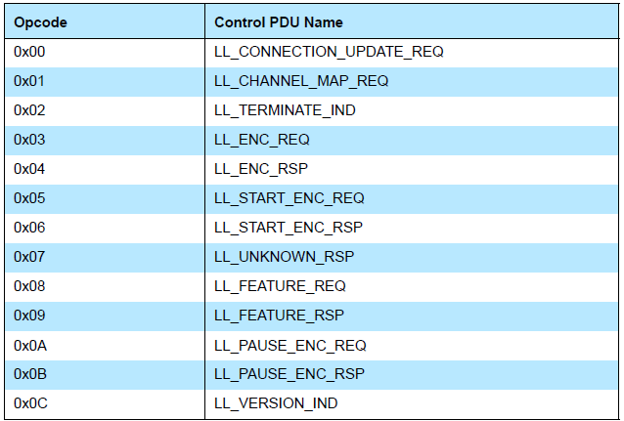
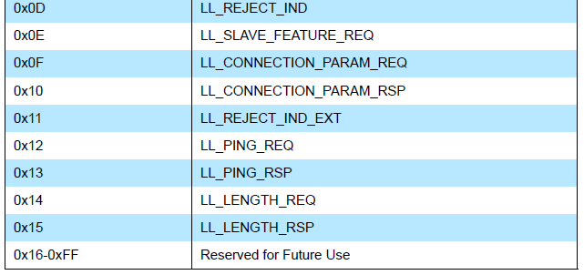
Control payloads
Examples:
Request update to connection parameters like interval (by peripheral)
Begin encrypting communication
Terminate a connection

Slide 24
Data payloads
SDU – Service Data Unit
Logical packet that may be split into several physical packets
Channel ID
Destination for data
ATTributes or Security
Can also make custom endpoints
Length (16 bits) | Channel ID (16 bits) | L2CAP SDU Length* (16 bits) | Information Payload (0 to 249 octets)

Slide 25
Ending connections
Termination control packet
Timeout is how long since hearing from a device before the connection breaks
Human-based devices may just wander away from each other
Or be shut off, or reprogrammed, etc.

Slide 26
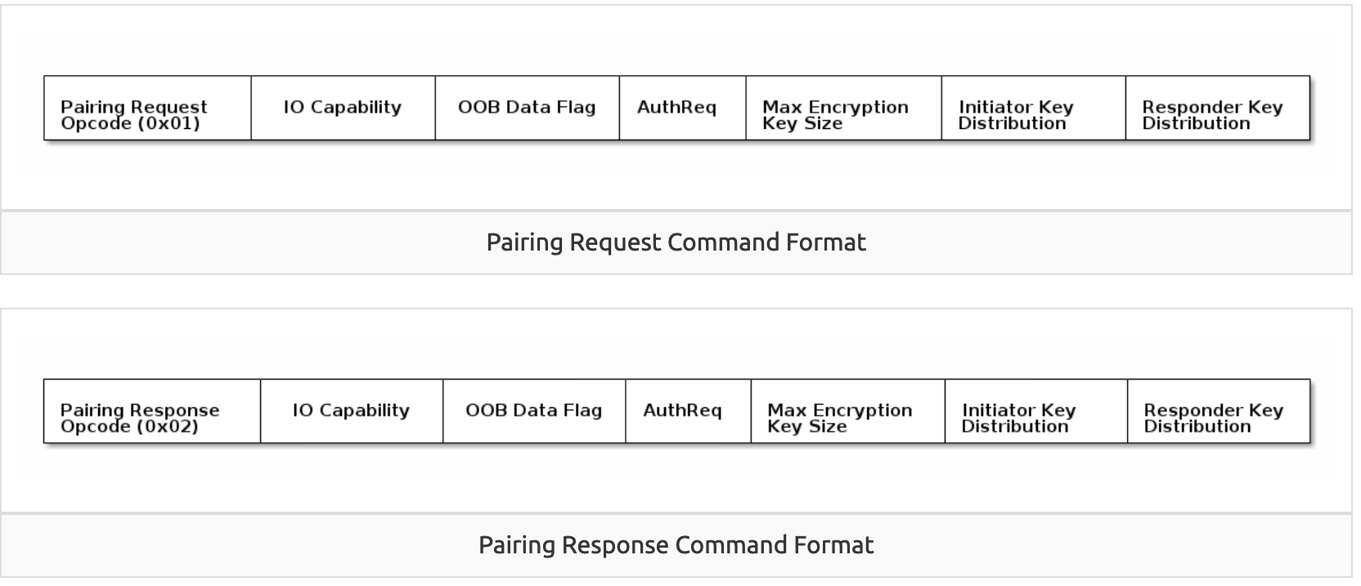
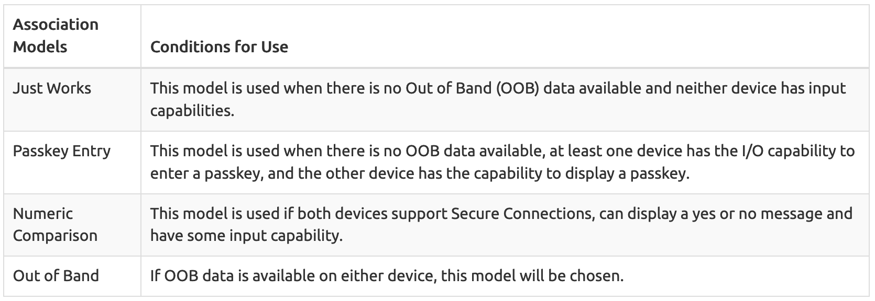
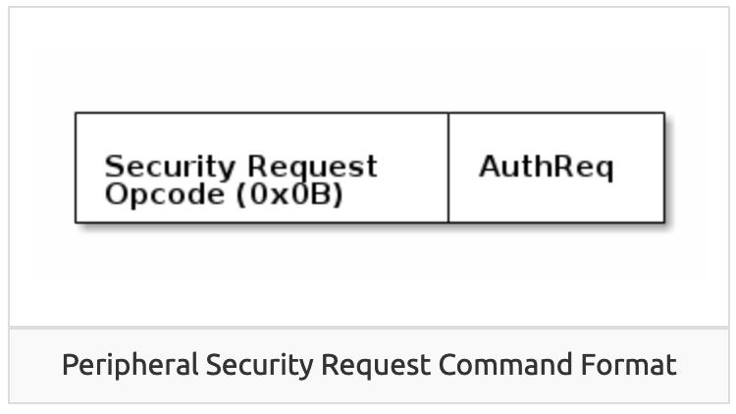
Very briefly: security in connections
Either side can request secure connection [central -> Pairing; peripheral -> Security Req]
“Bonding” saves pairing info between connections
Excellent TI resource here for more details: https://dev.ti.com/tirex/explore/node?node=AOPOY.GDApakIOYjiwoY6A__pTTHBmu__LATEST

Slide 27
Very briefly: security in addresses
All devices have a unique, hardware “Identity Address”, but may not share it
Public Address - Use the Identity Address. (The BDA never changes.)
Random Static Address - Generate a random address per power cycle. The address cannot be regenerated at any other time. Can be used as an Identity Address.
Resolvable Private Address (RPA) - Generate a random address with a given time interval. Generated using Identity Resolving Key (IRK) which can also be used by trusted peers (bonded devices) to resolve the Random Address to the Identity Address.
Non-resolvable Private Address - Generate a random address with a given time interval. Generated randomly. Cannot be resolved to an Identity Address.

Slide 28
Check your understanding
What makes connections more reliable than advertisements?
How does a Peripheral send data to a Central in a connection?
Why is a “termination” control packet useful?

Slide 29
Check your understanding
What makes connections more reliable than advertisements?
TDMA schedule and FHSS means less likely to collide
Each packet sent is acknowledged or resent
How does a Peripheral send data to a Central in a connection?
Wait until next connection interval
Respond to packet from Central with a data payload
Why is a “termination” control packet useful?
Timeout could delay for a while
Enables re-connection if desired

Slide 30
Break
xkcd.com/612/

Slide 31
Outline
Connection PHY and Link Layer
Connection Investigations
GATT
BLE 5

Slide 32
Questions about how a connection “network” works
How does TDMA MAC for connections work?
Implies a schedule
Implies synchronization
How many devices can be in a network?
How much throughput can a device have?

Slide 33
How is the TDMA schedule created/managed?
Only the central needs to know the schedule
It controls interactions with the peripheral(s) it is connected to
Anchor point and connection interval determines the schedule for a specific device
Central to Peripheral
Peripheral to Central
Central to Peripheral

Slide 34
How is synchronization managed?
Central sends first packet at each connection interval
So peripheral must be synchronized to central
Resynchronization can occur on each received packet
Specification describes how a peripheral must widen its listening window based on “Source Clock Accuracy”
$$windowWidening=\left(\frac{centralSCA+peripheralSCA}{1000000}\right)∗timeSinceLastAnchor$$

Slide 35
Clock drift is an energy burden due to large guard bands and energy cost of precise timekeeping
CC2520 Radio + AM18xx RTC:
300s * 2ppm * 2 = 1.2 ms guard
1.2 ms * 60 mW = 36 μJ (RF loss)
300s * 150nW = 45 μJ (RTC loss)
≈ 100 μJ loss / packet @ 300 s
1200 μs
@ 2ppm
Guard
Device time
(CC2520 is a 15.4 radio, but same idea applies) Max connection interval in BLE is 4 seconds
Static Power:
100 nW+
300 s
Wall time

Slide 36
How many devices can be connected?
We can schedule with granularity of at least 1.25 ms (offset steps)
That’s at least 800 devices per second
Intervals go up to 4 seconds, so multiply by four
That’s 3200 devices per max interval
Plus central can skip intervals on occasion without dropping the connection
And really the offset defines a window. More granularity is available
Answer: thousands of devices
Although each is sending minimum-sized packets each interval

Slide 37
How many devices can be connected in the real world?
The limit is much much lower on real devices
Example: Android sets a limit at around 4-15
nRF52 s140 softdevice allows up to 20
Connection management is often done in firmware
Softdevice for nRF, firmware on the radio chip in smartphones
Limited by memory and complexity

Slide 38
How much throughput can a device have?
1 Mbps?

Slide 39
How much throughput can a device have?
1 Mbps? Not even close. Packet overhead plus timing delays
Step 1: decrease connection interval as much as possible
More connection events per second mean more data
Range: 7.5 ms to 4.0 s
Somewhat device-specific configuration
Android allows 7.5 ms
iOS allows 15 ms

Slide 40
How much throughput can a device have?
Step 2, increase packet size
Use Data Length Extension (DLE) supported by BLE v4.2+
Notes:
https://punchthrough.com/maximizing-ble-throughput-part-3-data-length-extension-dle-2/
Connection event length = time duration where tx happens (different from connection interval)

Slide 41
How much throughput can a device have?
488 bytes per connection event
Maximum sized packets, discounting headers and timing delays
7 bytes of overhead / headers in the 251 bytes
Result: 520 kbps (65 kB per second)
iOS result 260 kbps
Original BLE 4.1 result on Android: 128 kbps
Lower in practice due to lost packets

Slide 42
Outline
Connection PHY and Link Layer
Connection Investigations
GATT
BLE 5

Slide 43
How is data actually exchanged between central and peripheral?
Attribute Protocol (ATT) and Generic Attribute Profile (GATT) used for this!
ATT is the underlying framework for GATT
Two roles: Client and Server
Data that the server exposes is structured as attributes
Attribute Protocol
Central
Peripheral
ATT Client
ATT Server

Slide 44
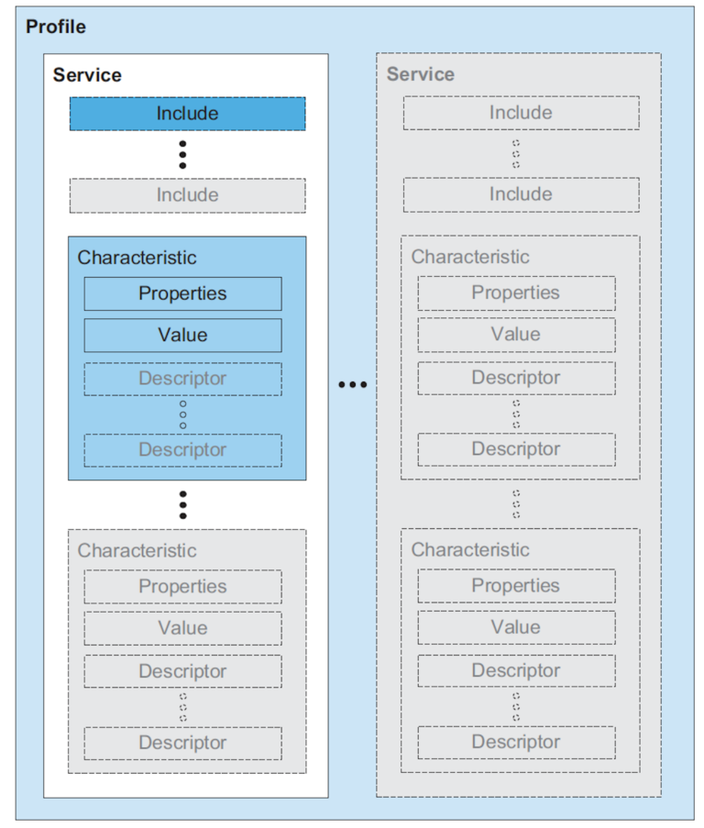
Attribute Server Keywords
Characteristic
A field with properties and a value
Descriptor: metadata about the characteristic
eg: Light Brightness
Service
Collection of characteristics
Profile
Collection of services
Each attribute has a type, permissions, and a value
Operations on attributes: Read, Write, Notify, Indicate

Slide 45
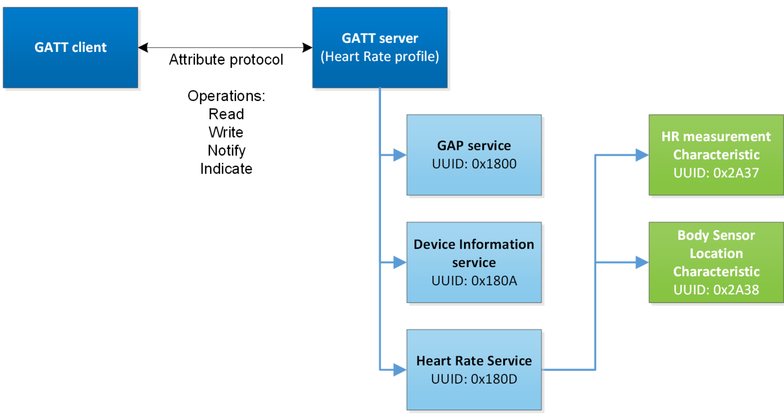
Overview of Generic Attribute Profile (GATT)
Attribute Type is specified as a UUID
Notes:
https://novelbits.io/bluetooth-gatt-services-characteristics/
A Notification is an unacknowledged message or update while an Indication is an acknowledged message or update. These Notifications and Indications are sent any time the relevant data in the GATT table on the GATT Server is updated. (You must "subscribe" to the data that you would like to be Notified or Indicated of) In a way Indications and Notifications are much like TCP and UDP packets. TCP requires that when data is sent, the receiver acknowledges that the data has been received by sending back an ACKnowledgement packet. UDP just sends off data without any concern whether it is actually confirmed to be received or not. In this sense Indications are akin to TCP and Notifications are akin to UDP.

Slide 46
UUIDs and handles
Universally Unique Identifiers
128-bit, mostly random with a few bits for versioning
Example: 00000000-0000-1000-8000-00805F9B34FB
This is the default BLE UUID for known services
You can generate your own UUID for custom services
Handles
Too long to pass around all the time, so pick 16 bits that mean that UUID
Must be unique among services/characteristics on that device
Taken from UUID: 0000xxxx-0000-1000-8000-00805F9B34FB
Handle often sequentially incremented for each new characteristic within a service
Resource: Useful post on identifying handles in the wild

Slide 47
How would our Smart Light expose its data?
Attribute Protocol
Central
Peripheral
ATT Client
ATT Server
Generic Access Profile Service (UUID: 0x1800)
Light Service (UUID: 0bd51666-e7cb-469b-8e4d-2742f1ba77cc )
service
Name (UUID: 0x2a00)
Brightness (UUID: 0xe7add780-b042-4876-aae1-112855353cc1)
Properties: Read
Properties: Read, Write
Value: Living Room Light
Value: 0.65
characteristic
Appearance (UUID: 0x2a01)
Color (UUID: 0xe7add780-b042-4876-aae1-112855353cc2)
Properties: Read
Properties: Read, Write
Value: 0x4142
Value: 00FFFF

Slide 48
Discovery
When a connection first occurs, each device can query the other for a list of services
And can further query for a list of characteristics in that service
Gets a list of handles/UUIDs
Standardized UUIDs can be interpreted immediately
Custom services/characteristics need documentation from the manufacturer

Slide 49
How would our smart light advertise its services?
Advertisement:
“I’m the Living Room Light. I have a GAP Service (0x1800), and a Light Service (…)”
Advertisement:
“I’m the Living Room Light”
Central
Peripheral
Notes:
Simple view
A peripheral is either advertising or in a connection
A central is scanning and in one or more connections
(Remember: actually false, devices can have many roles simultaneously)

Slide 50
Now you know how this interaction happens!
Higher throughput than advertisements
Supports bi-directional communication
Half-duplex (“one person talks at a time”)
During a connection both devices act like servers
Can read/write fields available on other device
Roles – simple view
Peripheral: can be advertising/in connection
Central: scanning / in 1 or more connections
Not quite accurate: devices can have many roles simultaneously
Advertisement:
“I’m the Living Room Light”
Peripheral
Phone: Hey, please set brightness
to 75%.
Light: Sure thing!
Central
(write)
(read)
Phone: What’s the current color?
Light: It’s blue.
Notes:
Simple view
A peripheral is either advertising or in a connection
A central is scanning and in one or more connections
(Remember: actually false, devices can have many roles simultaneously)

Slide 51
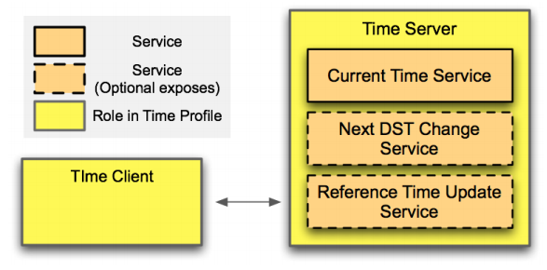
Example: Time Profile

Slide 52
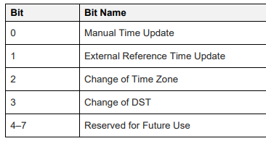
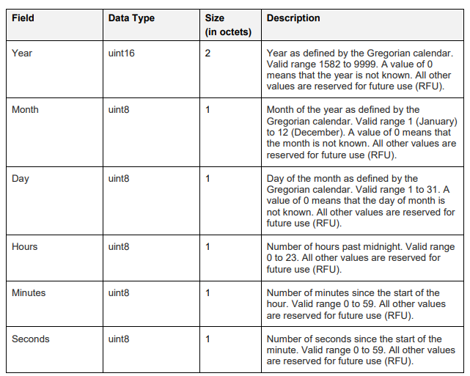
Current time characteristic
The Bluetooth SIG are pedantic people

Slide 53
Interacting with characteristics
Depends on their permissions
Readable, Writable, Notify-able, etc.
Notify
Automatically get a message sent whenever the characteristic value updates
Note: have to enable this on both sides, it’s not the default behavior
Long characteristics are automatically fragmented across multiple packets and/or connection events
L2CAP is in charge of this

Slide 54
Break + Example Services
https://btprodspecificationrefs.blob.core.windows.net/assigned-values/16-bit%20UUID%20Numbers%20Document.pdf

Slide 55
Documentation of GATT standards
https://www.bluetooth.com/specifications/gatt/
Various profiles and services that have been standardized
GATT Specification Supplement
Various characteristic definitions that have been standardized
Both incredibly specific and woefully inexhaustive

Slide 56
Break
xkcd.com/1892

Slide 57
Outline
Connection PHY and Link Layer
Connection Investigations
GATT
BLE 5

Slide 58
Changes in BLE 5
Major changes
Multiple physical layers
Advertising extensions
Minor changes
Various quality of life improvements
Examples:
Advertise on channels in any order
Better data channel hopping algorithm
Notes:
Hopping algorithms:
https://www.mathworks.com/help/bluetooth/ug/bluetooth-le-channel-selection-algorithms.html

Slide 59
Revised physical layers
2 Mbps PHY
Transmit data faster
Transmit more data in the same time
Coded PHY
Forward Error Correction in the data stream
1 bit -> 2 symbols or 8 symbols
Makes bits more reliable -> longer distance
500 kbps and 125 kbps modes
Connections can switch to these PHYs after creation
Advertisements can use these with extensions only

Slide 60
Coded PHY mixes physical and link layers
Different PHY settings at different times
Make beginning headers extra-reliable
Data might be slightly less reliable as a trade for faster speed
Packet sent with coded PHY

Slide 61
Revised processing path

Slide 62
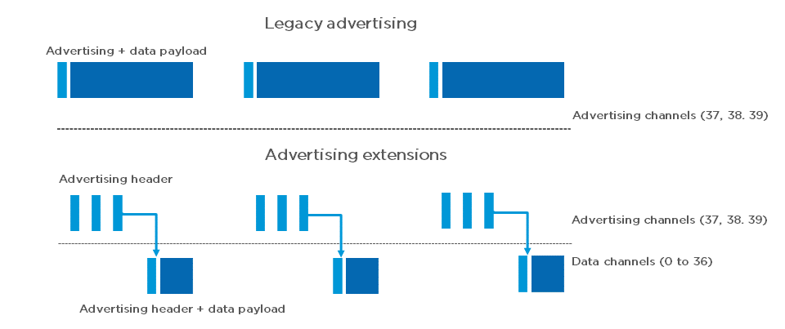
Extended advertising
Regular advertisements point to extended advertisements
Uses Data Channels to do so. Why?

Slide 63
Extended advertising
Regular advertisements point to extended advertisements
Uses Data Channels to do so. Why? Packet Collisions

Slide 64
Procedure for scanning extended advertisements
Scan on 3 primary channels for advertising packets.
If ADV_EXT_IND is scanned, record the secondary channel information (which channel and when etc.)
Scan the specific secondary channel at the given time.

Slide 65
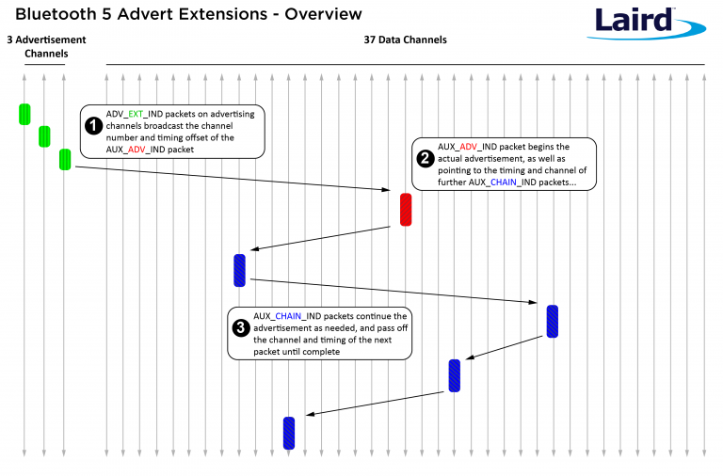
Extended advertisement train on data channels
Use case: long advertisements that need to be fragmented

Slide 66
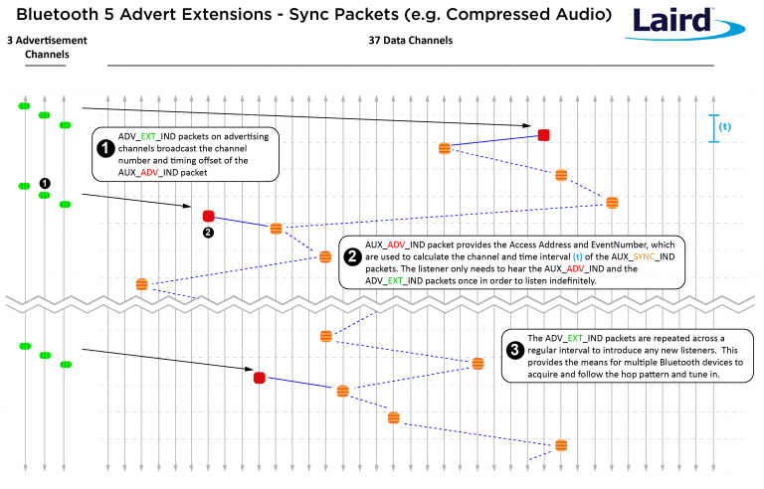
Periodic advertising on data channels
Use case: publicly-available localized audio sources
TV in a bar
Commentary in a museum
Broadcast analogy of a connection
Downside:
how many of these can a gateway follow at a time?

Slide 67
Outline
Connection PHY and Link Layer
Connection Investigations
GATT
BLE 5

Slide 68
Useful documentation
[5.2 specification] [4.2 specification] (link to PDF download)
https://www.novelbits.io/deep-dive-ble-packets-events/
Thinking about BLE connection data transfer rates
https://punchthrough.com/maximizing-ble-throughput-on-ios-and-android/
https://punchthrough.com/maximizing-ble-throughput-part-2-use-larger-att-mtu-2/
https://punchthrough.com/maximizing-ble-throughput-part-3-data-length-extension-dle-2/

