Slide 1
Wireless for the Internet of Things
IEEE 802.15.4 – Mesh
CS/ECE 4501
Spring 2023
UVA
[Pannuto, Ghena, Campbell]

Slide 2
Today’s Goals
Deep dive on mesh protocols
Flip mesh on its head

Slide 3
Outline
Mesh Motivation
Simple Routing
Mesh Routing
Better Flooding

Slide 4
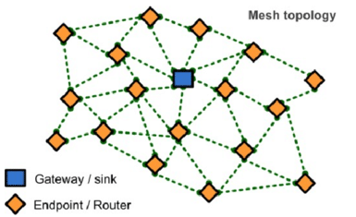
Mesh network layers
PHY Layer
  802.15.4 physical layer
MAC Layer: 802.15.4
  802.15.4 spec gives us the option of implementing our own
  Technically this layer is here, but we generally ignore it
MAC Layer
  Need to allow to TWO low power devices to communicate
  Devices are off most (~99%) of the time
  No assumption of energy asymmetry (as with PAN coordinator or BLE)
Network Layer: Mesh
  Handles organizing the network
  How should packets travel from nodes to the gateway?
  How should packets travel from the gateway to nodes?
  How should packets travel from node to node?
Network Layer
Mesh Routing
MAC Layer
Low Power
802.15.4 Contention MAC
PHY Layer
O-QPSK - 2.4 GHz

Slide 5
Mesh networks
Most devices are capable of communicating with multiple neighbors
What are advantages of mesh?
  Devices can communicate over longer distances
  Device failures less likely to collapse the entire network
What are disadvantages of mesh?
  Some nodes have to spend more energy communicating
  Network protocol becomes more complicated to manage routing

Slide 6
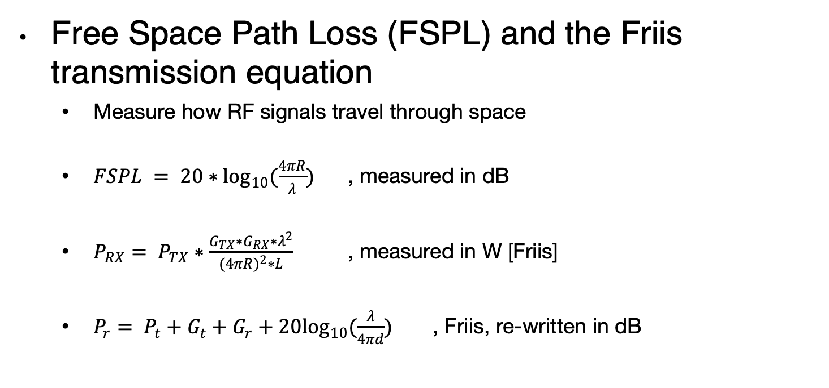
Quantitative intuition of ‘why bother meshing’
Free Space Path Loss (FSPL) and the Friis transmission equation
  Measure how RF signals travel through space
  $FSPL = 20∗\log_{10}(\frac{4πR}{λ})$ , measured in dB
  $P_{RX}= P_{TX}∗\frac{G_{TX}∗G_{RX}∗λ^{2}}{(4{πR)}^{2}∗L}$ , measured in W [Friis]
  $P_{r}= P_{t}+G_{t}+G_{r}+20\log_{10}(\frac{λ}{4πd})$ , Friis, re-written in dB
Traditionally written as transmit distance
Image: https://www.sciencedirect.com/topics/computer-science/transmitting-antenna

Slide 7
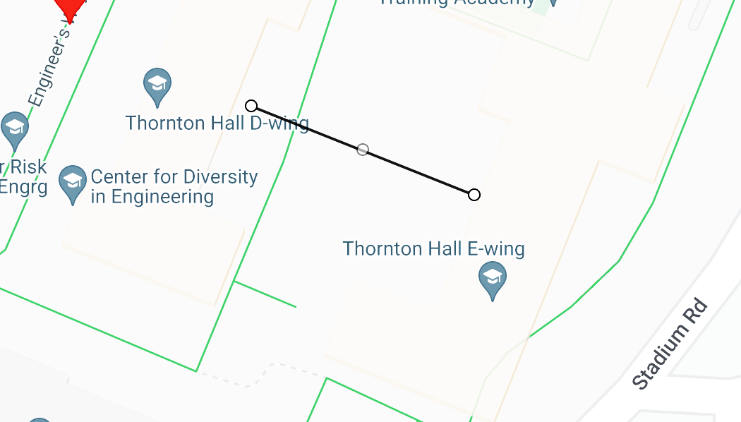




A hand-wavy quantitative analysis of ‘why bother meshing’
D-wing to E-wing is ~40m wide; how to get from one side to the other?
$$\frac{3e8 m/s}{2.4e9 Hz}=0.125 m= λ$$
0 dBm
1 mW
$$20 ∗ \log_{10}\left(\frac{4π∗40}{0.125}\right)≈72 dB$$
-72 dBm (6.3e-8 mW)
-68 dBm (1.6e-7 mW)
$$0 dBm+2.15 dBi+2.15 dBi+20\log_{10}\left(\frac{0.125}{4π∗40}\right)≈68 dBm$$
$$0 dBd=2.15 dBi$$
”reference dipole”
$$20 ∗ \log_{10}\left(\frac{4π∗20}{0.125}\right)≈66 dB$$
$$__ dBm+2.15 dBi+2.15 dBi+20\log_{10}\left(\frac{0.125}{4π∗20}\right)≈68 dBm$$
Multi-hop mesh…
Reduces TX power
  But adds RX, sync cost!
Improves aggregate network coverage
Can improve robustness
Reduces collision domain
-5.2 dBm
0.3 mW

Slide 8
Outline
Mesh Motivation
Simple Routing
Mesh Routing
Better Flooding

Slide 9
Routing goals
Have a packet, have a destination, how do we connect them?
Simple techniques
  Broadcast, tree structures
Mesh techniques
  Understand the available routes and select a “good” one

Slide 10
Simple routing solutions
Broadcast
  The link-layer solution for everything
Star topology
  Only one location to send to: parent
  Single parent needs to store information about all children
    Addresses, schedules, etc.
Tree topology
  “Star of stars”
  Two choices: send to descendent or send to parent
  Each parent needs to store information about all children beneath it
  Original ZigBee approach (knowledge built into addressing scheme)

Slide 11
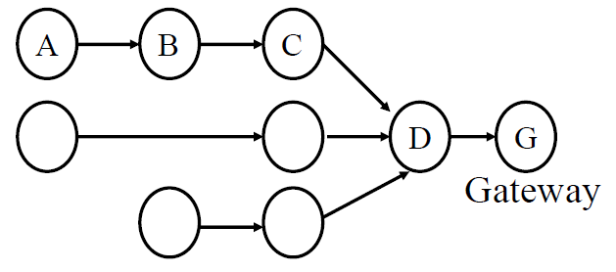
Many-to-one routing e.g. Collection Tree Protocol (CTP)
Tree optimization for sensor networks
  Keep all devices except the “gateway” as simple as possible
Each device only needs to remember hop to gateway
  If gateway wants to send message back, it must include a full hop path

Slide 12
Outline
Mesh Motivation
Simple Routing
Mesh Routing
Better Flooding

Slide 13
Mesh Routing
Mesh topology makes routing question more complicated
  Multiple hops in a route
  Multiple routes between source and destination
  Becomes a graph theory question based on cost metric
B
C
A
D
F
E

Slide 14
Naïve “routing” via flooding
Mesh equivalent of broadcast
  Each node sends to each other node
  Eventually packets will reach the desired destination
  Not really routing at all…
Question: how do we make it stop?
  Maximum retransmissions counter on each packet
    Decrement at each hop. Drop packet when it hits zero
    Need some guess for how many hops to destination
  Keep some history of recently flooded packets
    Don’t retransmit a recently sent packet

Slide 15
Reactive routing
Build up a map of the routes through a network
  Hopefully the “optimal” routes
Map routes in reaction to a packet arrival
  Sensor devices are slow and limited
  Most likely to resend to same prior address
  Discover a route when it is needed, then cache for next time
B
C
A
D
F
E
B Neighbor Table
A | c7:e3:45:00:1f:e4
C | c7:e3:45:ab:44:c6
D | 54:99:10:aa:b1:c3
B Forwarding Table
DST | Next Hop
F | C
A | A

Slide 16
Neighbor discovery
Which nodes are nearby to me?
  i.e. within one packet transmission range
General Techniques
  Periodically listen for nearby transmissions
    Overhear packets
    Source addresses indicate neighbors
  Periodically send neighbor discovery probes
    Announce your existence
    Ask for neighbors to respond
  Centrally collect neighbor information
    Gateway disseminates to nodes as needed
B Neighbor Table
A | c7:e3:45:00:1f:e4
C | c7:e3:45:ab:44:c6
D | 54:99:10:aa:b1:c3
B
C
A
D
F
E

Slide 17
Ad-hoc On-demand Distance Vector Routing (AODV)
On-demand: Construct routes only when needed
Modern ZigBee routing approach (for Mesh topology)
Routing table
  Destination node -> Next hop (for all cached destinations)
  Store only next hop instead of full route
    All routers along the path must also have Destination->Next mappings
  Also keep hops-to-destination and last-seen-destination-sequence-number
Route discovery
  Upon demand: check table
  If not cached send Route Request (RREQ) via Flooding
    Route is unknown, so flooding is needed

Slide 18
AODV Route Requests (RREQs)
Request ID | Source Address | Destination Address | Source SeqNo | Destination SeqNo | Hop Count
Request ID identifies this RREQ
  Used to discard duplicates during flooding
Sequence Numbers are per-device, monotonically increasing
  Used as a notion of “how recently” device has been seen
  Source SeqNo is the source’s most recent sequence number
  Destination SeqNo is the most recently seen from the destination by the source. (Defaults to zero)
Hop Count is the number of hops this request has taken
  Starts at 1 and incremented by each transmitter along the path

Slide 19
Example AODV RREQ (A to F)
Request ID | Source Address | Destination Address | Source SeqNo | Destination SeqNo | Hop Count
A wants to find a route to F, so it sends out an RREQ
B
C
A
D
F
E

Slide 20
Example AODV RREQ (A to F)
Request ID | Source Address | Destination Address | Source SeqNo | Destination SeqNo | Hop Count
1 | A | F | 1 | 0 | 1
B and D also opportunistically add a routing table entry for A
B
C
A
D
F
E

Slide 21
Example AODV RREQ (A to F)
Request ID | Source Address | Destination Address | Source SeqNo | Destination SeqNo | Hop Count
1 | A | F | 1 | 0 | 2
B goes first via some access control protocol (D also in contention)
A and D ignore duplicate Request ID
C opportunistically adds a routing table entry to A
B
C
A
D
F
E

Slide 22
Example AODV RREQ (A to F)
Request ID | Source Address | Destination Address | Source SeqNo | Destination SeqNo | Hop Count
1 | A | F | 1 | 0 | 2
D goes next by some access control protocol (C also in contention)
A, B, and C ignore duplicate Request ID
E and F opportunistically adds a routing table entry to A
B
C
A
D
F
E

Slide 23
Example AODV RREQ (A to F)
Request ID | Source Address | Destination Address | Source SeqNo | Destination SeqNo | Hop Count
1 | A | F | 1 | 0 | 3
C and E repeat this process with Hop Count 3 (but everyone ignores them)
They go one-at-a-time, but I’m getting tired of drawing these
Actually, they’re in contention with the response from F
B
C
A
D
F
E

Slide 24
AODV Route Response (RREP)
Source Address | Destination Address | Destination SeqNo | Hop Count
Reply is sent unicast back to the source via newly constructed route
  Each node along the way already knows the route back
Includes most recent destination sequence number as a sense of recency
  No need for source sequence number anymore

Slide 25
Example AODV RREP (F to A)
Source Address | Destination Address | Destination SeqNo | Hop Count
F | A | 7 | 2
F sends response back to A via D
D opportunistically adds a routing table entry for F
B
C
A
D
F
E

Slide 26
Activity – Reactive routing
Every student is a node
Communication range is one seat
  i.e. to people sitting immediately adjacent

Slide 27
Break + Practice
C wants to send a packet to E
  What RREQ(s) are sent and what RREP(s) are sent?
B
C
A
D
F
E

Slide 28
Break + Practice
C wants to send a packet to E
  What RREQ(s) are sent and what RREP(s) are sent?
    RREQs:
      C -> (B,D,F)
      (B or D) -> A
      (D or F) -> E
    RREPs:
      E -> (D or F) -> C
  Network could have multiple configurations
B
C
A
D
F
E

Slide 29
RREP optimization
An intermediate node responds with RREP if it has a path to destination with a more recent Destination sequence number
  Source may get multiple RREP responses with different recency and hop counts
Note: we’re optimizing for some combination of most recent and lowest hop count

Slide 30
Route maintenance in AODV
If a link in the routing table breaks, all active neighbors are informed with Route Error (RERR) messages
  After some number of retransmissions and timeouts
  RERR contains destination address that broke
Nodes receiving RERR can start RERQ for destination address
  Which lets them find a new path through the network
  And updates everyone’s cached next-hops

Slide 31
Dynamic Source Routing (DSR)
Another reactive routing technique
  Similar design as AODV
In DSR, routing tables have full route to destination
  Each packet transmission includes a list of hops to destination
  So the route to an important destination only has to be stored on the source device that cares about it
  Intermediate nodes do not need any route storage for that destination
    Cost is extra bytes used in each packet for route
During discovery, all paths are returned by destination
  So source gets a full list of possible route choices

Slide 32
Tradeoffs for reactive routing
Upside: no transmissions unless there is demand
  Routes might appear, disappear, reappear, but no need to update if no one actually wants to transmit anything
Downside: large, variable delay when actually sending a packet
  Full RREQ/RREP protocol before data can actually be sent
  Route might have broken at some point
    So data will be sent based on cached information
    RERR will occur
    RREQ/RREP will occur
    Then data will be sent again

Slide 33
Proactive routing
Alternative to reactive is to know the routes ahead of time
Periodically query for the possible routes in the network
  Save all routes that are important (maybe just all routes?)
  Also redetermine routes whenever topology changes (nodes join/leave)
Upside: when a packet arrives, route to destination is already known
Downside: requires more memory and effort on part of routers
  Wastes some network bandwidth on checking for route changes

Slide 34
Distance-Vector
Keep routes as “next hops” rather than full routes
  AODV uses this method (DV for Distance Vector)
Can be combined with proactive techniques too
  Each router periodically informs neighbors of its shortest paths to each destination (in terms of hop count)
    Essentially just broadcast your routing table
  Routers choose the best route available
    Old next-hop it was already aware of
    New next-hop through neighbor (with cost of their hops + 1)
  Need to be careful to avoid loops!

Slide 35
Break + Discussion
Hop count is one possible metric for determining routes
What else might be considered?

Slide 36
Reliability as a cost metric
Link quality can very from node to node
  Fewest hops might not be the “fastest” or “most reliable” path
ETX: minimize “expected transmissions”
  Measure link quality over time to determine each link’s reliability
B
C
A
D
F
E

Slide 37
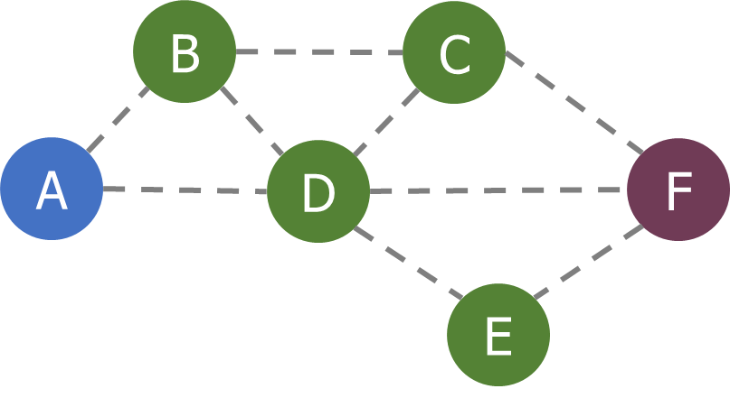
Alternative cost metrics
Spatial reuse
  Prefer transmission on links that do not interfere with each other
  Improves ability to pipeline data through network
  Example: A<->B and E<->F
Energy availability
  Prefer routing through nodes with more remaining
  available energy
  Prefer wall-powered nodes over battery-powered
Arbitrarily complex combinations possible

Slide 38
Outline
Mesh Motivation
Simple Routing
Mesh Routing
Better Flooding

Slide 39
Traditional flooding is a ’mesh-local broadcast’
Goal: get information to all nodes
  This is the problem of “data dissemination”
Problem: difficult in Mesh topologies
  Packet loss, retransmission delays
Really, the desire for data dissemination is just to broadcast to all nodes
  But broadcast transmissions don’t reach far enough to cover entire mesh

Slide 40
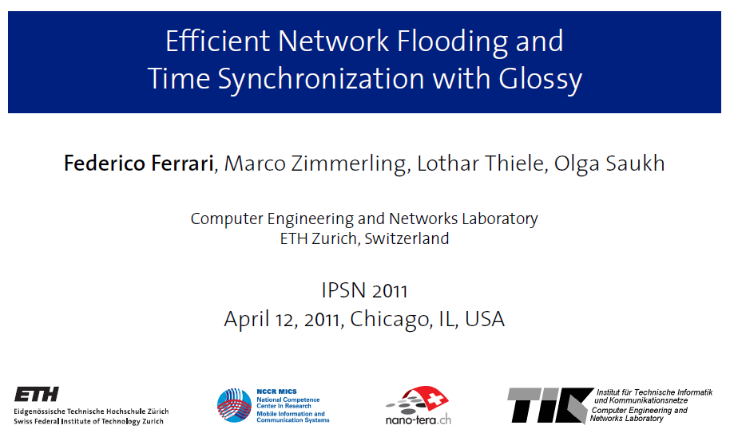
Glossy: What if we expand broadcast range by having multiple nodes participate?

Slide 41
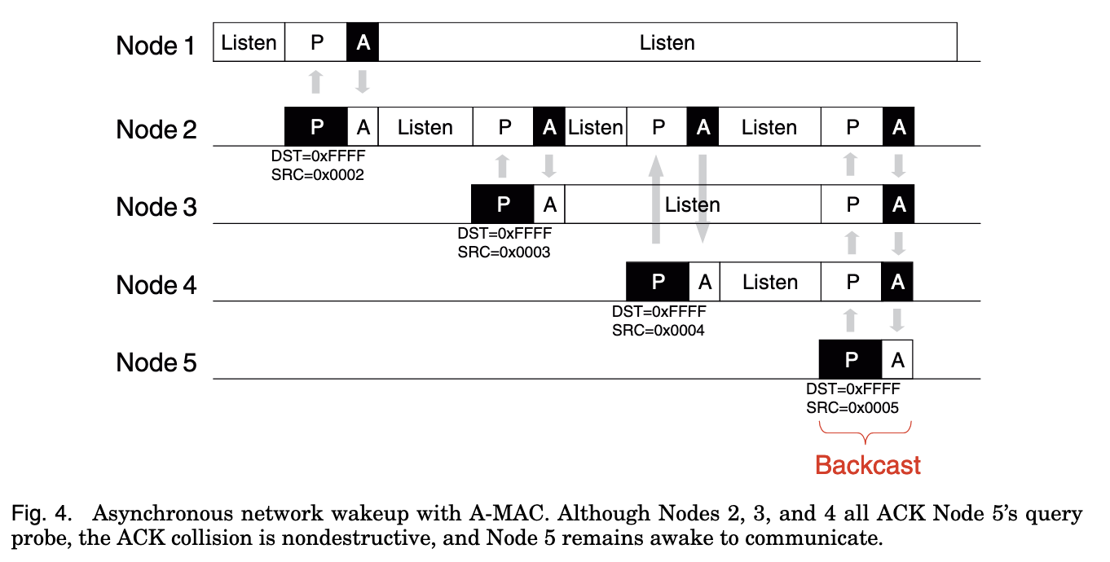
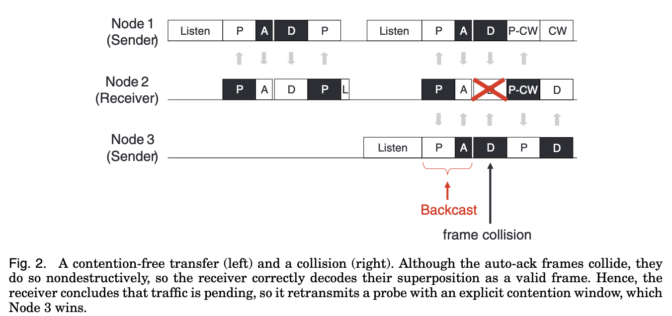
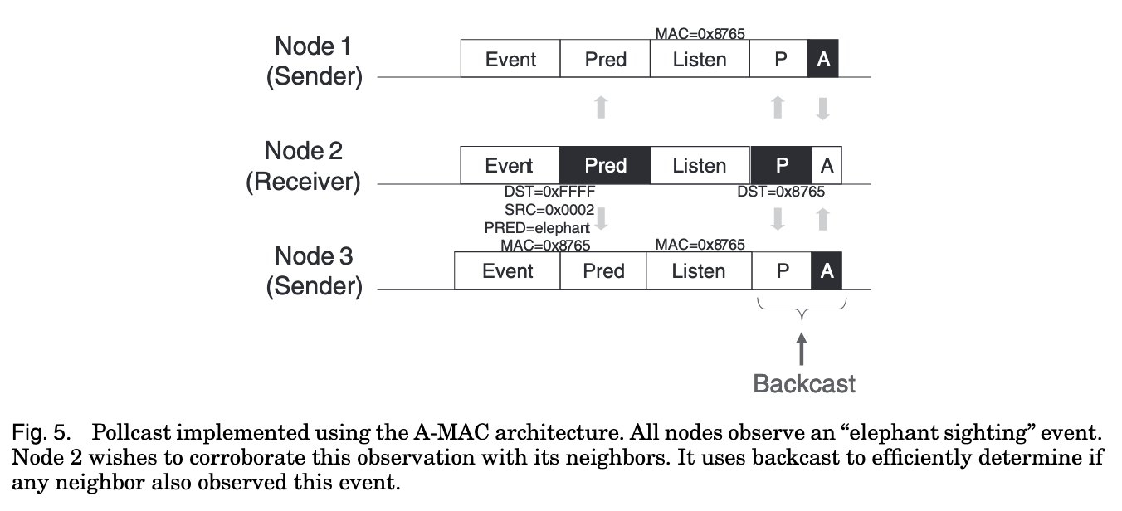
Glossy foundations: A-MAC and Backcast
A few lectures back I mentioned ‘broadcast ACKs can work’, here’s how:

Slide 42
Fundamental Insight: Say exactly the same thing at exactly (enough) the same time → coherence not interference
In 802.15.4, an ACK is sent exactly 192 µs after receiving
  The ACK packet contains only the sequence number being ACK’d
  Does not contain source address of the ACK-er
  Which is why this works:

Slide 43
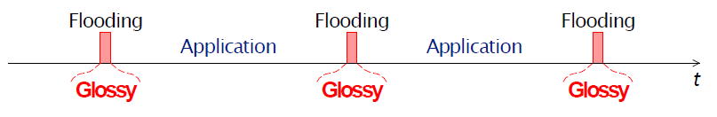
Glossy key techniques
Temporally decouple network flooding from application tasks
Exploit synchronous transmissions for fast network flooding

Slide 44
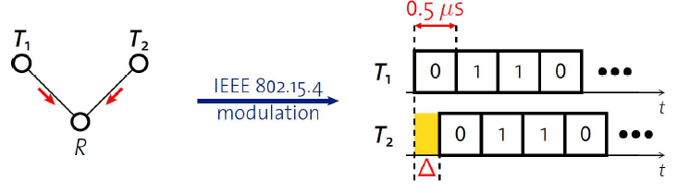
Synchronous transmissions
Multiple nodes transmit same packet at same time
R can receive packet with high probability if Δ is small
  May even improve probability of reception (more energy at receiver)
500 ns is 1/32 of a symbol for 802.15.4 (chip duration)

Slide 45
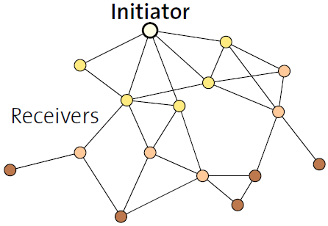
Fast packet propagation in Glossy

Slide 46
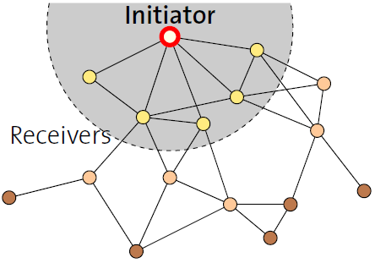
Fast packet propagation in Glossy

Slide 47
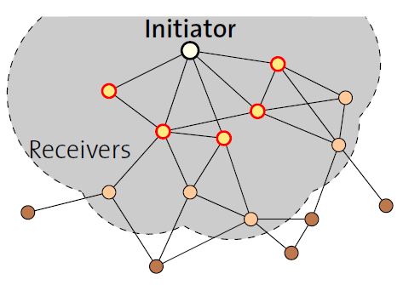
Fast packet propagation in Glossy

Slide 48
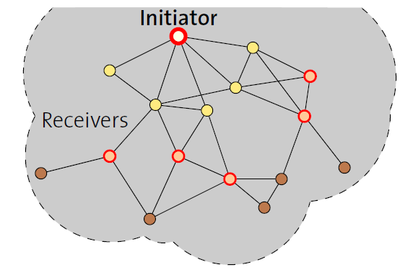
Fast packet propagation in Glossy

Slide 49
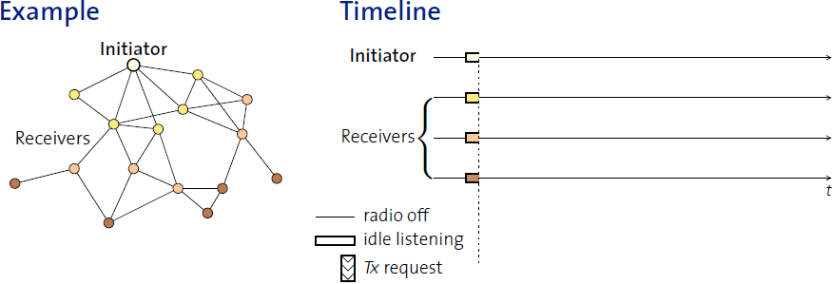
Glossy details
When Glossy starts
  All nodes turn on radios to receive

Slide 50
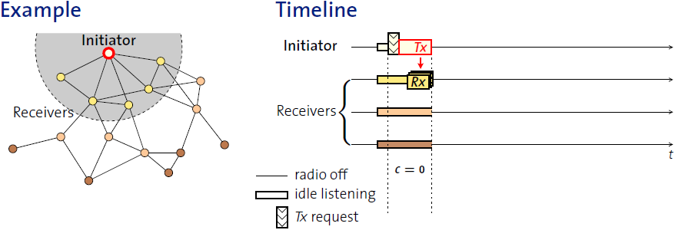
Glossy details
Initiator
  Set relay counter in packet, C = 0
  Broadcast packet

Slide 51
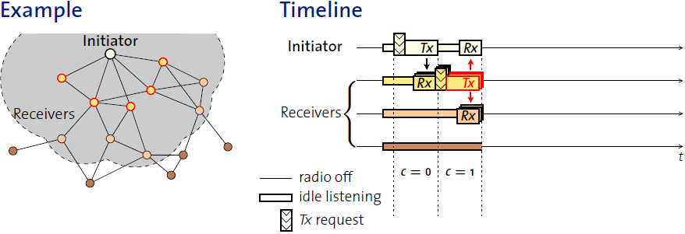
Glossy details
At packet reception:
  Increment relay counter C
  Transmit synchronously (at a fixed period after the reception)

Slide 52
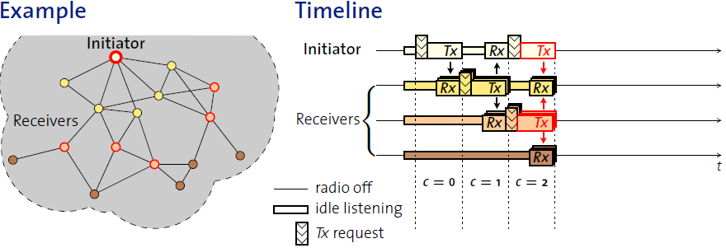
Glossy details
At packet reception:
  Increment relay counter C
  Transmit synchronously (at a fixed period after the reception)

Slide 53
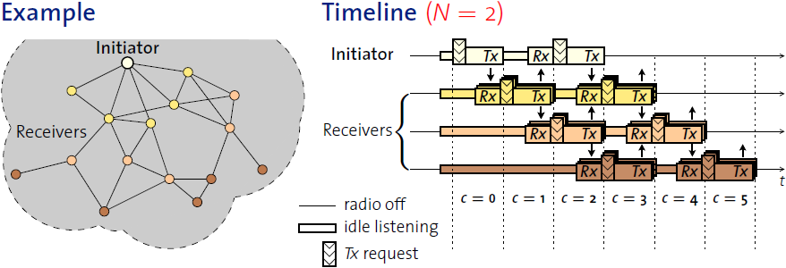
Glossy details
Stop rebroadcasting and turn off radio when
  Already transmitted N times
  Networks pick N for reliability/energy tradeoff

Slide 54
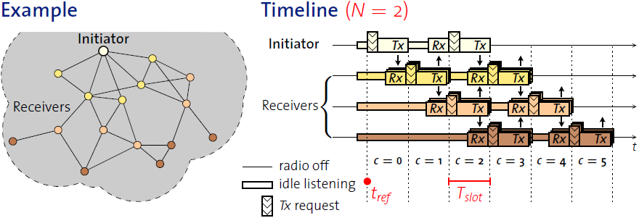
Glossy details
T_{slot} is constant by design
  Needs to be to make constructive interference work
Beginning of slot (t_{ref}) provides synchronization point
  As a bonus, all nodes are synchronized after flooding event

Slide 55
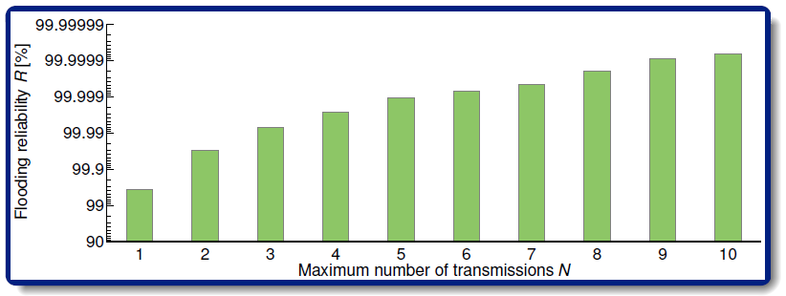
Glossy implementation
Device must be able to have tight time bounds on rx/tx
  500 ns wiggle room maximum
  Includes receive, processing, transmission
Need to pick an N for reliability

Slide 56
Application of Glossy: avoid routing altogether
Low-Power Wireless Bus (LWB)
  Federico Ferrari, Zimmerling, Mottola, Thiele. SenSys’12
Use Glossy for all device communication
  Make one broadcast domain (a bus) where all nodes communicate
  Avoids all issues of routing, everything is a broadcast
    Works for unicast, multicast, anycast, and broadcast transmissions
General idea: TDMA Glossy floods
  Synchronization is already given to nodes by Glossy
  One coordinator makes the TDMA schedule

Slide 57
Break + Implications of Flooding
Synchronous Transmission Protocols were a major disruption
  Showed that flooding data from A → F used less net energy than routing A → F
    (Net here is energy consumed by all nodes in the network)
  Why??
  What kinds of applications, traffic patterns would synchronous transmissions be worse than routing for?
B
C
A
D
F
E

