Slide 1
Wireless for the Internet of Things Cellular Networks and the IoT
CS/ECE 4501
Spring 2023
UVA
[Pannuto, Ghena, Nasir]

Slide 2
Today’s Goals
Why might you pick cellular as an iot communication option?
Evolution of cellular networks
Mobile/1G/2G/3G/4G/5G
Underlying design decisions and tech
Challenges via case studies

Slide 3
Outline
Cellular for IoT deployments
Cellular Network Technologies
History and foundation
1G
2G
3G/4G and beyond
Suitability of Classic Cellular for IoT
Sunsetting
“Global” deployment

Slide 4
Why is cellular a wireless option for IoT devices?
WiFi
4G
Higher Power & Higher Cost
3G
Data
Throughput
Bluetooth
2G
seems to be the
worst of the lot
Low-Power Wide-Area Networks
BLE
802.15.4
Lower Power & Lower Cost
Range

Slide 5
Cellular provides some unique advantages for IoT
Global deployment
If the goal is deploy-today + work-anywhere, cell is the only option
That’s not to say cell actually works everywhere, just the best-available
Reuse existing telecom infrastructure
Minimal overhead (no need to deploy network infrastructure)
Allows mobility
No need to modify destination address when moved
Reuse in-built security features
SIM card based subscriber authentication

Slide 6
Dominion Energy Smart Meters
Enables remote two-way communication between meter and Dominion Energy
Uses RF mesh to securely gather data from the meter
A network access point (router) collects data and send data to Dominion Energy via a secure cellular network
Routers are strategically placed in the field

Slide 7
Hardware Options
SIMCom
https://www.simcomm2m.com/
SIM800L
https://lastminuteengineers.com/sim800l-gsm-module-arduino-tutorial/
Integrated with ESP32
https://makeradvisor.com/tools/ttgo-t-call-esp32-sim800/

Slide 8
Outline
Cellular for IoT deployments
Cellular Network Technologies
History and foundation
1G
2G
3G/4G and beyond
Suitability of Classic Cellular for IoT
Sunsetting
“Global” deployment

Slide 9
Poll: What decade was the first commercial mobile phone?
1910-1920
1920-1930
1930-1940
1940-1950
1950-1960
1960-1970
1970-1980
1980-1990
1990-2000
2000-2010

Slide 10
The first commercial mobile phone was in 1946!
By 1948, 5000 users placing around 30,000 calls weekly
“The equipment, of course employing vacuum tubes, weighed eighty pounds, filled much of a vehicle’s trunk and drew so much power that it would cause the headlights to dim. Service cost $15 per month, plus thirty to forty cents per local call, equivalent to $175 2012 dollars, plus $3.50 to $4.65 per call. “
https://ethw.org/The_Foundations_of_Mobile_and_Cellular_Telephony
https://www.smithsonianmag.com/innovation/first-mobile-phone-call-was-made-75-years-ago-180978003/

Slide 11
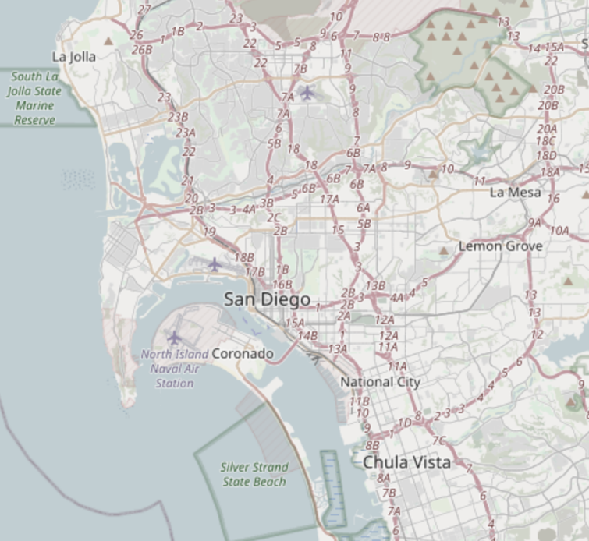
The first “mobile” network architecture
Single transmitter tower, multiple receiver towers
Why?
Medium Access Control?
Push-to-talk [half-duplex]
City-wide “party line”
Maximum of three concurrent callers
Notes:
A single transmitter on a central tower provided a handful of channels for an entire metropolitan area. Between one and eight receiver towers handled the call return signals. At most, three subscribers could make calls at one time in any city using the single transmitter and the tiny amount of spectrum allocated by the Federal Communications Commission to this service. It was in effect a massive party line, where a tightly controlled number of subscribers had to listen first for someone else on the line, and, if finding the line free, signal an operator, who would place the call. During the call, the user depressed a button on the handset to talk and released it to listen.

Slide 12
The first “mobile” network architecture
Single transmitter tower, multiple receiver towers
Why? Transmission energy of phone!
Medium Access Control?
Push-to-talk [half-duplex]
City-wide “party line”
Maximum of three concurrent callers
Notes:
A single transmitter on a central tower provided a handful of channels for an entire metropolitan area. Between one and eight receiver towers handled the call return signals. At most, three subscribers could make calls at one time in any city using the single transmitter and the tiny amount of spectrum allocated by the Federal Communications Commission to this service. It was in effect a massive party line, where a tightly controlled number of subscribers had to listen first for someone else on the line, and, if finding the line free, signal an operator, who would place the call. During the call, the user depressed a button on the handset to talk and released it to listen.

Slide 13
1965: The Improved Mobile Telephone Service
More spectrum in 3 different bands for Bell System US
VHF Low (35-44 MHz, 9 channels)
VHF High (152-158 MHz, 11 channels)
UHF (454-460 MHz, 12 channels)
Full Duplex
Implemented as channel pairs (two half-duplex)
More spectrum alone not enough
Limited to 40,000 total subscribers
E.g. NYC had 2,000 people on 12 channels with a typical wait of 30 mins to place a call
Phones fit in a briefcase now
https://en.wikipedia.org/wiki/Improved_Mobile_Telephone_Service
Notes:
Also now full duplex, and no more operators

Slide 14
Quick review: How can we share spectrum?
Frequency division
Time division
Code division
Didn’t come to the US mobile networks until the 80’s
Spatial division!!

Slide 15
What’s inefficient with this picture?
Early mobile networks handled the mobility challenge with wide-area coverage
The active user could be anywhere in the 40~60 mile range of the transmit tower
So they had exclusive access to that whole area!
12 frequency channels → 12 users

Slide 16
The “cell” in cellular networks
Cell is spatial division
Reduce transmit power, smaller area
Now…
12 / 3 = 4 channels per cell
* 6 cells in area
= 24 users of same spectrum!
And we can choose the cell size based on our expected needs
Notes:
The idea is that the basestations serve areas (“cells”) and those areas give you coverage everywhere. In the real world, they aren’t nice neat shapes. But they are drawn as hexagons to represent the ideal nice neat shapes. An omnidirectional antenna will (in an ideal world, with no hills or buildings) give you a perfect circle. But circles do not tesselate, so we plan them as hexagons.

Slide 17
Spatial division tradeoffs
?
Need more infrastructure (more towers)
Need logic to support handoff
Cellular concept in Bell labs at 1947 [one year after mobile], but no handoff

Slide 18
Spatial division in practice
Directional antennas at tessellation corners provide redundant coverage [robustness!]

Slide 19
Spatial division in practice
Directional isolation is imperfect, requires many bands in practice

Slide 20
How often does handoff need to happen anyway?
Really a question of “how big are cells”
A back-of-envelope answer for “Handoffs per 3-minute call”:
 | Speed (mph) | Speed (kph) | Cell Radius (km) | Handoffs
Freeway, rural | 65 | 104 | 16 | 0.33
Freeway, urban | 65 | 104 | 1.6 | 3.25
Surface streets, urban | 30 | 48 | 1 | 2.4
Pedestrian, urban | 1.5 | 2.4 | 1 | 0.12
Pedestrian, microcell | 1.5 | 2.4 | 0.1 | 1.2
Table data from Arthur H. M. Ross, PhD: http://www.cdg.org/technology/cdma_technology/a_ross/handoff.asp

Slide 21
Outline
Cellular for IoT deployments
Cellular Network Technologies
History and foundation
1G
2G
3G/4G and beyond
Suitability of Classic Cellular for IoT
Sunsetting
“Global” deployment

Slide 22
Introducing 1G! (First Generation)
AMPS — Advanced Mobile Phone Service by Bell Labs (circa 1983)
Other 1G’s:
Nordic Mobile Telephone (NMT) — Nordics, Eastern Europe, Russia
Total Access Communications System (TACS) — UK, West Germany, Portugal South Africa
Radiocom 2000 — France
1G is defined by:
Analog voice channels which uses Frequency Modulation (FM)
Established by digital control channel ← handoffs
Notes:
AMPS used in the US

Slide 23
AMPS
Created by Bell Labs in 1983
Voice was transmitted using frequency modulation (FM)
FCC approved 825–845 MHz and 870–890 MHz frequency bands for AMPS
Spectrum divided into 21 control channels (digital) and 395 voice channels (analog)
Voice channels: 30 kHz wide, 45 MHz separation
Control channel: used by phone and base station for call set-up, channel changing, handoff etc.
Each client assigned a separate channel for a single cellular phone call
Biggest disadvantage was analog voice transmission: can be overhead if tuned to
Microcontrollers not powerful enough to use secured digital channels for voice
Notes:
The control channel is a special frequency that the phone and base station use to talk to one another about things like call set-up and channel changing. If the phone cannot find any control channels to listen to, it knows it is out of range and displays a "no service" message.

Slide 24
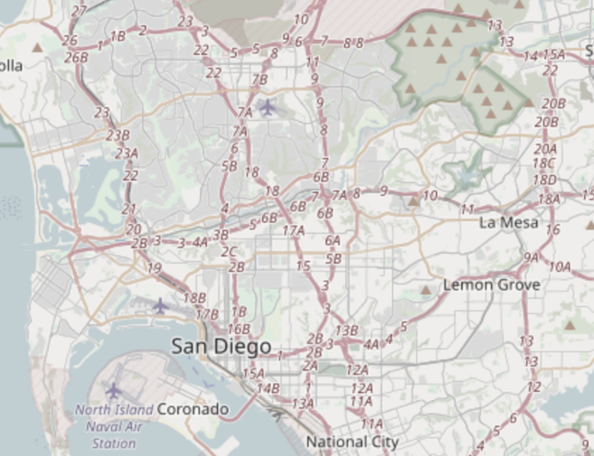
Break + Discussion: How to implement handoff?
<brainstorm>

Slide 25
How does AMPS implement handoff?
Base station detects weak signal
Base station tells mobile about new, better tower
Base station sends cutover trigger
Lots bad about this:
No `make before break` — many drops!
Mobile has better estimates than base station
Notes:
http://ece2526.elimu.net/Notes/AMPS/Amps_Home.html

Slide 26
Over time, AMPS did also get more frequencies
AMPS in the US:
850 MHz band
Divided into “A” block and “B” block
Granted to local phone company and ‘wireless company’ respectively
Each block had 21 control, 395 voice channels
Several expansions of this frequency block
Most interesting, in 1989, UHF TV channels 70-83 added 666 more channels
Notes:
https://medium.com/geekculture/howto-running-the-1g-analog-phone-from-1997-3caec77a9df9

Slide 27
The first “sunset”
Single-user analog channels not very efficient
Wireless carriers wanted to replace 1G
Key Takeaway: Spectrum allocation is the most scarce resource, therefore want to maximize efficiency of its use
But many things in the built environment relied on AMPS
Because when they were built, AMPS was the most reliable
FCC required network support until early 2008 (dropped soon after)
Notes:
OnStar
Some systems made adapters, others just stopped working. People sold adapter kits to replace transmit modules where possible [see 2G OnStar example for this happening now later in slides].
ADT home alarms
ADT got sued class-action for selling products that were ‘destined to fail’ (suit failed).

Slide 28
Aside: Super cool hackaday projects
Building your own 1G network!
https://hackaday.com/tag/amps/
https://github.com/unsynchronized/gr-amps
⚠ ⚠ ⚠ This uses spectrum you do not own ⚠ ⚠ ⚠
“The FCC can levy fines of up to $11,000, per transmitter, per day, with up to six months in federal prison, for violations of the Code of Federal Regulations.”
Could deploy with wired connections though…

Slide 29
Outline
Cellular for IoT deployments
Cellular Network Technologies
History and foundation
1G
2G
3G/4G and beyond
Suitability of Classic Cellular for IoT
Sunsetting
“Global” deployment

Slide 30
IS-54 aka 2G aka TDMA aka D-AMPS (Digital AMPS)
Deployed ~1993
Used TDMA to share AMPS channels
Each AMPS analog channel-pair was 30 kHz
Digital compression allowed for 3 time slots per channel — tripled capacity!
Later iterations would compress further, 6 time slots per channel
Beat out competing FDMA analog solution from Motorola
Narrowband AMPS, “N-AMPS”, compressed calls to fit in 10 kHz channels
Also encrypted [poorly: CMEA broken publicly in 1997]
Notes:
CMEA: Cellular Message Encryption Algorithm

Slide 31
GSM aka 2G aka TDMA
Wait, didn’t the last slide say 2G was something else?
What is “2G” then?

Slide 32
Sunset of D-AMPS and emergence of GSM
D-AMPS was discontinued along with AMPS in 2008
Modern “2G” is all GSM
“Global System for Mobile Communications”
It is a standard [the dominant 2G]

Slide 33
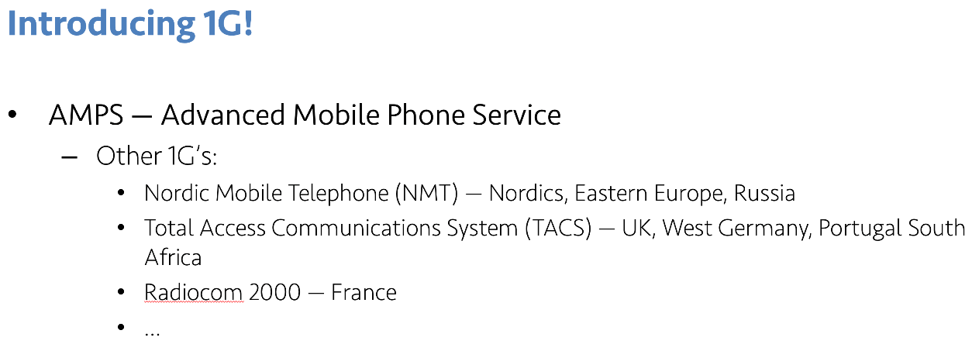
Origins of GSM
An incredible sweet spot of timing, technology need, and politics?
1987: 13 European countries sign accord to use one wireless standard
10 months later: GSM standard ratified
Insight: Not a ton new in GSM by ‘87, just a lot of arbitrary design decisions
Not a very `mobile` mobile network…

Slide 34
https://en.wikipedia.org/wiki/File:Gsm_structures.svg

Slide 35
GSM evolved over time to add data
GSM was voice-only at first
Then overlaid data on the voice channel
Circuit Switched Data (CSD)
9.6 — 14.4 kb/s
Previous hacks were literally cell phone calling a modem (~3.5 kb/s); same concept
Then added actual packetized data [“2.5G”]
General Packet Radio Service (GPRS)
Throughput 9.2 – 21.55 kbit/s/timeslot [goodput 8-20 kbit/s/timeslot]
Enhanced Data Rates for GSM Evolution (EDGE)

Slide 36
So why does the IoT care about 2G?
It’s easy
2G == GMSK, 3G = QPSK [requires linear PA], 4G = …
It’s cheap
Relative to other cellular plans, anyways
It’s low power*
*For select IoT workloads
Energy-per-bit of continuous stream improves each generation
Energy-per-event of infrequent events…

Slide 37
Outline
Cellular for IoT deployments
Cellular Network Technologies
History and foundation
1G
2G
3G/4G and beyond
Suitability of Classic Cellular for IoT
Sunsetting
“Global” deployment

Slide 38
Comparison of the cellular network generations
Features | 1G | 2G | 3G | 4G | 5G
Start / Development | 1970/1984 | 1980/1999 | 1990/2002 | 2000/2010 | 2010/2015
Technology | AMPS, NMT, TACS | D-AMPS, GSM | WCDMA | LTE, WiMax | MIMO, mm Waves
Frequency Bands (*not full list) | 800MHz | 850MHz, 1900MHz | 850MHz, 1700MHz, 1900MHz, 2100MHz | 700MHz, 1700MHz, 1900MHz, 2300MHz | Low-Band: 600MHz-2100MHz Mid-Band: 2.5GHz - 3.7GHz High-Band: 24GHz– 39GHz
Data rates | Only voice | Upto 64kbps | Upto 2Mbps | Upto 100Mbps | Upto 20Gbps
Access System | FDMA | TDMA/CDMA | CDMA | CDMA | OFDM/BDMA
Data rates increasing
Access system key to support more subscribers and achieving higher data rates
What about energy consumption?
Notes:
Sources:
https://net-informations.com/q/diff/generations.html
https://www.baeldung.com/cs/mobile-networking-generations
https://www.wilsonamplifiers.com/blog/frequencies-by-provider/
https://www.gsmarena.com/network-bands.php3?sCountry=UNITED+STATES
https://www.wilsonamplifiers.com/blog/5g-frequency-bands-explained/

Slide 39
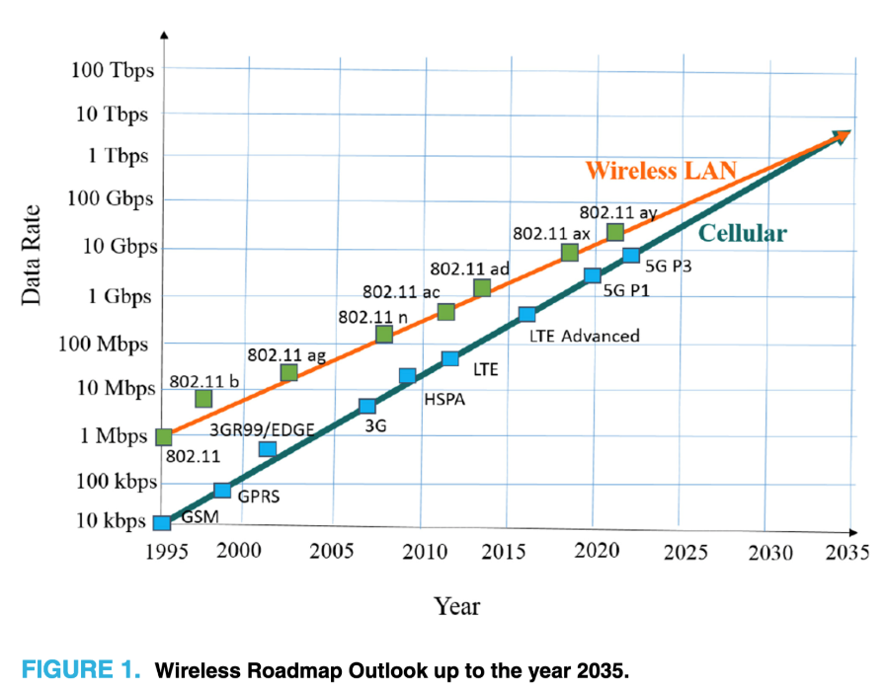
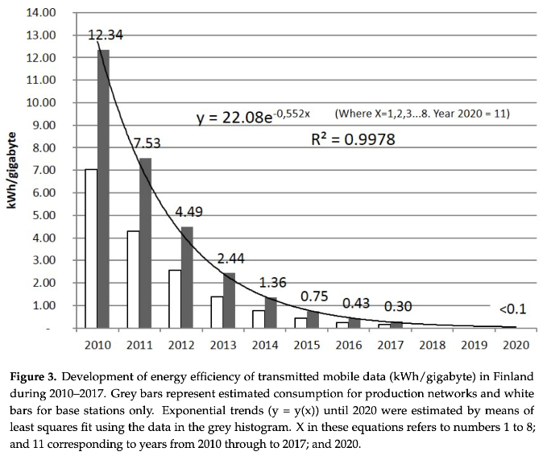
Corollary to improved throughput is improved energy
Same philosophy as high-performance architecture, etc
There is always baseline load, which going faster amortizes
Pihkola, H., et al. (2018). Evaluating the energy consumption of mobile data transfer—from technology development to consumer behaviour and life cycle thinking. Sustainability, 10(7), 2494.
Terahertz Band: The Last Piece of RF Spectrum Puzzle for Communication Systems (preprint; Elayan et al.)
Notes:
Pic as citation pretty lazy Pat… :D

Slide 40
But energy per transaction is complex
Radios, cellular protocols, and cellular providers have state machines
Hard to predict a priori and globally ☹
Characterizing radio resource allocation for 3G networks; Feng Qian, Zhaoguang Wang, Alexandre Gerber, Zhuoqing Morley Mao, Subhabrata Sen, Oliver Spatscheck; SIGCOMM’10

Slide 41
A very quick intro to 5G
Uses OFDM and other wider bandwidth technologies such as sub-6 GHz and mmWave (30GHz – 300GHz)
Vision:
sub-1ms end-to-end latency (10x decrease from 4G)
20 Gbps downlink speed (100Mbps for 4G)
(Perception of) 99.999% availability
(Perception of) 100% coverage
mmWaves can theoretically enable very high data rates
Source: National Instruments
Source: GSMA Intelligence. Understanding 5G: Perspectives on future technological advancements in mobile, 2014
Notes:
https://www.rcrwireless.com/20160815/featured/mmwave-5g-tag31-tag99
5G mmWave antennas support beamforming to direct the radio signal to a desired area. Conventional antennas provide coverage that is similar to how a floodlight illuminates a wide area. Beamforming antennas are like a flashlight providing coverage where it is needed and reducing unwanted signals. A few meters away from the core of the beam, the 5G signal is negligible.
Expectations:
sub-1ms latency and >1 Gbps downlink speed
Only services that demand at least one of these considered 5G use cases
1-10Gbps connections to end points in the field (i.e. not theoretical maximum)
1 millisecond end-to-end round trip delay (latency)
(Perception of) 99.999% availability
(Perception of) 100% coverage
90% reduction in network energy usage
Up to ten year battery life for low power, machine-type devices
In late 2021, the U.S. Federal Aviation Administration (FAA) raised urgent concerns about potential interference occurring between 5G and sensitive aircraft communication systems. This led to Verizon and AT&T agreeing to delay some of their 5G rollouts and sparked industry-wide discussion about the future of spectrum management and the implications of 5G technology.
Largely, 5G is a small(er)-cell technology
“Urban optimized”
Unlikely to roll out to all geographic area (because of infrastructure cost)
This does also allow for higher performance

Slide 42
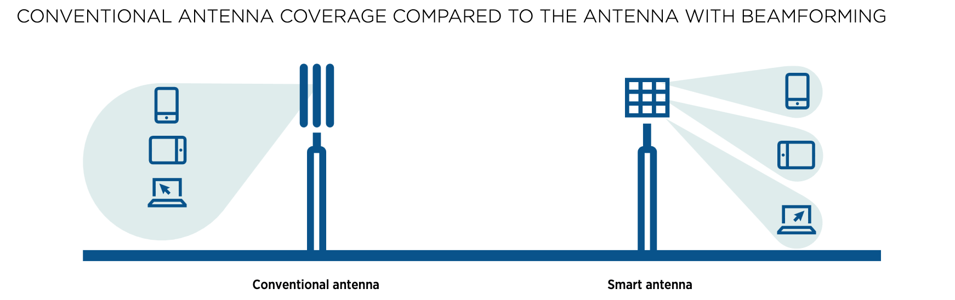
5G and the current challenges
Current base station coverage is very limited
mmWaves require specialized beam-forming antennas and more of them!
Signals do not propagate long distances and do not easily penetrate obstacles, thus requiring expensive investments in dense ground infrastructure to achieve full functionality.
U.S. found itself in a bit of a spectrum crisis amid the push for 5G.
For many years, most of the best frequency bands for deploying 5G — known as the "mid-band" spectrum — were allocated in the U.S. for federal use.

Slide 43
Outline
Cellular for IoT deployments
Cellular Network Technologies
History and foundation
1G
2G
3G/4G and beyond
Suitability of Classic Cellular for IoT
Sunsetting
“Global” deployment

Slide 44
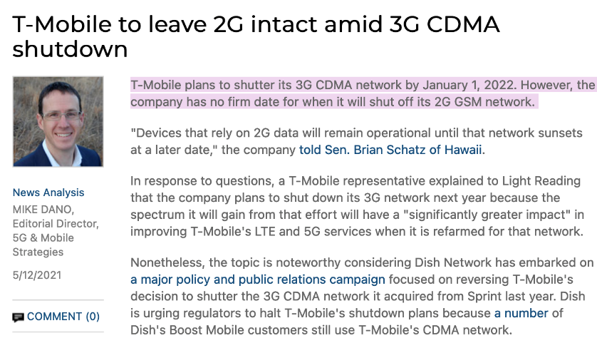
A real problem with cellular networks: “sunsetting”!
To sunset a service, software feature, etc. is to plan to intentionally remove or discontinue it.
2G Network
AT&T stopped servicing 2G networks in 2016
Verizon Wireless also phased out its 2G CDMA network at the end of 2020
T-Mobile plans on April, 2024
3G Network mostly sunset
Verizon: Dec 2022
AT&T: Feb 2022
T-Mobile: July 2022

Slide 45
Why sunset? and its implications
Primarily for spectrum land-grab
Wireless providers advocated [successfully] for [global] release of additional spectrum to support new, faster wireless
Lots of [initial] 4G rollout also on new spectrum
But no more coming — sunsets only way to get more 4G spectrum
5G is [mostly] on much higher bands, not suited for 4G
How does sunsetting affect your deployments?
Two real-world use cases
GM OnStar (US)
My friend’s project (India)

Slide 46
Case Study 1: General Motors (GM) OnStar Service
What’s OnStar: respond to crashes, track stolen cars, get roadside help,..
GPS module + 2G/3G cellular connection

Slide 47
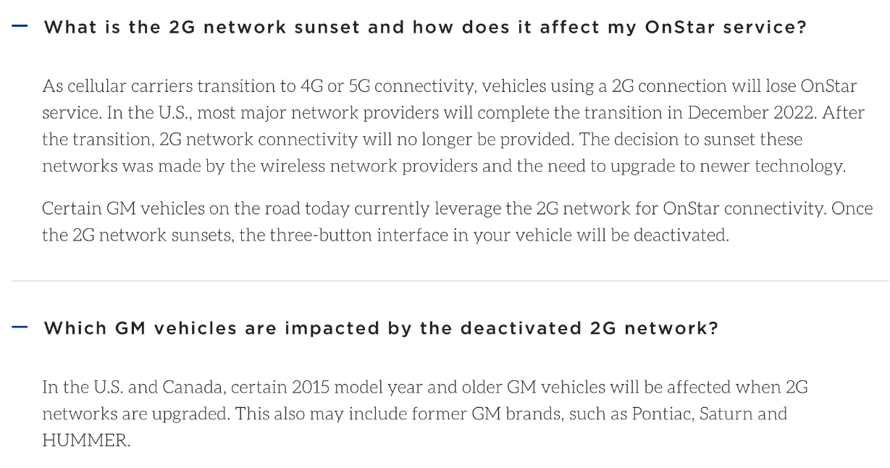
With the 2G/3G sunset, OnStar stopped working for 2015 and older models

Slide 48
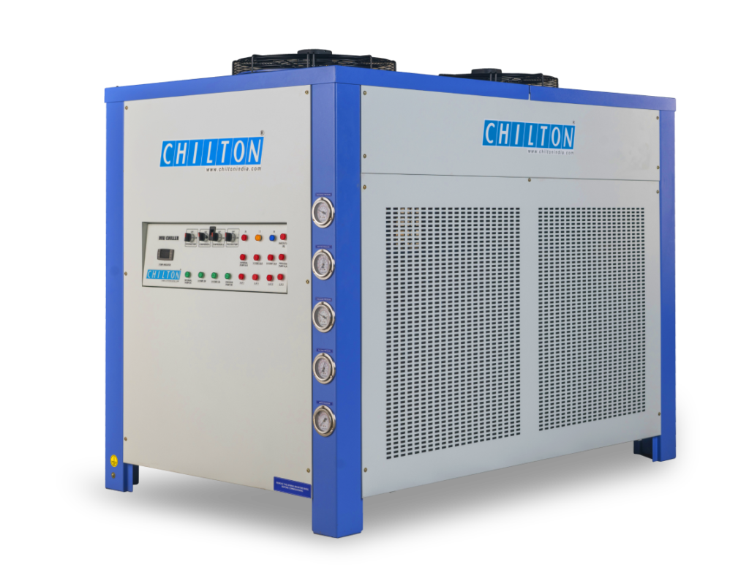
Case Study 2: Predictive maintenance for Industrial Chiller
Example Use case: Plastic molding by rapid cooling after heating
Offered predictive maintenance of the chiller:
Monitor chiller’s critical parameters and predict breakdowns
Sends alerts as text (SMS) messages to client
Initial choice: 2G cellular SIM
Cheap WiFi MCUs like ESP32 not available
Also didn’t want to risk on security
Faced several issues
Had to replace SIM cards with 2G sunsetting!
Provided SIMs didn’t have network coverage at all locations
Eventually switched to WiFi at client’s site
Notes:
An injection molding machine heats plastic particles until they become molten and then injects them into a shaped mold where the plastic part cools.

Slide 49
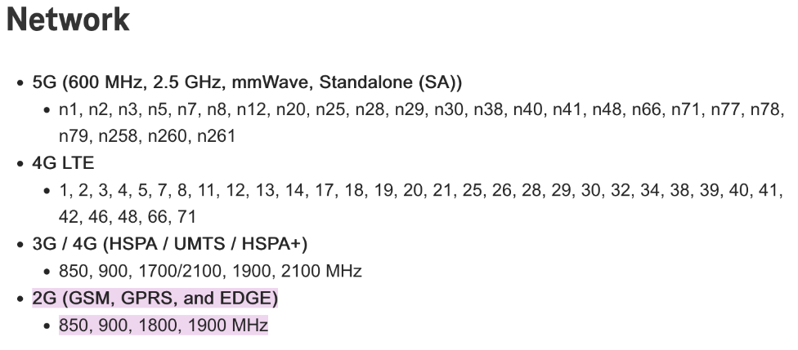
Why might 2G continue to survive [globally]?
More coverage for lower costs
2G has longer range than 3G
It fills the legacy niche
High performance HW includes fallbacks
2G/3G radios, then 2G/3G/4G radios, now 2G/3G/4G/5G radios
Consider the iPhone 13 Pro (2021):
Brick phones still popular!

Slide 50
Outline
Cellular for IoT deployments
Cellular Network Technologies
History and foundation
1G
2G
3G/4G and beyond
Suitability of Classic Cellular for IoT
Sunsetting
“Global” deployment

Slide 51
Does cellular really provide “global” connectivity?
Story by Pat Pannuto (UCSD) & nLine

Slide 52
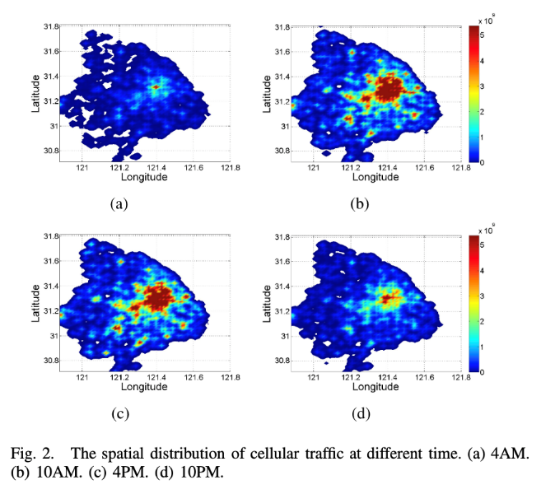
Traffic fluctuates in all networks, for cellular it becomes a function of both when and where you are
Understanding Mobile Traffic Patterns of Large Scale Cellular Towers in Urban Environment; Xu, Li, Wang, Zhang, Jin; IEEE ToN

Slide 53
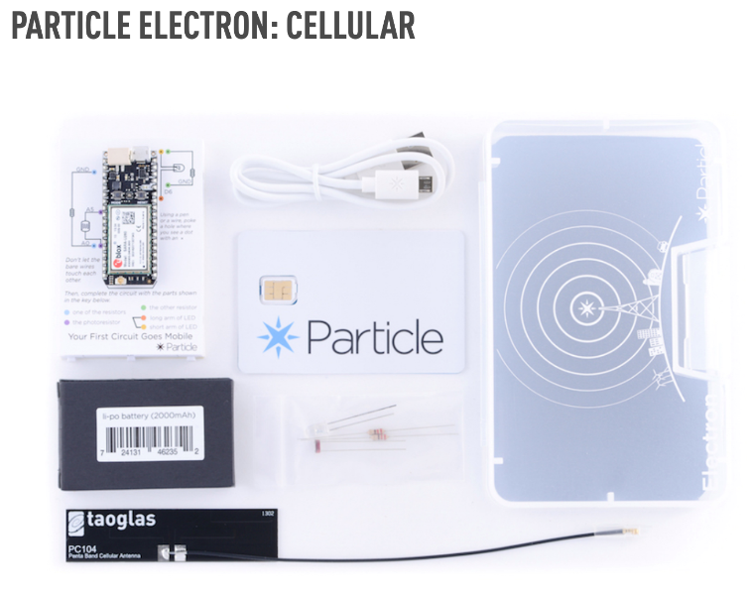
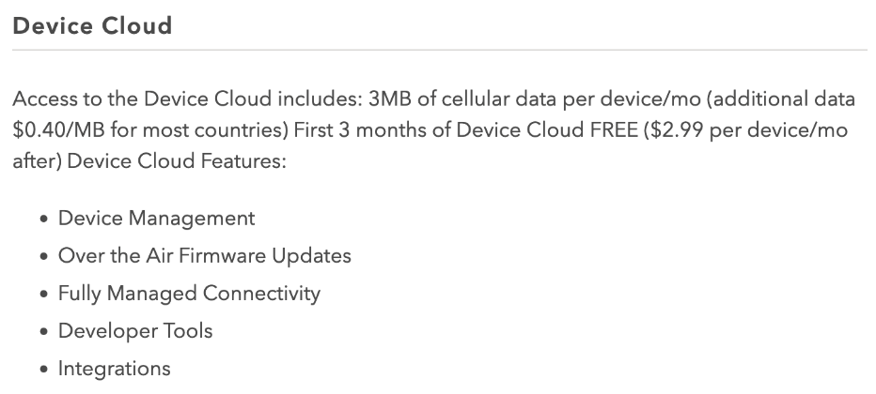
Why does this matter for IoT Deployments?
Say you’re building a power grid sensor you want to deploy globally…

Slide 54
What is Mobile Virtual Network Operator (MVNO)?
Decoupling the builders of infrastructure from the sellers
Not a new concept, but seeing aggressive growth
MintMobile, MetroPCS, Cricket, Boost Mobile, etc.
GoogleFi, Xfinity Cellular

Slide 55
So how does Particle, a small IoT platform startup, provide global cellular coverage?
Deployed some Electrons in Accra, Ghana sending a message once per minute 24/7 for a few weeks
PRR [POST Reception Rate] changes over time
Almost zero PRR from ~7-9am and ~4-7pm daily
Introducing traffic priority
Call Particle: “What gives?”
Particle buys from T-Mobile
T-Mobile buys from Deutsche-Telekom [didn’t own them yet]
DT buys from Vodafone
Vodafone buys from MTN
MTN has 5 tiers of traffic priority on their network [guess which tier we were in?]

Slide 56
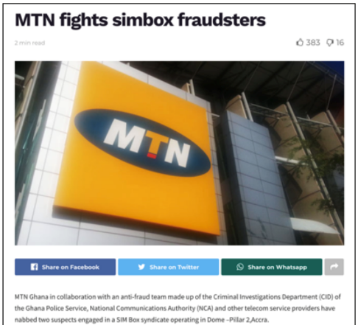
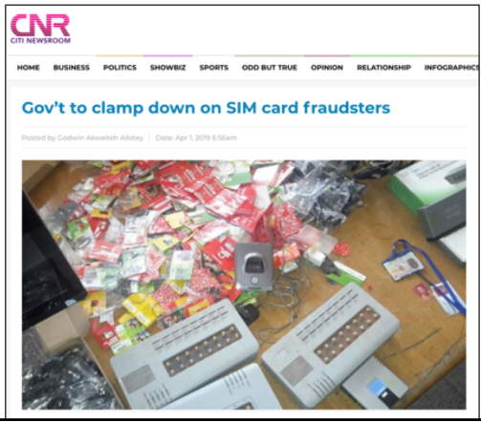
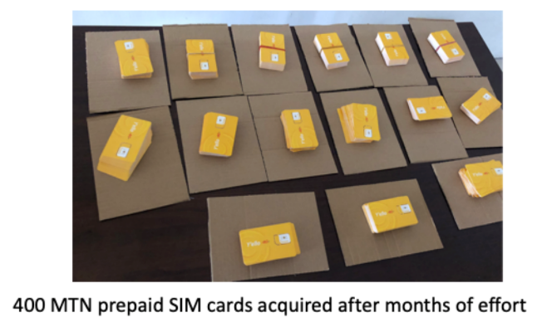
So how do you get higher on the priority list?
You buy from MTN
… also not easy
Limit of 3 SIMs / person due to fraud
Particularly important due to prevalence of SIM-based mobile money

Slide 57
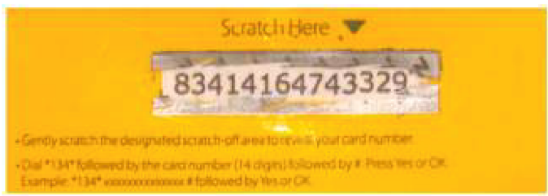
So how do you deploy in Tanzania?
Not limited in SIMs, but limited in payment plans
Post-paid plans not an option
Need to purchase ‘airtime recharges’
Which you use by texting from that phone to an SMS shortcode
So now you must have in-country staff!

Slide 58
Revisit: Cellular provides some unique advantages for IoT
Global deployment => practical issues
If the goal is deploy-today + work-anywhere, cell is the only option
That’s not to say cell actually works everywhere, just the best-available
Reuse existing telecom infrastructure => yes, longer-term deployments not the best idea
Minimal overhead (no need to deploy network infrastructure)
Allows mobility => yes
No need to modify destination address when moved
Reuse in-built security features => yes
SIM card based subscriber authentication

Slide 59
Outline
Cellular for IoT deployments
Cellular Network Technologies
History and foundation
1G
2G
3G/4G and beyond
Suitability of Classic Cellular for IoT
Sunsetting
“Global” deployment

Slide 60
Remaining part of the semester
Final projects
Guest lectures
Homework / quizzes
Demo day

Slide 61
Final Projects
In groups
Build something new with the technologies/hardware we have discussed in this class
Must have a purpose. Why would anyone care about your idea?
Include concrete prototype
Project ideas on canvas
Assignment description posted soon
Milestone 1: meet with instructor (in office hours) to discuss project idea
Final project due during exam slot (May 4)
Instead of exam, we will have a demo day and share the projects as a class

Slide 62
Remaining class sessions
This week:
Cellular, Matter
Guest lectures
Topics
Visible Light Communication
Evernet
CBRS
Read-ahead material
Post-lecture quiz
Work sessions
Come and work on final projects
Ask questions!

Slide 63
Homework and Quizzes
There will be a Homework 4 due at end of the class
Quizzes will focus on the guest lectures

